Slide 1
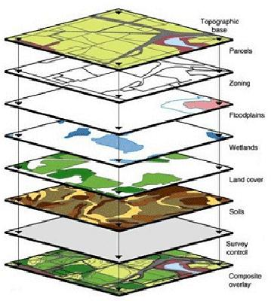
WEB GIS & WEB MAPPING
Presented by,
Prof. Vaishali Kavthekar
Asst. Professor Don Bosco Institute of Technology

Slide 2

Outline
Introduction to WebGIS
Installation of PostgreSql With PostGIS
Web interface of PostgreSql PGADMIN-III
Creating Geodatabase & Uploading Layers
Installing GeoServer
Creating Workspace, Store and Styles
Publising Layers
Openlayer
OpenStreetMap

Slide 3
GIS
A “geographic information system” (GIS) is a computer-based tool that allows you to create, manipulate, analyze, store and display information based on its location.
GIS makes it possible to integrate different kinds of geographic information, such as digital maps, aerial photographs, satellite images and global positioning system data (GPS), along with associated tabular database information

Slide 4
Geographic Information System
GIS means Geographical Information System. Its called that because there is information behind the map.
Mapping is inventory and presentation of spatial data.

Slide 5
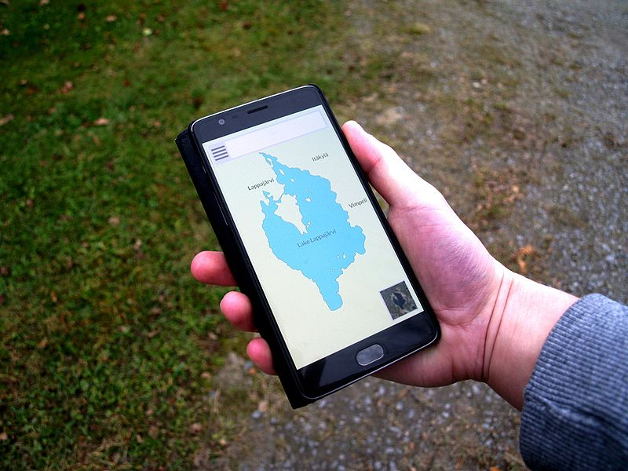
WEB GIS
Web GIS is a type of distributed information system, comprising at least a server and a client, where the server is a GIS server and the client is a web browser, desktop application, or mobile application. The server has a URL so that clients can find it on the web

Slide 6


Slide 7
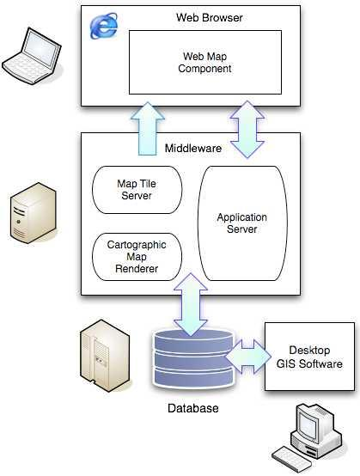
Architcture
Three tiers:
a base tier that is devoted to
Data storage and integrity,
a middle tier for data processing
a top tier for data presentation.

Slide 8
1. Spatial database that can provide random access to large data sets, query processing that understands spatial relationships
2. Desktop software that can provide direct editing and visualization of data in the database. For data management, quality control, and ad hoc reporting.
3. Cartographic map renderer reads spatial data from the database, applies styling rules and outputs map images
4. Application server provides a programming framework for custom applications.
5. Map tile server store pre-rendered image tiles and serve them up quickly to make maps refresh faster.
6. Web map component that can provide a map component inside a web browser.

Slide 9
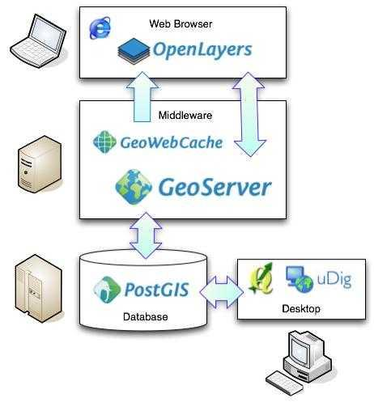

Slide 10
Web GIS
Is a technology that is used to display and analyze spatial data on the Internet. It combines the advantages of both the Internet and GIS. It offers public a new means to access spatial information without owning expensive GIS software.

Slide 11
PostgreSql With PostGIS
PostgreSQL, often simply Postgres, is an object-relational database management system (ORDBMS)
PostgreSQL and PostGis control the creation, maintenance, and use of a database which contains spatial and attribute data.
PostGIS is an open source software program that adds support for geographic objects to the PostgreSQL object-relational database.

Slide 12


Basic Commands
sudo apt-get update
Sudo apt-get upgrade
Sudo apt-get install apache2

Slide 13
Installation of Postgresql with postgis
sudo apt-get install postgresql-9.6
sudo apt-get install postgresql postgresql-contrib
sudo apt-get install postgresql-9.6-postgis-2.3 postgresql-contrib-9.6
postgresql-9.6-postgis-scripts
to get the commandline tools shp2pgsql, raster2pgsql you need to do this
sudo apt-get install postgis

Slide 14

PgAdmin - III
sudo apt-get install pgadmin3
Create a database “mymap”
To convert into postgis data
Create Extension postgis;
To check for proper installation
SELECT postgis_full_version();

Slide 15
If unable to create new registration
Then you should be able to log in with psql as the postgres superuser with this shell command:
sudo -u postgres psql
Once inside psql, issue the SQL command:
ALTER USER postgres PASSWORD 'newpassword';
Now Try to create new server registration with postgresql
\q to exit from postgresql

Slide 16
If you have an .sql file
Go to PgAdmin3 select database right click and import the database from selected path OR
Use Terminal to import the file
root@vaishalik:/# psql -U postgres -h localhost -d mymap -f "/home/vaishalik/webgis/nyc_buildings.sql"

Slide 17
Import shapefile
Points: A point consists of a pair of double-precision coordinates in the order X,Y.
Lines: More specifically a polyline, is an ordered set of points, or vertices, that consists of one or more parts. A part is a connected sequence of two or more points. Parts may or may not be connected to one another. Parts may or may not intersect one another.
Polygons: A polygon consists of one or more rings. A ring is a connected sequence of four or more points, or vertices, that form a closed, non-self-intersecting loop.

Slide 18
'shp2pgsql-gui' is a part of the postgis-gui package sometime it wont work then
Try : sudo apt-get install postgis-gui

Slide 19
root@vaishalik:/# shp2pgsql-gui
View connection details – enter postgres username and password
Add shapefiles to pgadmin-III
Put SRDI no 4326 and import
A Spatial Reference System Identifier (SRID) is a unique value used to unambiguously identify projected, unprojected, and local spatial coordinate system definitions.

Slide 20
Installing Geoserver
GeoServer is an open source software server written in Java that allows users to share and edit geospatial data.
Designed for interoperability, it publishes data from any major spatial data source using open standards: WMS, WFS, WCS, WPS and REST
WMS - Web Map Service Interface Standard (WMS) provides a simple HTTP interface for requesting geo-registered map images from one or more distributed geospatial databases.

Slide 21
GoeServer is one of the best server for storing Vector data.
GeoServer has been optimized for serving large shapefile (GB size) with good speed.
Download geoserver from
http://geoserver.org/release/stable/
link and click the Platform Independent Binary link.

Slide 22

JRE
Now make sure that you have already installed Java Runtime Environment (JRE) inyour system.
Currently Java 9 is not supported by geoserver so download JRE 8 from oracle.

Slide 23
1. Add the PPA.
sudo add-apt-repository ppa:webupd8team/java
2. Update and install the installer script:
Run commands to update system package index and install Java installer script:
sudo apt update; sudo apt install oracle-java8-installer
NOTE:http://tipsonubuntu.com/2016/07/31/install-oracle-java-8-9-ubuntu-16-04-linux-mint-18/

Slide 24
3. Check the Java version
To check the Java version after installing the package, run command:
javac -version
root@vaishalik:/# javac -version
javac 1.8.0_191

Slide 25
4. Set Java environment variables
The PPA also contains a package to automatically set Java environment variables, just run command:
sudo apt install oracle-java8-set-default

Slide 26
Installing GeoServer
for installing geoserver-
Step -1
root@vaishalik:/usr# sudo chmod -R 777 share
Extract the downloaded geoserver zip file. if you are not sure where to unzip it, navigate to usr/share folder and make a new folder name it as geoserver and unzip file in this folder.

Slide 27
Step 2 - Open the terminal in your system and add an environment variable to save the location of GeoServer by running given command
Root..../usr/share#
–> echo “export GEOSERVER_HOME=/usr/share/geoserver”

Slide 28
Step 3 for installing geoserver in ubuntu-
To make sure you are the owner of the geoserver folder, run the give command
–> sudo chown -R USER_NAME /usr/share/geoserver/
To know your username type $ echo "$USER"

Slide 29
Step 4-
After this navigate yourself to the bin folder inside the unzip geoserver folder and run the startup.sh file.To run this file on terminal, look given command
–> sh startup.sh
root@vaishalik:/usr/share/geoserver/bin# sh startup.sh

Slide 30
Step 5 for installing geoserver-
Now your geoserver is installed successfully to check open the browser and run the given command
–> http://localhost:8080/geoserver

Slide 31
Example
1> root@vaishalik:/usr/share# echo “export GEOSERVER_HOME=/usr/share/geoserver”
O/p :“export GEOSERVER_HOME=/usr/share/geoserver”
2> root@vaishalik:/usr/share# sudo chown -R vaishalik /usr/share/geoserver/
root@vaishalik:/usr/share# cd geoserver
3>root@vaishalik:/usr/share/geoserver/bin# sh startup.sh

Slide 32
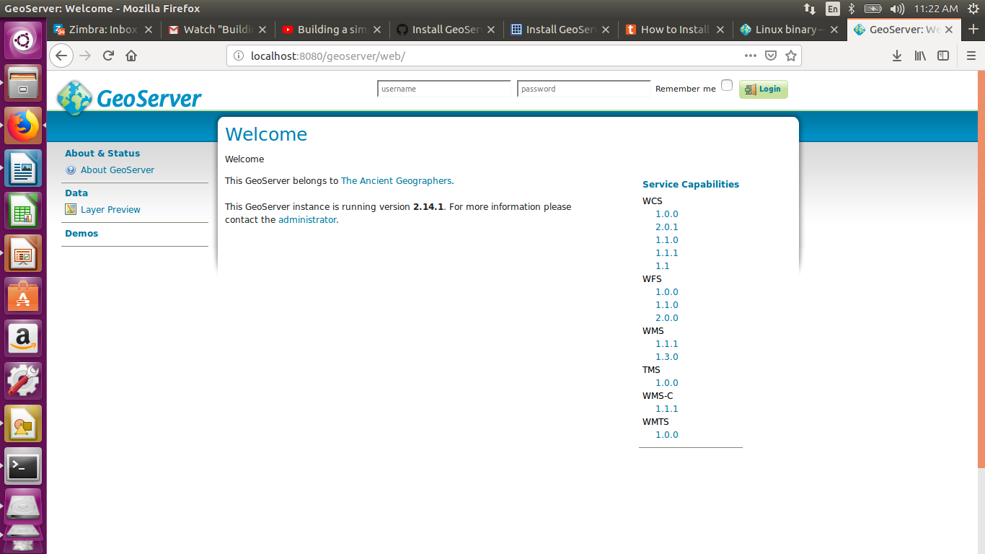
http://localhost:8080/geoserver/web/

Slide 33
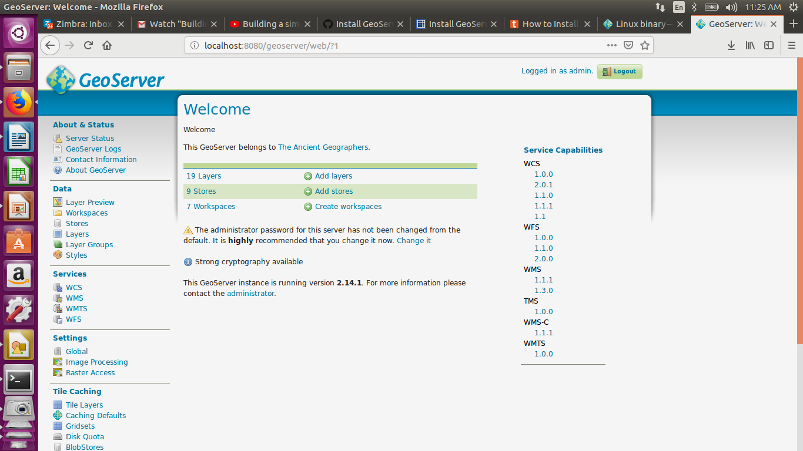
Give admin as username and geoserver as password. Create your workspace and datastores for various datasets and upload them on geoserver with various styles and icons.

Slide 34
GeoServer Workflow
Create a workspace -A workspace is a container used to group similar layers together.
Create a store - Once the workspace is created, we are ready to add a new store. The store tells GeoServer how to connect to the shapefile.
Style & Publish the layers – To apply a styles and publish a layers.

Slide 35
Types of GIS Web Services
OGC Standard services:
WMS - Web Map Service
WFS - Web Feature Servic
WCS - Web Coverage Service
WPS - Web Processing Service
WS – Common Web Services

Slide 36
Enter the name of the workspace and url associate with it.

Slide 37
Publishing shapefile
Download the file nyc_roads.zip. This archive contains a shapefile of roads from New York City
Unzip the nyc_roads.zip into a new directory named nyc_roads. The archive contains the following four files:
nyc_roads.shp - shape format
nyc_roads.shx – shape index format
nyc_roads.dbf – attribute format
nyc_roads.prj – projection format
Move the nyc_roads directory into <GEOSERVER_DATA_DIR>/data, where <GEOSERVER_DATA_DIR> is the root of the GeoServer data directory. If no changes have been made to the GeoServer file structure, the path is geoserver/data_dir/data/nyc_roads.

Slide 38
Creating a new workspace
The next step is to create a workspace for the shapefile. A workspace is a container used to group similar layers together.
Enter the Name as nyc and the Namespace URI as http://geoserver.org/nyc.

Slide 39
store
Once the workspace is created, we are ready to add a new store. The store tells GeoServer how to connect to the shapefile.
You should see a list of stores, including the type of store and the workspace that the store belongs to.
In order to add the shapefile, you need to create a new store. Click the Add new Store button. You will be redirected to a list of the data sources supported by GeoServer. Note that the data sources are extensible, so your list may look slightly different.

Slide 40
Click Shapefile. The New Vector Data Source page will display.
Begin by configuring the Basic Store Info.
Select the workspace nyc from the drop down menu.
Enter the Data Source Name as NYC Roads
Enter a brief Description (such as “Roads in New York City”).
Under Connection Parameters, browse to the location URL of the shapefile, typically nyc_roads/nyc_roads.shp.

Slide 41
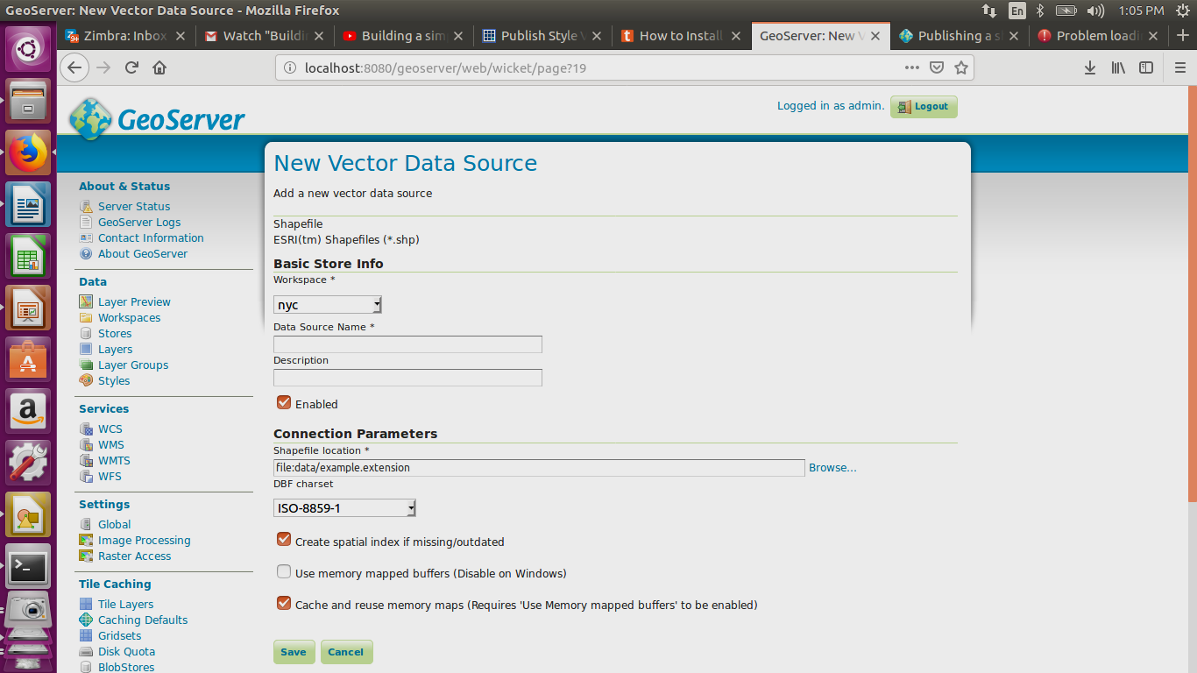

Slide 42
Layers
Now that the store is loaded, we can publish the layer.
1.On the New Layer page, click Publish beside the nyc_roads layer name.
2 The Edit Layer page defines the data and publishing parameters for a layer. Enter a short Title and an Abstract for the nyc_roads layer.
3. Generate the layer’s bounding boxes by clicking the Compute from data and then Compute from native bounds links.
4. Click the Publishing tab at the top of the page.
5. We can set the layer’s style here. Under WMS Settings, ensure that the Default Style is set to line.

Slide 43
We can set the layer’s style here. Under WMS(Web Map Service) Settings, ensure that the Default Style is set to line.

Slide 44
Previewing the layer
Navigate to the Layer Preview screen and find the nyc:nyc_roads layer.
Click the OpenLayers link in the Common Formats column.
An OpenLayers map will load in a new tab and display the shapefile data with the default line style. You can use this preview map to zoom and pan around the dataset, as well as display the attributes of features.

Slide 45
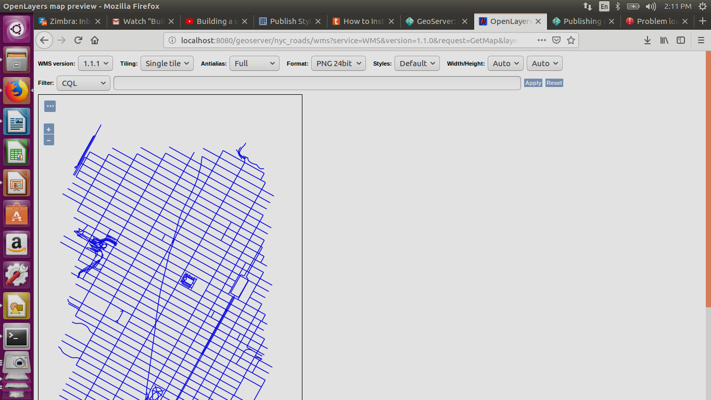

Slide 46
Publishing a PostGIS table
Download the file nyc_buildings.zip. It contains a PostGIS dump of a dataset of buildings from New York City.
Create a PostGIS database called nyc. This can be done with the following commands:
To createdb nyc :
psql -d nyc -c 'CREATE EXTENSION postgis'

Slide 47
Extract nyc_buildings.sql from nyc_buildings.zip.
Import nyc_buildings.sql into the nyc database:
psql -f nyc_buildings.sql nyc

Slide 48
PostGIS
Note :Creating a new works pace
Creating a store
Create a new store by clicking the PostGIS link.
Enter the Basic Store Info:
Select the nyc Workspace
Enter the Data Source Name as nyc_buildings
Add a brief Description

Slide 49
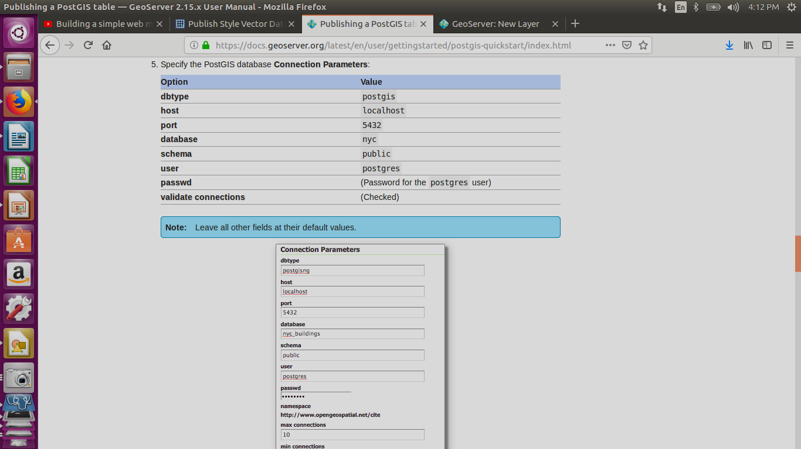

Slide 50
Creating a layer
Navigate to Data ‣ Layers.
Click Add a new resource.
From the New Layer chooser menu, select nyc:nyc_buidings.
On the resulting layer row, select the layer name nyc_buildings.
The Edit Layer page defines the data and publishing parameters for a layer. Enter a short Title and an Abstract for the nyc_buildings layer.
Generate the layer’s bounding boxes by clicking the Compute from data and then Compute from native bounds links.
Click the Publishing tab at the top of the page.
We can set the layer’s style here. Under WMS Settings, ensure that the Default Style is set to polygon.
Finalize the layer configuration by scrolling to the bottom of the page and clicking Save.

Slide 51
Previewing the layer
In order to verify that the nyc_buildings layer is published correctly, we can preview the layer.
Navigate to the Layer Preview screen and find the nyc:nyc_buildings layer.
Click the OpenLayers link in the Common Formats column.
An OpenLayers map will load in a new tab and display the shapefile data with the default line style. You can use this preview map to zoom and pan around the dataset, as well as display the attributes of features.

Slide 52
Layer Group
A layer group is a container in which layers and other layer groups can be organized in a hierarchical structure. A layer group can be referred to by a single name in WMS requests.

Slide 53
Openlayer & Geoserver
OpenLayers is the client, and GeoServer is the server. For basic cases, you load the data into GeoServer (and publish out whatever layers and styling you need), then use OpenLayers in your web page (javascript and HTML).
OpenLayers is a JavaScript library that allows for putting a dynamic map in any web page. It can display map tiles and markers loaded from any source.

Slide 54
Building Web Application using Openlayer
http://suite.opengeo.org/docs/latest/webapps/ol3/index.html

Slide 55
EPSG 4326 uses a coordinate system the same as a GLOBE (curved surface).
EPSG 3857 uses a coordinate system the same as a MAP (flat surface).

Slide 56
GeoNode
GeoNode is a web-based application and platform for developing geospatial information systems (GIS) and for deploying spatial data infrastructures (SDI).
It is designed to be extended and modified, and can be integrated into existing platforms.

Slide 57
OpenStreetMap

Slide 58
Openlayer

Slide 59
References
OpenGeoStack
Geoserver and geonode
http://suite.opengeo.org
https://www.igismap.com/install-geoserver-ubuntu/
https://gis.tackexchange.com/questions/63445/how-can-i-enable-postgis-shapefile-and-dbf-loader-2-0-plugin-in-pgadmin-iii
http://lyzidiamond.com/posts/4326-vs-3857
https://www.cse.iitb.ac.in/~pocra/MahaCensus_shapefile_data/MaharashtraCensus.html
https://mapcruzin.com/free-maharashtra-country-city-place-gis-shapefiles.htm

Slide 60
Thank You!

