Slide 1
INDUSTRIAL AI / INFINEON · HACKATHON 2026
Process Logic Transformer
Learning the rules of semiconductor process routes — and measuring whether they hold.
Team 123123
Volodymyr Sennikov
Ronald Juhasz
Stefan Ilic

Slide 2
01 · THE PROBLEM
Learn the logic, not the n-grams.
Semiconductor process routes are long, ordered sequences of 107–151 steps across three families: MOSFET, IGBT, IC.
The central question we kept honest about:
Does the model learn the rules that generate valid sequences — or just memorize n-grams?
Task 1
Task 2
Task 3
Bonus
Next-step prediction
Sequence completion
Anomaly detection
OOD 4th-family generalization
Team 123123 · Industrial AI / Infineon · Process Logic Transformer
2 / 10

Slide 3
02 · APPROACH
Small transformer, big evaluation.
1
Decoder-only, from scratch
Word-level vocab (~200 tokens). No pretrained LLM — its subword machinery would hurt, not help.
2
Validator in the eval loop
Every epoch, complete held-out prefixes and score with the rule validator. A process-logic signal independent of loss.
3
Trigram baseline as the floor
Pure frequency counting tells us what 'good' means — and its OOD collapse proves local stats don't transfer.
4
Likelihood-based anomaly head
Threshold tuned on labeled data — never on the eval set.
Team 123123 · Industrial AI / Infineon · Process Logic Transformer
3 / 10

Slide 4
03 · KEY INSIGHT
Number normalization: a free win.
Before
Measured effect (held-out)
ALIGN_MASK_LEVEL_1, ALIGN_MASK_LEVEL_2, … LEVEL_6 → treated as 6 unrelated tokens
Token accuracy
0.808 → 0.828
+0.020
After
Validation loss
0.332 → 0.300
−0.032
ALIGN_MASK_LEVEL + <N1> … <N6> → shared base + number token
Model size
— → —
unchanged
A tokenizer change — not a bigger model.
Team 123123 · Industrial AI / Infineon · Process Logic Transformer
4 / 10

Slide 5
04 · PIPELINE
From synthetic data to scored submission.
Generate
Vocab
Baseline
Train
Predict
Validate
›
›
›
›
›
5k seqs ×
MOSFET / IGBT / IC
~200 tokens
+ number split
Trigram
(CPU floor)
Decoder transformer
Leonardo · 1× A100
Next-step · Completion ·
Anomaly (likelihood)
Rule validator +
eval_metrics.py
Validator-in-the-loop: every epoch we score how often the model's completions introduce no new rule violation.
Team 123123 · Industrial AI / Infineon · Process Logic Transformer
5 / 10

Slide 6
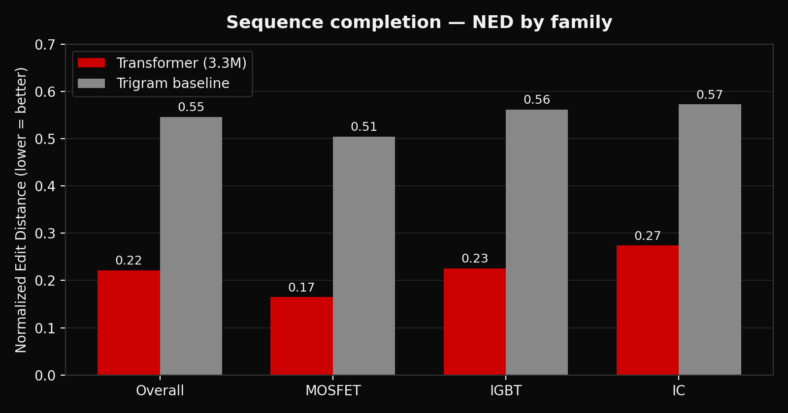
05 · RESULTS — COMPLETION (TASK 2)
More than halves the baseline's edit distance.
NED
0.22
vs 0.55 baseline
Token acc.
0.42
vs 0.32 baseline
Per-family wins
3 / 3
MOSFET · IGBT · IC
450 held-out examples · new seeds · same metrics as official eval_metrics.py
Team 123123 · Industrial AI / Infineon · Process Logic Transformer
6 / 10

Slide 7
06 · RESULTS — ANOMALY & NEXT-STEP
Strong on anomaly. Saturated on next-step.
NEXT-STEP · TASK 1
ANOMALY DETECTION · TASK 3
F1 = 0.96
Metric
Transformer
Trigram
Token accuracy
0.83
0.77
Top-5 accuracy
0.99
0.99
Model-likelihood scoring with a threshold tuned on labeled data — never on the eval set.
Top-5 is saturated for everyone — it does not discriminate models.
Applied to 987 official sequences → submission/anomaly.csv
Team 123123 · Industrial AI / Infineon · Process Logic Transformer
7 / 10

Slide 8
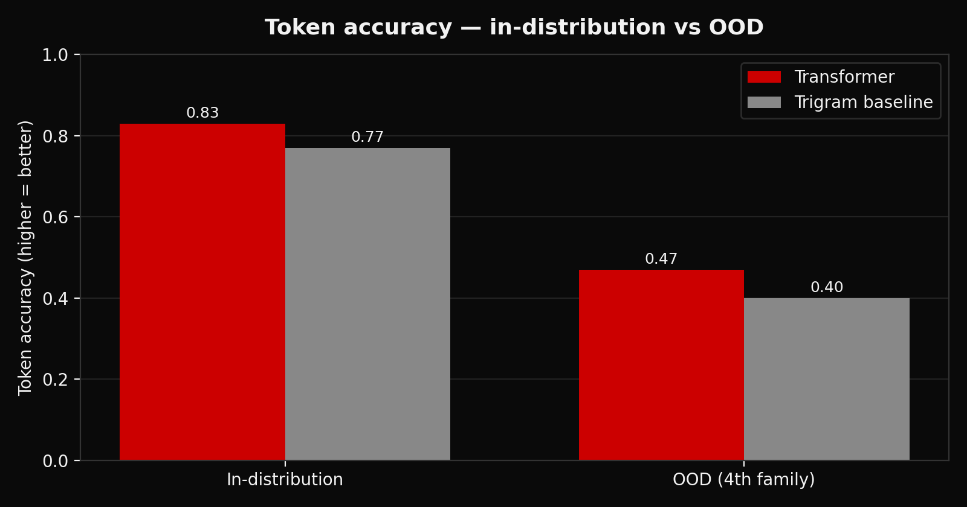
07 · HONEST FINDINGS
What worked. What didn't.
WHAT WORKED
Completion: NED 0.22 vs 0.55 — wins on all 3 families.
Anomaly: F1 = 0.96 on labeled data.
Tokenizer trick: free +0.02 accuracy, −0.03 loss.
Validator-in-loop gave a process-logic signal beyond loss.
Baseline kept us honest about saturated metrics.
WHAT DIDN'T
Scaling 3.3M → 25.5M didn't move accuracy (~0.83 ceiling). OOD weak: 0.47 vs 0.40 baseline — honest negative.
Team 123123 · Industrial AI / Infineon · Process Logic Transformer
8 / 10

Slide 9
08 · NEXT 36 HOURS
What we'd do with more time.
Randomize generation marginals
Vary optional-step probabilities and cycle counts so the model isn't calibrated to one distribution — likely the biggest OOD lever.
Discriminative anomaly head
Train directly on labeled valid/invalid examples instead of relying on generative likelihood.
Full scaling sweep
Run tiny / baseline / large / xl as four parallel single-GPU jobs and report a proper scaling curve.
Team 123123 · Industrial AI / Infineon · Process Logic Transformer
9 / 10

Slide 10
THANK YOU
Questions?
LIVE DEMO
streamlit run streamlit_process_dashboard.py
Side-by-side: trigram baseline vs. trained transformer on identical inputs.
CREDITS
Libraries: PyTorch · NumPy · pandas · Plotly · Streamlit
Infrastructure: Leonardo (EuroHPC / CINECA) · SLURM · pixi
Pretrained models: none — trained from scratch. External APIs: none.
Team 123123 · Volodymyr Sennikov · Ronald Juhasz · Stefan Ilic

