Slide 1
Sleep & Earn Crypto Trading Bot
Introduction Our bot utilizes a “confluence trading” machine learning algorithm which analyzes a combination of market indicators to increase the odds of a winning trade.
An optimal trading strategy is generated based on confluence between technical indicators to execute a “buy”, “sell”, “short” or “hold” action.
This bot trades cryptocurrencies using pine strategies in Tradingview. The pine strategies are optimized using machine learning techniques generated through Jupyter Notebook.
Tim Tennyson
Loc Thai
Rachel Bates
Kim Tung
Daniel English
Vic Gellon
Agenda:
Intro
Technical Indicators Machine Learning
Bot Logic
Learnings & Challenges
Next Steps

Slide 2
Indicators
EMA (Exponential Moving Average) - a technical chart indicator that tracks the price of an investment (like a stock or commodity) over time. It used to measure trend directions over a period of time. Trend-follow indicator.
MACD (Moving Average Convergence Divergence) - shows the relationship between two moving averages (i.e. 12,26). There are three components: MACD=EMA 12 minus EMA 26, MACD Signal Line is 9-period EMA , MACD Histogram=MACD minus the MACD Signal Line
CCI (Commodity Channel Index) - a technical indicator that measures the difference between the current price and the historical average price. When the CCI is above zero, it indicates the price is above the historic average. Conversely, when the CCI is below zero, the price is below the historic average. In short, it tells you when the market is overbought or oversold.
ICHIMOKU - a collection of technical indicators that show support and resistance levels, as well as momentum and trend direction. It does this by taking multiple averages and plotting them on a chart.

Slide 3
EMA vs SMA
The Exponential Moving Average (EMA) is a moving average that more heavily weighs recents data in its summation.
Where as the Simple Moving Average (SMA) is an average of prices for a given interval over designated period.
The EMA was designed to help spot entry and exits points with great rapidity and to identify price trends over a period of time

Slide 4
The Maths: Calculations for the EMA and SMA
Simple Moving aAverage =
((number of intervals in a given period) - sum of closing prices in that period)
(number of days in given period sum)
This is simple

Slide 5
Exponential Moving Average =
(closing price x (smoothing/ 1+ days)
+ EMA of last interval x (1- (smoothing/ 1+days))
Smoothing = 2
*A higher smoothing factor increases the influence of more recent observations
This is exponential

Slide 6
EMA and the MACD
Moving Average Convergence Divergence (MACD) is made up of three elements:
MACD Line (determines momentum and trend duration)
Signal Line (a nine period EMA of the MACD LINE)
Histogram (a visual graphic of the difference between the MACD and Signal Lines)

Slide 7
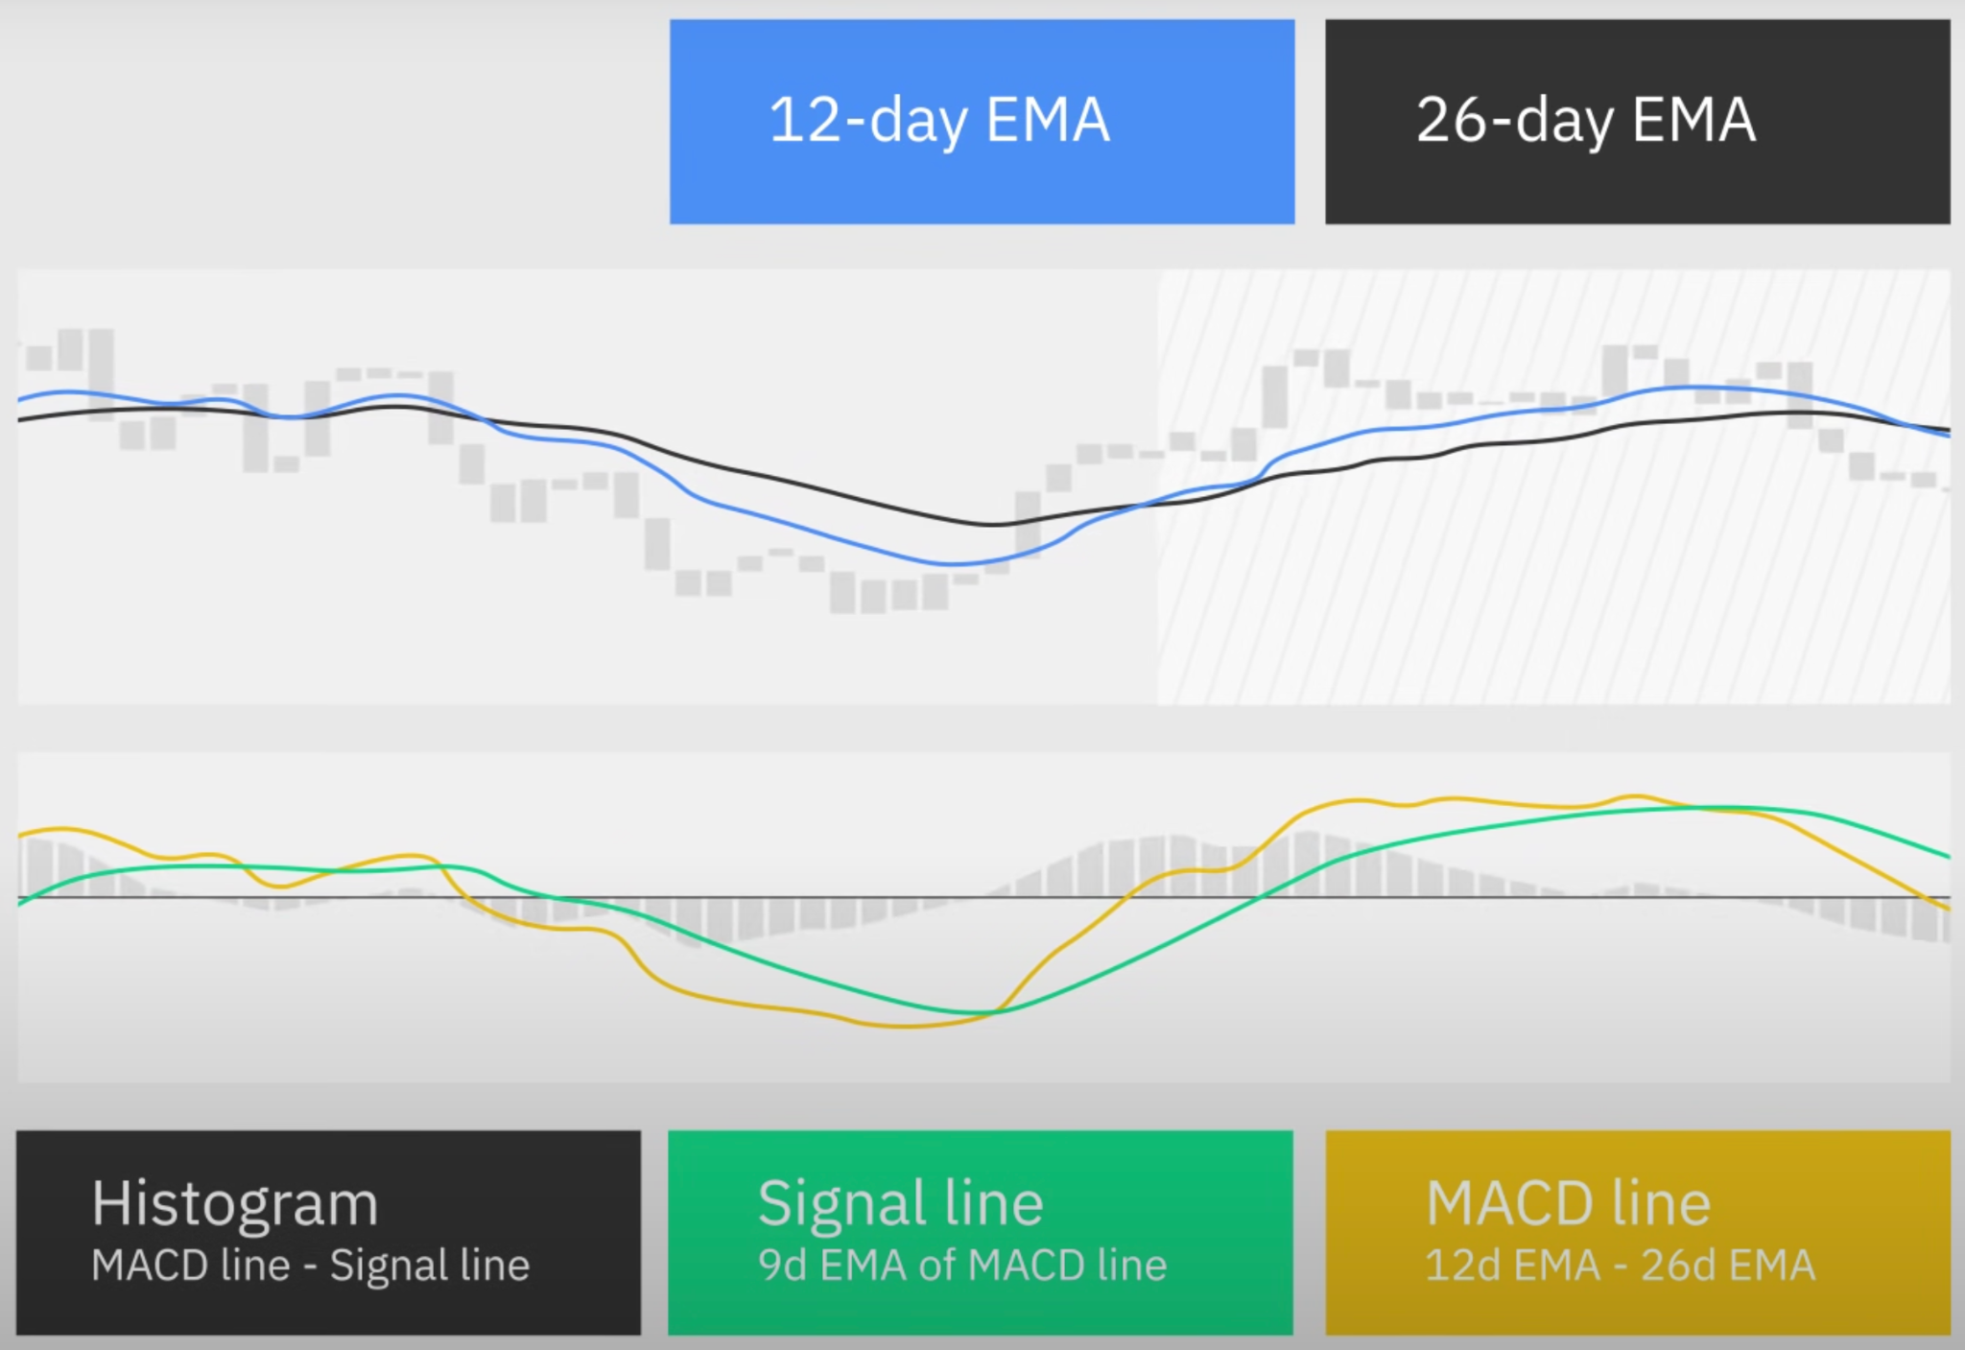
A Picture… finally

Slide 8
Some More Maths
MACD Line (common settings)=
(12-period EMA - 26-period EMA)
Signal Line =
(9-period EMA of MACD Line)
Histogram Equals =
(MACD Line - Signal Line)

Slide 9
Machine Learning
Data Source: CSV files generated using Tradingview
Model Application: Jupyter Lab
Models Used: XGBoost, Linear Regression
Why we chose the models: Reputation of high performing machine learning models.
Performance evaluation techniques: Dividing the datasets into the train/test subsets (70% train, 30% test) and fitting the model to create graphs that show highest performing indicators.

Slide 10
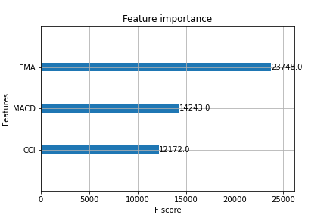
Bitcoin - Model Feature Importance

Slide 11
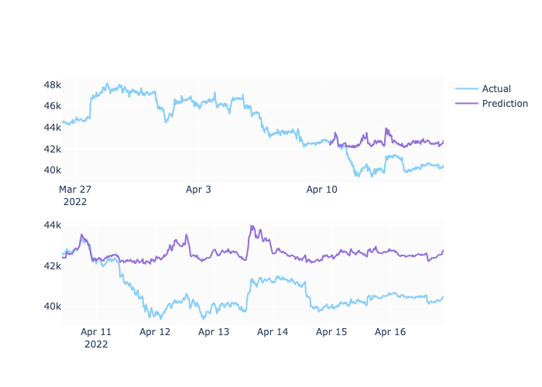
Bitcoin Predictions based on Model
Notes:
This prediction is based on 365 15 minute intervals with 70/30 train/test data

Slide 12
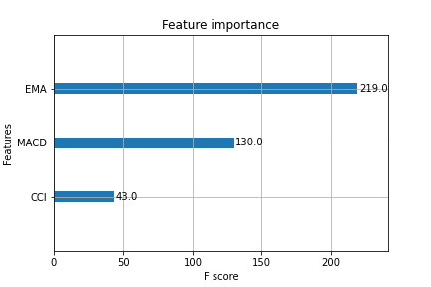
Matic - Model Feature Importance

Slide 13
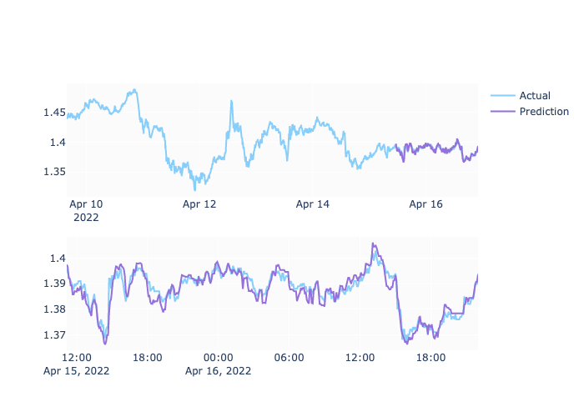
Matic - 5 minute predictions
Notes:
These predictions are on the 5 minute dataset - 70/30 - 180 intervals

Slide 14
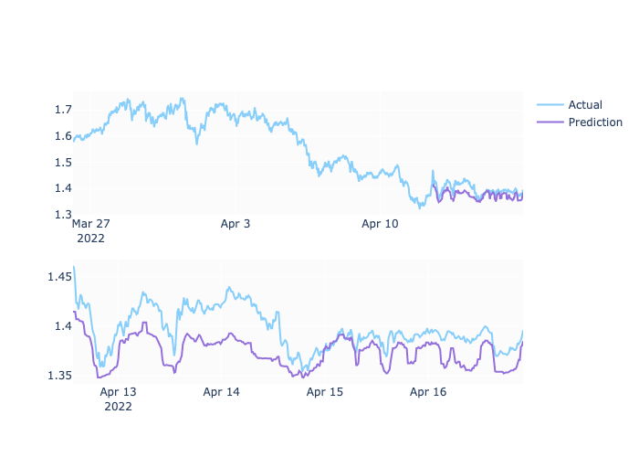
Matic - 15 minute predictions
Notes:
This model is 300 15 minute intervals with an 80/20 test/train dataset

Slide 15
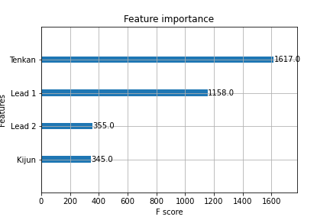
AVAX - Model Feature Importance

Slide 16
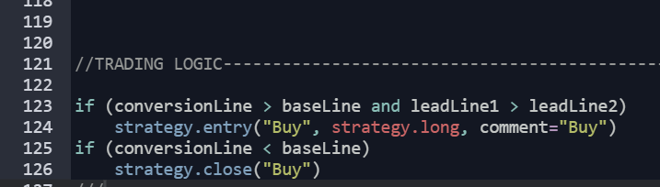
Bot Logic
Pine Editor in Tradingview is used to implement the optimal signal outputs generated through the machine learning model(s). The logic is coded using Pine, TradingView’s programming language.
Pine Introduction
The TradingView strategy is then integrated with the api of choice through the TradingView app to execute trades automatically once conditions are met

Slide 17
Learnings & Challenges
Images and Examples:
Dataset
Choice of Cryptocurrency
Choice of Technical Indicators
Choice of ML Algorithm
Choice of ML performance evaluation matrix
Fine tuning to achieve better machine learning predictive performance
Was project goal achieved? Is it in progress? TBD
Use of Machine Learning Algorithm to predict strategy returns
Use of dataset for analytics and buy/sell recommendation

Slide 18
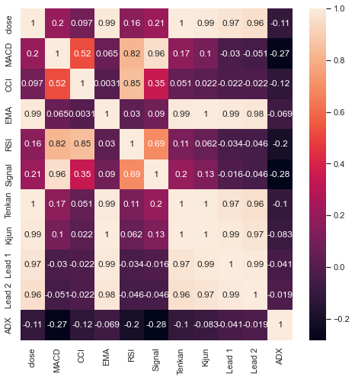
Correlation of technical indicators

Slide 19
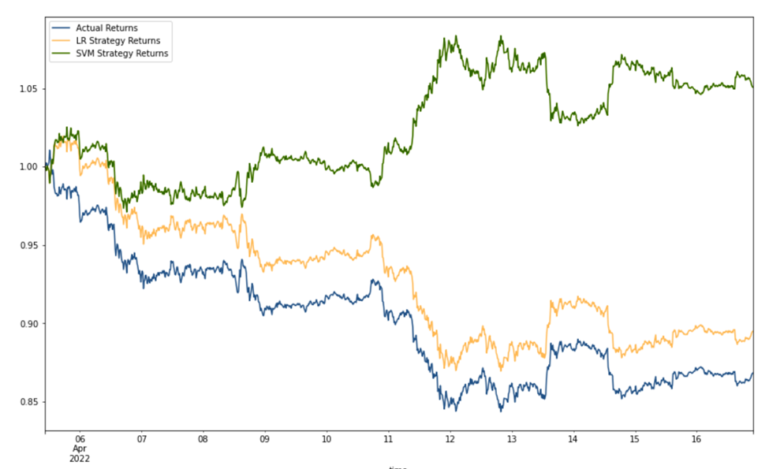
Short window =4
Long Window=100

Slide 20
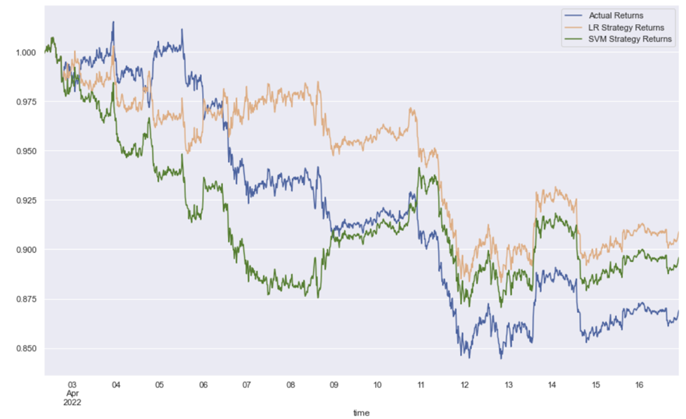
Short window =425
Long Window=100

Slide 21
Next Steps
(To get to end state)
What can we do to improve the product down the road?
Automate the machine learning by creating a more sophisticated application that can loop through the provided .csv files and send the outcome information directly to the trading bot.

