Slide 1



INTRAVENOUS FLUID MONITORING SYSTEM USING IOT
PRESENTED BY GUIDED BY
S.DINESH (17CSR030)
V.S.GOKUL ANANDH (17CSR042)
K.HARIPRAKASH (17CSR055)
Dr. K. SANGEETHA
Department of Computer Science and Engineering

Slide 2
PROBLEM STATEMENT
Forget to change the fluid bottle – reverse flow of blood
Constant manual monitor is required
Entering of flow of air bubbles in blood - immediate death

Slide 3
EXISTING SYSTEM
METHODOLOGY
Uses IR Sensor to detect the level
IR receiver senses the signal and alert using Buzzer

Slide 4
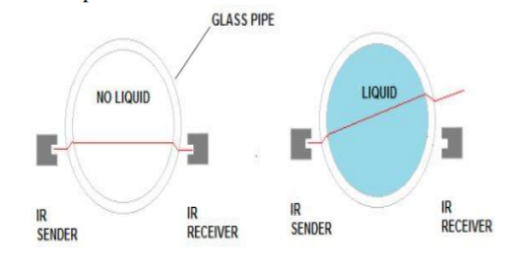
ARCHITECTURE

Slide 5
PROPOSED WORK
METHODOLOGY
Flow Sensor - detects the IV flow
Update the Database
Display the status
Alert the user according to the status

Slide 6
ARCHITECTURE
Status Viewer
Sends data to database
Retrieve and display
Database
LED
Sensor
Display

Slide 7
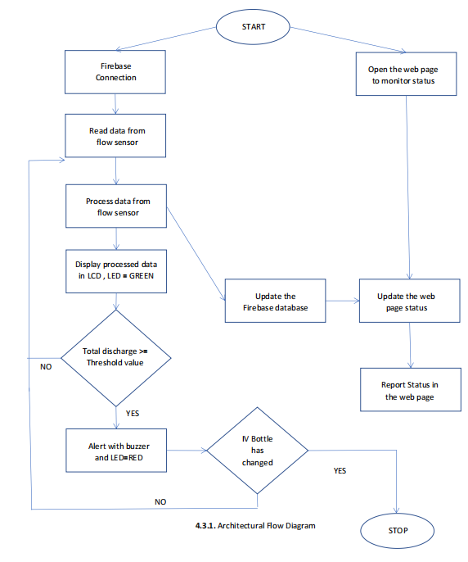
FLOWCHART

Slide 8
MODULES DESCRIPTION
Hardware setup establishment
Bottle status display establishment
Database establishment and connection
Data retrieval and status reporting

Slide 9
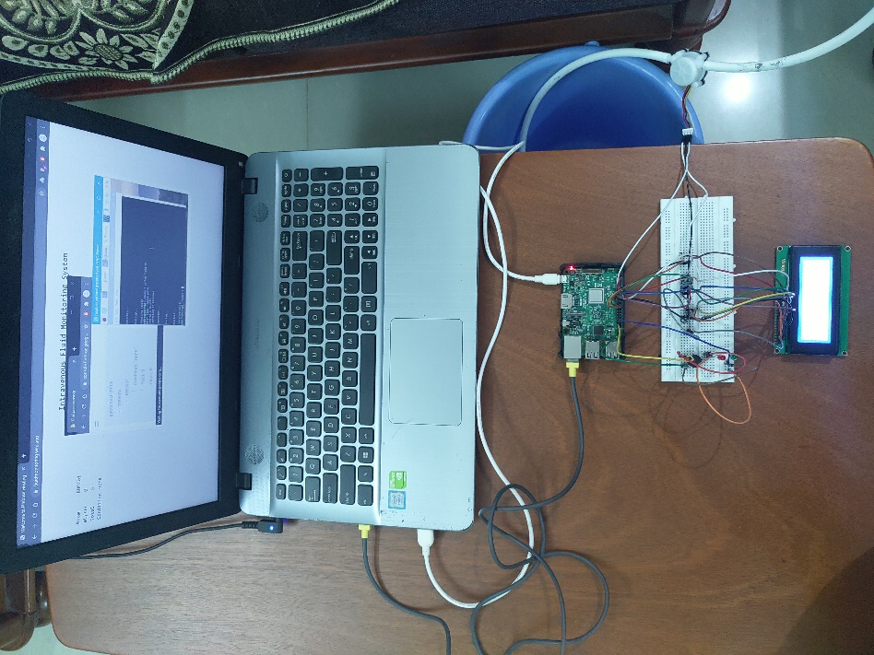
EXPERIMENTAL SETUP

Slide 10
METRICS CONSIDERED FOR EVALUATION
Discharge of fluid per second
Total discharge of fluid
Time taken

Slide 11
REFERENCES
Anagha R, Ashwini S, Keerthana G, Monica M, “IoT BASED INTRAVENOUS FLOW MONITORING SYSTEM”,International Research Journal of Engineering and Technology (IRJET), Volume: 07 Issue: 05 (2020)
Dr.K.Sampath kumar, S.Abinaya , M.Abirami , S.Kesavan , Sethu.S ,” Innovative intravenous fluid control and emergency monitoring system” , International Journal of Engineering and Manufacturing Science. ISSN 2249-3115 Vol.8, No.3, (2018)
Arulious Jora A, Divya Laveena A, Earlina D, Nirmala S, “Intravenous Fluid Level Indicator” ,International Research Journal of Engineering and Technology (IRJET), Volume: 05 Issue: 10 (2018)

Slide 12
THANK YOU

