Slide 1
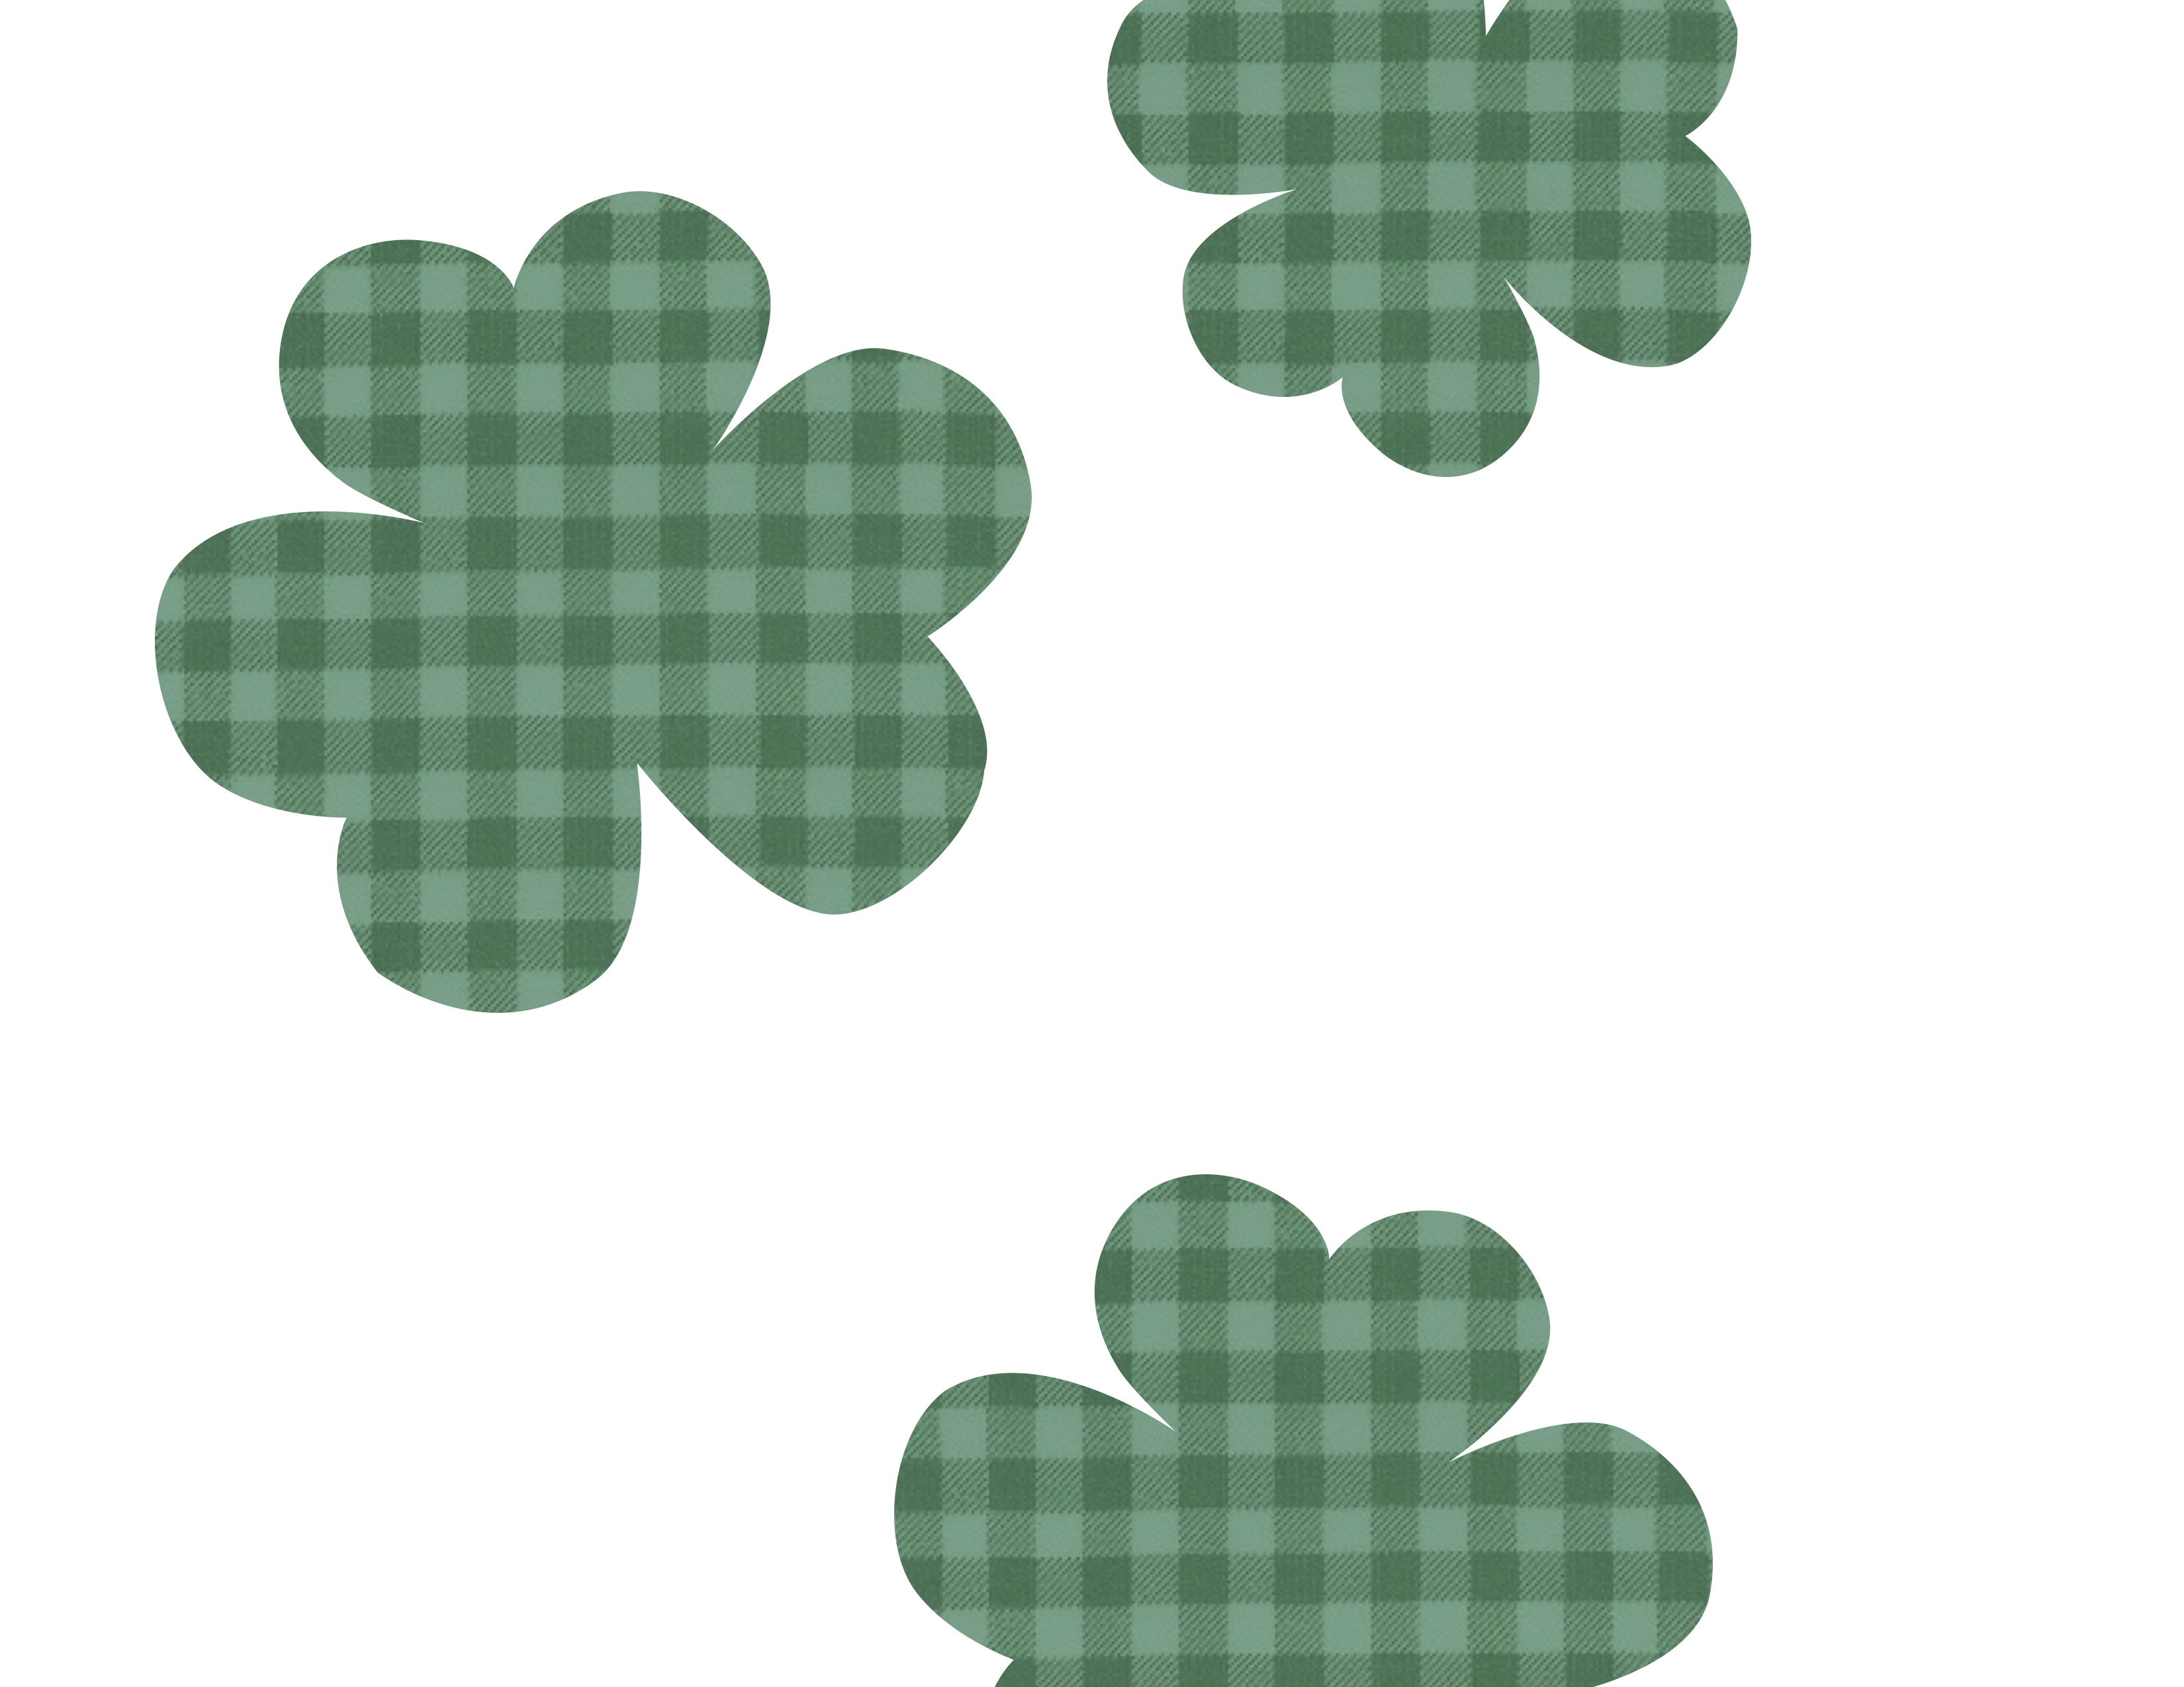

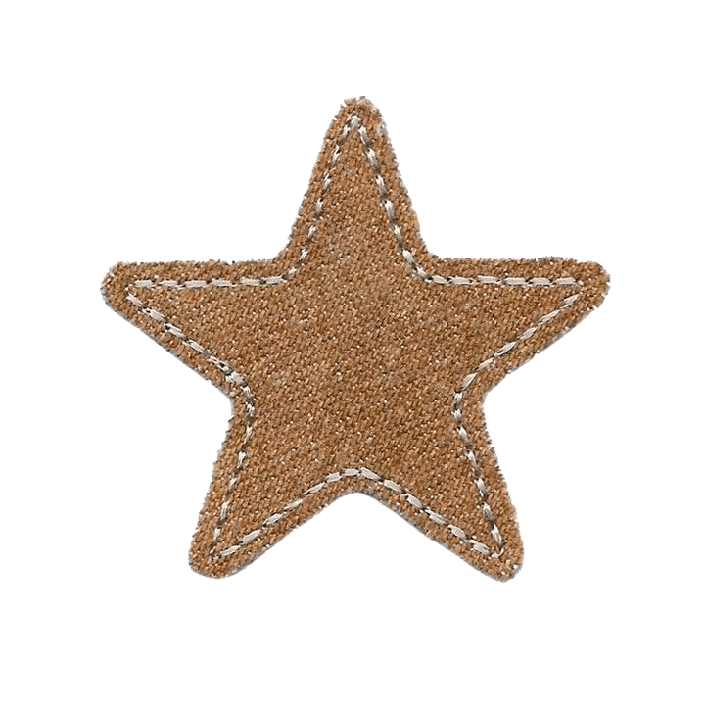

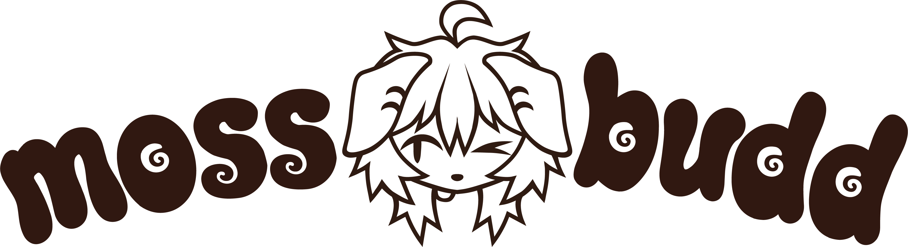


Slide 2
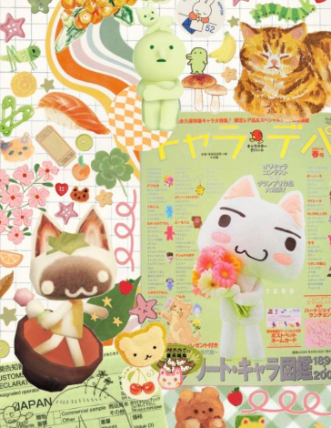
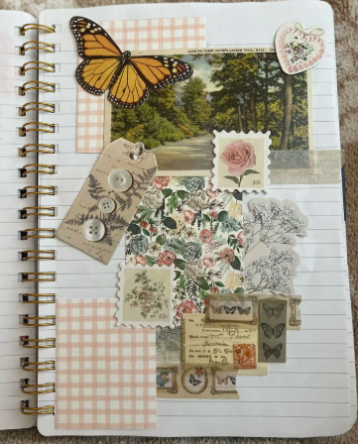
Design info
• Industry: Art and Design
• Target Audience: Teens, young adults, furries, anime and game fans
• Brand Personality: playful, fun, creative, friendly, whimsical, approachable
• Goals: attend conventions, find buyers, sell art
• Unique Selling Points: clear custom reference sheets, unique rendering style
• Rationale: Creating custom digital artwork
• Branding: playful, nostalgic, warm, crafty, hand-drawn and textured, cluttered, maximalist, nature-themed
• Inspiration and Research: nature, collage, scrapbooking, arts and crafts, the 70’s

Slide 3
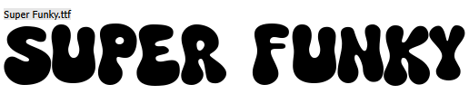
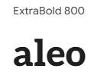
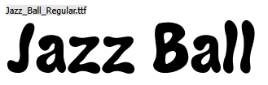


Design Info
• Color Scheme: earthy greens, teals, muted oranges and yellows, warm browns, creams, pops of bright red and blue. Very 70’s inspired. Creates a natural, comforting, and fun feel.
• Typography : rounded bubbly font for headings and a more readable clean font for body text. Creates a playful tone while still being readable
Logo is created using a combination of Jazzball and Gemsea and was made wider at the bottom.

Slide 4

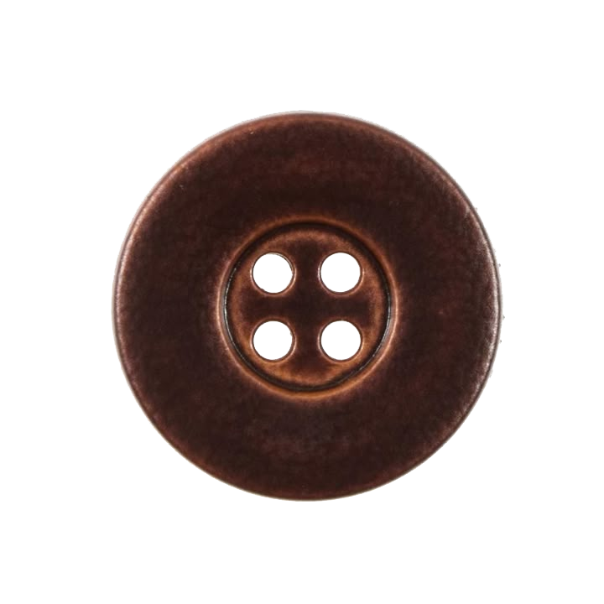
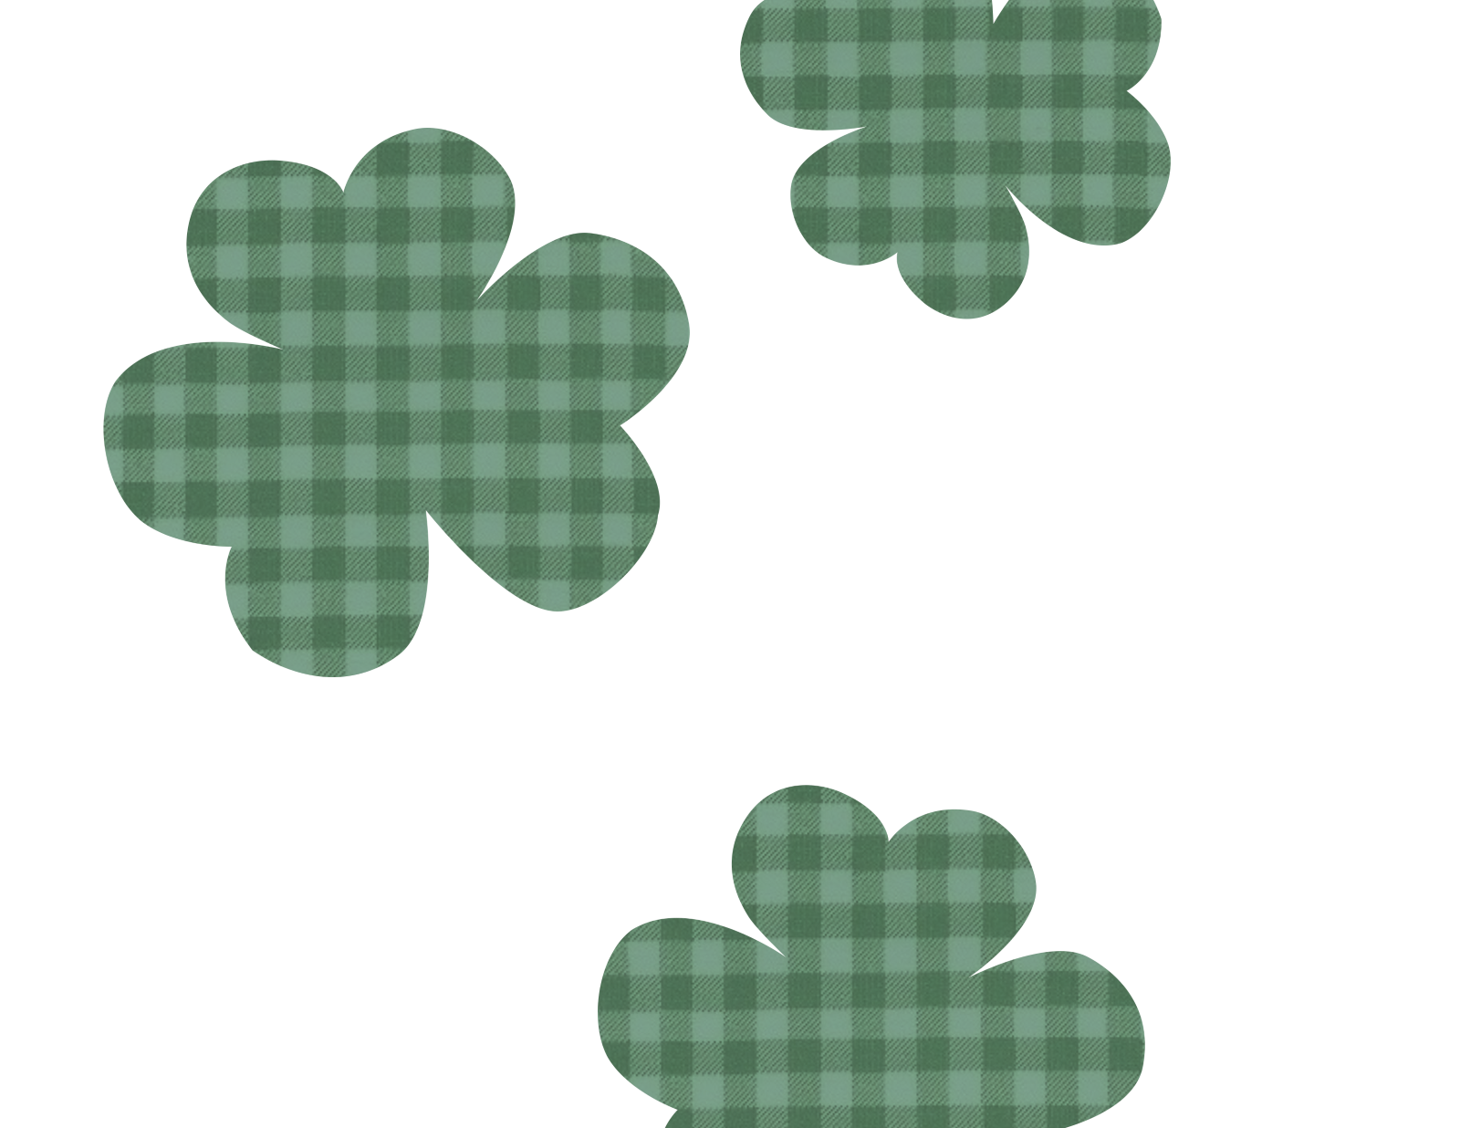
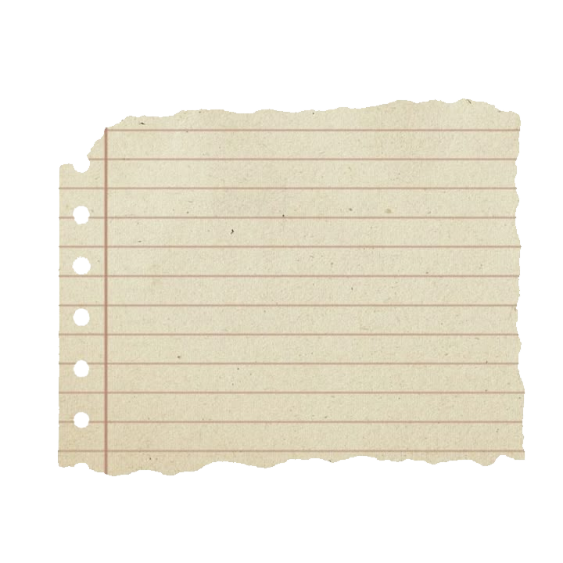
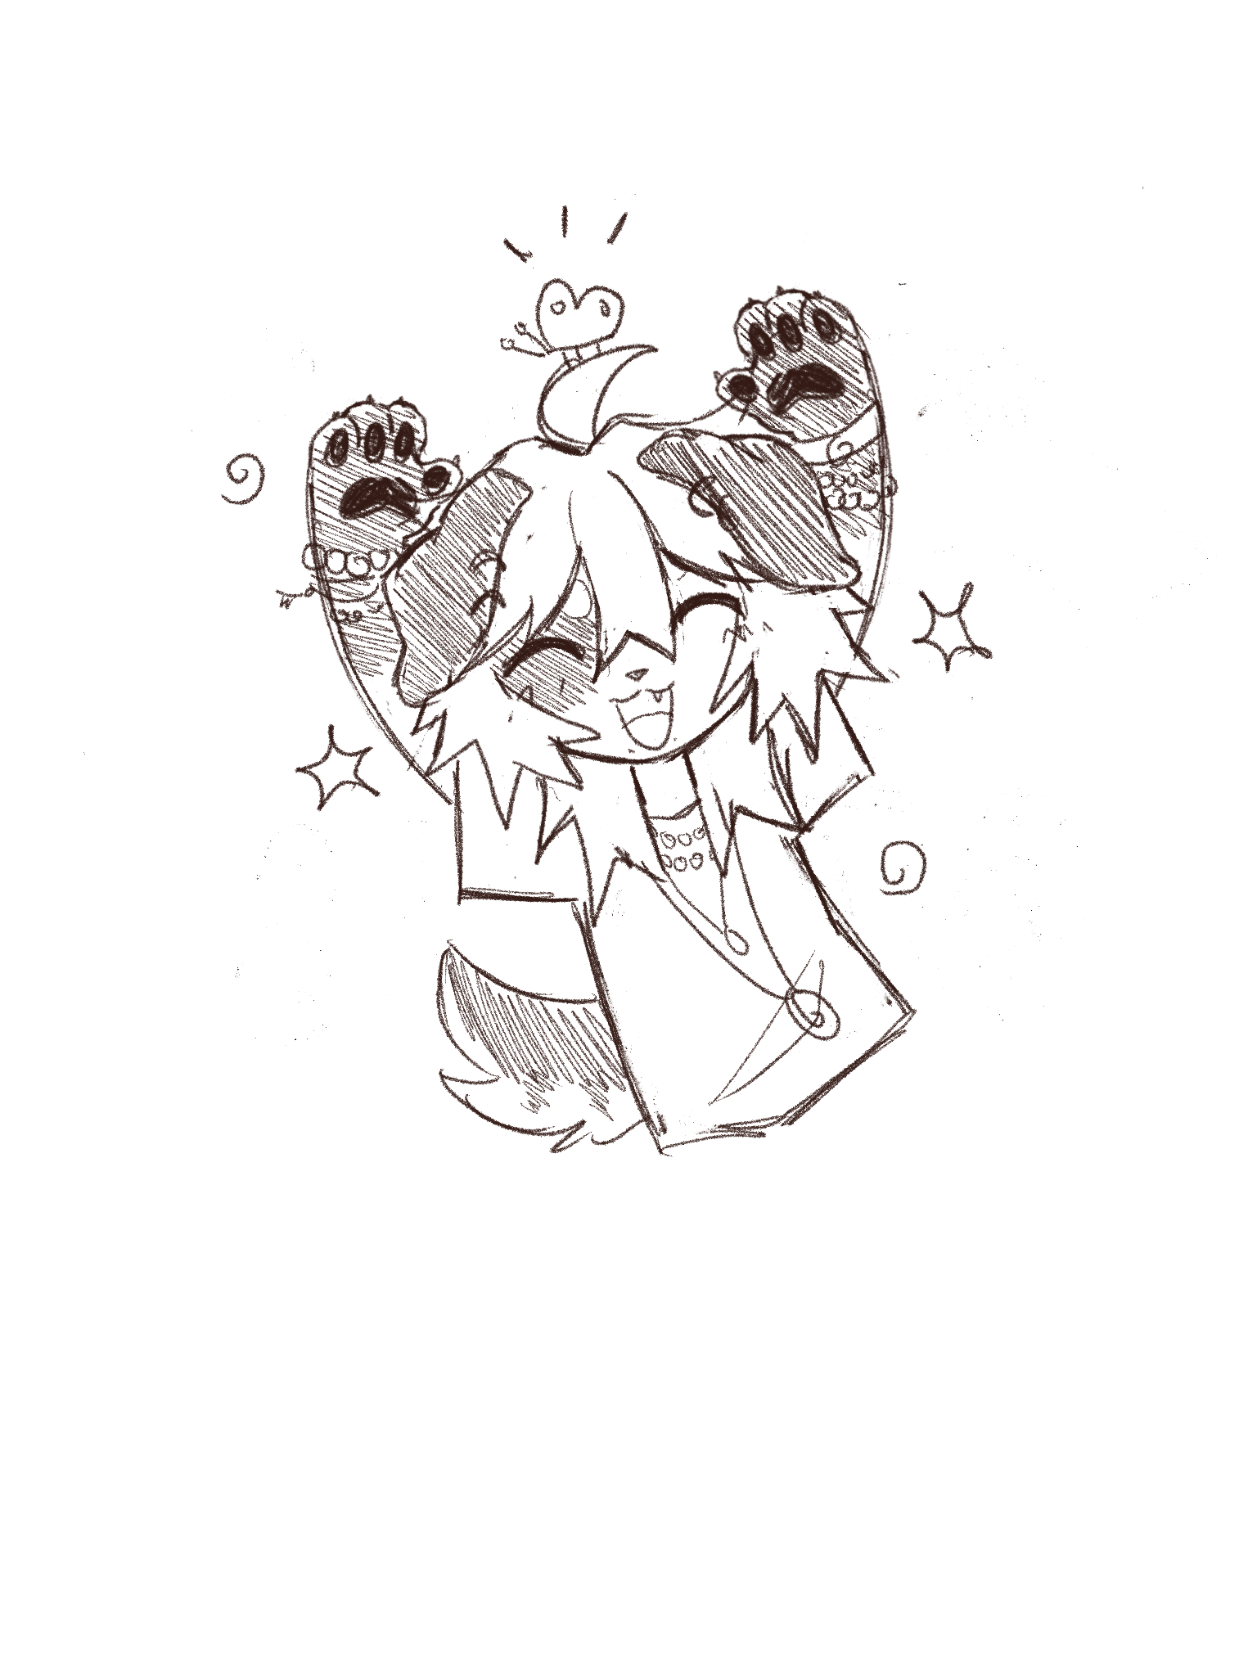
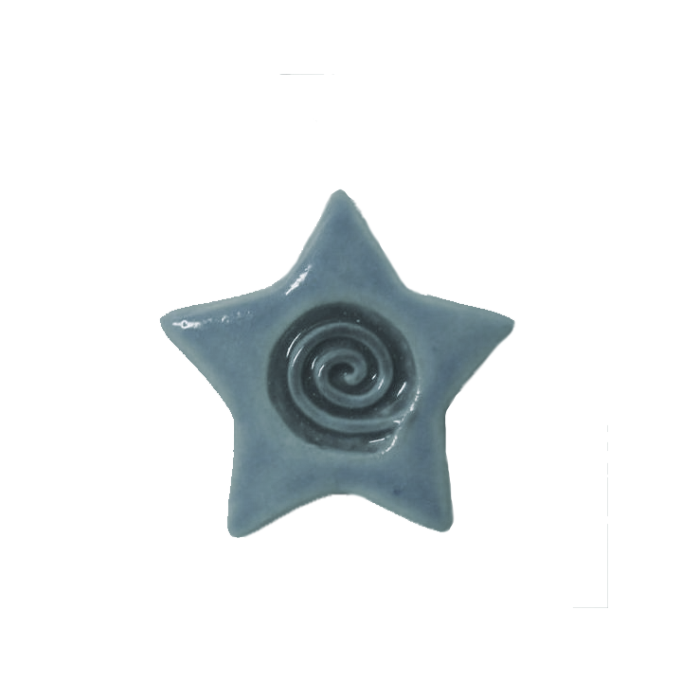

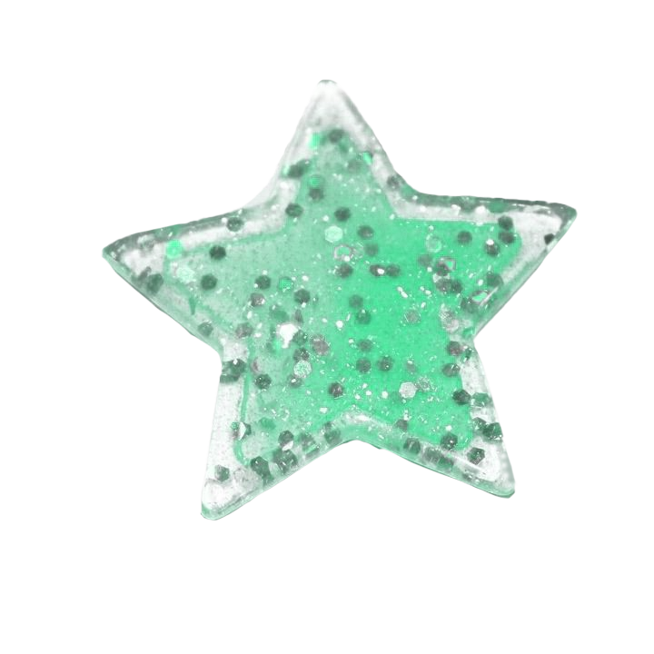
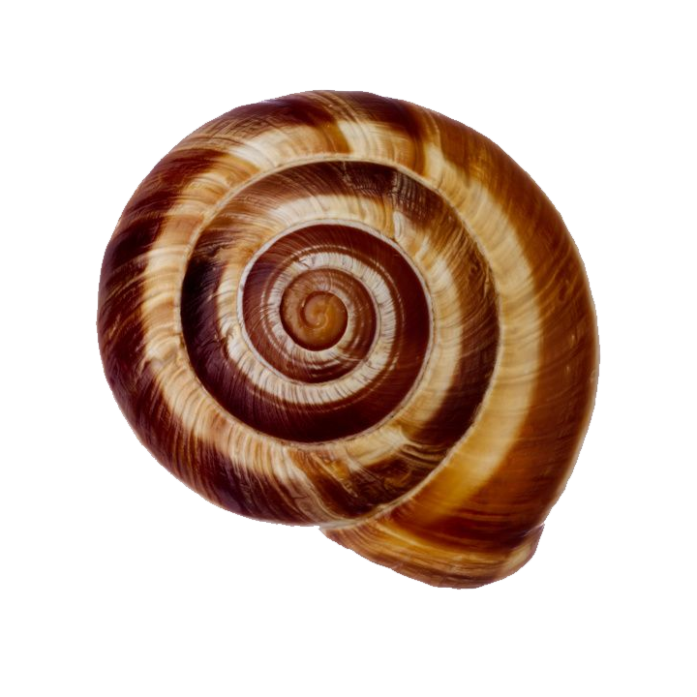
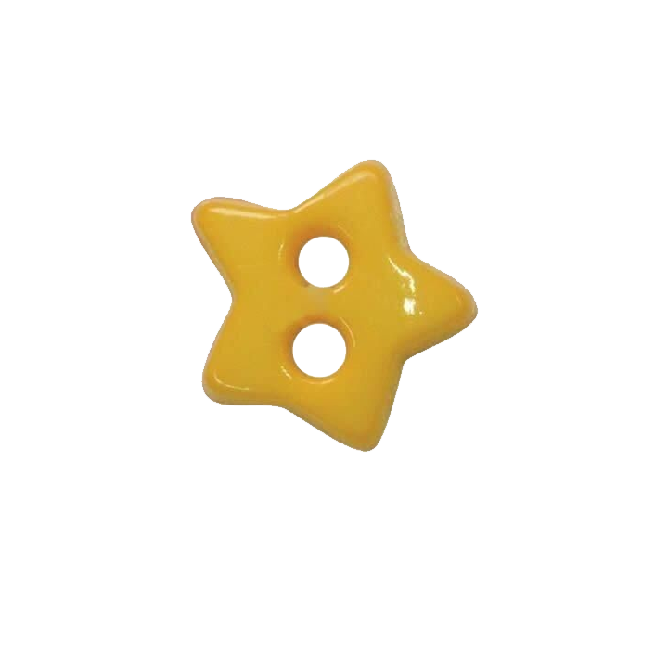
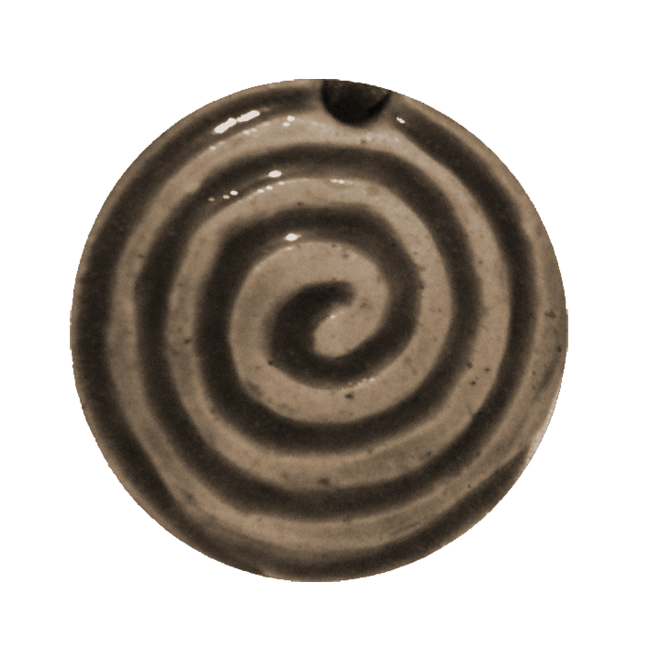
Design Info
• Shape usage: Soft organic shapes (clovers, waves, swirls), stars, paper tear effects, different textures, grid patterns (sketchbook and planner feel), flowers, stars, spirals. Mix of shapes creates a handmade, slightly chaotic feel

Slide 5
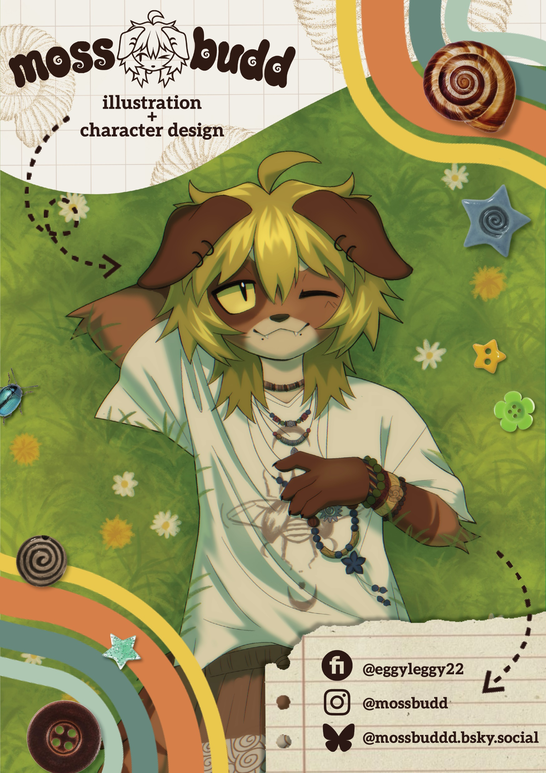
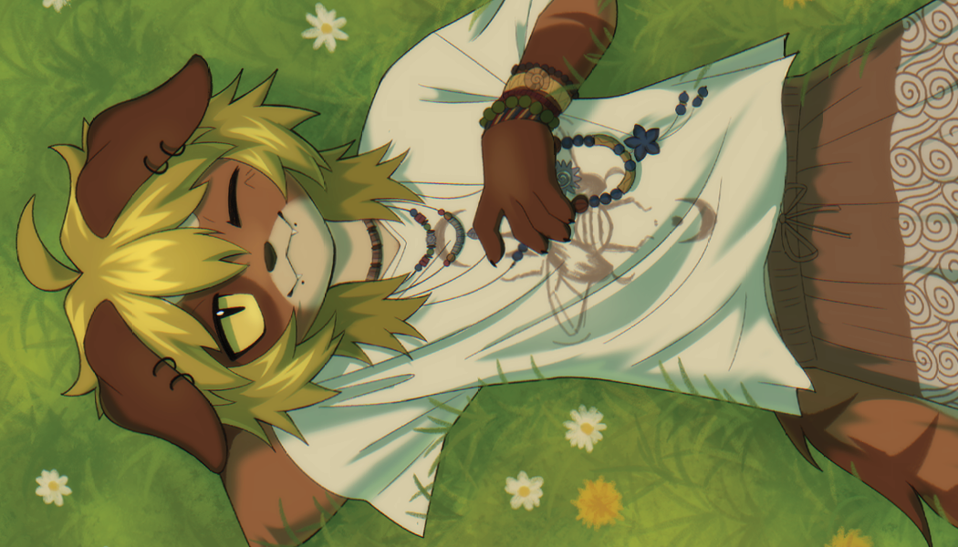
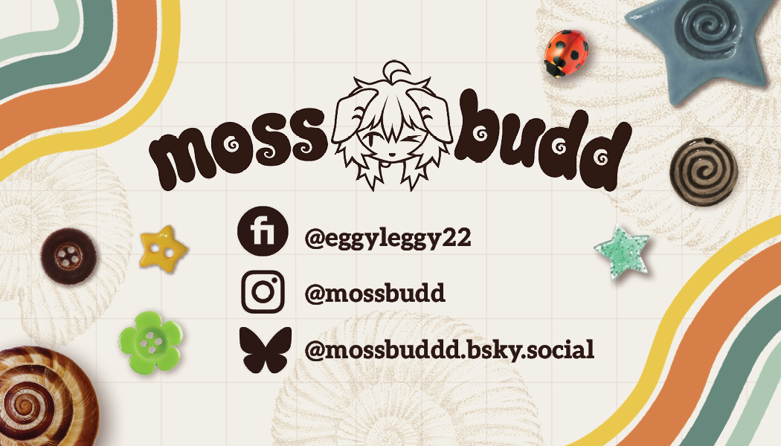
POSTER + BUSINESS CARD

Slide 6
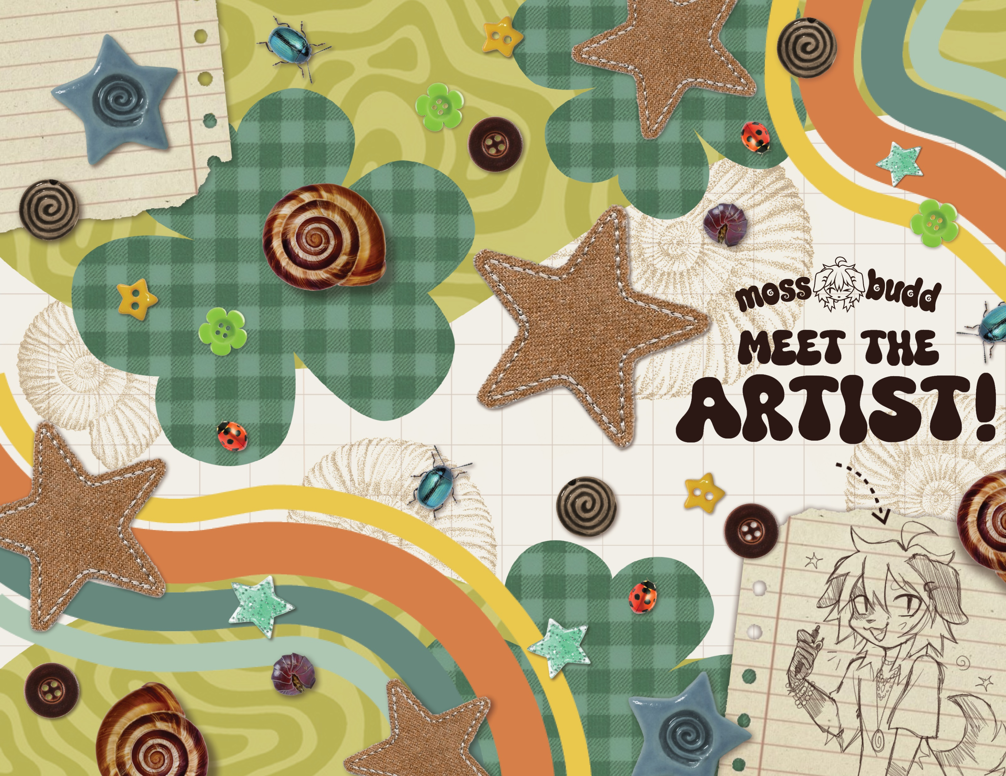
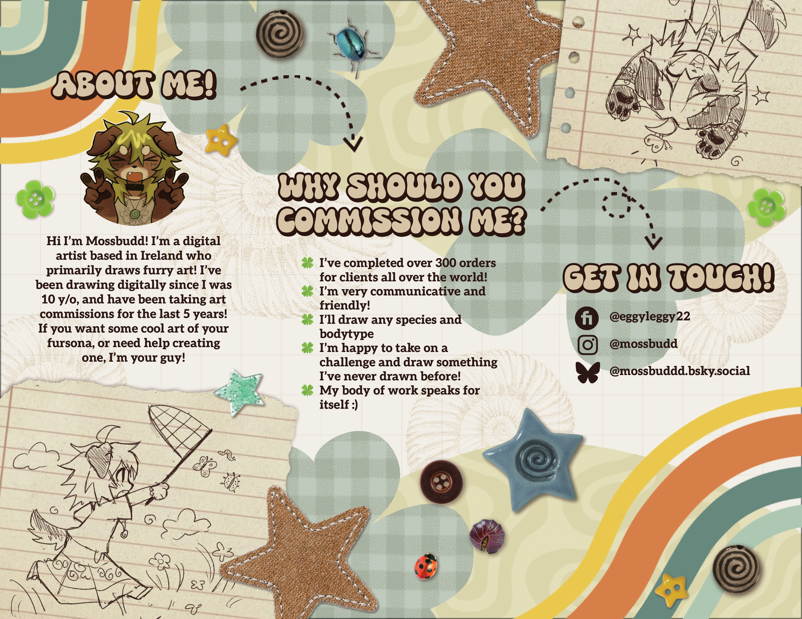
TRIFOLD LEAFLET

Slide 7
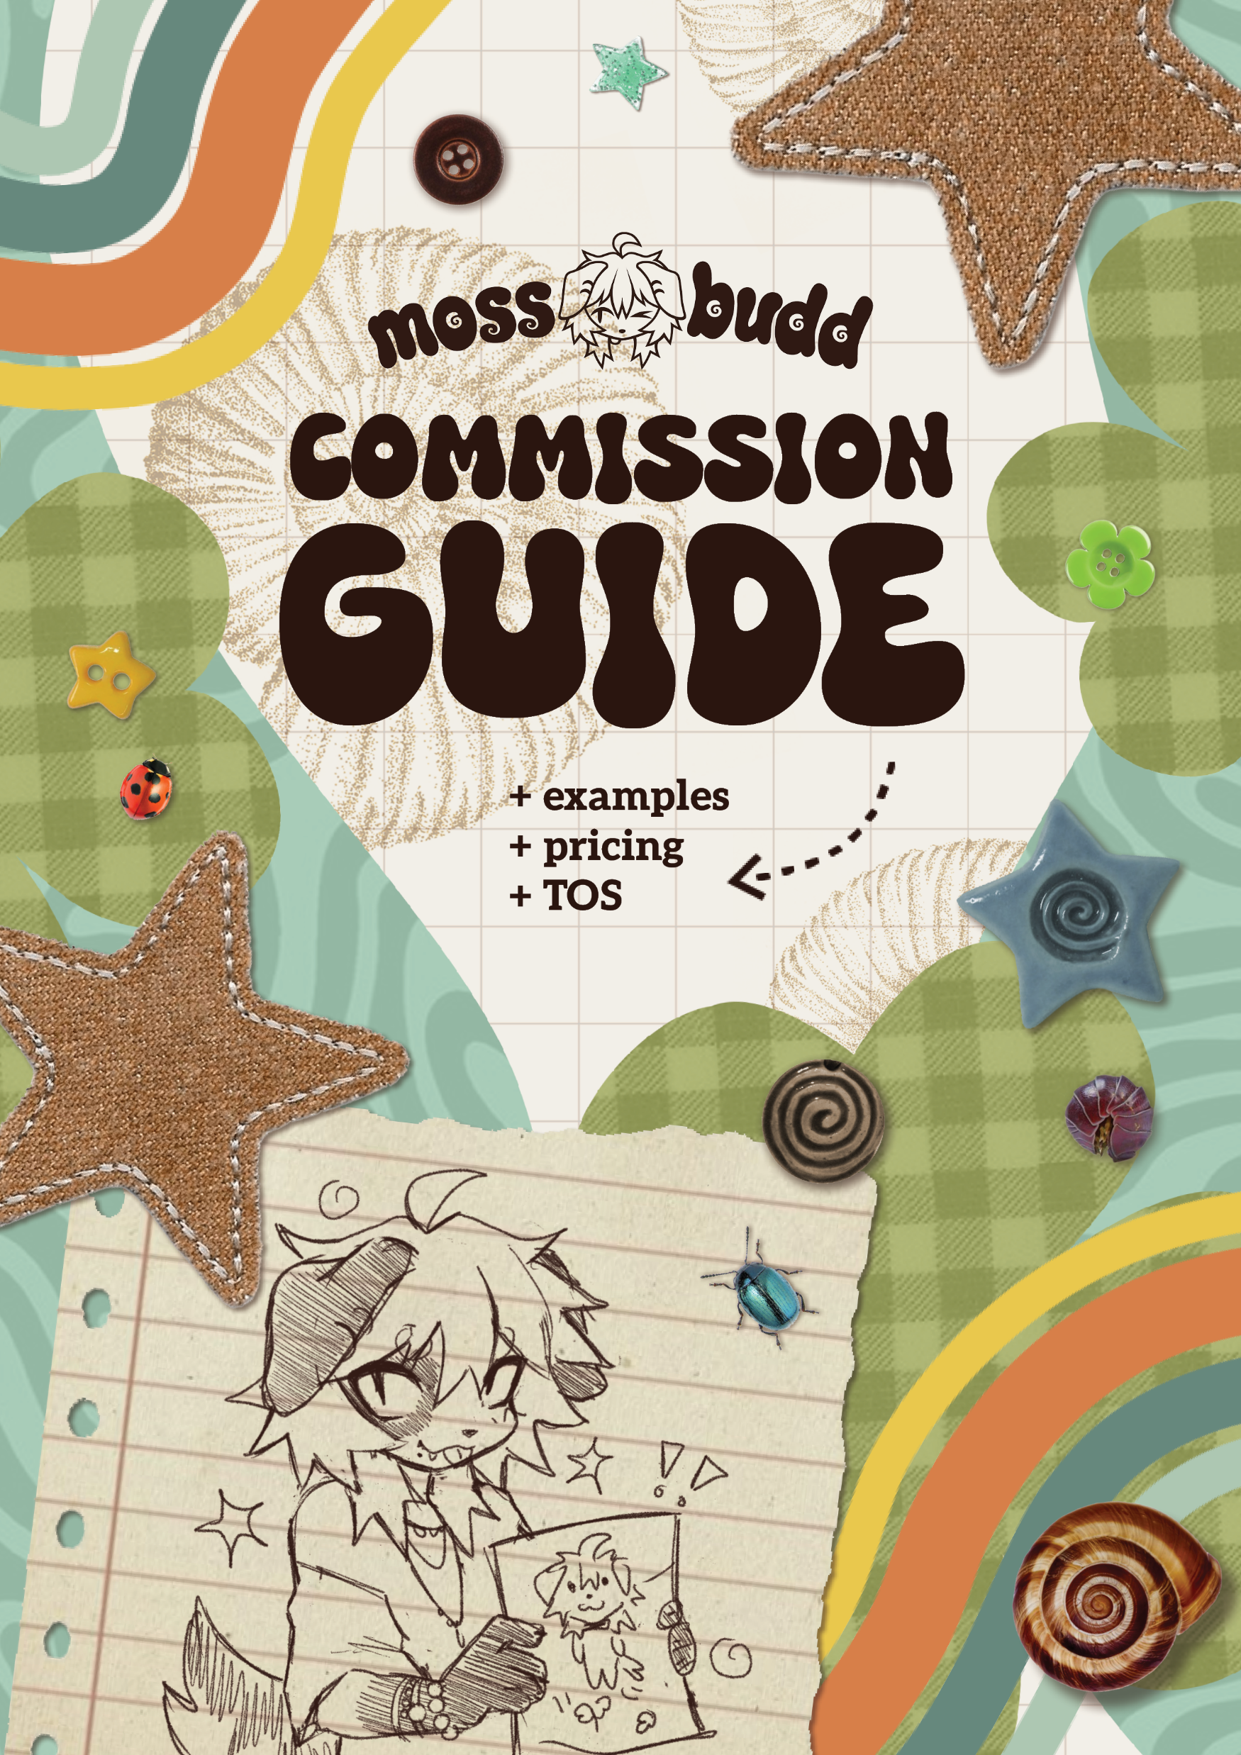
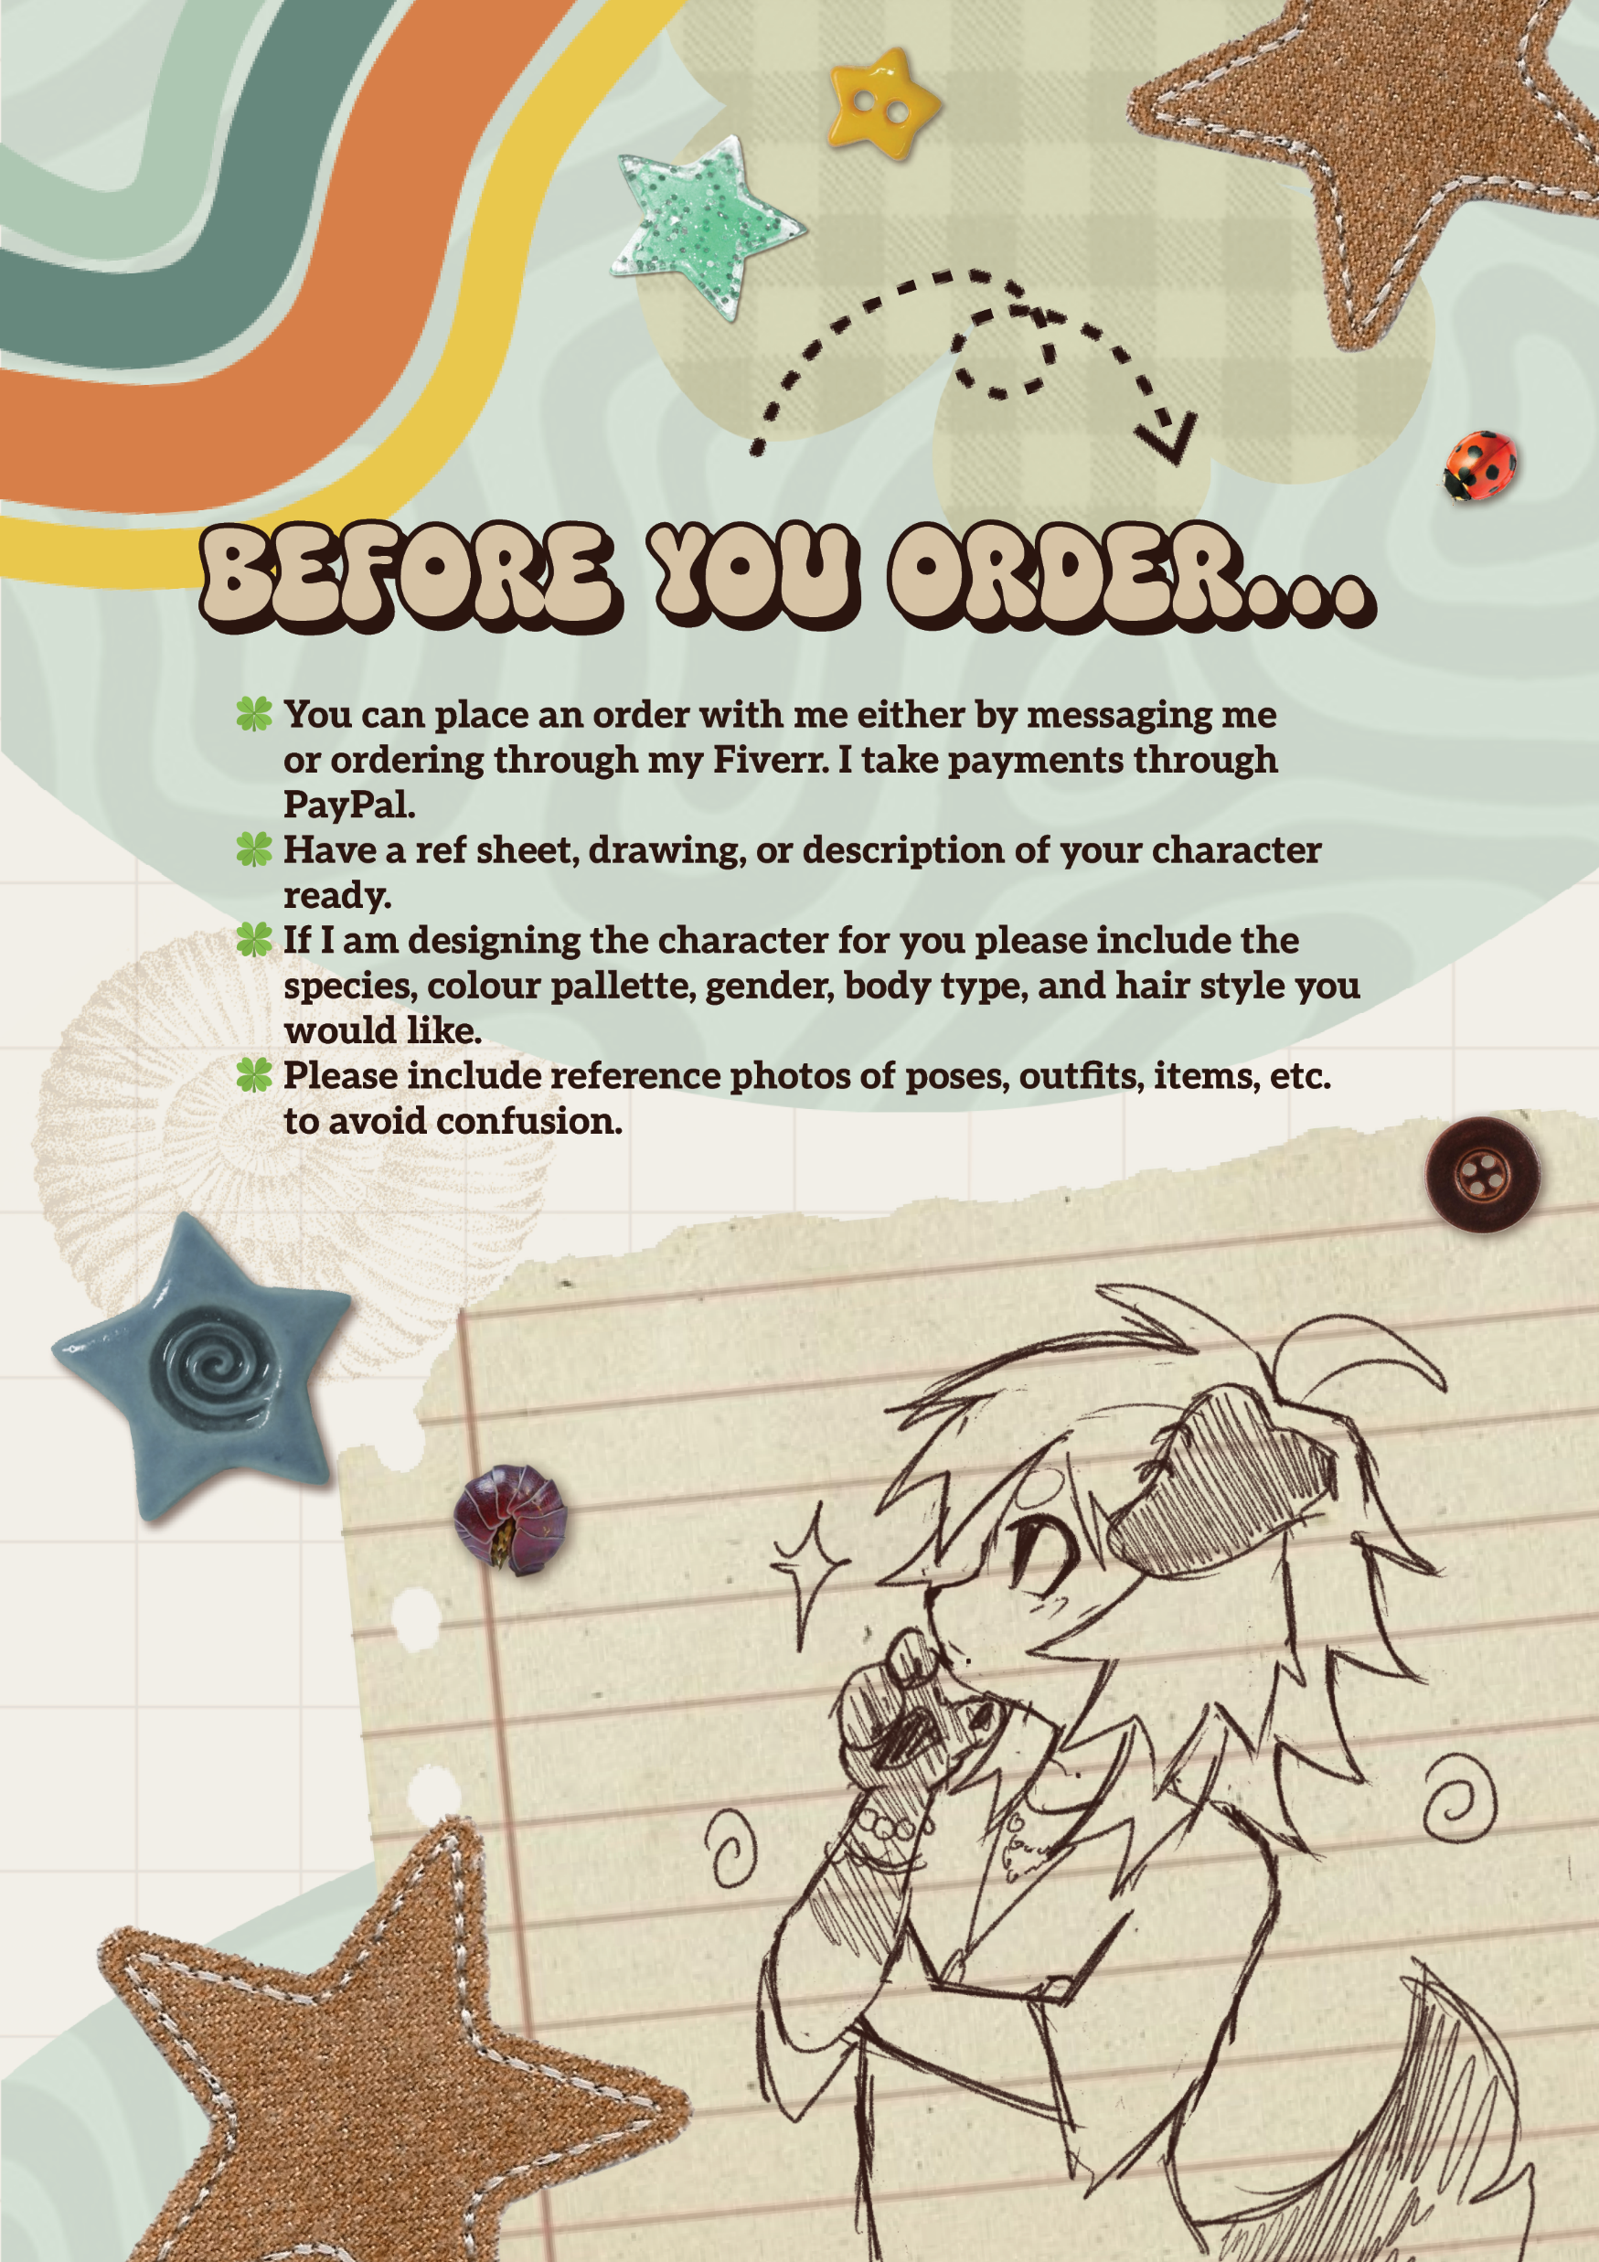
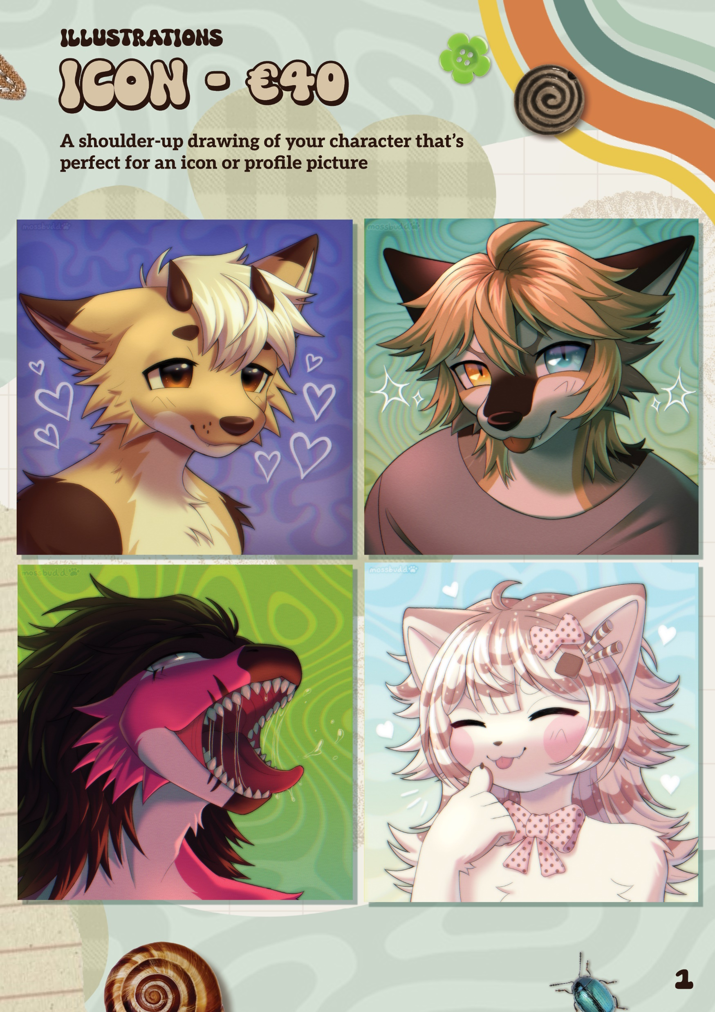
BROCHURE

Slide 8
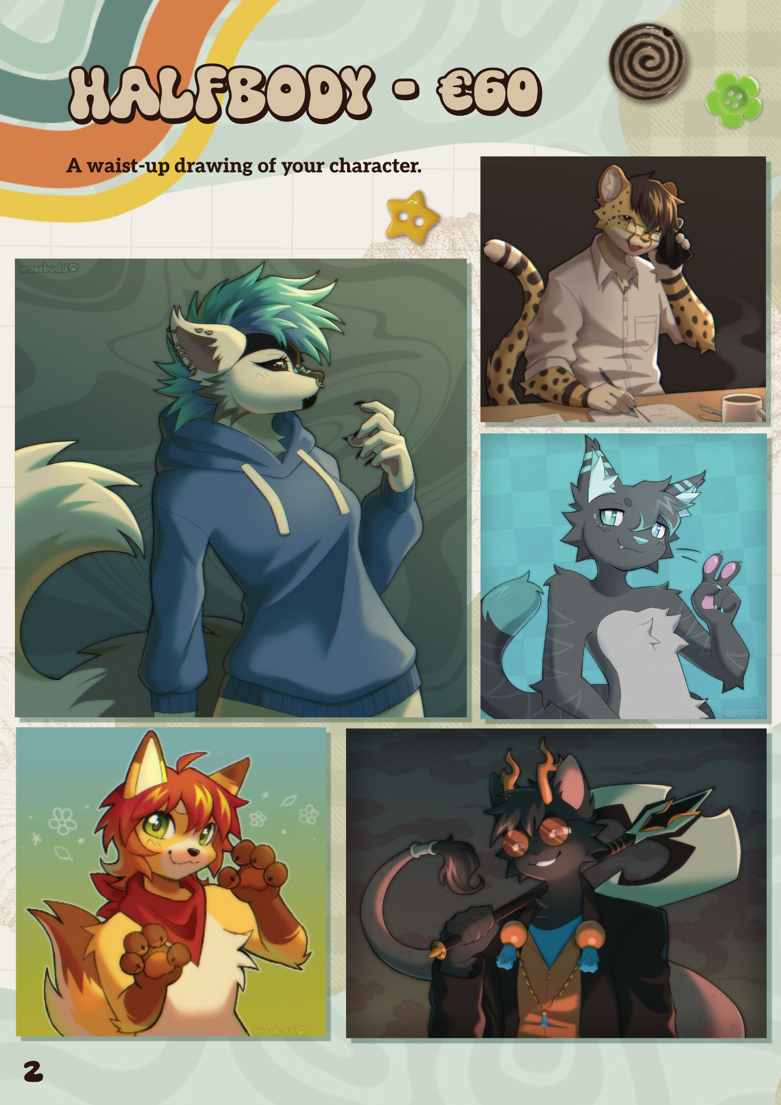
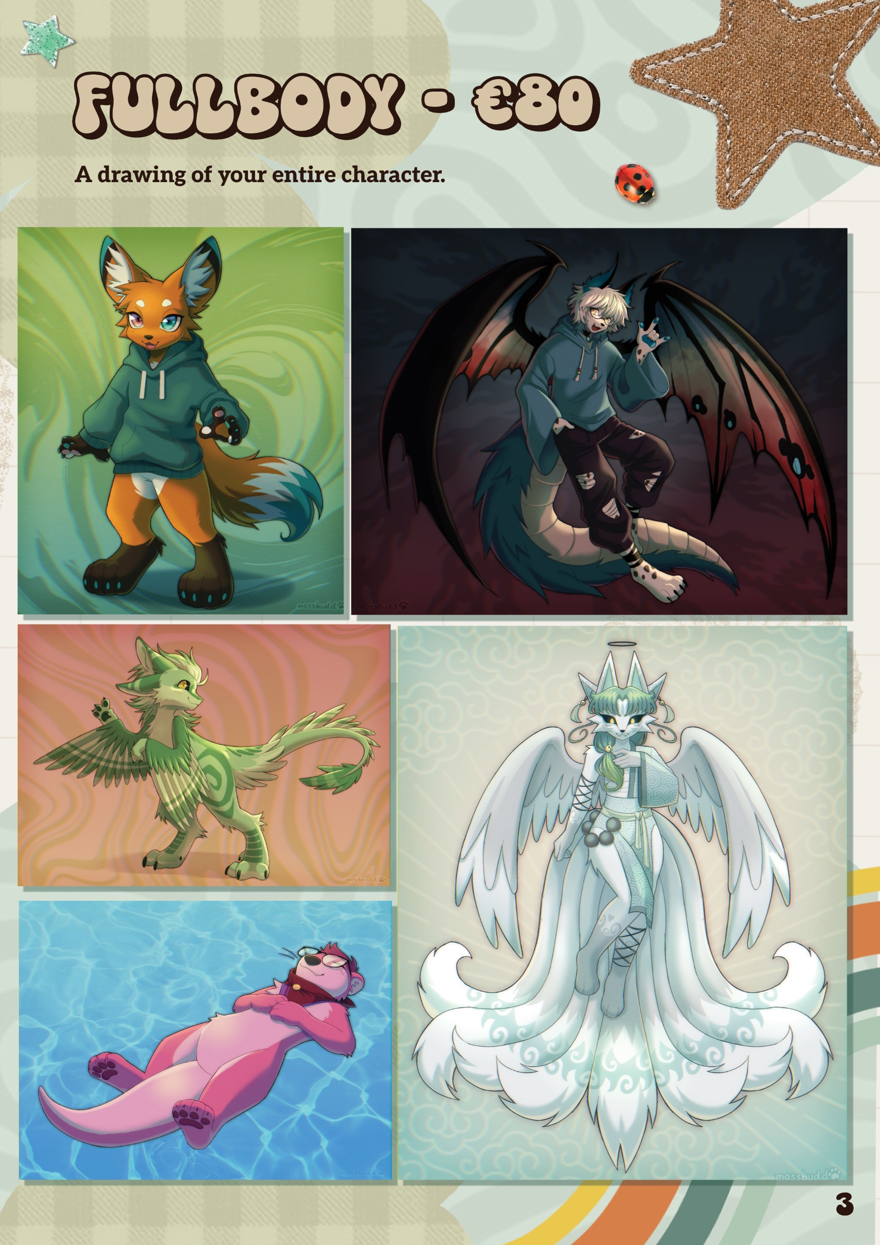
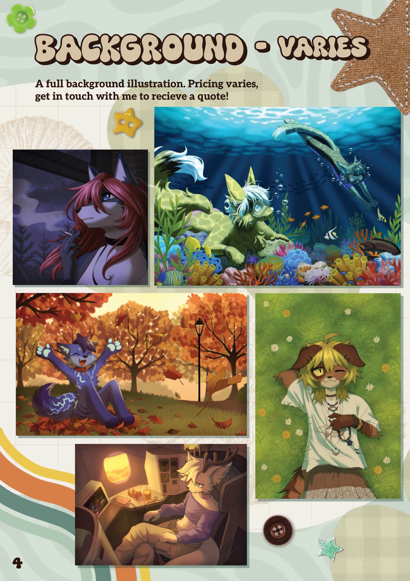
BROCHURE

Slide 9
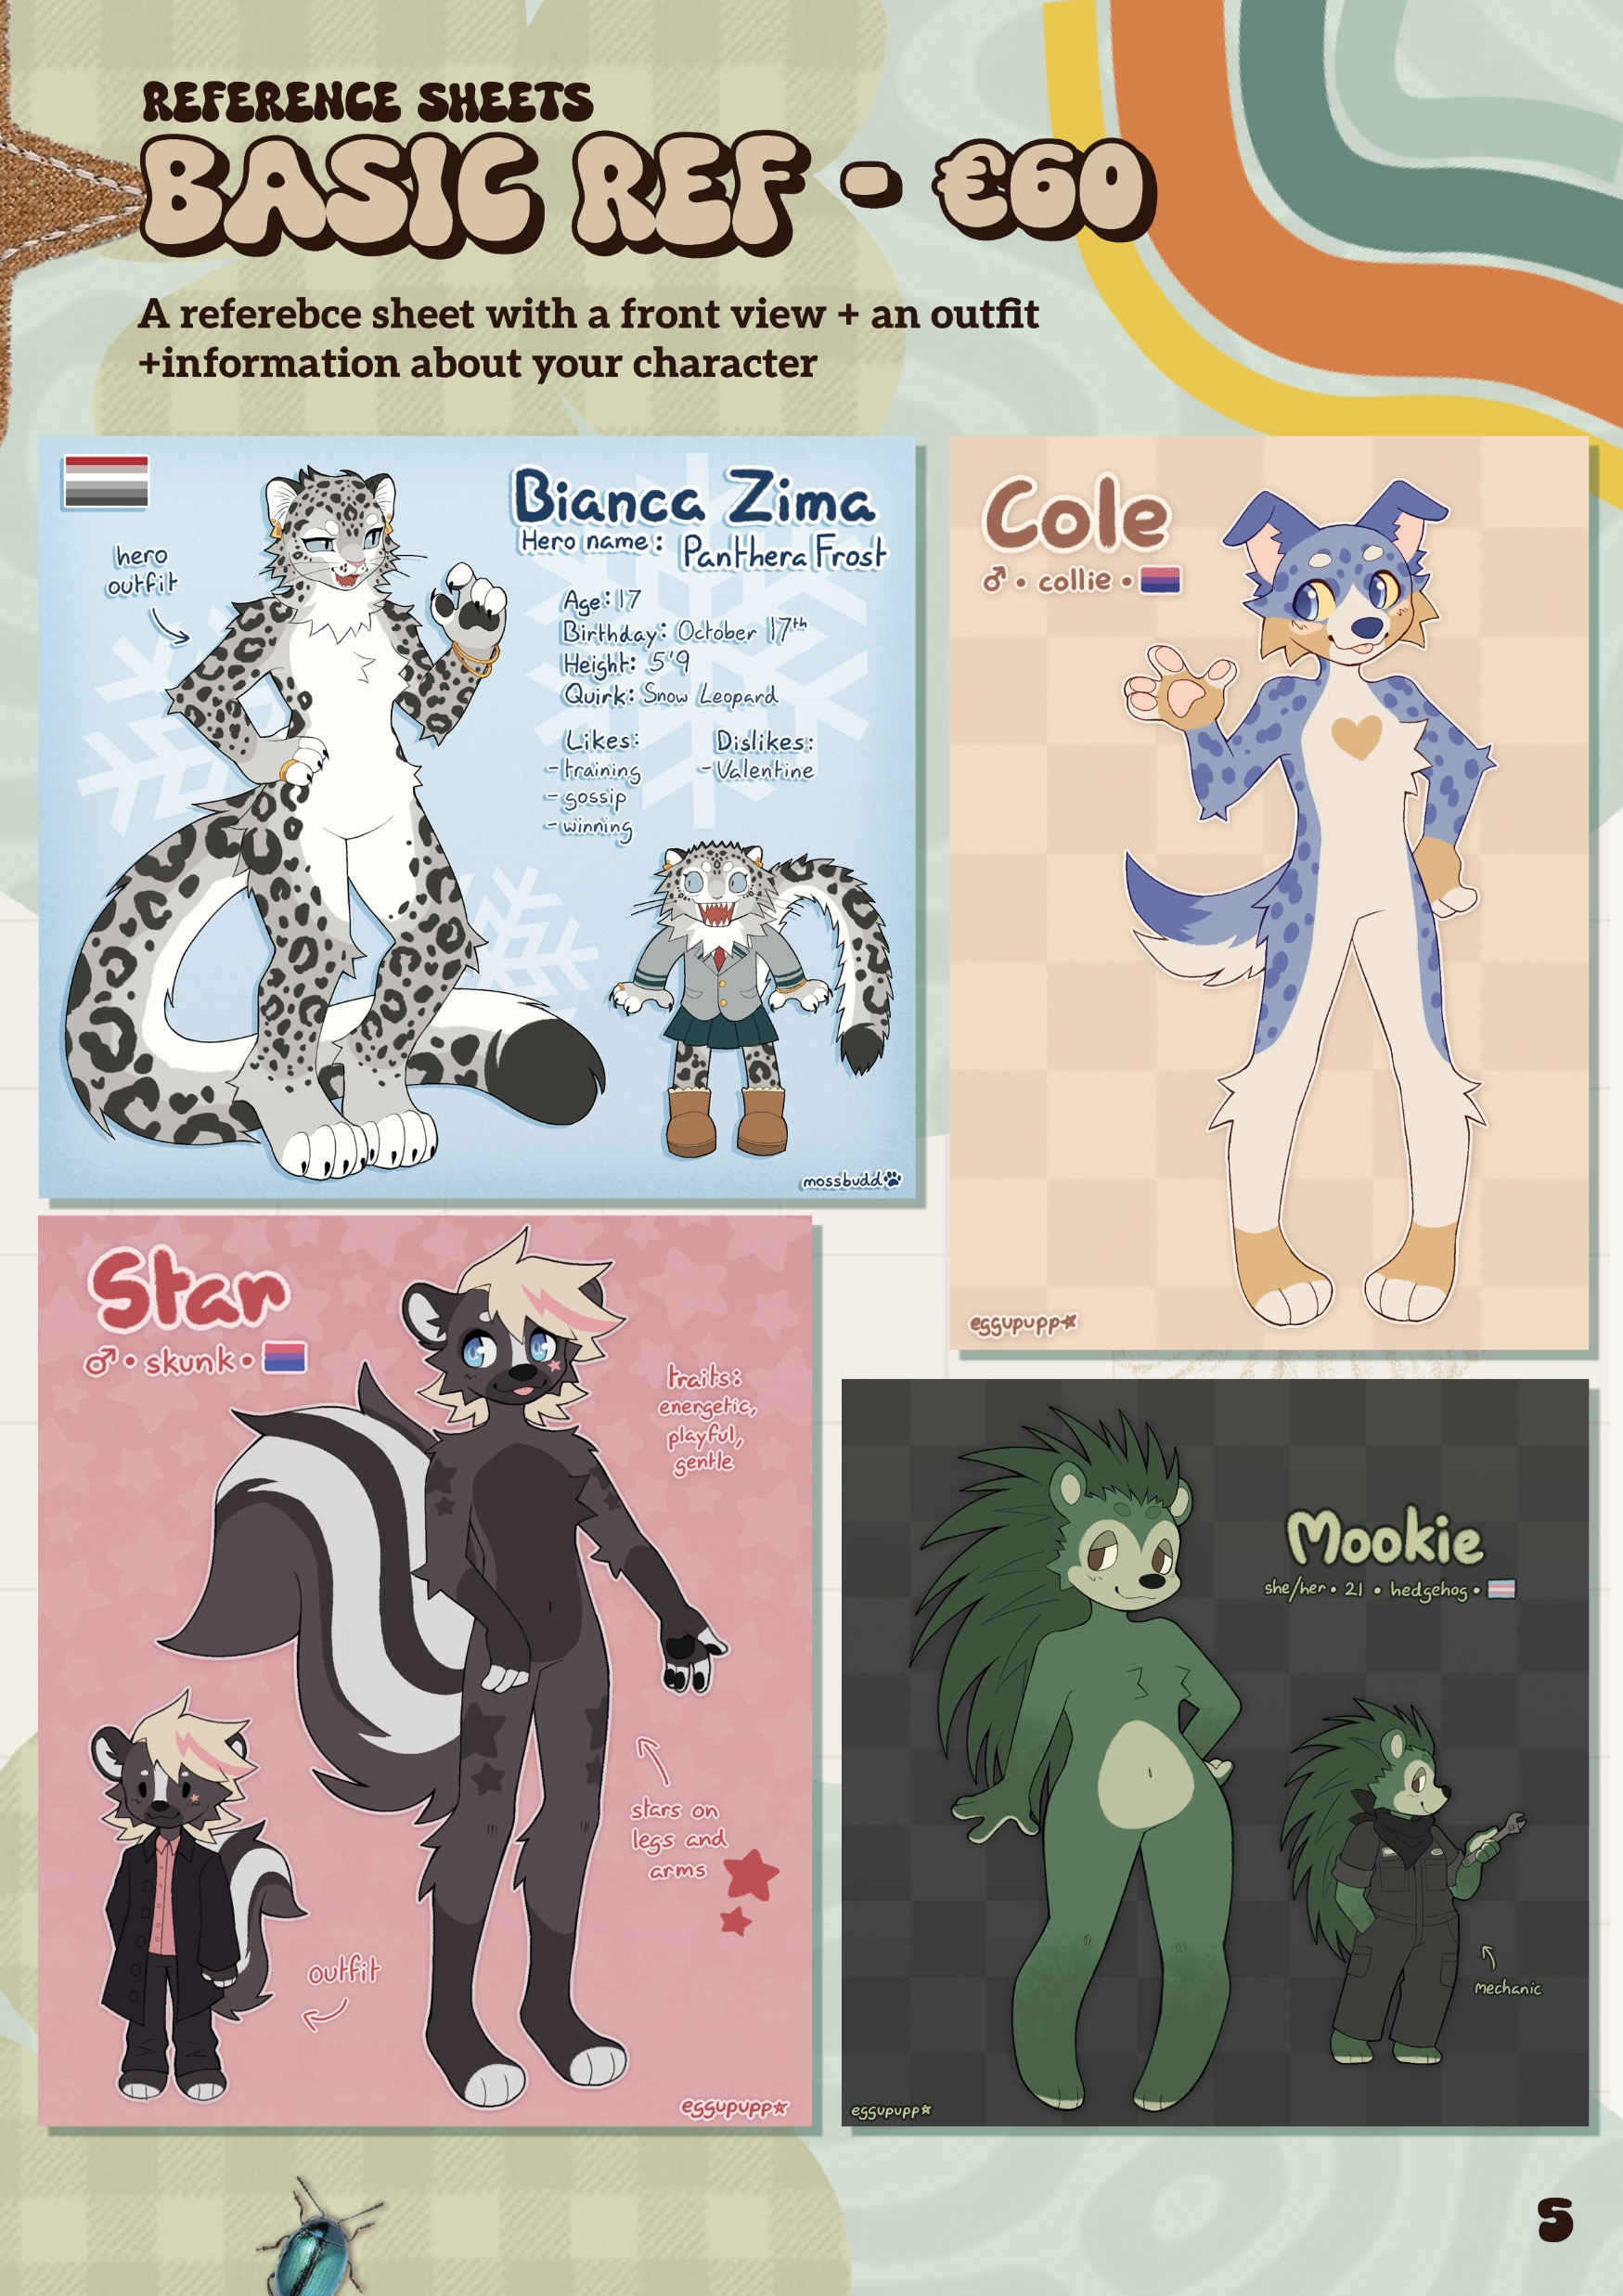
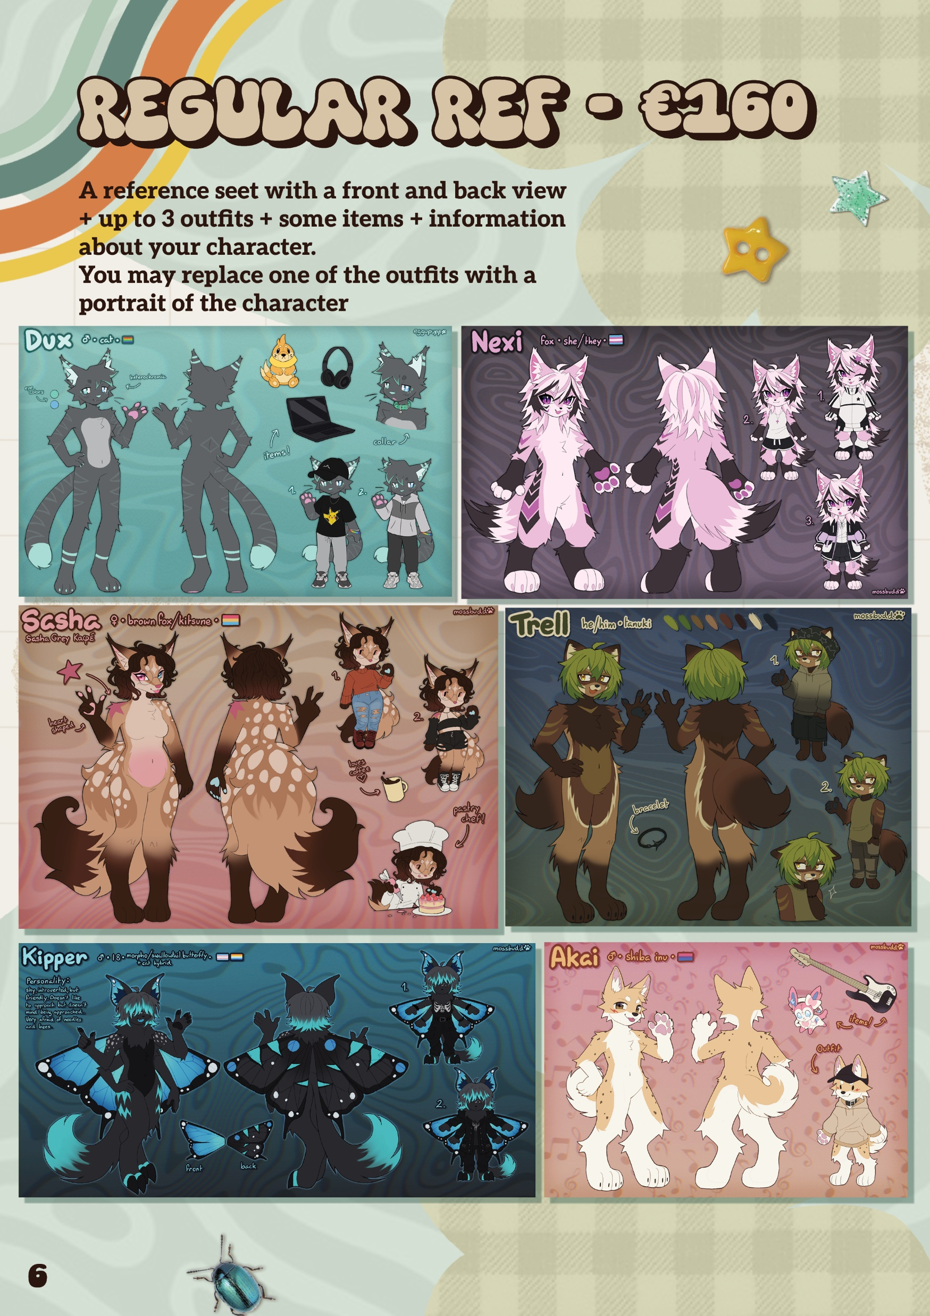
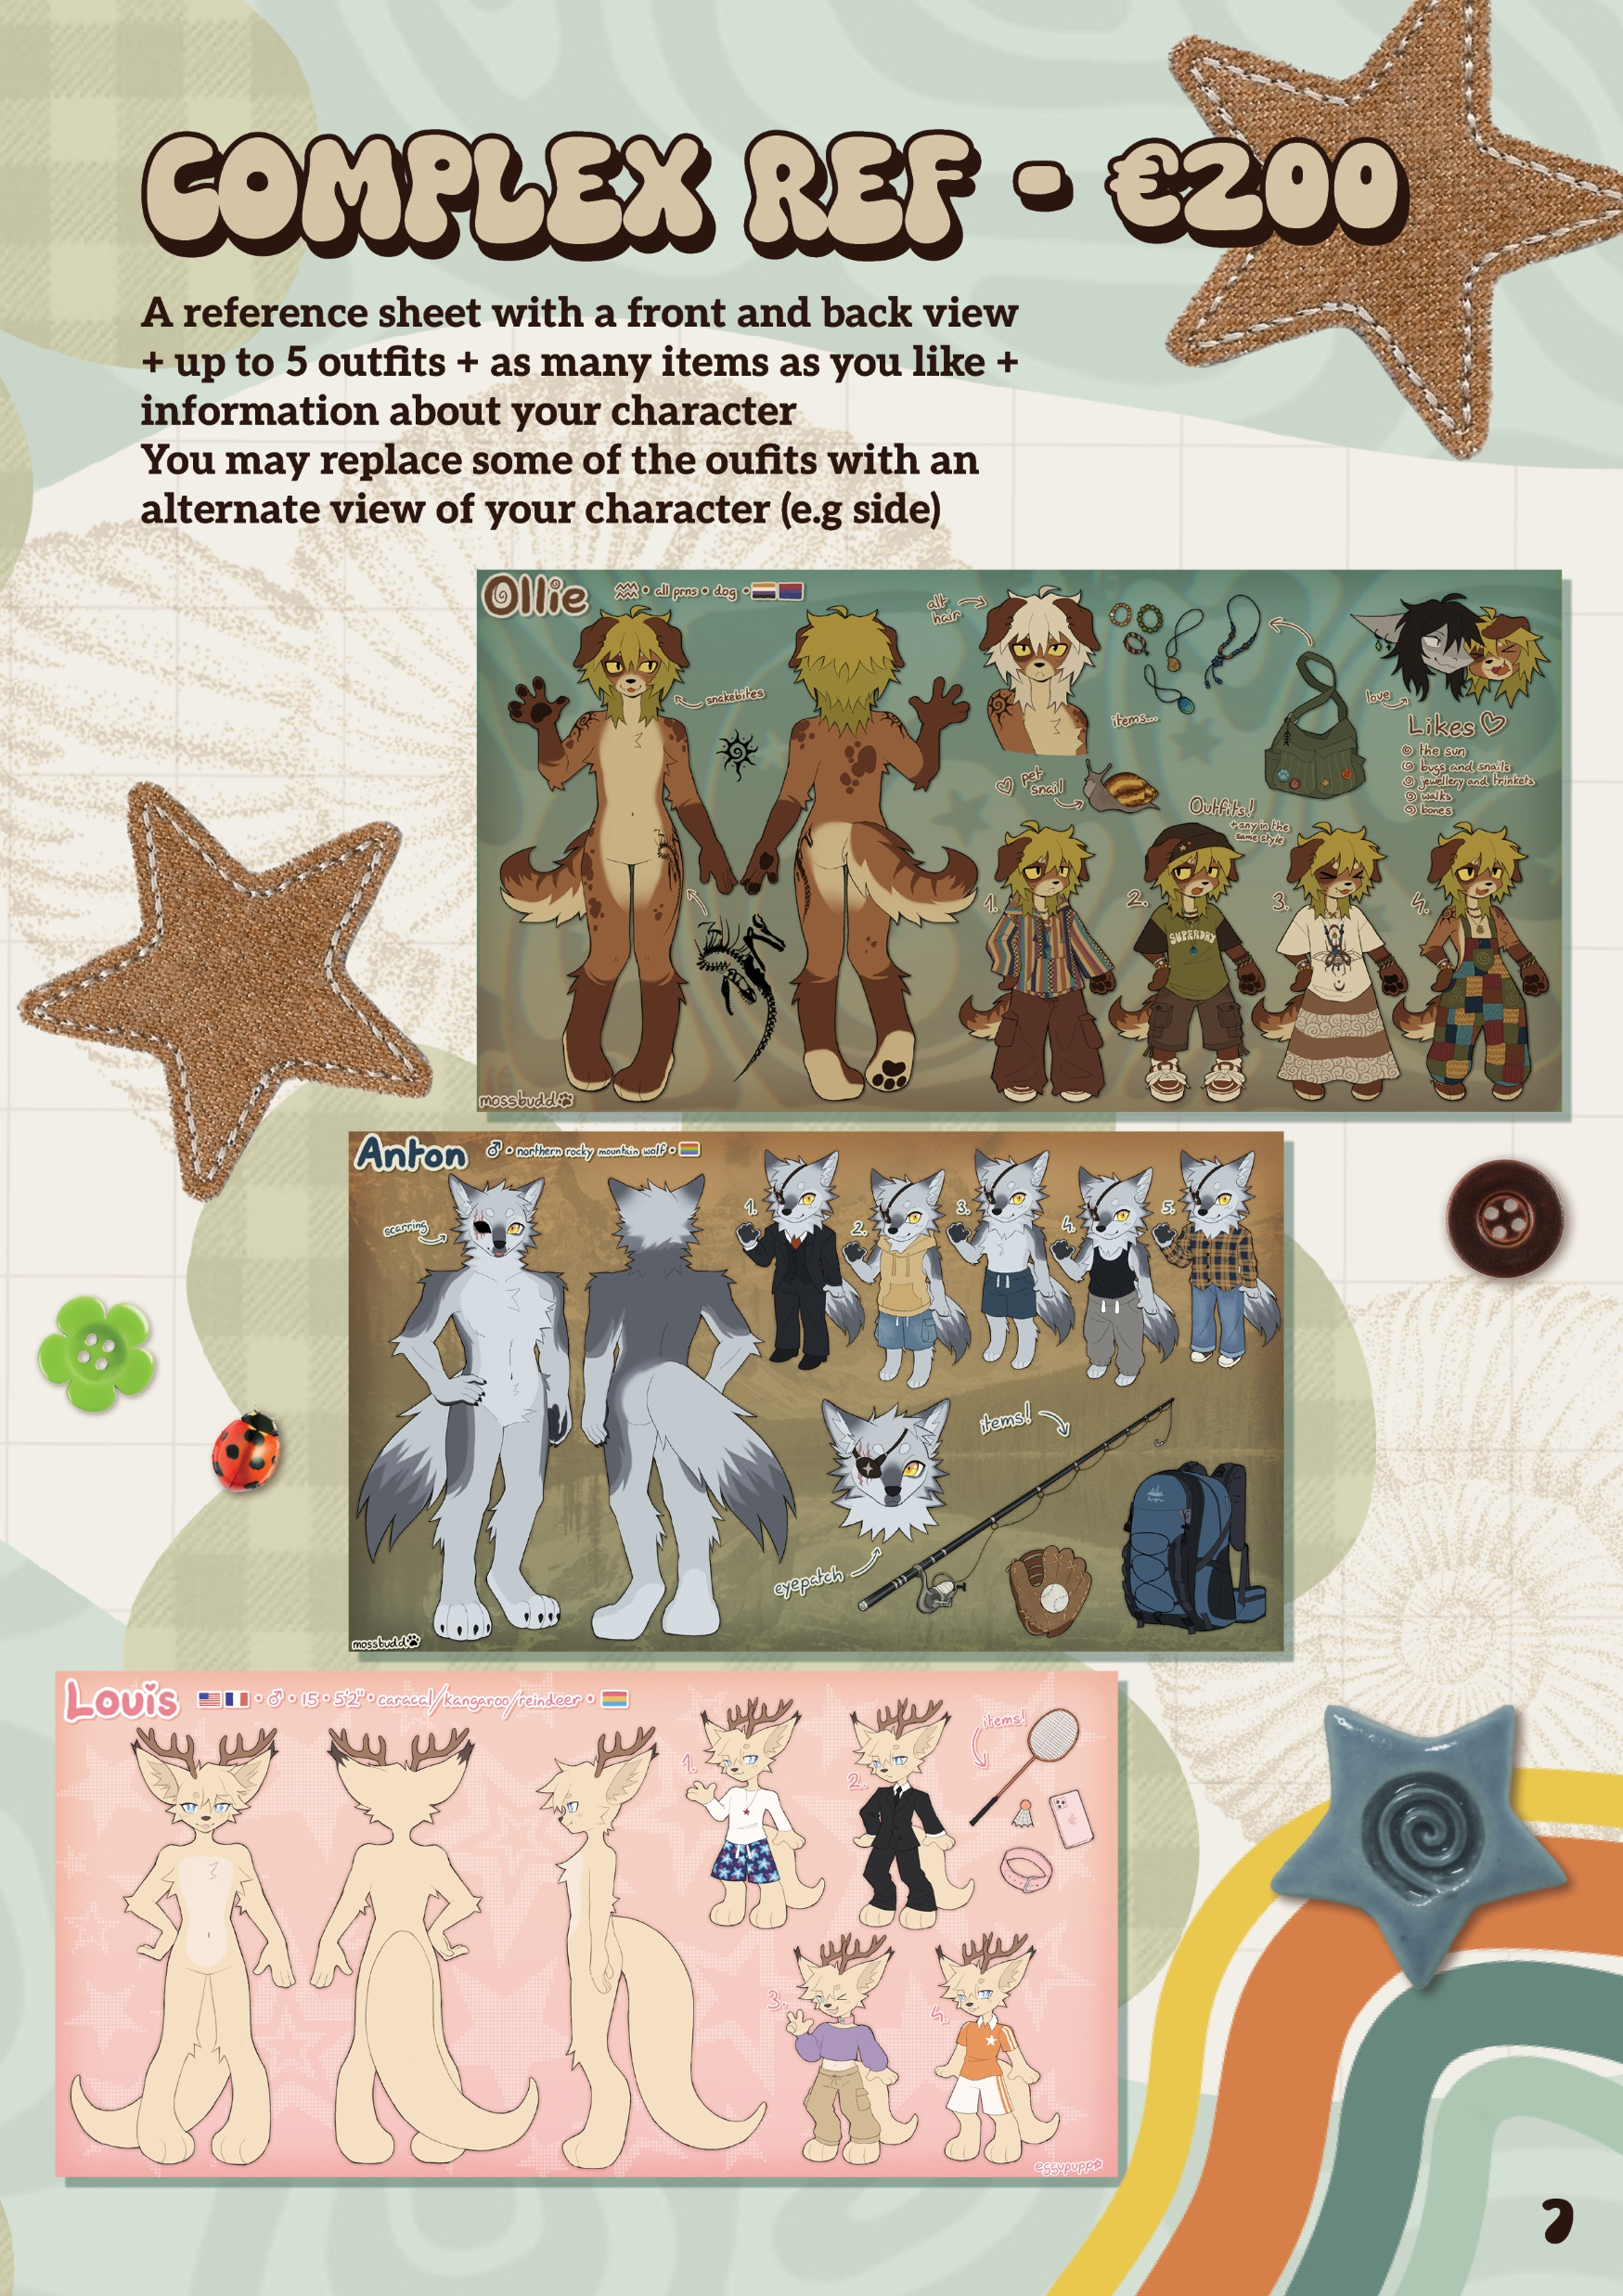
BROCHURE

Slide 10
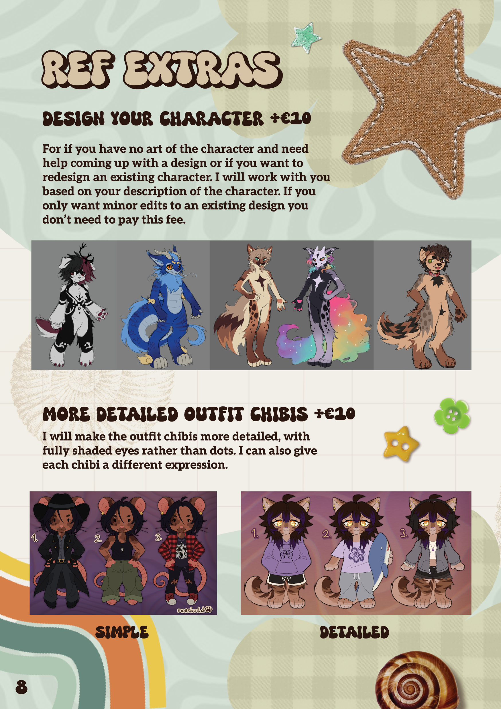
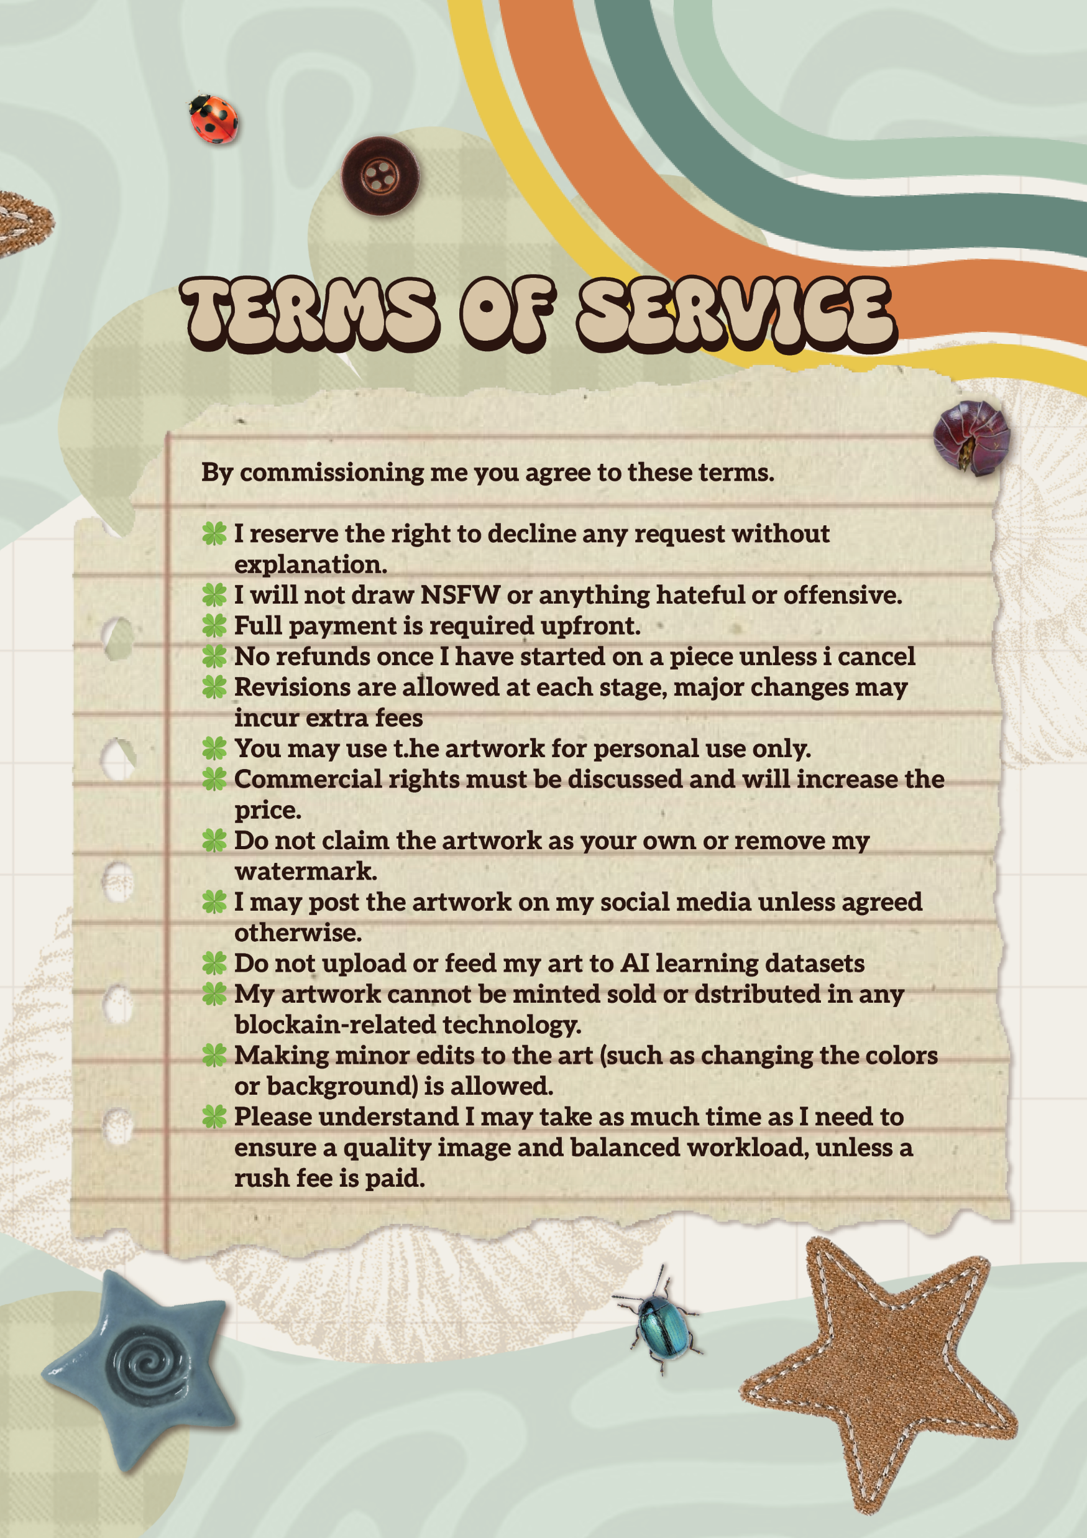
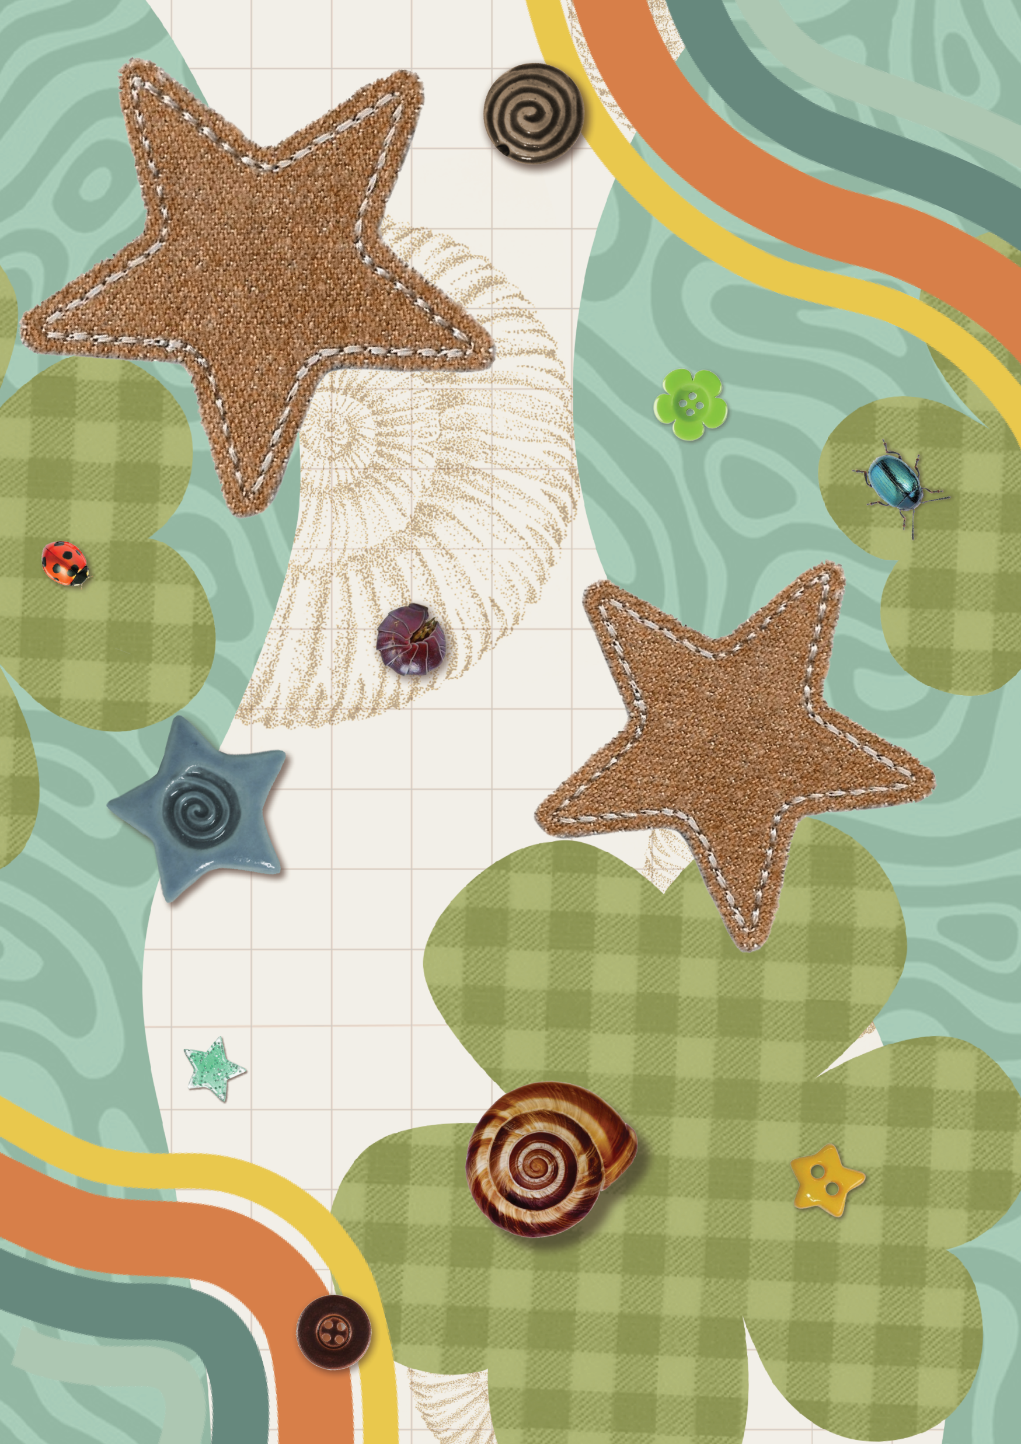
BROCHURE

Slide 11
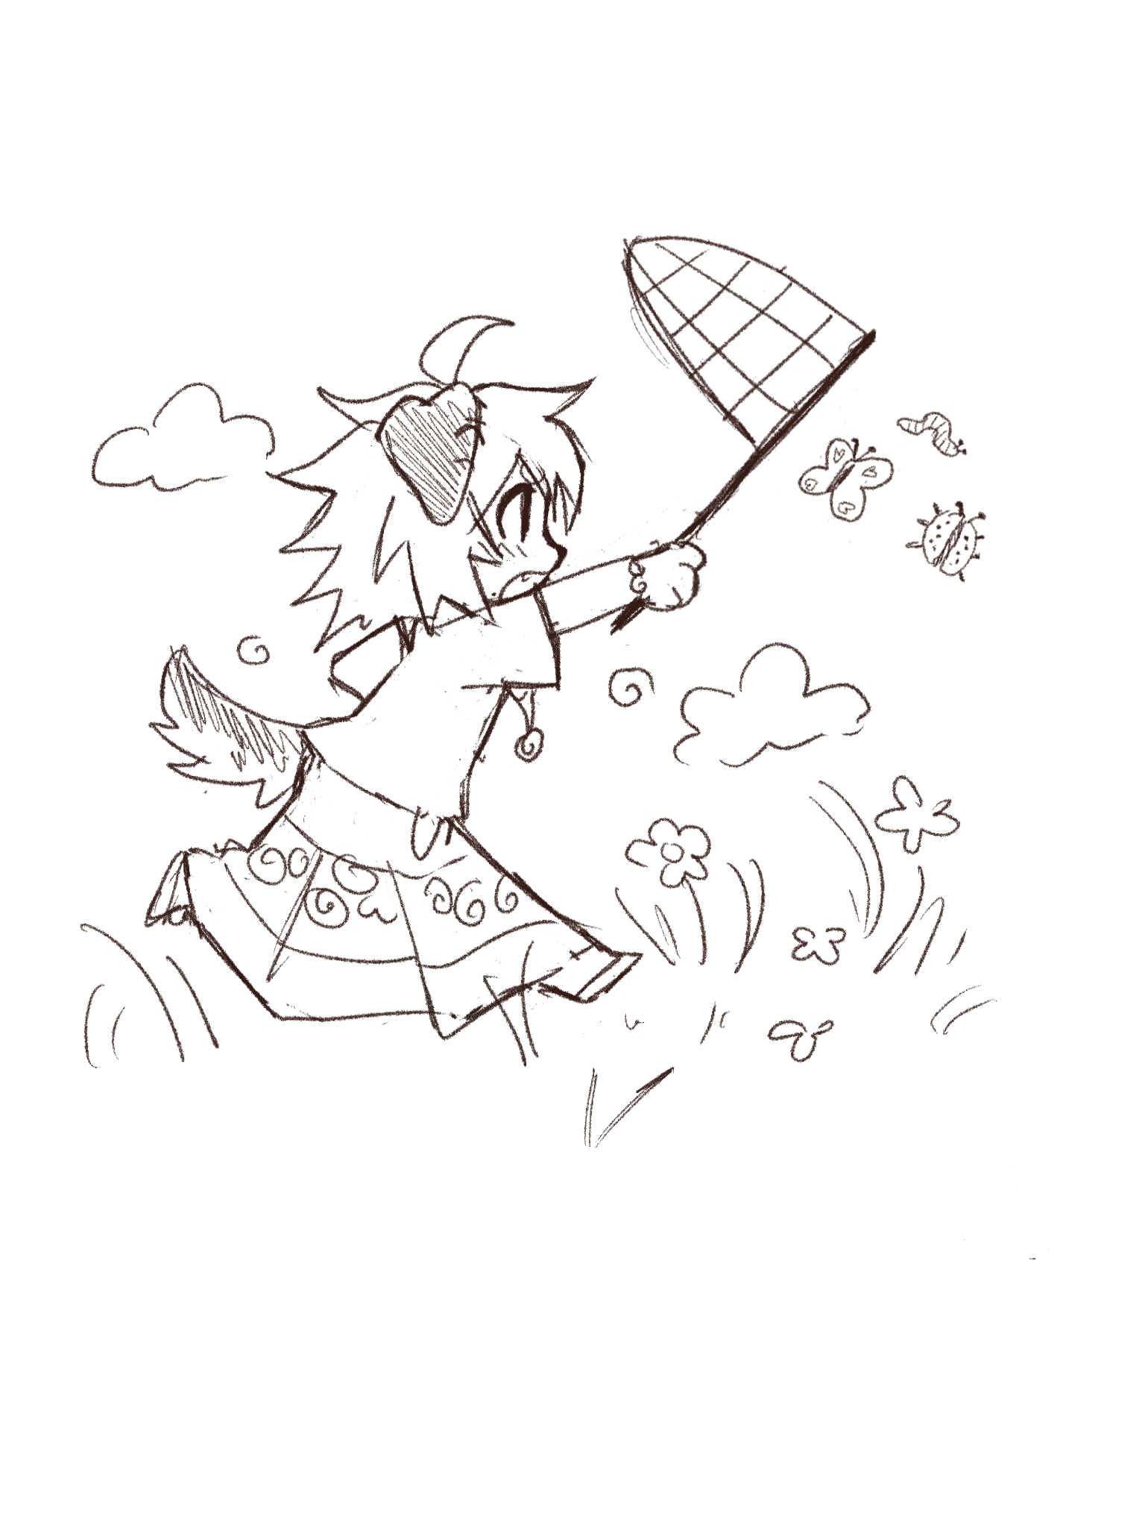
Thanks for listening

