Slide 1
Internet of Things
By Vishal, Junjie Feng, Yue Yang

Slide 2
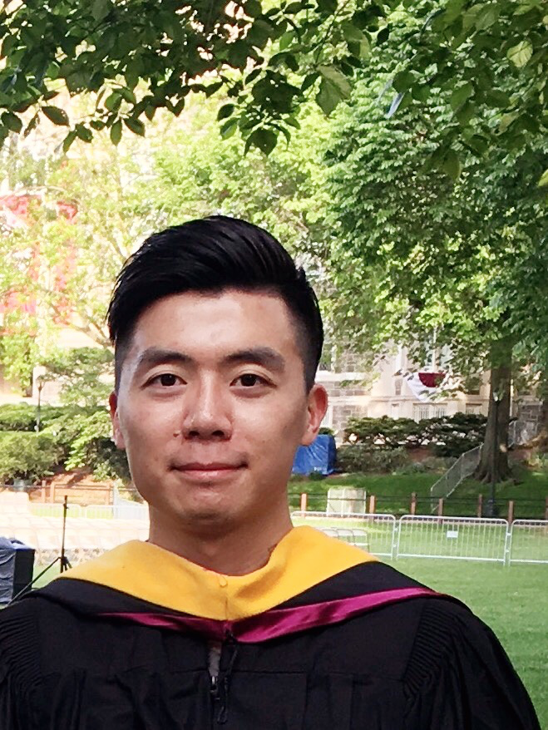
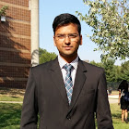
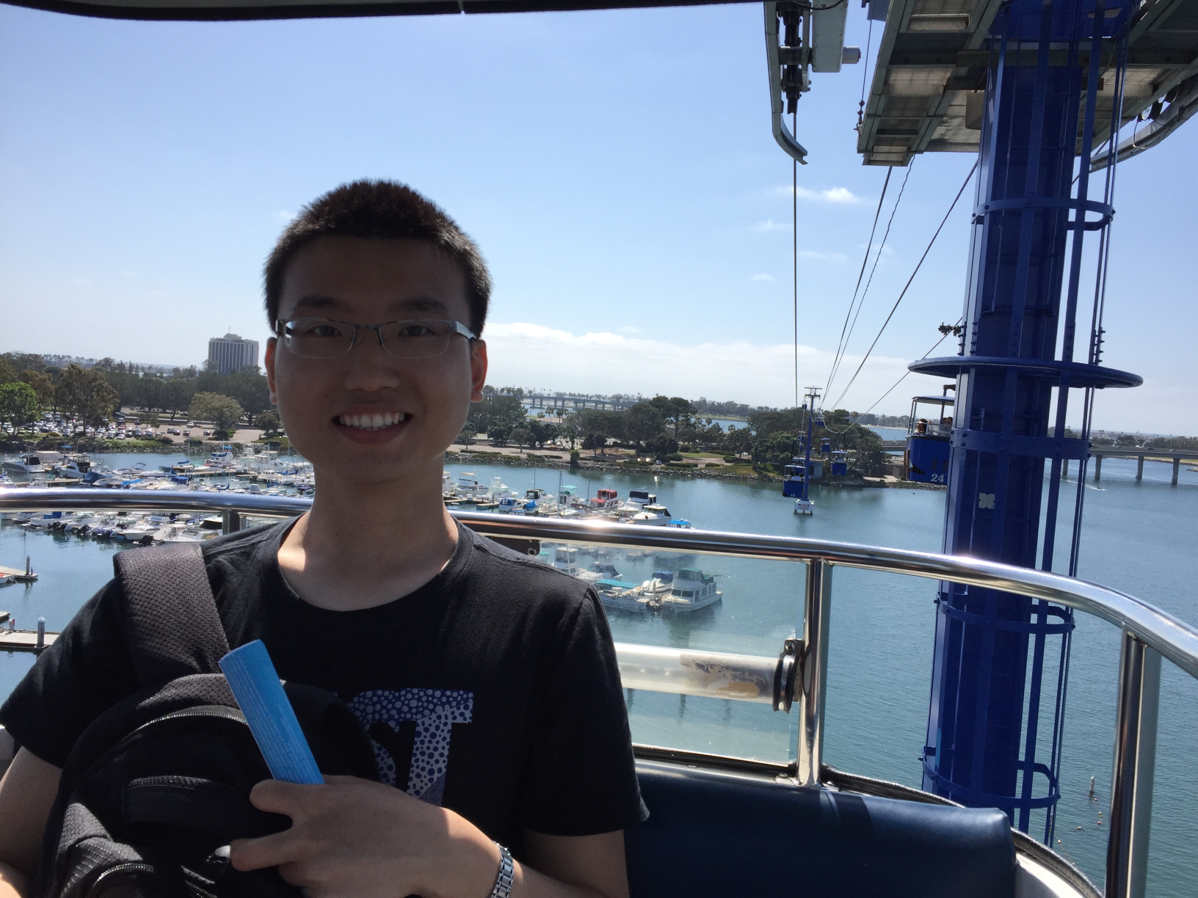
Team Members
Vishal
Junjie Feng
Yue Yang

Slide 3
Progress for this week
Face Recognition Project:
Trained the face recognizer with sample database (database_1);
Recognize faces in a live video, cut the face from a frame and store the “New_Face” in another database (database_2);
Using LHBP* face recognition module to predict the “New_Face” as someone in the database_1 or predict it as unknown people.
*LHBP = Local Binary Patterns Histograms
Smart Library:
Create a splash screen;
Successfully read data from txt file;
Successfully write the txt file(which is in Android Studio on Mac OS) from owl platform(which is on Linux);

Slide 4
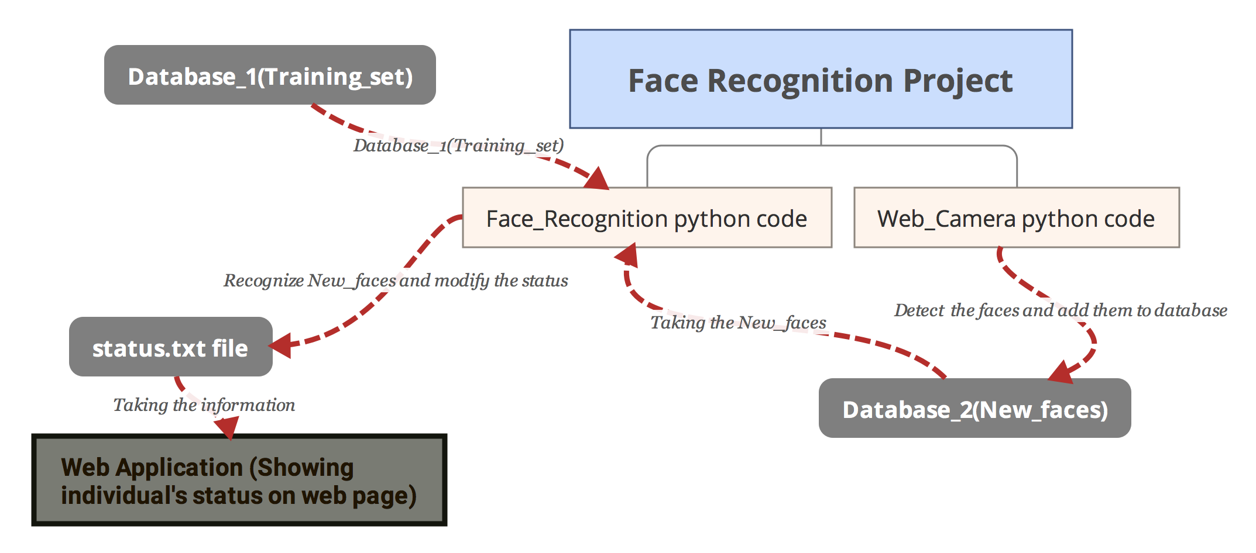

Slide 5
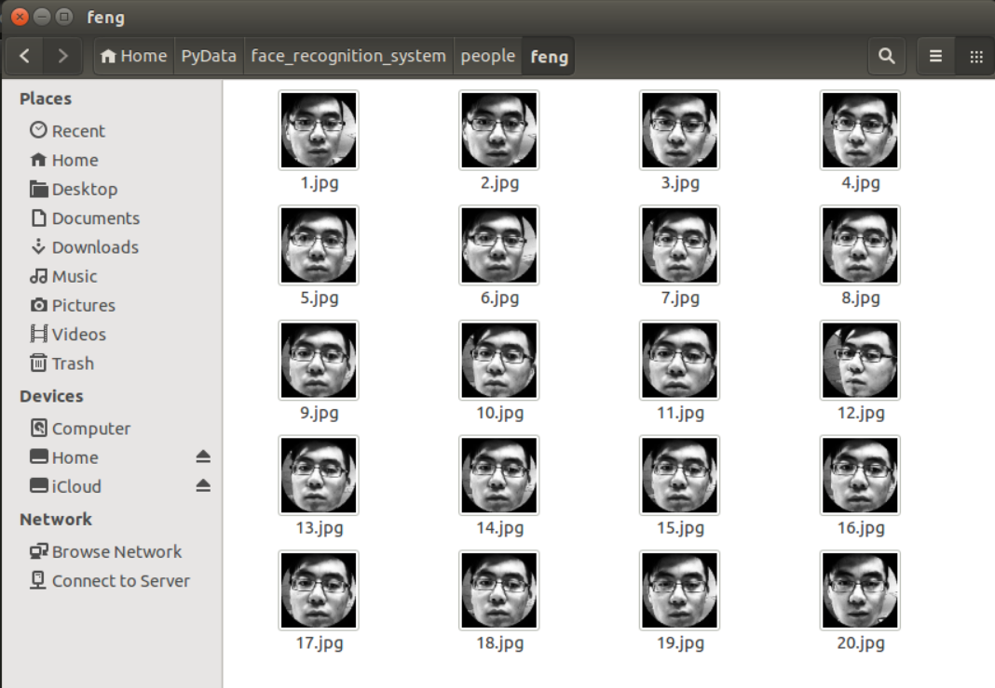

Slide 6
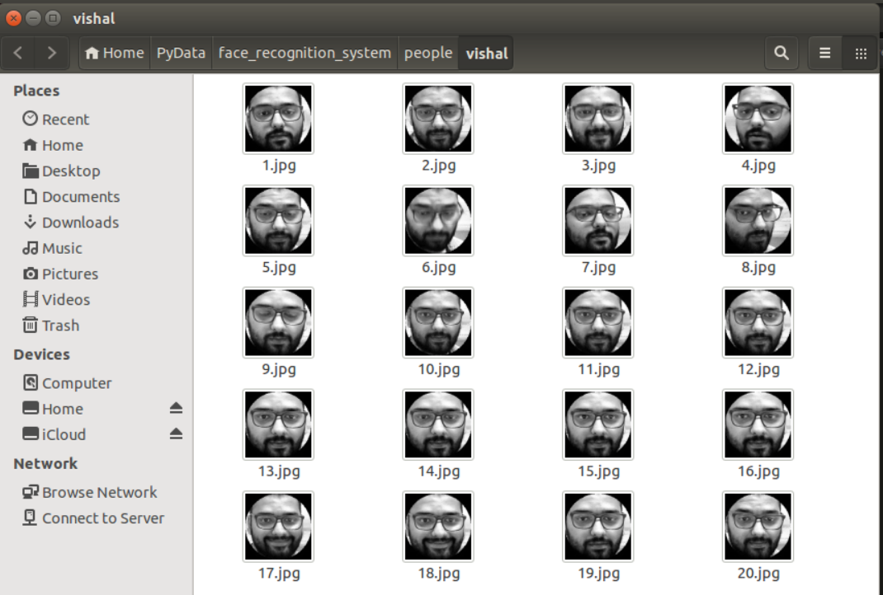

Slide 7
Plan for next week
Face Recognition Project:
Work on the robustness of the system;
Enlarge the training dataset;
Deploy the web application;
Comparative analysis of face recognition system.
Smart library:
Figure out how to read updated txt file while the app is running;
Add a large layout in the app and divide the layout into several part; While clicking a specific part, it will zoom in;

