Slide 1
Brampton Advanced Vehicle Operation (BRAVO)
Loyalty → Easeness →Sustainability
By: Team Barrie

Slide 2
Action Statement Smart City Transportation: Revolutionizing Urban Mobility
Track Passenger Flow using Geofencing and real time tracking data to identify peak hours of bus usage.
Predict Footfalls by building a predictive model to forecast passenger footfalls throughout the day.
Incorporate Loyalty Program and Reward Passengers for using public transit services.
Revenue generation through Congestion Charges in rush hours; inspired by Singapore and London.
Promote sustainability by encouraging cycling which can be leased for a small fee or redeeming the transit rewards.

Slide 3
Predicting Passengers
How Geofencing and ML work together to monitor Real Time Footfalls

Slide 4
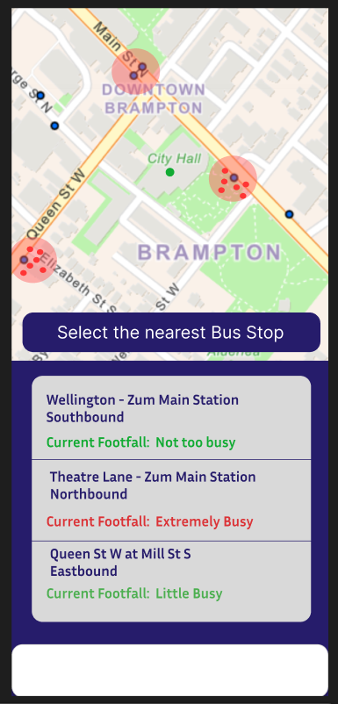
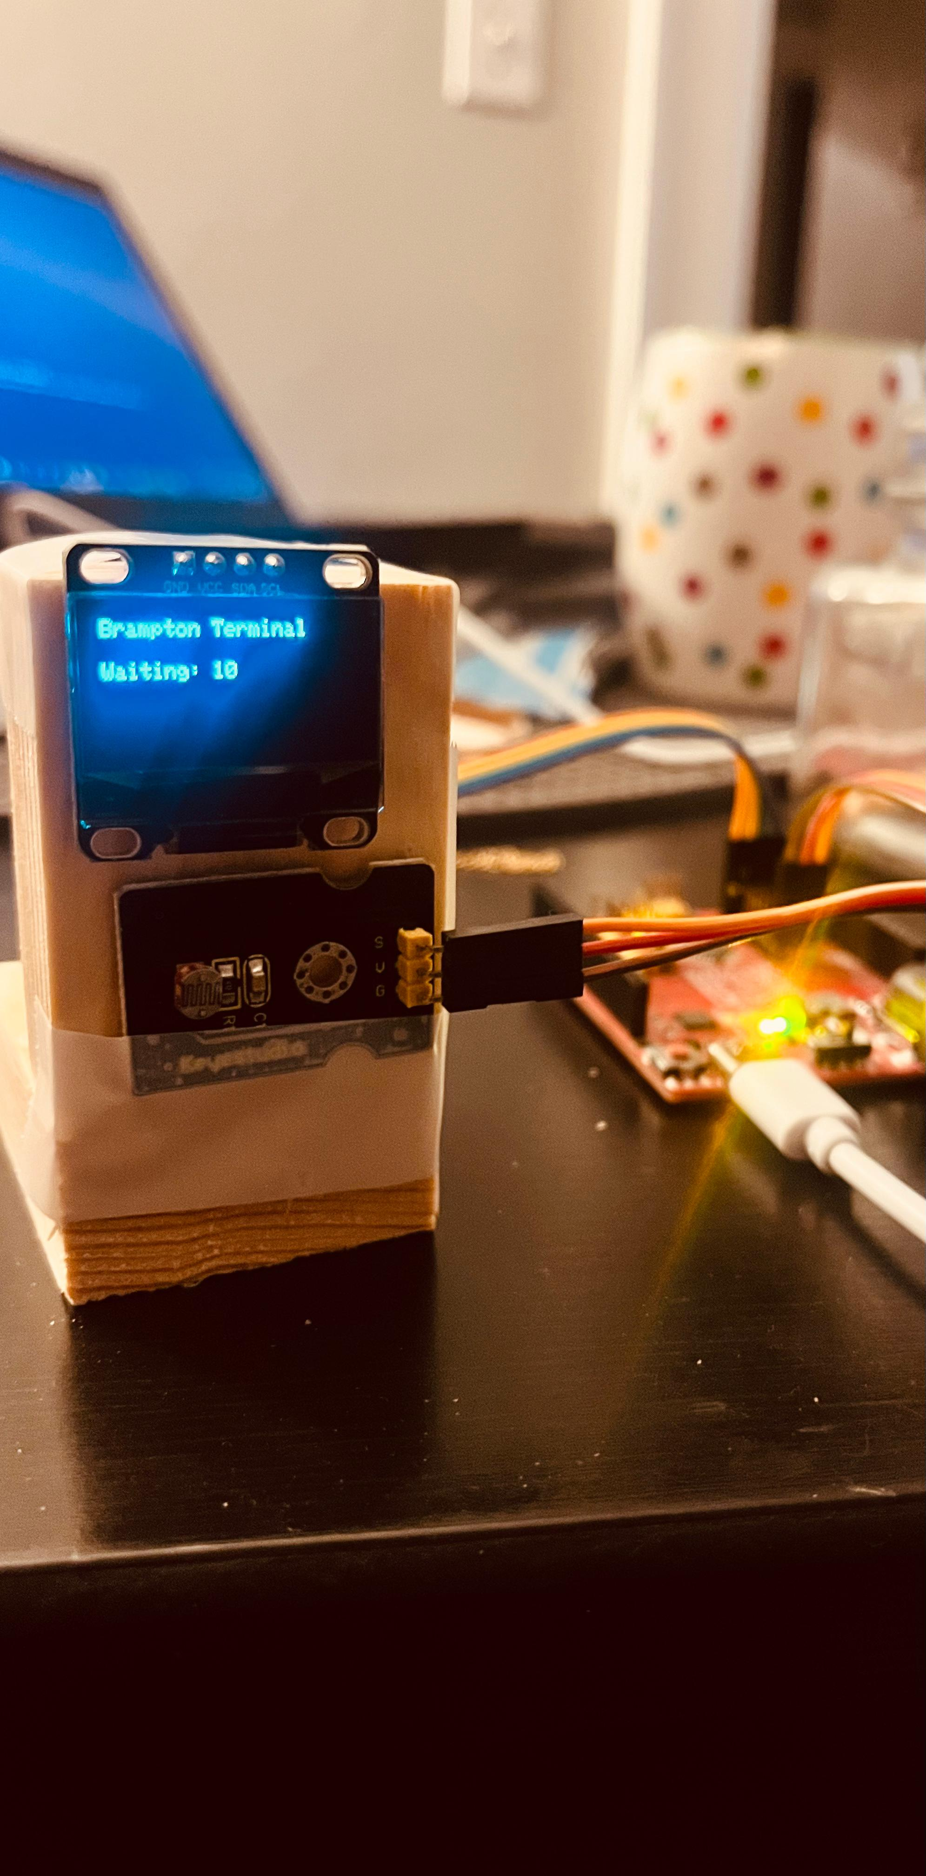
How to implement Geofencing using Maps
Consent to GPS Data tracking and define virtual Boundaries of 50 – 100 meters at every bus stops using latitudes and Longitudes. Coordinates.
RFID scanners installed at bus stops where PRESTO card can be swiped and creates a counter
Integrate with ML models for future use in prediction analysis.

Slide 5
Machine Learning Modelling
Footfall prediction using ML models (by predicting how many people are likely to deboard the bus).
This will provide us with initiation time for the next Ad-hoc bus to the route.
We trained a Random Forest model to predict the number of people getting off at a bus stop based on factors like bus stop number, day of the week, and time of day, using historical data. It then allows users to input specific bus stop details and get predictions from the saved model.

Slide 6
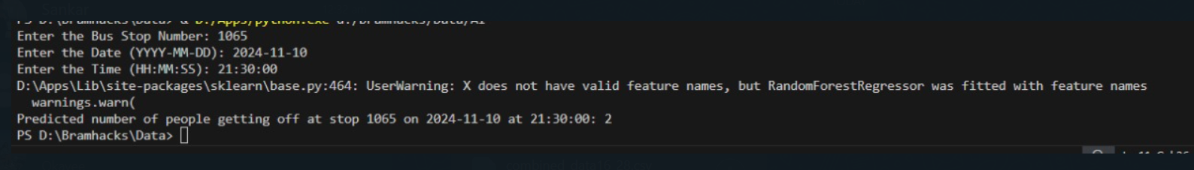
Predicting Deboarding Passengers

Slide 7
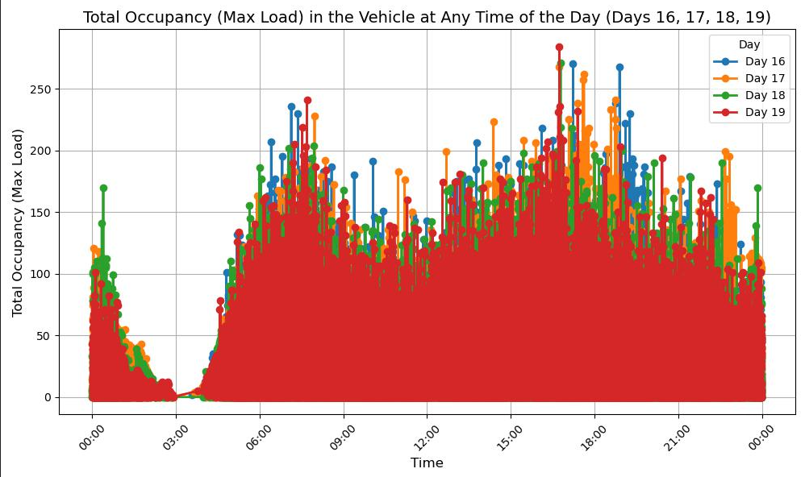

Slide 8
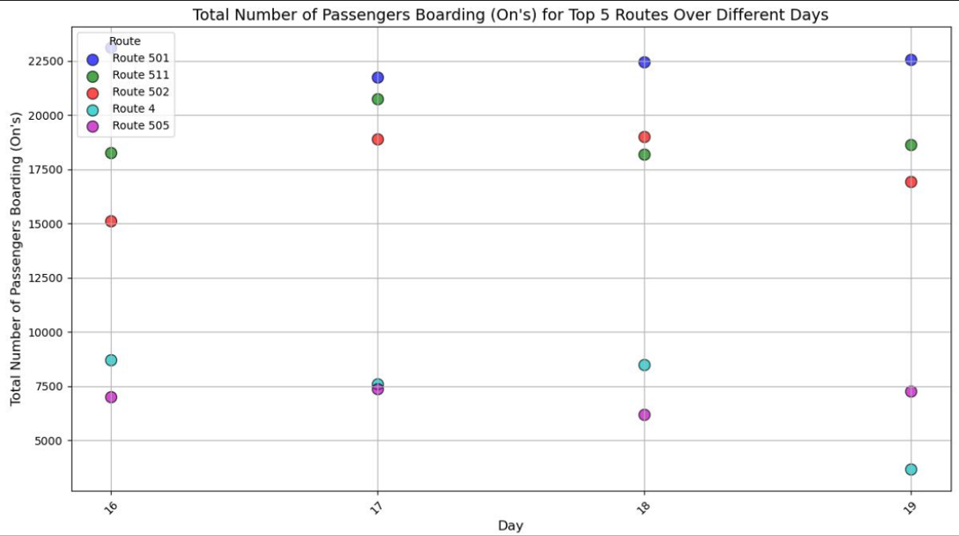

Slide 9
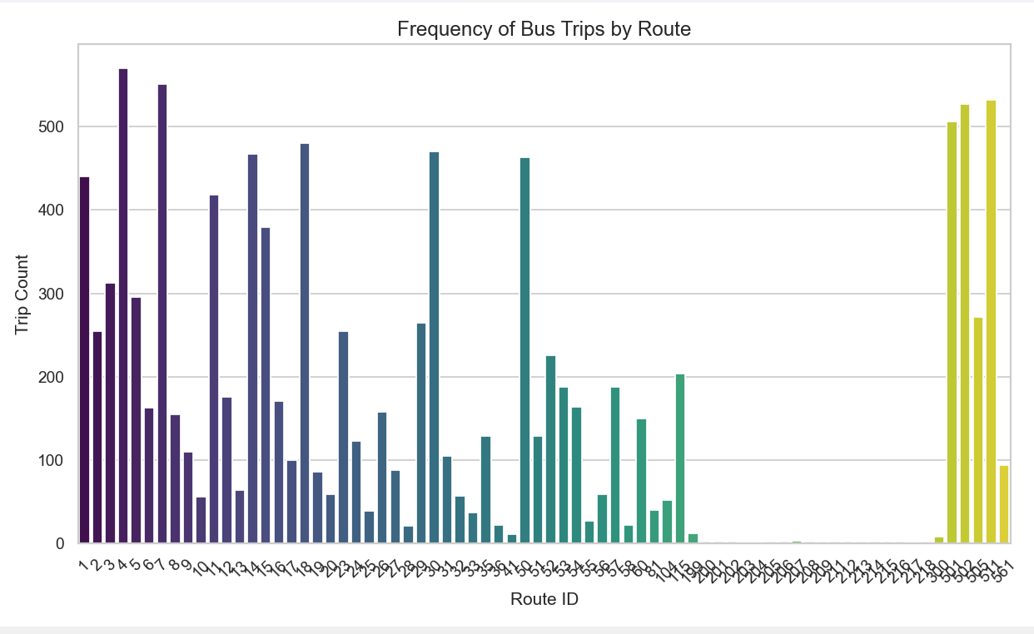

Slide 10
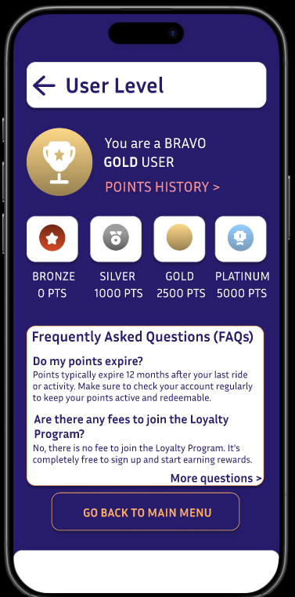
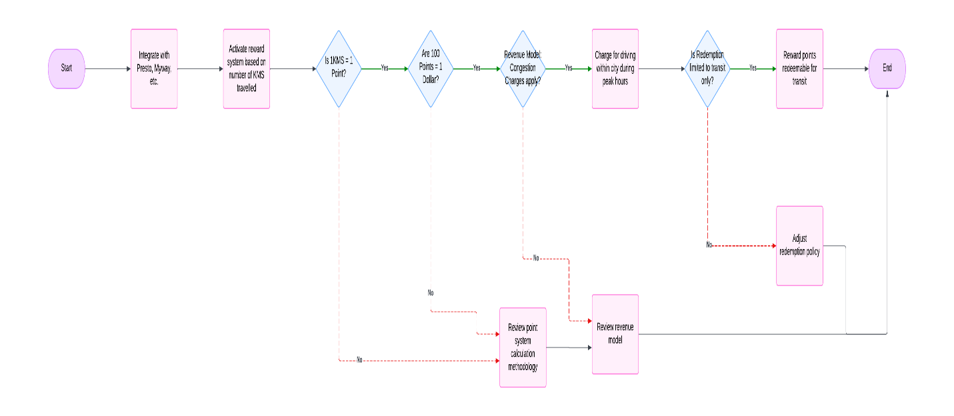
Loyalty Cards and Rewards

Slide 11
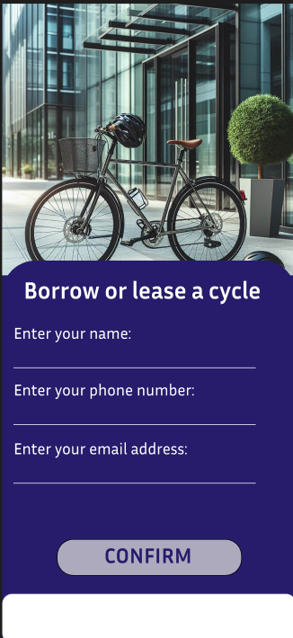
Promoting Sustainability
Cycle leasing Programs which lead to revenue generation.
Encourages Bike and Ride in Brampton transit.
Organising Bicycle promoting Events to promote Active Lifestyle.

Slide 12
Thanks!
Does anyone have any questions?

