Slide 1
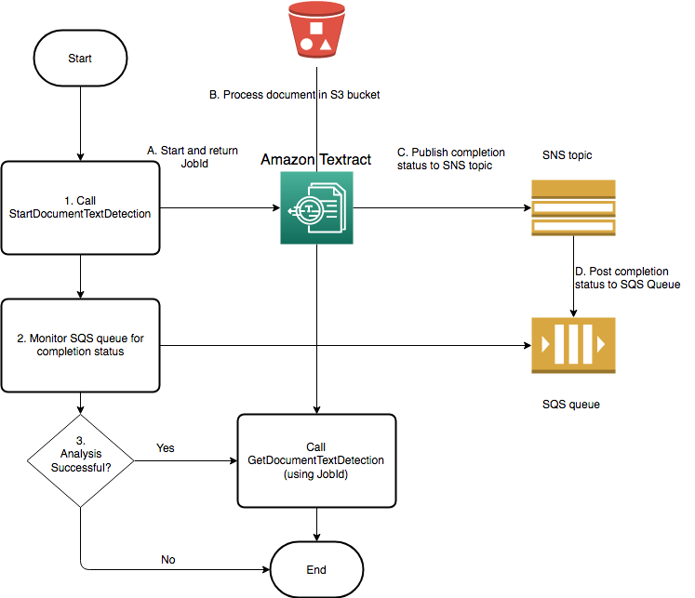

Slide 2
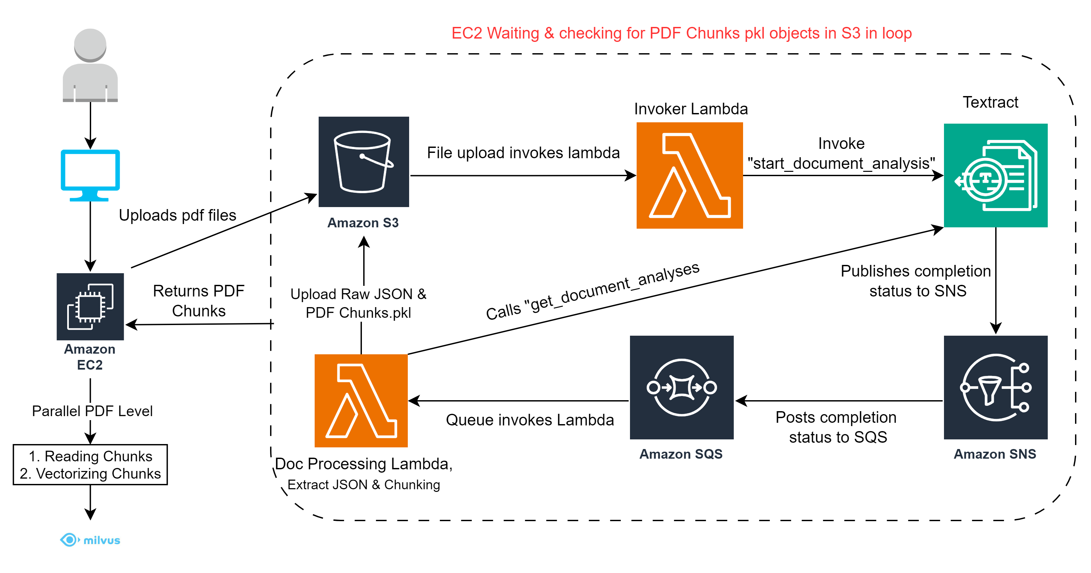
Textract Asynchronous Implementation using Lambda

Slide 3
PRO’s –
Better for multi pdf upload because of concurrent calls.
Partially independent of server load.
CON’s –
Server constantly checks the s3 & waits for PDF pkl files to be available.
No major decrease in time taken to process documents.
Questions –
Lambda Warmup time
Any better implementation to check if for a pdf all Json objects are present in s3.
FIFO vs Standard Queue, if a doc with large number of pages starts first then the other docs would have to wait for processing in 2nd lambda.

Slide 4
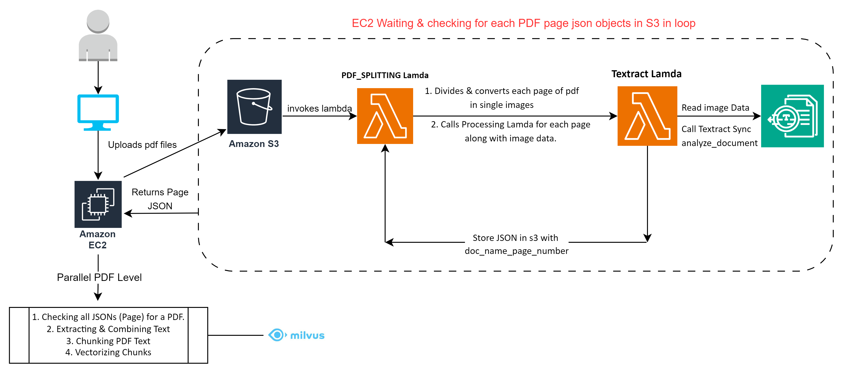
Textract Synchronous Implementation using Lambda

Slide 5
PRO’s –
Quick for single document upload
Flexibility to Increase number of pages without significant increase in time
CON’s –
Server constantly checks the s3 & waits for the single page json’s to be available.
Throttling analyze_document API.
Complex implementation
Questions –
Should we implement this using EC2 or Lambda?
Any better implementation to check if for a pdf all json objects are present in s3.
How many max number of pages we can have within 100 MB.

Slide 6
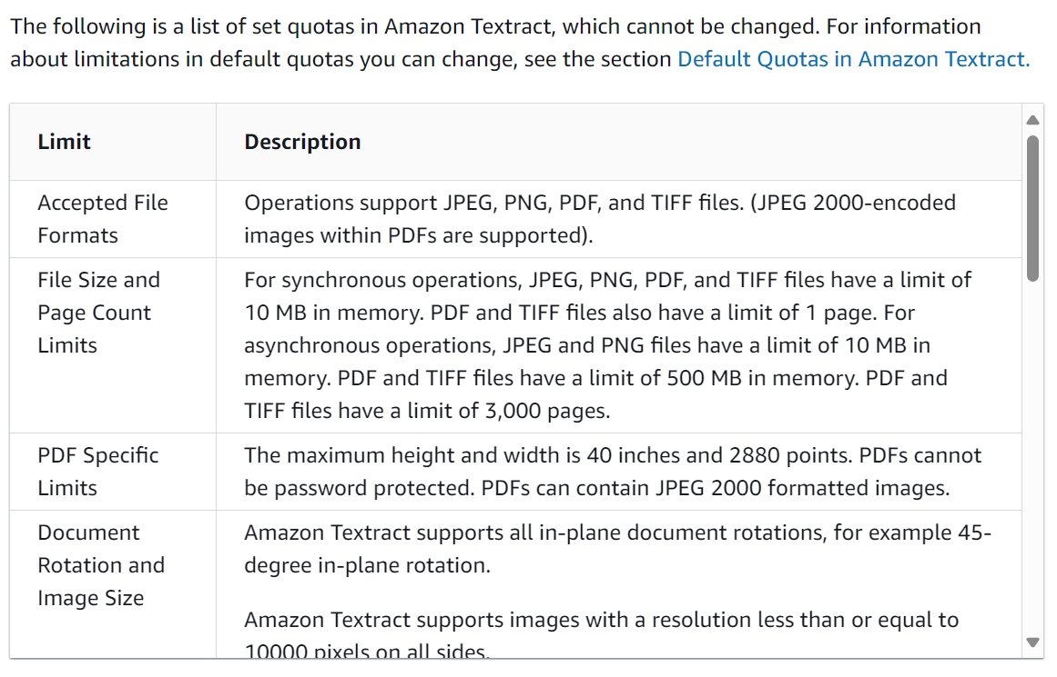

Slide 7
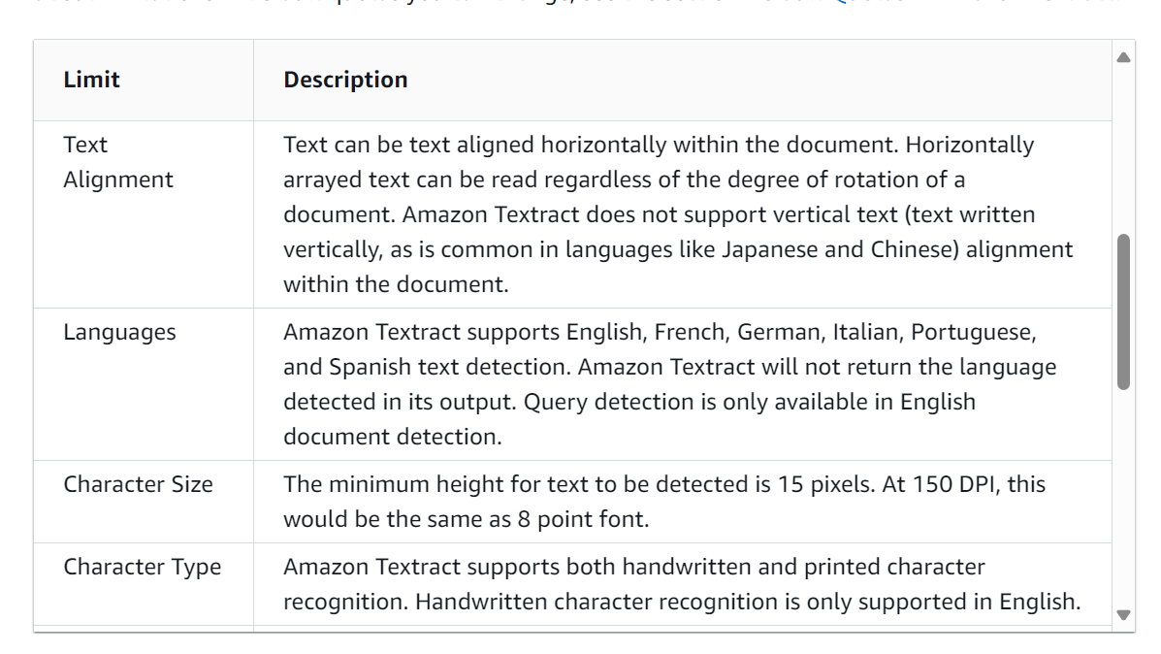

Slide 8
https://docs.aws.amazon.com/textract/latest/dg/limits-document.html

Slide 9
Questions
Should we create a new Queue for each new doc?
If lambda is implemented for each document, How would we know about its completion.
For multiple documents multiple lambdas will be invoked, How would I know the status of each lambda.

Slide 10
4 Pages Document
Run in parallel for multiple documents
Extract each page as single page pdf & store in s3.
Run Sync Textract on each pdf
Extract text from each json & combine text

Slide 11
Amazon Textract endpoints and quotas - AWS General Reference

Slide 12
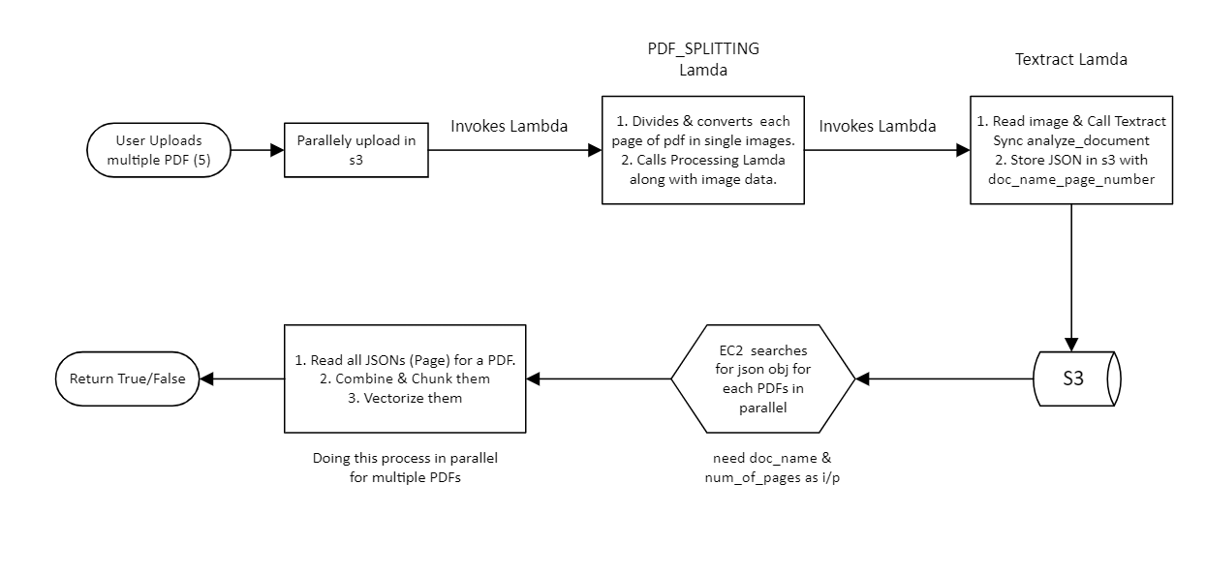
Questions –
Should we implement this using EC2 or Lambda?
Any better implementation to check if for a pdf all json objects are present in s3.
How many max number of pages we can have within 100 MB.
PRO’s –
Quick for single document upload
Flexibility to Increase number of pages without significant increase in time
CON’s –
Server constantly checks the s3 & waits for the single page json’s to be available.
Throttling analyze_document API.
Complex implementation

Slide 13
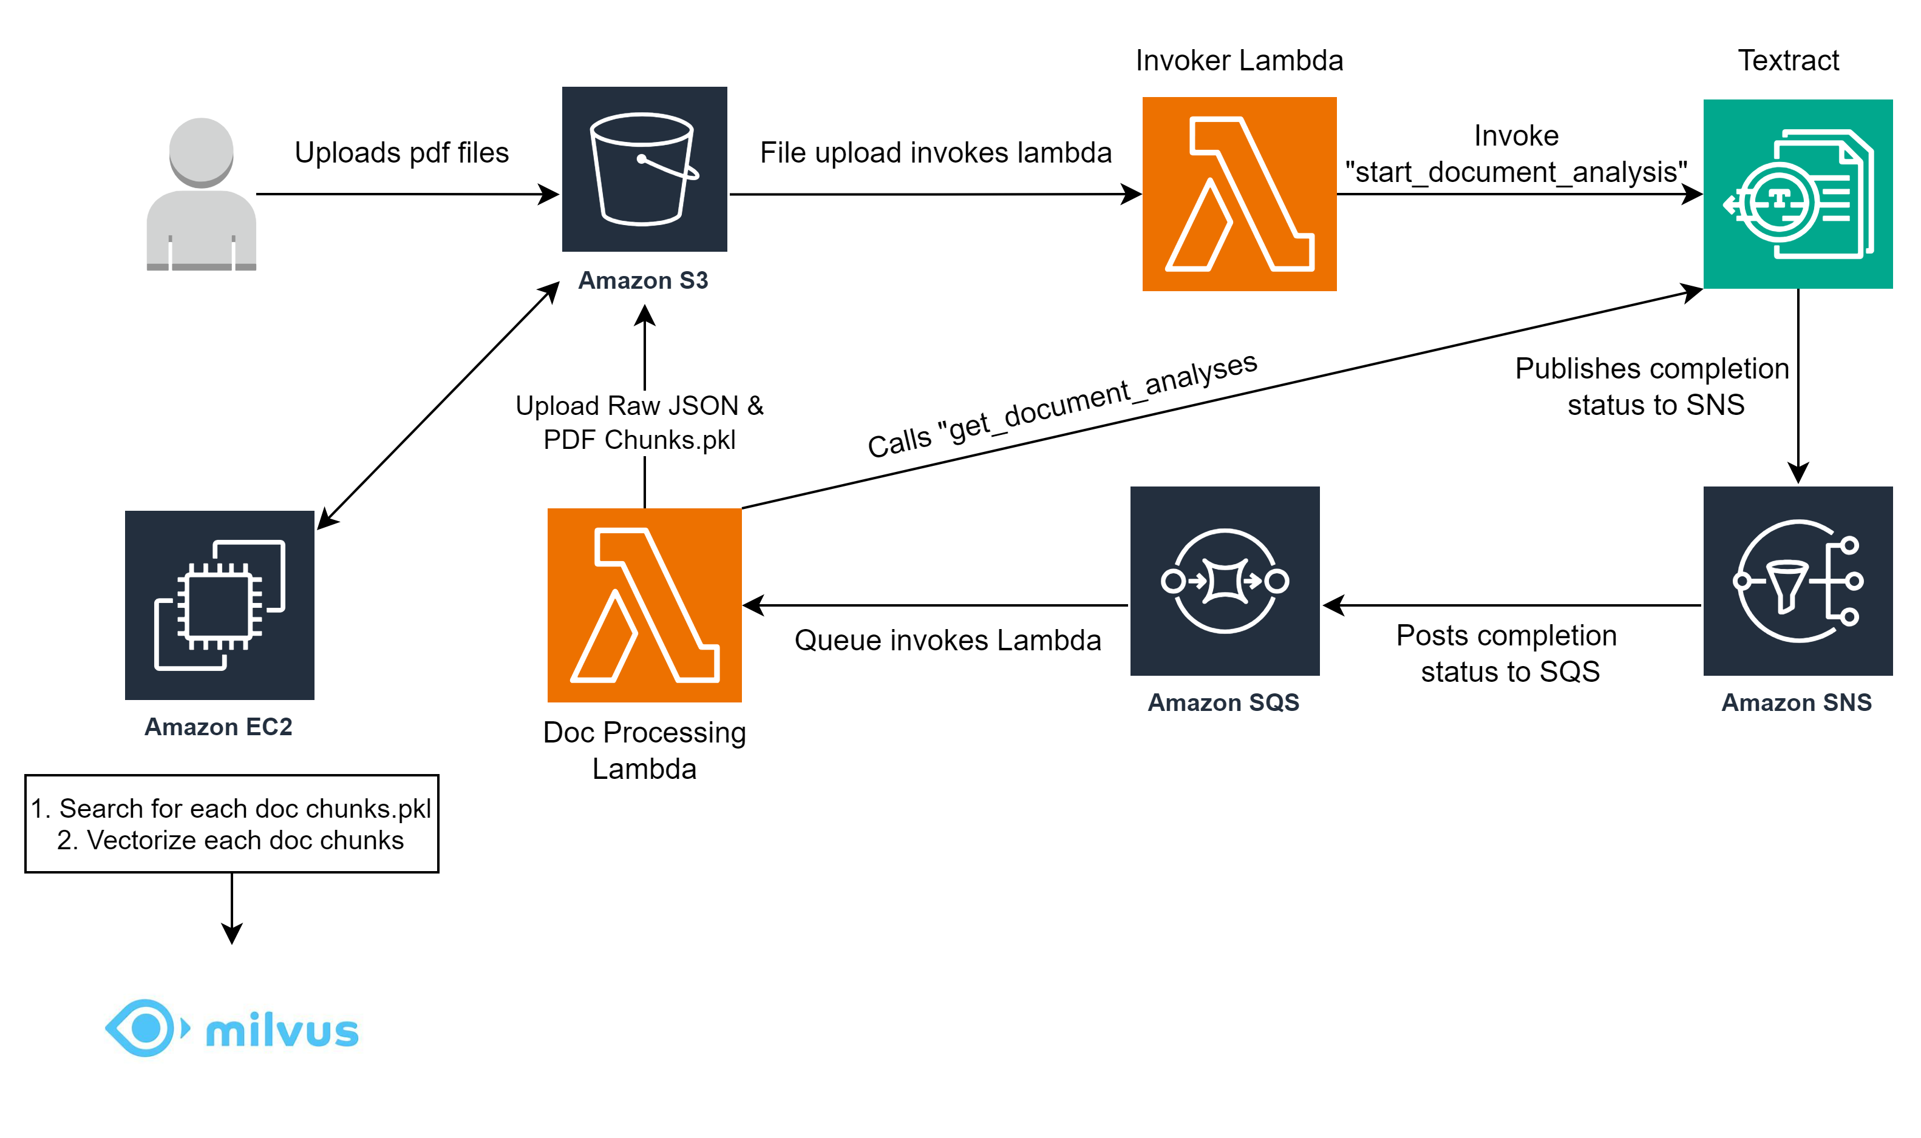
Questions –
FIFO vs Standard Queue, if a doc with more number of pages starts first then the other docs would have to wait for processing in 2nd lambda.

Slide 14
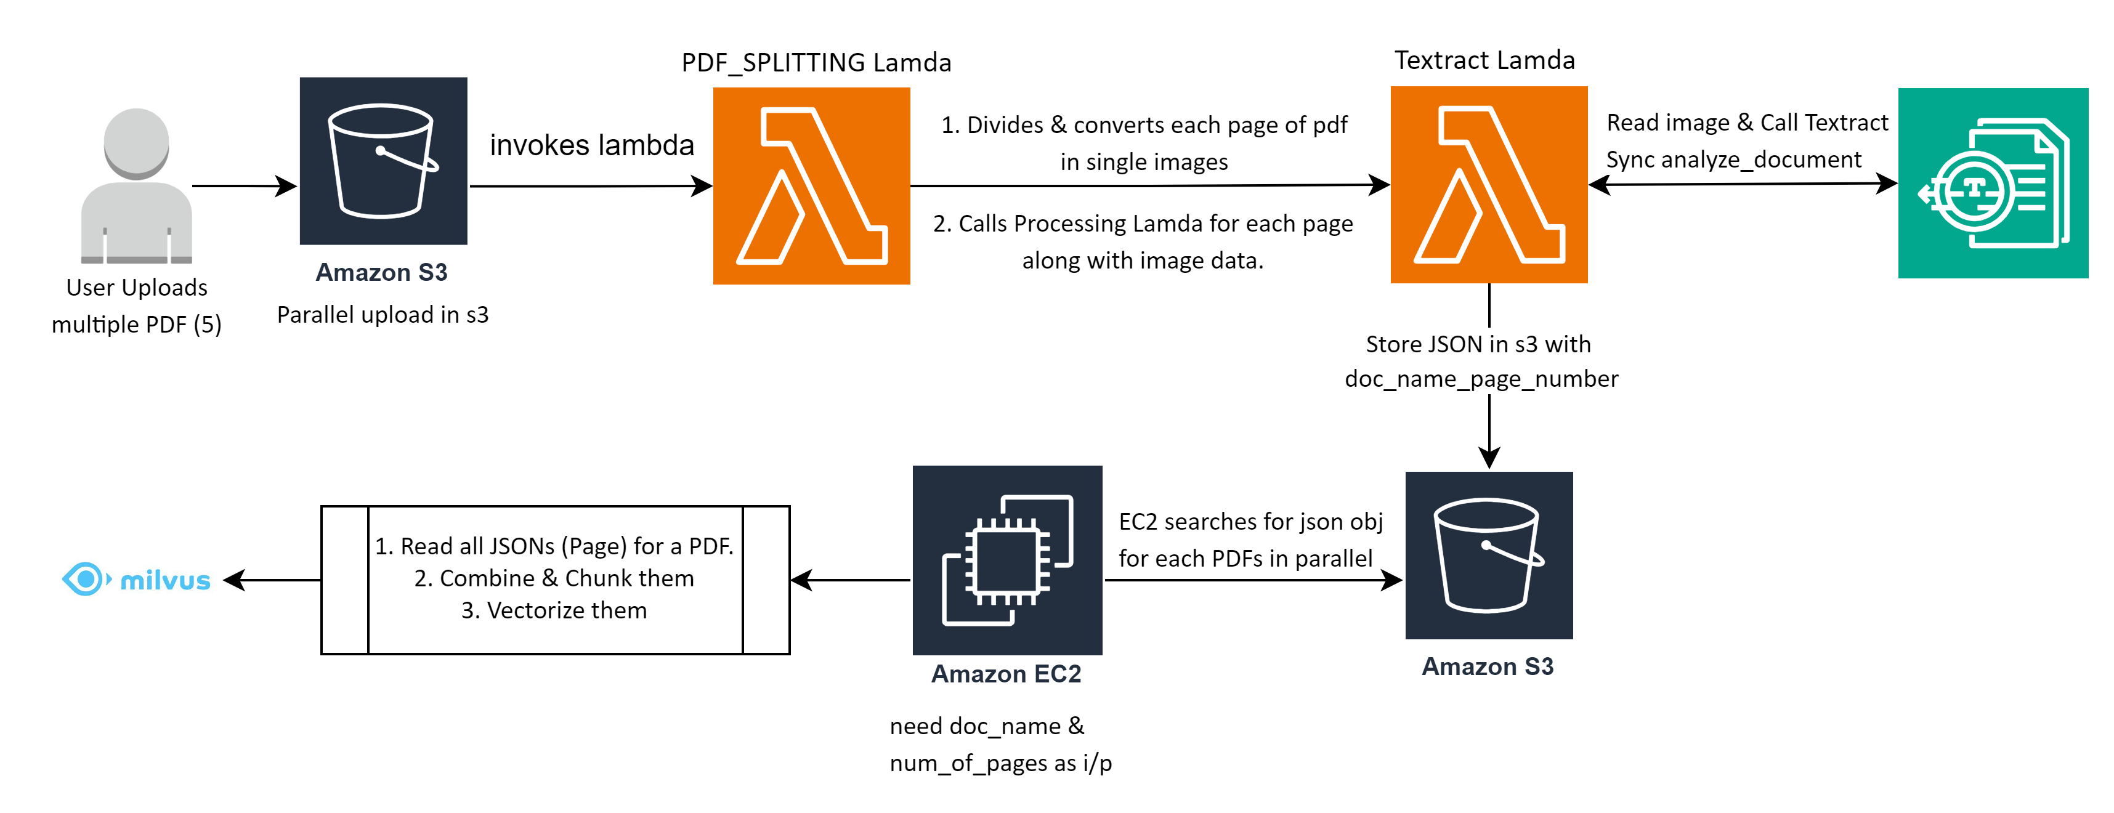

Slide 15
