Slide 1

Viridien Geoscience
Providing unique perspectives on our planet
HackTheBurgh LOGO Here
Michelle Iskander, Owen Pape, Xhorxh Bushi
UK Geoscience and AI Lab

Slide 2

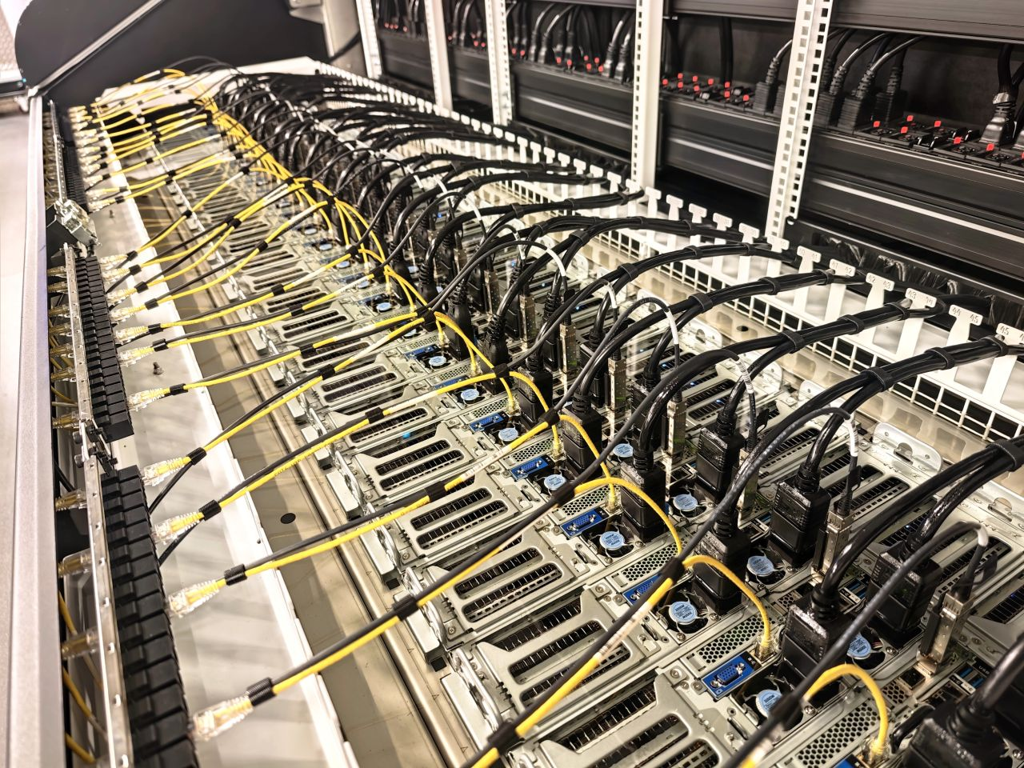
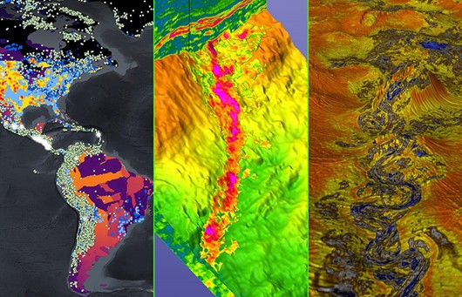
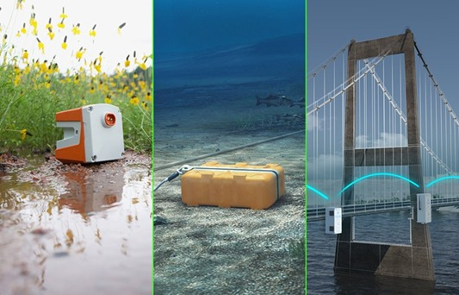
A global leader in data intensive geoscience & scientific HPC
A culture of scientific excellence and technological innovation built on collaboration and learning
People 3200 globally in 25 locations >100 geophysicists based nr. London ~100 data scientists, ML engineers, software developers and platform engineers (UK) 21+ nationalities |  | Technology 800+ PFlops global scientific HPC Pioneers in geophysical imaging since 1931 70+ years of expertise in industrial scientific computing
 | Data >300 Pbytes disk storage >1 million job submissions/day for high-end scientific applications
Notes:
We’re proud of the diverse range of roles and technical expertise within our team. This diversity empowers us to bring a wealth of knowledge to every project, allowing us to tailor our solutions to the unique needs of our clients across various markets.
On this slide, you’ll see a detailed overview of our core businesses: Geoscience, Earth Data, and Sensing and Monitoring. These areas are at the heart of what we do.

Slide 3
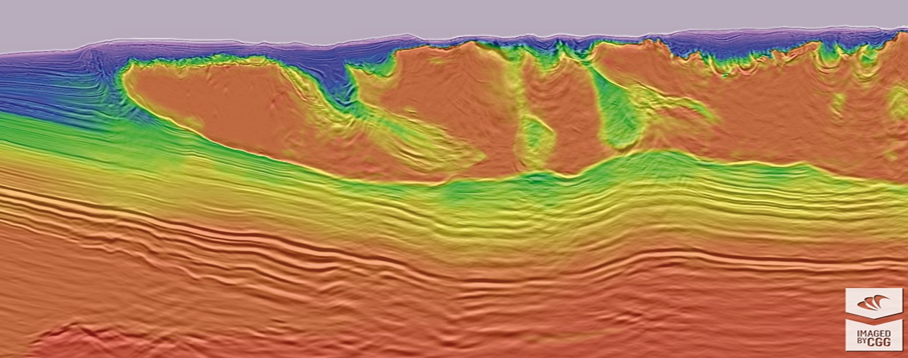
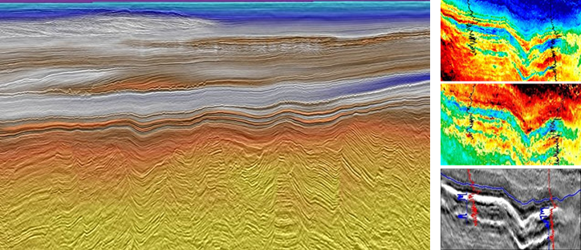
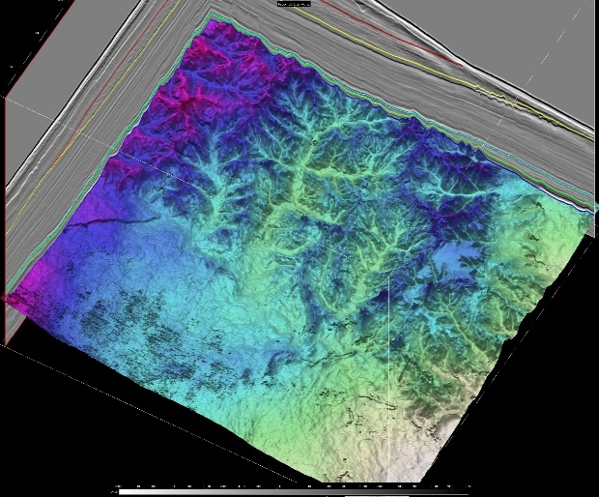
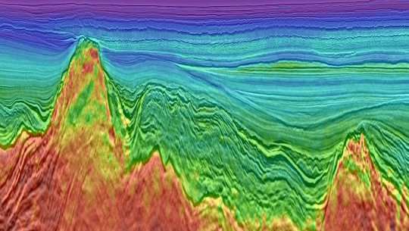
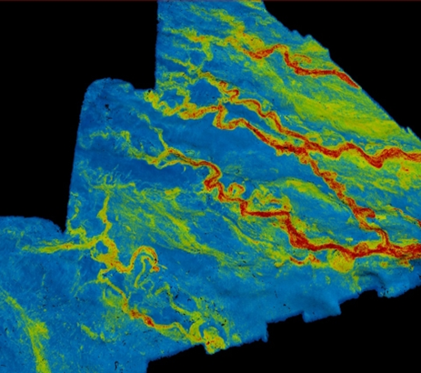
Understanding the subsurface through geophysical sensing and imaging
Notes:
Subsurface imaging is typically performed using seismic (acoustic) waves, as of all the geophysical methods these are the best constrained, offer the highest resolution and penetrate the deepest. When we image the Earth what we are actually imaging & modelling is its acoustic properties. This technology was a key driver and enabler for the growth of the hydrocarbons industry allowing them to move offshore and into more complex geological settings when the easy targets on land where tapped. [With the energy transition it looks set to repeat this for the mining sector who face a similar challenge to meet the huge demand for battery metals and critical minerals. Additionally due to its sensitivity to fluid content in combination with reductions in acquisition cost due to the growth of 3D borehole seismic and distributed acoustic sensing we are likely to see applications in carbon capture and hydrogen storage & potentially sectors such as infrastructure.]

Slide 4
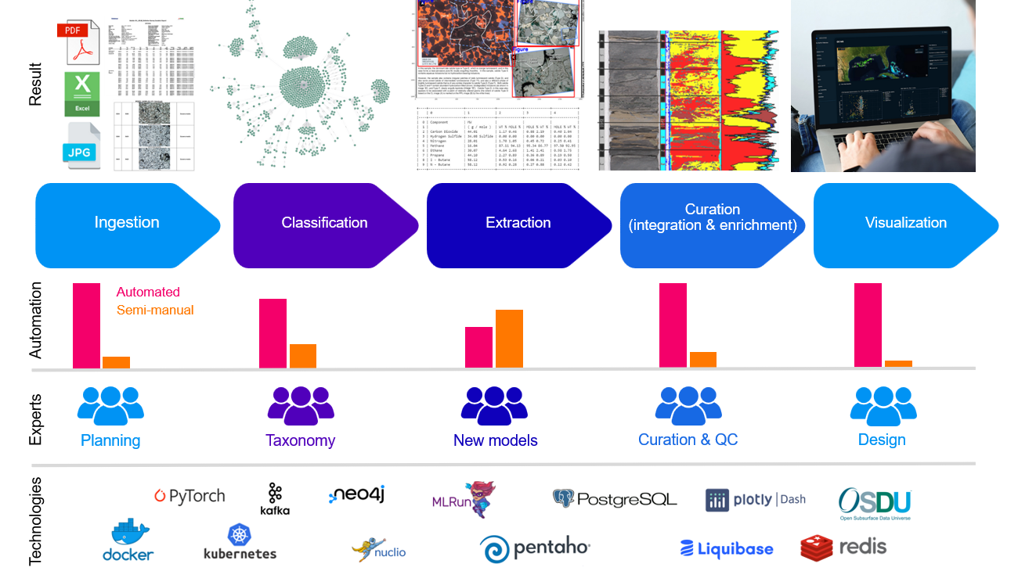
And expert geoscience data transformation services and technology

Slide 5
Decoding the Subsurface: Lithology Segmentation and Clustering
Michelle Iskander @HTB

Slide 6
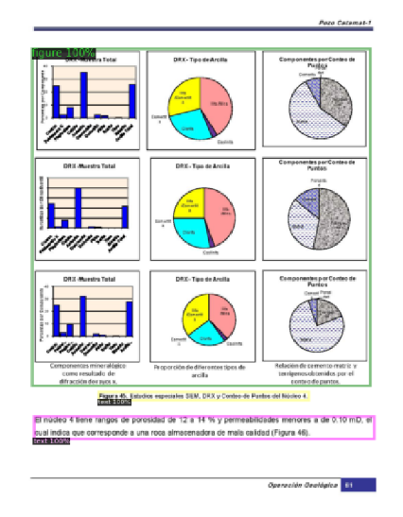
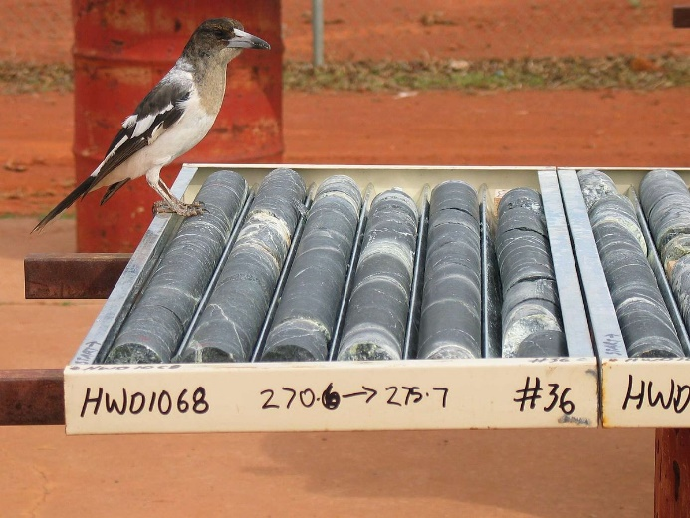


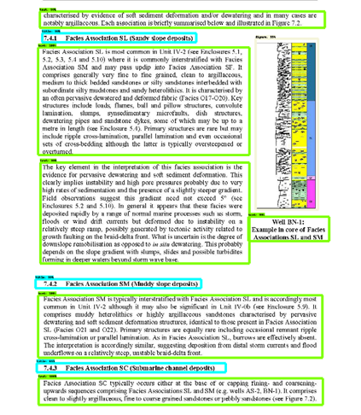
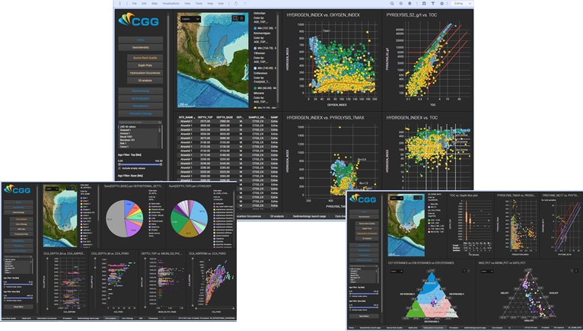
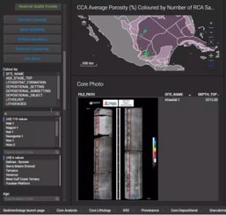
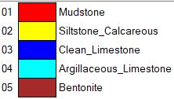
Why does extracting siloed geoscience data matter?
Notes:
NLP, machine learning classification of digitised images, ETL. Decades of data in many different formats and digitilisation of core and thin slices.

Slide 7
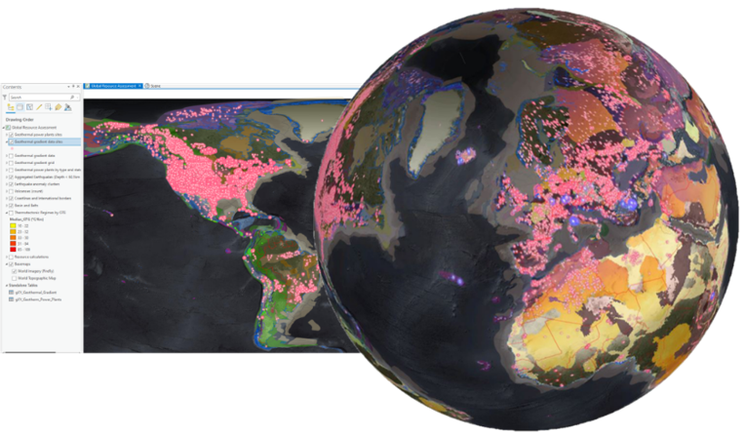
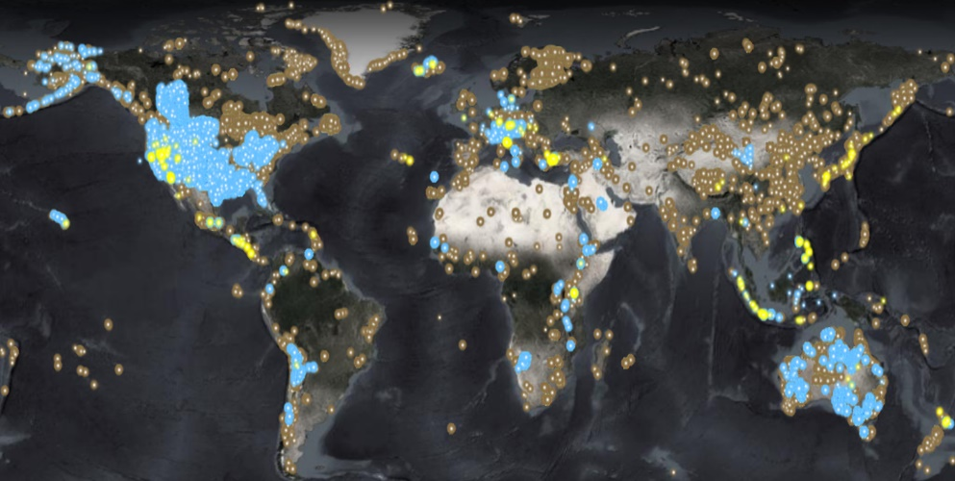
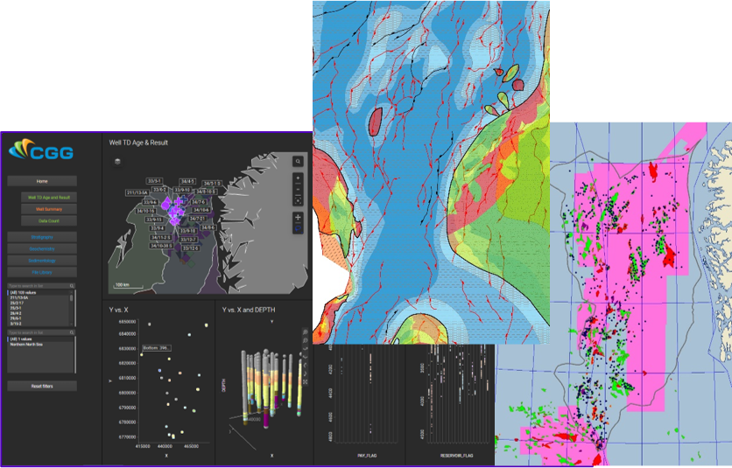
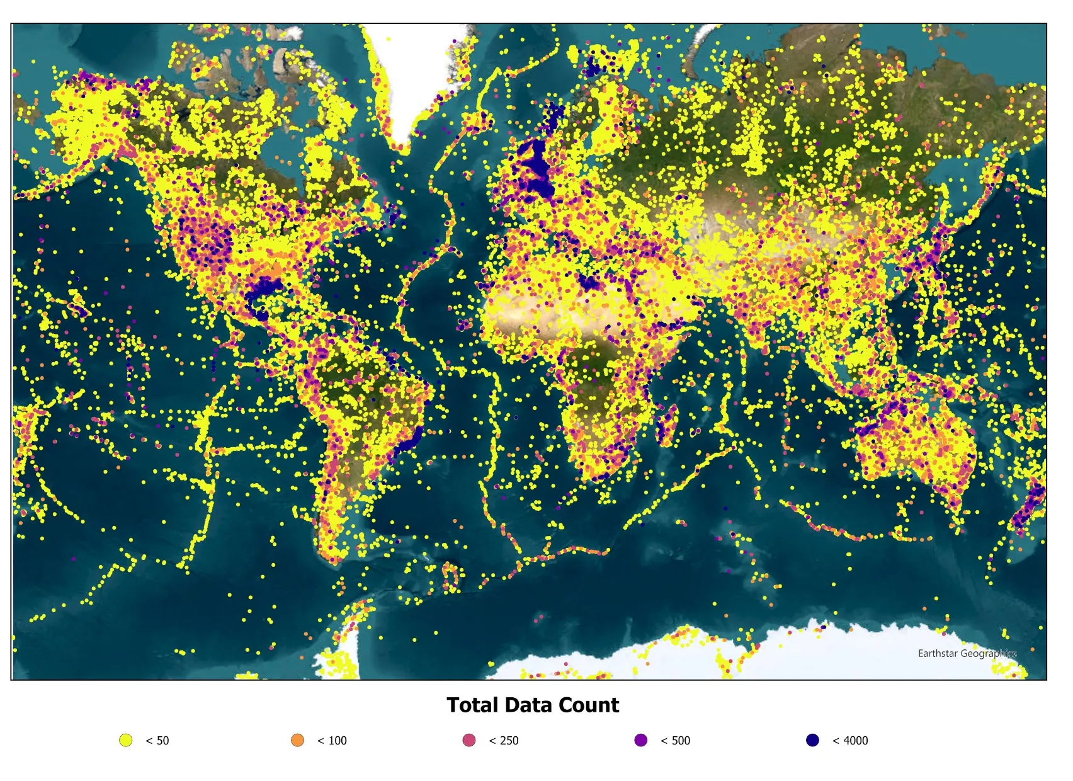
It unlocks huge amounts of information for a large range of industries
Geothermal
Critical minerals, native hydrogen
Subject matter expertise
Carbon storage
HPC
Geothermal Resource Assessment
Oil and gas
Notes:
NLP, machine learning classification of digitised images, ETL

Slide 8
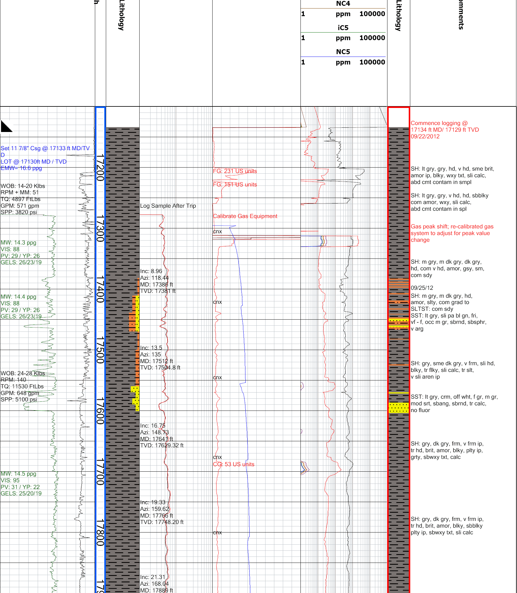
Understanding Lithology Columns
What is lithology?
Lithology refers to the physical characteristics of rocks, including their composition, texture and colour.
What are lithology columns?
Visual representations of geological formations at different depths.
Use colours, symbols and patterns to represent different rock types.
Commonly found in geological well logs to help understand subsurface formations.

Slide 9
Why Automate Lithology Extraction?
Geological reports contain valuable information about subsurface rock formations.
Much of this information is stored in PDFs and other unstructured or semi-structured formats.
Extracting lithological information often involves repetitive, time-consuming manual work.

Slide 10
The Challenge
Develop an automated solution that can:
Identify individual lithological intervals and their boundaries.
Group intervals containing the same or similar visual patterns.
Determine the top and base depths corresponding to each interval.
Map each group of intervals to their corresponding legend to give the lithology name.
(Bonus) Automatically locate the depth column, interpreted lithology column, and lithology legend without using the supplied bounding boxes.
top_y | bottom_y | lithology | cluster_id | top_depth | base_depth
300 | 450 | Siltstone | A | 100 | 115
450 | 620 | Shale | B | 115 | 132
620 | 700 | Siltstone | A | 132 | 140

Slide 11
Example Approach
Segment the Column
  Identify individual intervals and their boundaries
Cluster Similar Patterns
  Group the visually similar intervals
  Match them to their legends
Estimate Depths
  Convert pixel values to depth values
top_y
top
depth
bottom_y
bottom
depth
This is one possible approach, not a prescribed method. Teams may use any technique or combination of techniques, provided their solution meets the task requirements and submission format.

Slide 12
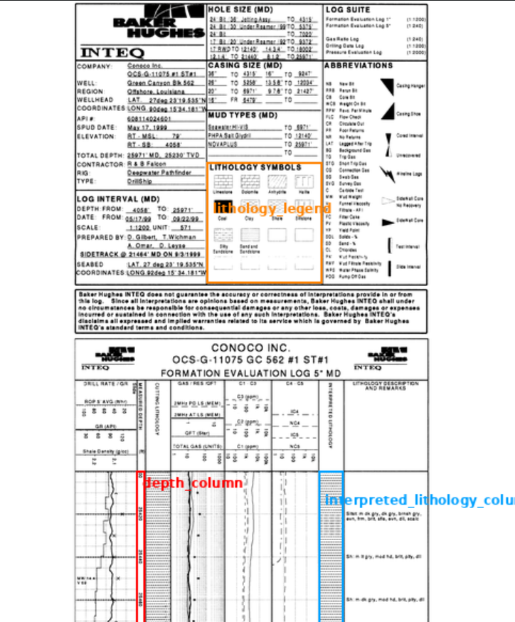
Dataset
50 Document Images
Annotation files with bboxes
  Depth Column
  Interpreted Lithology Column
  Lithology Legend
Manual annotation of development images is allowed for training, tuning, and validation.
Held out evaluation images will be released near the end

Slide 13
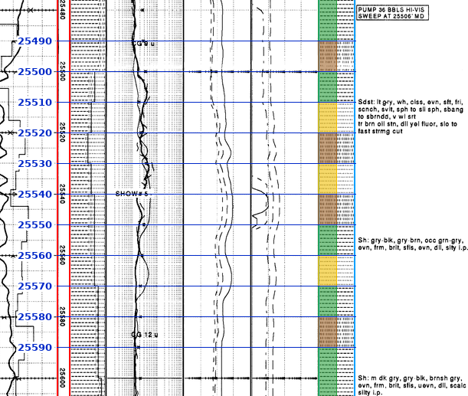
Expected Outputs
For each document:
1. Structured Results — CSV
  One row per detected interval containing:
  top_y — top boundary in pixels
  bottom_y — bottom boundary in pixels
  cluster_id — identifier for visually similar patterns within the column
  lithology — name obtained by matching the pattern to the supplied legend
  top_depth, base_depth — boundary depth values
2. Annotated Image
  Show the original lithology column with:
  Predicted interval boundaries
  Depth estimates
  Cluster labels/Lithology labels

Slide 14
Things to Consider
Correctness: Will your solution work on challenging cases?
Generalisation: Does it work on unseen documents, not just your development examples?
Efficiency: Consider processing time, memory, hardware requirements, and running costs.
Simplicity: Use complexity where it improves results, not for its own sake.
Automation: Final predictions should be generated without manual correction.
In your demo: explain your approach, show results and limitations, and report runtime and resource requirements. Solutions will be judged on correctness, and efficiency.

Slide 15


Our prizes
The winning team will each receive:
  Airpods 5 with wireless charging case
  £100 worth of fossils from Edinburgh’s Mr Wood’s Fossil Shop in Grassmarket

Slide 16

Our journey continues …
We are driven to discover new insights, develop innovative technologies and deliver powerful solutions that support our clients in resolving their complex challenges efficiently and responsibly.
Join us!
We Are Viridien.
Notes:
Thank you –

