Slide 1
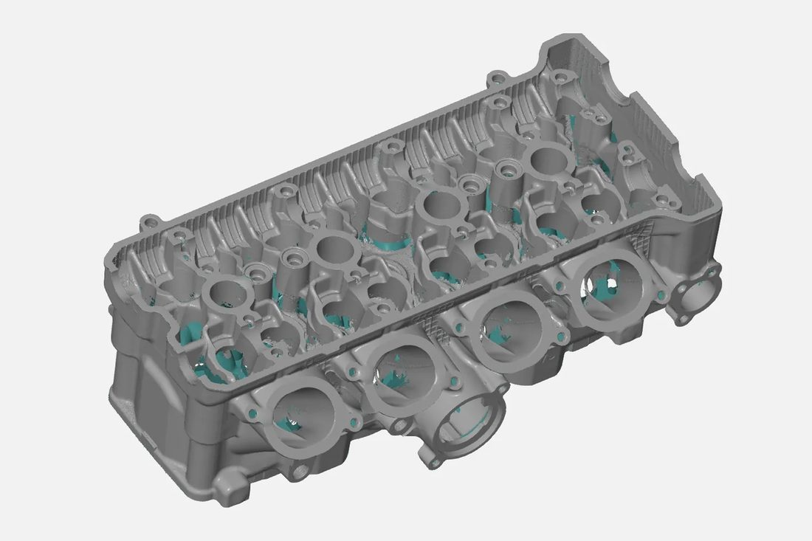
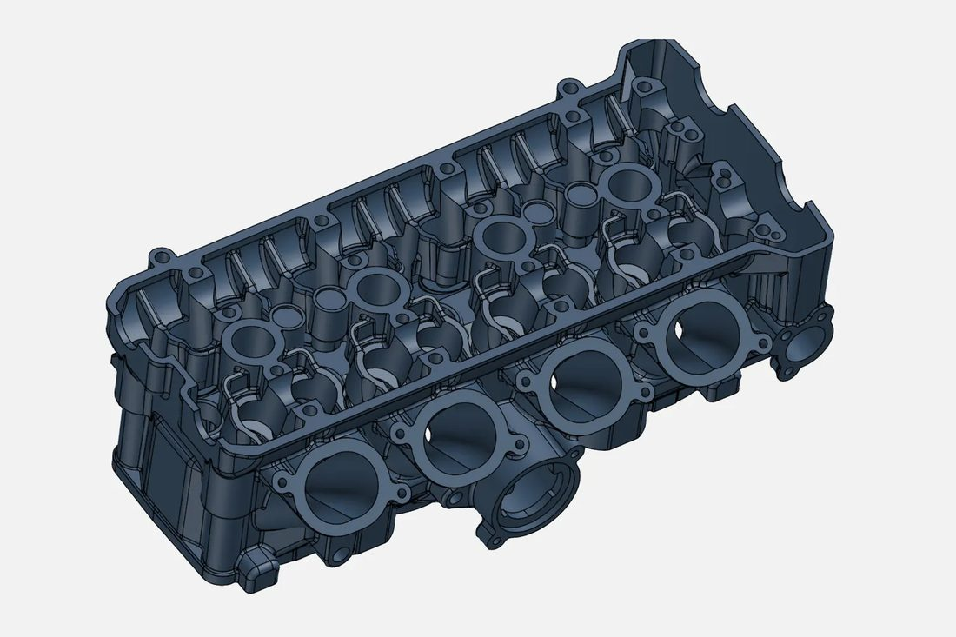
We capture reality.
Then we engineer it.
01 · SCAN
3D SCANNING & 3D DESIGN SERVICES
Precise 3D scanning and innovative 3D design that transform physical parts, products and spaces into digital models — and back into physical prototypes.
02 · CAD
EMAIL
INDIA
UAE
info@vsharksolutions.com
+91 95142 48525
+971 52 248 6238
Notes:
Opening: VShark captures physical parts, products and spaces as digital data, then engineers that data into whatever the customer needs.

Slide 2
From physical to digital and back
( 01 ) — WHO WE ARE
VShark Solutions provides state-of-the-art 3D scanning and 3D design services for businesses and individuals.
We capture parts, products and spaces as accurate digital data — then engineer that data into editable CAD, flawless surfaces, BIM models, inspection reports, prototypes and photoreal visuals. One partner, from the physical object to the finished digital deliverable and back again.
0.02 mm
7
SCANNER PRECISION (UP TO)
CORE SERVICES
6
7
INDUSTRIES SERVED
COUNTRIES SERVED
Notes:
Who we are: one partner from the physical object to the finished digital deliverable.

Slide 3
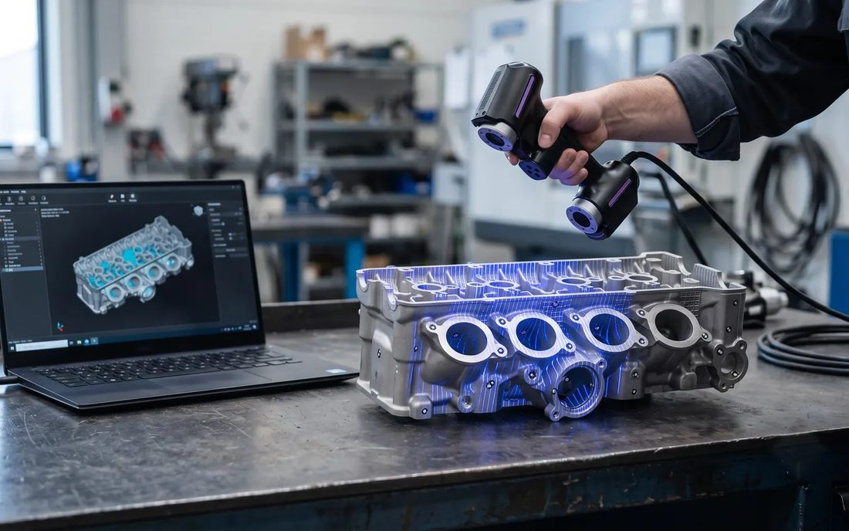
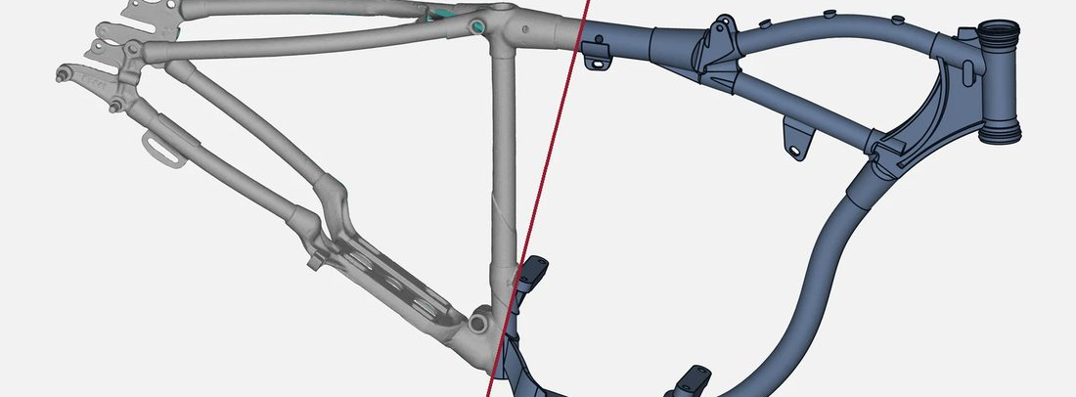
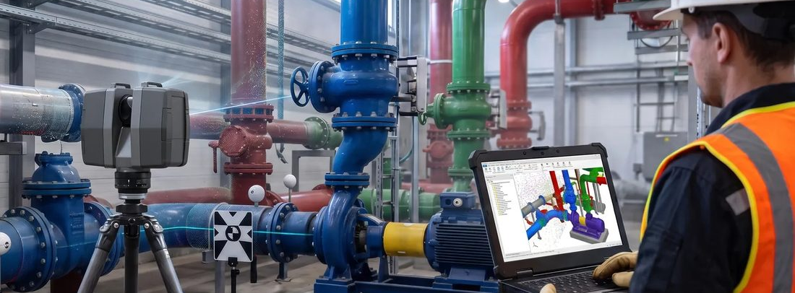
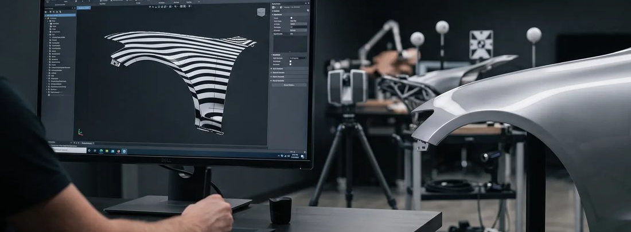
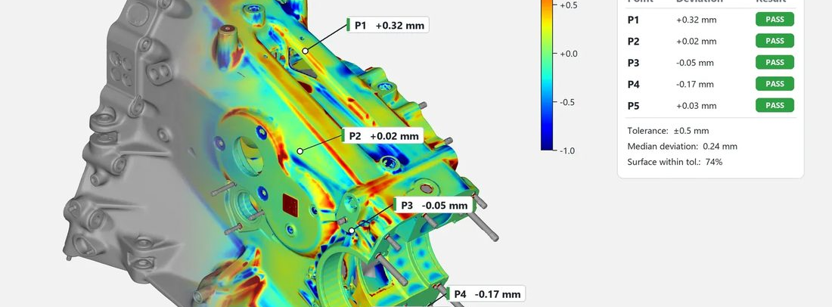
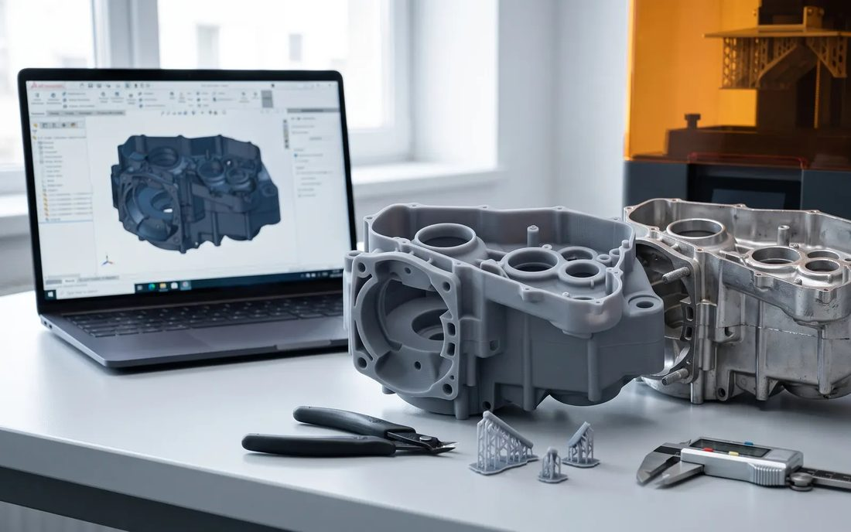
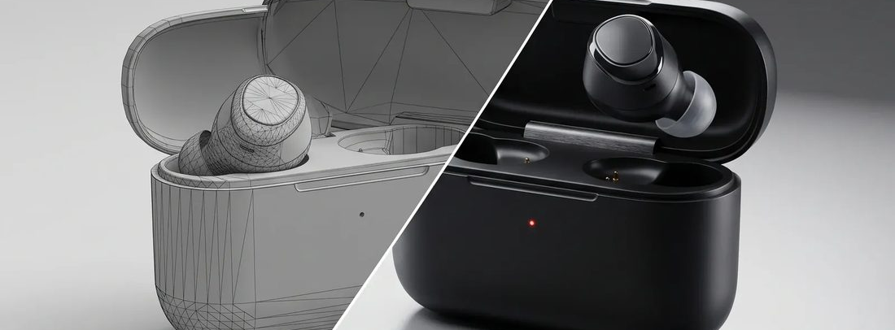
Seven services, one partner
( 02 ) — SERVICES
Use one service on its own, or hand us the whole job — from first scan to final file.
01
02
03
04
3D Scanning
Reverse Engineering
Scan to BIM
Class A Surfacing
Capture any part, product or space as an accurate digital model.
Turn scan data into fully editable, manufacturable CAD.
Existing buildings captured as accurate, intelligent BIM models.
Flawless, curvature-continuous surfaces for visible parts.
05
06
07
End-to-end delivery
Digital Metrology
3D Printing
Product Rendering
Scan, engineer, inspect, print and render — under one roof, with one point of contact.
Compare manufactured parts to their CAD — to the micron.
Rapid prototypes and functional parts, straight from your model.
Photoreal visuals that sell a product before it is ever made.
Notes:
Seven services. Customers can use one on its own, or hand VShark the whole job from first scan to final file.

Slide 4
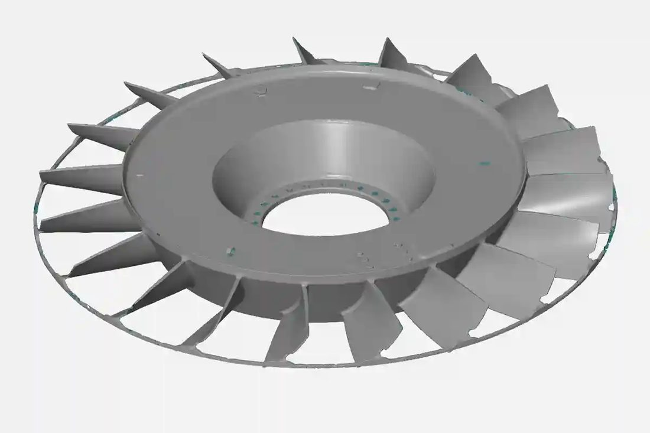
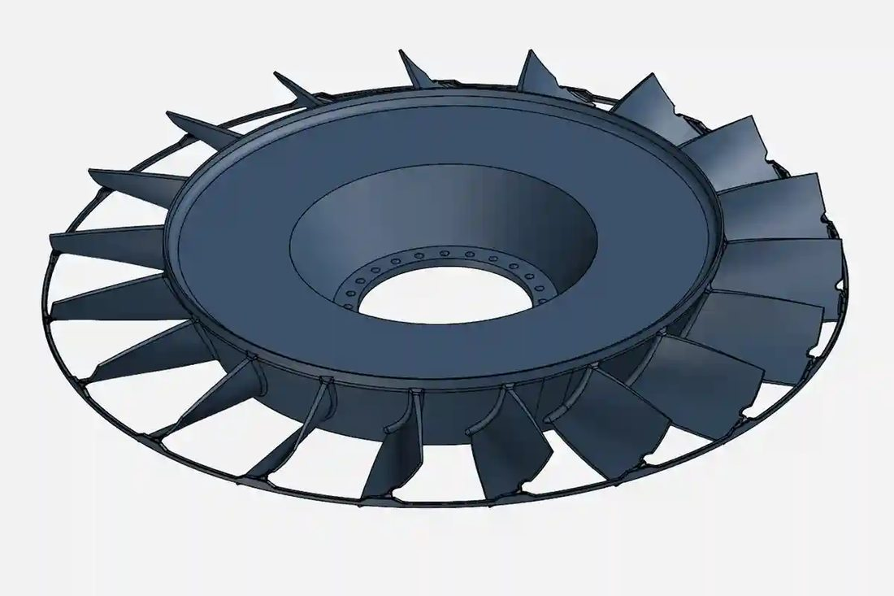
Four steps — scan to solution
( 03 ) — HOW WE WORK
01
02
03
04
Capture
Process
Engineer
Deliver
We scan the part, product or site — in our lab or on location.
Scans are aligned, cleaned and merged into usable, watertight data.
CAD, Class A surfaces, BIM or inspection built from that data.
CAD files, drawings and reports in the formats your team uses.
Notes:
The process: capture, process, engineer, deliver.

Slide 5
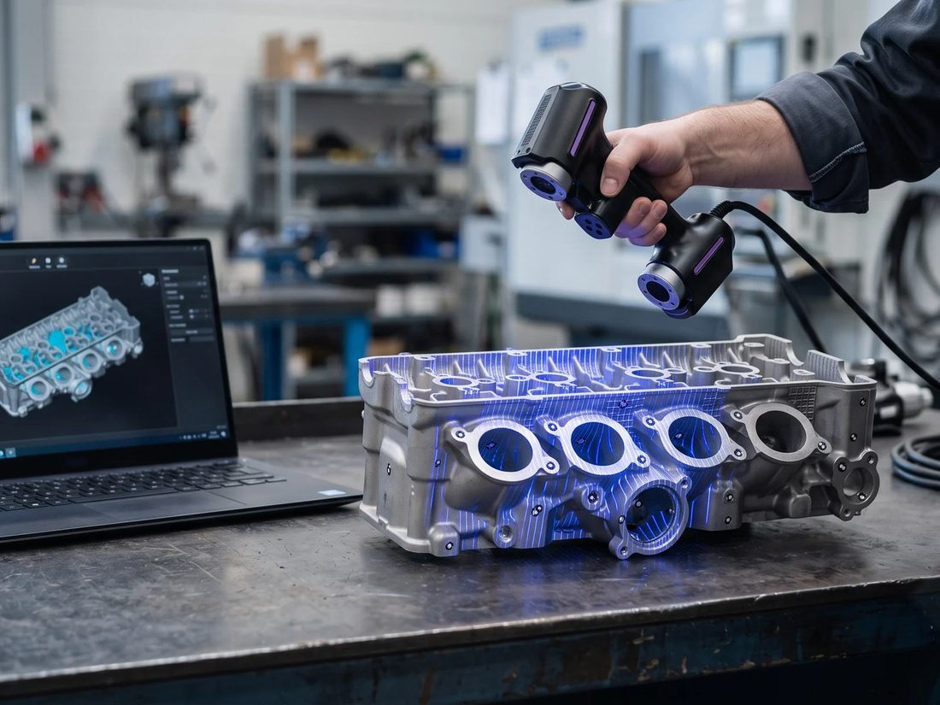
3D Scanning
( 02.1 ) — SERVICES
Capture any part, product or space as an accurate digital model.
We scan parts of every size with a range of professional 3D scanners — from small precision components to car bodies and full buildings. The result is a precise digital copy of the physical object, ready for product design, reverse engineering and quality control.
High-accuracy capture
Any size, on site or in-house
Blue-laser and structured-light scanners record detail down to hundredths of a millimetre.
From jewellery to vehicles and plant rooms — we bring the scanner to you when the part can't travel.
SERVICE 01 / 07
Clean, usable data
Ready for the next step
DELIVERABLES
Scans are aligned, cleaned and merged into watertight meshes, not raw point dumps.
Data is prepared for reverse engineering, inspection, printing or visualisation.
Point cloud (.PLY, .TXT)
Mesh (.STL, .OBJ)
Colour/texture scans
Scan report
INDUSTRIES
Aerospace
Automobile
Healthcare
Jewellery
Education
Notes:
We scan parts of every size with a range of professional 3D scanners — from small precision components to car bodies and full buildings. The result is a precise digital copy of the physical object, ready for product design, reverse engineering and quality control.

Slide 6
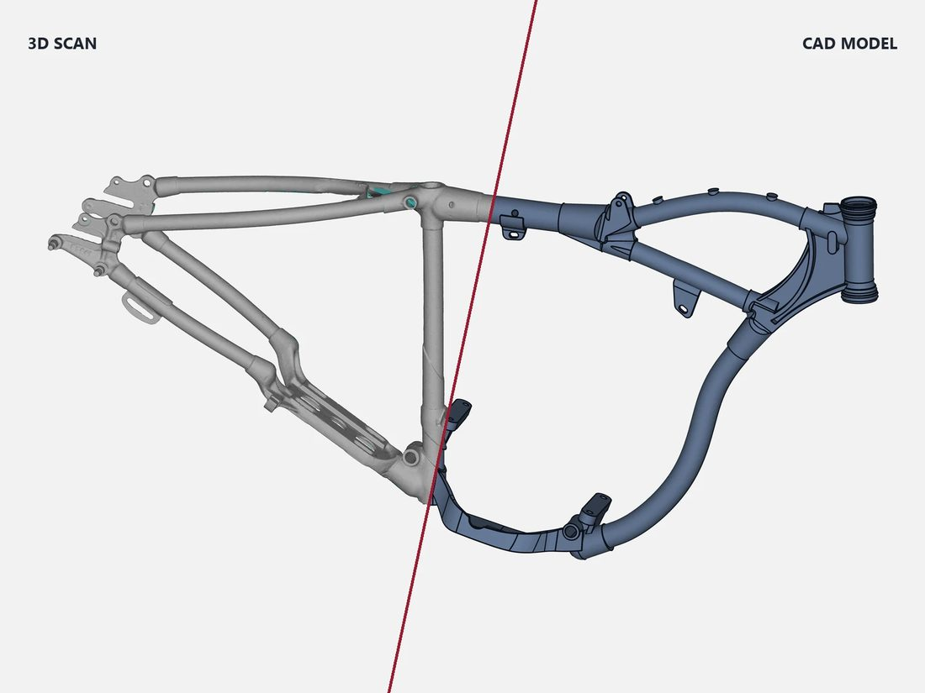
Reverse Engineering
( 02.2 ) — SERVICES
Turn scan data into fully editable, manufacturable CAD.
We rebuild physical parts as parametric CAD models — for re-manufacturing legacy parts with no drawings, modifying existing designs, or creating moulds and tooling. You choose how faithful the model should be to the scanned part.
Design-intent modelling
NURBS surface models
A clean CAD model with manufacturing imperfections removed — ideal for re-manufacture from 3D models or 2D drawings.
Precise freeform surfaces fitted over scan data where an exact as-is representation matters.
SERVICE 02 / 07
Hybrid modelling
Drawings on request
DELIVERABLES
Prismatic features modelled to design intent, freeform areas surfaced to the scan — the best of both.
2D manufacturing drawings with GD&T generated from the final model.
Parametric CAD (.STEP, .IGES, .X_T)
Scan data (.STL)
2D drawings (.PDF, .DWG)
Deviation report vs. scan
INDUSTRIES
Automobile
Aerospace
Healthcare
Notes:
We rebuild physical parts as parametric CAD models — for re-manufacturing legacy parts with no drawings, modifying existing designs, or creating moulds and tooling. You choose how faithful the model should be to the scanned part.

Slide 7
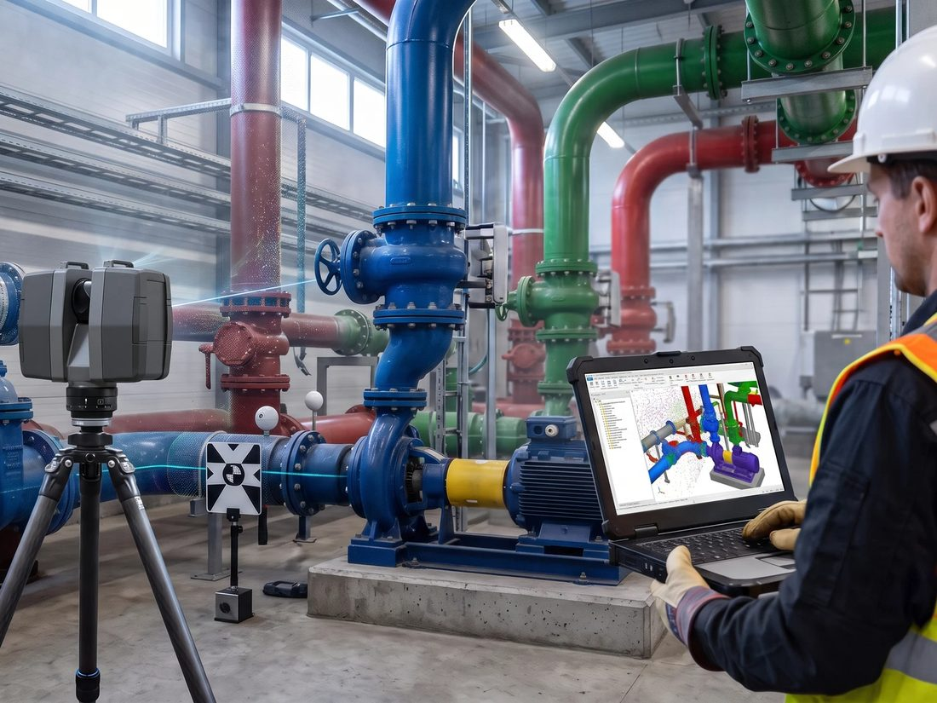
Scan to BIM
( 02.3 ) — SERVICES
Existing buildings captured as accurate, intelligent BIM models.
We laser-scan existing structures and convert the point cloud into detailed BIM models. Architects, engineers and contractors get an accurate as-built foundation for renovation, retrofit and facility-management projects — with every wall, slab, column and service documented.
As-built accuracy
LOD 200–400 models
Terrestrial laser scanning records the true geometry of the building, not the original drawings.
Walls, floors, structure and MEP modelled to the level of detail your project needs.
SERVICE 03 / 07
Clash-ready coordination
Drawings from the model
DELIVERABLES
Models are set up for coordination with new design work in Revit and Navisworks.
Floor plans, sections and elevations exported straight from the BIM.
Registered point cloud (.E57, .RCP)
Revit model (.RVT)
IFC export
2D plans, sections, elevations
INDUSTRIES
Construction
Education
Healthcare
Notes:
We laser-scan existing structures and convert the point cloud into detailed BIM models. Architects, engineers and contractors get an accurate as-built foundation for renovation, retrofit and facility-management projects — with every wall, slab, column and service documented.

Slide 8
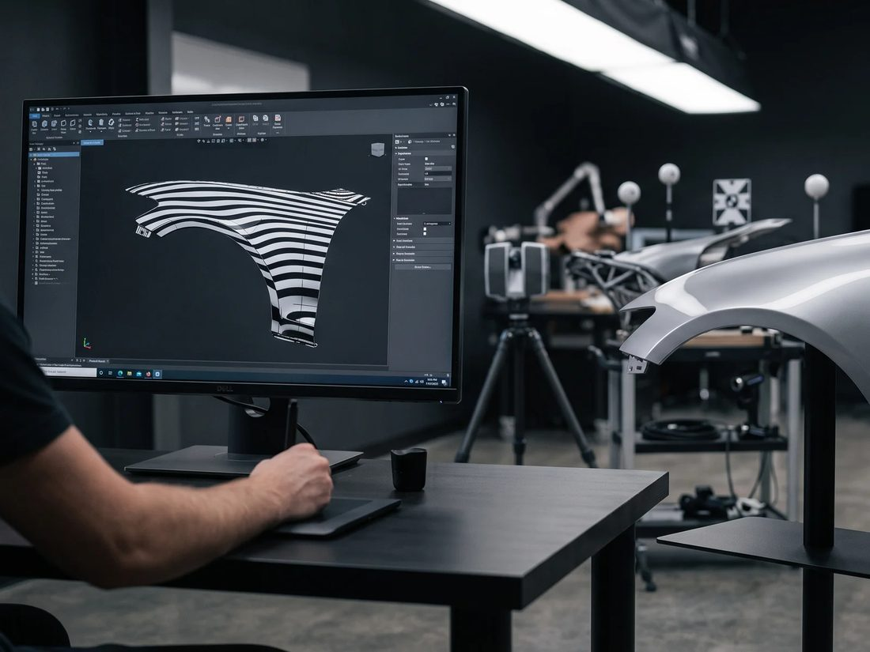
Class A Surfacing
( 02.4 ) — SERVICES
Flawless, curvature-continuous surfaces for visible parts.
Class A surfaces are the visible skins of a product — car body panels, aircraft fairings, consumer-product housings. We build G2/G3-continuous surfaces with clean patch layouts and verify them with zebra and curvature analysis, so reflections flow without a ripple.
G2 / G3 continuity
Analysis-verified
Curvature-continuous transitions between every patch for perfect reflections.
Zebra stripes, highlight lines and curvature combs checked on every surface.
SERVICE 04 / 07
From scan or sketch
Tooling-ready
DELIVERABLES
Start from a clay-model scan, a reference surface or concept sketches.
Surfaces handed over with draft, flanges and offsets ready for engineering.
Class A surfaces (.IGES, .STEP)
Surface-analysis reports
Render-ready model
INDUSTRIES
Automobile
Aerospace
Notes:
Class A surfaces are the visible skins of a product — car body panels, aircraft fairings, consumer-product housings. We build G2/G3-continuous surfaces with clean patch layouts and verify them with zebra and curvature analysis, so reflections flow without a ripple.

Slide 9
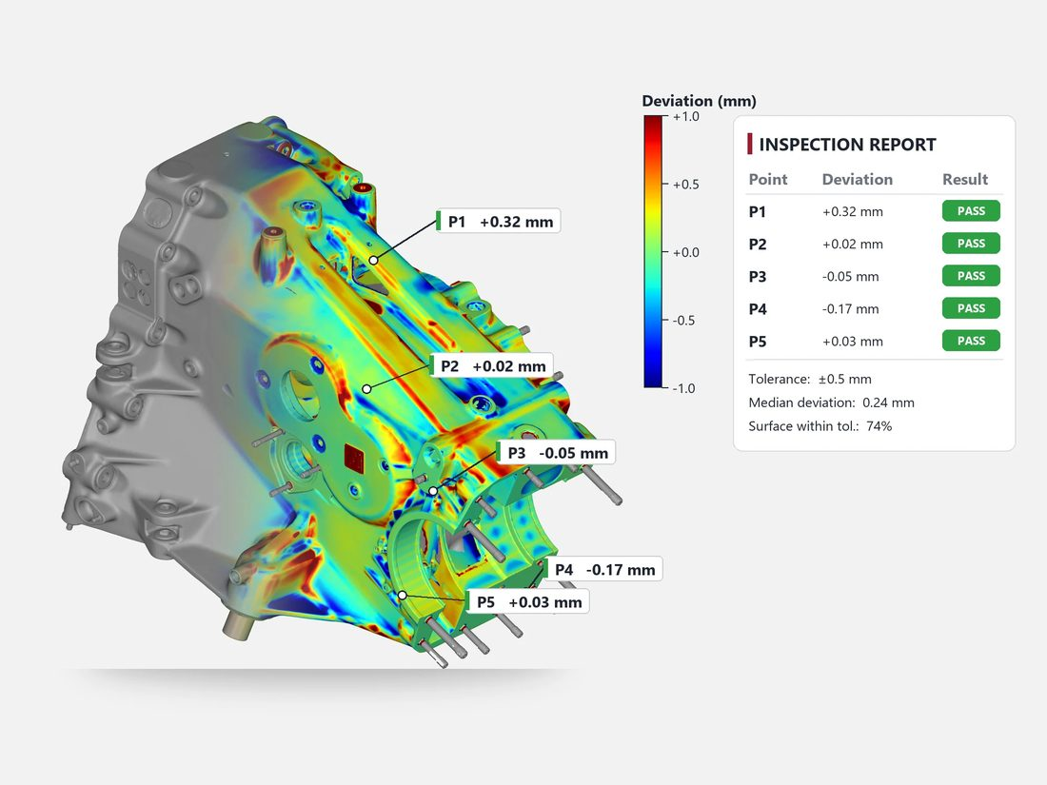
Digital Metrology
( 02.5 ) — SERVICES
Compare manufactured parts to their CAD — to the micron.
We inspect manufactured parts by scanning them and comparing the result against the nominal CAD. Colour deviation maps, GD&T checks and first-article reports show exactly where a part is in or out of tolerance — fast, and without contact.
Colour deviation maps
GD&T inspection
Full-surface comparison against CAD, instantly showing where material is over or under.
Flatness, position, profile and more, measured and reported against the drawing.
SERVICE 05 / 07
First-article inspection
Trend analysis
DELIVERABLES
Complete FAI reports for new parts, tools and suppliers.
Repeated inspections track tool wear and process drift over time.
Inspection report (.PDF)
Colour deviation maps
GD&T results tables
Scan data for records
INDUSTRIES
Aerospace
Automobile
Healthcare
Notes:
We inspect manufactured parts by scanning them and comparing the result against the nominal CAD. Colour deviation maps, GD&T checks and first-article reports show exactly where a part is in or out of tolerance — fast, and without contact.

Slide 10
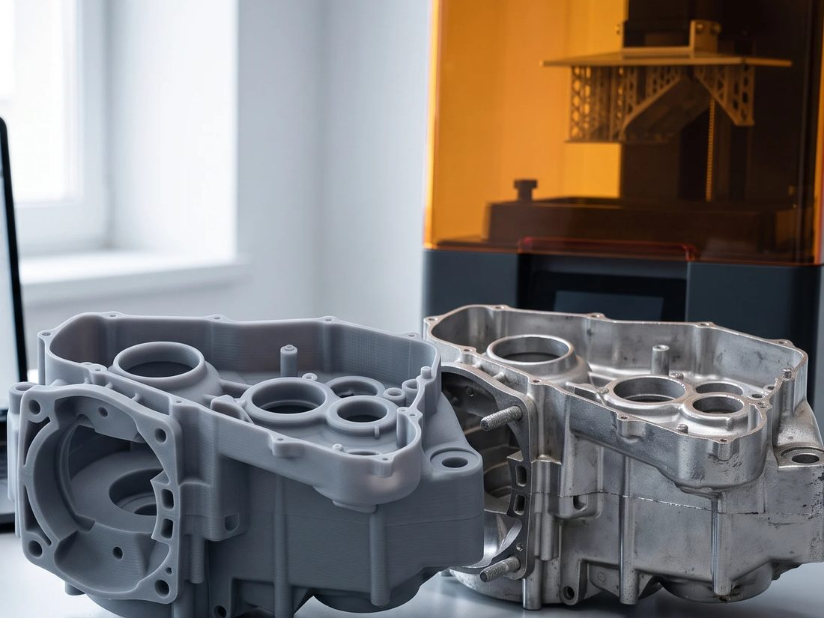
3D Printing
( 02.6 ) — SERVICES
Rapid prototypes and functional parts, straight from your model.
We print prototypes, fit-check models, jigs, fixtures and short-run end-use parts directly from CAD or scan data. Our team also prepares and repairs files — including sculpted character models — so they print right the first time.
Rapid prototyping
FDM and SLA printing
Physical parts in days to check form, fit and function before tooling.
FDM engineering plastics for strong parts, SLA resins for fine detail.
SERVICE 06 / 07
Print-ready preparation
Character & figure models
DELIVERABLES
Mesh repair, hollowing, supports and orientation handled for you.
Digitally sculpted busts and figures prepared for high-detail resin printing.
Printed parts
Print-ready files (.STL, .3MF)
Finishing / painting on request
Small production batches
INDUSTRIES
Education
Healthcare
Jewellery
Automobile
Notes:
We print prototypes, fit-check models, jigs, fixtures and short-run end-use parts directly from CAD or scan data. Our team also prepares and repairs files — including sculpted character models — so they print right the first time.

Slide 11
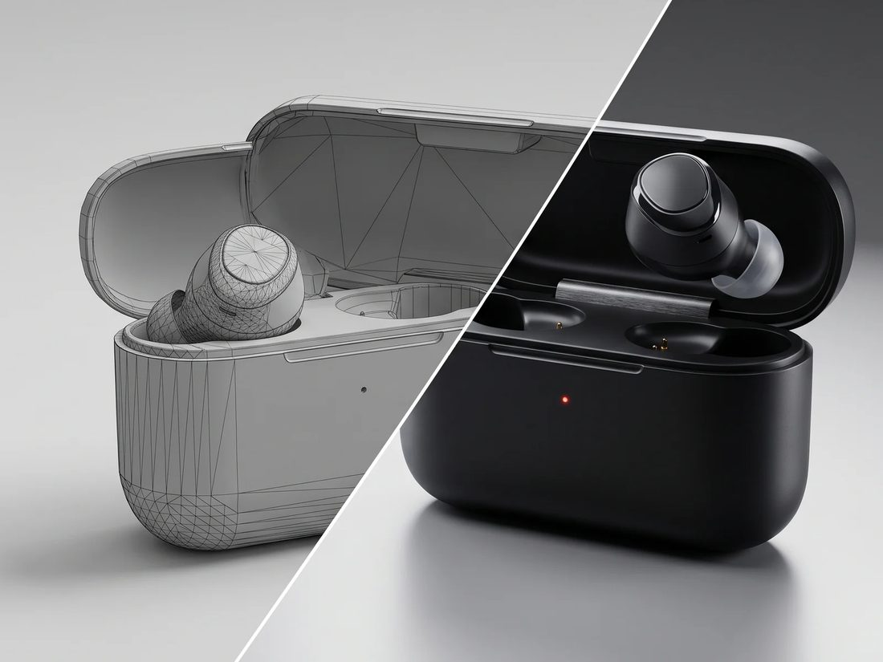
Product Rendering
( 02.7 ) — SERVICES
Photoreal visuals that sell a product before it is ever made.
We turn CAD and design models into photorealistic images and animations for marketing, presentations and design reviews. Materials, lighting and scenes are tuned so your product looks real — and looks its best — before the first unit is built.
Photoreal stills
Animations & turntables
Studio and lifestyle shots with accurate materials, finishes and lighting.
Exploded views, assembly sequences and 360° spins.
SERVICE 07 / 07
Interiors & exhibitions
Jewellery visualisation
DELIVERABLES
Spaces, stands and environments visualised before construction.
Metals and gemstones rendered with true reflections and sparkle.
High-res stills (.PNG, .TIFF)
Animations (.MP4)
360° turntables
Web-ready image sets
INDUSTRIES
Jewellery
Construction
Automobile
Notes:
We turn CAD and design models into photorealistic images and animations for marketing, presentations and design reviews. Materials, lighting and scenes are tuned so your product looks real — and looks its best — before the first unit is built.

Slide 12
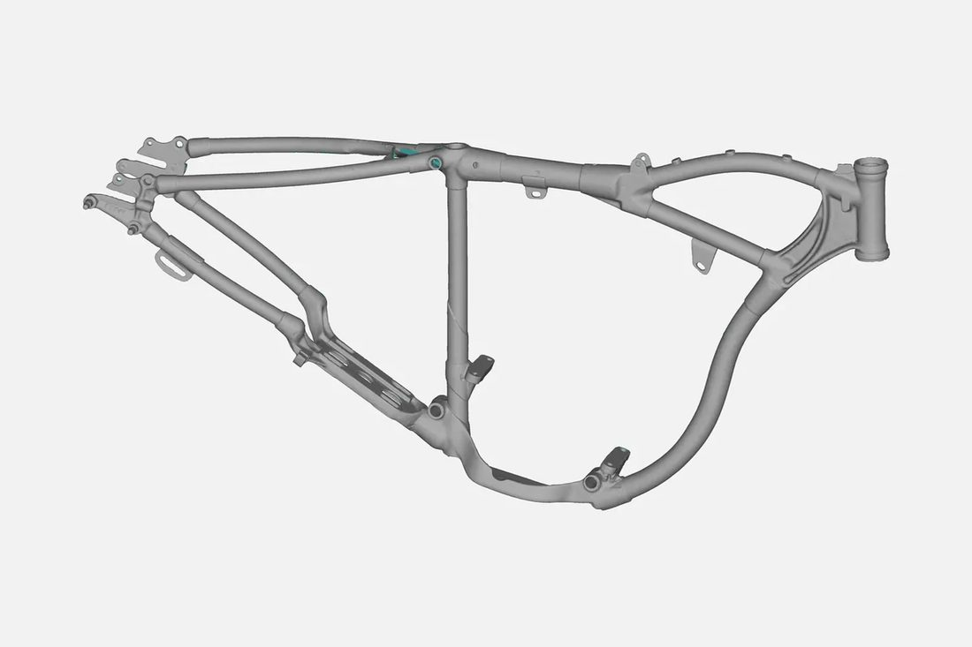
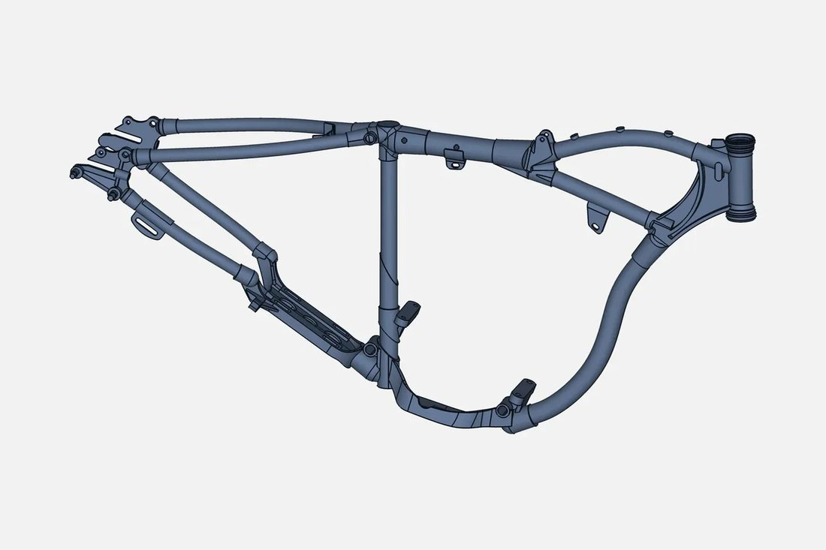
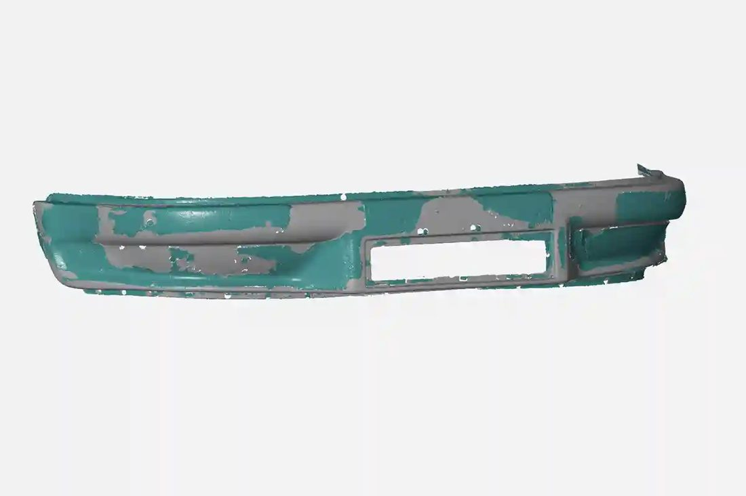
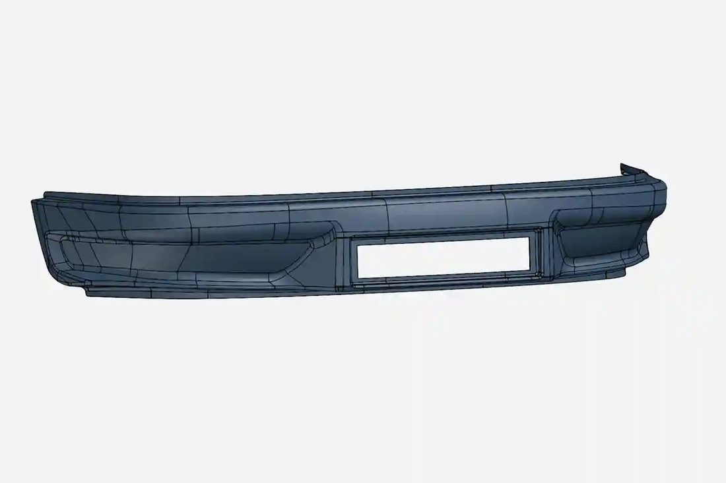
Scan in. CAD out.
( 04 ) — PORTFOLIO
Real parts we have captured and rebuilt as editable, manufacturable CAD.
SCAN
CAD
SCAN
CAD
Engine Cylinder Head Engine cylinder head scanned and rebuilt as parametric CAD.
Impeller Bladed impeller captured and modelled with precise freeform blade surfaces.
SCAN
CAD
SCAN
CAD
Motorcycle Tubular Frame Tubular motorcycle frame digitised and converted into an editable CAD model.
Bumper Vehicle bumper scanned and resurfaced for tooling.
Notes:
Real parts VShark has captured and rebuilt as editable, manufacturable CAD.

Slide 13
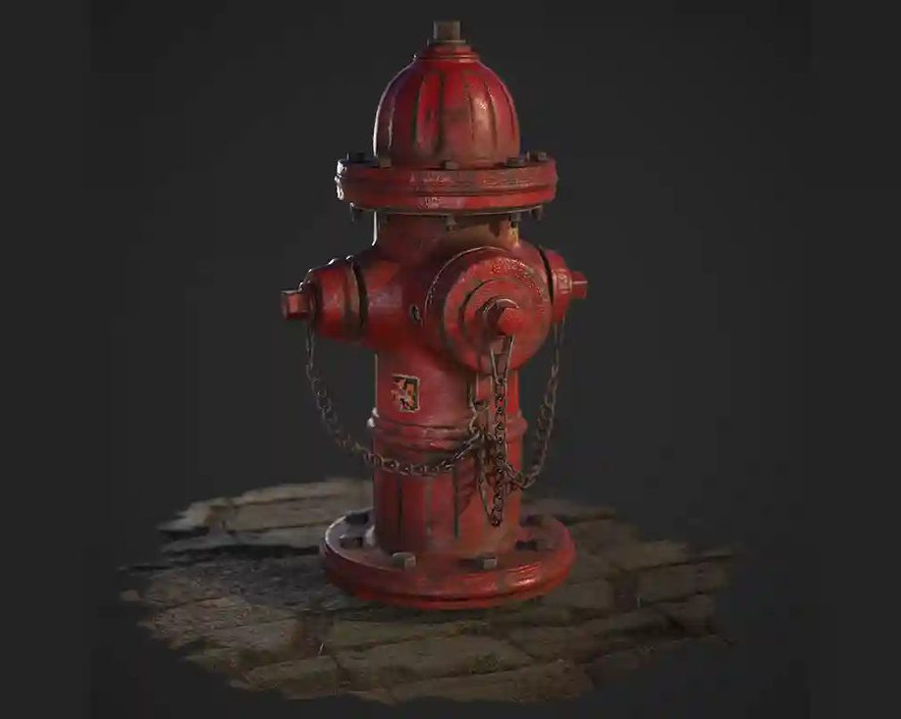
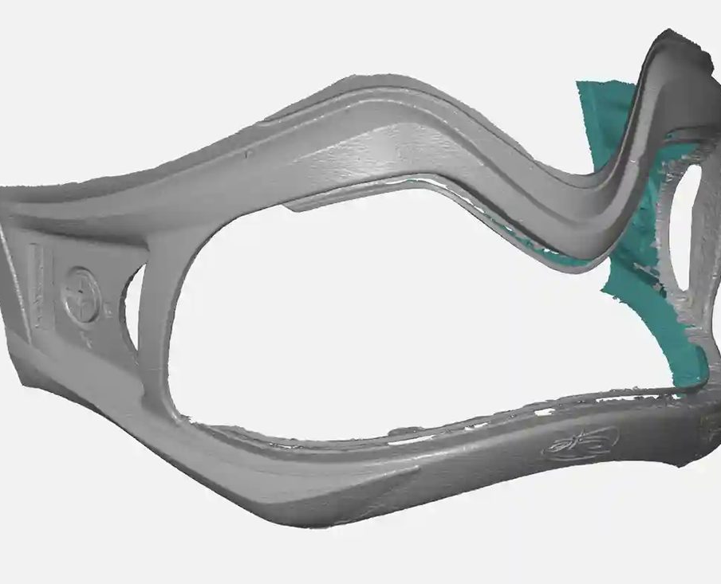
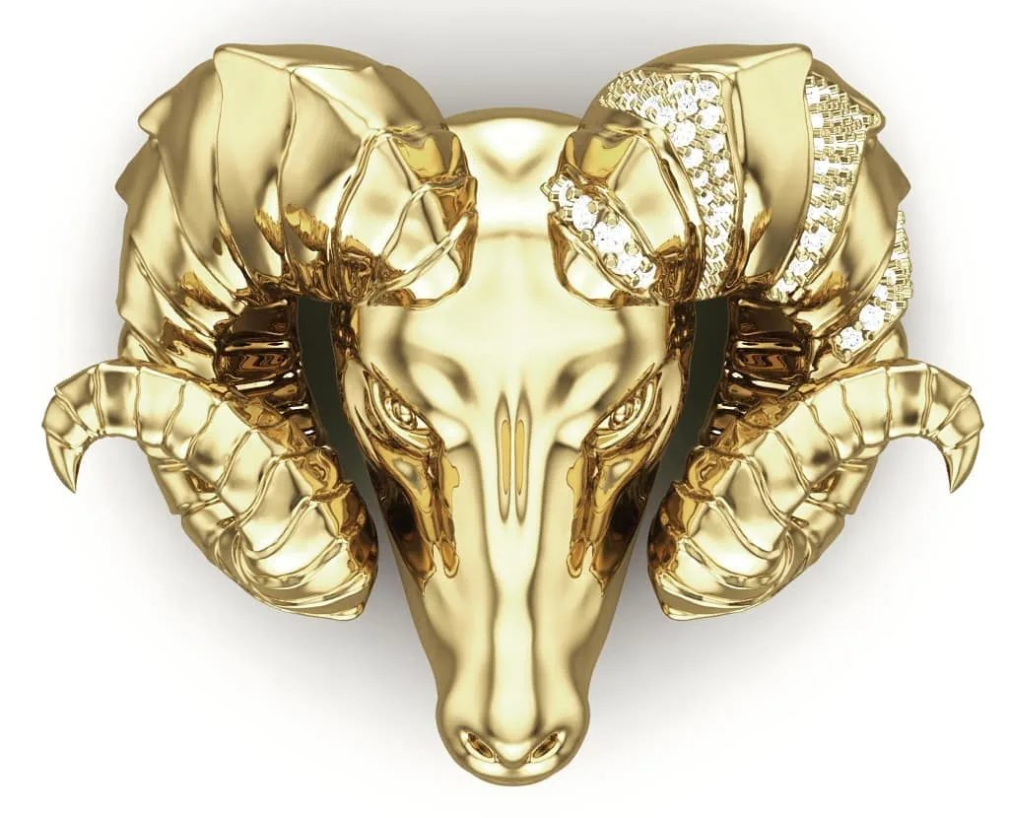
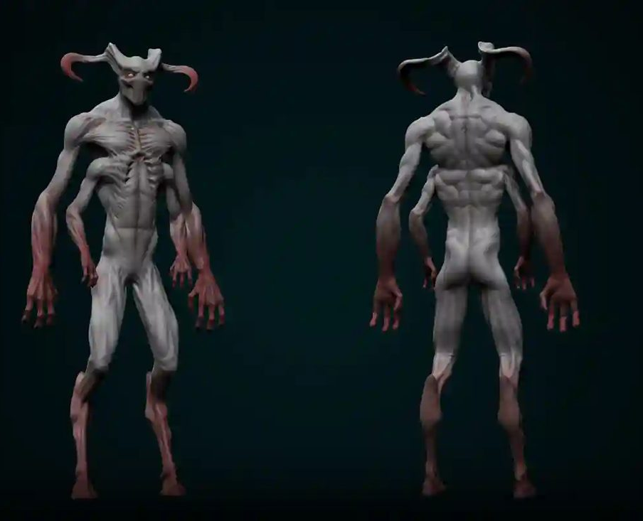
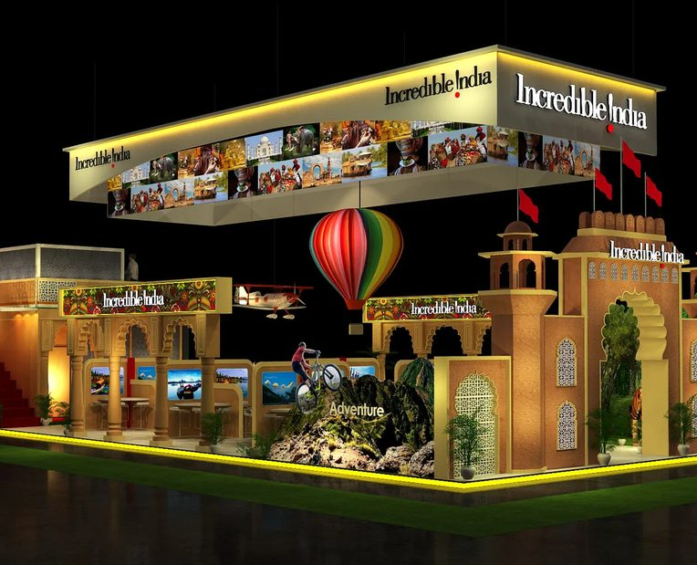
Design & visualisation
( 04 ) — PORTFOLIO
Surfacing, sculpting and photoreal rendering — visuals that sell a product before it is made.
Eyewear surfacing
Jewellery rendering
Eyewear frame surfaced over scan data for a custom-fit product.
Rings rendered with true metal reflections and gemstone sparkle.
Product rendering
Character sculpts
Exhibition stands
Photoreal product visuals: electronics, tools and props.
Figures, reliefs and creatures sculpted digitally for high-detail resin printing.
Exhibition stands and interiors visualised before they are built.
Notes:
Surfacing, sculpting and photoreal rendering — visuals that sell a product before it is made.

Slide 14
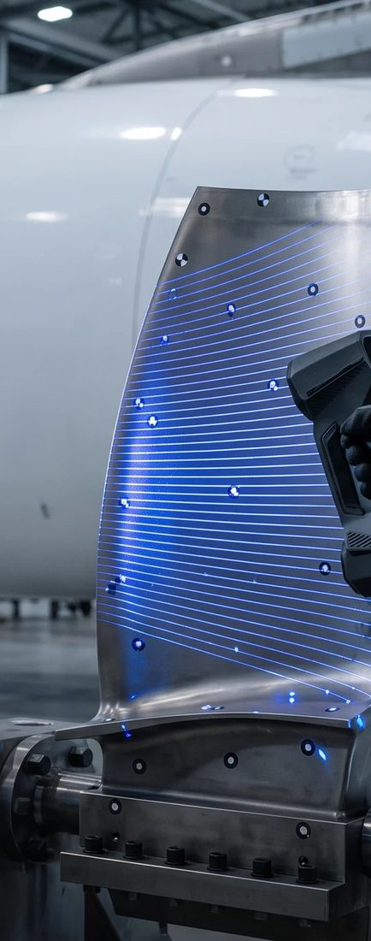
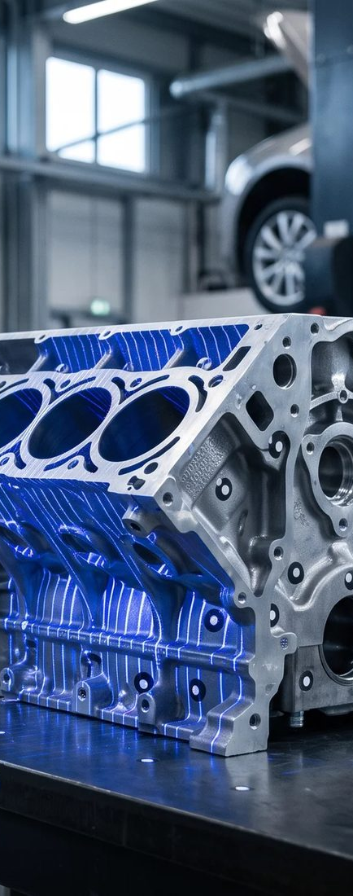
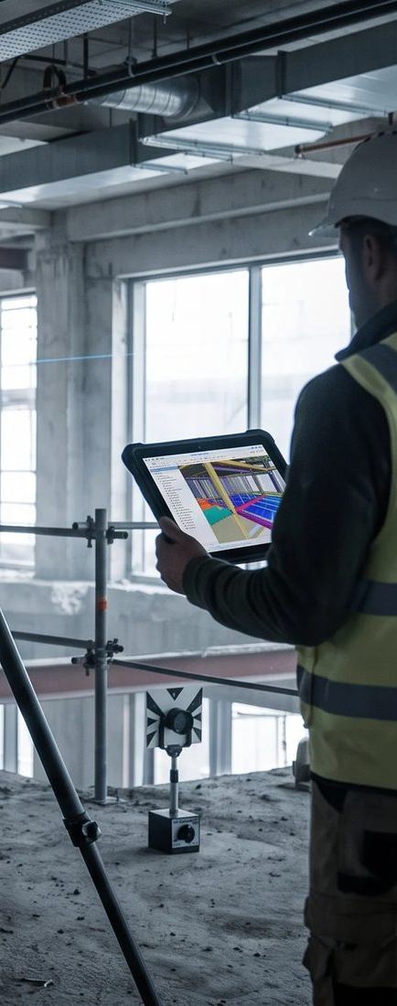
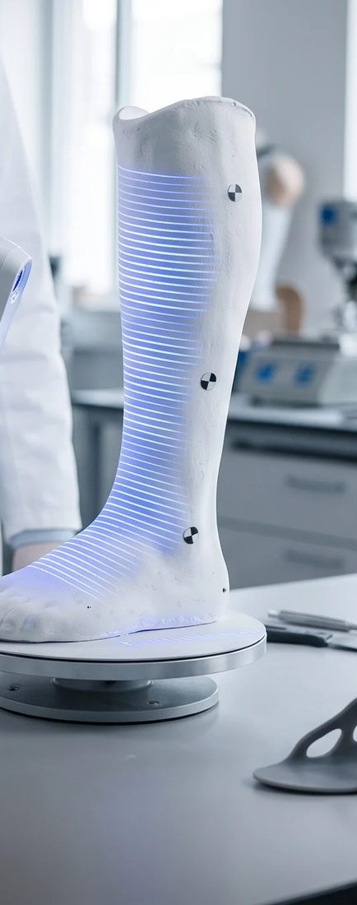
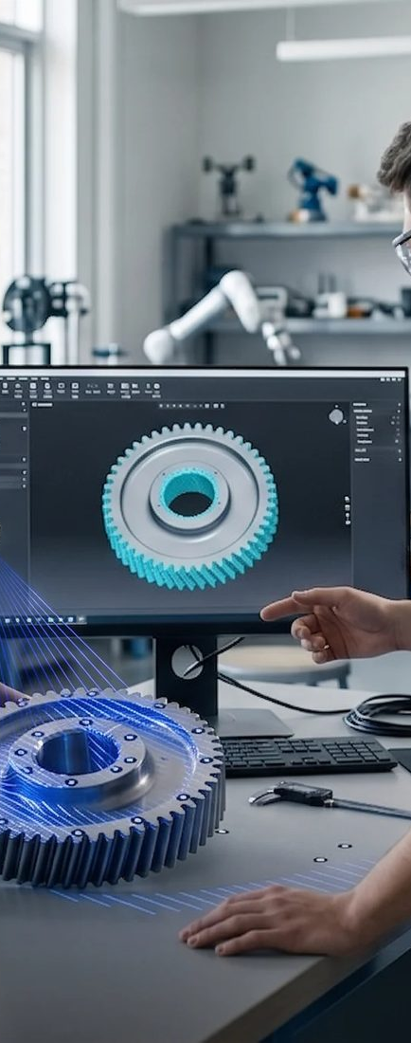
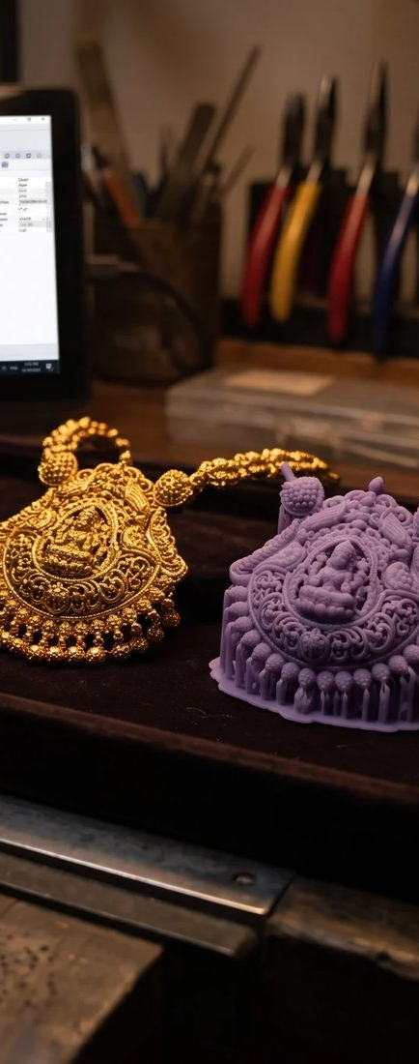
Industries we serve
( 05 ) — INDUSTRIES
Six sectors, one standard of precision.
01
02
03
04
05
06
Aerospace
Automobile
Construction
Healthcare
Education
Jewellery
Inspection and reverse engineering of high-precision aircraft components.
Body surfacing, part digitising and fixture design for vehicles.
As-built scanning and BIM models for buildings and sites.
Medical devices and custom-fit parts captured and modelled in 3D.
Scanning and 3D printing support for labs, research and teaching.
Fine-detail scanning and printing for jewellery design and casting.
Notes:
Six sectors, one standard of precision.

Slide 15
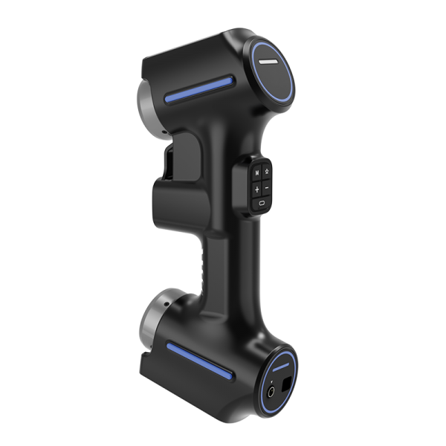
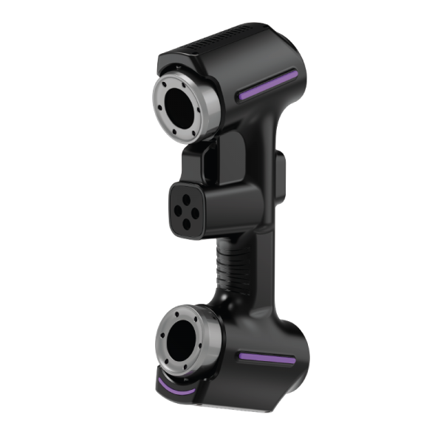
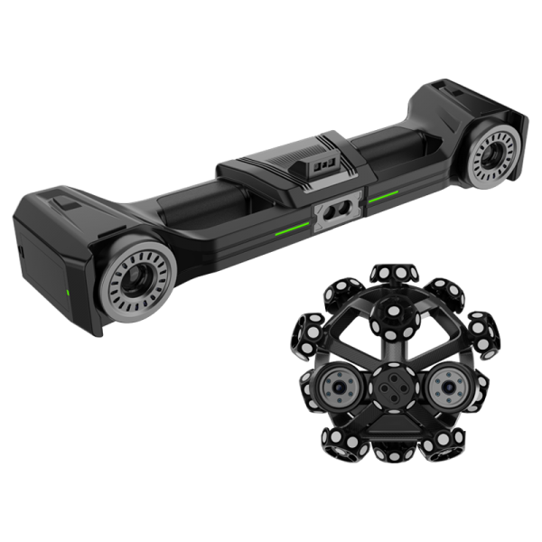
Professional 3D scanners
( 06 ) — PRODUCTS
Vertex blue-laser and optical-tracking scanners — sold, set up and supported by VShark.
Vertex3D
Vertex3D Pro
Vertex Tracker
Handheld blue-laser 3D scanner
Handheld blue-laser 3D scanner
Optical-tracking 3D scanning system
0.020 mm precision
0.020 mm precision
0.025 mm precision
SPECIFICATION | VERTEX3D | VERTEX3D PRO | VERTEX TRACKER
High-speed scanning | 26 crossed blue laser lines | 50 crossed blue laser lines | 50 crossed blue laser lines
Max. scanning speed | 5,400,000 measurements/s | 7,100,000 measurements/s | 7,100,000 measurements/s
Max. scanning field | 650 × 550 mm | 650 × 550 mm | 1100 × 800 mm
Max. resolution | 0.01 mm | 0.01 mm | 0.01 mm
Volume accuracy | 0.015 mm + 0.035 mm/m | 0.015 mm + 0.035 mm/m | 10.0 m³: 0.060 mm · 25.0 m³: 0.083 mm
Recommended sample size | > 10 mm | > 10 mm | 10 mm – 8000 mm
Output formats | .STL, .PLY, .ASC, .TXT | .STL, .PLY, .ASC, .TXT | .STL, .PLY, .ASC, .TXT
RECOMMENDED PC Windows 10 or later (64-bit) · NVIDIA GTX/RTX GPU (e.g. RTX 4060 or higher), 8 GB+ VRAM · Intel Core i7-13700H or better · 32 GB RAM or more
Notes:
Vertex blue-laser and optical-tracking scanners, now available from VShark with set-up and support. Full spec sheet in the scanners brochure.

Slide 16
Trusted worldwide
( 07 ) — WHAT CLIENTS SAY
INDIA · UAE · SAUDI ARABIA · USA · UK · GERMANY · CANADA
“
“
“
VShark Solutions was able to take a relatively poorly scanned object and convert it to a solid model with very accurate dimensions. Their surfacing skills are amazing, and the accuracy is perfect for our needs.
VSHARK provided the best engineering service we've ever experienced. Their attention to detail and quick responsiveness made working with them a pleasure. We've collaborated with them many times and will continue to do so.
Working with VSHARK on a reverse engineering and 3D modelling project was impressive; their professionalism, clear communication, and dedication to quality made the entire process smooth and efficient.
Rachel Labonte
Mace Roper
Benedikt Klein
CANADA
UNITED STATES
GERMANY
“
“
“
Exceptional work and accuracy! I will be using VSHARK skills again; I highly recommend them if you need something converted accurately. No need to look further.
VShark Solutions delivered exceptional work beyond my expectations! Their attention to detail and professionalism made the entire process seamless. I highly recommend them for any project.
Working with VSHARK Engineers was a fantastic experience. Their creative approach and attention to detail perfectly aligned with our brand, and they were always polite and cooperative throughout the project.
Xander Elon
Ahtisham Muhammad
Mariam Al-Ghayousi
UNITED KINGDOM
SAUDI ARABIA
DUBAI
Notes:
Clients in India · UAE · Saudi Arabia · USA · UK · Germany · Canada.

Slide 17
Let’s start
your project.
( 08 ) — GET IN TOUCH
EMAIL
info@vsharksolutions.com
INDIA
+91 95142 48525
UAE
+971 52 248 6238
Send us a photo, drawing or the part itself — we’ll come back with the right approach, timeline and quote.
WHATSAPP
+91 95142 48525
WEB
vsharksolutions.com
Notes:
Close: ask for a photo, drawing or the part itself, and offer to come back with approach, timeline and quote.

