Slide 1


Make-A-Difference (M-A-D)

Slide 2

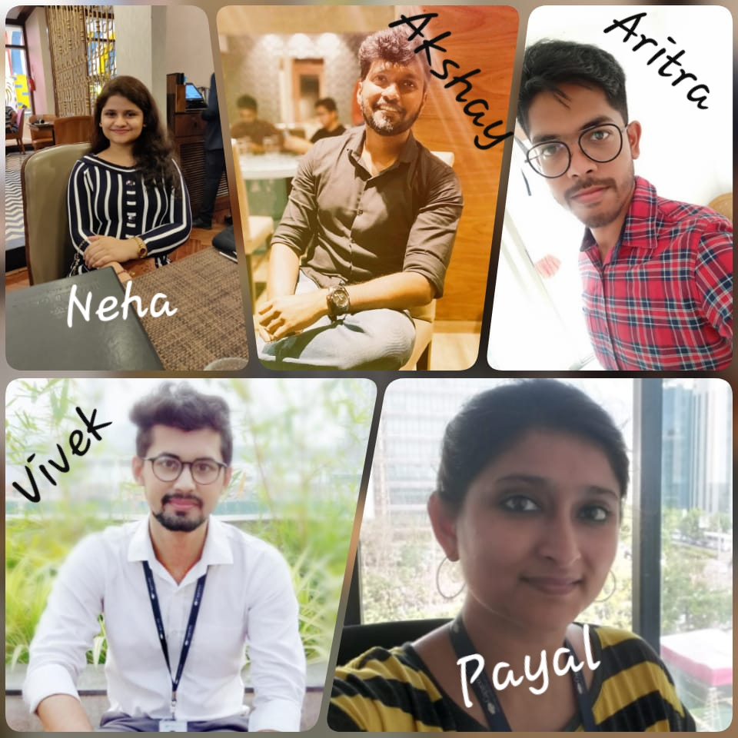
Call for Code 2019 Challenge
Akshay Mahale
Aritra Basu
Neha Pandey
Payal Mankodi (Team Leader)
Vivek Sharma

Slide 3

CHALLENGE
During disasters, on the ground information is needed to monitor resource utilization– food, medicines and healthcare personnel – as these are limited. It is essential to address people based on their exposure or vulnerability to health risks on priority, to better utilize available people and inventory.
Notes:
A description of the problem statement you are trying to resolve.

Slide 4
TECHNOLOGY SUGGESTIONS
User Interface:
Mobile App using Responsive Web Design (RWD) concept and Native features
Information Intake:
Chatbot – IBM Watson Assistant service
Interactive Voice Response system – IBM Voice Agent service
Structural Stability Assessment:
Image Processing Classifier algorithm – IBM Watson Service
Integrations:
API Integration between mobile app and IBM services on IBM Cloud
Notes:
A raw list of technology that can be used to implement the solution, as well as alternatives. Mention any base code pattern, IBM Cloud service offerings, open source technologies, infrastructure etc.

Slide 5
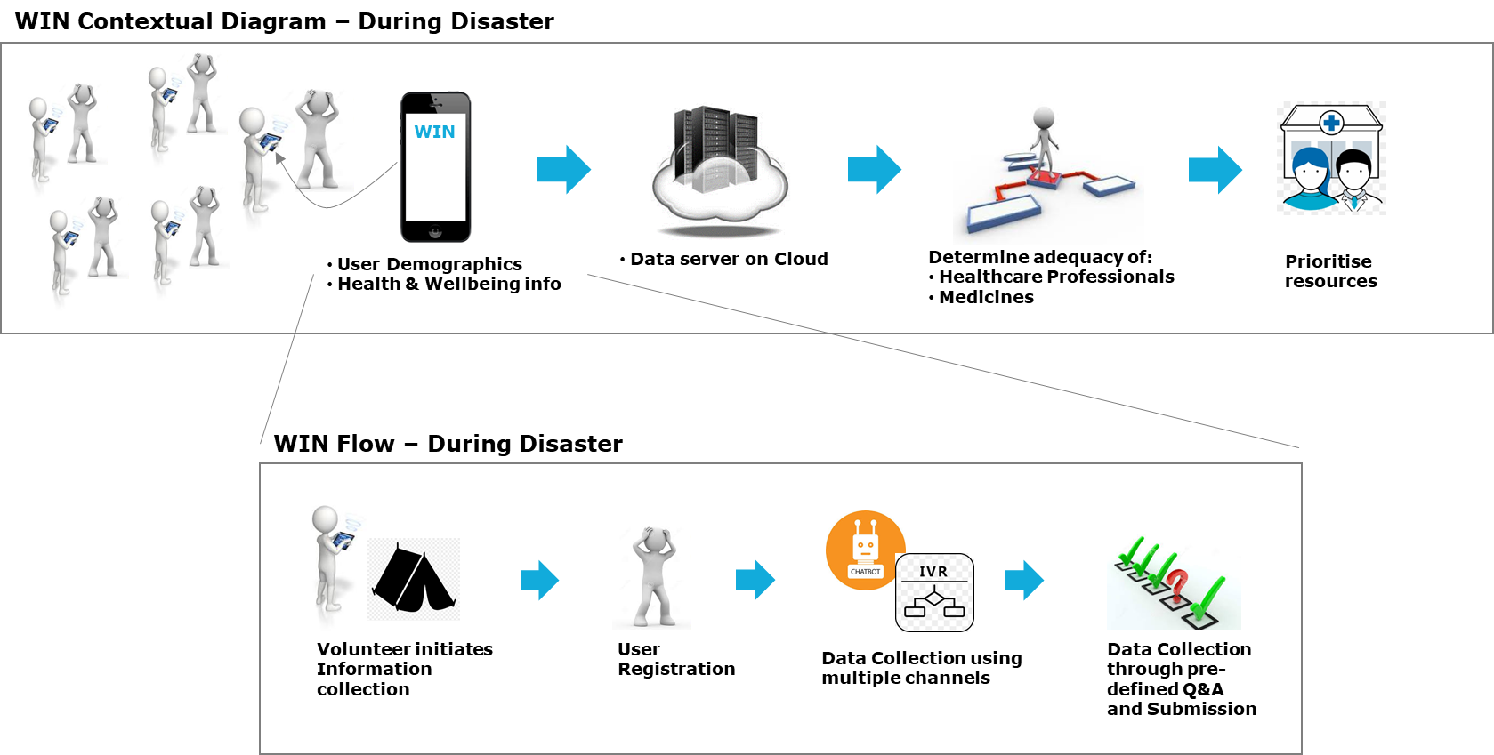
SOLUTION APPROACH (1/2)
WIN - When In Need is an information intake tool from Make-A-Difference (M-A-D) team. As part of the Call for Code program we are proposing a tool that will collate information needed to channel health and wellness resources. This will address the end problem of healthcare resource allocation. Here’s a schematic of the process flow.
Notes:
Describe the approach of resolving the challenge identified & the outcomes

Slide 6
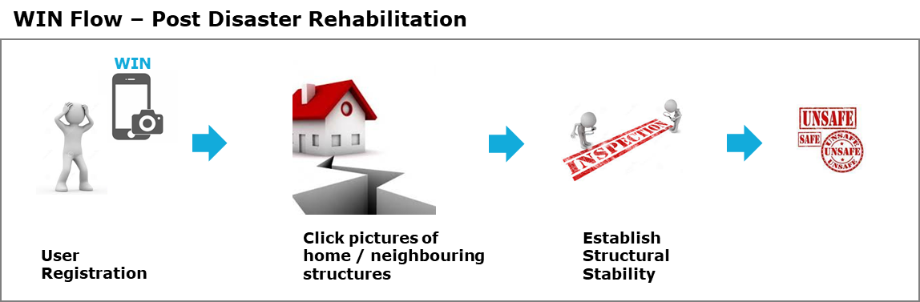
SOLUTION APPROACH (2/2)
An added feature of WIN is for use after the natural calamity. Once people are ready to move into their houses, It helps people assess the structural stability of their homes The person is expected to click photos of their home using WIN. They will be given an indication of whether the structure is safe to inhabit. This is needed when floods, cyclone or earthquake has hit this area. The same assessment can be done for neighbouring structures as well.
Here’s a schematic of the post disaster feature:
In summary, WIN includes :
Features: Data Collection (during disaster), Structural Stability assessment (post disaster)
Natural Disasters: Floods, Cyclones, Earthquake
Geography: India (though this solution can be implemented across tropical countries)
Diseases: Cholera, Dengue
User: Volunteers
Few Assumptions taken into consideration:
Volunteers are proficient in operating smartphones and apps
There is one of either internet connectivity or telephone connectivity available
People and inventory of resources is available at the relief camps as a first measure
Notes:
Describe the approach of resolving the challenge identified & the outcomes

Slide 7
SOLUTION ROADMAP
As a future roadmap, here are a few steps to be taken to enhance WIN into an independent offering:
Data collection
Feed symptom data collected presently into Machine Learning algorithms to assess Utilisation and Prioritization using Analytics.
Analysis of wellness and symptom data collected during disaster to understand impact and trends of such occurrences
A single relief camp scenario is addressed, expanded coverage to multiple relief camps during a disaster, to enable re-distribution of limited resources between camps.
Ongoing monitoring of place of disaster using images relayed by drones. This is for local authorities to measure impact of disaster for rehabilitation and evaluate future preventive measures.
Structural Stability assessment
Extend the image processing algorithm to identify:
structural damages, specific to calamities, for better results
classify structures into home, office spaces, warehouse or more to assess risk and stability aligned to its use
Notes:
Describe the future scope of the solution, possible next steps

Slide 8
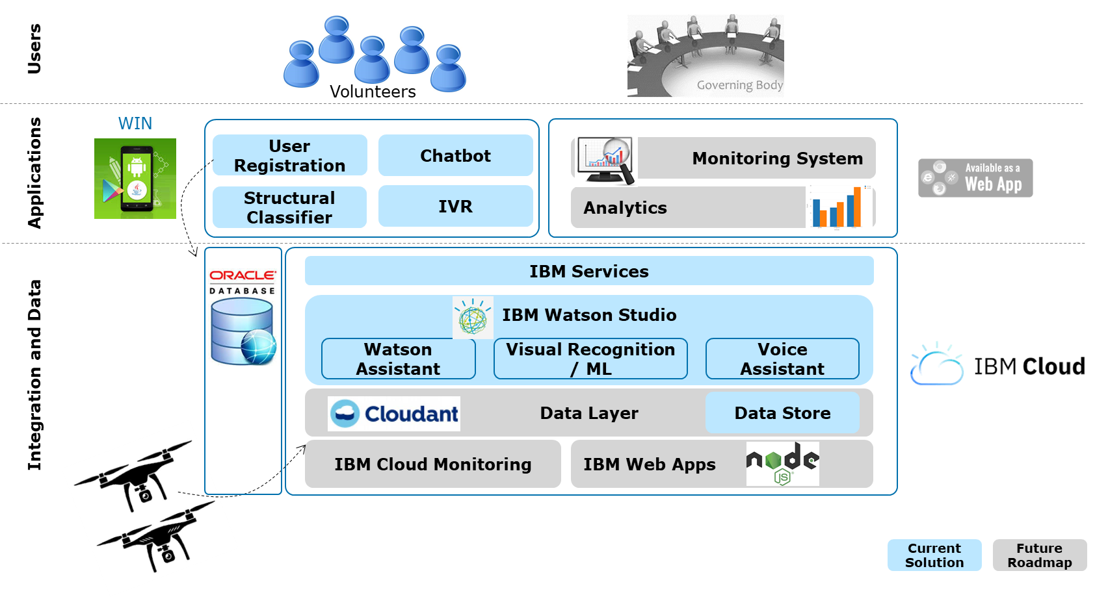
HIGH LEVEL ARCHITECTURE
Notes:
Add architecture diagrams as applicable, e.g. – overall architecture, sequence, deployment etc.

Slide 9
SOURCE CODE
Github link to the Source Code is provided below:
https://github.com/vsharm29/IBM-Call-for-Code-Challenge.git
Notes:
Add GIT link

Slide 10
RECOMMENDED RESOURCES
Documents
National Disaster Management Authority, Guidelines on Minimum Standards of Relief- https://ndma.gov.in/images/guidelines/guideline-on-minimum-standard-of-relief.pdf
Data sets
Opinion pieces
Epidemics after Natural Disasters- https://wwwnc.cdc.gov/eid/article/13/1/06-0779_article
About Disaster Management- https://www.ifrc.org/en/what-we-do/disaster-management/about-disaster-management/
Notes:
Add GIT link

