Slide 1
Simple Linear Regression

Slide 2
Definition
Simple Linear Regression is a statistical method that allows us to study and summarize relationship between two continuous quantitative/numerical variables.
Simple Linear Regression/ Uni-variant Regression is a Supervised Machine Learning Algorithm.

Slide 3
CONCEPT
There are two Quantitative variables: Independent Variable(x) and Dependent Variable(y).
Independent variables are denoted by x and are also known as Features.
Features can be Continuous and Categorical in general, but we use Simple Linear Regression for Continuous Numerical Independent variables .
Dependent variable is denoted by y and is also known as Target.
Notes:
The Chi-Square Test of Independence can only compare categorical variables. It cannot make comparisons between continuous variables or between categorical and continuous variables. Additionally, the Chi-Square Test of Independence only assesses associations between categorical variables, and can not provide any inferences about causation.

Slide 4
CONCEPT
The equation of Simple Linear Regression is manifestation of Straight line formula given as : y = mx + c,
y target variable
x independent variable
Notes:
The Chi-Square Test of Independence can only compare categorical variables. It cannot make comparisons between continuous variables or between categorical and continuous variables. Additionally, the Chi-Square Test of Independence only assesses associations between categorical variables, and can not provide any inferences about causation.

Slide 5
CONCEPT
y = m*x +c
Predictor (present in data)
Coefficient (estimated by regression)
Intercept (estimated by regression)
Predicted value(calculated from a, b and X)
Notes:
The Chi-Square Test of Independence can only compare categorical variables. It cannot make comparisons between continuous variables or between categorical and continuous variables. Additionally, the Chi-Square Test of Independence only assesses associations between categorical variables, and can not provide any inferences about causation.

Slide 6
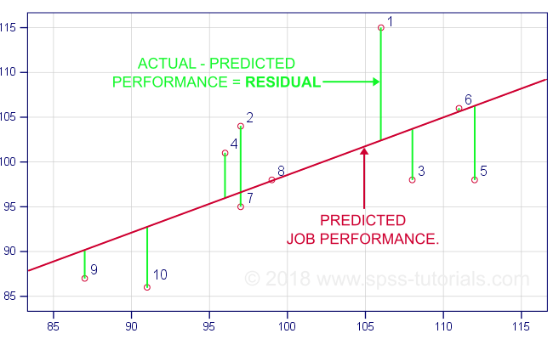

CONCEPT
Notes:
The Chi-Square Test of Independence can only compare categorical variables. It cannot make comparisons between continuous variables or between categorical and continuous variables. Additionally, the Chi-Square Test of Independence only assesses associations between categorical variables, and can not provide any inferences about causation.

Slide 7
Cost Function
The mathematical problem is straightforward:
given a set of n points (Xi,Yi) on a scatterplot,
find the best-fit line, y_{i} =mx_{i}+ c
such that the sum of squared errors in is minimized
Error Function (Q)=
Notes:
The Chi-Square Test of Independence can only compare categorical variables. It cannot make comparisons between continuous variables or between categorical and continuous variables. Additionally, the Chi-Square Test of Independence only assesses associations between categorical variables, and can not provide any inferences about causation.

Slide 8
Solution
Finding values from Excel
Will be explained in Excel
Notes:
The Chi-Square Test of Independence can only compare categorical variables. It cannot make comparisons between continuous variables or between categorical and continuous variables. Additionally, the Chi-Square Test of Independence only assesses associations between categorical variables, and can not provide any inferences about causation.

Slide 9
Solution
Finding values from ML
Will be explained in Python
Notes:
The Chi-Square Test of Independence can only compare categorical variables. It cannot make comparisons between continuous variables or between categorical and continuous variables. Additionally, the Chi-Square Test of Independence only assesses associations between categorical variables, and can not provide any inferences about causation.

Slide 10
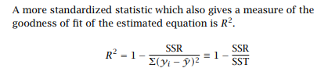
R²
• SSR can be thought of as the “unexplained” variation in the dependent variable—the variation “left over” once the predictions of the regression equation are taken into account.
• Σ(yi − y¯)2 (total sum of squares or SST), represents the total variation of the dependent variable around its mean value.
Notes:
The Chi-Square Test of Independence can only compare categorical variables. It cannot make comparisons between continuous variables or between categorical and continuous variables. Additionally, the Chi-Square Test of Independence only assesses associations between categorical variables, and can not provide any inferences about causation.

Slide 11
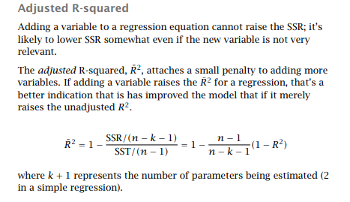
Adjusted R²
Notes:
The Chi-Square Test of Independence can only compare categorical variables. It cannot make comparisons between continuous variables or between categorical and continuous variables. Additionally, the Chi-Square Test of Independence only assesses associations between categorical variables, and can not provide any inferences about causation.

Slide 12
Thank You

