Slide 2
Contextualized x₁
Contextualized x₂
Contextualized x₃
Self-Attention
x₁
x₂
x₃

Slide 3
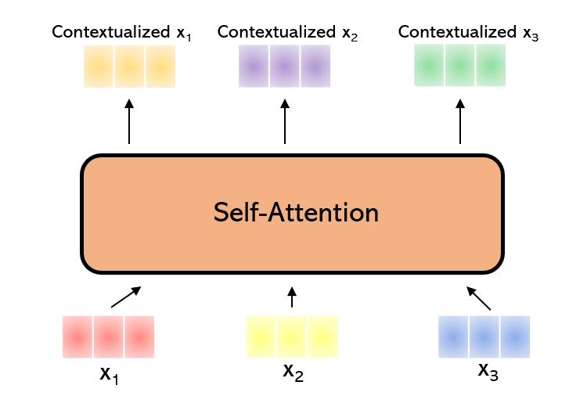
Contextualized x₁
Contextualized x₂
Contextualized x₃
Self-Attention
x₁
x₂
x₃

Slide 4
Want info on
Actor
Verb
Subject

