Slide 1
Web-scale Entity Annotation
Using MapReduce
Shashank Gupta
IIT Bombay
Varun Chandramouli
Netapp India
Soumen Chakrabarti
IIT Bombay
Notes:
***
A very good afternoon everyone. I am Shashank. Today, I’ll be talking about [Title]
***
[Add basic animations in all slides - Bullets]
Coordinate animations in all slides, acc. to the talk.

Slide 2

Querying the Web of objects
jaden smith debut movie
  Jaden Christopher Syre Smith (born July 8, 1998) is an American child-actor, ... Smith made his major role debut in the 2006 film The Pursuit of Happyness as ...
  His parents are the actors Will Smith and Jada Pinkett-Smith, and singer Willow Smith is his younger sister. Smith made his acting debut in the 2006 film The Pursuit of Happyness…
  What was Jaden Smith's first movie? pursuit of happyness with his dad he was 6 years old. What is Jaden Smith favorite movie? Karate Kid,Men In Black…
  In 2006 Jaden made his film debut in the Sony release The Pursuit of Happyness, playing his father's son. When Will was reading the script…
Target type
Response entity
Match these
imdb.com/title/tt0454921/
Entity ID
Notes:
***
Search engines these days are increasingly exploiting information from various structured knowledge bases like Wikipedia, IMDB, FreeBase, Linkedin and others to make their results even more meaningful, But this is still a work in progress.
For example, if you ask Google, “Jaden smith debut movie”, Google produces many snippets with the actual answer “Pursuit of happyness” embedded in them, but of course not explicitly specified…Whereas, we as a user might want an authoritative response, something like …[the picture], i.e. just the answer with a possible obscure entityID like [entId] from IMDB, mentioned along.
Do note that tokens in the query have diverse purposes here. Jaden, smith and debut are expected to match documents literally, whereas we want the type movie to instantiate into “pursuit of happyness”.
***
[add animations]
Search engines responses increasingly exploit knowledge bases, but this is still work in progress.
[Search Engines these days increasingly exploit information from various structured knowledge bases like FreeBase, Wikipedia, Linkedin, IMDB …. But this is still work in progress] … like this pursuit of happyness entity from IMDB.
If you ask Google “jaden smith debut movie”, Google produces many snippets with the answer embedded (but not explicitly specified) whereas we would really like authoritative links to the movie itself say with this obscure entity id from IMDB.
Note that query tokens have diverse purposes here. Jaden, smith and debut are expected to match documents literally, whereas we want to instantiate the type movie into “pursuit of happyness”.

Slide 3
What’s needed to support such queries?
Annotate token span in Web corpus as a mention of entity from large catalog
Index these annotations like regular tokens
  E.g., imdb.com/title/tt0454921/ mentioned at token offsets 48…51 of doc ID …
Also encode that imdb.com/title/tt0454921/ isA type=movie
  “Jaden smith debut movie” can be translated to “find docs containing snippets where jaden, smith, debut and a movie instance appear within 5 token window”
  Merge postings across types, entities and regular tokens during query time
Aggregate over instantiations of the target type.
Notes:
***
So, what’s needed to support such queries..
Firstly, we should be able to identify and annotate a span of tokens in a document as a mention of some entity from a large catalog like Wikipedia or Freebase.
Secondly, we need to index those annotations like a normal text index.. E.g., entID mentioned at token offsets 48…51 of doc ID
We also need to encode the type of an entity … say in this case, entID [this] has a type “movie”
Now, a query like “Jade smith debut movie” can be translated into find docs where jaden, smith, debut and a movie instance appear within 5 token window.
This can be achieved by merging type, entity and token index postings during query time.
Now, just aggregate over all the snippets; the instantiations of the target type. And our previous experience with the “Jade Smith Debut movie” query confirms that such a technique can indeed work.
***
Largely read out.
Identify and annotate a span of tokens in web corpus as a mention of some entity from a large catalog like wikipedia or freebase.
Then we’ll have to index those annotations like regular text indices. For ex. [Picture here]
So, the previous query can be translated into something like …

Slide 4
Definitions: Lemma, entity, spot, model
A lemma is any word or phrase known to refer to an entity
Lemma to entity map is many-to-many
A spot is an occurrence of a lemma embedded in a textual context
The mention in a spot can be disambiguated to one of several candidate entities
Involves machine learnt models that need to be in RAM during disambiguation
Michael
Basketball player
Jordan
Swimmer
Country
River
Michael scored a goal in the last minute and lead team to the victory
Notes:
***
Before we move ahead, let’s setup some conventions :-
1. A lemma is any word or a phrase known to refer to an entity, for example a word Michael can refer to Michael Jordan, the basketball player. Jordan can refer to the Jordan Country
Similarly, Big Apple, City that nvr sleeps and New York can all refer to the same entity New York City.
2. But note that Lemma to entity map is many to many.. Michael can also refer to Michael Phelps, the swimmer…similarly jordan can refer to Michael Jordan and Jordan River as well.
3. A spot is an occurrence of a lemma embedded in a textual context.. For ex. If Michael is a lemma, then its occurrence in a document like “Michael scored a 3 pointer and lead the team to a victory”… makes it a spot..
4. The mention or the lemma in a spot, can be disambiguated to one of the several candidate entities using the context words as a hint…for example the context words in the previous example makes it obvious that Micheal there refers to Michael jordan the basketball player and not Michael Phelps the swimmer.
5. This involves machine learnt models that need to be resident in RAM during disambiguation for us to be able to scan the documents with good speed.
***
Read bullet, insert an example verbally
[Add animations on the right as well]
Nomenclature for the talk to follow..
[Give example of a spot … For example Michael scored a basket in the last minute]
[The mention of a spot …. This is done with the help of the context around the mention….for example by looking at the context in the example above…one can confidently claim that Michael here refers to Michael Jordan]
[Holding all the models in RAM is quite vital for maintaining good scanning and annotation speed.]
--
Having said that, extracting information from the corpus directly will come at its own cost mainly because the word Michael can refer to … , similarly Jordan … …
And to add to our trouble, there will be words like Big Apple, NYC, New york which refer to the same concept or entity i.e. NYC but go by different names.. So, all this calls for Disambiguation i.e. given a word, attach it to an entity or a concept in the entity catalog to which it actually refers to..
--
Some of you might have already figured that such a technique might not fly since the word Michael can refer to Michael Jordan, the Basketball player or Michael Phelps, the swimmer ..similarly the word Jordan can refer to Michael Jordan, the Basketball Player or the Jodan country itself.. So basically, we’ll end up aggregating over all of them when actually they all refer to different entities… So this calls for disambiguation…. i.e. given a word, attach the entity to which it actually refers to, and only then will such an aggregation make sense..
Now, there is another problem here, not only are we aggregating over the wrong guys, we are also failing to aggregate over the right guys… For example, Big Apple, NY City and New York can all refer to the New York City but in the proposed approach, they won’t be aggregated over as a single unit… So, this calls for a Entity Catalog, which will contain a set of entities, to which we’ll disambiguate these words or lemmas to … so that later they can be aggregated over..

Slide 5




The Bulgaria national football team is the national football team of Bulgaria and is controlled by the Bulgarian Football Union. Bulgaria's best World Cup performance was in the 1994 World Cup in USA,
Spotter
Dictionary
The Bulgaria national football team is the national football team of Bulgaria and is controlled by the Bulgarian Football Union. Bulgaria's best World Cup performance was in the 1994 World Cup in USA,
Spots
Feature
Extractor
CFVs
Disambiguator
Model
Buffer
(DocId, TokenSpan, EntId, Confidence)
Annotations
CSAW v.1
Notes:
***
So, now let’s have a look at the pipeline of one such search system. This is version 1 of our system at IIT-B, which we call CSAW.
As I said earlier, one needs to annotate documents in the corpus and index annotations for future use. This talk will mostly be about the annotator module, so lets explore it further.
Every host has its own share of documents to process. So, a document is scanned and possible places for entity linking known as spots are marked by the spotter.
Then a feature extractor module kicks in and wraps the context around the mention of a spot in a feature vector, known as a context feature vector or a cfv.
Now, the disambiguation module starts and runs a classifier on a CFV to classify it into zero or more candidate entities. Currently, the collection of all such classifiers is bundled together into a single highly compressed and optimized buffer, known as model buffer or a LFEM, which the disambiguation module loads up at once and keeps in memory for its entire life-span.
outputs tuples of [this] form.. i.e. Docid this contains EntID this at this TokenSoan with this much confidence.
***
As you trace through the flow, highlight:
Feature extractor is applied on the context of the mention
Model buffer and how it is used.
TokenSpan this of a DocId this annotated with entID this with confidence this.
[Highlight v1]
[Holding all the models in RAM is quite vital for maintaining good scanning and annotation speed.]
---
So, let’s look at the annotation module in detail..
Each host has its own share of corpus to process..
The document first goes through the spotter module which by using a memory-resident Dictionary, marks words for entity linking or disambiguation.. We call them the spots
Then, a Feature Extractor module kicks in and wraps the context around the spot in a vector…which we call the Context Feature Vector or a CFV..
Now, the disambiguation module starts and runs a classifier on the CFV to classify it into zero or more candidate entities. Currently, the collection of all such classifiers is bundled together into a single highly compressed and optimized buffer, which the disambiguation module loads up at once and is completely memory-resident
And it outputs tuples of the form (DocID, TokenSpan (i.e. the context considered), EntID of the entity linked, and the confidence with which it was linked)
Which is later on indexed by the Indexer module

Slide 6
Scaling up the entity catalog
Can never respond with entity that is not in catalog
Wikipedia: 2—4 M entities;
Freebase: >40 M entities
Crisis: total lemma disambiguation model space
  scales with number of entities
  becomes larger than typical RAM
  Wikipedia: 2.2 GB; Freebase: est. >30 GB
Cannot hold all lemma models in RAM and stream through Web corpus from disk, as in v.1
Also need much RAM for buffering index runs, can’t afford to spend it all on lemma models
Notes:
***
Now, we were faced with the problem of entity catalog scale-up. Let’s first try to understand why this is important.
Query coverage of the search system depends critically on the number of entities that one can recognize and annotate since a query seeking an entity which is absent in the catalog can never be addressed by the system … For example if our catalog doesn’t contain Sachin Tendulkar, then we’ll nvr be able to address queries like :- who is knows as the master blsaster or who is the leading run scorer in Test Cricket.
CSAW v1 uses wikipedia which contains 2-4 million entities, but we would like to go to something like Freebase..which contains over 40 Million entities…
But when we attempt to do so, we are faced with a crisis with the total disambiguation model buffer space..
Since, it scales with number of entities as new entities will bring along new lemmas and hence, we’ll need more models for those new lemmas.
It will become larger than the typical RAM size.
CSAWv1 used a model buffer of size 2.2 GB, which will now scale up to 30GB or so.
So, now we can’t hold all the lemma models in RAM at once, while streaming through millions of documents from the corpus.. And as I mentioned earlier, our annotation speed, depends critically on holding all the lemma models in RAM at once.
Do note that the RAM requirements specified might not look impractical for present day servers but we should better preserve RAM for buffering index runs.
***
Query coverage of the search system depends critically on the number of entities that one can recognize and annotate since a query seeking an entity which is absent in the catalog can never be addressed by the system … For example if our catalog doesn’t contain Sachin Tendulkar, then we’ll nvr be able to address queries like :- who is knows as the master blsaster or who is the leading run scorer in Test Cricket.
----
Another possibility of scale up is to scale up the Catalog..from say over 2 million entities in YAGO to over 30 million in Freebase…But why?
Query coverage of the search system depends critically on the number of entities that one can recognize and annotate since a query seeking an entity which is absent in the catalog can never be addressed by the system
So, what would be the effect of such a scale up on the system
Migration to Freebase will result into over 15x growth in the total size of the Model buffer..i.e. say from 2GB it’ll shoot up to 30GB..
Our annotation rate is so high, because we are able to fit the entire model set into RAM… which will no longer be the case..
One can argue that why don’t you go back and compress the size further or buy bigger RAM…so my answer would be, firstly, this is possibly a never ending cycle.. In future more data will be generated and hence bigger and bigger catalogs will be required….secondly, even if we are able to compress it further…..it would be a sub-optimal use of the RAM since we should rather preserve our RAM for indexing runs so that smaller number of merge runs will be required…
So, can this design challenge be addressed to make the system…infinitely scalable?
So, that’s our contribution and is what the rest of the talk is all about…

Slide 7
Talk outline
Need to scale entity catalog
  Lemma models need too much RAM
Cheap tricks that didn’t work
  Bin packing
  Per-host caching of models from disk
  Distributed memcache
Overhauling code into map-reduce framework
  Skew problem
  Mitigation via key splitting
Notes:
So, lets setup the outline for the rest of the talk.
We have already looked at the need to scale up the entity catalog and that as a side effect of it, lemma models won’t fit in RAM at once.
Now, we’ll look at some of the cheap tricks that we tried that didn’t work… like Bin Packing, Per host cache and Distributed memcache for model storage.
Then finally, we’ll look at the MapReduce expression for our application and the skew problem that we faced. Which will we followed by our solution via key-spitting.

Slide 8
Bin packing
Partition lemma models into minimum number of disjoint subsets
Each partition must fit in RAM
Make multiple passes over the corpus loading up a different partition each time
Delivered impractical performance
  Work to convert a document into CFVs is repeated
  Quite comparable to the disambiguation work itself.
Notes:
So, we tried Bin Packing … i.e. Partition lemma models into minimum number of disjoint subsets such that each partition fits into RAM at once. Now, make multiple passes over the corpus, holding up a different partition in RAM each time.
This delivered impractical performance…mainly because of the fact that the work to convert a document into CFVs is repeated multiple times and that that work itself is quite comparable to the disambiguation work itself.

Slide 9
Local model cache
Single pass over the corpus + load models on demand
Maintain a cache of models with suitable eviction policy to reduce disk accesses.
Delivered impractical performance
  Inherent randomness of lemmas over the corpus lead to low cache hit rate.
  Too high lemma spotting rate.
Notes:
So, poor performance of Bin Packing naturally leads us to our second cheap trick Local model cache.. Which means that you make a single pass over the corpus, and load models on demand from the disk. And to reduce the number of costly accesses to the disk, maintain a cache of models with a suitable eviction policy like LRU or LFU.
But this also delivered impractical performance mainly because of the fact that lemmas are distributed quite randomly over the entire corpus which leads to a low cache hit rate… This combined with the fact that we have a very high lemma spotting rate, leads to a large number of disk access per second.

Slide 10
Models in distributed memcache
Document
Document
Spotter
Store 1
Spotter
Spots
Spots
Feature
Extractor
Store 2
Feature
Extractor
CFVs
CFVs
Disambiguator
Model
Buffer
Store 3
Disambiguator
Annotations
Annotations
Indexer
Store N
Indexer
Index
Index
Notes:
So, after that we tried another cheap trick by using a distributed key-value store like memcached or HBase…
The way it will work is that..instead of holding up the model buffer in RAM at each and every host, we’ll shatter the model buffer, and will load up individual models into a distributed key-value store keyed by the lemmaID.. and will request those models on demand as and when a corresponding lemma is encountered by the system.
The reason why it is expected to perform better than the earlier approach is that a lemma model is most likely to be resident in RAM in one of the hosts…
But this also gave impractical performance, mainly because of the skewed distribution of lemma frequency over the corpus, as we shall see in the upcoming slides… Which unless we replicate keys by hand, puts up impractical load over the store serving the top lemma.

Slide 11
Scatter CFVs to disambiguators specialized to subsets of lemmas
Document
Spotter
Disambiguator 1
Indexer
Annotations
Index
Spot
Feature
Extractor
Disambiguator 2
Annotations
Indexer
Index
CFV
Scheduling
Logic
Disambiguator 3
Indexer
Annotations
Index
Disambiguator N
Indexer
Annotations
Index
Notes:
So, at this point we started speculating if we can really get away without fundamentally changing the pipeline.. So we thought, why not to push rather than pull i.e. why not to transmit CFVs to hosts containing models instead of transmitting models..
So, we’ll transmit CFVs as and when they are encountered with the help of a scheduler which will tell us where to send a particular CFV to .. Upon receiving a CFV, a disambiguator will load up the model on demand, and the rest of the pipeline remains the same i.e. disambiguation, followed by indexing.
The main advantage of this approach being that, every disambiguator won’t have to deal with all the lemma models and can specialize to a subsets of lemmas.
But note that, this approach neither solves the network problem as encountered in the key-value store nor the bad cache hit rate problem as encountered in the local caching of models.

Slide 12

If CFVs sorted during shuffle, then need only one lemma model in RAM at a time
Document
Spotter
Disambiguator 1
Indexer
Annotations
Index
Spots
Feature
Extractor
Disambiguator 2
Annotations
Indexer
Index
CFVs
Scheduling
Logic
Disambiguator 3
Indexer
Annotations
Index
Sort &
Group
Disambiguator N
Indexer
Annotations
Index
Notes:
A very fine but clever variant of the previous approach is to sort the incoming CFVs by the lemma key and then transmit them in a batch.
Advantage of this investment would be that now CFVs will be processed at each host in lemma order… so basically only one model will be loaded in RAM at once and for all and all the CFVs keyed on that will be disambiguated in a batch…
This results into negligible RAM requirements per host.
Of all the approached tried till now, this appears to be the most promising and desirable. … Do note that, we haven’t yet discussed what to put inside that scheduling logic black box.

Slide 13
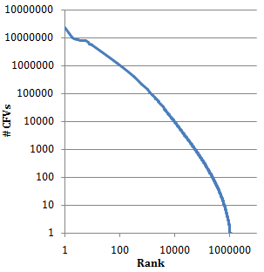
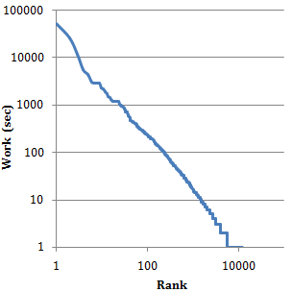
Preliminary Measurements
Distribution of number of CFVs per lemma is highly skewed.
Distribution of work per lemma is highly skewed as well.
How to schedule these jobs?
Min. #CFVs/lemma | 1
Max. #CFVs/lemma | 23.42 M
Min. work/lemma | 0.6 ms
Max. work/lemma | 14h 12m
Notes:
That said, we did some preliminary measurements and noticed that all is not done yet, mainly because the distribution of number of CFVs per lemma is highly skewed… Min #Cfvs or occurences per lemma is as low as 1 and as high as 23.42 M say for Michael or John.
and hence if we define work or a job as the time to disambiguate a batch of CFVs corresponding to a lemma
It turns out to be quite skewed as well.. With min. work/lemma being 0.6ms (we call such lemmas as cold)and the max being 14h and 12 mins. (we call such lemmas as hot)
This suggests that we might want to aggressively setup more disambiguation sites for such lemmas so as to distribute the load evenly…
So, the question that we face now is, what to put inside that scheduling logic black box, that we witnessed earlier.

Slide 14
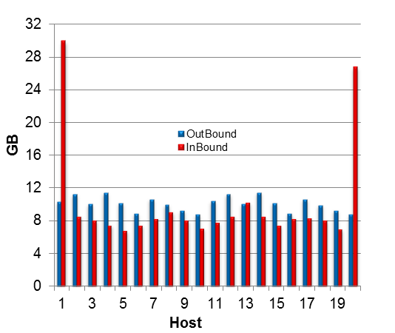
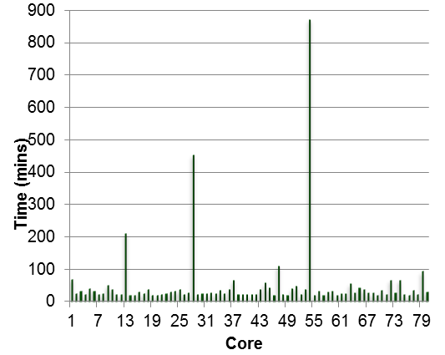
Greedy Scheduling: Performance
Job Completion Time (Only CPU): 14hours 32mins
Minimum time/host | 20m
Maximum time/host | 14h 32m
Avg. CPU Idle Time | 13h 41m
%CPU Idle Time | 94%
Maximum outgoing traffic/host | 11.50 GB
Minimum outgoing traffic/host | 8.80 GB
Maximum incoming traffic/host | 29.98 GB
Minimum incoming traffic/host | 6.83 GB
Notes:
So, we tried Greedy scheduling.. i.e. schedule jobs in decreasing order of their finish times…
And we got a job completion time of 14 hours and 32 mins… with over 94% CPU Idle time…
Look at the computation profile… And the sole reason being the skewed work distribution that we looked at.
Also note that, not only do we have a skew in computation, but also in communication..also because of the skewed distribution of #NoCFvs per lemma.
----
So, how does it perform… for 54 GB of corpus size… this approach takes 14hours and 32mins… that’s just the CPU time…totally neglecting the communication time… This performs even worse than the Bin Packing approach..which took around 6 hours… why is it so…read through the plot… so, the skewed work distribution lead to huge computation imbalance, giving us as much as 94% CPU idle time…
It’s not all over yet…not only do we have a huge computation imbalance but also huge communication imbalance…outbound communication is fairly balanced since the corpus has been striped randomly…but chunky lemma jobs lead to fairly imbalanced inbound communication profile as well…
So, key partitioning seems vital now…

Slide 15
Document
Spotter
Disambiguator 1
Reducer 1
Indexer
Annotations
Index
Mapper M
Spots
Feature
Extractor
Reducer 2
Disambiguator 2
Indexer
Annotations
Index
CFVs
Mapper M
Scheduling
Logic
Reducer 3
Disambiguator 3
Indexer
Annotations
Index
Mapper M
Sort &
Group
Reducer N
Disambiguator N
Indexer
Annotations
Index
Notes:
Most of you would have already figured out the MapReduce expression for this problem… But still for completeness…. Have a look at the animation..
So a mapper effectively will input a document and will transmit CFVs keyed by lemma id
And a reducer will load up a model corresponding to the key, and will disambiguate CFVs in batch and will emit out indexes.

Slide 16
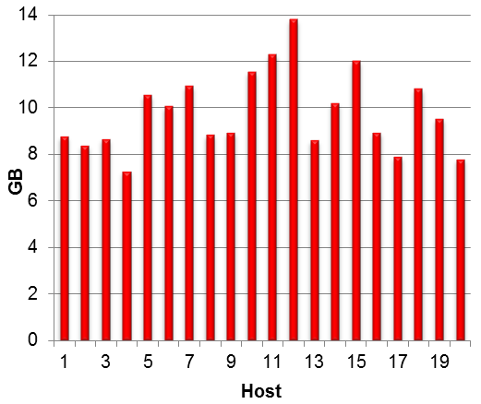
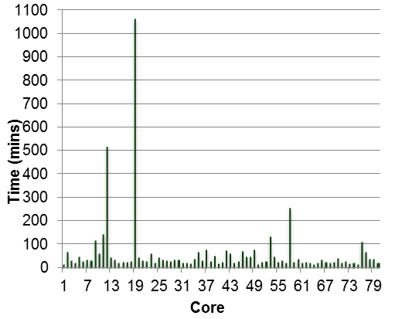
Vanilla Hadoop
Rely on Hadoop’s default key packing strategy:-
Job Completion Time: 20hours 19min
Min. time/reducer | 16mins
Max. time/reducer | 17h 44mins
Avg. CPU Idle Time | 16h 41mins
%CPU Idle Time | 82.12%
Minimum incoming traffic/host | 7.28 GB
Maximum incoming traffic/host | 13.79 GB
Is it possible to obtain better packing of jobs?
Notes:
So, how does this simple MR expression work…
We are basically relying on hadoop’s default key packing strategy (i.e. random allocation) for good load balance..
But we get almost similar computation and communication profiles… with as much as 82% CPU Idle time.
So the fundamental question that we need to answer now is .. Is it possible to obtain better packing of job?

Slide 17
Talk outline
Need to scale entity catalog
Cheap tricks that didn’t work
Overhauling code into map-reduce framework
  Skew problem (hot and cold lemmas)
  SkewTune: negligible improvement
  Mitigation via key splitting - replicate hot lemma models over multiple disambiguator hosts
Notes:
Repeat first 2 bullets..
Looked at the skew problem and a simple MR expression of the problem.
Now literature is full of skew mitigation techniques in Hadoop which try dynamic load balancing of keys.. We tried one such popular technique .. Skewtune..but we obtained negligible improvements mainly because of the fact that Skewtune doesn’t partition individual key.
So, it is quite obvious now that we’ll have to partition a key.
So, finally we mitigated skew by splitting up keys… which means replicating hot lemma models over multiple disambiguator hosts…
So, the main questions that needs to be answered are…which all keys to partition, how many partitions and how to schedule jobs.

Slide 18
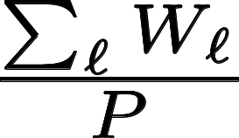




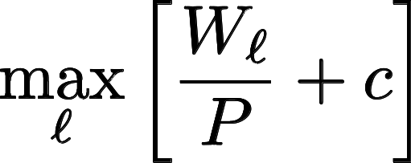
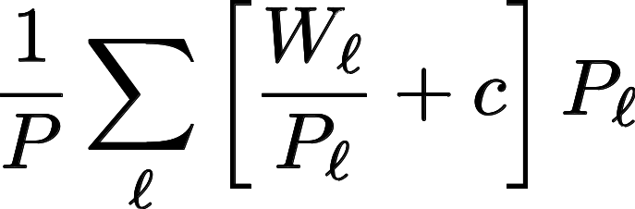
Scheduling objective
Total disambiguation
CPU work for lemma
Work for hottest lemma
Average work per CPU
Within a factor of 1 −1/P of optimal schedule
Split work of lemma into partitions
Scheduling overhead per partition = c
Avg work after
partitioning
Reduced
skew
+
How to select number of partitions for each lemma
  Approx algo with guarantee;
  All-or-One good in practice
Notes:
So we came up with a scheduling objective of our own :-
Infinitesimally
Both are lowesr bounds….
If there were no per-partition overhead, we could partition lemma work in an infinitely fine manner for “perfect” load balance…. About need for c
Fix the objective..division by PsubL
$$\frac{\sum_\ell W_\ell}{P}$$
\[ \max_\ell \left[ \frac{W_\ell}{P} + c \right] \]
\[ \frac{1}{P} \sum_\ell \left[ \frac{W_\ell}{P_\ell} + c \right] P_\ell \]

Slide 19
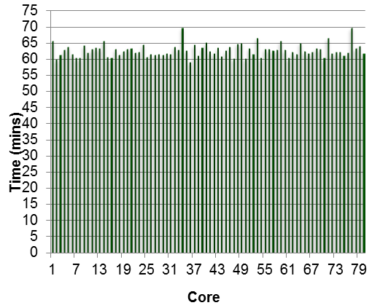
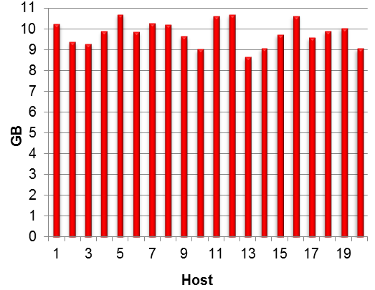
Custom Partitioner: Performance
Job Completion Time: 3hours 47mins
Min. time/reducer | 59mins
Max. time/reducer | 69mins
Avg. CPU Idle Time | 7mins
%CPU Idle Time | 3%
Maximum incoming traffic/host | 10.7 GB
Minimum incoming traffic/host | 8.65 GB
5.4x faster than standard Hadoop MR, and 5.2x faster than even Skewtune
Notes:
And we obtained a Job completion time of 3hours and 47 mins
With almost balanced computation and communication profile..
5.4 x …. 5.2 x

Slide 20
Generalization
Can be used for any application in general
  Sample data offline and obtain estimates of work.
  Add application specific costs to the objective.
  Optimize the objective to obtain optimal replication per key.
  Schedule greedily.
  Use partition function to implement the schedule.
Notes:
Read through…
Schedule greedily and store the schedule in a file … Which partition function will pick up later and will implement it.

Slide 21
Thank You
Notes:
Thank you for reading the Notes section as well! ;-)

