Slide 1
A Robust Color Video Watermarking Technique Using DWT, SVD and Frame Difference
GROUP - 16

Slide 2
INTRODUCTION
Digital Watermarking
What it is ?
Protection of copyright and ownership of digital assets
Why is it used?
To prevent unauthorised individuals from accessing content

Slide 3
BACKGROUND
Watermarking -
1. Host Signal
2. Watermark signal
Watermarking methods till now-
1. Spatial Domain
2. Transform Domain

Slide 4
BACKGROUND
Proposed method
Aim- To use a hybrid method which combines benefits of transforms like DWT , SVD along with making use of frame differences.
Instead of applying watermarking to all the frames , a random frame is selected to add the watermark. This leads to reduced embedding time.

Slide 5
PROPOSED ALGORITHMS

Slide 6
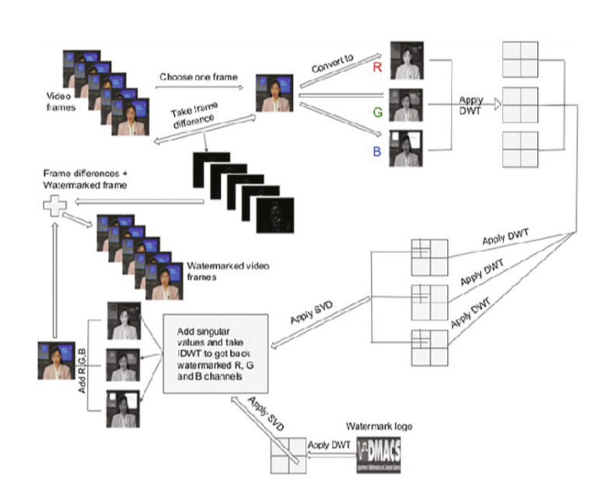
Embedding Algorithm

Slide 7
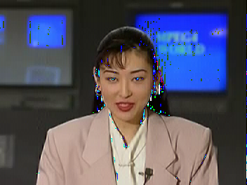
Embedding Algorithm: Output

Slide 8
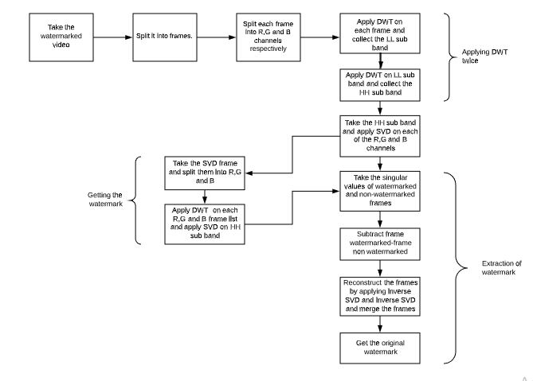
Extraction Algorithm

Slide 9

Extraction Algorithm: Output

Slide 10
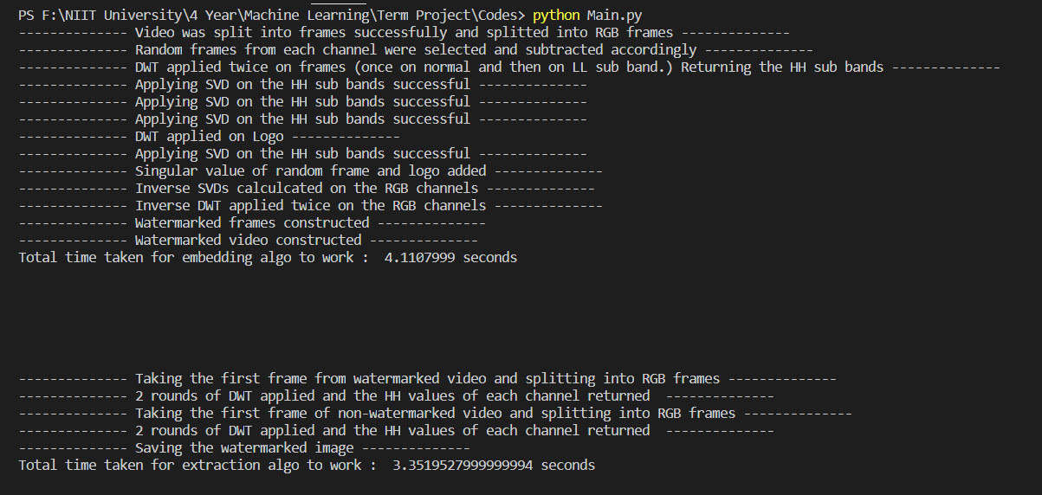
Notes:
Console output

Slide 11
EXPERIMENTS

Slide 12
Proposed Algorithm
Notes:
https://www.openstego.com/ - Read this

Slide 13
Steganography
What is Steganography?
Communicating in such a way that presence of a message cannot be detected.
Why Steganography?
Embedding Copyright Information within the document/image is harder to identify and remove.

Slide 14
USE CASES

Slide 15
Digital watermarking is used to protect propriety digital assets.
Copyright protection.
Video authentication.
Notes:
Propriety - conformity to conventionally accepted standards of behaviour or morals

Slide 16
Name | Enrollment Number | Work Done
Sourish Das | U101116FCS135 | Embedding algorithm, OpenStego Tool
Shruti Varghese | U101116FCS123 | Embedding algorithm, OpenStego Tool
Sreemoyee Nag | U101116FCS138 | Extraction algorithm, OpenStego Tool
Saloni Jain | U101116FCS107 | Extraction algorithm, OpenStego Tool

