Slide 1
WEALTHSCAPE REPORTING 2.0
Strategic recommendation for broker-dealer operating intelligence
A recommended path to evolve reporting into governed advisor productivity, supervision evidence, AI accountability, and retention insight.
Deliverable
Strategy and implementation path
Evidence: strategy packet; public market sources; prototype captures
01
Notes:
[Sources]
Internal strategy packet: Broker-Dealer Strategy Expansion Research Packet, July 2026.
Wealthscape Reporting 2.0 prototype captures, July 2026.
FINRA, 2026 Annual Regulatory Oversight Report and GenAI topic page.
SIFMA, 2025 Capital Markets Fact Book; communications-retention comment materials.
J.D. Power, 2026 U.S. Financial Advisor Satisfaction Study.
Fidelity Institutional, Wealth management trends for 2026.

Slide 2
WEALTHSCAPE REPORTING 2.0
Make Wealthscape the broker-dealer operating intelligence layer
Reporting becomes more valuable when it helps leaders govern risk, prove AI use, improve advisor productivity, and protect platform retention.
Govern risk
Prove AI use
Lift productivity
Protect retention
Prioritize supervision, communications, product, and branch issues by operating impact.
Attach policy status, source data, model context, review, and retention rationale.
Connect usage, blockers, support load, and next actions to daily advisor work.
Spot field friction before it becomes advisor movement or platform bypass.
Evidence: strategy packet; FINRA; SIFMA; J.D. Power
02
Notes:
[Sources]
Internal strategy packet: Broker-Dealer Strategy Expansion Research Packet, July 2026.
FINRA, 2026 Annual Regulatory Oversight Report and GenAI topic page.
SIFMA, 2025 Capital Markets Fact Book; communications-retention comment materials.
J.D. Power, 2026 U.S. Financial Advisor Satisfaction Study.

Slide 3
WEALTHSCAPE REPORTING 2.0
Market pressure has moved reporting from output to operating control
Fewer, larger broker-dealers are absorbing more complexity while AI, communications retention, and advisor expectations are all accelerating.
Broker-dealer scale
BD economics
AI adoption
Channel controls
3,249
$641B
2/3+
66%
FINRA-registered firms in 2024
gross revenues in 2024
wealth firms using or piloting GenAI
firms banning communications channels
Evidence: SIFMA; FINRA; Fidelity; Global Relay
03
Notes:
[Sources]
SIFMA, 2025 Capital Markets Fact Book; communications-retention comment materials.
FINRA, 2026 Annual Regulatory Oversight Report and GenAI topic page.
Fidelity Institutional, Wealth management trends for 2026.
Global Relay, Industry Insights 2026.

Slide 4
01 / Strategic Mandate
Wealthscape should become a governed operating system for broker-dealers
The strategic question is not whether the prototype works. It is what Fidelity should build, wrap, partner for, and measure.
Evidence: strategy packet; public source synthesis
04
Notes:
[Sources]
Internal strategy packet: Broker-Dealer Strategy Expansion Research Packet, July 2026.

Slide 5
WEALTHSCAPE REPORTING 2.0
The winning position is governed productivity
Wealthscape can differentiate by making advisor work faster only when supervision, data lineage, and client-ready evidence are visible.
Do not treat AI as a side feature; make its approval and evidence trail native to reporting.
Do not treat supervision as a back-office console; bring review state into the advisor and branch workflow.
Do not treat adoption as vanity analytics; use it as an early warning signal for friction and retention risk.
Evidence: strategy packet; FINRA GenAI; Fidelity trends
05
Notes:
[Sources]
Internal strategy packet: Broker-Dealer Strategy Expansion Research Packet, July 2026.
FINRA, 2026 Annual Regulatory Oversight Report and GenAI topic page.
Fidelity Institutional, Wealth management trends for 2026.

Slide 6
WEALTHSCAPE REPORTING 2.0
The strategy has four priority moves
Each move converts a broker-dealer pain point into an implementation-ready capability with a clear ownership model.
Capability
Operating problem
Implementation move
Call
AI evidence ledger
AI speed creates review, source, and auditability burden.
Build a ledger across narratives, reports, and advisor actions.
Build
Retention rationale
Archive status alone does not explain what must be retained.
Pair capture rails with reason codes and review state.
Wrap
Advisor telemetry
Field friction appears too late in support and attrition signals.
Instrument usage, blocker, training, AI quality, and exceptions.
Build
Team workbench
Branch and hybrid teams lose owner and escalation context.
Route exceptions by client impact, role, aging, and evidence.
Build
Evidence: strategy packet; FINRA; SIFMA; J.D. Power
06
Notes:
[Sources]
Internal strategy packet: Broker-Dealer Strategy Expansion Research Packet, July 2026.
FINRA, 2026 Annual Regulatory Oversight Report and GenAI topic page.
SIFMA, 2025 Capital Markets Fact Book; communications-retention comment materials.
J.D. Power, 2026 U.S. Financial Advisor Satisfaction Study.

Slide 7
WEALTHSCAPE REPORTING 2.0
Profiles define operating requirements
Home office, OSJ, and hybrid advisor teams define the control points Wealthscape must connect.
Home office
OSJ principal
Hybrid advisor team
Enterprise prioritization across risk, AI policy, platform adoption, support load, revenue impact, and advisor retention.
Local exception triage, coaching, escalation packet quality, and evidence completion across branch reps.
Client-ready reporting across brokerage, advisory, planning, suitability, disclosures, and team ownership.
Evidence: broker-dealer strategy packet
07
Notes:
[Sources]
Internal strategy packet: Broker-Dealer Strategy Expansion Research Packet, July 2026.

Slide 8
WEALTHSCAPE REPORTING 2.0
Build, wrap, and partner decisions should preserve Fidelity's control points
The strategy is to own workflow intelligence while using mature rails where the market already has regulated infrastructure.
Build
Wrap
Partner
Advisor telemetry, branch workbench, evidence ledger, and prioritization model.
Brokerage/advisory data, planning context, AI governance controls, and suitability state.
Communications capture, archive, surveillance, legal hold, and specialist vendor-risk monitoring.
Evidence: capability matrix; vendor public positioning
08
Notes:
[Sources]
Internal strategy packet: Broker-Dealer Strategy Expansion Research Packet, July 2026.
Global Relay, Industry Insights 2026.
Envestnet, R2 2026 platform announcements.
Addepar wealth management and AI/data/workflow positioning.

Slide 9
02 / Recommendation Detail
The strategic moves should become investment-ready workstreams
The next phase should fund capabilities, governance, data access, and pilot measures, not another prototype-only cycle.
Evidence: strategy packet; public source synthesis
09
Notes:
[Sources]
Internal strategy packet: Broker-Dealer Strategy Expansion Research Packet, July 2026.

Slide 10
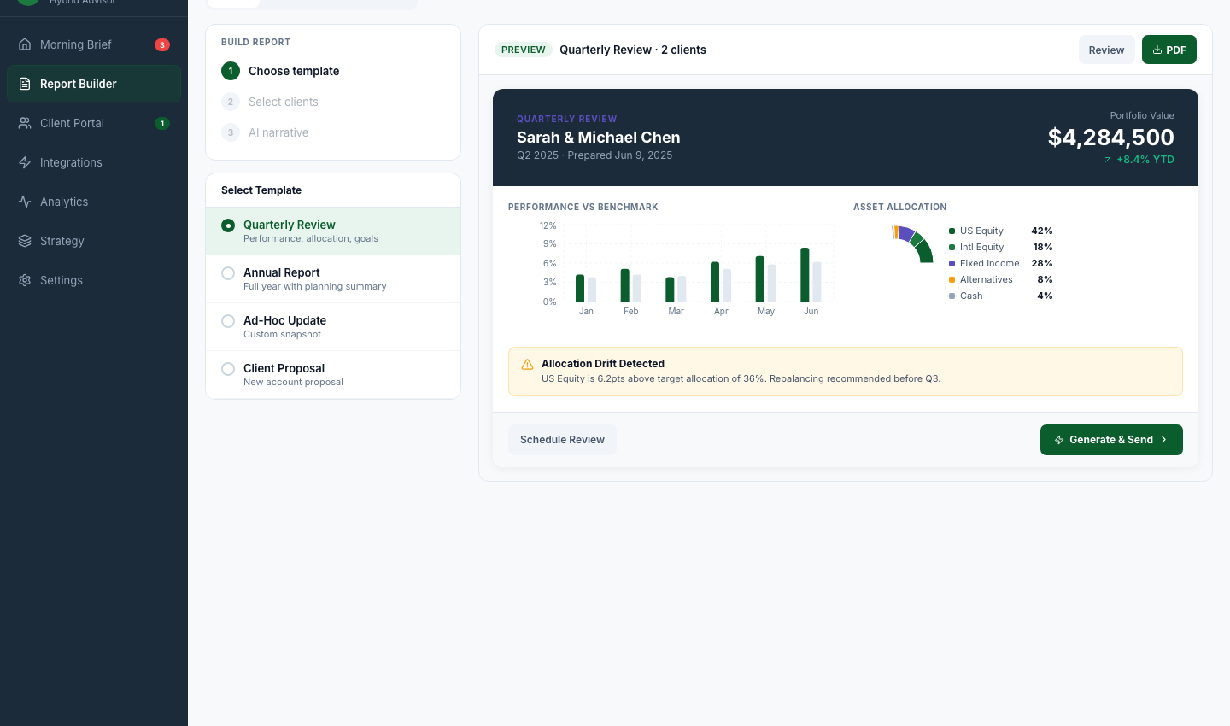
WEALTHSCAPE REPORTING 2.0
Workstream 1: AI evidence ledger
Make every AI-assisted report, summary, proposal support action, and future agent action explainable before it becomes client-ready.
Core capability
Operating owner
Success measure
Policy status, prompt lineage, source data, model/version, reviewer, artifact state.
Product, supervision, compliance, data governance, and advisor platform leadership.
Review cycle time, blocked-language rate, explainability coverage, advisor usage quality.
Illustrative proof only: policy-aware report flow
Evidence: FINRA GenAI; J.D. Power; strategy packet
10
Notes:
[Sources]
FINRA, 2026 Annual Regulatory Oversight Report and GenAI topic page.
J.D. Power, 2026 U.S. Financial Advisor Satisfaction Study.
Internal strategy packet: Broker-Dealer Strategy Expansion Research Packet, July 2026.
Wealthscape Reporting 2.0 prototype captures, July 2026.

Slide 11
WEALTHSCAPE REPORTING 2.0
Workstream 2: retention rationale layer
Move from archive visibility to decision-grade rationale: why an artifact is retained, excluded, pending review, or escalated.
Strategic role
Implementation path
Decision gate
Reduce ambiguity between client-facing evidence, operational noise, AI artifacts, and internal collaboration.
Partner for capture and archive rails; build rationale, reason codes, workflow state, and review packet UX.
Confirm regulated-source systems, retention policies, and exception ownership model.
Evidence: SIFMA retention materials; Global Relay 2026
11
Notes:
[Sources]
SIFMA, 2025 Capital Markets Fact Book; communications-retention comment materials.
Global Relay, Industry Insights 2026.
Internal strategy packet: Broker-Dealer Strategy Expansion Research Packet, July 2026.

Slide 12
WEALTHSCAPE REPORTING 2.0
Workstream 3: advisor productivity and retention telemetry
Treat platform usage, AI effectiveness, support load, blocker volume, and exception history as one management signal.
Employee advisors
Independent advisors
Management implication
632 -> 781
688 -> 826
AI quality is not only an efficiency metric. It is a retention, training, and platform-confidence signal.
satisfaction when firm AI is effective
satisfaction when firm AI is effective
Evidence: J.D. Power; Fidelity 2026 trends
12
Notes:
[Sources]
J.D. Power, 2026 U.S. Financial Advisor Satisfaction Study.
Fidelity Institutional, Wealth management trends for 2026.
Internal strategy packet: Broker-Dealer Strategy Expansion Research Packet, July 2026.

Slide 13
WEALTHSCAPE REPORTING 2.0
Workstream 4: team-aware exception workbench
Branch and hybrid teams need routed work with evidence, aging, client impact, policy dependency, and escalation state.
Triage
Coach
Escalate
Close
Rank by client impact, regulatory risk, aging, and dependency.
Identify repeated rep patterns and training needs.
Preserve owner, due date, source evidence, and home-office state.
Retain the resolution evidence and learning signal.
Evidence: strategy packet; FINRA 2026 AOR
13
Notes:
[Sources]
Internal strategy packet: Broker-Dealer Strategy Expansion Research Packet, July 2026.
FINRA, 2026 Annual Regulatory Oversight Report and GenAI topic page.

Slide 14
03 / Implementation Path
Implementation should fund the operating model, not the artifact
The prototype is useful as evidence. The next investment decision should be about capability ownership, data readiness, governance, and measured pilots.
Evidence: strategy packet; public source synthesis
14
Notes:
[Sources]
Internal strategy packet: Broker-Dealer Strategy Expansion Research Packet, July 2026.

Slide 15
WEALTHSCAPE REPORTING 2.0
The roadmap should sequence decision readiness before build scale
Leadership should approve the capability spine, source-system access, governance rules, and pilot cohorts before broad implementation.
0-30 days
31-90 days
3-6 months
6-12 months
Decision readiness: confirm executive owner, source systems, AI governance policy, retention taxonomy, and pilot profiles.
Capability foundation: build ledger schema, retention states, telemetry model, routing, and baseline measures.
Pilot release: test home-office, OSJ, and hybrid advisor workflows with governed AI review evidence.
Scale: integrate partner rails, expand data coverage, harden controls, and tie metrics to planning.
Evidence: strategy packet; implementation lane trail
15
Notes:
[Sources]
Internal strategy packet: Broker-Dealer Strategy Expansion Research Packet, July 2026.
Internal implementation trail: Broker-dealer strategy lanes and prototype PR sequence, July 2026.

Slide 16
WEALTHSCAPE REPORTING 2.0
The operating model needs named owners and measurable proof
A governed reporting strategy will fail if ownership stays split across product, compliance, data, supervision, and field enablement.
Executive steering
Pilot measures
Release gates
Advisor platform, compliance/supervision, data governance, AI governance, operations, and field leadership.
Review cycle time, evidence completeness, exception aging, advisor adoption quality, blocker resolution, retention watchlist movement.
Source access, policy approval, human-review workflow, partner-risk review, and production readiness.
Evidence: strategy packet; FINRA governance themes
16
Notes:
[Sources]
Internal strategy packet: Broker-Dealer Strategy Expansion Research Packet, July 2026.
FINRA, 2026 Annual Regulatory Oversight Report and GenAI topic page.

Slide 17
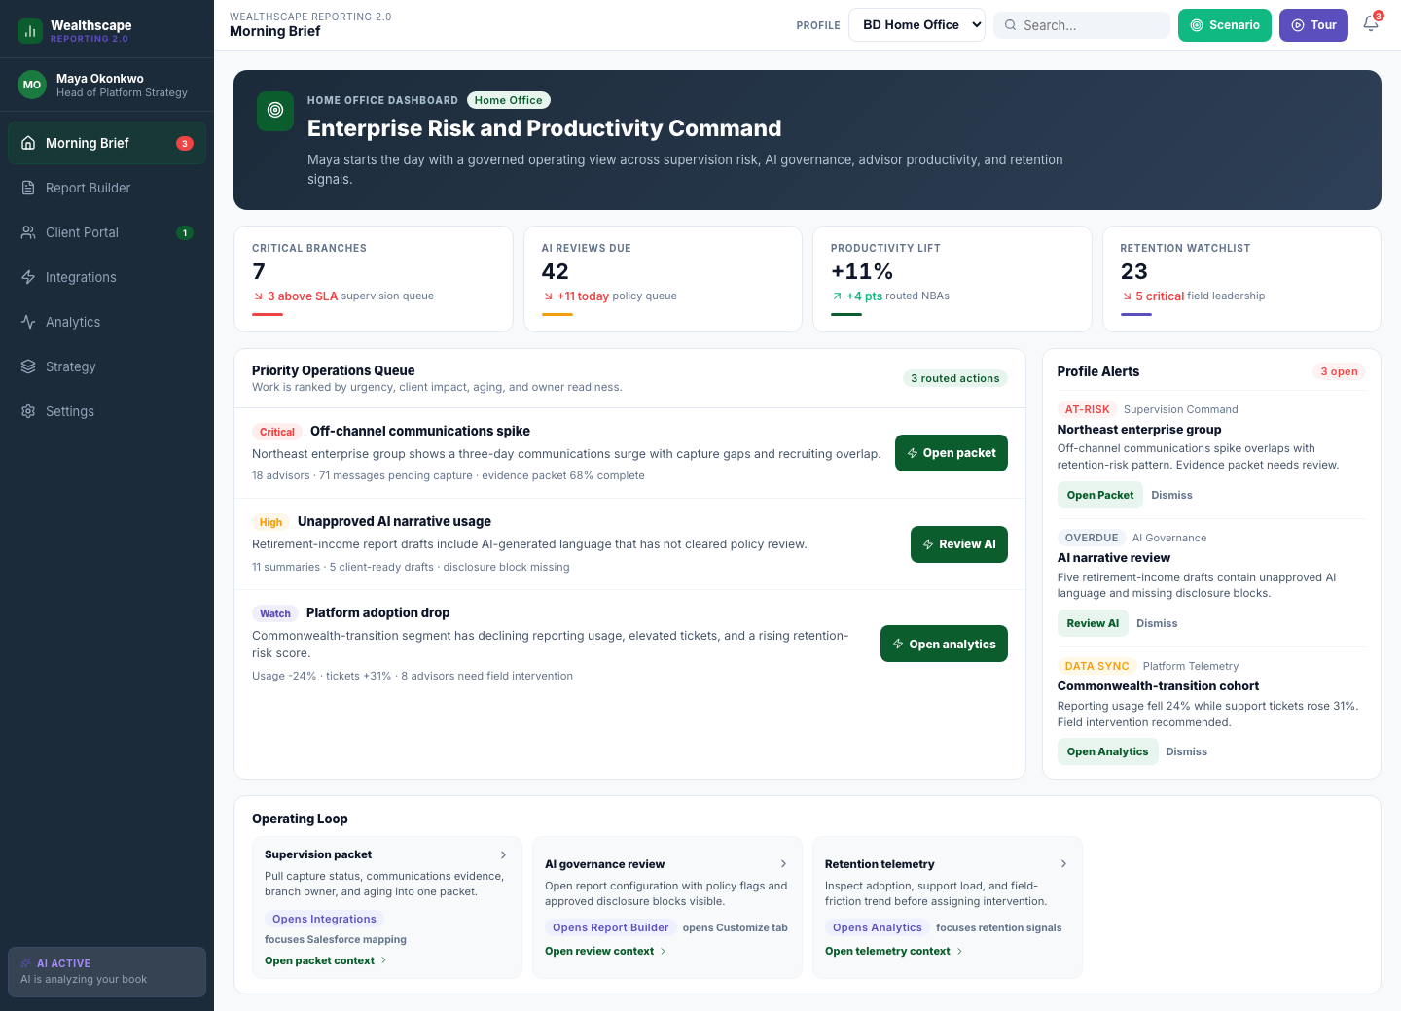
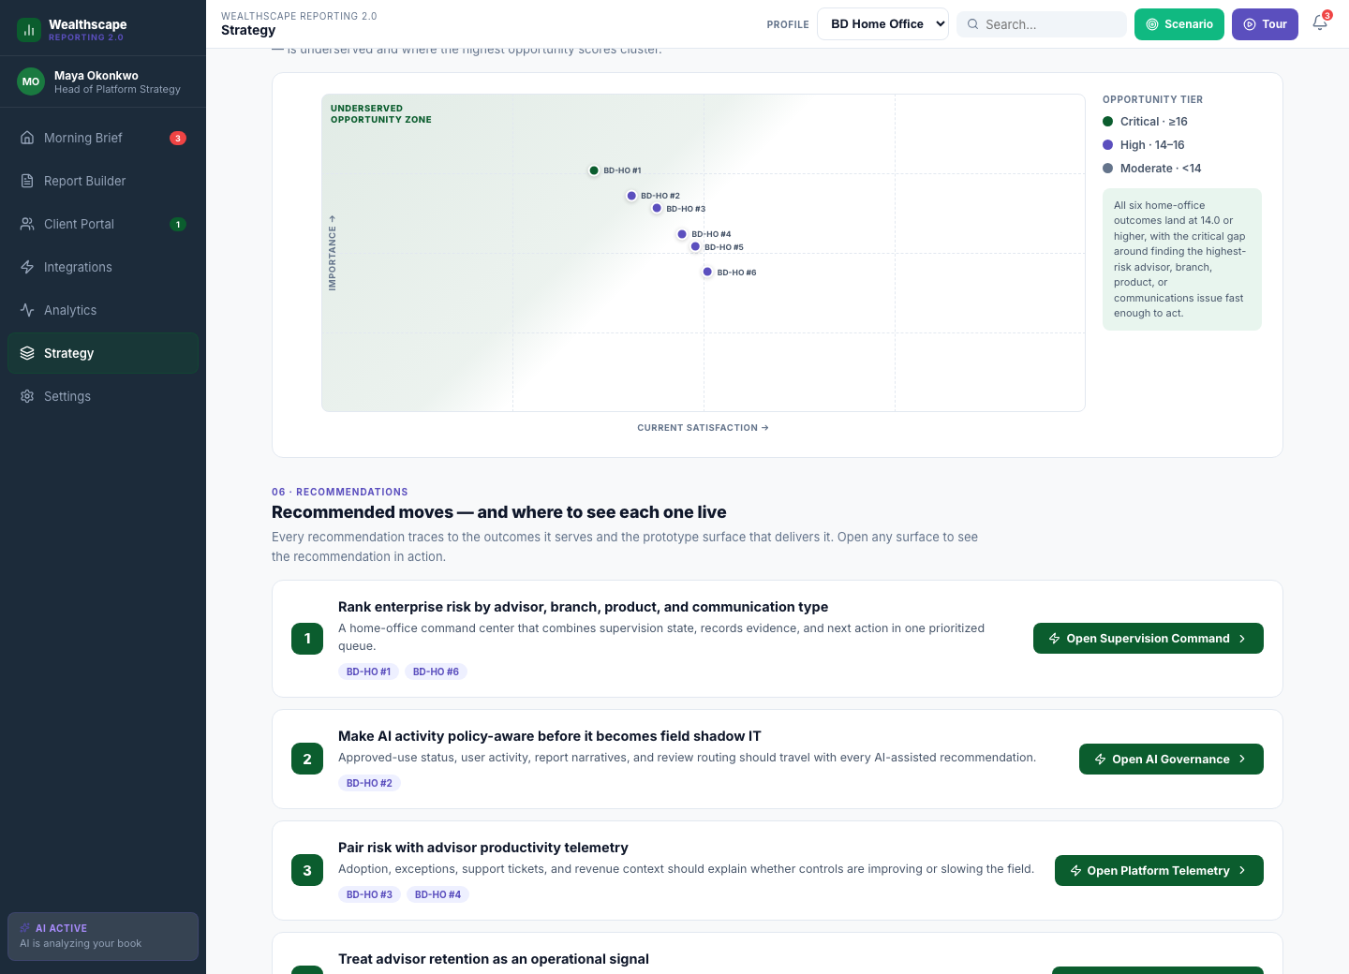
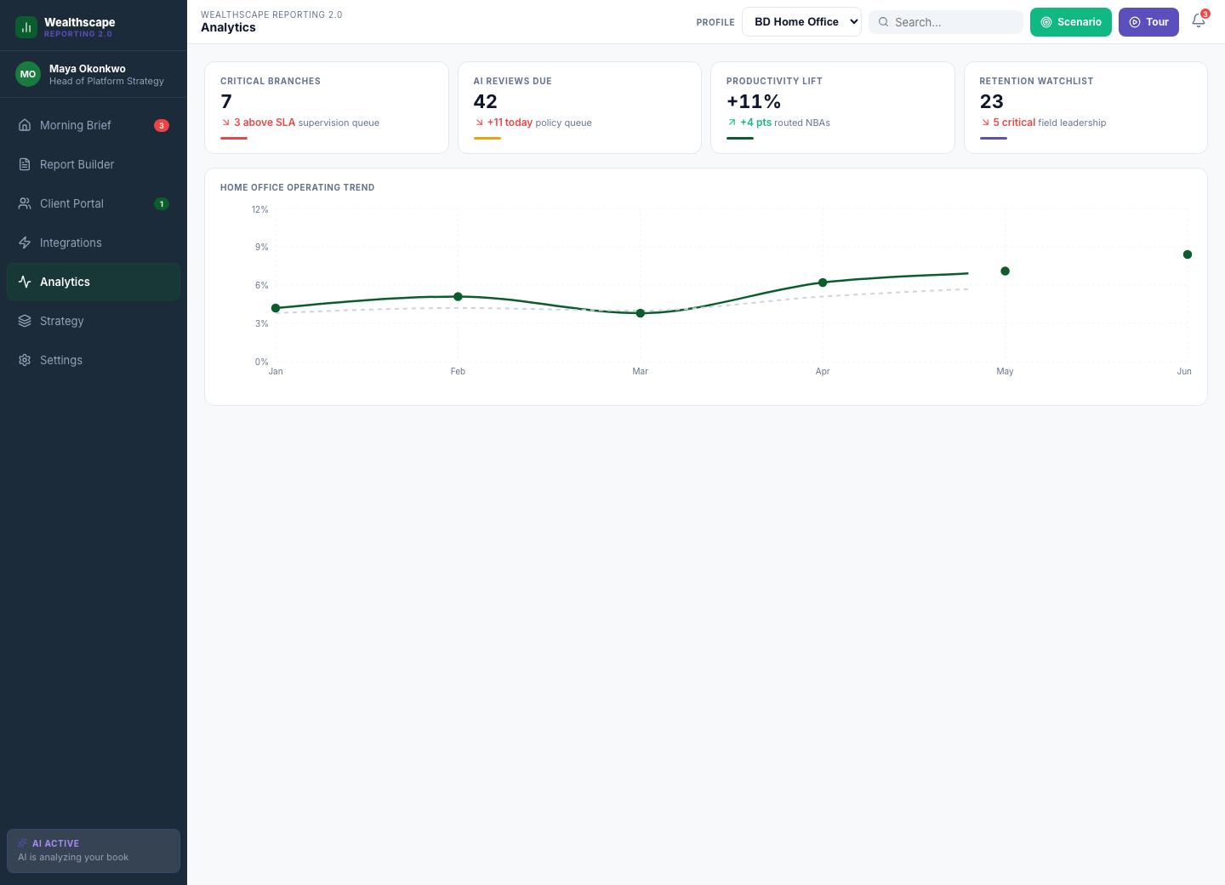
WEALTHSCAPE REPORTING 2.0
Prototype evidence should support strategy, not lead it
Use the prototype to make the recommendation tangible, then return the discussion to investment decisions.
Telemetry example
Command layer example
Strategy-link example
Evidence: prototype captures; strategy packet
17
Notes:
[Sources]
Wealthscape Reporting 2.0 prototype captures, July 2026.
Internal strategy packet: Broker-Dealer Strategy Expansion Research Packet, July 2026.

Slide 18
WEALTHSCAPE REPORTING 2.0
Bibliography and evidence base
Public sources
- FINRA 2026 Annual Regulatory Oversight Report
- FINRA GenAI topic page
- SIFMA 2025 Capital Markets Fact Book
- J.D. Power 2026 U.S. Financial Advisor Satisfaction Study
- Global Relay Industry Insights 2026
- Fidelity Institutional wealth management trends for 2026
- Envestnet R2 2026 platform announcement
- Envestnet AI explainability announcement
- Addepar for Wealth Management
- Addepar AI/data/workflow positioning
Internal and prototype evidence
- Broker-dealer strategy expansion packet
- Strategy lane prompts and implementation trail
- Wealthscape Reporting 2.0 prototype screenshots
Evidence: bibliography compiled July 30, 2026
18
Notes:
[Sources]
FINRA 2026 Annual Regulatory Oversight Report: https://www.finra.org/rules-guidance/guidance/reports/2026-finra-annual-regulatory-oversight-report
FINRA GenAI topic page: https://www.finra.org/rules-guidance/guidance/reports/2026-finra-annual-regulatory-oversight-report/gen-ai
SIFMA 2025 Capital Markets Fact Book: https://www.sifma.org/research/statistics/fact-book
J.D. Power 2026 U.S. Financial Advisor Satisfaction Study: https://www.jdpower.com/business/press-releases/2026-u-s-financial-advisor-satisfaction-study/
Global Relay Industry Insights 2026: https://www.globalrelay.com/resources/guides-reports/industry-insights-2026/
Fidelity Institutional wealth management trends for 2026: https://clearingcustody.fidelity.com/insights/topics/running-your-business/wealth-management-trends-for-2026
Envestnet R2 2026 platform announcement: https://newsroom.envestnet.com/2026-05-19-LIVE-FROM-ELEVATE-2026-Envestnet-Unveils-AI-Driven-Enhancements-and-Accelerates-Financial-Planning-Integration-for-Advisors-on-its-Wealth-Management-Platform
Envestnet AI explainability announcement: https://newsroom.envestnet.com/2026-05-19-Envestnet-Enhances-Wealth-Data-Platform-with-New-AI-Explainability%2C-Workflow-Explainability%2C-and-Advisor-Decisioning-Capabilities-at-Elevate-2026
Addepar for Wealth Management: https://addepar.com/wealth-management
Addepar AI/data/workflow positioning: https://www.prnewswire.com/news-releases/addepar-advances-its-ai-innovation-across-agents-data-and-workflow-capabilities-302779567.html
Internal strategy packet: Broker-Dealer Strategy Expansion Research Packet, July 2026.
Internal implementation trail: Broker-dealer strategy lanes and prototype PR sequence, July 2026.
Wealthscape Reporting 2.0 prototype captures, July 2026.

