Slide 1
CSC 381/481
Quarter: Fall 2013
Daniela Stan Raicu
Email: draicu@cs.depaul.edu
Homepage: http://facweb.cs.depaul.edu/dstan
School of Computing, DePaul University
Daniela Stan - CSC381/481

Slide 2
Outline
Chapter 2: Digital Image Fundamentals
  Section 2.4: Image sampling and quantization
    Basic concepts
    Representing digital images
    Spatial and gray-level resolution
  Section 2.5: Some basic relationships between pixels
    Neighbors of a pixel
    Adjacency, connectivity, regions, and boundaries
    Distance measures
  Section 2.6.5: Some basic relationships between pixels
    Image operations on a pixel basis
Summary of the algebra review from Lecture 1
MatLab tutorial
Daniela Stan - CSC381/481

Slide 3
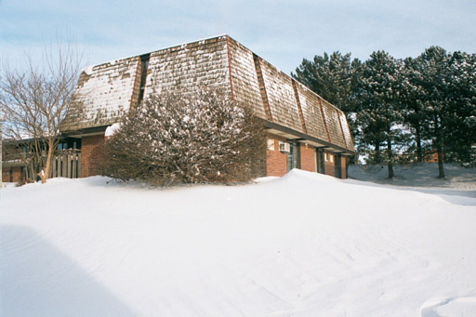
Fundamentals of Digital Images
x
Origin
y
Image “After snow storm”
f(x,y)
⬥ An image: a multidimensional function of spatial coordinates.
⬥ Spatial coordinate: (x,y) for 2D case such as photograph,
(x,y,z) for 3D case such as CT scan images
(x,y,t) for movies
⬥ The function f may represent intensity (for monochrome images)
or color (for color images) or other associated values.
Daniela Stan - CSC381/481

Slide 4
Digital Images
Digital image: an image that has been discretized both in spatial coordinates and associated value.
 Consist of 2 sets:(1) a point set and (2) a value set
 Can be represented in the form
I = {(pos,a(pos)): pos ∈X, a(pos) ∈ F}
where X and F are a point set and value set, respectively.
 An element of the image, (pos,a(pos)) is called a pixel where
- pos is called the pixel location and
- a(pos) is the pixel value at the location pos
Daniela Stan - CSC381/481

Slide 5
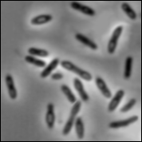
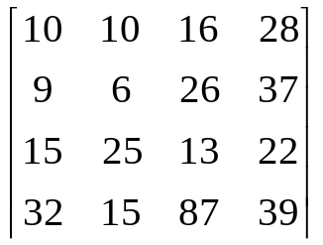
Image Types
Intensity image or monochrome image:
each pixel corresponds to light intensity
normally represented in gray scale (gray
level).
Gray scale values
Daniela Stan - CSC381/481

Slide 6
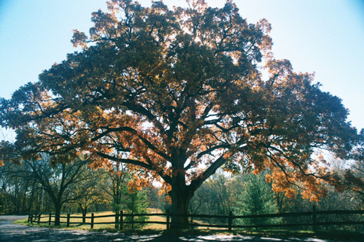
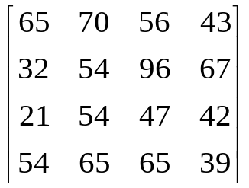
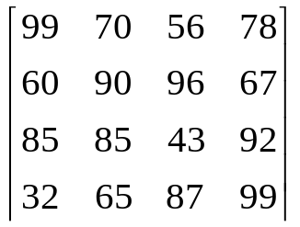
Image Types
Color image or RGB image:
each pixel contains a vector
representing red, green and
blue components.
RGB components
Daniela Stan - CSC381/481

Slide 7

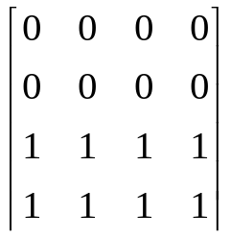
Image Types
Binary image or black and white image
Each pixel contains one bit :
1 represent white
0 represents black
Binary data
Daniela Stan - CSC381/481

Slide 8
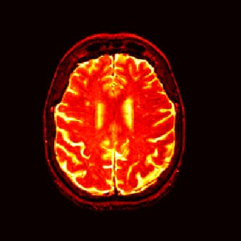
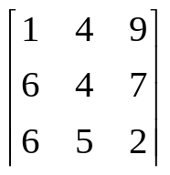
Image Types
Index image
Each pixel contains index number
pointing to a color in a color table
Color Table
Index No. | Red component | Green component | Blue component
1 | 0.1 | 0.5 | 0.3
2 | 1.0 | 0.0 | 0.0
3 | 0.0 | 1.0 | 0.0
4 | 0.5 | 0.5 | 0.5
5 | 0.2 | 0.8 | 0.9
… | … | … | …
Index value
Daniela Stan - CSC381/481

Slide 9
Image Sampling
Image sampling: discretize an image in the spatial domain
Spatial resolution / image resolution:
pixel size or number of pixels
Daniela Stan - CSC381/481

Slide 10
How to choose the spatial resolution
Spatial resolution
= Sampling locations
Original image
Sampled image
Under sampling, we lost some image details!
Daniela Stan - CSC381/481

Slide 11
How to choose the spatial resolution :
Nyquist Rate
Sampled image
Original image
2mm
1mm
No detail is lost!
Minimum
Period
Nyquist Rate:
Spatial resolution must be less or equal
half of the minimum period of the image
or sampling frequency must be greater or
equal twice of the maximum frequency.
Spatial resolution
(sampling rate)
= Sampling locations
Daniela Stan - CSC381/481

Slide 12
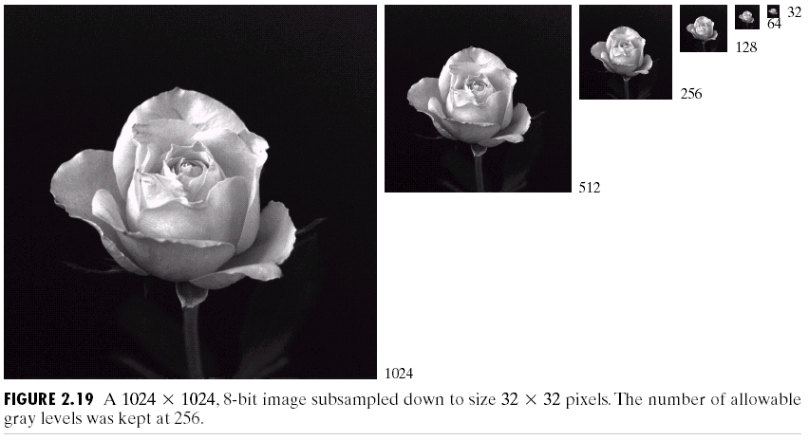
Effect of Spatial Resolution
Daniela Stan - CSC381/481

Slide 13
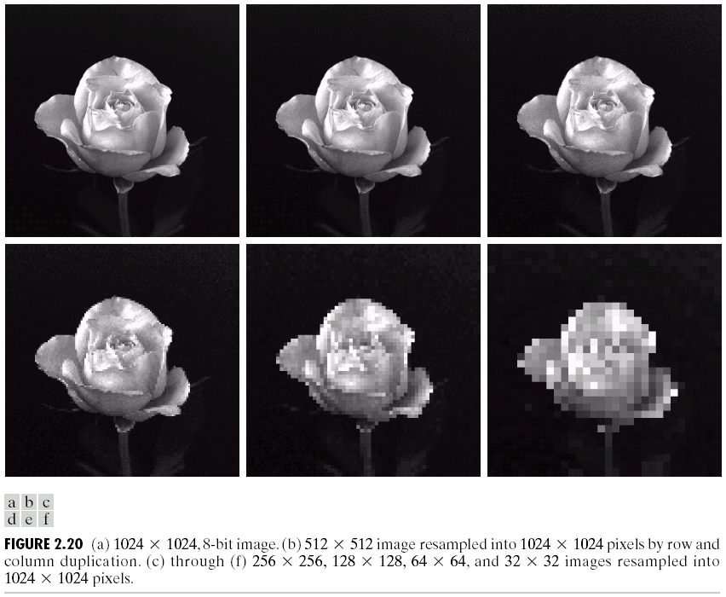
Effect of Spatial Resolution
Daniela Stan - CSC381/481

Slide 14
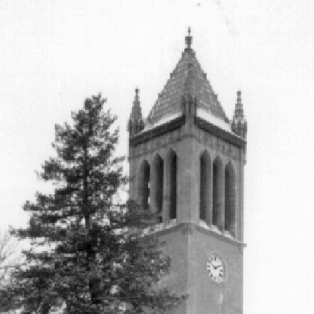
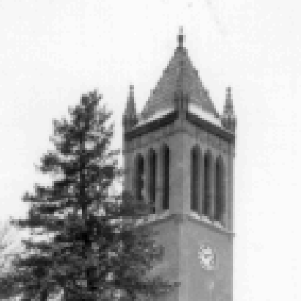

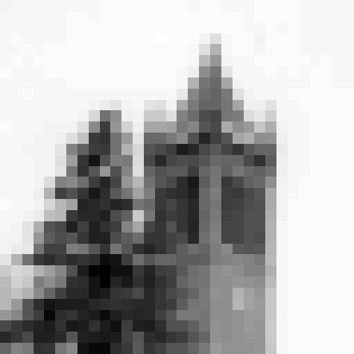
Effect of Spatial Resolution
Down sampling
is an irreversible
process.
256x256 pixels
128x128 pixels
64x64 pixels
32x32 pixels
Daniela Stan - CSC381/481

Slide 15
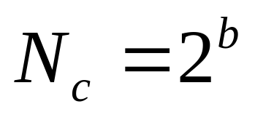
Image Quantization
Image quantization:
discretize continuous pixel values into discrete numbers
Color resolution/ color depth/ levels:
- No. of colors or gray levels or
- No. of bits representing each pixel value
- No. of colors or gray levels N_{c} is given by
where b = no. of bits
Daniela Stan - CSC381/481

Slide 16
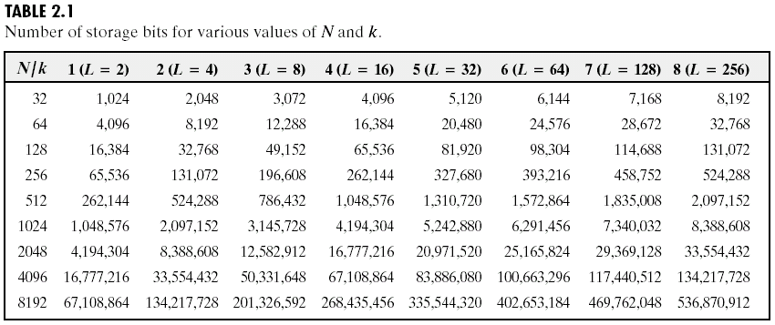
Image Quantization
The number of bits required to store a digitized image of
size M by N and having L=2^{k} (Nc from the previous slide) gray
levels is equal to M *n*k.
Daniela Stan - CSC381/481

Slide 17
Image Quantization :
Quantization function
N_{c}-1
N_{c}-2
Quantization level
The example shows
that perceived brightness
is not a simple function
of the intensity.
2
1
0
Light intensity
Darkest
Brightest
Daniela Stan - CSC381/481

Slide 18



Effect of Quantization Levels
256 levels
128 levels
64 levels
32 levels
Daniela Stan - CSC381/481

Slide 19




Effect of Quantization Levels (cont.)
16 levels
8 levels
In this image,
it is easy to see
false contouring:
this effect is caused by
insufficient number of
gray levels in smooth
areas of a digital image.
4 levels
2 levels
Daniela Stan - CSC381/481

Slide 20

Effect of Quantization Levels (cont.)
Daniela Stan - CSC381/481

Slide 21

Effect of Quantization Levels (cont.)
Daniela Stan - CSC381/481

Slide 22
Basic relationship between pixels
(0,0)
x
(x-1,y-1)
(x,y-1)
(x+1,y-1)
(x-1,y)
(x,y)
(x+1,y)
y
(x-1,y+1)
(x,y+1)
(x+1,y+1)
Conventional indexing method
Daniela Stan - CSC381/481

Slide 23
Neighbors of a Pixel
Neighborhood relation is used to tell adjacent pixels. It is
useful for analyzing regions.
4-neighbors of p:
(x,y-1)
(x−1,y)
(x+1,y)
(x,y−1)
(x,y+1)
(x-1,y)
p
(x+1,y)
N₄(p) =
(x,y+1)
4-neighborhood relation considers only vertical and
horizontal neighbors.
Note: q ∈ N₄(p) implies p ∈ N₄(q)
Daniela Stan - CSC381/481

Slide 24
Neighbors of a Pixel (cont.)
8-neighbors of p:
(x-1,y-1)
(x,y-1)
(x+1,y-1)
(x−1,y−1)
(x,y−1)
(x+1,y−1)
(x−1,y)
(x+1,y)
(x−1,y+1)
(x,y+1)
(x+1,y+1)
(x-1,y)
p
(x+1,y)
(x-1,y+1)
(x,y+1)
(x+1,y+1)
N₈(p) =
8-neighborhood relation considers all neighbor pixels.
Daniela Stan - CSC381/481

Slide 25
Neighbors of a Pixel (cont.)
Diagonal neighbors of p:
(x-1,y-1)
(x+1,y-1)
(x−1,y−1)
(x+1,y−1)
(x−1,y+1)
(x+1,y+1)
p
N_{D}(p) =
(x-1,y+1)
(x+1,y+1)
Diagonal -neighborhood relation considers only diagonal
neighbor pixels.
Daniela Stan - CSC381/481

Slide 26

Connectivity and Pixels’ Adjacency
Connectivity is adapted from neighborhood relation.
Two pixels are adjacent if they are in the same class (i.e. the
same color or the same range of intensity) and they are
neighbors of one another.
For p and q from the same class
⬥ 4-adjacency: p and q are 4-adjacent if q ∈ N₄(p)
⬥ 8-adjacency: p and q are 8-adjacent if q ∈ N₈(p)
⬥ mixed-adjacency (m-adjacency):
p and q are m-adjacent if q ∈ N₄(p) or
(q ∈ N_{d}(p) and N₄(p) ∩ N₄(q) =∅)
Daniela Stan - CSC381/481

Slide 27
Adjacency
Two image subsets S₁ and S₂ are adjacent if some pixel
in S₁ is adjacent to some pixel in S₂
S₁
S₂
We can define type of adjacency: 4-adjacency, 8-adjacency
or m-adjacency depending on type of connectivity.
Daniela Stan - CSC381/481

Slide 28
Path
A path from pixel p at (x,y) to pixel q at (s,t) is a sequence
of distinct pixels:
(x₀,y₀), (x₁,y₁), (x₂,y₂),…, (x_{n},y_{n})
such that
(x₀,y₀) = (x,y) and (x_{n},y_{n}) = (s,t)
and
(x_{i},y_{i}) is adjacent to (x_{i-1},y_{i-1}), i = 1,…,n
q
p
We can define type of path: 4-path, 8-path or m-path
depending on type of adjacency.
Daniela Stan - CSC381/481

Slide 29
Path (cont.)
8-path
m-path
p
p
p
q
q
q
m-path from p to q
solves this ambiguity
8-path from p to q
results in some ambiguity
Two pixels are connected in S if there is a path between them
consisting entirely of pixels in S.
Daniela Stan - CSC381/481

Slide 30
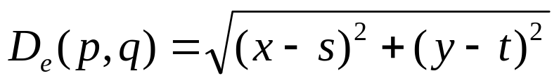
Distance
For pixel p, q, and z with coordinates (x,y), (s,t) and (u,v),
D is a distance function or metric if
⬥ D(p,q) ≥ 0 (D(p,q) = 0 if and only if p = q)
⬥ D(p,q) = D(q,p)
⬥ D(p,z) ≤ D(p,q) + D(q,z)
Example: Euclidean distance
Daniela Stan - CSC381/481

Slide 31
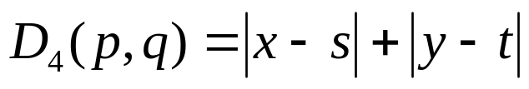
Distance (cont.)
D₄-distance (city-block distance) is defined as
2
2
1
2
2
1
0
1
2
2
1
2
2
Pixels with D₄(p) = 1 are the 4-neighbors of p.
Daniela Stan - CSC381/481

Slide 32
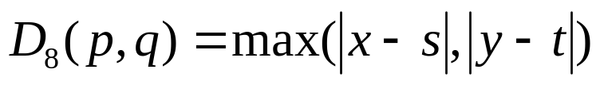
Distance (cont.)
D₈-distance (chessboard distance) is defined as
2
2
2
2
2
2
1
1
1
2
2
1
0
1
2
2
1
1
1
2
2
2
2
2
2
Pixels with D₈(p) = 1 are the 8-neighbors of p.
Daniela Stan - CSC381/481

Slide 33
Template, Window, & Mask Operation
Sometime we need to manipulate values obtained from
neighboring pixels
Example: How can we compute an average value of pixels
in a 3x3 region center at a pixel z?
Pixel z
2
4
1
2
6
2
9
2
3
4
4
4
7
2
9
7
6
7
5
2
3
6
1
5
7
4
2
5
1
2
2
5
2
3
2
8
Image
Daniela Stan - CSC381/481

Slide 34
Template, Window, and
Mask Operation (cont.)
Step 1. Selected only needed pixels
Pixel z
2
4
1
2
6
2
…
9
2
3
4
4
4
3
4
4
7
2
9
7
6
7
…
9
7
6
…
5
2
3
6
1
5
3
6
1
7
4
2
5
1
2
…
2
5
2
3
2
8
Daniela Stan - CSC381/481

Slide 35
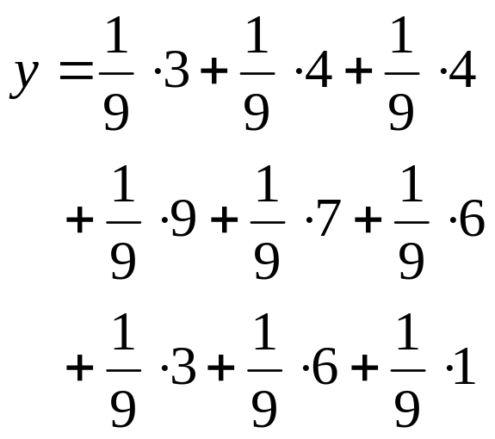

Template, Window, and
Mask Operation (cont.)
Step 2. Multiply every pixel by 1/9 and then sum up the values
…
3
4
4
…
9
7
6
…
3
6
1
…
X
1
1
1
Mask or
Window or
Template
1
1
1
1
1
1
Daniela Stan - CSC381/481

Slide 36
Template, Window, and
Mask Operation (cont.)
Question: How to compute the 3x3 average value at every pixel?
Solution: Imagine that we have
a 3x3 window that can be placed
everywhere on the image
2
4
1
2
6
2
9
2
3
4
4
4
7
2
9
7
6
7
5
2
3
6
1
5
7
4
2
5
1
2
Masking Window
Daniela Stan - CSC381/481

Slide 37
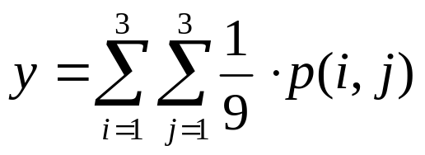
Template, Window, and
Mask Operation (cont.)
Step 1: Move the window to the first location where we want to
compute the average value and then select only pixels
inside the window.
2
4
1
2
6
2
2
4
1
Step 2: Compute
the average value
9
2
3
4
4
4
9
2
3
7
2
9
7
6
7
7
2
9
5
2
3
6
1
5
Sub image p
7
4
2
5
1
2
Step 3: Place the
result at the pixel
in the output image
Original image
4.3
Step 4: Move the
window to the next
location and go to Step 2
Daniela Stan - CSC381/481
Output image

Slide 38
Template, Window, and
Mask Operation (cont.)
The 3x3 averaging method is one example of the mask
operation or Spatial filtering.
⬥ The mask operation has the corresponding mask (sometimes
called window or template).
⬥ The mask contains coefficients to be multiplied with pixel
values.
Example : moving averaging
w(1,1)
w(2,1)
w(3,1)
1
1
1
w(1,2)
w(2,2)
w(3,2)
1
1
1
w(1,3)
w(2,3)
w(3,3)
1
1
1
Mask coefficients
The mask of the 3x3 moving average
filter has all coefficients = 1/9
Daniela Stan - CSC381/481

Slide 39
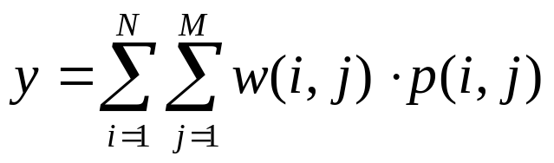
Template, Window, and
Mask Operation (cont.)
The mask operation at each point is performed by:
1. Move the reference point (center) of mask to the
location to be computed
2. Compute sum of products between mask coefficients
and pixels in subimage under the mask.
…
Mask frame
p(1,1)
p(2,1)
p(3,1)
w(1,1)
w(2,1)
w(3,1)
…
p(1,2)
p(2,2)
p(3,2)
…
w(1,2)
w(2,2)
w(3,2)
p(1,3)
p(2,3)
p(3,3)
w(1,3)
w(2,3)
w(3,3)
…
Mask coefficients
Subimage
The reference point
of the mask
Daniela Stan - CSC381/481

Slide 40
Template, Window, and
Mask Operation (cont.)
The mask operation on the whole image is given by:
Move the mask over the image at each location.
Compute sum of products between the mask coefficients
and pixels inside sub-image under the mask.
Store the results at the corresponding pixels of the
output image.
Move the mask to the next location and go to step 2
until all pixel locations have been used.
Daniela Stan - CSC381/481

Slide 41
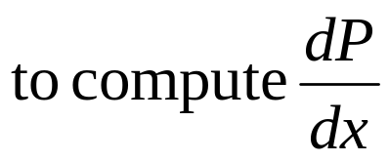
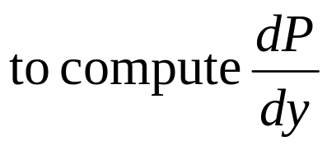
Template, Window,
and Mask Operation (cont.)
Examples of the masks
Sobel operators
3x3 moving average filter
-1
0
1
-1
-2
-1
1
1
1
-2
0
2
0
0
0
1
1
1
-1
0
1
1
2
1
1
1
1
3x3 sharpening filter
-1
-1
-1
-1
8
-1
-1
-1
-1
Daniela Stan - CSC381/481

Slide 42
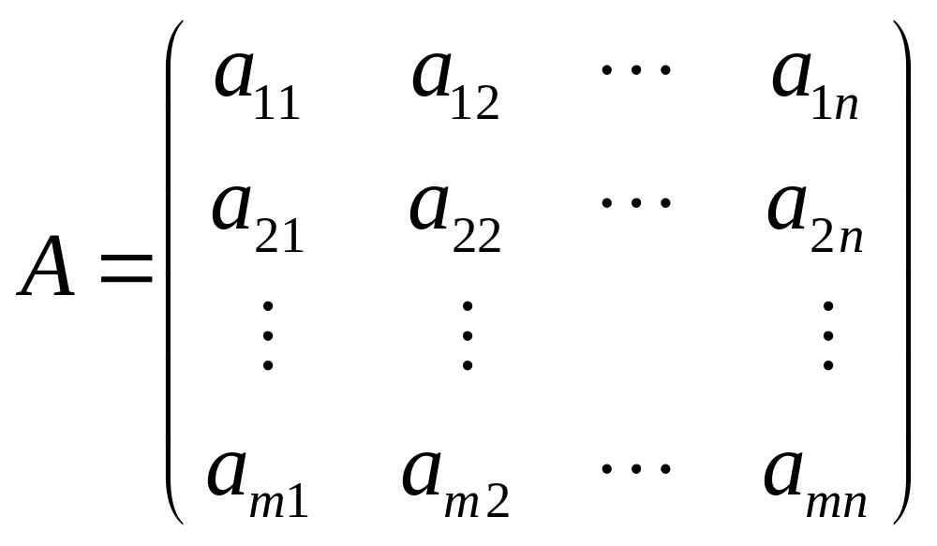
Matrix Algebra Review
A = (a_{ij}) is a matrix of size (A)=m by n,
where m=#of rows, n=#of columns
Daniela Stan - CSC381/481

Slide 43
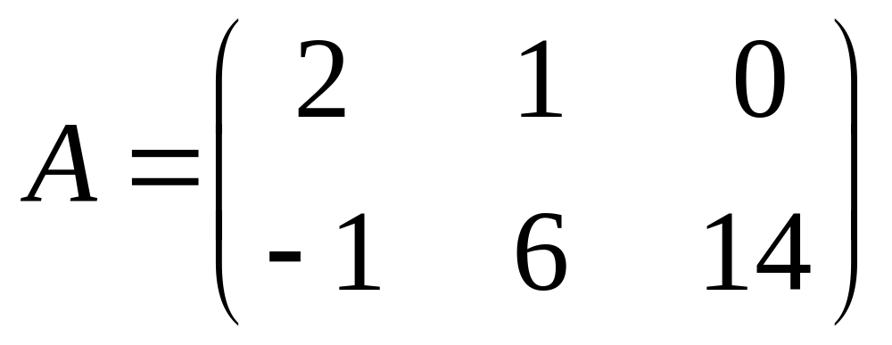
Matrix: Example
Size: 2x3
Example
  a₁₁ = 2
  a₂₁ = -1
  a₁₃ = 0
Daniela Stan - CSC381/481

Slide 44
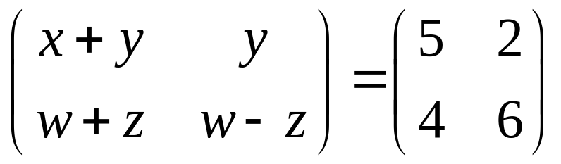
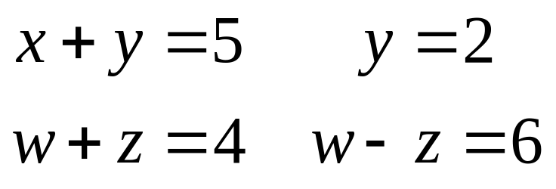
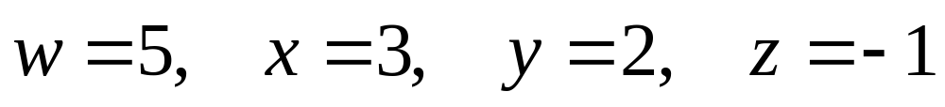
Matrix Equality
Two matrices A and B are equal: A = B
  Same size
  Corresponding entries are equal
  Example:
The matrices are equal if:
Therefore:
Daniela Stan - CSC381/481

Slide 45
Matrix Sum
Let A = (a_{ij}) and B = (b_{ij}) be two m by n matrices
Sum of A and B
  A + B = (a_{ij} + b_{ij})
The scalar product of a number c and a matrix A=(a_{ij})
  cA = (ca_{ij})
If A and B are matrices
  -A = (-1)A
  A - B = A + (-B)
Daniela Stan - CSC381/481

Slide 46
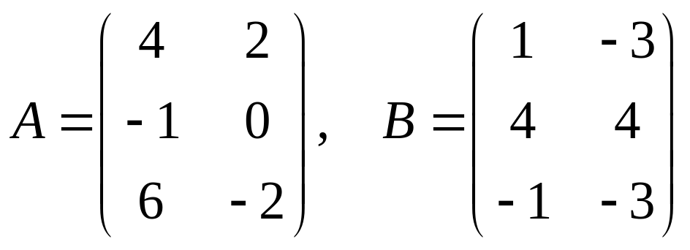
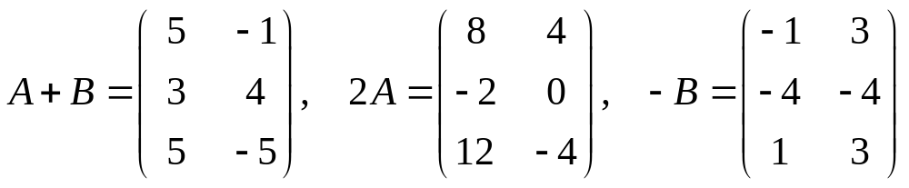
Matrix Sum
Example: If
Then
Daniela Stan - CSC381/481

Slide 47
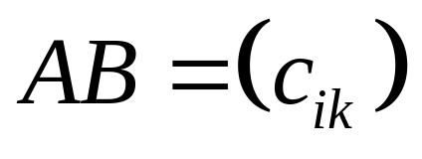
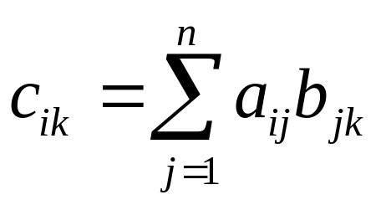
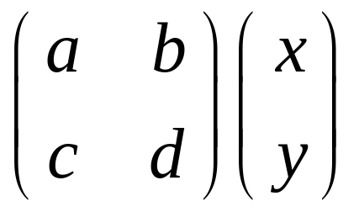
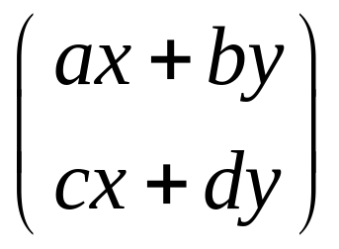

Matrix Product
Let A = (a_{ij}) be an m x n matrix and let B = (b_{jk}) be an n x l matrix
Where
The matrix product:
Daniela Stan - CSC381/481

Slide 48
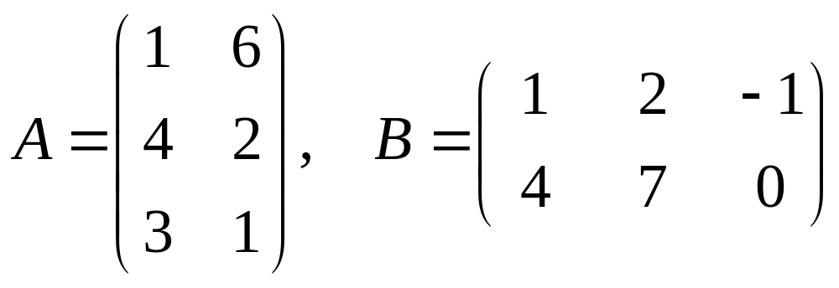
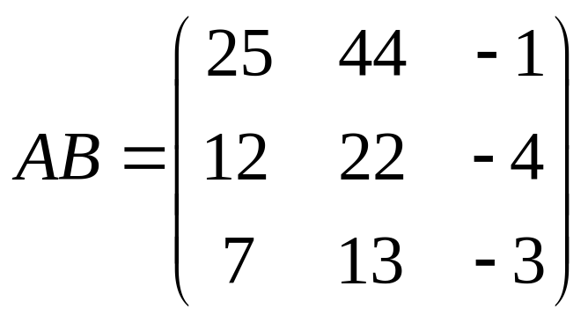
Matrix Product: Example
Let
The matrix product of A*B
Daniela Stan - CSC381/481

Slide 49
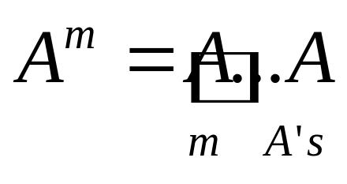
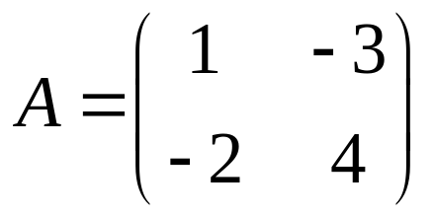
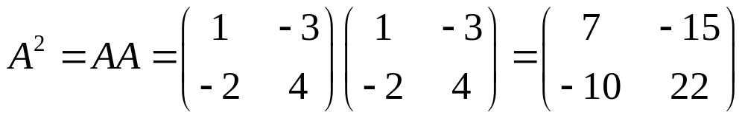
Matrix Product: Example
Let A be an n x n matrix. If m is a positive integer, the m^{th} power of A is defined as the matrix product
Example: If
Then
Daniela Stan - CSC381/481

Slide 50
References
Lecture slides:
    Textbook: Digital Image Processing by R. Gonzalez
    Http://gear.kku.ac.th/~nawapak/ip.html
    Book: Discrete Mathematics by R. Johnsonbaugh
Daniela Stan - CSC381/481

