Slide 1
CSC 381/481
Quarter: Fall 2013
Daniela Stan Raicu
Email: draicu@cs.depaul.edu
School of Computing, DePaul University
Daniela Stan - CSC381/481

Slide 2
Outline
Chapter 2: Digital Image Fundamentals
Zooming and shrinking digital images
Some basic relationships between pixels
    Regions, boundary, and edges
Chapter 3: Image Enhancement in the Spatial Domain
    Introduction (Section 3.1)
    Enhancement by point processing (Section 3.2):
        Image negatives
        Log transformations
        Power-law transformations
        Piecewise-linear transformations
    Histogram Processing (Section 3.3)
    Enhancement using arithmetic/logic operations (Section 3.4):
        Image subtraction
        Image averaging
    Smoothing spatial filters (Sections 3.5 & 3.6)
    Sharpening spatial filters (Section 3.7)
Daniela Stan - CSC381/481

Slide 3
Zooming and Shrinking
Zooming: Oversampling
Steps for zooming a digital image:
  creation of new pixel locations
  assignment of gray levels to those new locations:
      nearest neighbor interpolation
      pixel replication
      bilinear interpolation
Shrinking: Subsampling
Steps for shrinking a digital image:
  row-column deletion---the equivalent of pixel replication
Daniela Stan - CSC381/481

Slide 4
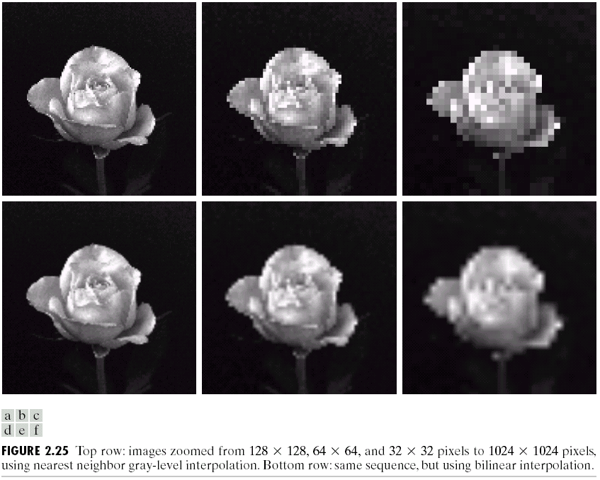
The effects of zooming
Checkerboard as an
effect of the nearest
neighbor interpolation
Blurring as an effect
of bilinear interpolation
Daniela Stan - CSC381/481

Slide 5
Regions, boundaries & edges
Let R be a subset of pixels in an image. We call R a region of the image if R is a connected set.
The boundary (also called border or contour) of a region R is the set of pixels in the regions that have one or more neighbors that are not in R.
    The boundary of a region is a closed path
Edges are formed from pixels with derivatives values that exceed a preset threshold.
    The edges can be thought of intensity discontinuities
Daniela Stan - CSC381/481

Slide 6

Image Enhancement:
Introduction
Image Enhancement procedures are techniques used to achieve a subjective improvement in image “quality” for a specific application (problem-oriented).
Typical applications:
  noise removal
  geometric correction
  smoothing
  sharpening
  edge enhancement or extraction.
Usually ad hoc procedures.
Image Enhancement:
  in the Spatial Domain (pixel operators)
  the Frequency Domain (frequency filtering).
Daniela Stan - CSC381/481

Slide 7
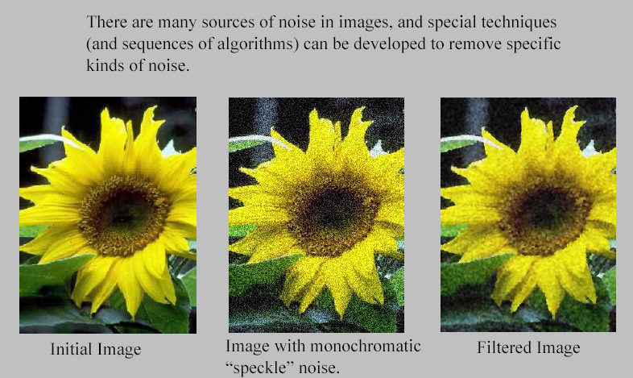
Noise removal
Daniela Stan - CSC381/481

Slide 8
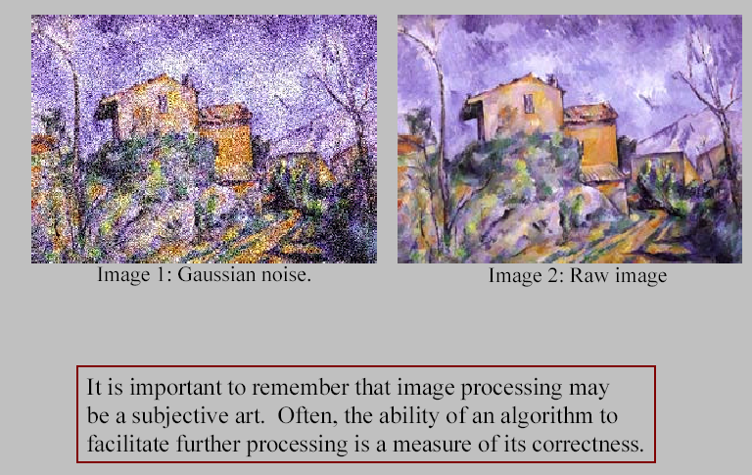
Subjective Image Processing
Daniela Stan - CSC381/481

Slide 9
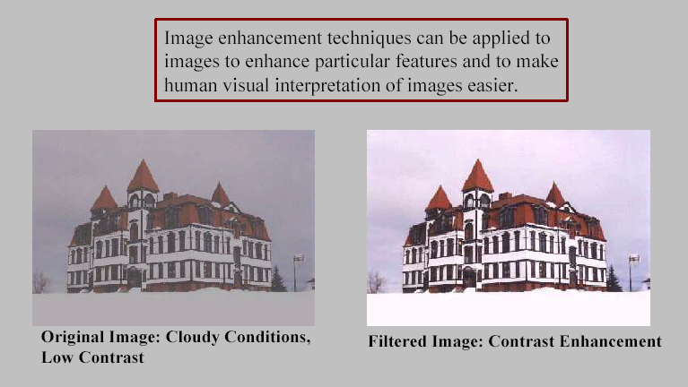
Visualization
Daniela Stan - CSC381/481

Slide 10

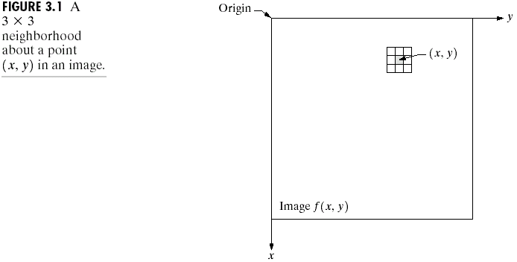
Spatial Domain Methods
Procedures that operate directly on the aggregate/neighborhood of pixels composing an image
A neighborhood about (x,y) is defined by using a square (or rectangular) subimage area centered at (x,y).
Daniela Stan - CSC381/481

Slide 11
Spatial Domain Methods
When the neighborhood is 1 x 1 then g depends only on the value of f at (x,y) and T becomes a gray-level transformation (also called an intensity or mapping) function:
s=T(r)
r,s: gray levels of f(x,y) and g(x,y) at any point (x,y)
  r denotes the pixel intensity before processing
  s denotes the pixel intensity after processing.
These intensity transformations are also called point processing techniques.
Daniela Stan - CSC381/481

Slide 12
Enhancement by
Point Processing
The following methods are based only on the intensity of single pixels.
Image negatives
Log transformations
Power-law transformations
Piecewise-Linear Transformation Functions:
  Contrast stretching
  Gray-level slicing
  Bit-plane slicing
Daniela Stan - CSC381/481

Slide 13
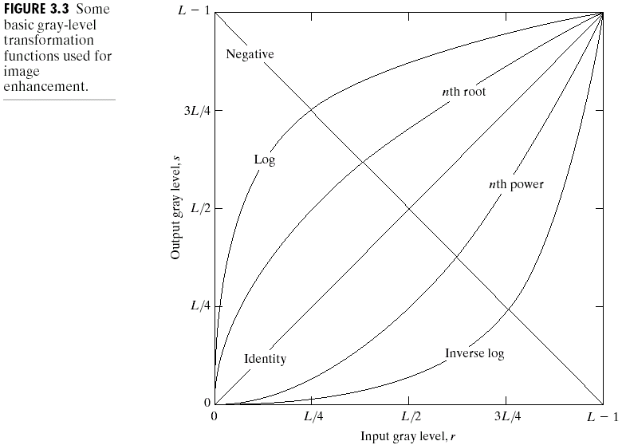
Image Enhancement in the
Spatial Domain
Linear: Negative, Identity
Logarithmic: Log, Inverse Log
Power-Law: nth power, nth root
Daniela Stan - CSC381/481

Slide 14
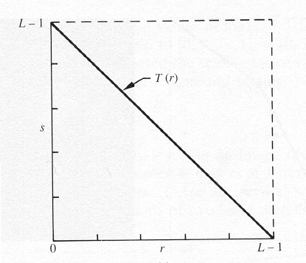
Image Negatives
Are obtained by using the transformation function s=T(r).
Function T reverses the order from black to white so that the intensity of the output image decreases as the intensity of the input increases.
[0,L-1] the range of gray levels
S= L-1-r
Daniela Stan - CSC381/481

Slide 15
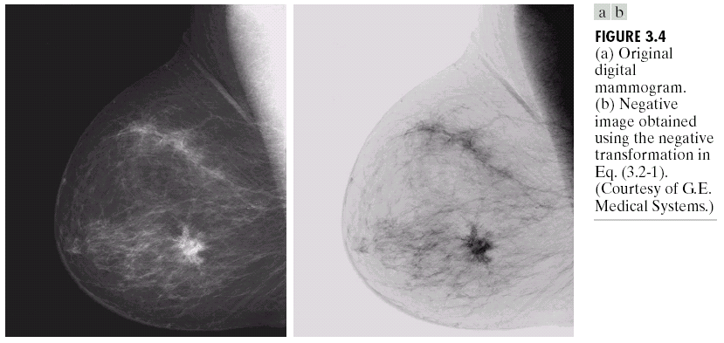
Image Enhancement in the
Spatial Domain
Medical applications: much easier to analyze the breast tissue in the
negative image
Daniela Stan - CSC381/481

Slide 16
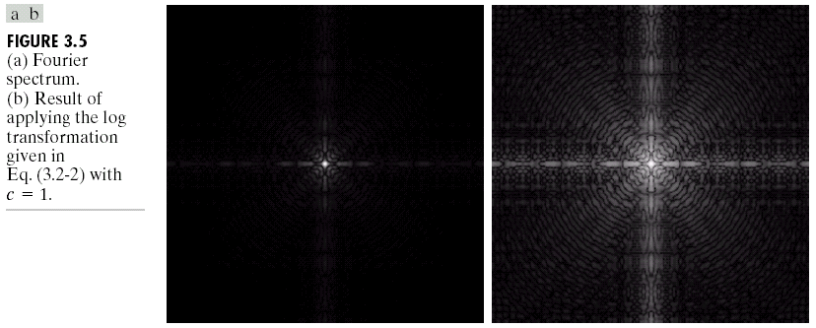
Log Transformations
s = c log(1+r)
c: constant, r >=0
Compresses the dynamic range of images with large variations in pixel values
Daniela Stan - CSC381/481

Slide 17
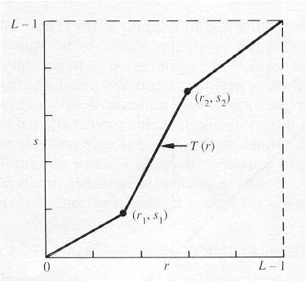
Piecewise-Linear Transformation Functions: Contrast Stretching
To increase the dynamic range of the gray levels in the image being processed.
Daniela Stan - CSC381/481

Slide 18
Contrast Stretching
The locations of (r₁,s₁) and (r₂,s₂) control the shape of the transformation function.
  If r₁= s₁ and r₂= s₂ the transformation is a linear function and produces no changes.
  If r₁=r₂, s₁=0 and s₂=L-1, the transformation becomes a thresholding function that creates a binary image.
Daniela Stan - CSC381/481

Slide 19
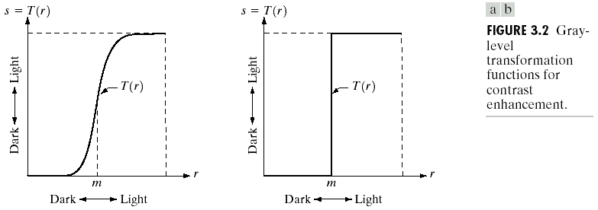
Image Enhancement in the
Spatial Domain
Contrast Stretching
Thresholding
Daniela Stan - CSC381/481

Slide 20
Contrast Stretching
More on function shapes:
  Intermediate values of (r₁,s₁) and (r₂,s₂) produce various degrees of spread in the gray levels of the output image, thus affecting its contrast.
  Generally, r₁≤r₂ and s₁≤s₂ is assumed.
Daniela Stan - CSC381/481

Slide 21

Image Enhancement in the
Spatial Domain
Low contrast
image
High contrast
image
Daniela Stan - CSC381/481

Slide 22
Spatial Domain Methods
Mask processing or filtering: when the values of f in a predefined neighborhood of (x,y) determine the value of g at (x,y).
  Through the use of masks (or kernels, templates, or windows, or filters).
  More in the next lecture when we discuss about Basics of Spatial filtering (Section 3.5)
Daniela Stan - CSC381/481

Slide 23
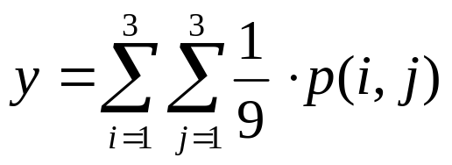
Example of the use of a mask
Step 1: Move the window to the first location where we want to
compute the average value and then select only pixels
inside the window.
2
4
1
2
6
2
2
4
1
Step 2: Compute
the average value
9
2
3
4
4
4
9
2
3
7
2
9
7
6
7
7
2
9
5
2
3
6
1
5
Sub image p
7
4
2
5
1
2
Step 3: Place the
result at the pixel
in the output image
Original image
4.3
Step 4: Move the
window to the next
location and go to Step 2
Daniela Stan - CSC381/481
Output image

Slide 24
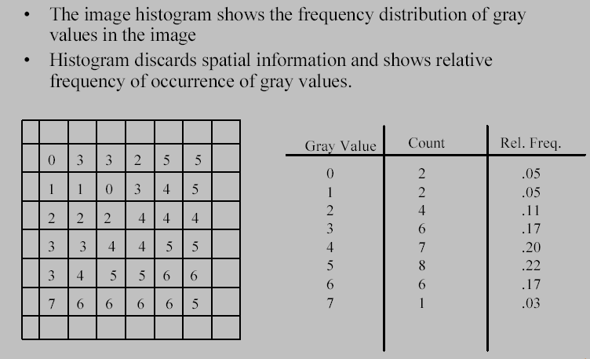
Image Histogram
Daniela Stan - CSC381/481

Slide 25
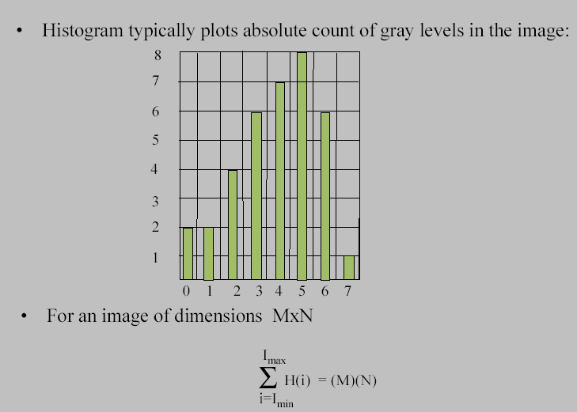
Image Histogram
Daniela Stan - CSC381/481

Slide 26
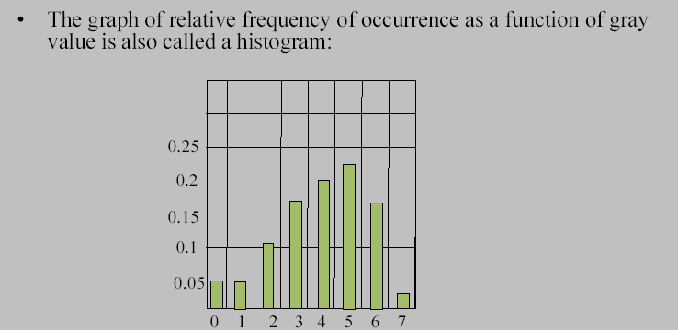
Image Histogram
Daniela Stan - CSC381/481

Slide 27
Histogram Processing
The histogram of a digital image with gray levels from 0 to L-1 is a discrete function h(r_{k})=n_{k}, where:
  r_{k} is the kth gray level
  n_{k} is the # pixels in the image with that gray level
  n is the total number of pixels in the image
  k = 0, 1, 2, …, L-1
Normalized histogram: p(r_{k})=n_{k}/n
  sum of all components = 1
To visualize the histogram of a digital image, we plot pr(r_{k})
versus r_{k}
Daniela Stan - CSC381/481

Slide 28
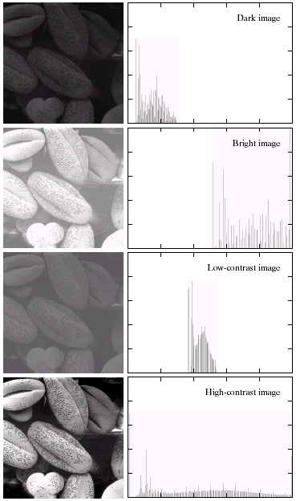
Image Enhancement in the
Spatial Domain
The shape of the histogram
of an image does provide
useful info about the
possibility for contrast
enhancement.
Daniela Stan - CSC381/481

Slide 29
Types of Histogram Processing
Histogram equalization
Histogram matching (specification)
Local enhancement
Daniela Stan - CSC381/481

Slide 30
Histogram Equalization
As mentioned above, for gray levels that take on discrete values, we deal with probabilities:
p_{r}(r_{k})=n_{k}/n, k=0,1,.., L-1
  The plot of p_{r}(r_{k}) versus r_{k} is called a histogram and the technique used for obtaining a uniform histogram is known as histogram equalization (or histogram linearization).
Daniela Stan - CSC381/481

Slide 31
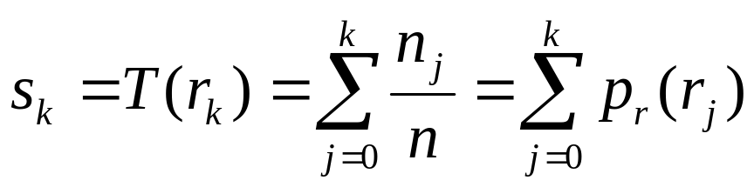
Histogram Equalization (HE)
  The technique used for obtaining a uniform histogram
  is known as histogram equalization (or histogram linearization).
where pr(r_{k})=n_{k}/n, k=0,1,.., L-1
Histogram equalization(HE) results are similar to contrast stretching but offer the advantage of full automation, since HE automatically determines a transformation function to produce a new image with a uniform histogram.
Daniela Stan - CSC381/481

Slide 32
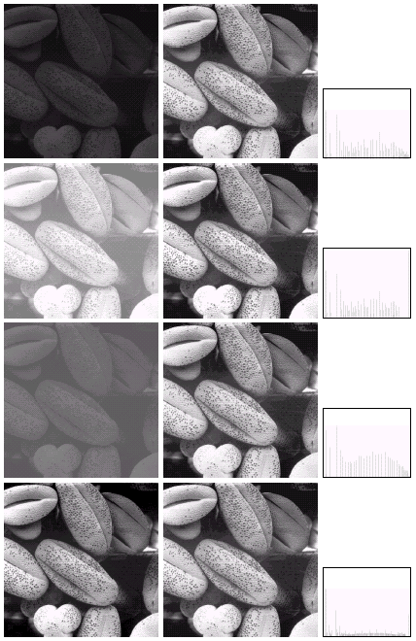
Daniela Stan - CSC381/481

Slide 33
Local Enhancement
When it is necessary to enhance details over smaller areas, then we need to devise transformation functions based on the gray-level distribution in the neighborhood of every pixel
The procedure is:
1. Define a square (or rectangular) neighborhood and move the center of this area from pixel to pixel.
2. At each location, the histogram of the points in the neighborhood is computed and either a histogram equalization or histogram specification transformation function is obtained.
3. This function is finally used to map the gray level of the pixel centered in the neighborhood. The center is then moved to an adjacent pixel location and the procedure is repeated.
Daniela Stan - CSC381/481

Slide 34
Image Enhancement in Matlab
Point operation image enhancement:
      Contrast stretching: Matlab function
IMADJUST Adjust image intensity values or colormap.
J = IMADJUST(I,[LOW_IN HIGH_IN],[LOW_OUT HIGH_OUT],GAMMA)
maps the values in intensity image I to new values in J such that values between
LOW_IN and HIGH_IN map to values between LOW_OUT and HIGH_OUT. Values
below LOW_IN and above HIGH_IN are clipped.
GAMMA specifies the shape of the curve describing the relationship between the values
in I and J. If GAMMA is less than 1, the mapping is weighted toward higher (brighter)
output values. If GAMMA is greater than 1, the mapping is weighted toward lower
(darker) output values. If you omit the argument, GAMMA defaults to 1 (linear mapping).
Previous example: b=imadjust(a,[.3 .7]; [0 1],1);
Daniela Stan - CSC381/481

Slide 35
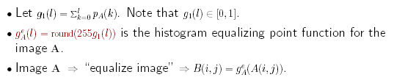
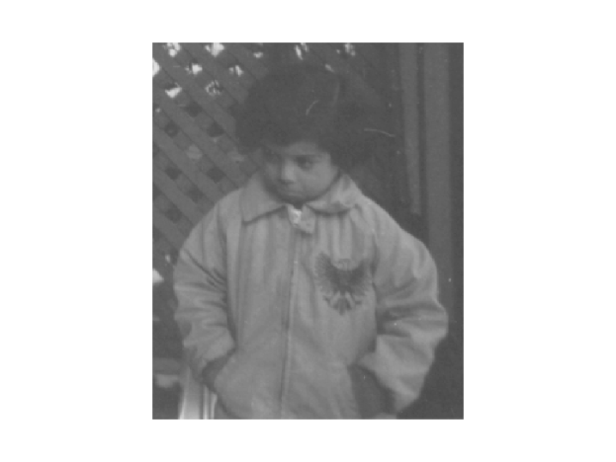
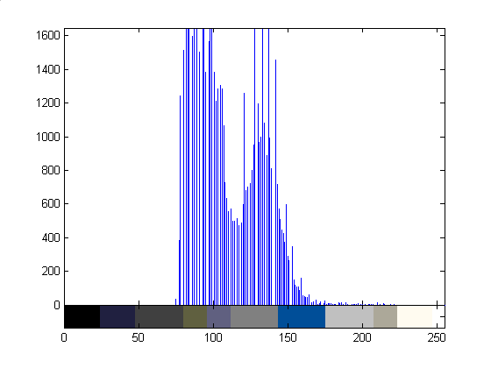
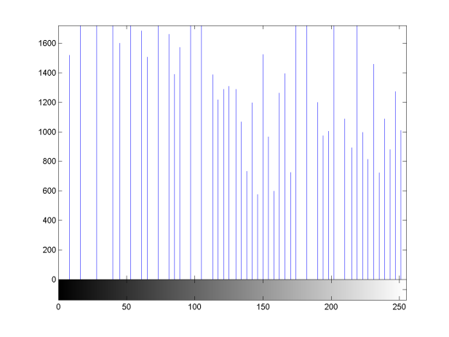
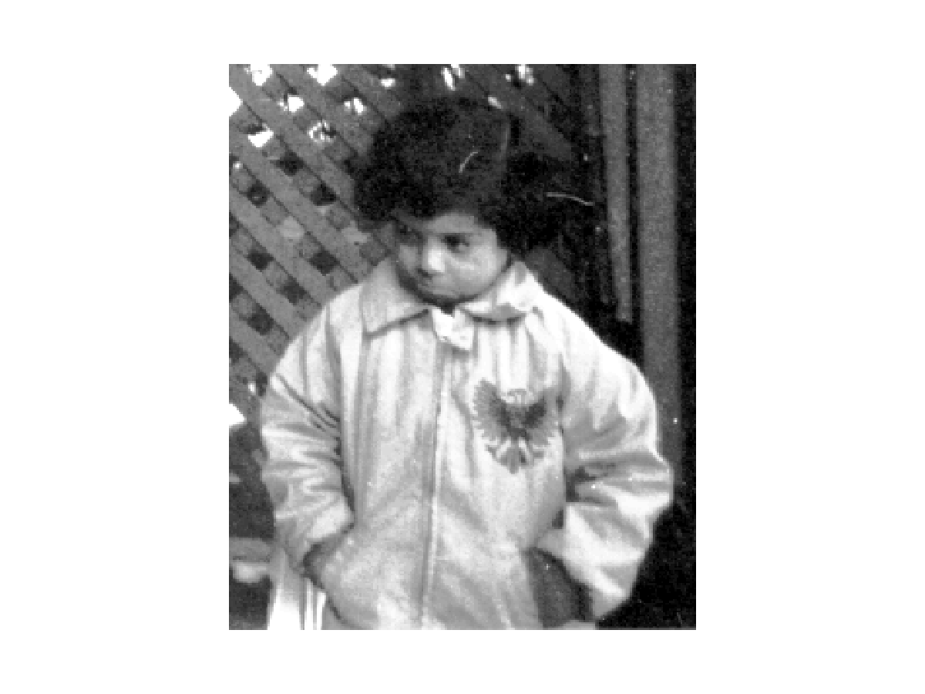
Histogram Equalization in Matlab
I = imread('pout.tif');
imhist(I)
Imshow(I)
>> J=histeq(I);
imshow(J), figure, imhist(J)
Daniela Stan - CSC381/481

Slide 36
Application: Histogram-based Segmentation
If one views an image as depicting a scene composed of different
objects, regions, etc. then segmentation is the decomposition of an
image into these objects and regions by associating or “labeling” each
pixel with the object that it corresponds to.
Most humans can easily segment an image. Computer automated
segmentation is a difficult problem, requiring sophisticated algorithms
that work in tandem.
“High level” segmentation, such as segmenting humans, cars etc., from an image is a very difficult problem. It is still considered unsolved
and is actively researched.
Based on point processing, histogram-based image segmentation is a
very simple algorithm that is sometimes utilized as an initial guess at
the “true” segmentation of an image.
Daniela Stan - CSC381/481

Slide 37
Histogram-based Segmentation
Steps:
For a given image, decompose the range of pixel values (0..255) into “discrete” intervals R_{t} = [a_{t}; b_{t}]; t = 1… T, where T is the total number of segments.
Each R_{t} is typically obtained as a range of pixel values that correspond to a hill of the histogram.
“Label” the pixels with pixel values within each Rt via a point function.
Main Assumption: Each object is assumed to be composed of pixels with similar pixel values.
Daniela Stan - CSC381/481

Slide 38
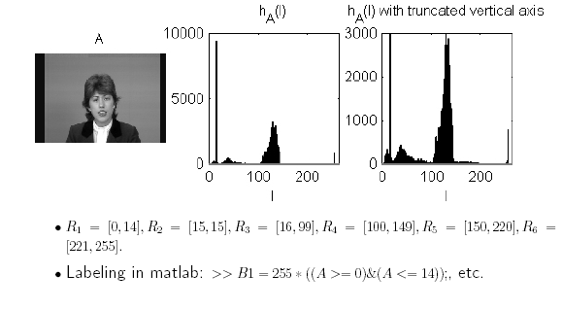
Daniela Stan - CSC381/481

Slide 39
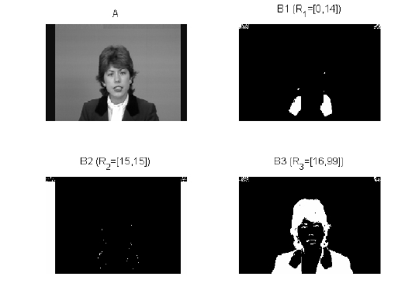
Daniela Stan - CSC381/481

Slide 40
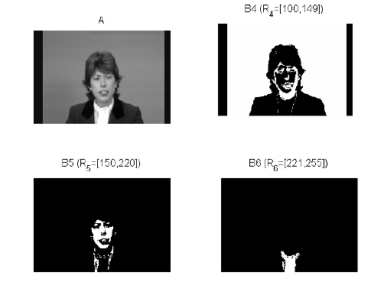
Daniela Stan - CSC381/481

Slide 41
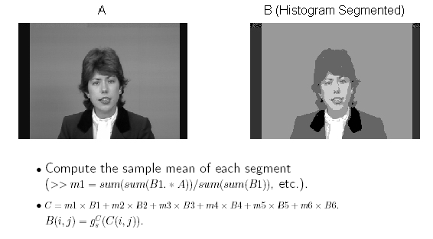
Daniela Stan - CSC381/481

Slide 42
Limitations
Histogram-based segmentation operates on each image pixel independently. As mentioned earlier, the main assumption is that objects must be composed of pixels with similar pixel values.
This independent processing ignores a second important property: Pixels within an object should be spatially connected. For example, B3, B4, B5 group spatially disconnected objects/regions into the same segment.
In practice, one would use histogram-based segmentation in tandem with other algorithms that make sure that computed objects/regions are spatially connected.
Daniela Stan - CSC381/481

Slide 43
Summary
Chapter 3: Image Enhancement in the Spatial Domain
  Covered:
    Point-wise operations
    Histogram equalization
    Histogram equalization for segmentation
  To be covered:
    Enhancement using arithmetic/logic operations (Section 3.4):
      Image subtraction
      Image Averaging
    Smoothing spatial filters (Sections 3.5 & 3.6)
    Sharpening spatial filters (Section 3.7)
Daniela Stan - CSC381/481

Slide 44
Image Enhancement (new material)
Point operation image enhancement:
    Image Subtraction:
      Ex: mask mode radiography
    Image averaging:
      Example: noise reduction
Mask operations for image enhancement:
    Smoothing filters
      Ex: average filtering ~ low pass filtering, median filters
      Applications:
      Blurring: This is usually a preprocessing step for removing small (unwanted) details before extracting the relevant (large) object, bridging gaps in lines/curves.
      Noise reduction: Mitigate the effect of noise by linear or nonlinear operations.
Daniela Stan - CSC381/481

Slide 45
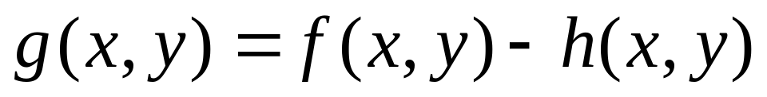

Section 3.4.1: Image Subtraction
The difference between two images f and h:
  Pixel-by pixel operation
Applications: Mask mode radiography
  h(x,y) is the mask, an X-ray of a region of a patient’s body captured by an intensified TV camera located opposite an X-ray source.
  f(x,y) represents different images of the same anatomical region as h(x,y) but taken after injecting a contrast medium into the patient’s bloodstream.
Daniela Stan - CSC381/481

Slide 46
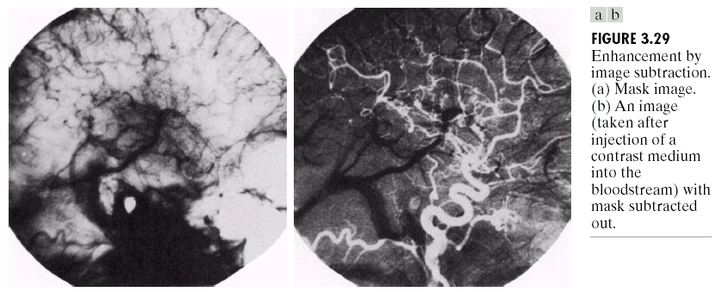
Applications: Mask Mode Radiography
Top of a patient’s head: before and after mask subtraction
Core of the spinal cord
Daniela Stan - CSC381/481

Slide 47
Applications: Change detection
Image subtraction for segmentation is used to detect if there are any “changes”.
Example: Moving vehicle tracking
Implementation tips for image subtraction:
--- scaling is necessary for the difference image:
Tip 1: add 255 and divide by 2
Tip 2: add the negative of the minimum difference and then multiply by 255/max where max is the maximum of the modified difference image
Daniela Stan - CSC381/481

Slide 48
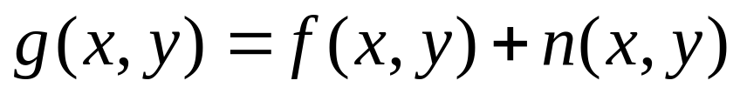
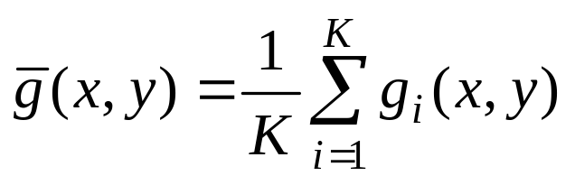
Section 3.4.2: Image Averaging/Noise reduction
A noisy image:
Where the noise at every pair of coordinates (x,y) is uncorrelated and has zero average value.
The goal is the noise reduction by averaging K different noisy images g_{i}(x,y):
Daniela Stan - CSC381/481

Slide 49
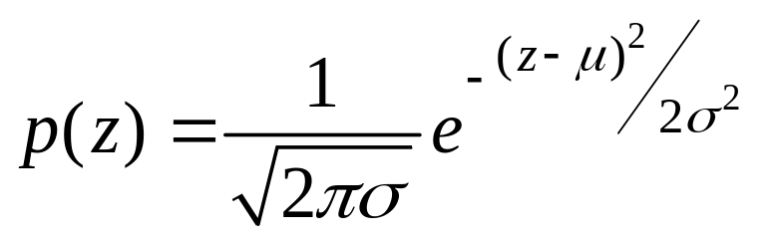
Image Averaging
As K increases, the variability of the pixel values at each location decreases.
  This means that g(x,y) approaches f(x,y) as the number of noisy images used in the averaging process increases.
Registering/aligning of the images is necessary to avoid blurring in the output image.
Example of noise: Gaussian Noise
Where z represents the gray level in the image
Daniela Stan - CSC381/481

Slide 50
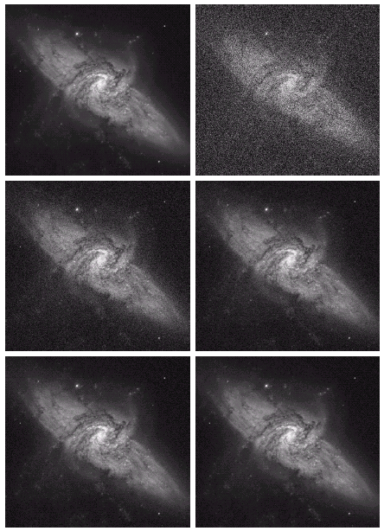
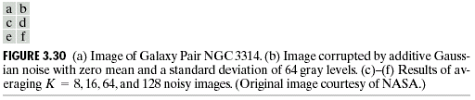
Applications of Image Averaging
Image of a galaxy pair called NGC3314
Corrupted image by uncorrelated Gaussian noise with zero mean and std=64
Through f) results of averaging
K=8,16,64 and 128 images, respectively
Daniela Stan - CSC381/481

Slide 51
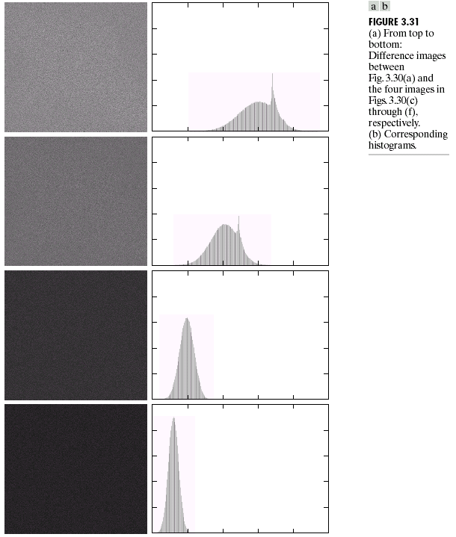
Applications of Image Averaging
Notice that:
Mean and standard deviation of the histograms in the difference images decrease as k increases
Conclude that:
-the averaging image gets closer to the original image
Daniela Stan - CSC381/481

Slide 52
Section 3.5: Spatial Filtering
Use of spatial masks for image processing (spatial filters)
Linear and nonlinear filters
Low-pass filters eliminate or attenuate high frequency components in the frequency domain and result in image blurring.
High-pass filters attenuate or eliminate low-frequency components and result in sharpening edges and other sharp details.
Band-pass filters remove selected frequency regions between low and high frequencies (for image restoration, not enhancement).
Daniela Stan - CSC381/481

Slide 53
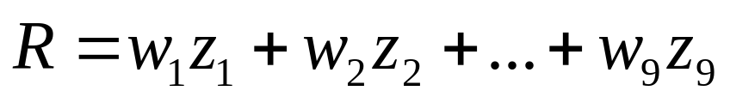
Spatial Linear Filtering
The basic approach is to sum products between the mask coefficients and the intensities of the pixels under the mask at a specific location in the image:
(for a 3 x 3 filter)
Daniela Stan - CSC381/481

Slide 54
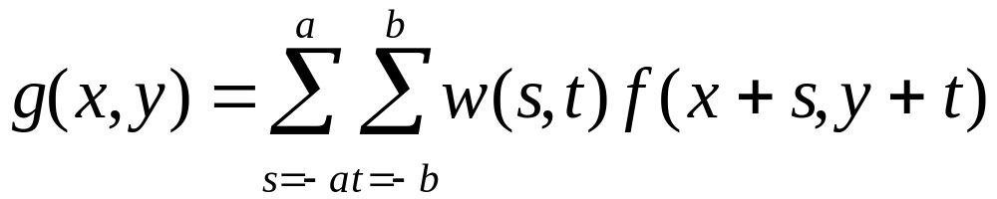
General formula for
Spatial Filtering
a=(m-1)/2 and b=(n-1)/2,
m x n (odd numbers)
For x=0,1,…,M-1 and y=0,1,…,N-1
Also called convolution (primarily in the frequency domain)
Daniela Stan - CSC381/481

Slide 55
Spatial Non-linear Filtering
Non-linear filters also use pixel neighborhoods but do not explicitly use coefficients
  e.g. noise reduction by median gray-level value computation in the neighborhood of the filter:
      Replace the value of the center pixel by the median of the gray levels within the neighborhood of that pixel.
      Very good for eliminating “salt and pepper” noise (white and black dots superimposed on the image).
  Max filter which useful in finding the brightest parts in the images
Daniela Stan - CSC381/481

Slide 56
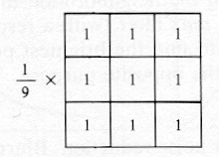
Smoothing Filters
Used for blurring (removal of small details prior to large object extraction, bridging small gaps in lines) and noise reduction.
Low-pass (smoothing) spatial filtering
  Neighborhood averaging filters
- Results in image blurring
Advantages: for noise reduction, reduction of false contouring,
and gross representation of objects of interest
Disadvantages: blurred edges
Daniela Stan - CSC381/481

Slide 57
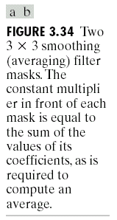
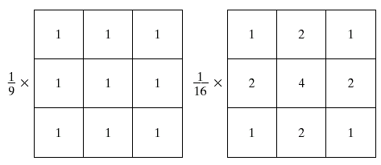
Smoothing Filters
Examples of averaging filters
Daniela Stan - CSC381/481

Slide 58
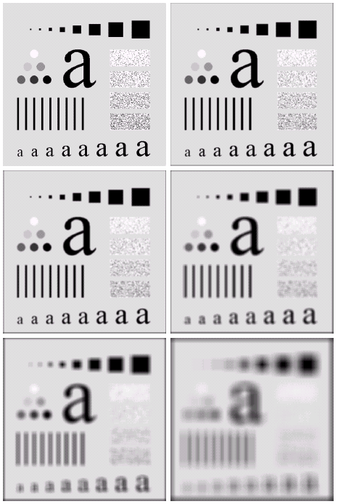
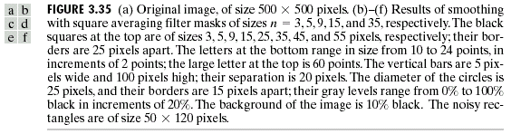
Effects of smoothing as a function of filter size
Filter sizes:3, 5, 9, 15, and 35
Daniela Stan - CSC381/481

Slide 59
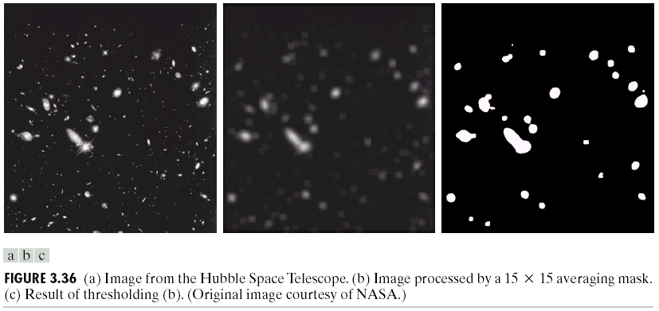
Examples
Daniela Stan - CSC381/481

Slide 60

Example of noise reduction with averaging and median filters
Median filtering (nonlinear)
  Used primarily for noise reduction (eliminates isolated spikes)
  The gray level of each pixel is replaced by the median of the gray levels in the neighborhood of that pixel (instead of by the average as before).
Daniela Stan - CSC381/481

Slide 61
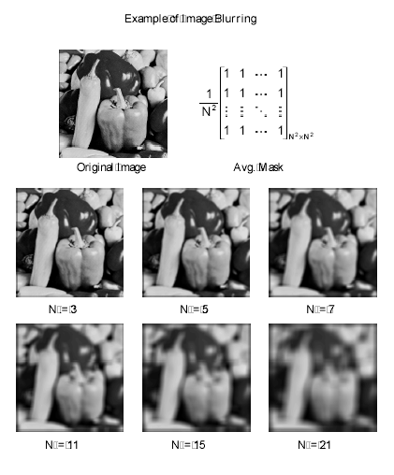
Example of Image Blurring
Questions:
What is the size of the filter?
What is the property of the mask coefficients?
Daniela Stan - CSC381/481

Slide 62

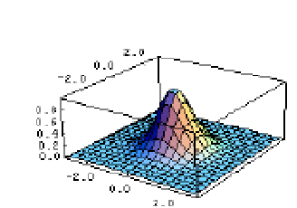
Gaussian Filters
Gaussian filter - The use of the Gaussian kernel for smoothing has become extremely popular. This has to do with certain properties of the Gaussian:
rotationally symmetric, so it provides very good starting points for some edge detection algorithms.
separable, in that a Gaussian filter maybe applied by first applying a one-dimensional Gaussian in the x direction, followed by another in the y direction. (this can lead to very fast implementation).
Larger sigma (standard deviation) blurs more
Daniela Stan - CSC381/481

