Slide 1
MediX Workshop Hands on Tutorial
Valerie Simonis w/ slides from Dr. Raicu
5/1/2015

Slide 2
Welcome!
Please go to https://github.com/vsimonis/medix-workshop and download and extract all folders & subfolders

Slide 3
Before we start… Introductions
Who am I?
Valerie Simonis
BS In Math/CS from DePaul
working towards a PhD in CS
CV, AI, DM
Scripting: SAS, R, SPSS, Matlab
Programming: Java, Python
Who are you?
Name
Degree & Major/Concentration
Programming/scripting experience

Slide 4
Agenda
Goal: Process C. elegans images in MATLAB!
MATLAB basics
Image Processing
Image Types
Image enhancement
Segmentation
Image Analysis
Feature Extraction

Slide 5
MATLAB basics
When to use MATLAB
Prototyping
Easy to use
Many functions already implemented (especially for Image Processing)
Objected-oriented approach is not appropriate
Matrix operations
Avoid using for loops!
Can inspect elements easily
How to use MATLAB
Development environment
Basic programming

Slide 6

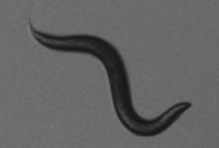
Finding patterns in images
Image Processing
Image Analysis
Size:
Area
Axis lengths
Shape:
Elongation
Eccentricity
img | f1 | f2 | f3 | f4
1
…
n
Data Mining
Machine Learning
Knowledge Discovery
Image Understanding
Intensity
Statistical qualities
Texture
Roughness
+
labels

Slide 7
Overview of the field
Image Processing (CSC 381/481):
Produces images that are enhanced, segmented, or processed in any way to increase the quality of an image and its understanding and interpretation
Image Analysis (CSC 382/482):
Produce numerical descriptors of images and ROIs
Find patterns in images
Uses Machine Learning (CSC 578), and Data Mining (CSC 367/ IS 567)
Computer Vision (CSC 528 ):
Often produces 3D models from image data; the image data can take many forms, such as video sequences, views from multiple cameras, or multi-dimensional data from a medical scanner.

Slide 8
Introduction to Image Processing
Image Types, Image enhancement and segmentation

Slide 9
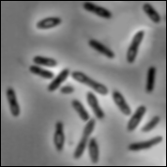
Intensity image or monochrome image:
each pixel corresponds to light intensity
normally represented in gray scale (gray
level).
Gray scale values

Slide 10
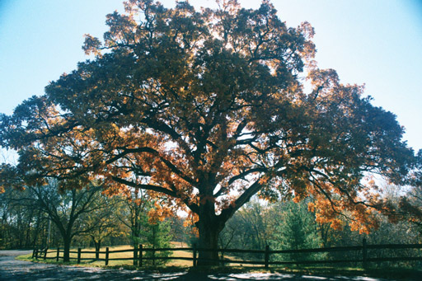
Color image or RGB image:
each pixel contains a vector
representing red, green and
blue components.
RGB components

Slide 11

Binary image or black and white image
Each pixel contains one bit :
1 represent white
0 represents black
Binary data

Slide 12
MATLAB
Read in images (imread)
Display images (imshow)
Resize (imresize)
Type conversions (rgb2gray, gray2rgb)

Slide 13
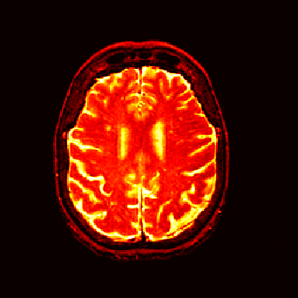
Index image
Each pixel contains index number
pointing to a color in a color table
Color Table
Index No. | Red component | Green component | Blue component
1 | 0.1 | 0.5 | 0.3
2 | 1.0 | 0.0 | 0.0
3 | 0.0 | 1.0 | 0.0
4 | 0.5 | 0.5 | 0.5
5 | 0.2 | 0.8 | 0.9
… | … | … | …
Index value

Slide 14
Image Processing Sequence
Original Image
Image Enhancement
Thresholding
Morphological Operations
Segmented
Image
Histogram equalization
Contrast Stretching
Mean pixel value
Otsu
Histogram
Area Under Histogram
Opening
Closing
Connected Components

Slide 15
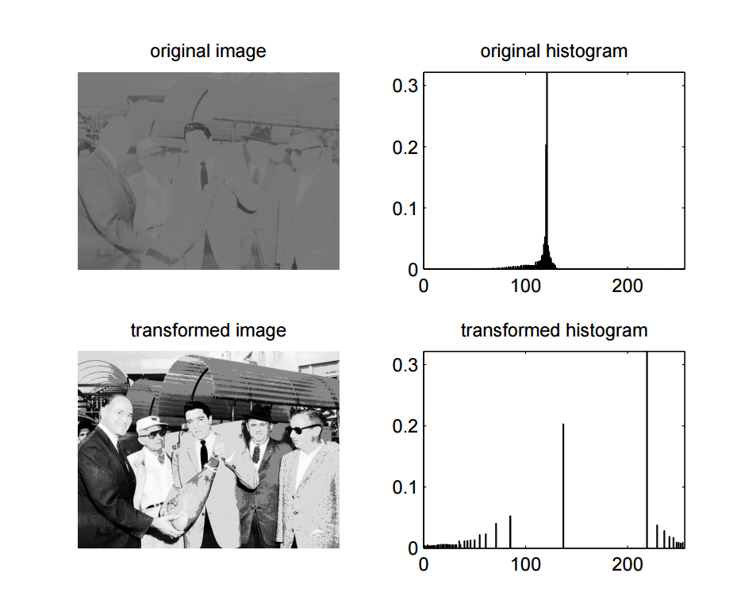
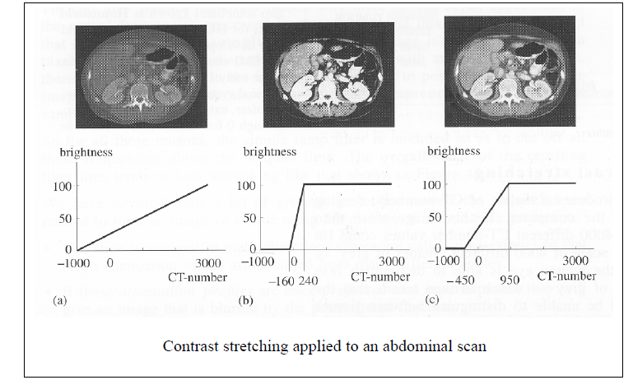
Image Enhancement
Histogram equalization
Contrast stretching

Slide 16
Segmentation: Histogram based
Simple thesholding
Select threshold T
Create binary image:
I(x,y) < T -> O(x,y) = 0
I(x,y) > T -> O(x,y) = 1
Number of pixels
Gray value
T

Slide 17
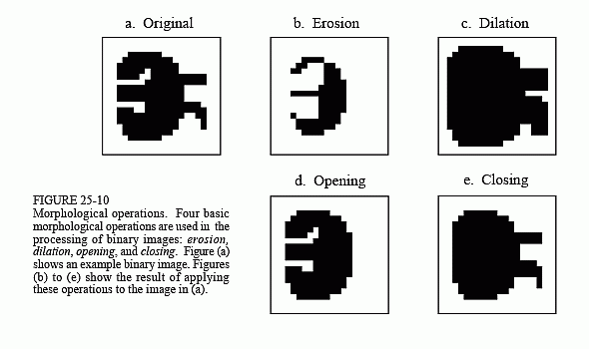
Morphological operations

Slide 18
Demo
Run nematodes.m in the Demo folder!
Play with different configurations to decide which combination of:
Image enhancement
Threshold method
Morphological operation to use

Slide 19
Image Features
Calculated from binary image:
Regionprops in MATLAB
http://www.mathworks.com/help/images/ref/regionprops.html

Slide 20
Thanks!

Slide 21

Computer-aided Diagnosis for Lung Cancer
Valerie Simonis
Richard Spotswood
Thavaselvi Ramalingam

Slide 22
Agenda
Motivation
Data Overview
Challenges and Opportunities
Bayesian Networks
Resource allocation by identifying easy vs. hard cases

Slide 23
Motivation
Valerie Simonis

Slide 24
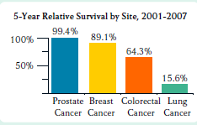
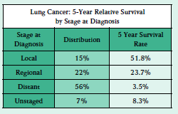
Motivation: Medical Domain
General context
Study of abnormalities in anatomy
Lung Cancer
Lung Cancer Survival Rate
Early Detection Rate

Slide 25
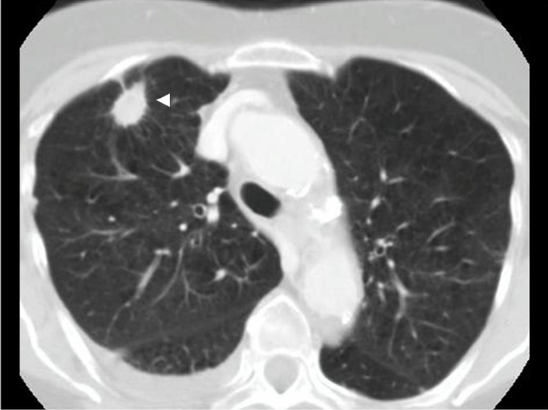
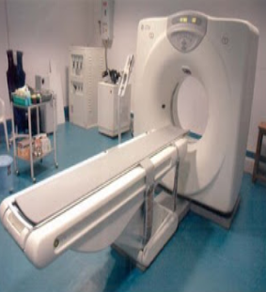
Motivation: CS
Conduct analysis and develop techniques to advance the state-of-art in computer aided diagnosis (CAD) of lung nodules using CT scans and X-ray modalities
Computer Diagnosis (CADx)
Content-Based Image Retrieval (CBIR)
Visualization

Slide 26

Why CAD?
Screening is expensive
Radiologist cost
False Positive Diagnosis
CAD can reduce cost and improve diagnosis
Serve as a second reader in diagnostic decision making
Provide information to guide analysis workflow
Provide visualizations
Retrieve similar cases to aid in analysis
Presents interesting challenges for us
Image Processing
Data Mining / Machine Learning
Computer Vision

Slide 27
LIDC: Data, Challenges, Future Directions
Richard Spotswood

Slide 28


Data Overview: LIDC Database
Semantic Ratings (per nodule)
Malignancy
Lobulation
Spiculation
Internal Structure
Calcification
Sphericity
Margin
Subtlety
Texture
Labels
(Classes)
Radiologist
Outlines (One per slice)
Features from CT Scans
(Predictors)
(Not shown: X-ray)

Slide 29
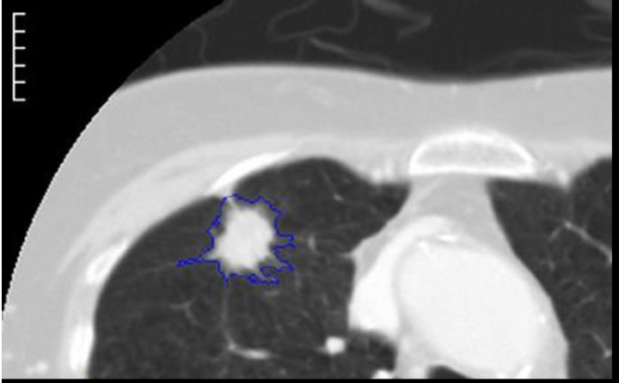
Data Overview: Typical Workloads
Image Features
Shape
Texture
Intensity
Size
CT Scan Images
Classification
Malignant
Benign
Diagnosis?
Label?

Slide 30
Data Overview: LIDC attributes
NIH/NCI Lung Image Database Consortium (LIDC)
1,018 CT scans
2,669 nodules > = 3 mm
Each nodule has multiple slices
~40,000 images in the database
Up to 4 radiologists review each nodule
Each radiologists provides
A rating on 9 semantic characteristics per nodule
A segmentation (outline of the nodule) in each slice

Slide 31
Data Overview: Native XML data layout
edgeMap.csv |  | roi.csv |  | LidcReadMessage.csv
StudyInstanceUID |  | StudyInstanceUID |  | StudyInstanceUID
SeriesInstanceUID |  | SeriesInstanceUID |  | SeriesInstanceUID
roi_Id |  | imageSOP_UID |  | LidcReadMessage_Id
xCoord |  | roi_Id |  | uid
yCoord |  | unblindedReadNodule_Id
 |  | inclusion
 |  | imageZposition
characteristics.csv |  | readingSession.csv |  | ResponseHeader
StudyInstanceUID |  | StudyInstanceUID |  | StudyInstanceUID
SeriesInstanceUID |  | SeriesInstanceUID |  | SeriesInstanceUid
unblindedReadNodule_Id |  | readingSession_Id |  | LidcReadMessage_Id
subtlety |  | servicingRadiologistID |  | Version
internalStructure |  | annotationVersion |  | MessageId
calcification |  | LidcReadMessage_Id |  | DateRequest
sphericity |  |  |  | TimeRequest
margin |  |  |  | RequestingSite
lobulation |  |  |  | ServicingSite
spiculation |  |  |  | TaskDescription
texture |  |  |  | CtImageFile
malignancy |  |  |  | DateService
 |  |  |  | TimeService
 |  |  |  | ResponseDescription
unblindedReadNodule.csv |  | locus.csv |  | NonNodule.csv
StudyInstanceUID |  | StudyInstanceUID |  | StudyInstanceUID
SeriesInstanceUID |  | SeriesInstanceUID |  | SeriesInstanceUID
unblindedReadNodule_Id |  | nonNodule_Id |  | imageSOP_UID
readingSession_Id |  | xCoord |  | nonNodule_Id
noduleID |  | yCoord |  | readingSession_Id
 |  |  |  | nonNoduleID
 |  |  |  | imageZposition

Slide 32
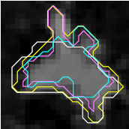
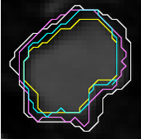
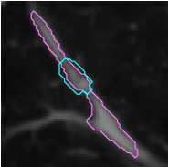

Challenge: Noisy data
Outline Annotation Noise
Low-Resolution Images

Slide 33
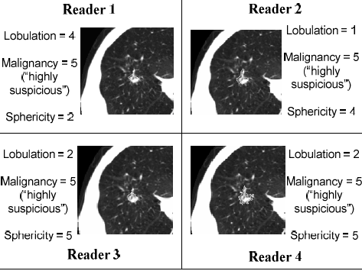
Challenge: Reader disagreement
Multiple Labels
Analyst Disagreement on Labels
No ground truth
Uncertainty in labels

Slide 34
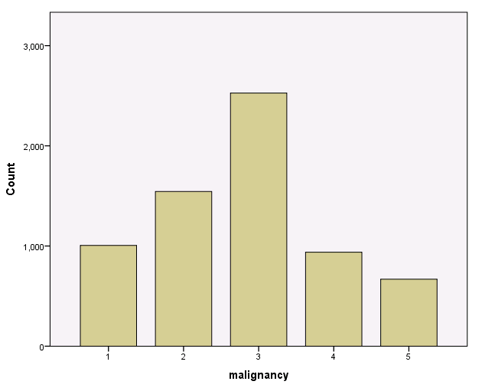
Challenge: Unbalanced data
Multiple Instances Per Label
Several slices per nodule (for each radiologist)
Multiple Classes and Unbalanced Datasets
Malignancy Rating Classes
Highly unlikely
Moderately unlikely
Indeterminate
Moderately suspicious
Highly suspicious

Slide 35
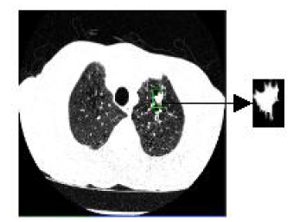



Challenge: Feature Extraction
Outline
Feature Calculations
Instance 12238
Size
Area
Perimeter
Shape
Compactness
Roughness
Texture
Gabor
Haralick
Intensity
Mean Intensity
Mean Intensity BW
Crop
Nodule
Background

Slide 36
Opportunities for Research
Segmentation
Weak Segmentation
Soft Segmentation
Texture-based Segmenting
Image Features
Image Feature Evaluation
2D+ Features
3D Features
Variability Metrics
Machine Learning Techniques
Decision Trees
Belief Decision Trees
Probabilistic Classifiers
Genetic Algorithms
Bayesian Networks
Unsupervised Learning
Similarity Measures
Learning Models
Ensemble of Classifiers
Stacked Classifiers
Crowd-Sourcing
Multi-Instance Learning
Multi-Label Learning
Probabilistic Labels

Slide 37
Accomplishments
34 published papers since 2007
Some examples:
Learning lung nodule similarity using a genetic algorithm
Consensus Versus Disagreement in Imaging Research: a Case Study Using the LIDC Database
Building an Ensemble of Probabilistic Classifiers for Lung Nodule Interpretation
Probabilistic lung nodule classification with belief decision trees
A texture-based probabilistic approach for lung nodule segmentation
An Investigation into the Relationship between Semantic and Content Based Similarity using LIDC

Slide 38
Current Research Directions
Consolidation of LIDC dataset within and across two modalities (CT and X-Ray) to accommodate new data
Bayesian networks for discovering relationships between features and ratings.
Resource allocation by identifying easy vs. hard cases.

Slide 39
Bayesian Networks
Goal: Empirical discovery of relationships between LIDC image features and semantic ratings
…
Image Features
Area
Roundness
BG Intensity
Spiculation
Sphericity
Malignancy
Intermediate Characteristics
Lobulation

Slide 40
Resource allocation by identifying easy vs. hard cases
Thavaselvi Ramalingam

Slide 41
Agenda
Objective
Approaches
Preliminary Results
Future work

Slide 42
Objective
Address radiologist resource allocation problem
Patient categorization
Compare performance of selective and non-selective approaches

Slide 43
Approach: Selective Vs Non-selective
LIDC dataset has annotations from four radiologists. In iterative approach, four models are built using different subset of these four labels in each of the model.
Non-selective approach: Incremental addition of labels with each model. M1 uses 1 label, M2 uses 2 labels and so on
Non-selective approach: Addition of labels only for cases that have been misclassified in the previous model. M1 uses first label, M2 uses the first 2 labels only for cases which were misclassified in the first model
Which approach is better?

Slide 44
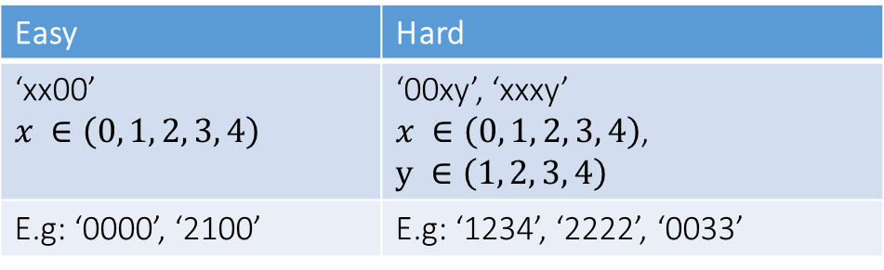
Dataset partition
 | M1 | M2 | M3 | M4
Actual | 3 | 2 | 2 | 2
Predicted | 4 | 2 | 2 | 2
Error | 1 | 0 | 0 | 0
Random partition
Smart partition
Separate cases into meaningful subsets
How to accomplish smart partition
Calculate error sequences
Define Easy/Hard
Cluster error sequences
Similarity metric
Easy | Hard
‘xx00’ $$x ∈\left(0, 1, 2, 3, 4\right)$$ | ‘00xy’, ‘xxxy’ $x ∈\left(0, 1, 2, 3, 4\right)$, $$y ∈\left(1, 2, 3, 4\right)$$
E.g: ‘0000’, ‘2100’ | E.g: ‘1234’, ‘2222’, ‘0033’

Slide 45
Flow chart
Selective (S)
Non selective (NS)
Easy
Hard
Easy
Hard
NSE
SE
SH
NSH
Common
Easy
Common
Hard
Indeterminate

Slide 46
Preliminary Results
Full dataset
9% increase in Accuracy using the Selective approach
The number of labels used to achieve this accuracy is less.
Clinical implications: Less number of radiologists to predict a case
Easy cases
The accuracy of non-selective approach is 17.82% higher than selective approach.
Selective approach identifies more number of cases that can be categorized as easy
Cases converge faster with selective approach.
236 cases with error sequence ‘0000’ using the non-selective approach as opposed to 369 cases using selective approach
Similarly 225 cases converged to zero using selective approach, whereas only 189 cases converged using non-selective approach.
Less number of labels used with selective approach: cost effective

Slide 47
Preliminary Results
NSE
SE
SH
NSH
Common
Easy
Common
Hard
Indeterminate
Hard cases
Selective approach has 13% higher accuracy
Cost – Selective: 2 labels per case
Common easy cases
Non-selective approach was 8% higher accuracy
Selective approach is more cost effective – Less labels than 2 labels per case
Common hard cases
Selective approach has 11% higher accuracy
Cost - Selective: 3 labels per case, Non-selective: 4 labels per case
Indeterminate cases
Selective approach has 14% higher accuracy
Cost – Selective: 2 labels per case

Slide 48
Future Work
Different classifiers to explore the Easy/hard partitioning
Build a model to classify whether a new case is Easy/Hard.

Slide 49
Questions?

Slide 50
Acknowledgements
Many Thanks!
Dr. Raicu
Dr. Furst
Evan Story
Camille Harbison

Slide 51
References
[1] American Cancer Society, Cancer facts and figures, 2012.
[2] National Lung Screening Trial Research Team, D. Aberle, A. Adams, C. Berg, W. black, J. Clapp, R. Fagerstrom, I. Gareen, C. Gatsonis, P. Marcus and J. Sicks, “Reduced lung-cancer mortality with low-dose computed tomography screening,” New England Journal of Medicine, vol. 246, no. 3, pp 697-722, March 2008.
[3] Armato SG III, McLennan G, Bidaut L, et al., “The Lung Image Database Consortium (LIDC) and Image Database Resource Initiative (IDRI): A completed reference database of lung nodules on CT scans,” Medical Physics, 38: 915--931, 2011.
[4] Mike Seidel, Alexander Rasin, Jacob D. Furst, Daniela S. Raicu ,”Towards Achieving Diagnostic Consensus in Medical Image Interpretation”, Data Mining Workshop (ICDMW), 2014 IEEE International Conference, Shenzhen, China, Dec 14, 2014.
[5] Amelia R. Riely, Kyle J. Sablan, Xiaotao Fang, Jacob D. Furst, Daniela S. Raicu, “Reducing annotation cost and uncertainty in computer-aided diagnosis through selective iterative classification”, SPIE Medical Imaging, Orlando, Florida, February 21-26, 2015

Slide 52
Hands-On Tutorial!
Valerie Simonis -- CDM 801

