Slide 1
🏏
Cricket Match Report
Analyzer
NLP Course Project
Team: Adhi · Khaise · Meera · Indrajith
Tools: spaCy · HuggingFace Transformers · scikit-learn

Slide 2
Project Overview
What we built and why
🔍
💬
📂
NER
Sentiment Analysis
Classification
Extract player names,
team names & venues
from commentary text
Detect tone of each
delivery — positive
or negative
Predict play type:
four, six, wicket,
no run, wide...
Dataset: 90,401 cricket commentary rows · Python · spaCy · HuggingFace · scikit-learn

Slide 3
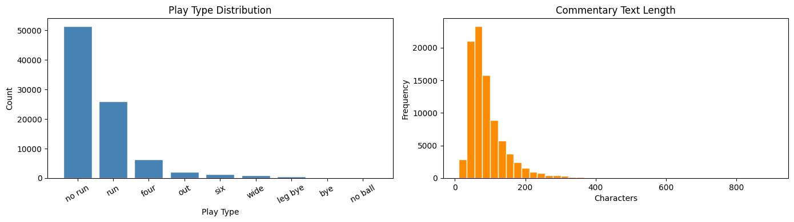
Dataset Overview
Section 1 — Adhi
90,401
89,338
393
268
Total Rows
After Cleaning
Unique Batsmen
Unique Bowlers

Slide 4
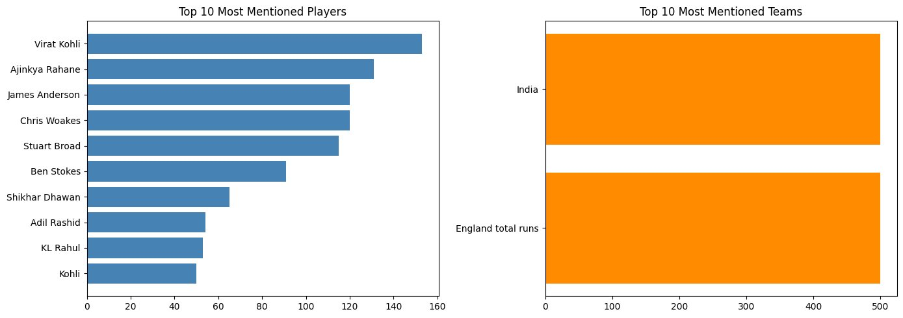
Named Entity Recognition
Section 2 — Khaise · spaCy en_core_web_sm
100%
100%
Player Coverage (500 rows)
Team Coverage (500 rows)

Slide 5
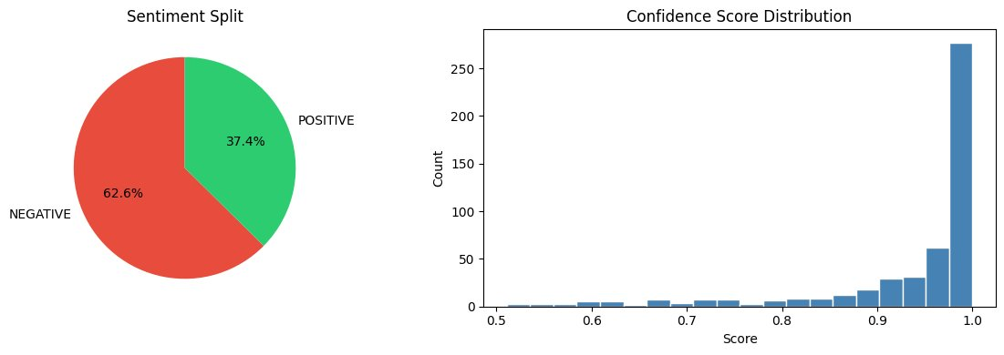
Sentiment Analysis
Section 3 — Meera · DistilBERT
62.6%
37.4%
93.4%
NEGATIVE
POSITIVE
Avg Confidence

Slide 6
Text Classification
Section 4 — Indrajith · TF-IDF + Logistic Regression
90.06%
9
71,470
Overall Accuracy
Play Type Classes
Training Rows
Play Type | Precision | Recall | F1-Score
no run | 0.91 | 0.97 | 0.94
run | 0.89 | 0.85 | 0.87
four | 0.87 | 0.80 | 0.83
out | 0.87 | 0.78 | 0.82
six | 0.90 | 0.74 | 0.81
wide | 0.86 | 0.61 | 0.72

Slide 7
Live Demo Output
analyze_commentary() — Full pipeline in action
📝 "Kohli drives beautifully through the covers for a magnificent four! The crowd erupts at Wankhede as India take control of the chase."
🔍 NER — Venue
💬 Sentiment
📂 Play Type
Wankhede
😊 POSITIVE
four
Detected from text
Confidence: 100%
Confidence: 84.80%

Slide 8
Results Summary
90.06%
Classification Accuracy — TF-IDF + Logistic Regression on 9 classes
100%
NER Coverage — players and teams extracted from all 500 test rows
93.4%
Avg Sentiment Confidence — DistilBERT model
90,401
Total rows processed across train / test / validation splits
Built with spaCy · HuggingFace Transformers · scikit-learn · Google Colab

