Slide 1
Language Identification from Short Audio Clips Using MFCC and Machine Learning
Group 2 — Predictive Analytics Project

Slide 2
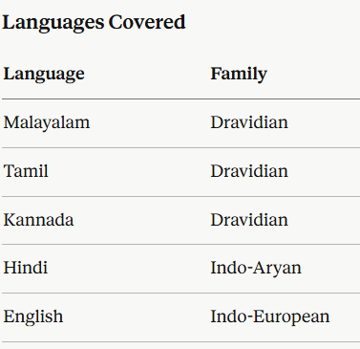
Problem statement
spoken language identification is the task of automatically determining which language a person is speaking from a short audio recording. in this project we classify speech into one of five languages — Malayalam, Tamil, Hindi, English, and Kannada — using only a 3 to 10 second audio clip, without using any deep learning techniques.

Slide 3
Data Collection and Preprocessing
Data Source
All audio data was collected from OpenSLR, an open repository of speech corpora maintained by Google. No manual recording was needed and no paid datasets were used. Every file was downloaded programmatically using verified URLs.
Processing pipeline
Step 1 — Format conversion
Step 2 — Silence trimming
Step 3 — Amplitude normalization
Step 4 — Class balancing
Step 5 — Stratified splitting
Step 6 — Metadata export

Slide 4
Feature Engineering
Extracted features, each targeting a different phonological property of speech.
MFCC with Delta and Delta-Delta (78 features)
Pitch or Fundamental Frequency (5 features)
Formant Frequencies F1, F2, F3 (6 features)
Energy or RMS (4 features)
After extracting all features, we applied two selection steps.
First, we removed features with pairwise correlation above 0.95 to eliminate redundancy.
Then we applied an ANOVA F-test and ranked features by their ability to separate the five language classes.
The top 60 statistically significant features were selected for the final feature matrix.

Slide 5
Model Training and Results
Three classifiers were trained using scikit-learn Pipelines, each consisting of a StandardScaler followed by the classifier.
This prevents data leakage since scaling parameters are learned only from training data.
Hyperparameter tuning was done using GridSearchCV with 5-fold stratified cross-validation.
The metric optimized during tuning was accuracy, and the reported evaluation metric is macro F1 score.

Slide 6
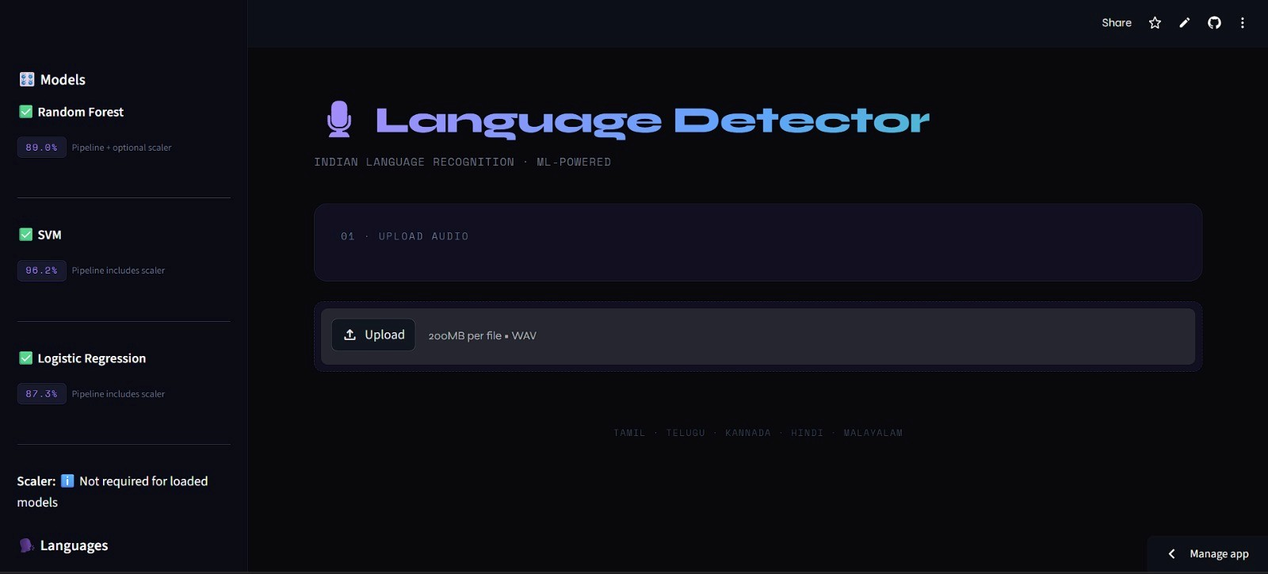

Slide 7
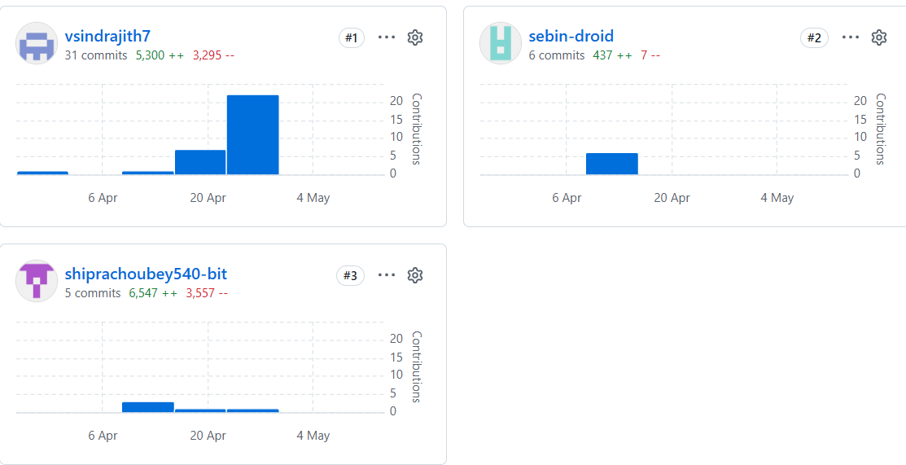
Individual commits

