Slide 1
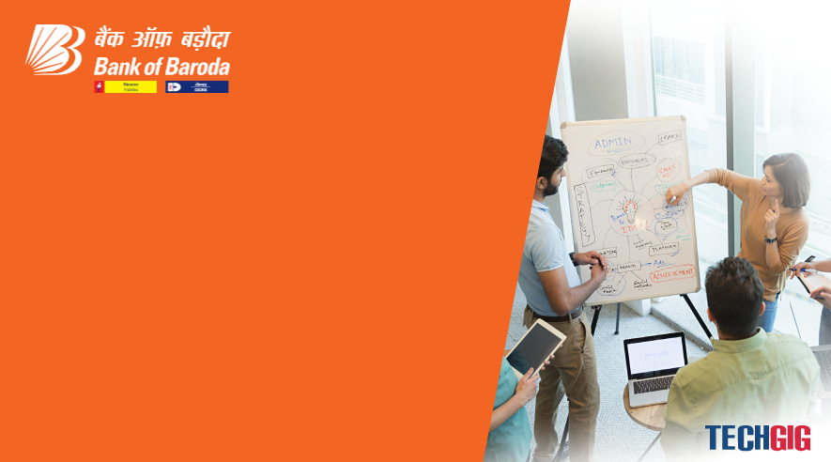

Bank of Baroda Hackathon - 2022
Technology Partner
Your Team Name :GutsyGeeker
Your team bio : Mohit / Gurpreet / Vikas / Vivek
Date :

Slide 2
Problem Statement?
Why did you decide to solve this Problem statement?
We are in the Banking industry and have experience in same domain. We have been working on improving the customer experience for seemless authentication.

Slide 3
User Segment & Pain Points
Which user /advertiser segment would be early adopter of your product & why?
User Segment:
Feature is not specific to an user and it should be available to all user to improve their experience.
Considering the feature set of voice and video; any user having smart phone with BoB mobile app should be early adopter or user of the technology we provide. The only reason is seamless authentication experience for user using its biometric footprints.
Any mobile user, feature support will changes depend on mode of communication. If not using mobile app – voice based assistant.
Pain:
Remembering password/account number while logging or performing high amount transaction.
Questioning every time on call for authenticating valid user.

Slide 4
Pre-Requisite
What are the alternatives/competitive products for the problem you are solving?
There are different solutions in business arena but not all of them used by any single bank for all the users.
The features are premium and used based on user classification. Still experience is not seam less

Slide 5
Azure tools or resources
Azure tools or resources which are likely to be used by you for the prototype, if your idea gets selected - Cognitive speech/image service may be used for voice and image based scoring.

Slide 6
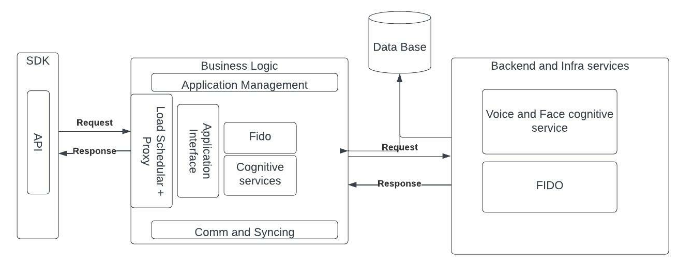
Any Supporting Functional Documents
Architecture and services

Slide 7
Key Differentiators & Adoption Plan
How is your solution better than alternatives and how do you plan to build adoption?
Password less solution
Enhanced user experience and personalized experience based on voice based authentication and mobile app interaction.
Friction less experience

Slide 8
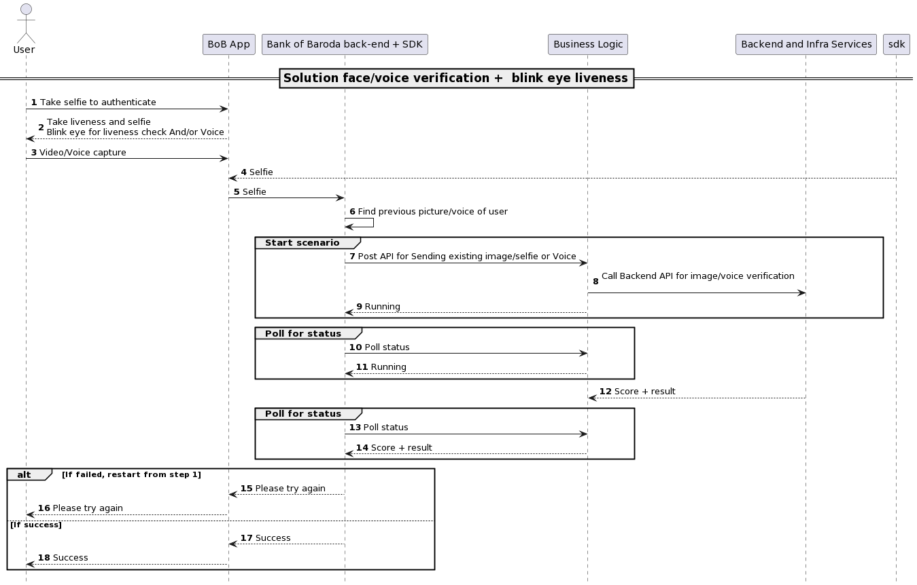
GitHub Repository Link & supporting diagrams, screenshots, if any
Use case and Sequence diagram

Slide 9
Thank You
Mohit / Gurpreet / Vikas / Vivek

