Slide 1

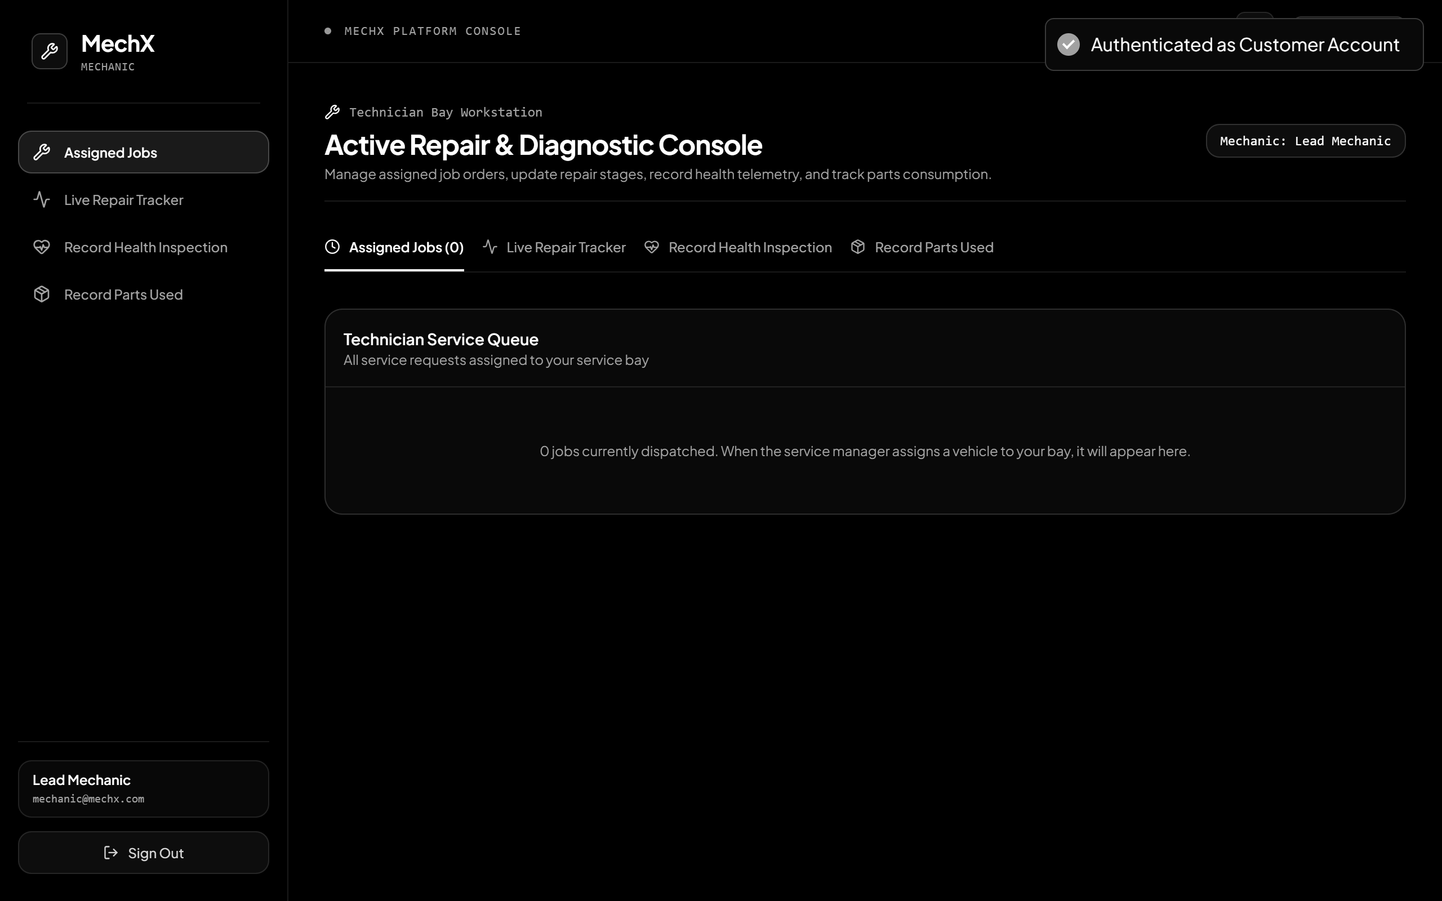
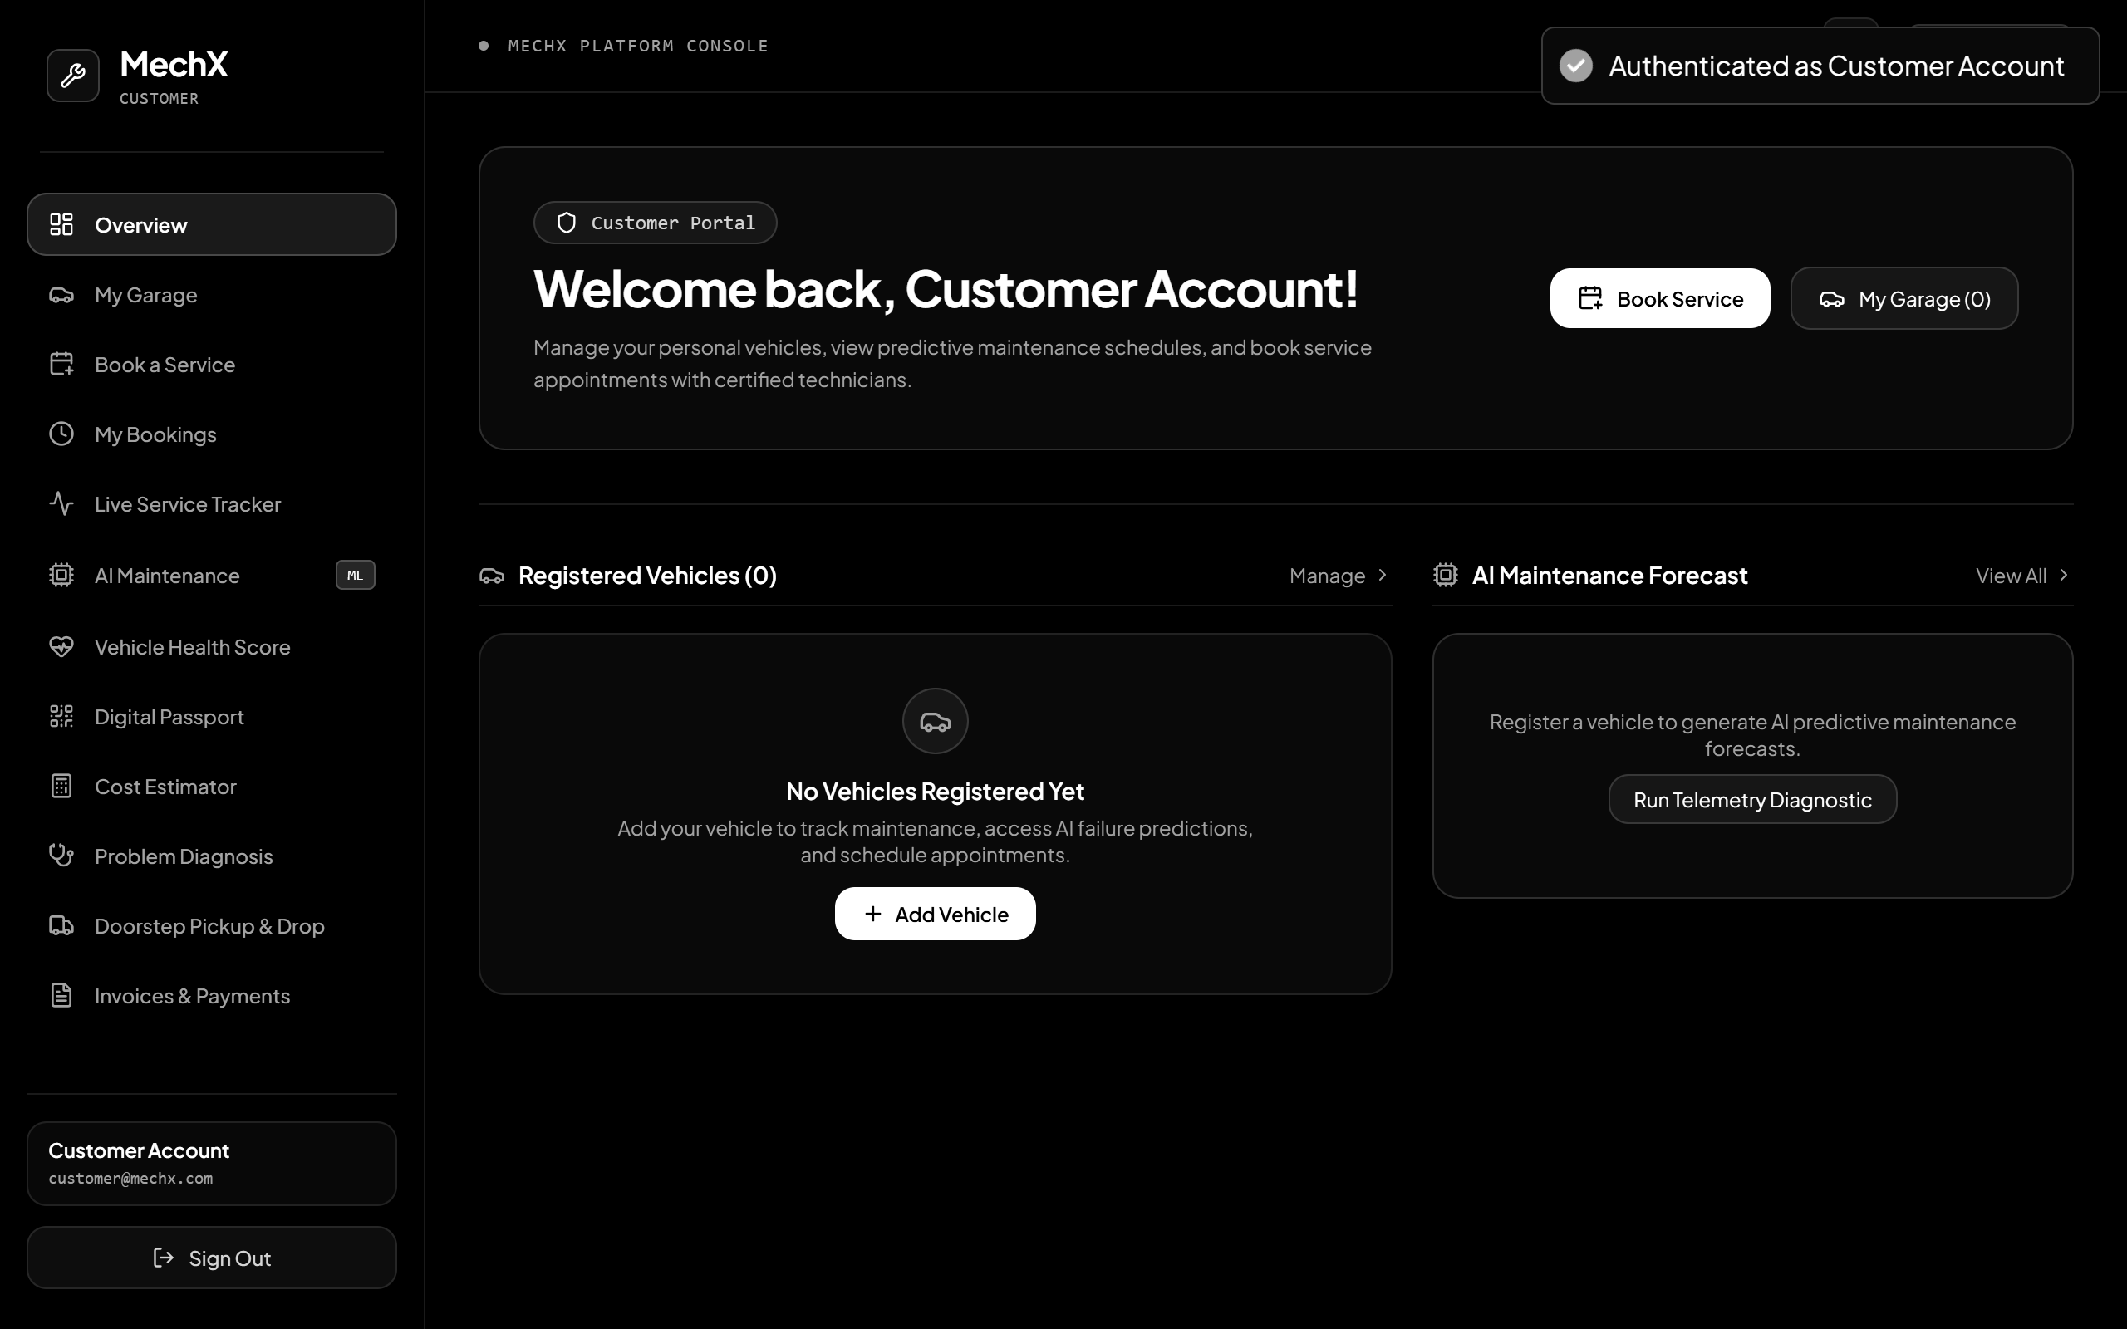
MechX
Vehicle Service Management Platform
One platform for vehicle owners, mechanics, service managers and administrators.
By:
Venkata Sai Krishna - 2520030027
Pujith Pavan Kumar - 2520030029
Sri Varun - 2520030324
LIVE PORTALS | CUSTOMER + MECHANIC
Notes:
Good morning everyone. We are presenting MechX, an Enterprise Vehicle Service Management Platform. MechX brings vehicle owners, mechanics, service managers and administrators onto one connected platform. The screenshots on the right are from the running application: the customer portal and the mechanic console. Over the next twelve slides we will cover the problem, our solution, how the system works, its architecture and database, security, and what we have verified so far. [Introduce team members and guide here.]

Slide 2






Why Do We Need This?
02 | CONTEXT
Vehicle servicing today involves many disconnected activities:
Customers struggle to track vehicle repairs
Unclear service charges and unexpected bills
Manual mechanic allocation
Delayed maintenance
Unorganized vehicle service history
Unverified vehicle pickup and delivery
CURRENT SERVICE JOURNEY
Customer
Vehicle
Service Booking
Mechanic
Repair
Billing
Delivery
Managing these activities separately makes vehicle servicing difficult and less transparent.
02 / 12
Notes:
Start with the real-world problem. When someone gives a car for servicing, they usually cannot see what is happening. Charges are unclear and bills can be a surprise. Mechanics are allocated manually, maintenance is often delayed until something breaks, service history is scattered, and handing over the vehicle is not verified. The flow at the bottom shows the journey from customer to delivery. Each step is usually handled separately, which makes servicing hard to manage and not transparent.

Slide 3
The Problem
03 | PROBLEM ANALYSIS
Problem | Effect
Information asymmetry | Customers lack repair transparency.
Manual mechanic assignment | Workshop delays and workload imbalance.
Reactive maintenance | Unexpected breakdowns and expensive repairs.
Paper service records | Records can be lost or manipulated.
Unsecured vehicle handover | Vehicle custody and liability risks.
Disconnected workshop operations | Difficult to manage servicing efficiently.
Our goal: bring all of these service activities together in one connected platform.
03 / 12
Notes:
This table maps each problem to its effect. Information asymmetry: the workshop knows everything, the customer knows nothing, so there is no transparency. Manual mechanic assignment causes delays and uneven workload. Reactive maintenance means people only fix things after they fail, which is more expensive. Paper records can be lost or altered. Handing a vehicle over without verification creates custody and liability risks. And when workshop operations are disconnected, running a service centre efficiently is hard. Our goal was to bring all of this together in one platform.

Slide 4








Our Solution
04 | SOLUTION
MechX is a centralized vehicle service management platform that connects:
Customers
Cost estimates
Vehicles
MechX
Central Platform
Billing and payments
Service bookings
Vehicle passports
Mechanics
Pickup and delivery
Repair tracking
Maintenance predictions
One platform for complete vehicle service management.
04 / 12
Notes:
This is our answer: MechX, one central platform. On the left are the core records: customers, vehicles, service bookings, mechanics and repair tracking. On the right are the outcomes: cost estimates, billing and payments, vehicle passports, pickup and delivery, and maintenance predictions. Every one of these connects through the same platform and the same database, so information is entered once and visible to everyone who needs it. One platform for complete vehicle service management.

Slide 5



Introducing MechX
05 | USERS AND ROLES
An enterprise vehicle service management platform connecting vehicle owners, mechanics, service managers and platform administrators.
CUSTOMER
MECHANIC
SERVICE MANAGER
SYSTEM ADMIN
Manage vehicles
Book services
Track repairs
Approve estimates
View invoices
Access vehicle passport
View maintenance predictions
View assigned jobs
Inspect vehicles
Update repair stages
Record vehicle health
Deduct spare parts
Manage service requests
Assign mechanics
Approve estimates
Manage inventory
Monitor workshop operations
Manage users
Manage service centers
Monitor analytics
View audit logs
Control platform operations
Four roles. One connected platform. Each user sees only what their role allows.
05 / 12
Notes:
MechX serves four types of users. The customer manages vehicles, books services, tracks repairs, approves estimates, views invoices, and accesses the vehicle passport and maintenance predictions. The mechanic sees assigned jobs, inspects vehicles, updates repair stages, records vehicle health and deducts spare parts. The service manager manages service requests, assigns mechanics, approves estimates, manages inventory and monitors workshop operations. The system admin manages users and service centres, monitors analytics, views audit logs and controls platform operations. Each portal shows only what that role needs.

Slide 6
How the System Works
06 | WORKFLOWS
VEHICLE SERVICE LIFECYCLE
01
Customer
02
Vehicle Registration
03
Service Booking
04
Mechanic Assignment
05
Vehicle Inspection
06
Cost Estimate
11
Completion
10
Invoice
09
Quality Check
08
Repair
07
Customer Approval
Customer step
Workshop step
PREDICTIVE MAINTENANCE
Vehicle Information
Odometer and Service History
Java Spring Boot
Python FastAPI
Random Forest Model
Maintenance Prediction
Customer Dashboard
The platform connects the complete service lifecycle instead of treating each activity separately.
06 / 12
Notes:
Two workflows. The top one is the vehicle service lifecycle: the customer registers a vehicle and books a service, a mechanic is assigned and inspects the vehicle, a cost estimate is prepared, the customer approves it, then repair, quality check, invoice and completion. Lime-outlined steps are customer actions. The bottom workflow is predictive maintenance: vehicle information, odometer and service history go from Spring Boot to the Python FastAPI service, where a Random Forest model produces a maintenance prediction, shown on the customer dashboard. The key point is that the platform treats this as one connected journey.

Slide 7



What Can the System Do?
07 | FEATURES
01
02
03
04
Customer and Vehicle Management
Service Booking and Appointment Scheduling
Smart Mechanic Assignment
11-Stage Service Tracking
Register owners and vehicles in a digital garage.
Pick a service category and an appointment slot.
Allocate each request to a suitable mechanic.
Follow repair progress from booking to completion.
05
06
07
08
Vehicle Health Score
Cost Estimation and Invoice Generation
Digital Vehicle Passport
Pickup and Drop Management
Mechanic inspections recorded as health reports.
Estimates for approval and PDF invoices.
SHA-256 verified record with a QR code.
Doorstep valet with secure OTP handover.
SUPPORTING INTELLIGENCE Python Predictive Maintenance: a FastAPI + Random Forest service forecasts upcoming maintenance needs.
07 / 12
Notes:
Eight functional areas. One: customer and vehicle management, the digital garage. Two: service booking with appointment slots. Three: smart mechanic assignment. Four: 11-stage service tracking so customers see live progress. Five: vehicle health score from mechanic inspections. Six: cost estimation and invoice generation, with PDF invoices. Seven: the digital vehicle passport, protected with a SHA-256 hash and a QR code. Eight: pickup and drop with secure OTP handover. Highlighted at the bottom is the Python predictive maintenance service, which supports the platform by forecasting upcoming maintenance.

Slide 8
System Architecture
08 | ARCHITECTURE
CLIENT TIER React 19 + Vite + Tailwind CSS
ARCHITECTURE RULES
Customer Portal
Mechanic Portal
Manager Portal
Admin Portal
React uses REST APIs only; it never touches MySQL
Spring Boot is the primary backend
Python is a supporting service for predictions only
Swagger / OpenAPI documents the APIs
REST APIs | HTTP / JSON
SECURITY AND API TIER Spring Security 6.3
JWT Authentication
Role-Based Access Control
REST Controllers
API Validation
Authenticated, role-checked requests
APPLICATION AND BUSINESS LOGIC TIER Java 21 + Spring Boot 3.3.4
SUPPORTING ML TIER
Customer Management
Vehicle Management
Booking Management
Mechanic Assignment Engine
11-Stage Service Lifecycle
REST
Python 3.14 + FastAPI
Cost Estimation
Digital Passport Generator
Invoice PDF Generator
Pickup and Drop Management
Analytics
HTTP
Scikit-learn
Random Forest pipeline
Joblib model
Predictive maintenance
Entities and repositories
PERSISTENCE TIER
Spring Data JPA + Hibernate
JDBC
DATABASE
MySQL 8.0 | 28 normalized tables
08 / 12
Notes:
Read the diagram top to bottom. The client tier is a React 19 app built with Vite and Tailwind, with four portals: customer, mechanic, manager and admin. React calls the backend only through REST APIs. Requests pass through the security tier, Spring Security 6.3, which verifies the JWT and checks the role. Then they reach the business logic tier in Java 21 and Spring Boot 3.3.4, which holds the core modules: bookings, mechanic assignment, the 11-stage lifecycle, cost estimation, passports, PDF invoices, pickup and drop, and analytics. Spring Boot talks to MySQL through Spring Data JPA and Hibernate. On the right, Python FastAPI is a supporting microservice used only for predictive maintenance. Spring Boot calls it over REST HTTP. Python does not replace Spring Boot and React never connects to the database directly.

Slide 9
Database Design
09 | DATABASE
vehicle_service_management | 28 tables | 6 domains
03 CATALOG AND SCHEDULING
04 SERVICE LIFECYCLE
05 INVENTORY AND BILLING
service_categories
service_packages
appointment_slots
service_requests
mechanic_assignments
service_records
service_status_history
spare_parts
service_parts
service_estimates
invoices
payments
vehicles to service requests
01 USERS AND IAM
02 FLEET AND PASSPORTS
06 DIAGNOSTICS AND SUPPORT
users
customer_profiles
mechanic_profiles
service_centers
vehicles
vehicle_passports
vehicle_maintenance_history
vehicle_health_reports
diagnosis_reports
maintenance_predictions
maintenance_rules
pickup_drop_requests
notifications
reviews
complaints
audit_logs
KEY RELATIONSHIPS
Users → Vehicles → Service Requests → Mechanic Assignments → Service Records
Service Requests → Estimates → Invoices → Payments
Vehicles → Maintenance History → Maintenance Predictions
Vehicles → Digital Passports
09 / 12
Notes:
The database is called vehicle_service_management and has 28 normalized tables organised into six domains. Domain 1: users and identity, with customer and mechanic profiles and service centres. Domain 2: fleet and passports, with vehicles, digital passports and maintenance history. Domain 3: the catalogue, service categories, packages and appointment slots. Domain 4: the service lifecycle, requests, mechanic assignments, records and status history. Domain 5: inventory and billing, spare parts, estimates, invoices and payments. Domain 6: diagnostics and support, including health reports, predictions, pickup requests, notifications, reviews, complaints and audit logs. The arrows show how domains connect, and the strip at the bottom lists the key relationships: users own vehicles, vehicles raise service requests, requests are assigned to mechanics, and billing flows from estimate to invoice to payment.

Slide 10




Keeping the Platform Secure and Controlled
10 | SECURITY AND RELIABILITY
AUTHENTICATION
AUTHORIZATION
DATA SECURITY
RELIABILITY
JWT authentication
HMAC-SHA256 signing
BCrypt password hashing
Customer role
Mechanic role
Service Manager role
System Admin role
Protected REST APIs
Input validation
Ownership verification
Secure OTP handover
SHA-256 digital passport integrity
ACID transactions
Safe inventory deduction
Timestamped service status history
Audit logs
SECURE REQUEST FLOW
User Login
JWT Verification
Role Validation
Authorized API
Database Operation
The right user sees the right information.
10 / 12
Notes:
Security is built in layers. Authentication: users log in and receive a JWT signed with HMAC-SHA256; passwords are stored only as BCrypt hashes. Authorization: four roles, customer, mechanic, service manager and system admin, each limited to its own portal and APIs. Data security: all REST APIs are protected, inputs are validated, ownership is verified so a customer can only see their own vehicles, pickup handover uses a secure OTP, and the digital passport uses a SHA-256 hash to detect tampering. Reliability: ACID transactions, safe inventory deduction, timestamped status history and audit logs. The flow at the bottom shows every request: login, JWT verification, role validation, then the authorized API, and only then the database operation.

Slide 11
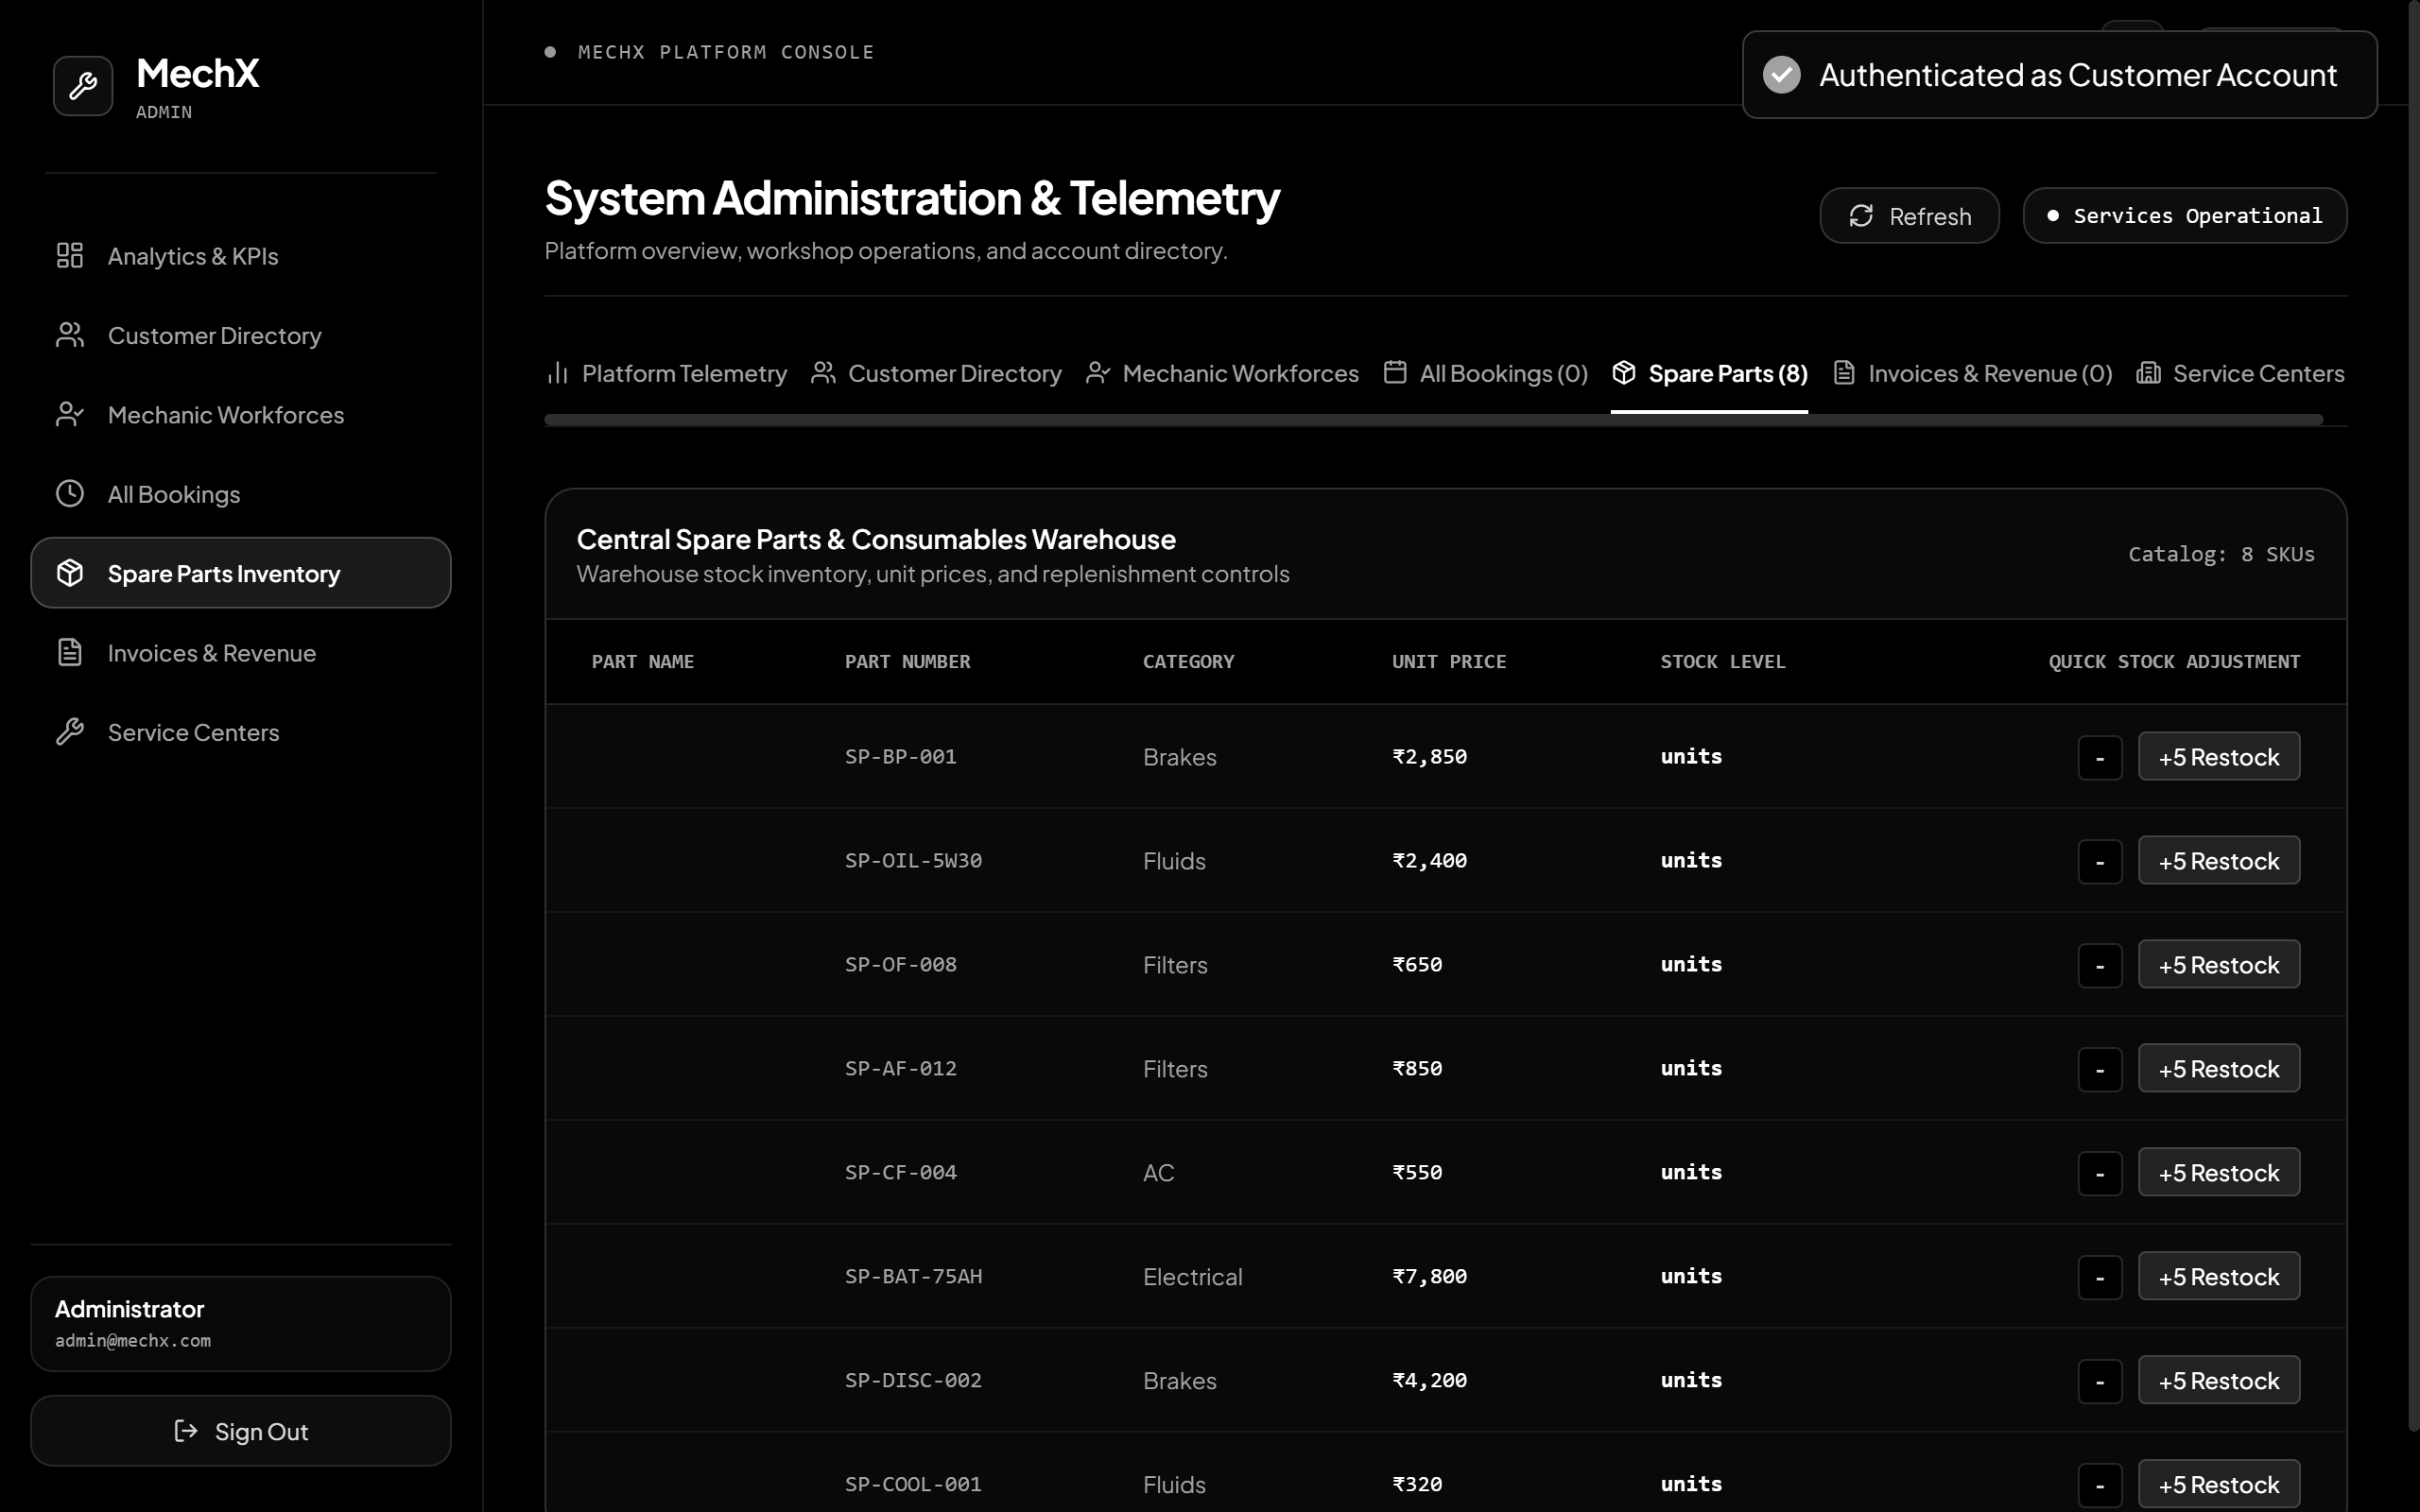
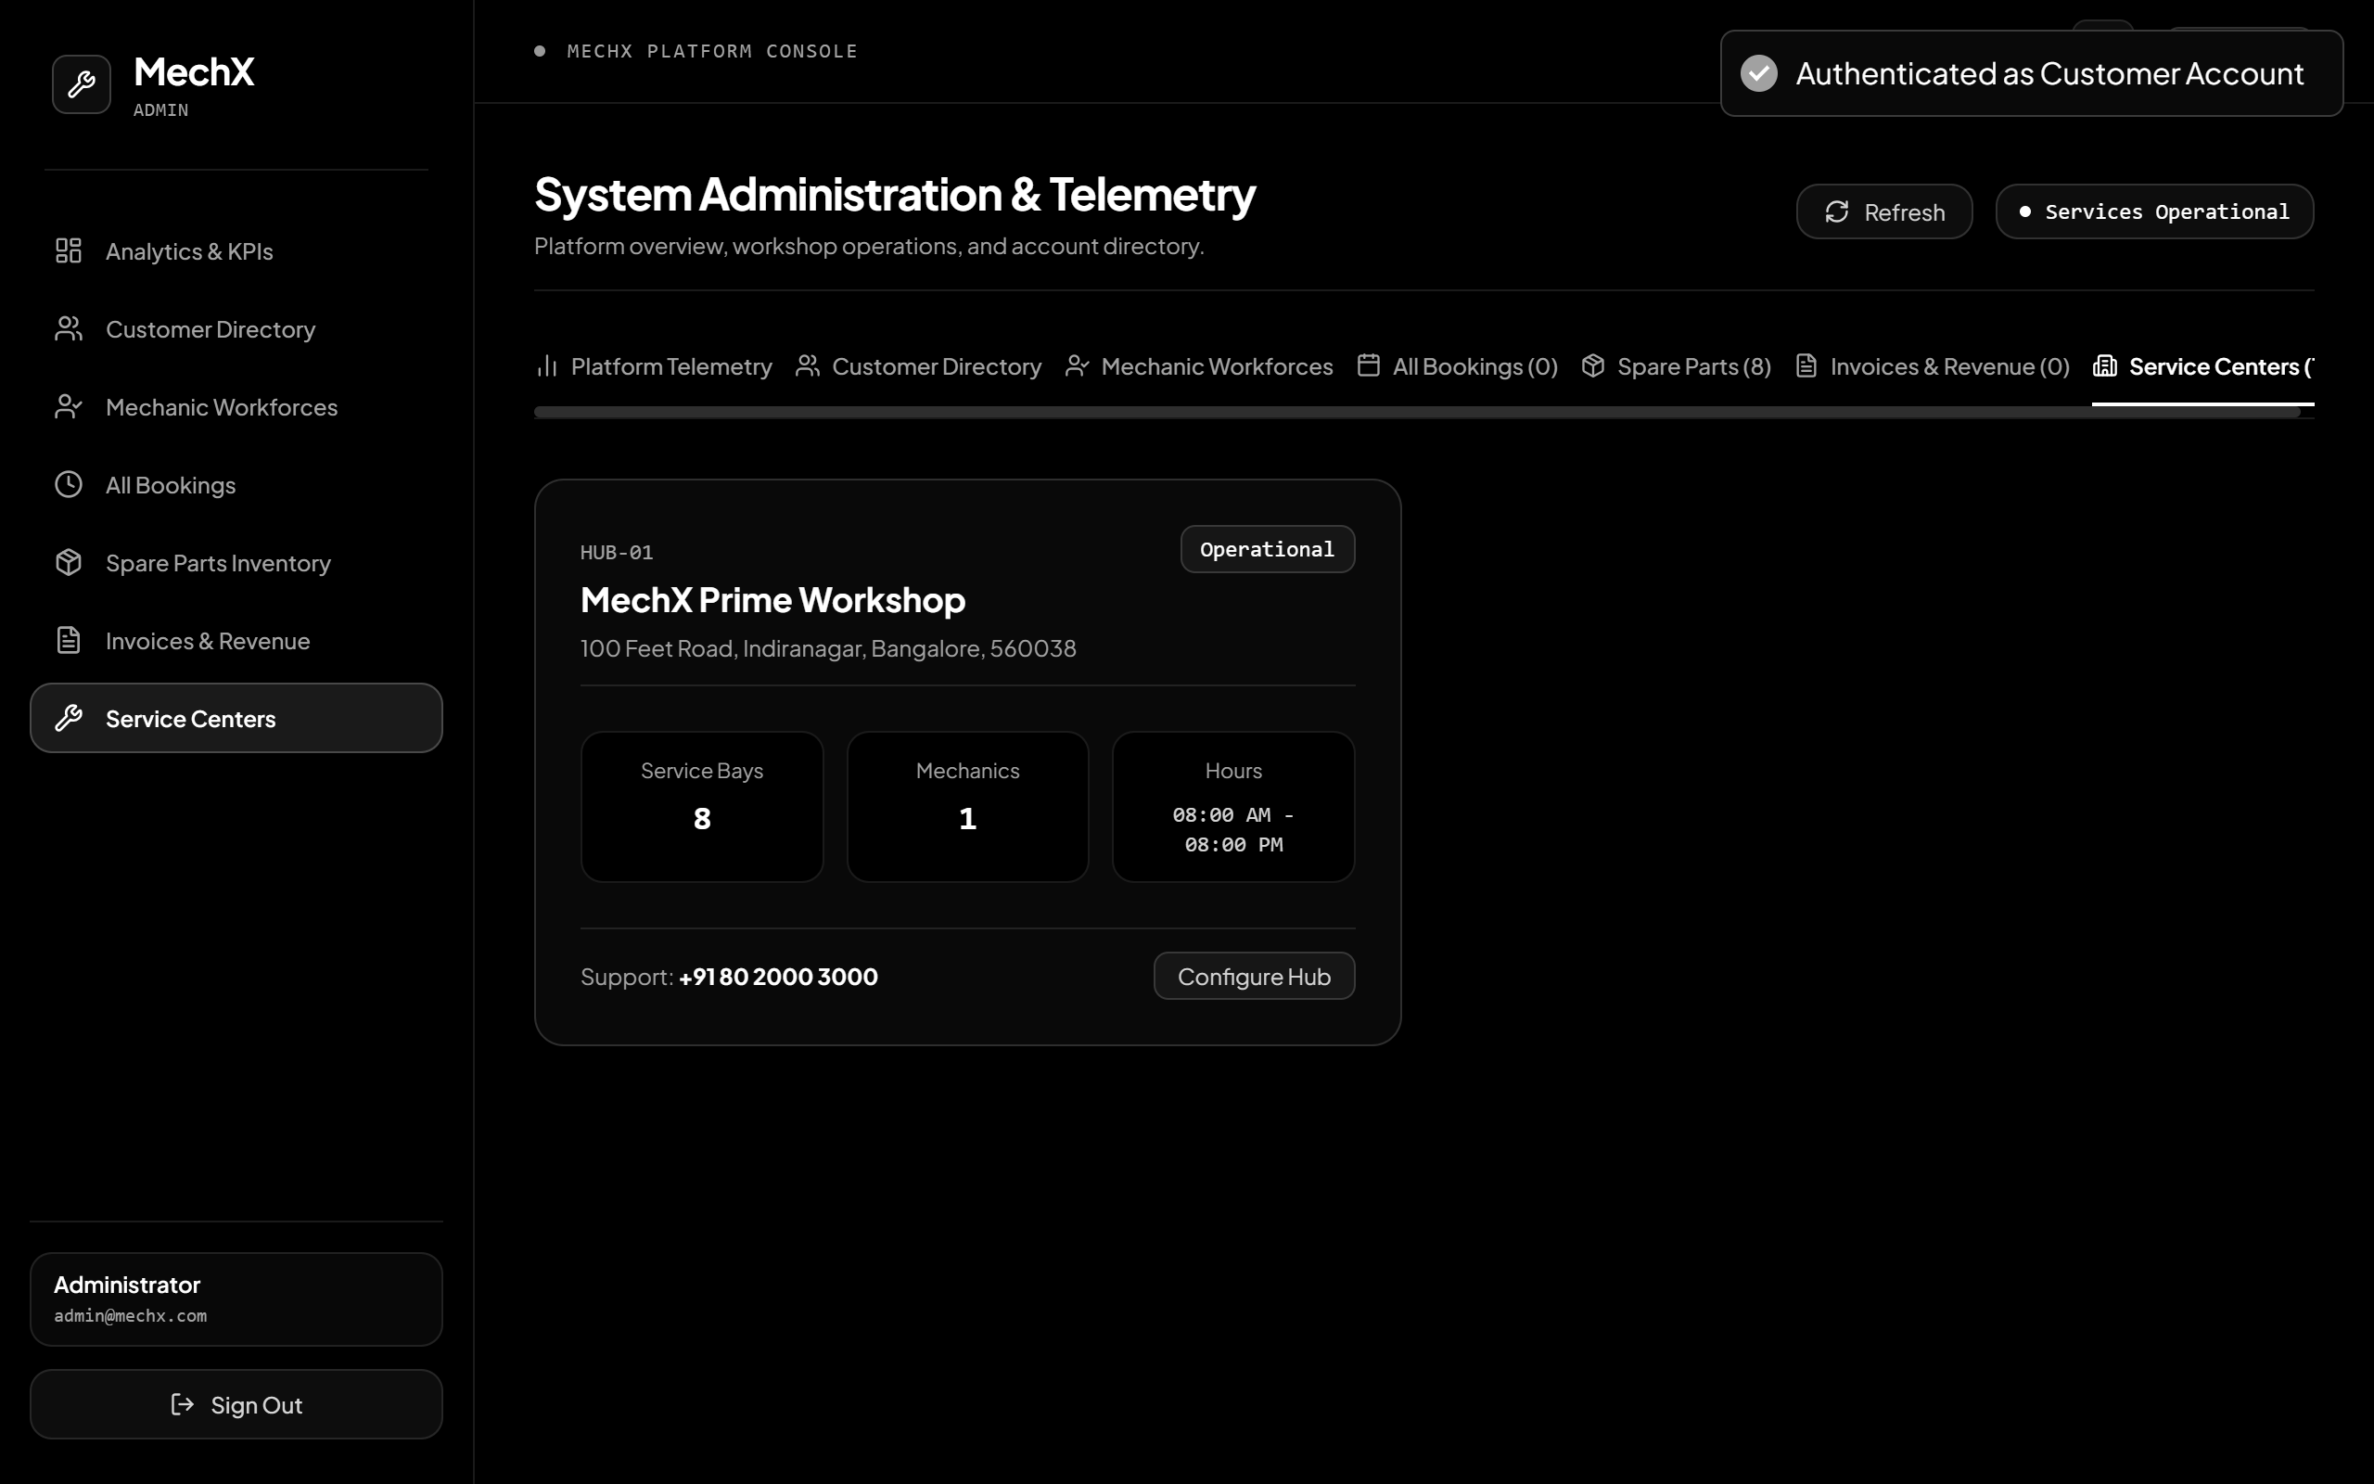
Testing & What We Achieved
11 | VERIFICATION
Frontend
Backend
VERIFIED IN THE RUNNING PLATFORM
React 19 + Vite + Tailwind CSS
Java 21 + Spring Boot 3.3.4
REST API integration
Swagger documentation (Spring Boot)
FastAPI Swagger documentation
Role-based portals
Database connectivity
Predictive maintenance integration
Service lifecycle
Mechanic assignment
Billing and inventory operations
PORT 5173
● ONLINE
PORT 8080
● ONLINE
Predictive Microservice
Database
Python 3.14 + FastAPI
MySQL 8.0
PORT 8000
● ONLINE
28 TABLES
● ONLINE
Future scope (not yet implemented): external payment gateway.
A working full-stack vehicle service management platform connecting customers, mechanics and service centers.
11 / 12
Notes:
This slide is about what is actually working. We have run the full stack: the React frontend on port 5173, the Spring Boot backend on port 8080, the Python FastAPI predictive service on port 8000, and MySQL with 28 tables, all online. We verified the REST API integration, Swagger documentation for both Spring Boot and FastAPI, the role-based portals, database connectivity, the predictive maintenance integration, the service lifecycle, mechanic assignment, and billing and inventory operations. The screenshots are from the running application. We are not claiming test counts, performance figures or model accuracy, and an external payment gateway is future scope, not implemented. In short, this is a working full-stack platform connecting customers, mechanics and service centres.

Slide 12
THANK YOU!!
MechX | Vehicle Service Management Platform
Notes:
Thank you for listening. MechX gives vehicle owners transparency, gives workshops structure, and gives the platform a verified record of every vehicle. Smarter service, complete transparency, better vehicle care. We are happy to take any questions.

