Slide 1

Subscription and Billing SaaS for Banking and Fintech
Team 18
Venkata Sai Krishna — 2520030027
Pujith Pavan Kumar — 2520030029
Srivarun — 2520030324
Guides
Dr. S. Spandana
Dr. Yerragudipadu Subbarayudu

Slide 2
Why Do We Need This?
Financial companies handle many activities every day:
Customer management
Subscription plans
Loan processing
Repayment tracking
Billing and invoices
Payments and refunds
Customer support
Customer
›
Loan
›
Repayment
›
Billing
›
Payment
When these activities are handled separately, managing everything becomes difficult.
02 / 12

Slide 3
The Problem
Many financial operations are connected, but they are often handled through different processes.
Problem | Effect
Operations handled through different processes | Information is difficult to track
Same work done again and again | Repeated manual work
Loans and repayments kept separate | Difficult to manage loans and repayments
Billing and payments in different processes | Billing and payments are handled separately
Many companies and customers | Difficult to manage them together
Our goal was to bring these activities together in one place.
03 / 12

Slide 4
Our Solution
We developed a centralized platform for banking and fintech companies. It brings together:
Customers
Plans and subscriptions
Loans and repayments
Billing and invoices
Payments and refunds
Notifications and support
One platform for the main financial operations.
04 / 12

Slide 5
Introducing
FinCore is our multi-company SaaS platform for managing banking and fintech financial operations.
CUSTOMER
COMPANY ADMIN
View plans
Manage subscriptions
Apply for loans
Track repayments
View invoices
Make payments
Manage customers
Manage plans
Review loans
Track payments
View reports
Manage support
Each company manages its own customers and financial data.
05 / 12

Slide 6
How the System Works
Subscription and Billing
Customer
›
Plan
›
Subscription
›
Invoice
›
Payment
Loan
Loan Application
›
Review
›
Approval
›
Loan
›
Repayment Schedule
›
Repayment
The system connects the complete journey instead of treating each activity separately.
06 / 12

Slide 7
What Can the System Do?
Customer Management
Plans & Subscriptions
Loan Management
Repayment Tracking
Add and manage customers
Create plans and subscribe
Handle applications and loans
Track schedules and repayments
Billing & Invoices
Payments & Refunds
Notifications & Support
Search & Reporting
Create invoices and track payments
Record payments and refunds
Send updates and handle support
Find records and view reports
07 / 12

Slide 8
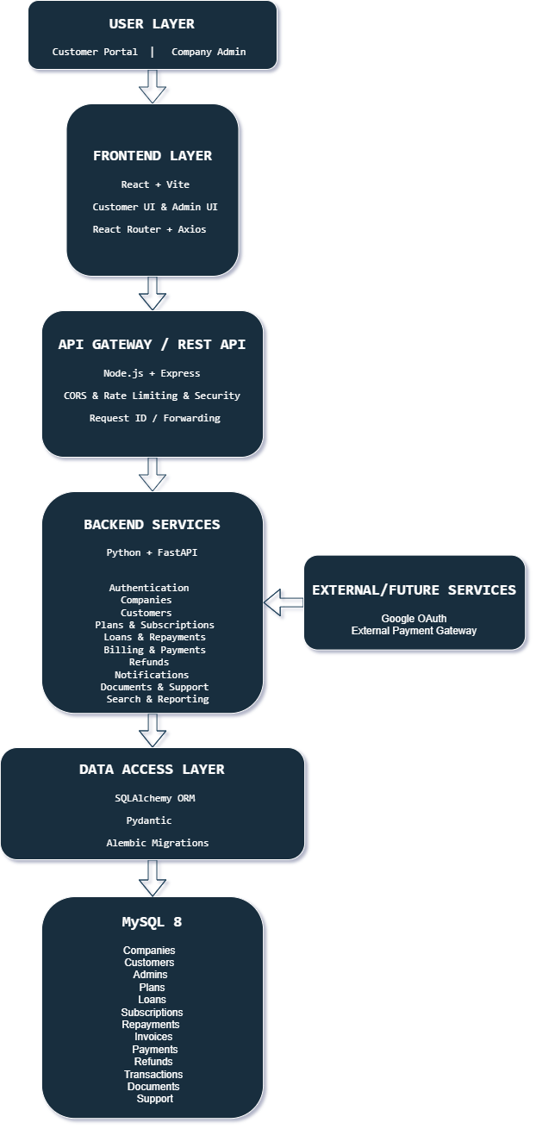
System Architecture
React handles the user interface, Node.js and Express provide the API gateway, FastAPI manages the backend services, and MySQL stores the data.
Figure: FinCore system architecture
08 / 12

Slide 9
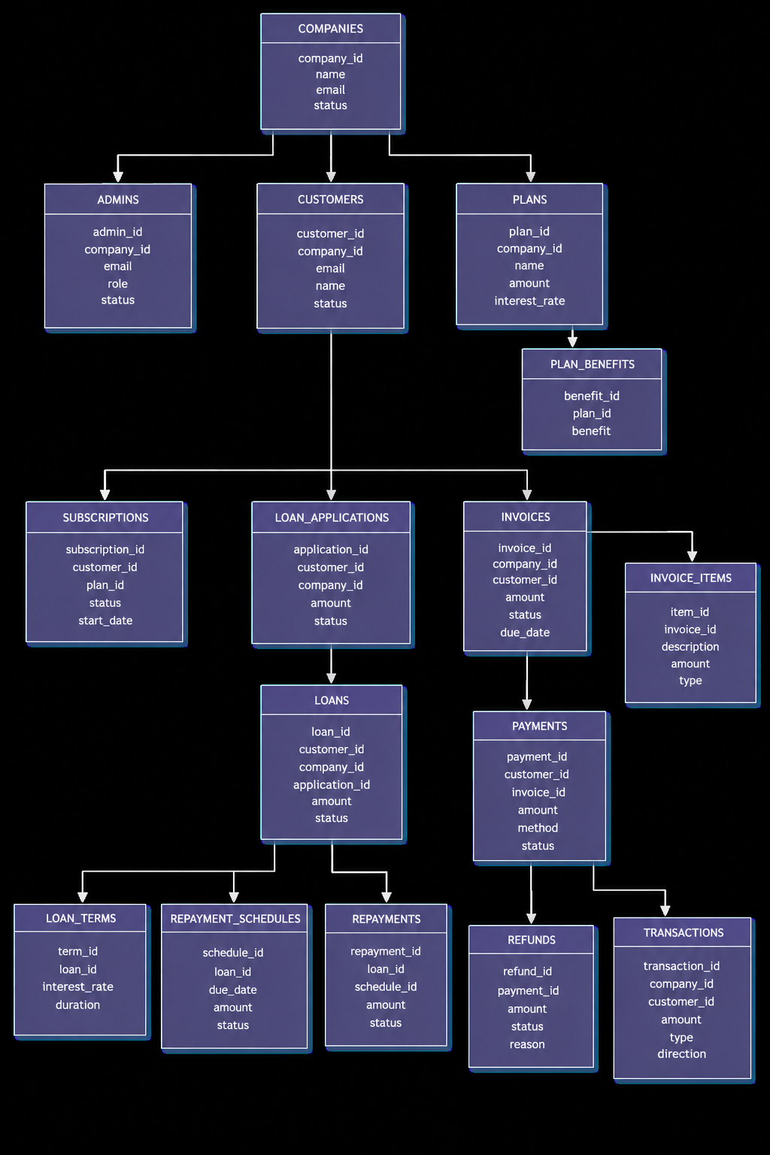
Database Design
The database connects companies, customers, plans, loans, repayments, invoices, payments and other supporting information.
Figure: FinCore database design
09 / 12

Slide 10
Keeping Data Separate and Controlled
FinCore is designed to support multiple financial companies. Each company can have:
ADMINISTRATORS
CUSTOMERS
SEPARATE DATA
Administrators manage their company’s operations.
Customers belong to their respective company.
One company’s information should not be mixed with another company’s data.
Security features
Authentication | Role-based access | Session management
Request validation | Rate limiting | Security headers
The right user should see the right information.
10 / 12

Slide 11
Testing & What We Achieved
We checked the important parts of the system during development.
Tested
What we achieved
Financial calculations
Loan and repayment logic
Backend services
API routes
Database migrations
Application startup
Billing and payment operations
A working foundation for managing banking and fintech financial operations through one platform.
Future improvements
Real email and OTP delivery
Google authentication
External payment gateway
Advanced event processing
Monitoring and deployment improvements
23 Financial Calculation Tests Passed
11 / 12

Slide 12
Thank You
Subscription and Billing SaaS for Banking and Fintech

