Slide 1
Data Structures and Algorithms -3 (25CS2103E)
Email Content Analysis for Detecting Spam Messages
Submitted by
Venkata Sai Krishna (2520030027) Pujith Pavan Kumar (2520030029) Ajai Manikanta (2520030320)
Under the Esteemed Guidance of
Dr S Madhavi Professor,CSE

Slide 2
Contents
Abstract
Introduction
Literature survey
Problem Statement and Objectives
Hardware and Software requirements
Results
Conclusion
Future Scope

Slide 3
Abstract
Email Content Analysis for Detecting Spam Messages is a Java-based console application designed to identify spam and suspicious emails by analyzing their content. The system reads emails and spam-related keywords from text files, preprocesses the content, and uses string-matching algorithms such as KMP, Rabin-Karp, Z-Algorithm, and Aho-Corasick to detect suspicious words and phrases.
The project also demonstrates other Data Structures and Algorithms concepts, including Bitmask Dynamic Programming, Edmonds-Karp, Greedy Set Cover, randomized hashing, and parallel processing. Based on the detected patterns and calculated score, each email is classified as SPAM or NOT SPAM. This project shows how different DSA concepts can be combined to solve a practical problem in a simple and understandable way.

Slide 4
Introduction
Email has become an important part of everyday communication, but the increasing number of spam and suspicious messages has also created security and privacy concerns. Spam emails may contain unwanted advertisements, fake prize notifications, account verification requests, or attempts to collect personal information. Therefore, identifying such messages based on their content is useful for reducing the risk caused by suspicious emails.
This project, Email Content Analysis for Detecting Spam Messages, uses different Data Structures and Algorithms to analyze email content and identify suspicious patterns. The system searches for spam-related words and phrases using multiple string-matching algorithms and then applies additional DSA techniques to calculate and analyze the detected features. Finally, each email is classified as SPAM or NOT SPAM, showing how concepts learned in DSA can be applied to a practical real-world problem.

Slide 5
Literature Survey
Several existing studies have focused on detecting spam emails using different computational and algorithmic techniques. Traditional spam detection methods mainly analyze email content and identify suspicious words, phrases, and patterns. String-matching algorithms such as KMP, Rabin-Karp, and Aho-Corasick are useful for efficiently searching multiple patterns in large text. These approaches provide a simple and understandable way to identify common spam indicators.
Recent approaches also use machine learning, statistical methods, and advanced algorithms to improve spam detection. However, such methods can require large datasets and additional training. This project takes a simpler DSA-based approach by combining string matching with Dynamic Programming, network flow, greedy approximation, randomized hashing, and parallel processing. This makes the system useful for demonstrating how different DSA concepts can be applied together to solve a practical email spam detection problem.

Slide 6
Problem Statement and Objectives
Spam emails are a common problem that can contain unwanted advertisements, fake offers, prize scams, account verification requests, and attempts to obtain personal information. Manually checking a large number of emails is time-consuming and may not always identify suspicious messages accurately. Therefore, there is a need for a simple system that can analyze email content and detect suspicious patterns efficiently.
The proposed project aims to develop a Java-based email content analysis system that uses different Data Structures and Algorithms to identify spam-related words and phrases and classify emails as SPAM or NOT SPAM.
Objectives
To develop a system for detecting spam and suspicious emails.
To preprocess email text for efficient analysis.
To apply KMP, Rabin-Karp, Z-Algorithm, and Aho-Corasick for pattern matching.
To use Dynamic Programming for feature-score calculation.
To demonstrate Edmonds-Karp network flow in spam analysis.
To apply Greedy Set Cover for selecting suitable spam detection rules.
To demonstrate randomized hashing and parallel processing.
To classify emails based on their calculated spam score.

Slide 7
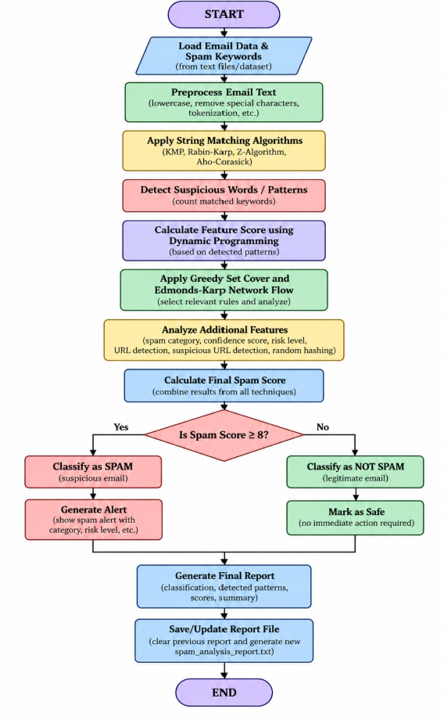
Flow Chart

Slide 8
Results
The Email Content Analysis for Detecting Spam Messages system was successfully implemented and tested using sample email data. The system reads emails and spam keywords from text files, preprocesses the content, and identifies suspicious words and phrases using KMP, Rabin-Karp, Z-Algorithm, and Aho-Corasick. The detected patterns are then used for further scoring and analysis.
Based on the calculated spam score, emails are classified as SPAM or NOT SPAM. The system also displays the detected patterns, scores, classification results, and a final summary of the analyzed emails. The implementation demonstrates that multiple DSA concepts can be combined effectively to solve a practical email spam detection problem.

Slide 9
Hardware and Software requirements
Hardware Requirements
Processor: Intel Core i3 or equivalent
RAM: 4 GB or above
Storage: 500 MB free space
Input: Keyboard and mouse
Display: Standard monitor/laptop display
Software Requirements
Operating System: Windows 10/11
Programming Language: Java
JDK: JDK 17 or above
IDE: Visual Studio Code
Java Extension: Microsoft Java Extension Pack
InputData: Text files (emails.txt, spam_keywords.txt, spam_analysis_report.txt)
Execution: Windows Command Prompt / VS Code Terminal

Slide 10
Conclusion
The Email Content Analysis for Detecting Spam Messages project successfully demonstrates the use of different Data Structures and Algorithms for detecting spam emails. By combining string-matching techniques, Dynamic Programming, network flow, greedy approximation, randomized hashing, and parallel processing, the system can analyze email content and classify messages as SPAM or NOT SPAM.
The project provides a simple and practical way to understand how DSA concepts can be applied to a real-world problem. It also shows how multiple algorithms can work together to improve the analysis process and generate meaningful results from email data.

Slide 11
Future Scope
Improve spam detection accuracy using Machine Learning and AI techniques.
Support larger email datasets and real-time email analysis.
Add multilingual spam detection for different languages.
Develop a web or mobile interface for easier use.
Include attachment and suspicious-link analysis.
Use advanced features to reduce false positives and false negatives.
Integrate the system with real email services for automatic spam filtering.

Slide 12
Thank you

