Slide 1
Data Structures and Algorithms -3 (25CS2103E)
Email Content Analysis for Detecting Spam Messages
Submitted by
Venkata Sai Krishna (2520030027)
Pujith Pavan Kumar (2520030029)
Ajai Manikanta (2520030320)
Under the Esteemed Guidance of
Dr S Madhavi
Professor, CSE

Slide 2
Contents
Introduction
Problem Statement
Project Workflow
Algorithms Used
Spam Analysis
Tools & Technologies
Results
Expected Outcomes
Conclusion
Future Scope

Slide 3
Introduction
Spam emails may contain fake offers, suspicious links or misleading messages.
Checking a large number of emails manually takes time.
Our project analyzes the actual content of an email.
It searches for suspicious words and patterns using DSA algorithms.
Finally, the email is classified as SPAM or NOT SPAM.
DSA concepts are used to solve a practical email analysis problem.

Slide 4
Problem Statement
Spam emails are common and may contain fake prizes, account warnings, financial scams or suspicious links.
Manually checking every message is difficult when the number of emails increases.
Therefore, we need a simple system that can:
Read email content
Detect suspicious patterns
Analyze spam-related features
Identify suspicious URLs
Calculate a spam score
Classify the email as SPAM or NOT SPAM

Slide 5
Project Workflow
Load Email
Preprocess Text
Search Spam Patterns
Analyze Detected Features
Calculate Spam Score
Check URLs & Risk
SPAM / NOT SPAM
Generate Result

Slide 6
String Matching Algorithms
1. KMP
Uses the LPS table to search for a pattern efficiently.
2. Rabin-Karp
Uses hashing to search for matching text.
3. Z-Algorithm
Uses a Z-array to identify pattern matches.
4. Aho-Corasick
Searches for multiple spam patterns together.
These algorithms help us find suspicious words and phrases in email content.

Slide 7
Other DSA Algorithms
Bitmask Dynamic Programming
Checks combinations of detected spam features.
Edmonds-Karp
Uses the maximum-flow concept for feature analysis.
Greedy Set Cover
Selects useful rules that cover detected spam features.
Randomized Hashing
Generates a hash value for email content.
Parallel Processing
Processes multiple emails using multiple threads.

Slide 8
Spam Analysis
Suspicious words found
Information shown by the system
Matched Keywords
Spam Category
Confidence Score
Risk Level
URLs Detected
Suspicious URLs
Final Result
Matched patterns
Feature score
URL analysis
Risk & confidence
Final classification
Final Result: SPAM or NOT SPAM
Based on DSA algorithms and rule / feature-based analysis.

Slide 9
Tools and Technologies Used
Category | Tools / Technologies Used
Programming Languages | Java, HTML, CSS, JavaScript
Software / IDEs | Visual Studio Code, JDK 17 or above
Frameworks / Libraries | Java standard libraries
Databases / Platforms | Text files for data storage, Windows 10/11
Hardware / IoT Components (if applicable) | Not applicable. Standard laptop/desktop (Intel Core i3 or equivalent, 4 GB RAM)
Other Tools / Platforms | Chrome / Edge browser, VS Code Terminal / Command Prompt

Slide 10
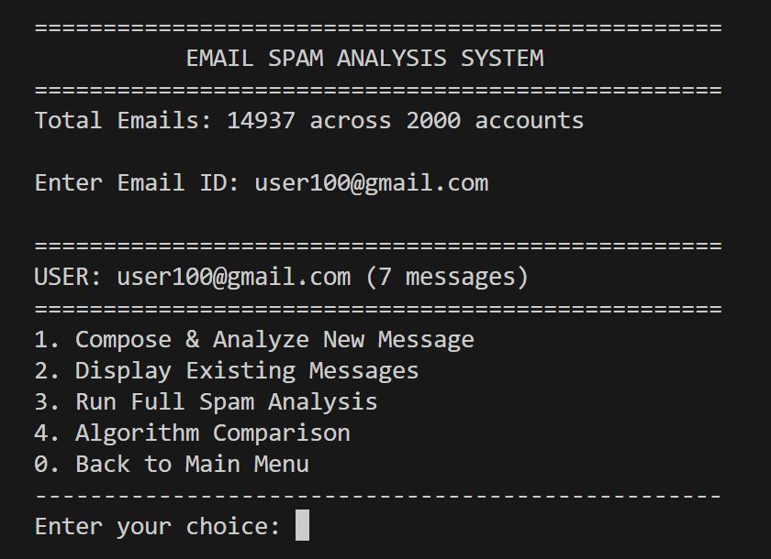
Results
Console email menu: Starting screen of the console application.

Slide 11
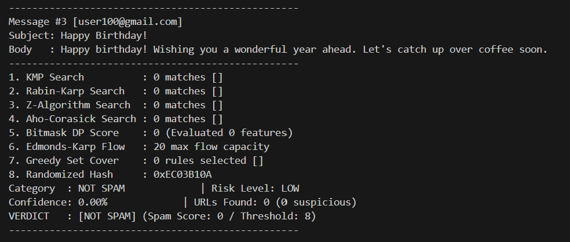
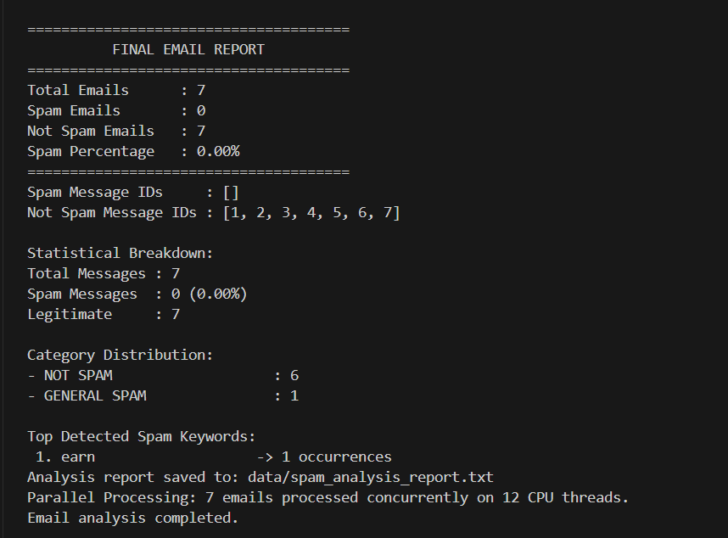
Results
Individual email analysis: Analyzes an individual email.

Slide 12
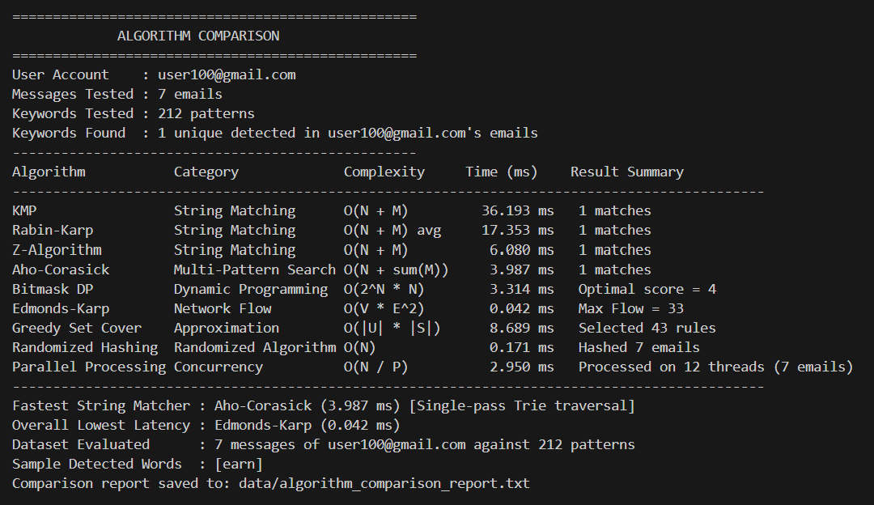
Results
Algorithm comparison: Shows matches from the implemented algorithms.

Slide 13
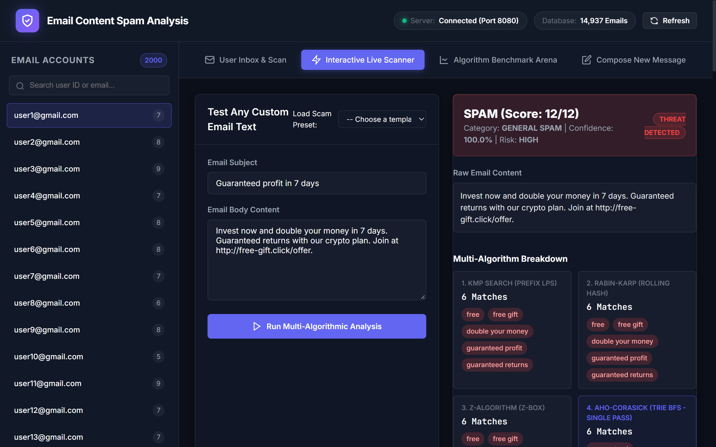
Results
Web interface: Displays spam category, confidence and risk, with the final SPAM / NOT SPAM result.

Slide 14
Expected Outcomes
Detect suspicious words and phrases in email content.
Show how different DSA algorithms work on the same email.
Give a spam score, category, confidence and risk level.
Identify suspicious URLs in the email.
Give a clear SPAM / NOT SPAM result.

Slide 15
Conclusion & Future Scope
CONCLUSION
The system analyzes email content using DSA algorithms.
Suspicious words and patterns can be detected.
Multiple algorithms are demonstrated in one project.
Emails are classified as SPAM or NOT SPAM.
Results can be accessed through the console and web interface.
FUTURE SCOPE
Improve spam detection rules
Support larger email datasets
Add Machine Learning in the future
Improve phishing-link detection
Add real email-service integration
Support more languages

Slide 16
Thank you

