Slide 1

Match Outcome Prediction Using Logistic Regression and Random Forest
09
TEAM MEMBERS
Venkata Sai Krishna 2520030027
Ajai Manikanta 2520030320
SECTION
Notes:
Introduce the project: CricVision predicts match winners across TEST, ODI, T20 and IPL using Logistic Regression and Random Forest.

Slide 2
Problem Definition
1
What problem are we solving?
2
Why is it important?
Predict the winner of a cricket match from historical data.
A supervised classification task across TEST, ODI, T20 and IPL.
Results depend on team strength, recent form, venue and toss.
A data-driven model gives a consistent, explainable estimate.
3
Who will use it?
4
What is the expected output?
Cricket analysts, fans and commentators.
Students and researchers in sports analytics.
The predicted winner.
Prediction probabilities for each outcome (TEST also includes Draw).
02 / 12
Notes:
Four required questions. Core idea: supervised classification on historical cricket data. For TEST the model also gives a draw probability.

Slide 3
Dataset Collection
Cricsheet match files (JSON)
Downloaded & processed in Python / Colab
Combined table: 8,247 rows × 13 columns
8,247
13
TEST
ODI
T20
IPL
894
2,571
3,539
1,243
records
raw features
matches
matches
matches
matches
Target variable: winner
used for modelling: 894
used for modelling: 2,442
used for modelling: 3,423
used for modelling: 1,218
RAW DATASET FEATURES (13 match-level columns)
format
date
team1
team2
venue
toss_winner
toss_decision
winner
result
team1_runs
team2_runs
team1_wickets
team2_wickets
03 / 12
Notes:
Source: Cricsheet. JSON match files were downloaded and processed in Python/Colab into one combined table of 8,247 matches and 13 raw columns. Raw columns are not the model inputs - the models use 10 engineered features (slide 7). Matches used for modelling are fewer for ODI, T20 and IPL because matches without a clear winner were excluded in the model notebooks.

Slide 4
Data Understanding
df.shape
df.dtypes
print("Number of records:", df.shape[0])
print("Number of features:", df.shape[1])
Number of records: 8247
Number of features: 13
print(df.dtypes)
format object
team1 object
toss_decision object
team1_runs int64
team2_wickets int64
# 9 categorical + 4 numerical columns
df.nunique()
df.describe()
print(df.nunique())
format 4
team1 128
venue 476
toss_decision 2
team1_runs 735
team1_wickets 22
team1_runs team2_runs team1_wkts
mean 220.24 198.40 7.89
std 140.24 131.81 4.04
min 0.00 0.00 0.00
50% 179.00 162.00 8.00
max 1078.00 892.00 21.00
We first understood the structure, data types, distributions and quality of the dataset before preprocessing.
04 / 12
Notes:
We first inspected shape, data types, unique values and the statistical summary. All values on this slide are copied from the Colab output on the combined dataset.

Slide 5
Data Preprocessing
Missing values
Duplicate records
Incorrect data
7,809
0
0
missing in ‘result’ only (94.69%)
duplicates found
negative runs or wickets
Filled with “Unknown”. The other 12 columns have 0 missing.
8,247 rows before and after drop_duplicates().
Checked team1 / team2 runs and wickets.
Categorical variables
Numerical variables
Outliers (IQR rule)
9
4
1.5×IQR
text columns
numeric columns
beyond Q1 − / Q3 + 1.5×IQR
Team, venue and toss become numeric features (Elo, win rates, form), not raw inputs.
StandardScaler is used only for Logistic Regression (TEST). Random Forest needs no scaling.
Flagged: team1_runs 731, team2_runs 713, team1_wickets 488, team2_wickets 420. Kept — big totals and collapses are real matches.
05 / 12
Notes:
All numbers come from the Colab checks on the combined 8,247-row dataset. Only the 'result' column had missing values, and it was filled with 'Unknown'. Outliers were detected with the IQR rule but NOT removed. No one-hot or label encoding appears in the notebooks: team, venue and toss information is converted to numeric features through feature engineering. StandardScaler is only inside the Logistic Regression pipeline.

Slide 6
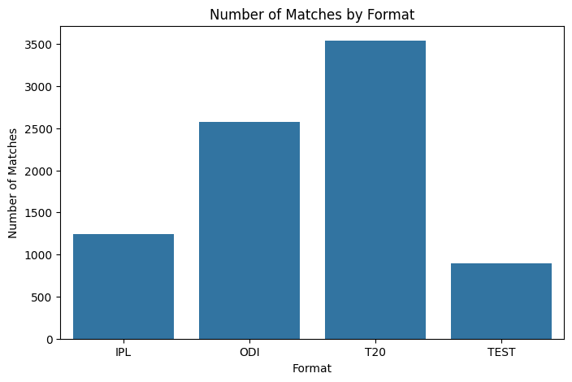
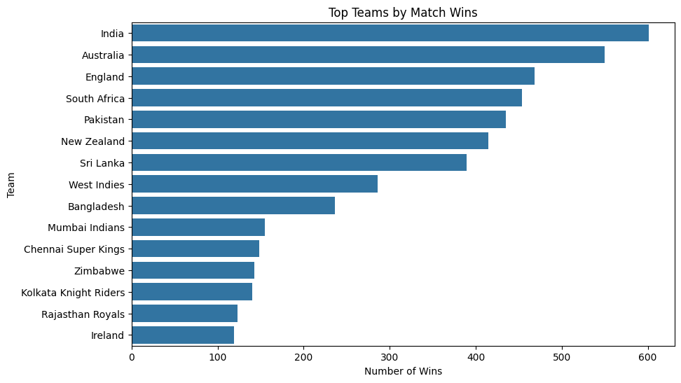
Exploratory Data Analysis
Number of matches by format
Top teams by match wins
T20 has the most matches (3,539); TEST has the fewest (894).
India has the most wins in the data: 601 (all formats combined).
06 / 12
Notes:
Charts are taken directly from the Colab notebook. India's 601 wins is the most frequent winner in the combined dataset (all formats). Outlier counts from the box plot are on the Data Preprocessing slide.

Slide 7
Feature Engineering
RAW DATA · 13 columns
FEATURE ENGINEERING
ML FEATURES · 10 engineered, pre-match
format
date
team1 / team2
venue
toss_winner
toss_decision
winner
result
Go through matches in date order
Update each team’s history after the match
Compare Team 1 with Team 2
Elo, win rate, form, head-to-head, venue, toss
elo_diff
win_rate_diff
Gap in team strength rating
Gap in past winning %
recent_form_diff
avg_runs_diff
Gap in last-5-match form
Gap in average runs scored
avg_wickets_diff
run_rate_diff
Gap in average wickets lost
Gap in average run rate
✕ team1_runs
✕ team2_runs
✕ team1_wickets
✕ team2_wickets
team_1_h2h_win_rate
venue_win_rate_diff
Team 1’s record vs this rival
Gap in record at this venue
toss_winner_diff
bat_first_diff
✕ known only after the match
Which team won the toss
Which team bats first
Why aren’t team1_runs, team2_runs, team1_wickets, team2_wickets used? They are known only after the match ends, so using them would leak the result. Only their past averages are used (avg_runs_diff, avg_wickets_diff).
Pitch type is a context input in the CricVision app only — it is not a trained model feature.
07 / 12
Notes:
Raw data has 13 match-level columns; the models use 10 engineered pre-match features. Matches are processed in date order and team history is updated only AFTER each match, so features use only what was known before kickoff. The four post-match columns are not model inputs. Pitch type is a context input in the CricVision app only (pitch_type_used = False in the saved model info). The TEST model names its head-to-head feature team1_h2h_points_rate because draws are counted.

Slide 8
Train-Test Split
100% of matches used for modelling (sorted by date)
TRAIN 70%
VALIDATION 15%
TEST 15%
Training data
Validation data
Testing data
Used to train the machine learning model.
Used to tune settings, such as the decision threshold.
Newest, unseen matches — kept separate so the model is evaluated fairly.
Format | Matches used | Train | Validation | Test
TEST | 894 | 625 | 134 | 135
ODI | 2,442 | 1,709 | 366 | 367
T20 | 3,423 | 2,396 | 513 | 514
IPL | 1,218 | 852 | 183 | 183
08 / 12
Notes:
The notebooks split each format by date, not randomly: 70% train, 15% validation, 15% test (oldest matches train, newest matches test). Validation was used to tune settings such as the decision threshold. For ODI the final saved model was fitted on train + validation (first 85%) and evaluated on the final 15%.

Slide 9
Machine Learning Models
Logistic Regression
TEST
Random Forest
ODI
T20
IPL
Simple, interpretable classifier
Learns a weight for each feature
Predicts Team 1 win, Team 2 win or Draw
Ensemble of many decision trees
Captures non-linear relationships
Trees vote together on the winner
TEST · Logistic Regression
T20 / ODI · Random Forest
Pipeline([
("scaler", StandardScaler()),
("model", LogisticRegression(
max_iter=3000,
random_state=42))
])
RandomForestClassifier(
n_estimators=500,
max_depth=8,
min_samples_leaf=4,
class_weight="balanced",
random_state=42)
09 / 12
Notes:
TEST uses Logistic Regression (a 3-class model: Team 1 win, Team 2 win, Draw). ODI, T20 and IPL use Random Forest. Code shown is from the notebooks: T20/ODI final Random Forest uses 500 trees, max depth 8, min samples per leaf 4; IPL final uses 700 trees and leaf 3.

Slide 10
Model Evaluation
Format | Model | Accuracy | F1-score | ROC-AUC
TEST | Logistic Regression | 57.04% | 0.3773* | 0.5923
ODI | Random Forest | 63.49% | 0.6339* | 0.6628
T20 | Random Forest | 70.82% | 0.7170 | 0.7927
IPL | Random Forest | 57.92% | 0.4031 | 0.5529
Confusion matrix · IPL Random Forest
Predicted
Team 2 wins
Team 1 wins
80
23
Actual: Team 2 wins
54
26
Actual: Team 1 wins
* Macro-F1 (TEST is a 3-class problem: Team 1 win, Team 2 win, Draw; ODI reports macro-F1). T20 and IPL: F1 for “Team 1 wins”.
Scores are measured on each format’s test set of unseen, newest matches: TEST 135, ODI 367, T20 514, IPL 183.
Team 1 wins: precision 0.53 · recall 0.33 (from the matrix)
The models were evaluated using standard classification metrics to measure prediction performance.
10 / 12
Notes:
All values are copied from the Colab outputs, measured on each format's held-out, newest-matches test set. TEST is a 3-class problem (Team 1 win, Team 2 win, Draw) so macro-F1 and one-vs-rest ROC-AUC are reported and are not directly comparable with the binary formats. ODI reports macro-F1. T20 and IPL report F1 for 'Team 1 wins'. Precision and recall were printed in the notebooks only for IPL's confusion matrix on this slide's models; for the other final models only accuracy, F1 and ROC-AUC were printed, so nothing else is shown. IPL precision 26/49 and recall 26/80 are computed from the printed confusion matrix.

Slide 11
Save the Final Model
Dataset
Preprocessing
Feature Engineering
Model Training
Model Evaluation
Saved Model
Future Prediction
SAVED FILES PER FORMAT (.pkl = trained model / feature list · .json = model information)
TEST Logistic Regression
ODI Random Forest
test_match_outcome_model.pkl
test_model_features.pkl
test_model_info.json
odi_match_outcome_model.pkl
odi_model_features.pkl
odi_model_info.json
T20 Random Forest
IPL Random Forest
t20_final_match_outcome_model.pkl
t20_final_model_features.pkl
t20_final_model_info.json
ipl_match_outcome_model.pkl
ipl_model_features.pkl
ipl_model_info.json
Train once, save the model, and reuse it for every future prediction — no retraining needed.
11 / 12
Notes:
Each trained model is saved once and reloaded for future predictions - no retraining is needed. Files are saved with joblib (TEST, ODI, IPL) and pickle (T20). Each package has the trained model (.pkl), the feature list (.pkl) and model metadata (.json), plus supporting history/statistics files.

Slide 12
Thank You
Match Outcome Prediction Using Logistic Regression and Random Forest

