Slide 1

Match Outcome Prediction Using Logistic Regression and Random Forest
09
TEAM MEMBERS
Venkata Sai Krishna 2520030027
Ajai Manikanta 2520030320
SECTION
01 / 13

Slide 2




Problem Definition
What problem are we solving?
Why is it important?
Predicting the winner of a cricket match, with a win probability for each team, from historical team and match data. A supervised classification task across TEST, ODI, T20 and IPL.
Results depend on many interacting factors: team strength, recent form, venue and toss. A data-driven model gives a consistent, explainable estimate instead of guesswork.
Who will use it?
What is the expected output?
Cricket fans, analysts and commentators, and students or researchers working on sports analytics.
The predicted winner, the win probability of each team, and the key factors behind the prediction.
02 / 13

Slide 3
Dataset Collection
DATASET DETAILS
IMPORTANT FEATURES
Dataset source | Cricsheet – International & IPL Cricket Data
Collection method | Downloaded match data in JSON format and extracted for analysis
File format | JSON
Number of records | 8,247
Number of features | 13
Target variable | Match winner (winner)
TEAM STRENGTH
Elo difference
Win rate difference
FORM & HISTORY
Recent form difference
Head-to-head statistics
BATTING & BOWLING
Avg. runs difference
Avg. wickets difference
Run rate difference
MATCH CONTEXT
Venue win-rate difference
Toss-related features
Batting-first information
TEST
ODI
T20
IPL
Logistic Regression
Random Forest
Random Forest
Random Forest
Records: 894
Records: 2,571
Records: 3,539
Records: 1,243
03 / 13

Slide 4
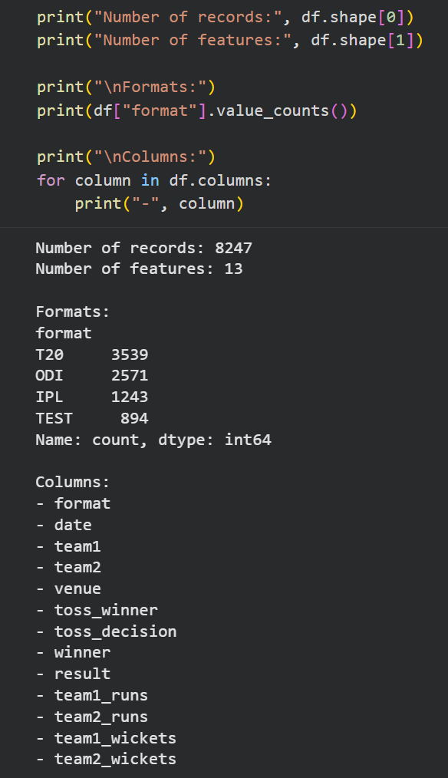
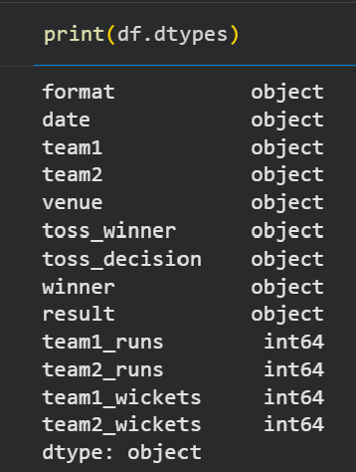
Data Understanding
df.shape
df.info()
Number of records and features
Data types and non-null counts
04 / 13

Slide 5
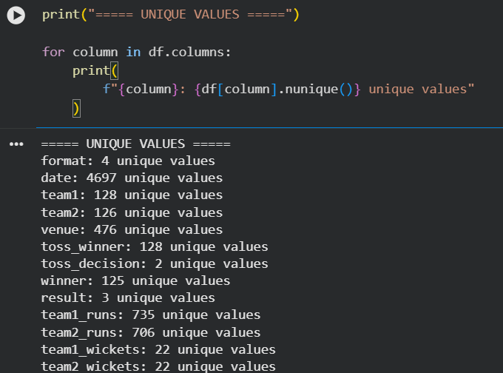
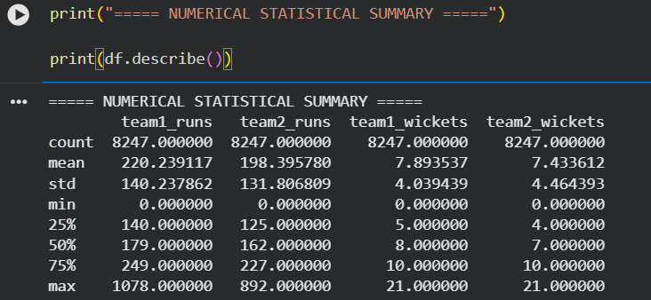
Data Understanding
df.nunique()
df.describe()
Unique values in each column
Statistical summary: mean, std, min, max
05 / 13

Slide 6
Data Understanding
df.nunique() — Unique values
df.describe() — Statistical summary
Reading the summary
• count confirms all 8,247 rows are populated for the numeric columns
• mean / std show typical run and wicket totals and their spread
• min / max expose the outer range used later for outlier checks
06 / 13

Slide 7


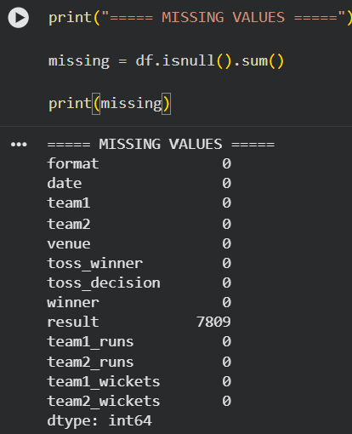
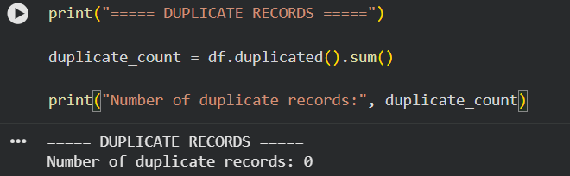
Data Preprocessing
Missing values
Duplicates
df.isnull().sum()
df.duplicated().sum()
Impute numeric gaps or drop incomplete rows.
Find and remove repeated match records.
07 / 13

Slide 8


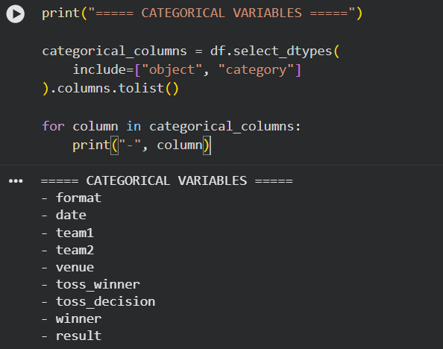
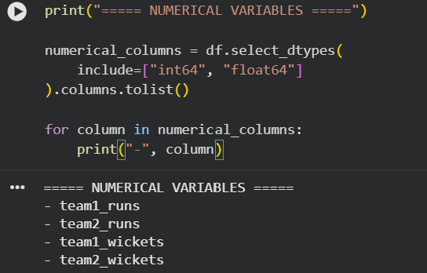
Data Preprocessing
Categorical variables
Numerical variables
pd.get_dummies()
StandardScaler()
Convert team, venue and toss decision to numeric form.
Scaling helps Logistic Regression (TEST), not Random Forest.
08 / 13

Slide 9

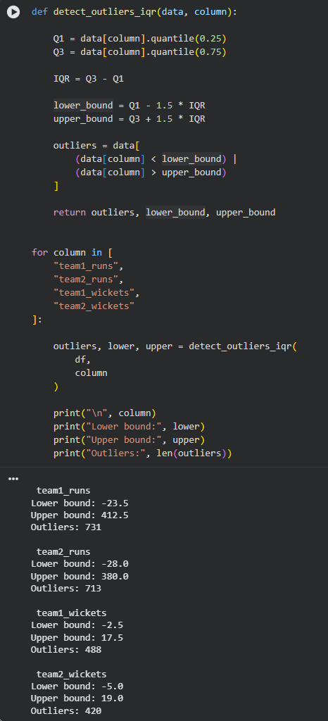
Data Preprocessing
Outliers
IQR rule / boxplot
Inspect with box plots and the IQR rule; keep, cap or remove.
What the IQR rule flags
Values beyond 1.5×IQR from Q1/Q3 on team runs and wickets — kept as genuine high-scoring or collapse innings, not data errors.
detect_outliers_iqr() applied to runs and wickets
09 / 13

Slide 10
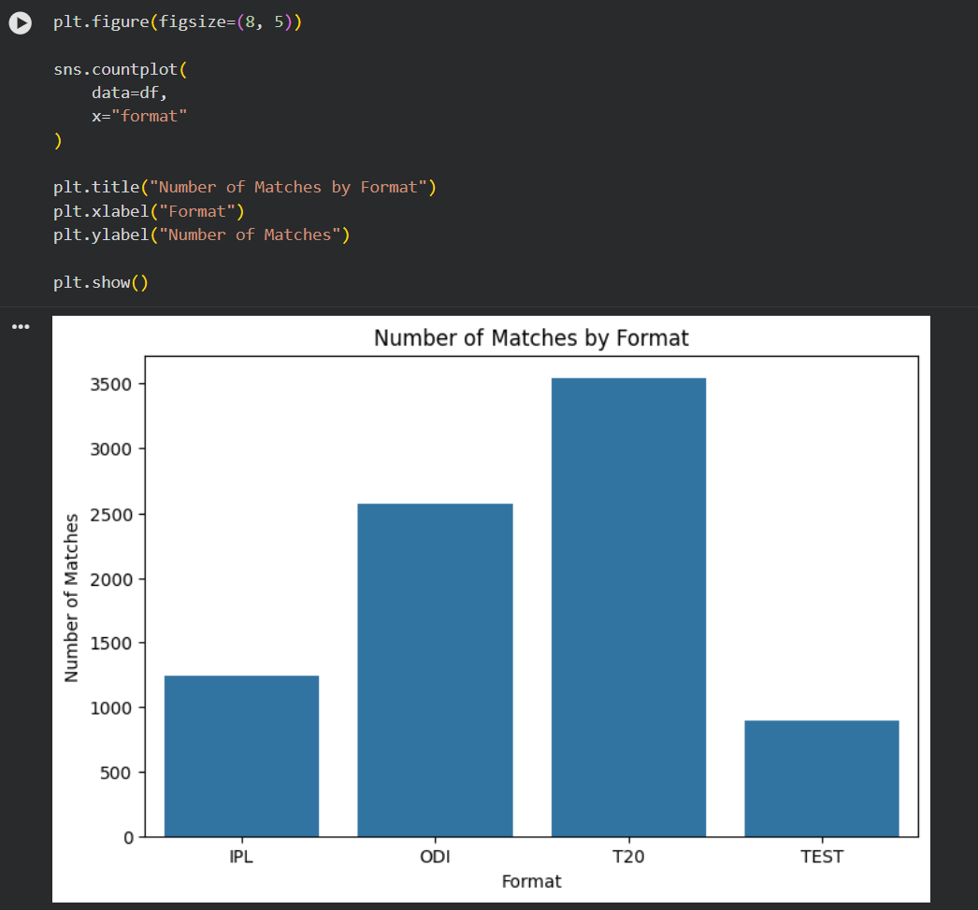
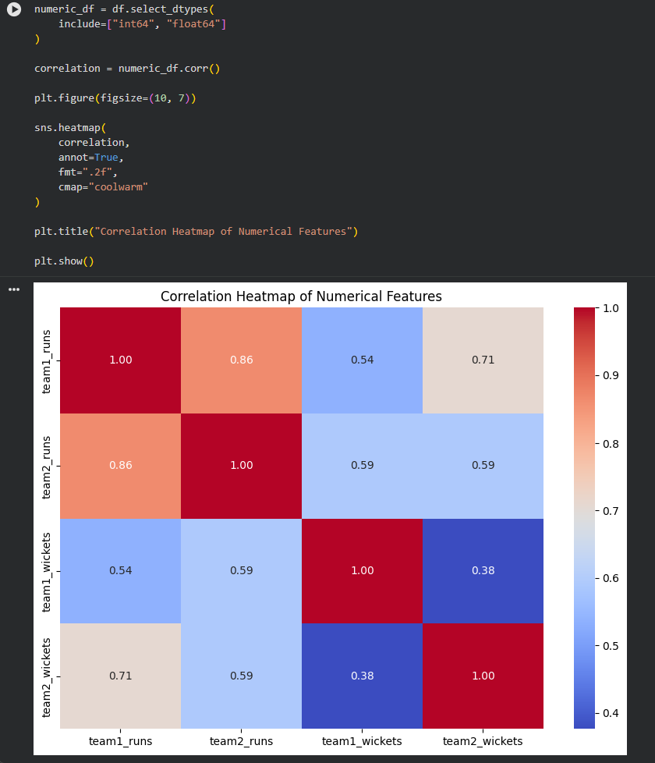
Exploratory Data Analysis
Number of matches by format
Correlation heatmap of numerical features
10 / 13

Slide 11
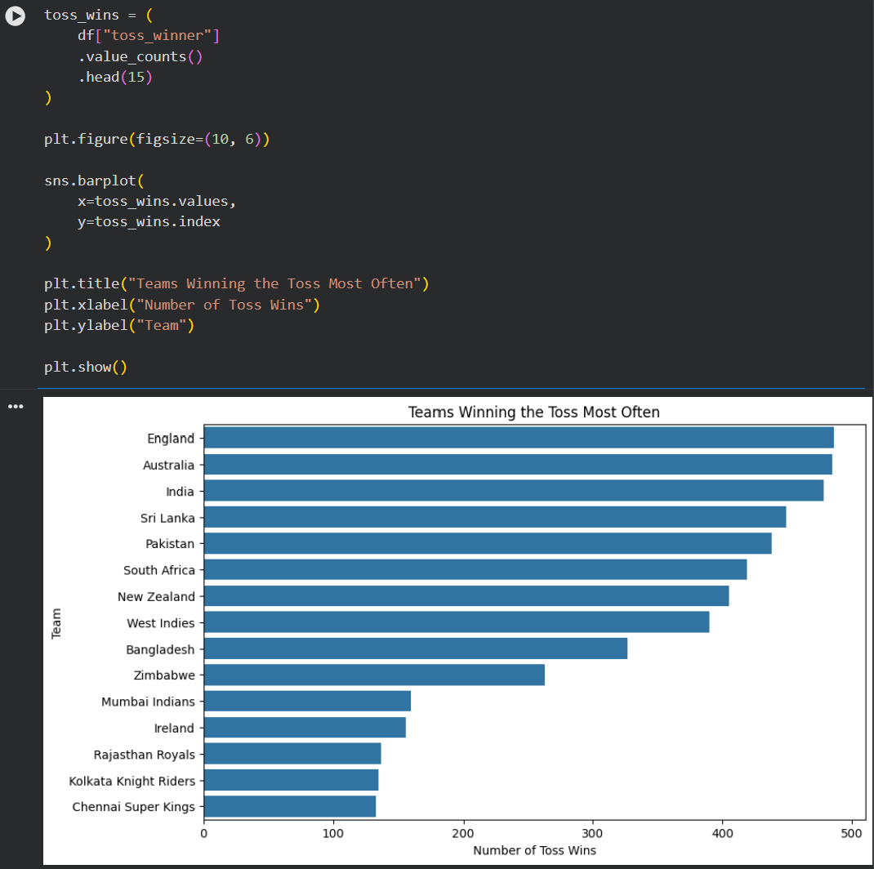
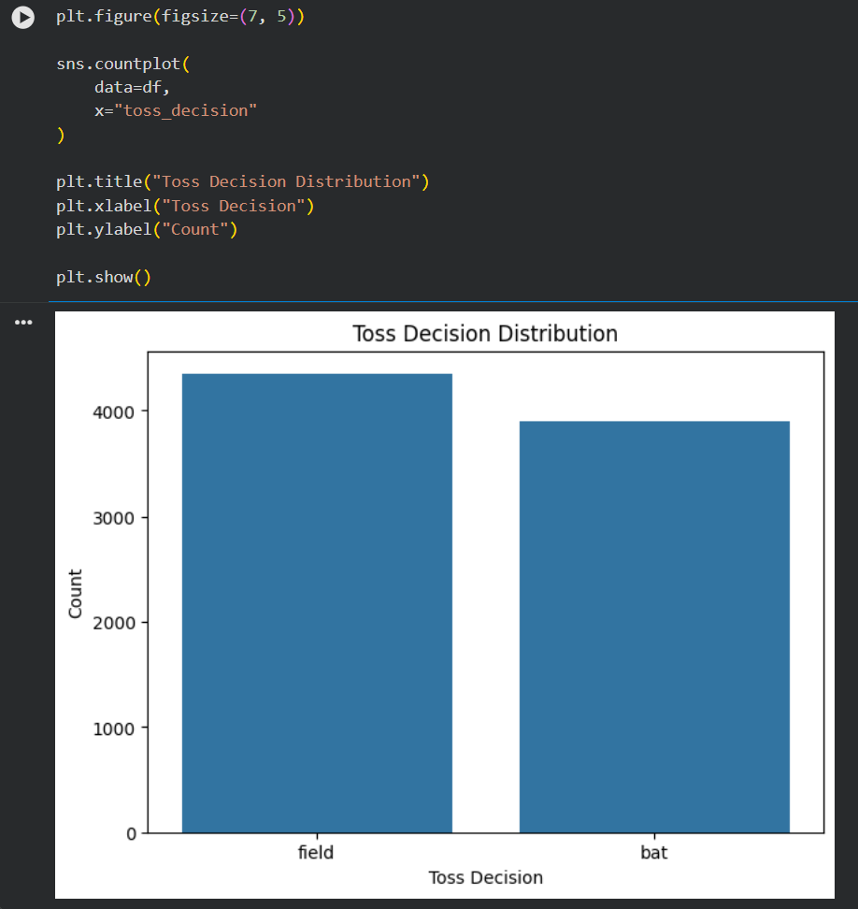
Toss Analysis
Teams winning the toss most often
Toss decision distribution: bat vs field
11 / 13

Slide 12
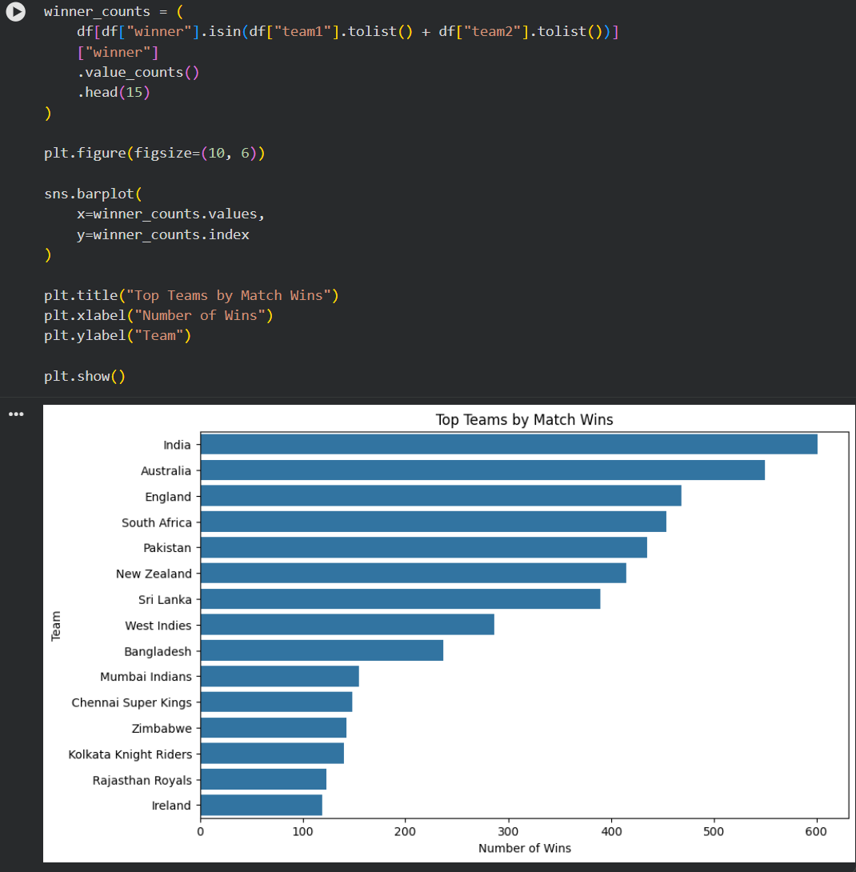
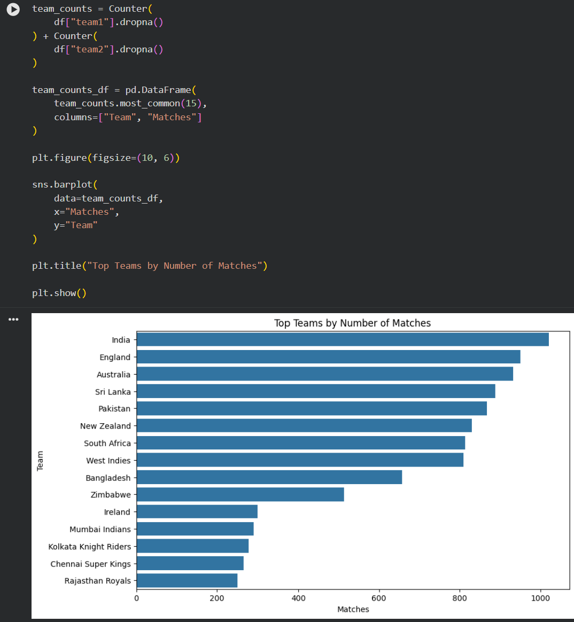
Team Performance
Top teams by match wins
Top teams by number of matches played
12 / 13

Slide 13
Thank You!
Match Outcome Prediction Using Logistic Regression and Random Forest
Venkata Sai Krishna (2520030027) • Ajai Manikanta (2520030320)

