Slide 1
OSSP · 25CS2104E · SECTION 08 · TEAM 09
TEAM 09
Linux System Information & Resource Monitoring Tool
V
Venkata Sai Krishna
2520030027
P
Pujith Pavan Kumar
2520030029
A
Ajai Manikanta
2520030320
Operating Systems and Systems Programming · 2026–27, Term-I
B
Bandla Vinay
2520030437

Slide 2



The Problem
Competing processes
One menu.
One tool.
Everything in one place.
Many processes share CPU, memory and disk at once.
Hard for beginners
Beginners struggle to see where resources go.
Scattered commands
Separate commands make monitoring inconvenient.

Slide 3




Objectives
Monitor
Collect
Track CPU, memory, disk usage and running processes.
Read live data through Linux interfaces such as /proc.
Apply
Build
Use process, memory, file system and system call concepts.
Deliver a simple, user-friendly C-based monitoring tool.

Slide 4
Methodology
01
02
03
04
User Selection
Collect Data
Process Data
Display Results
Menu choice 1–7
Read /proc and system calls
Compute usage and status
Show clear, formatted output
BUILT WITH
Ubuntu (WSL2)
C
GCC
VS Code
Linux Terminal
Tested under varied system conditions to verify every reading.

Slide 5
OS Concepts & Linux APIs
Process Management
Lists PIDs, states and a parent–child tree
/proc Filesystem
Source of CPU, memory, uptime and process data
System Calls
uname(), statvfs(), sysconf(), select()
Memory Management
Total, used and available RAM plus swap
File Systems
Disk space and inode usage

Slide 6
Team Contributions
V
P
A
B
Venkata Sai Krishna
Pujith Pavan Kumar
Ajai Manikanta
Bandla Vinay
Process monitoring and system information module
Project planning, system information and overall integration
CPU and memory monitoring module
Disk monitoring, testing and documentation
Four members, one integrated tool.

Slide 7
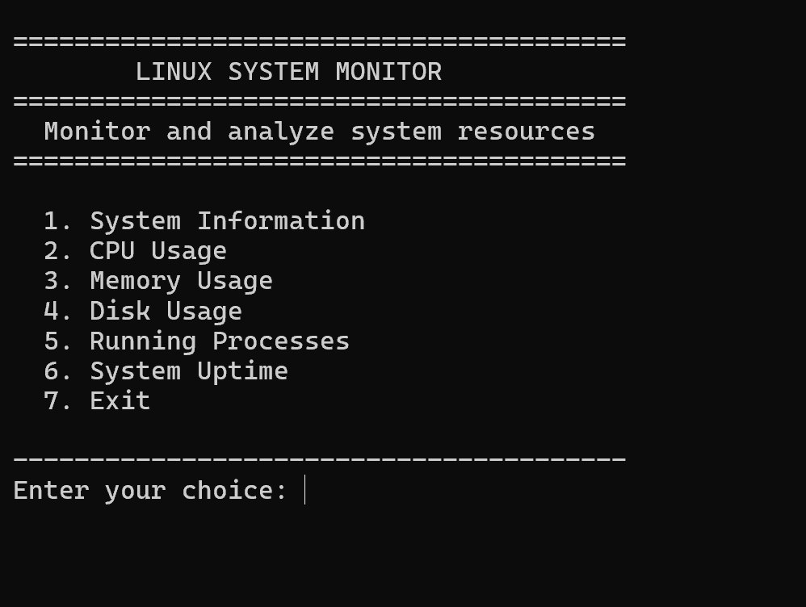
Main Menu
monitor — bash
Seven options in one clean interface. Invalid input is caught, and every feature offers return or exit.
7
options in one menu

Slide 8
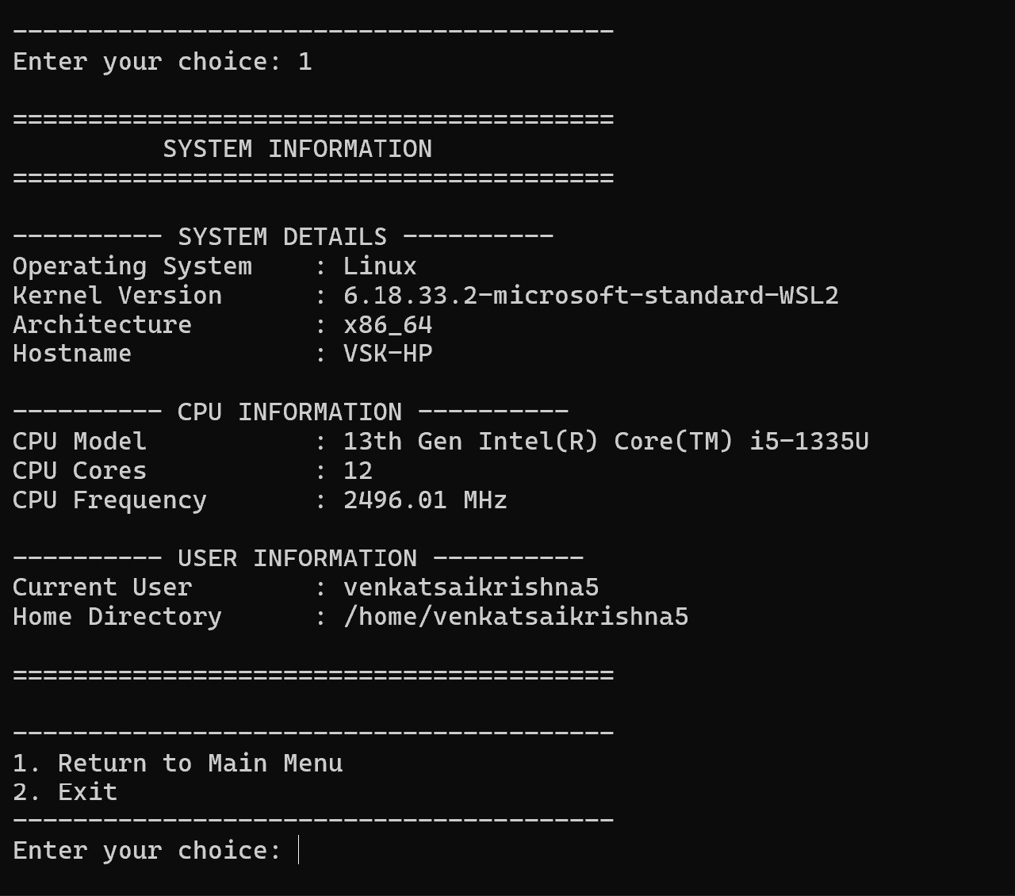
System Information
monitor — bash
OS, kernel, architecture, hostname, CPU model, cores, frequency and user details, gathered from the system.
uname()
/proc/cpuinfo
sysconf()

Slide 9
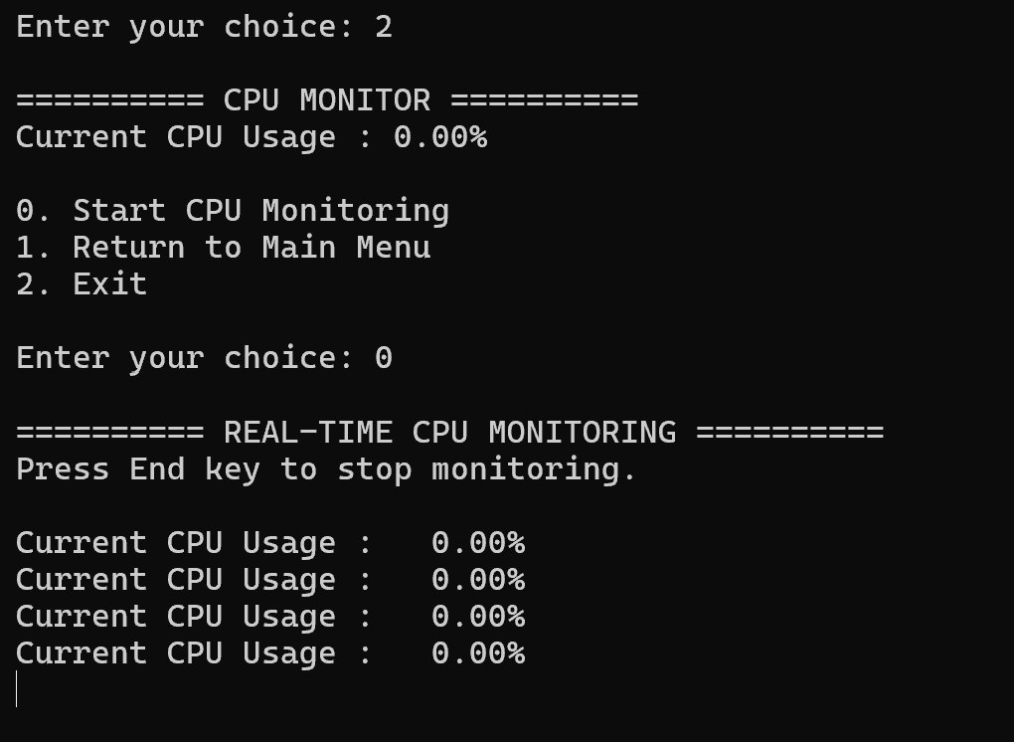
Real-Time CPU Monitor
monitor — bash
Reads /proc/stat twice, one second apart, and computes usage from the difference. Press End to stop.
1 s
sampling gap

Slide 10
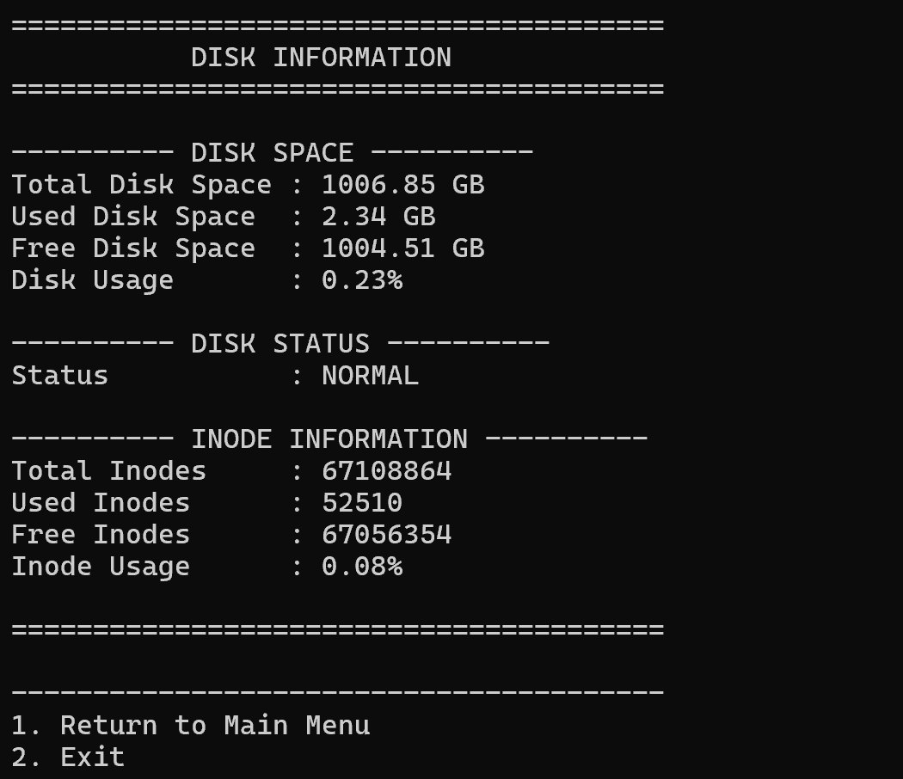
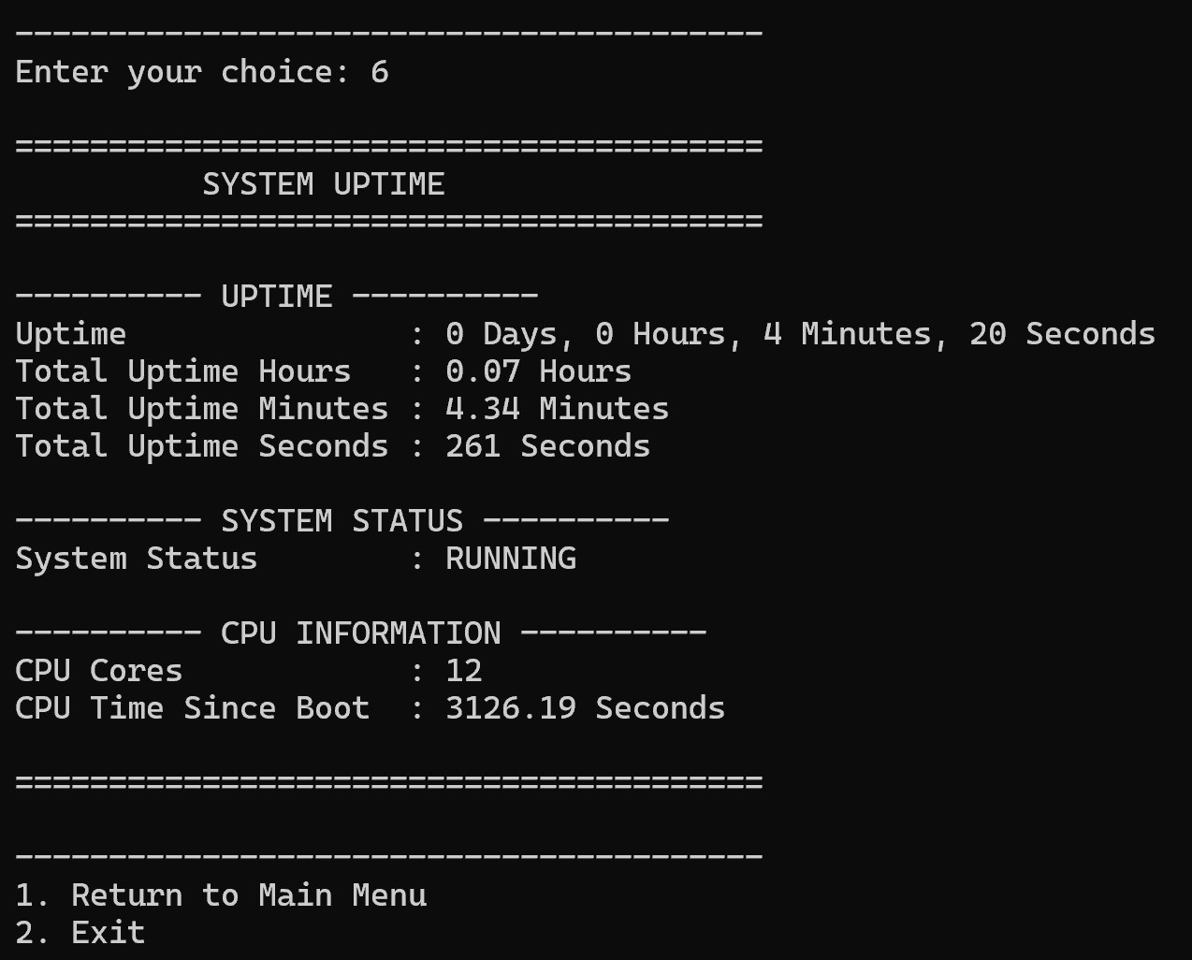
Disk & Uptime
DISK Space, status and inode usage through statvfs().
UPTIME Days to seconds, plus CPU time since boot.
monitor — bash
monitor — bash

Slide 11
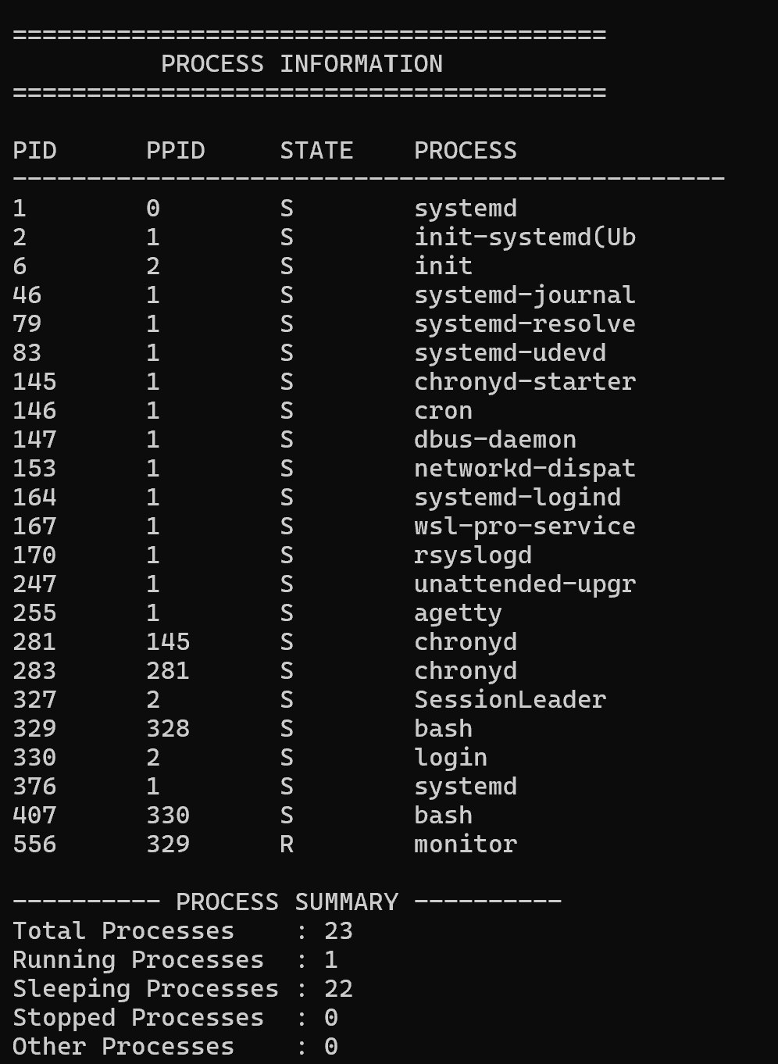
Process Monitor
monitor — bash
Scans /proc for every running PID
Shows PID, PPID and process state
Counts running, sleeping and stopped
Draws a parent–child process tree
23
processes captured, 1 running

Slide 12
Expected Outcome
A lightweight, reliable monitor that turns Operating Systems theory into practical Linux skills.
6
7
C
monitoring modules
menu options
built on /proc and syscalls
GitHub · V-max-OSSP/V-Max_OSSP_Project

