Slide 1

Linux System Information and Resource Monitoring Tool
TEAM MEMBERS
Venkata Sai Krishna 2520030027
Pujith Pavan Kumar 2520030029
Ajai Manikanta 2520030320
Bandla Vinay 2520030437

Slide 2
What is our project?
Our project is a simple Linux tool that helps us check what is happening inside a computer.
CPU usage
Memory usage
Disk usage
Running processes
Network activity
System uptime
All these features are available from one menu.
02 / 16

Slide 3
Why did we build it?
Linux has different commands for checking different parts of the system.
CPU
→ CPU information
Different commands
Memory
→ RAM information
One monitoring tool
→
Disk
→ Storage information
Processes
→ Running programs
Network
→ Network activity
For beginners, checking all of these separately can be confusing.
We combined the important information into one C program.
03 / 16

Slide 4
What can our tool do?
System
Processes
Other
System Information
CPU Usage
Memory Usage
Disk Usage
System Uptime
Running Processes
Process Tree
Top Resource Processes
Process Search
System Health
Network Monitoring
Resource Alerts
Resource Logging
04 / 16

Slide 5
How does it work?
User
›
Main Menu
›
Select a Feature
›
Read Information from Linux
›
Process the Data
›
Show Result
terminal
The program reads information directly from the Linux system.
05 / 16

Slide 6
Technologies used
Programming Language | C
Operating System | Linux / Ubuntu
Compiler | GCC
Editor | Visual Studio Code
Interface | Linux Terminal
System Information | /proc
Filesystem Information | statvfs()
06 / 16

Slide 7
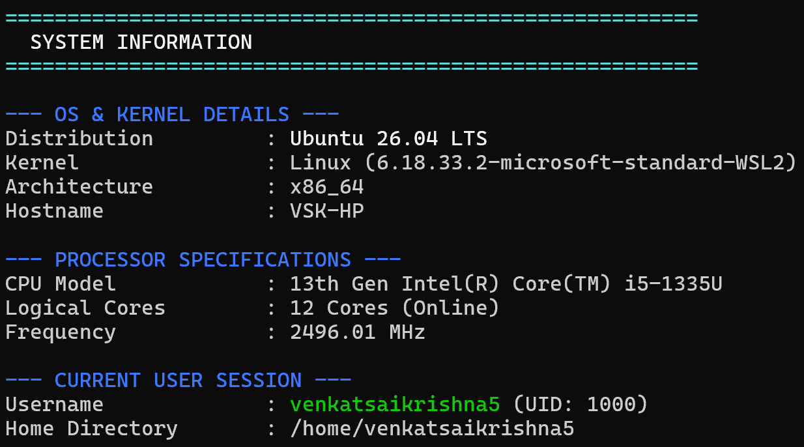
System Information
Our program shows:
Insert screenshot here
(System Information)
Operating system
Kernel version
Computer name
CPU model
CPU speed
Number of CPU cores
Current user
uname() + /proc/cpuinfo
System Information
07 / 16

Slide 8
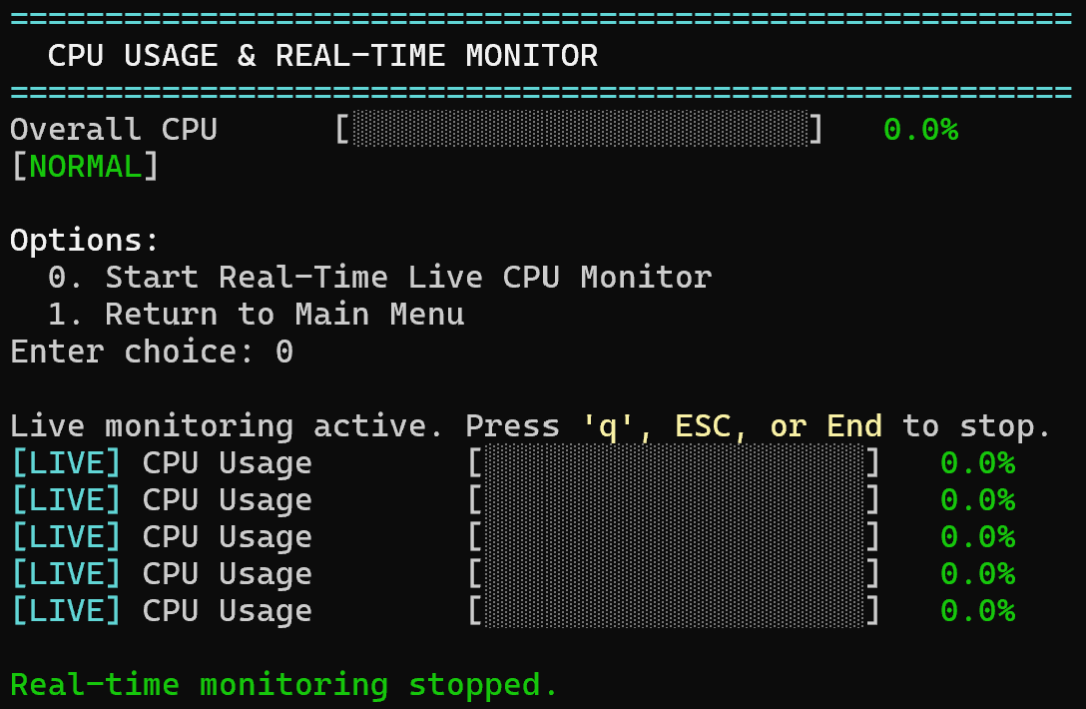
CPU and memory monitoring
CPU
Insert screenshot here
(CPU Monitoring)
Shows current CPU usage
Reads statistics from /proc/stat
Compares CPU readings
Calculates CPU usage
Memory
Total RAM
Used RAM
Available RAM
Cached memory
Swap memory
CPU Monitoring
08 / 16

Slide 9
Disk and process monitoring
Disk
Processes
Total storage
Used storage
Free storage
Disk usage
Inode usage
Process ID
Parent Process ID
Process name
Process state
Process hierarchy
09 / 16

Slide 10
Network and other features
Network
Other features
Network interfaces
Data received
Data sent
Network activity
System Health
Shows the overall condition of the system.
Process Search
Finds a process by its name.
Resource Alerts
Warns when usage is high.
Resource Logging
Saves resource data to a file.
10 / 16

Slide 11
How does Linux give us the data?
/proc is a special folder in Linux that contains information about the running system.
/proc
/proc/cpuinfo
→ CPU
/proc/stat
→ CPU statistics
/proc/meminfo
→ Memory
/proc/uptime
→ Uptime
/proc/net/dev
→ Network
/proc/[PID]/stat
→ Processes
Our C program reads this information and displays it.
11 / 16

Slide 12
Operating System concepts
System Calls | Getting system information
Process Management | Viewing running processes
Memory Management | Monitoring RAM and Swap
File System | Checking disk and inodes
CPU Management | Measuring CPU usage
Resource Management | Monitoring system resources
Process Hierarchy | Showing parent and child processes
12 / 16

Slide 13
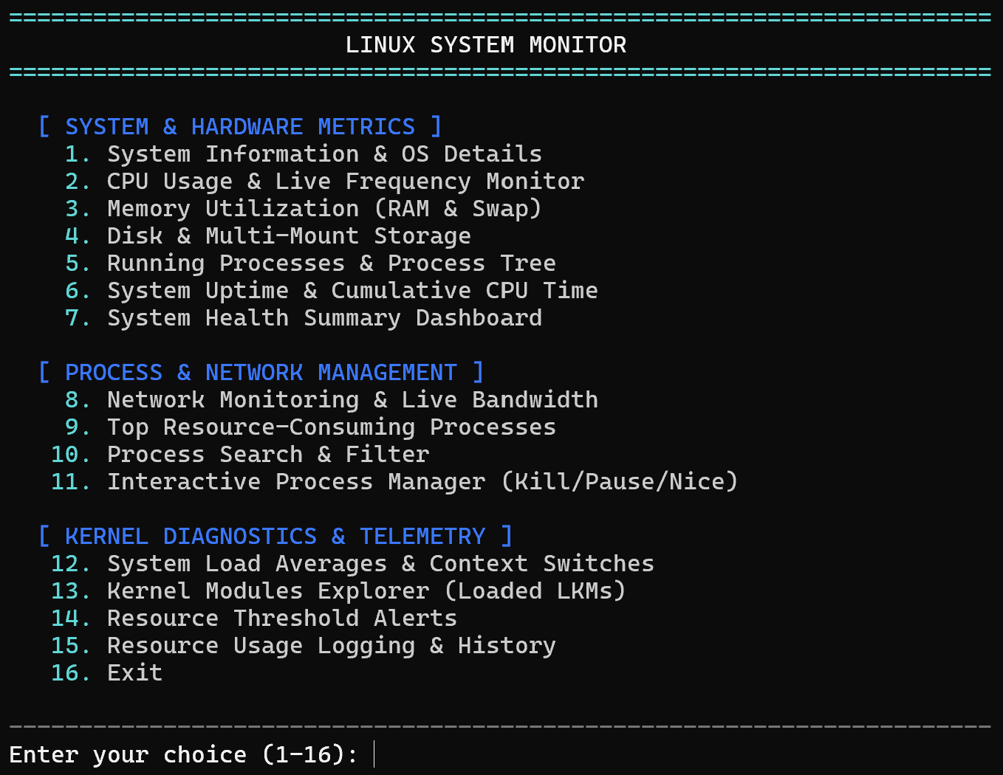
Our main menu
Insert screenshot here
(Main Menu)
Main Menu
The user can select any feature from one menu and return to the menu after viewing the result.
13 / 16

Slide 14
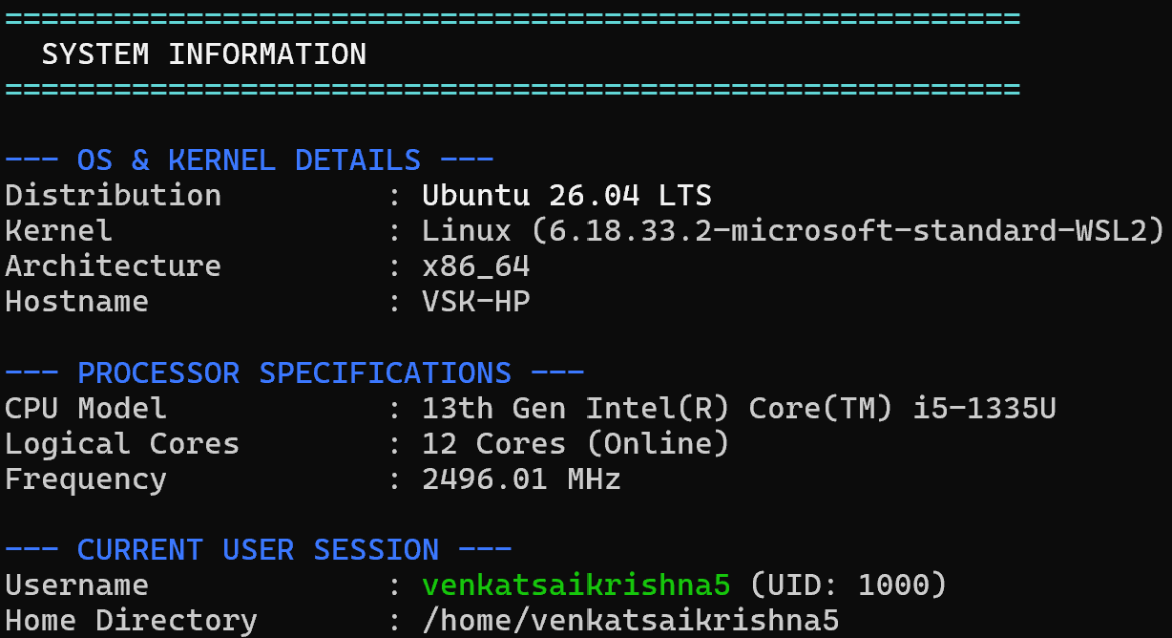
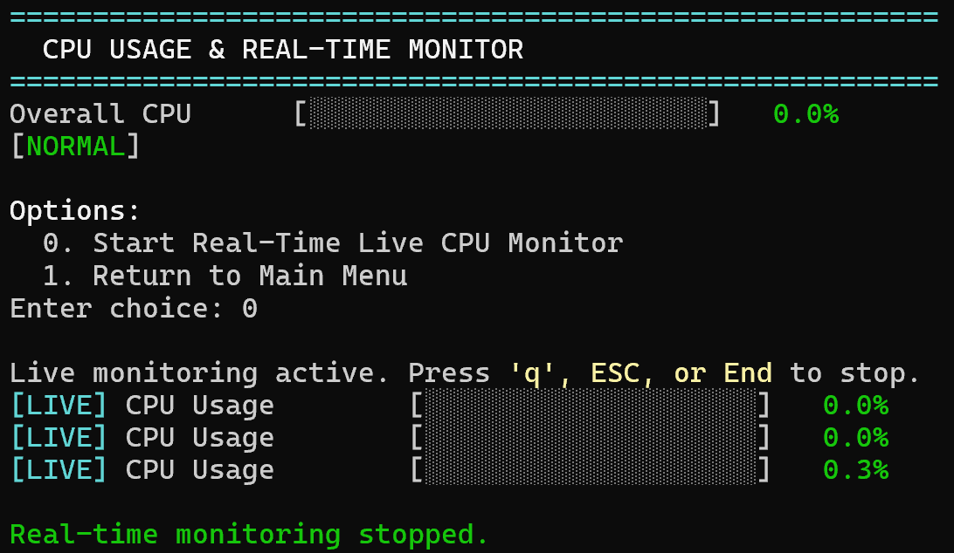
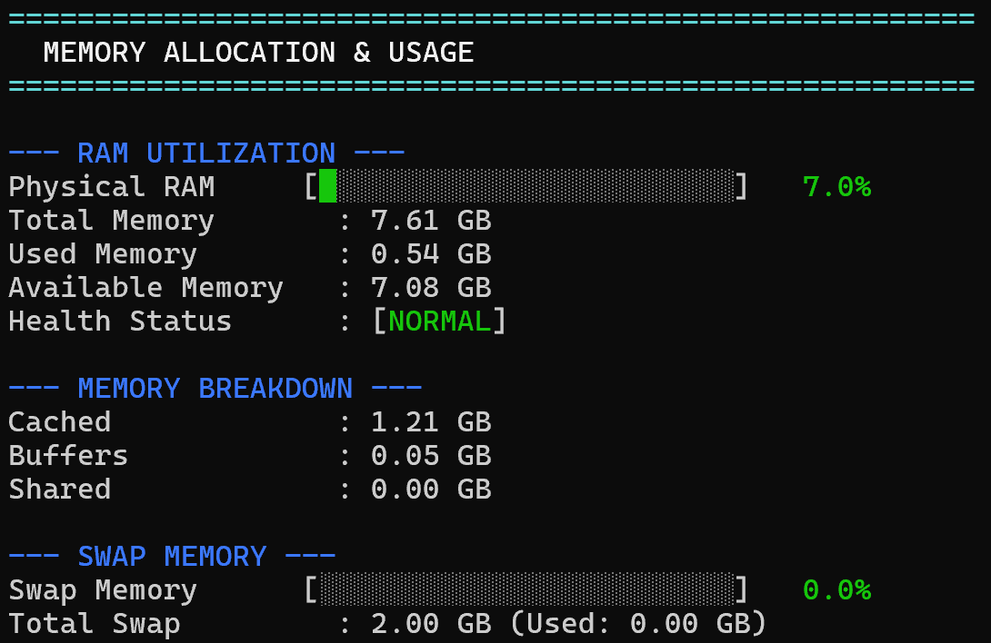
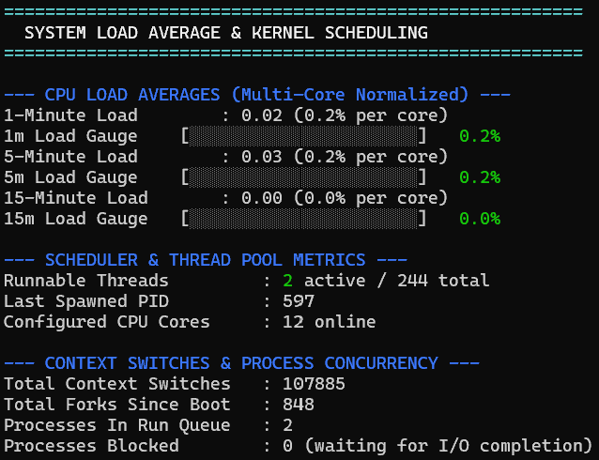
Project in action
Insert screenshot here
(System Information)
Insert screenshot here
(CPU Monitoring)
System Information
CPU Monitoring
Insert screenshot here
(Memory / Disk)
Insert screenshot here
(Process Monitoring)
Memory and Disk
System Load Averages & Context Switches
14 / 16

Slide 15
What did we achieve?
What we achieved
Future improvements
Built a working Linux monitoring tool using C.
Combined different monitoring features into one program.
Monitored CPU, memory, disk, processes and network activity.
Added process search, alerts and logging.
Applied Operating System concepts practically.
Graphical interface
Real-time graphs
Temperature monitoring
Remote monitoring
Historical usage graphs
15 / 16

Slide 16
Thank You

