Slide 1

Parallel File Search Using Threads
A file search program in C that uses multiple threads
TEAM MEMBERS
08
Venkata Sai Krishna 2520030027
Pujith Pavan Kumar 2520030029
Ajai Manikanta 2520030320
Bandla Vinay 2520030347
SECTION
Notes:
Introduce the project: a C program that uses POSIX threads so that several workers search folders at the same time. It runs on Ubuntu Linux. Check the team names, ID numbers and section on this slide before presenting.

Slide 2
Problem Statement
1
Finding files in big folders takes a long time
One worker: slow
1 worker
file_1
file_2
file_3
2
Text search has to open and read many files
Files are checked one after another
3
Searching one file at a time leaves CPU cores unused
Many workers: faster
Worker 1
file_1
file_2
4
Duplicate files and file filters are hard to find by hand
Worker 2
file_3
file_4
Worker N
file_5
file_6
5
Search tasks are independent, so workers can share them
Tasks are shared from one common list
02 / 11
Notes:
Searching big folders one file at a time is slow, and text search must open many files. Because the search tasks are independent, several workers can share them. Say clearly that more threads are not always faster; it depends on the folder and the disk.

Slide 3
Technologies Used
1
Language and Build
2
Threads
C Programming Language: used to write the program
GCC and Make: compile and build the program
POSIX Threads (pthread): runs many threads at once
Mutex (pthread_mutex_t): a lock that protects shared data
Condition variable (pthread_cond_t): lets threads wait for tasks
3
Folder and File Functions
4
Platform
opendir() / readdir(): read the files inside a folder
stat() / lstat(): get file details and find shortcuts (symbolic links)
Ubuntu Linux: used to build and run the program
WSL: runs Linux on Windows; Windows files are at /mnt/c
03 / 11
Notes:
The program is written in C and built with GCC and Make. POSIX threads (pthread) give us threads, a mutex to protect shared data and condition variables so threads can wait for tasks. opendir/readdir read folders, and stat/lstat give file details. It runs on Ubuntu Linux, and WSL lets it reach Windows files through /mnt/c.

Slide 4
System Architecture
User Menu
1
The user selects a search option.
Main Search Function
2
The program adds tasks to a shared list.
Shared Task List
Worker Thread 1
Worker Thread 2
Worker Thread N
3
Worker threads take tasks and search files or folders.
File and Folder Search
4
Results are collected safely.
Results and Statistics
Search History
The results are displayed and the search history is saved.
5
04 / 11
Notes:
Read the diagram from top to bottom. The user picks an option in the menu. The main search function puts tasks in a shared task list. Worker threads take tasks and search files and folders. Results and statistics are collected safely, then shown, and the search is saved in the search history file.

Slide 5
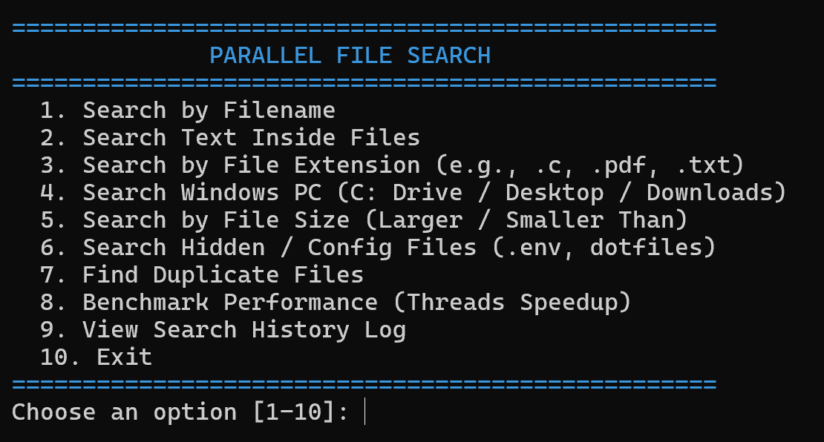
Working Methodology
1
2
3
4
5
6
Select
Check
Add Tasks
Search
Update
Show
User picks a search option
The folder path is checked
Tasks go into a shared list
Workers search files and folders
Results are saved safely
Results are shown and history is saved
The Main Menu
Safeguards
Permission errors
Non-text files
Folders that cannot be opened are skipped
Skipped during text search
Folder loops
Clean exit
Visited folders are tracked to avoid endless loops
All worker threads stop properly at the end
The program shows 10 menu options.
05 / 11
Notes:
Six steps: select an option, check the folder path, add tasks to the shared list, let workers search, save the results safely, then show the results and save the history. Safeguards: unreadable folders are skipped, non-text files are skipped in text search, visited folders are tracked to avoid loops, and workers stop cleanly.

Slide 6
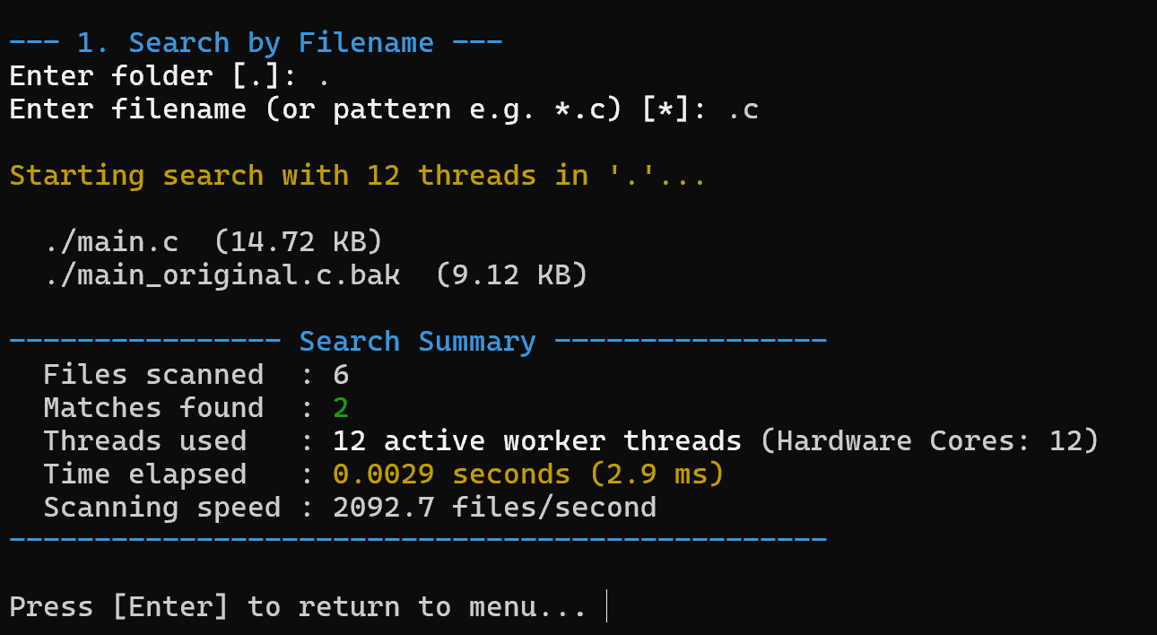
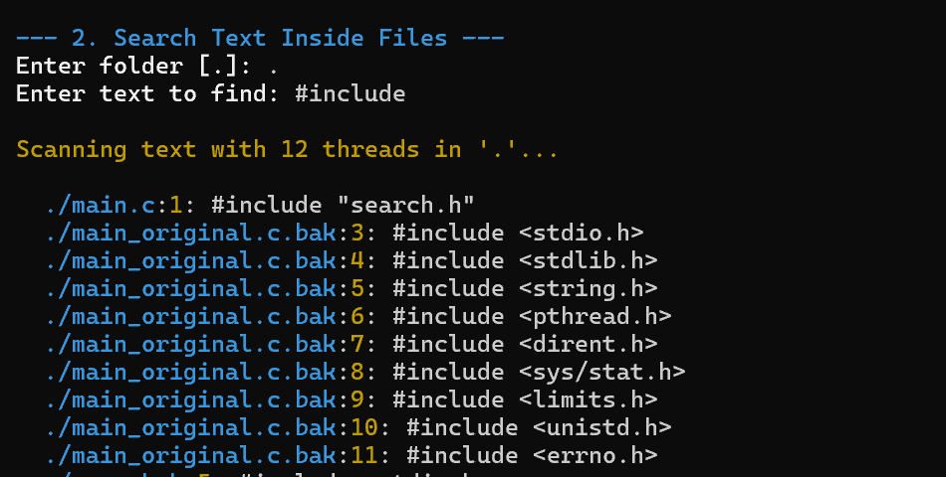
Main Menu: Search and Discovery
1
Search by Filename
Matches any part of the name (capital or small letters)
Can use patterns like *.c
Looks inside all sub-folders
2
Search Text Inside Files
Filename search found 2 matches.
Reads files line by line to find the text
Shows the file path, line number and the line
Skips non-text files
3
Search by File Extension
Extensions like .c, .h, .pdf, .json
Accepts .c or just c
Groups the files by type
Text search displayed matching lines.
06 / 11
Notes:
Options 1 to 3. Option 1 finds names that match, with or without patterns. Option 2 reads files line by line and shows the path, line number and the line. Option 3 groups files by extension. The screenshots are real runs: the filename search found 2 matches and the text search for #include found 27.

Slide 7
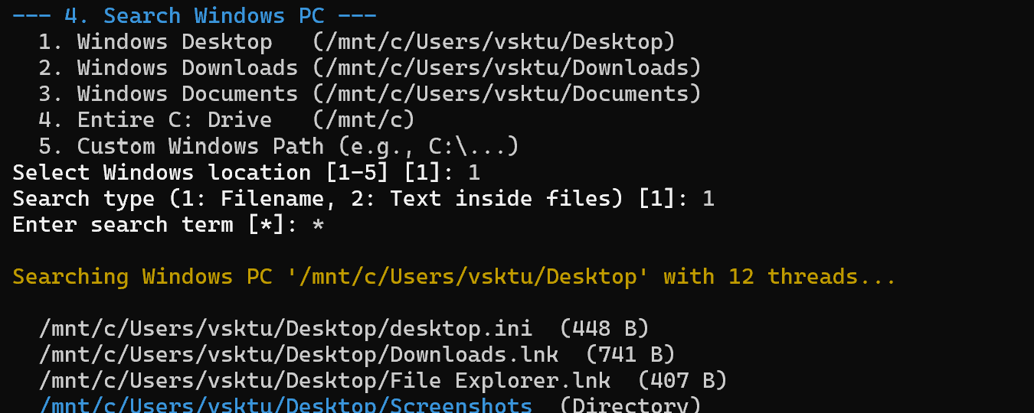
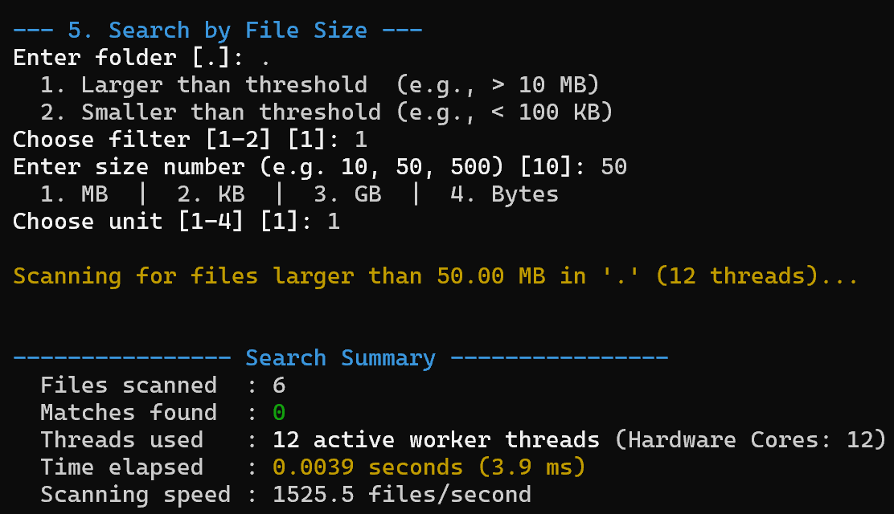
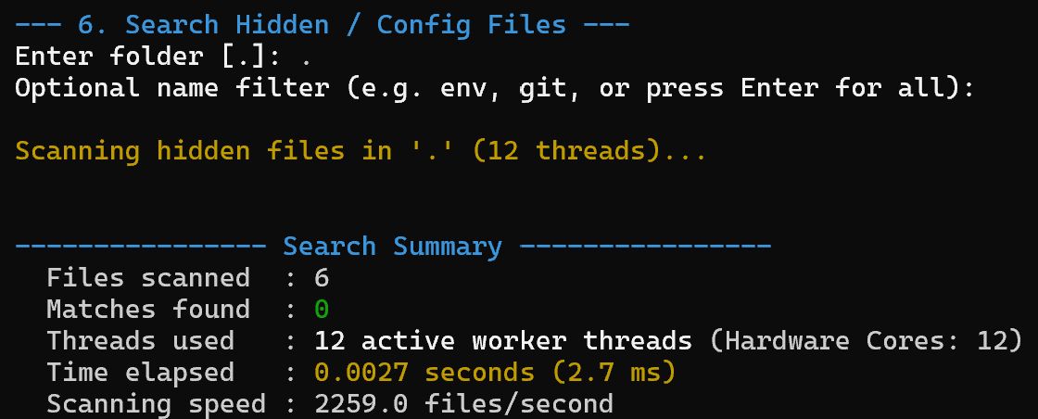
Main Menu: Advanced Search Operations
4
Search Windows PC
5
Search by File Size
6
Search Hidden / Config Files
Searches Windows folders (/mnt/c/)
Desktop, Downloads, Documents
By filename or text inside files
Larger or smaller than a size
Bytes, KB, MB or GB
Finds large or empty files
Hidden files like .env, .bashrc, .git
Optional name filter
Finds project settings files
Searching the Windows Desktop through /mnt/c.
Search for files larger than 50 MB.
Hidden file search with no filter.
07 / 11
Notes:
Options 4 to 6. Option 4 searches the Windows computer through /mnt/c, for example Desktop, Downloads or Documents. Option 5 finds files larger or smaller than a chosen size. Option 6 lists hidden files such as .env and .bashrc. The size and hidden-file runs found 0 matches in our 6-file test folder.

Slide 8
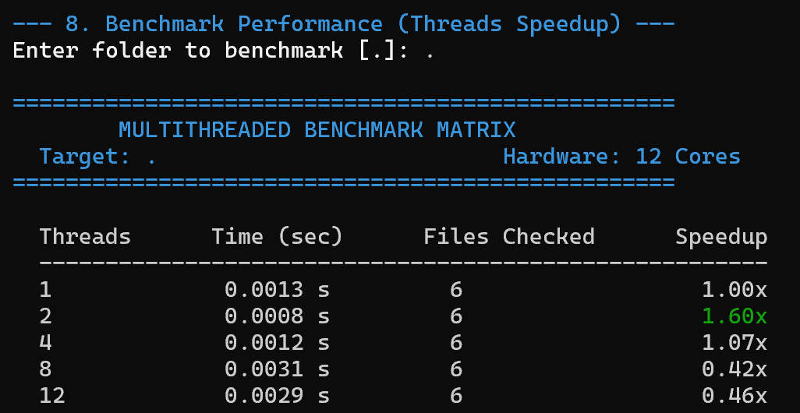
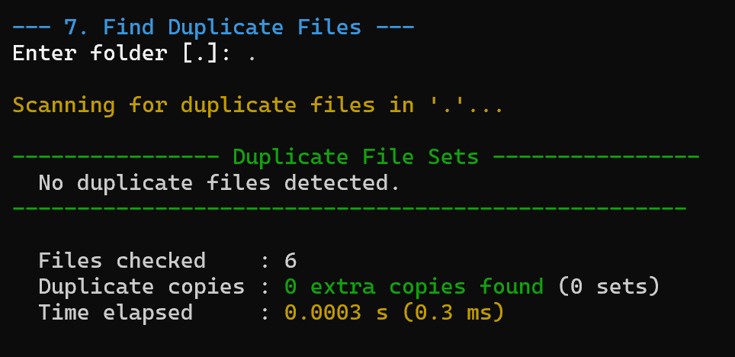
Main Menu: Duplicates and Utilities
7
Find Duplicate Files
1. File size
2. Hash value
3. Byte check
Shows groups of duplicates and the storage space that could be saved.
Test with 1, 2, 4, 8 and 12 threads.
8
Benchmark Performance
Runs the search with 1, 2, 4, 8 and 12 threads and compares the speed.
9
View Search History Log
10
Exit
Shows past searches and their times
Closes the program safely
Checked 6 files, found no duplicates.
08 / 11
Notes:
Options 7 to 10. Duplicate search first compares file size, then a hash value, then the file contents byte by byte, and reports storage space that could be saved. Benchmark runs the search with 1, 2, 4, 8 and 12 threads. Option 9 shows the history log and option 10 exits safely. Our test folder had only 6 files and no duplicates.

Slide 9
Algorithms and Multithreading
How the threads share the work
1
Workers share the tasks
Shared Task List
Several worker threads take search tasks from one shared task list.
Worker 1
Worker 2
Worker N
2
Mutex (a lock)
A mutex lets only one thread change the shared results and task list at a time.
Results and Statistics (protected by a mutex)
3
Condition variables
These tools let worker threads wait until a task is ready, instead of checking again and again.
How duplicate files are found
1. Same size
2. Same hash
3. Same bytes
4
Folder tracking
FNV-1a: a method that calculates a short value from file contents.
memcmp: a function that compares file contents byte by byte.
Shortcuts (symbolic links) can loop back to a folder. The program remembers visited folders to avoid this.
09 / 11
Notes:
The program uses several worker threads that share search tasks from one task list. A mutex is a lock that protects shared results and the task list. Condition variables let workers wait until a task is ready. Visited folders are tracked so symbolic links cannot cause endless loops. Duplicate detection checks file size first, then a hash value (FNV-1a calculates a short value from the file contents), then memcmp compares the contents byte by byte.

Slide 10
Results and Testing
Speed compared with 1 thread
1
1.00x
2
1.60x
4
1.07x
8
0.42x
12
0.46x
Threads (top) and speed (bottom), 6-file folder
Filename search found 2 matches.
Text search displayed matching lines.
Why not faster?
A small folder may not get faster with more threads, because starting and managing the threads also takes time.
Still to do
Duplicate search checked 6 files and found no duplicates.
A performance test compared 1, 2, 4, 8 and 12 threads.
A test on a larger folder is still pending.
10 / 11
Notes:
All four screenshots are real terminal output from our runs. The filename search found 2 matches in 6 files. The text search for #include showed matching lines. The duplicate search checked 6 files and found none. The performance test on the same 6-file folder gave 1.00x, 1.60x, 1.07x, 0.42x and 0.46x for 1, 2, 4, 8 and 12 threads. With so few files, the time to manage threads is larger than the work, so a bigger folder test is still pending.

Slide 11
Thank You
Notes:
Thank the audience.

