Slide 1
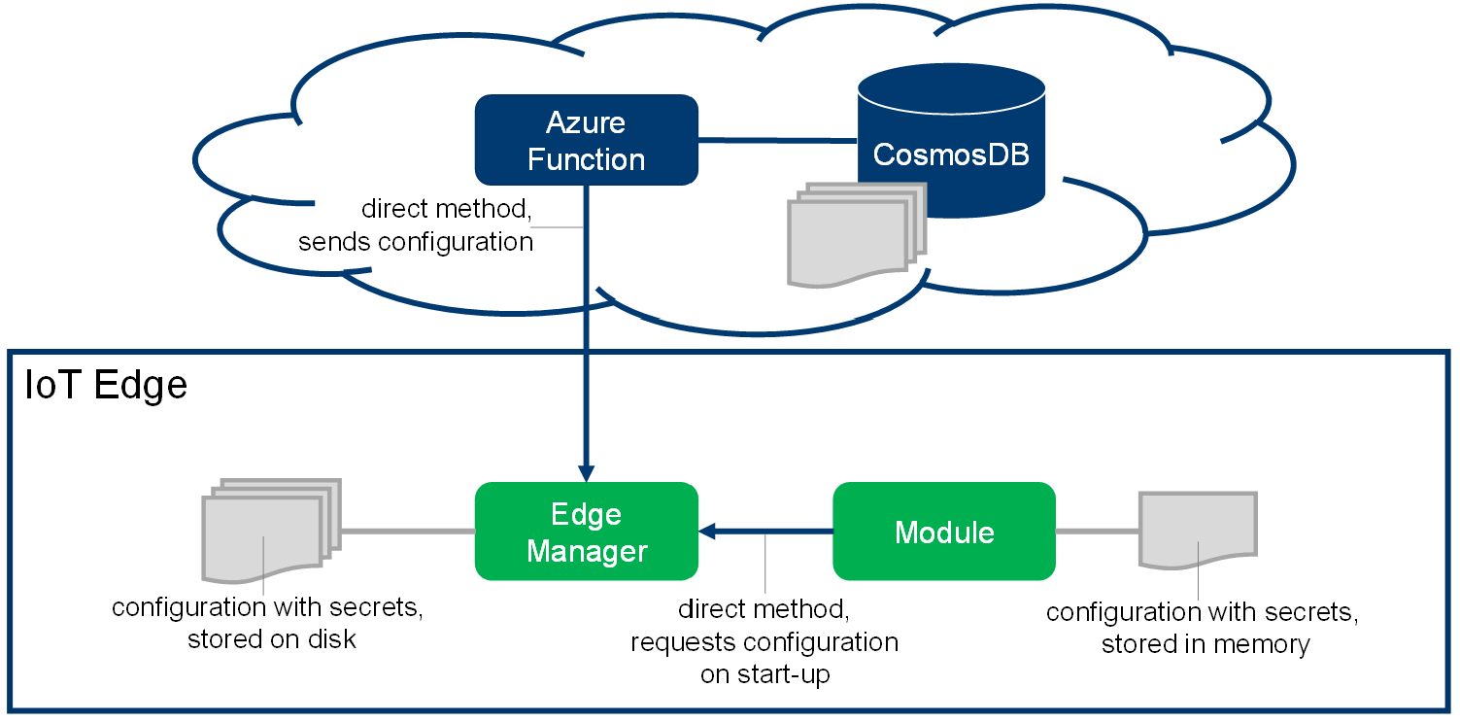

Slide 2








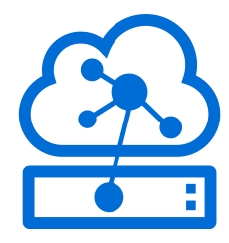
Azure Container Registry
Azure Active Directory
APP IMAGE
APP SERVICE PRINCIPAL
SECRETS
Azure IoT Hub
Azure Container Apps
Azure KeyVault
Azure Event Grid
AUDIT TRAIL
Azure Log Analytics
SecretManager
EDGE MODULE
encrypted secrets store
client(s)
CryptoProvider
Azure IoT Edge

Slide 3
Azure Container Registry
Azure Active Directory
[CONTAINER REGISTRY]
[IMAGE URI]
APP SERVICE PRINCIPAL
[TENANT ID] [APP CLIENT ID] [APP PASSWORD]
APP IMAGE
[RG NAME]
[WebHook API Key]
SECRETS
Azure IoT Hub
Azure Container Apps
Azure KeyVault
Azure Event Grid
AUDIT TRAIL
Azure Log Analytics
SecretManager
EDGE MODULE
encrypted secrets store
client(s)
CryptoProvider
Azure IoT Edge

Slide 4


Azure Container Registry
AcrPull role
Azure Active Directory
APP IMAGE PULL
Service Principal
role
SecretDeliveryApp
SECRETS
Azure KeyVault
Azure IoT Hub
Azure Event Grid
Azure Container Apps
Azure Log Analytics
AUDIT LOGS
“deployment.influxdb.template.json” edge solution
“influxdb” module
“sampleApp” module
InfluxDBClient
influxDBClient = InfluxDBClientFactory.Create(
url, username, dbPassword);
dbPassword = await
secretManagerClient.GetSecretValueAsync( “InfluxDbPassword“, …)
SecretManagerClient
encrypted secrets store
"/usr/local/cache/secrets.json"
CryptoProvider
Azure IoT Edge RUNTIME

Slide 5
Azure KeyVault
SecretDeliveryApp
2
Azure IoT Hub
your application consuming the secrets
(IoT Edge module, host-level application, …)
CryptoProvider defined through ENVs
SecretStore defined through code
1
SecretManager Nuget
Azure IoT Edge 1.2+
IdentityServiceCryptoProvider
uses
RemoteSecretStore
uses
(or the iot-identity-service stand-alone component)
uses
uses
WorkloadApiCryptoProvider
SecretManagerClient
FileSecretStore
File System
Azure IoT Edge 1.1+
uses
uses
uses
AzureKeyVaultCryptoProvider
uses
uses
InMemorySecretStore
Azure KeyVault
uses
encrypt/decrypt secrets
stores encrypted secrets

Slide 6
PRE-REQUISITE
Azure Container Registry
AcrPull role
Azure Active Directory
APP IMAGE PULL
deployAll.sh
Service Principal
role
SecretDeliveryApp
SECRETS
Azure KeyVault
Azure IoT Hub
Azure Event Grid
Azure Container Apps
Azure Log Analytics
AUDIT LOGS

Slide 7
PRE-REQUISITE
[CONTAINER REGISTRY]
[IMAGE URI]
Azure Container Registry
AcrPull role
Azure Active Directory
[TENANT ID] [APP CLIENT ID] [APP PASSWORD]
APP IMAGE PULL
deployAll.sh
[RG NAME]
role
Service Principal
SecretDeliveryApp
SECRETS
Azure KeyVault
Azure IoT Hub
Azure Event Grid
Azure Container Apps
Azure Log Analytics
[WebHook API Key]
AUDIT LOGS

Slide 8
“deployment.influxdb.template.json” edge solution
“influxdb” module
“sampleApp” module
InfluxDBClient
influxDBClient = InfluxDBClientFactory.Create(
url, username, dbPassword);
dbPassword = await
secretManagerClient.GetSecretValueAsync( “InfluxDbPassword“, …)
SecretManagerClient
encrypted secrets store
"/usr/local/cache/secrets.json"

