Slide 1
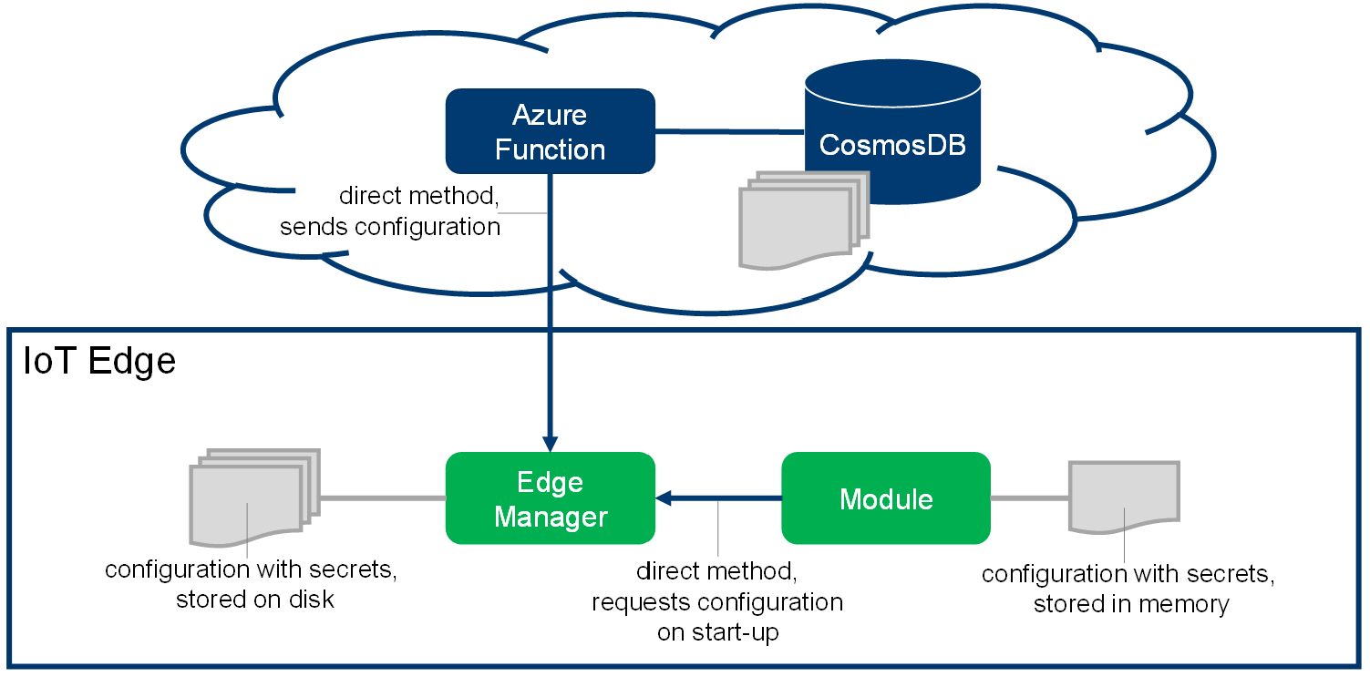
Customer Stories
Ask from Marel (machine builder)
Is there a supported solution?
Daimler Story – Vitaliy
Examples
Airlift/PGI need from the field + drop some customer names – Arturo
Examples

Slide 2
Challenges
Secure storage (availability and access)
Secret delivery
Lifecycle management
Observability (which device has which secrets?)
Auditability
Access Control (which secrets does a device have access to?)
Dev experience
Deliverable/reusable artifact/pattern
AKV access

Slide 3
Edge: Secrets Lifecycle
request secrets again
after timeout
Initialize
Request Secrets
boot
no secrets
secrets available
ran out of attempts
Wait for Secret Updates
secrets update available
received secrets
delete secrets request
Delete Secrets
Report
Status
Store Secrets
secrets stored

Slide 4
Cloud: Edge requests Secrets
Handle
Secrets Request
Create
Secrets Bundle
incoming secrets request
Send Secrets to Edge

Slide 5
Architecture
responsibility
IoT Edge
Key Vault
SampleModule
IoT Hub
MSFT
Customer
IoT Edge Module
CryptoProvider defined through ENVs
SecretStore defined through code
SecretManager Nuget
uses
IdentityServiceCryptoProvider
RemoteSecretStore
uses
uses
SecretManagerClient
WorkloadApiCryptoProvider
FileSecretStore
File System
uses
uses
AzureKeyVaultCryptoProvider
uses
uses
InMemorySecretStore
encrypt/decrypt secrets
stores encrypted secrets

Slide 6
Secret Storage
Edge Device
Azure
Container
Memory
D2C Message { request-id, secrets[] }
RemoteSecretStore
SecretDeliveryApp
DirectMethod UpdateSecrets { request-id, secrets[] }
KeyVaultSecretStore
Key Vault
SecretManagerClient
File System
FileSecretStore
File System
InMemorySecretStore
Memory

Slide 7
Demo
Edge Device
Azure
SampleModule
⑩
RemoteSecretStore
cs
SecretDeliveryApp
⑧
⑨
⑫
⑦
cs
⑪
WorkloadApi CryptoProvider
FileSecretStore
⑭
File System
Key Vault
cs
cs
cs
①
cs
⑥
⑬
⑤
cs
⑮
②
③
SQL Server
ReadProducts
SecretManagerClient
InMemorySecretStore
⑯
Memory
cs
⑲
cs
cs
④
⑱
⑰

