Slide 1

AI Video Violence Detection System
AI Video Violence Detection with GenAI Explanations
Date: January 29, 2026
Chaitrika

Slide 2
Agenda
Problem Statement
Proposed Solution
Key Features
Technology Stack
System Architecture
ML Pipeline & Video Processing Workflow
GenAI Integration for Incident Explanations
Conclusion & Future Scope

Slide 3
Problem Statement
Human operators cannot continuously monitor multiple video feeds, leading to delayed incident detection.
Security personnel face overwhelming volumes of surveillance footage, making it difficult to identify critical events.
Traditional "Black Box" detection systems provide alerts without context, reducing trust and actionable insights.
Many existing systems require expensive GPU infrastructure and real-time streaming, limiting accessibility.
Most academic projects lack production-ready architecture suitable for deployment in resource-constrained environments.

Slide 4
Proposed Solution
CNN + LSTM architecture for analyzing spatial features (frames) and temporal patterns (motion sequences).
Pre-trained model inference without local training, making it CPU-friendly for student machines.
Generates human-readable incident reports from detection results for security personnel.
Professional 5-layer architecture with React.js frontend, Flask backend, and PostgreSQL database.
JWT authentication with User and Admin dashboards for controlled access.
Processes short pre-recorded video clips (30-60 seconds) without requiring real-time streaming infrastructure.

Slide 5
How This Differs from Existing Solutions
Key Differentiators
Aspect | Existing Solutions | This Project
Architecture | Black box ML scripts | N-Tier enterprise architecture
Explainability | Binary alerts only | GenAI incident explanations
Hardware | GPU-dependent | CPU-optimized inference
Security | Basic or none | JWT + RBAC + audit logging
Processing | Real-time streaming | Offline short video analysis
Unique Innovations:
1. Hybrid Deep Learning + GenAI: Combines CNN-LSTM (85% accuracy) with GenAI for human-readable incident reports.
2. CPU-Optimized Design: Inference-only execution with pre-trained models, no expensive GPU required.
3. Enterprise N-Tier Architecture: Professional 5-layer design suitable for both academic evaluation and real-world deployment.
4. Explainable AI: Security personnel receive actionable context: *"Incident at 00:15-00:23. Aggressive contact detected. 87% confidence."*
5. Production-Ready Security: JWT authentication, role-based access, complete audit trail for institutional deployment.
6. Academic + Practical Balance: Defendable technical decisions with real-world utility.

Slide 6
Key Features
Violence Detection
Confidence Scoring
GenAI Incident Reports
User & Admin Dashboards
Video Processing Pipeline
Audit Trail
CPU-Optimized

Slide 7
Technology Stack
Frontend: React.js, TypeScript, Redux Toolkit, Tailwind CSS
Backend/API: Python 3.9+, Flask, Flask-JWT-Extended
Deep Learning: TensorFlow/Keras (CNN + LSTM), OpenCV
Generative AI: Google Gemini API / OpenAI
Database: PostgreSQL
Architecture: N-Tier
Security: JWT, RBAC
DevOps: Docker/Podman, GitHub Actions

Slide 8
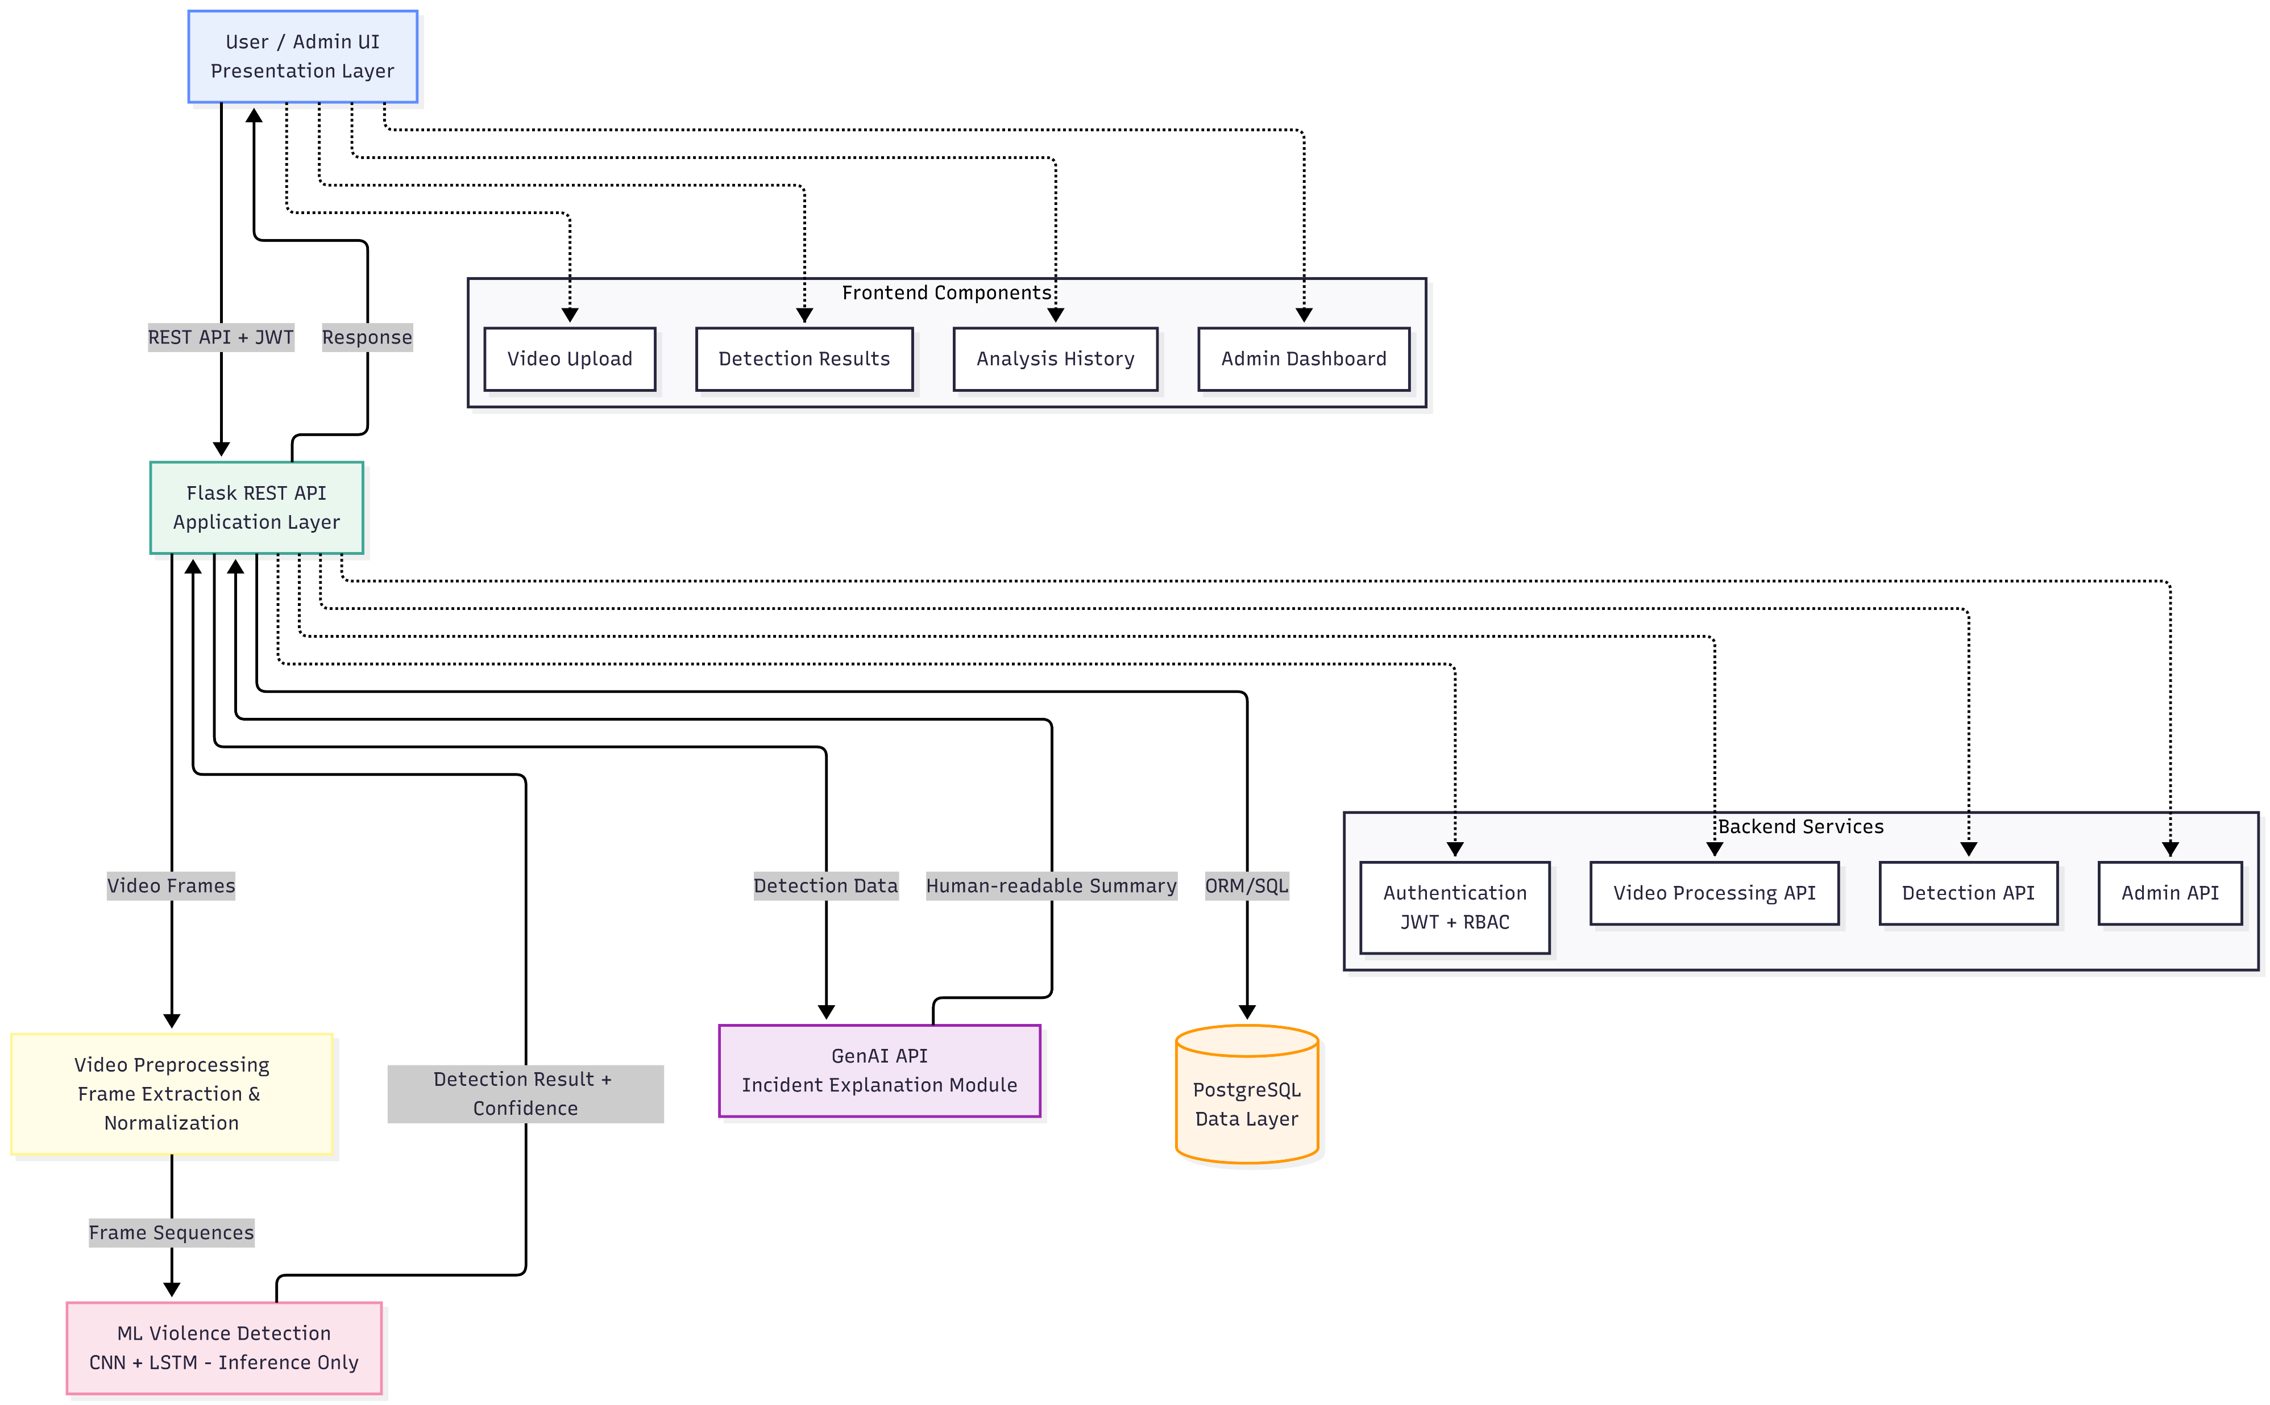
System Architecture
N-Tier Enterprise Architecture
1. Presentation Layer (React dashboards)
2. Application Layer (Flask APIs)
3. ML Processing Layer (preprocessing, CNN+LSTM inference)
4. GenAI Service Layer (explanation generation)
5. Data Layer (PostgreSQL)

Slide 9
ML Pipeline & Workflow
Video Upload
Preprocessing (frame extraction, resize to 224x224, normalization)
Sequence Generation
CNN Feature Extraction
LSTM Temporal Analysis
Violence Classification (probability score)
GenAI Explanation
Storage & Audit

Slide 10
Explainable AI Integration
Why GenAI Explanations Matter (trust, actionability, compliance)
Input to GenAI (detection result, confidence, timestamps, frame summary)
Output: 'Incident detected between 00:15-00:23... 87% confidence'
Design: GenAI uses detection metadata only, not raw video

Slide 11
Conclusion & Future Scope
Hybrid CNN+LSTM + GenAI approach summary
Academic and practical contributions
Future: Real-time processing (RTSP/HLS)
Multi-class detection, Edge deployment
Active learning, Dashboard analytics, Multi-camera support

