Slide 1
Reverse Dual Photography
Adding the projector as a third camera for closed-loop 3D reconstruction
Tawsif Ahmed · Bahaa Alattar · Gyungmin Ko · Victor Marcenac
June 8, 2026

Slide 2
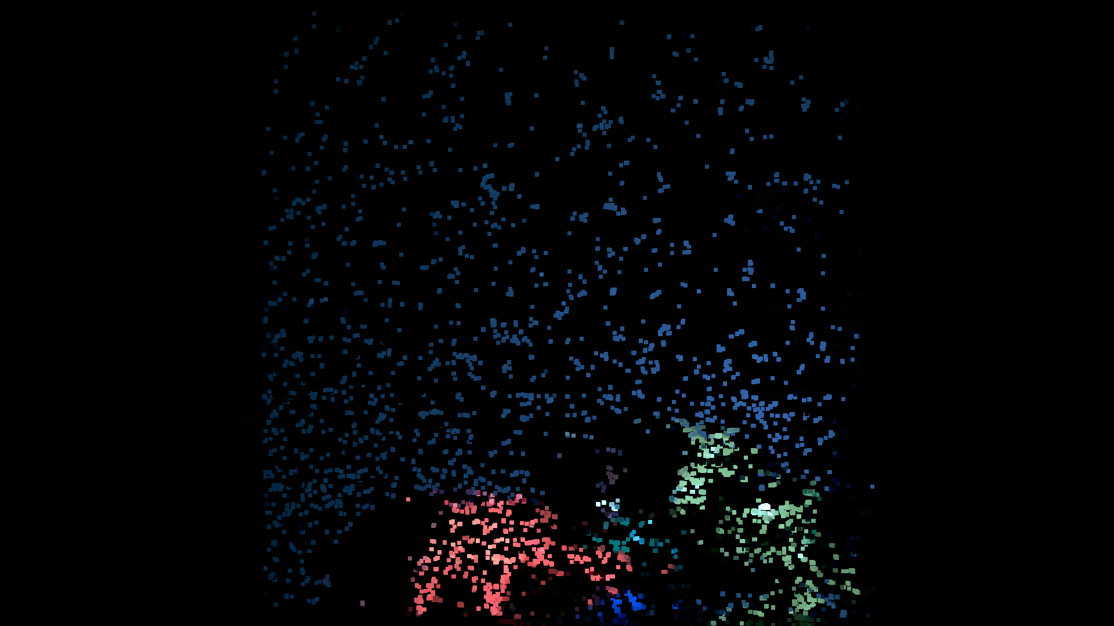
BACKGROUND
Dual Photography
Dual photography (Sen et al., 2005)
Measure the light transport between a projector and a camera with structured illumination, and you can re-render the scene from the projector's point of view — projector and camera swap roles.
Our system
A structured-light scanner: two RealSense cameras + one projector. Every camera pixel is decoded to the projector cell that lit it — a dense projector↔camera correspondence.
Scene re-rendered from the projector's viewpoint (our result)
Reference: Sen, Chen, Garg, Marschner, Horowitz, Levoy, Lensch. "Dual Photography." SIGGRAPH 2005.

Slide 3
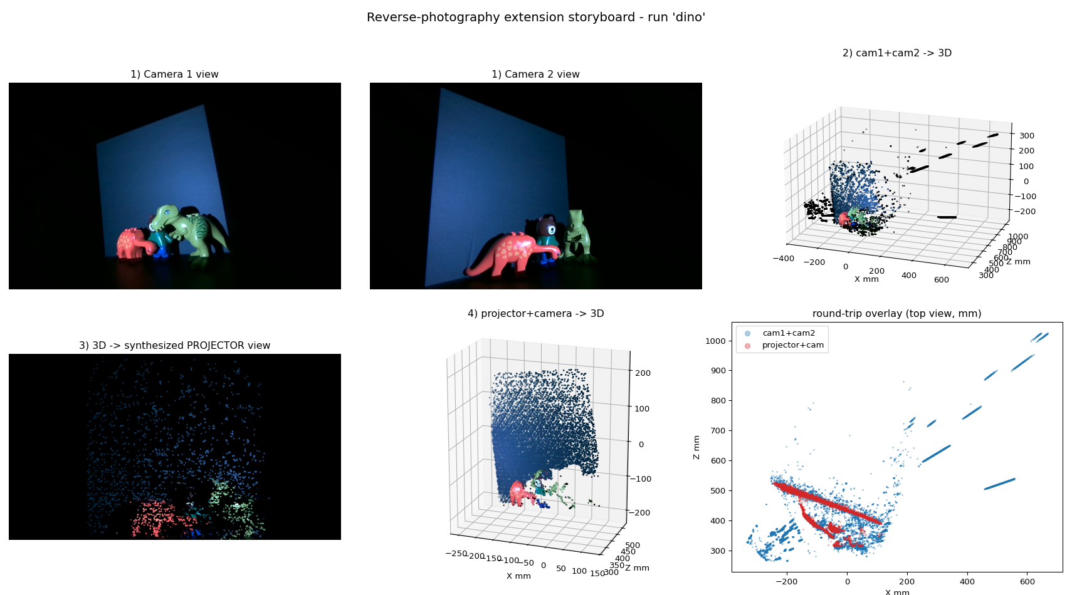
OUR APPROACH
The projector as a third camera
1
Two cameras → 3D Stereo-calibrate the cameras (checkerboard), triangulate the matched pixels into a metric point cloud.
2
Calibrate the projector From those 3D points and their projector pixels, calibrate the projector as a 3rd camera — no extra capture.
3
Reverse: synthesize Project the 3D back into the projector plane to rebuild the projector's 2D view.
4
Reconstruct again Triangulate projector + one camera into an independent 3D cloud, and compare.
Full pipeline on a real object (dino): camera views → 3D → projector view → projector+camera 3D → overlay

Slide 4
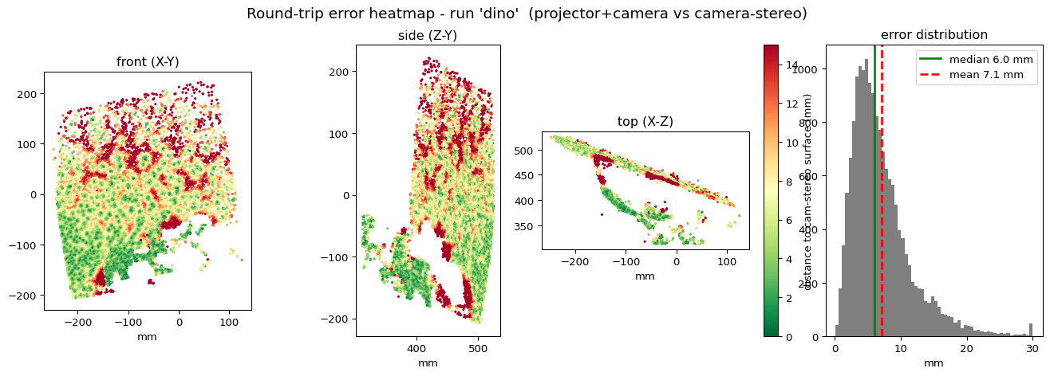
RESULTS
The loop closes
~1 px
3.2 px
~7 mm
camera 3D reprojection error
projector calibration RMS
round-trip agreement (median)
Two independent reconstructions of the same object — camera-stereo and projector+camera — agree to ~7 mm. Errors are local (red), concentrated at edges and occlusion boundaries; the surface is mostly green.

Slide 5
WHAT'S NEXT
Limitations & next steps
Approximate projector intrinsics. A single shallow object under-constrains focal length (depth degeneracy), so we fixed square pixels and a centered principal point.
Dedicated projector calibration. Project a checkerboard onto a flat plane at several depths → tighter intrinsics → lower round-trip error.
Round-trip distance as a metric. The camera-stereo vs projector+camera agreement gives the system a built-in accuracy check.
Reverse Dual Photography · structured-light 3D scanning

