Slide 1
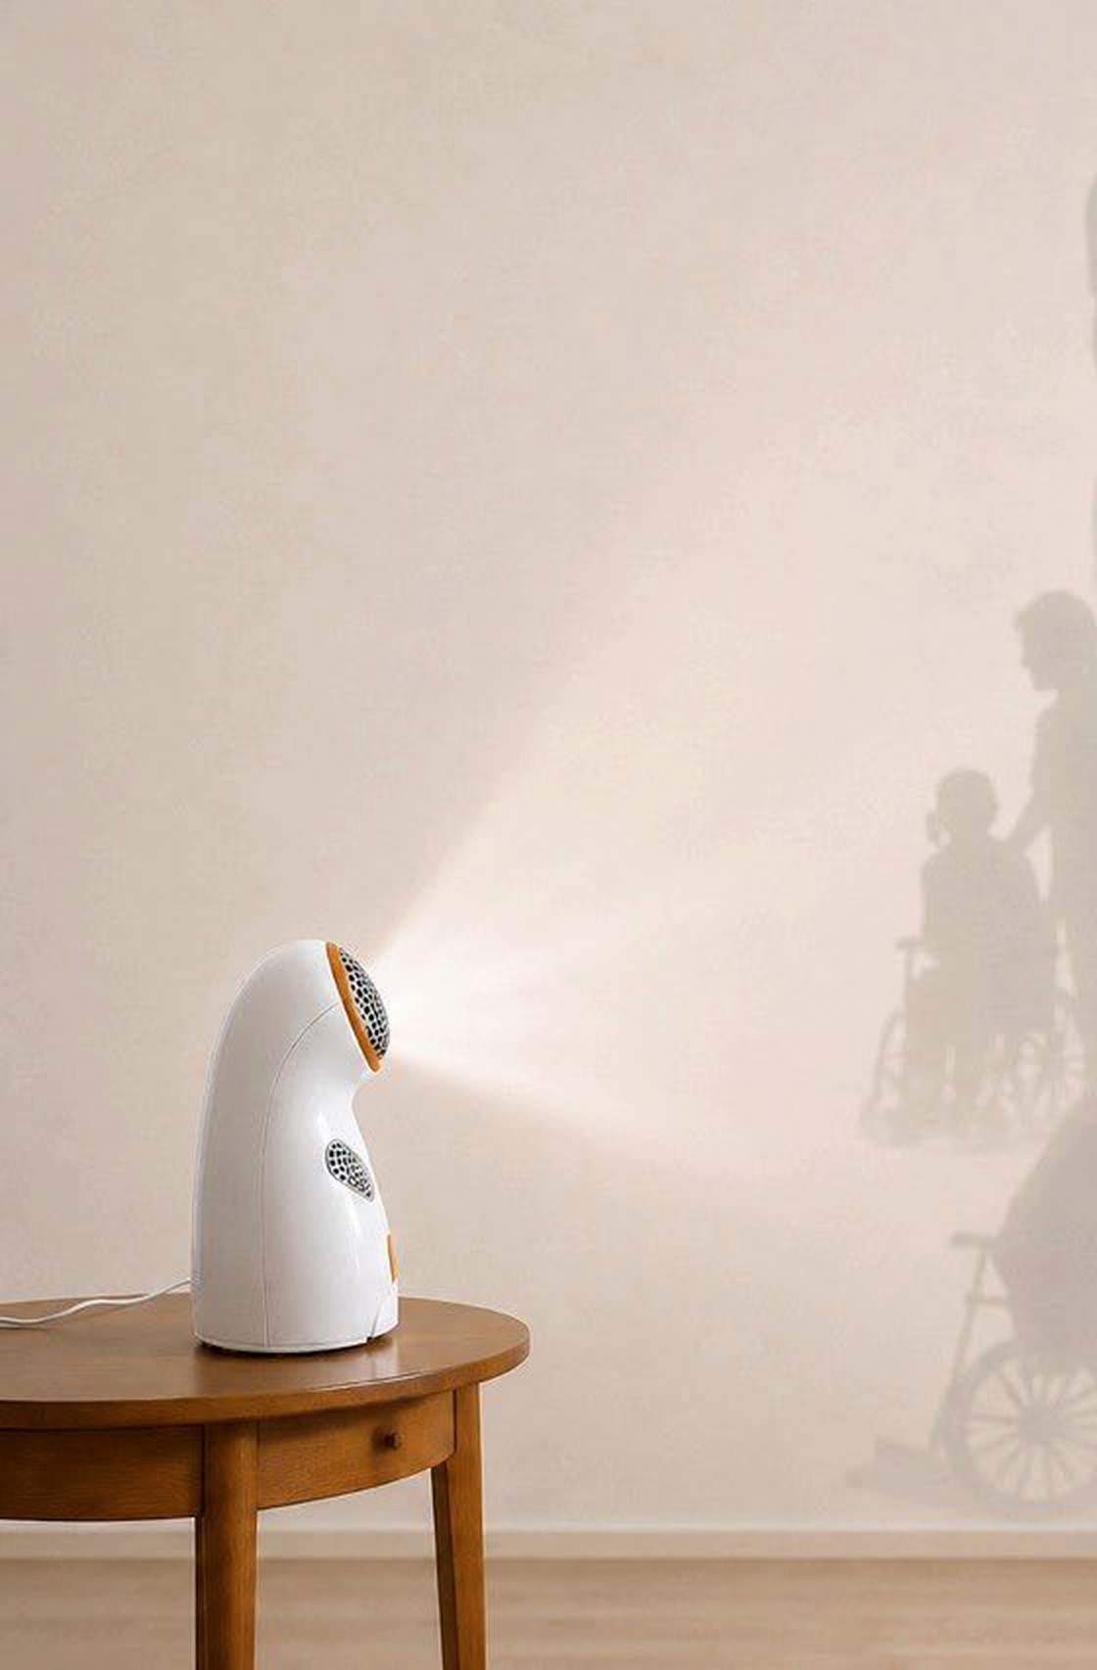
MADE IN EUROPE
GDPR-COMPLIANT
EMAi
AI VOICE ASSISTANT FOR SENIORS
caring by tech
Independent living. Peace of mind.
An intelligent voice assistant that listens to seniors, relieves care teams and connects families — no screens, no barriers.
THE CHALLENGE
An aging society meets an overstretched care system.
19M
~30K
Families
Seniors aged 65+
Care providers
Informal caregivers
Health risks, isolation and barriers to modern technology.
Staff shortage, growing workload, fragmented IT systems.
Little time, long distances, constant worry about safety.
THE SOLUTION
Natural conversation in 17+ languages —
voice-first instead of complicated.
One voice. Three winners.
FOR SENIORS
FOR CARE PROVIDERS
FOR FAMILIES
Independent every day
More time for care
Connected from afar
○ Medication & visit reminders
○ Voice calls, messages & SOS alerts
○ Conversation in 17+ languages
○ Automates 20–30 requests per day
○ Central dashboard, early detection
○ FHIR/HL7 · BEEP / §113c SGB XI
○ Remote monitoring via app
○ Activity updates, calls & chat
○ Instant emergency notifications
— Supports independent living
— €0 upfront for providers
— Peace of mind from anywhere
€200 device · €40/month reimbursable · providers €0 + up to €30/user reimbursed
Made in Europe · GDPR · EU servers
THE MARKET
WHY NOW · TRACTION
TAM
€11–15B
THE ASK
2026: BEEP Act opens a fast track to reimbursement.
Assistive tech, Europe
INVESTMENT
PRE-MONEY
SAM
€1–3B
€900K
€3.6M
Market entry before full clinical validation — evidence from real-world pilots (GKV).
Home care, Germany + EU
12 MVP users · pilots · pre-orders · 4 LOIs
SOM
€100–150M
Co-investment open · Min. ticket €250K
Funds pilots, regulatory & scaling — Seed in 12–18 months.
Via care provider networks
EMAi
emai.group jshelekhova@emai.group +49 151 72632908 Instagram

