Slide 1

Connectivity in the Age of COVID-19 A private burden within a public service
Presentors: Colin Neagle, Phillipe Volcy, Michael Foster and Victor Molina
Notes:
NOTE:
To change the image on this slide, select the picture and delete it. Then click the Pictures icon in the placeholder to insert your own image.

Slide 2

Agenda
Introduction – Colin Neagle
Why we chose this topic
What datasets we used
Explain the internet data set
The Cost of Broadband – Michael Foster
Sample cities selected
Cost as a function of median income – a growing class inequity
$/MB by city
The Current Broadband and Cellular Infrastructure – Victor Molina
Major metropolitan areas
The growing inequity between rural and urban infrastructure
Known Problem Areas – Michael FCC Complaint Data
Conclusion– Philippe
The case for broadband as a public service

Slide 3
The growing inequity arising from the work and learn from home world
Broadband vs Internet
“Broadband refers to high-speed internet access that delivers faster speeds via DSL, Cable, fiber, wireless, or satellite”₁
Broadband is a term defined by the FCC, and is periodically updated to reflect advances in technology
The FCC’s current definition, which was updated in 2015 is ‘25/3’, which denotes 25 mbs download / 3 mbs upload
However, current FCC Commissioner Jessica Rosenworcel has called for increasing this definition to represent a minimum of 100 mbs download speed, with other consumer advocacy groups supporting a minimum of 1gb/s.
Why does this matter? (it does)
According to a Pew Research Center survey conducted in 2016(!), the average US household uses 5 devices, with 20% of households use at least 10 internet connected devices.
While speeds below the existing 25/3 standard are sufficient for a single device, households with 5 or more devices over 25/3 for even “moderate internet use”, which the FCC defines as “basic functions plus 1 high demand application, such as (sic) videoconferencing”
Of the 290 plans researched in New America’s Open Technology Institute ‘The Cost of Connectivity 2020 Study (Chao and Park, July 2020), the 118 plans have advertised initial promotional prices of $50/month, or under, and only 64 of those plans meet the FCC standard for Broadband.

Slide 4
The growing inequity arising from the work and learn from home world: Lack of Choice for the Consumer
The US Market for internet service is dominated by just 4 companies:
AT&T, Charter, Comcast (Xfinity), and Verizon.
It is outside the scope of our study, but we highly encourage the reader to read the ‘The Cost of Connectivity 2020’ study, which outlines the various mechanisms (high monthly prices, early termination fees, locked in contracts) that limit competition (and this price regressing to marginal cost, in theory)
Based on our research, most US cities are served by 1 or 2 ISP’s that offer Broadband quality service. [I have data for this, but I know its too late]
The essential nature of the internet
In an April 2020 Study₂, 53% of Americans stated that access to the internet has been essential to them during the Covid-19 Pandemic.
This survey found at least 28% of consumers reported concerns about how they could pay their internet bills over the coming months.
Our presentation covers the following: a representative sample of the cost of basic broadband access in a subsample of cities, a function of this cost in terms of both median income in that area, and the infrastructure that supports those areas (may have to cut broadband and use complaints data)

Slide 5
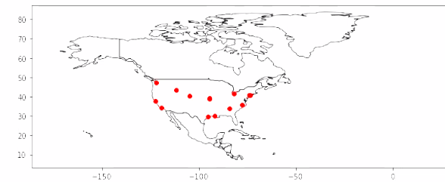
Map of the cities in our study

Slide 6
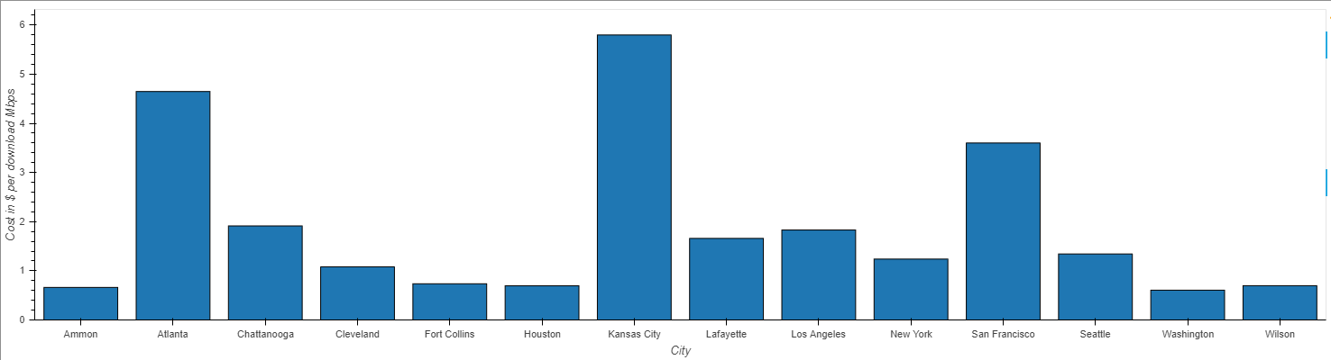
Average Download Speed Mbps by City

Slide 7
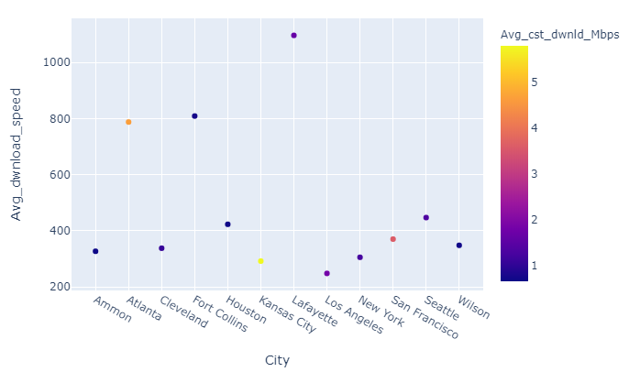
Average Download Speed and Avg Cost per Download Mbps by City

Slide 8
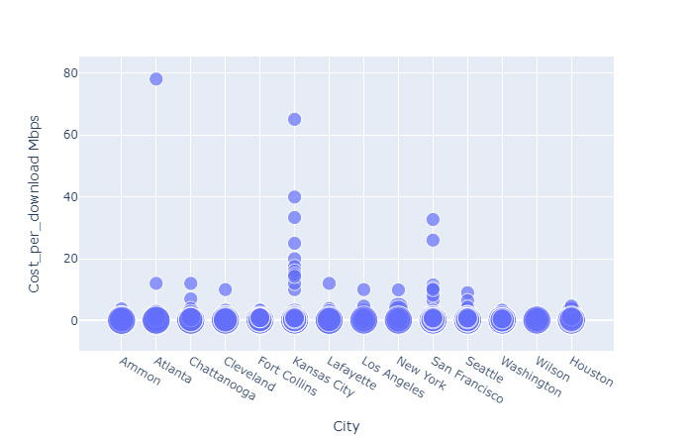
Cost per Mbps by City (plotted by the size of internet speed series)

Slide 9
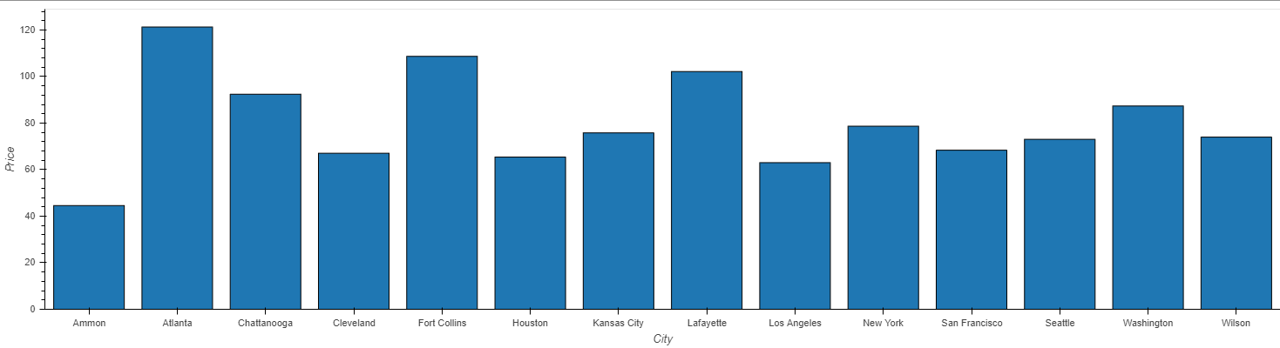
Average cost of Broadband by City

Slide 10
Cellular and Fixed Broadband Infrastructure

Slide 11
FCC Complaints data

Slide 12
Where US cities rank amongst the world in terms of internet cost
Caption

Slide 13
Conclusion - Philippe
Have to talk about Ammond, ID. Read first 10 pages of the report, it explains why they chose that city, why its cheap there (municipal infrastructure (ie public), and 20 states have outlawed similar solutions

