Slide 1

Connectivity in the Age of COVID-19
Presenters: Colin Neagle, Phillipe Volcy, Michael Foster and Victor Molina
Notes:
NOTE:
To change the image on this slide, select the picture and delete it. Then click the Pictures icon in the placeholder to insert your own image.

Slide 2

Agenda
Introduction – Colin
Why we chose this topic
What datasets we used
Explain the internet data set
Examining the cities connectivity in our study – Victor
Major metropolitan areas
Cost and download differences
Known Problem Areas – Michael FCC Complaint Data
Conclusion– Philippe
The case for broadband as a public service

Slide 3
The growing inequity arising from the work and learn from home world
Broadband vs Internet
“Broadband refers to high-speed internet access that delivers faster speeds via DSL, Cable, fiber, wireless, or satellite”₁
Broadband is a term defined by the FCC, and is periodically updated to reflect advances in technology
The FCC’s current definition, which was updated in 2015 is ‘25/3’, which denotes 25 mbs download / 3 mbs upload
Our series of Mbps download speeds for this report.
Why does this matter?
The average US household uses 5 internet devices.
High speed availability
Affordability

Slide 4
The growing inequity arising from the work and learn from home world: Lack of Choice for the Consumer
The US Market for internet service is dominated by just 4 companies:
AT&T, Charter, Comcast (Xfinity), and Verizon.
Most US cities are only limited by ISP’s in their area
The essential nature of the internet
In an April 2020 Study₂, 53% of Americans stated that access to the internet has been essential to them during the Covid-19 Pandemic.

Slide 5
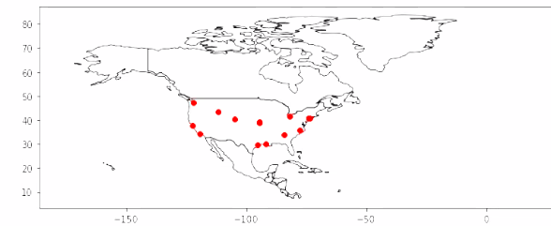
GeoPandas Map of the cities in our study

Slide 6
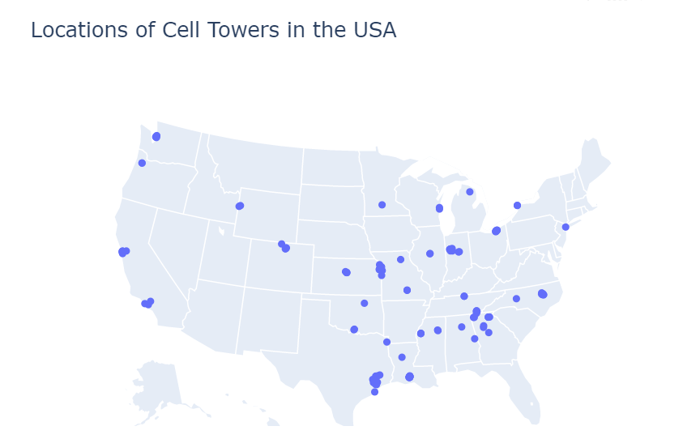
Cellular and Broadband Infrastructure

Slide 7
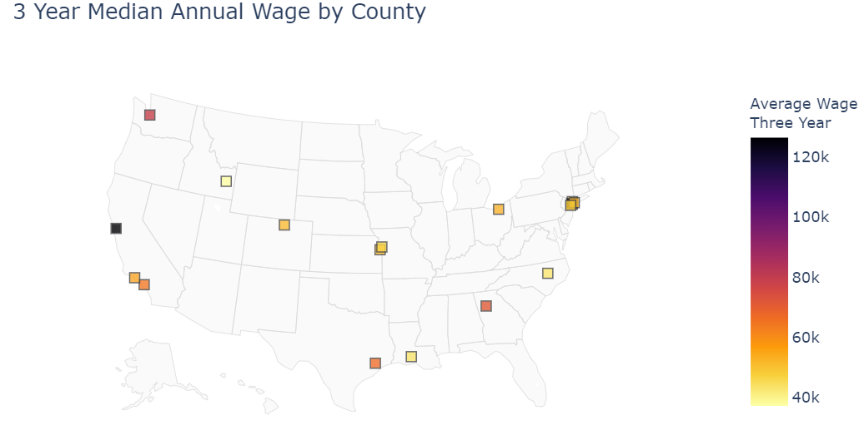
Plot of Counties (for the Cities in our study) with 3 Years Median Wage

Slide 8
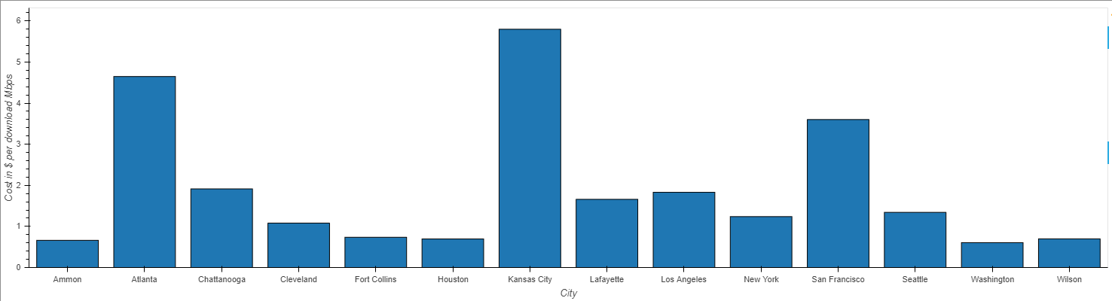
Average $/Mbps (Download) by City

Slide 9
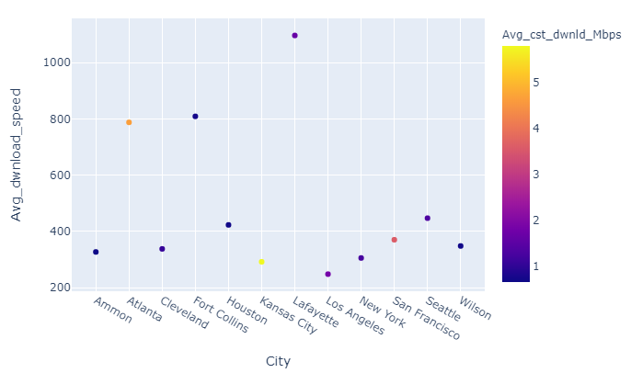
Average Download Speed and Avg Cost per Download Mbps by City

Slide 10
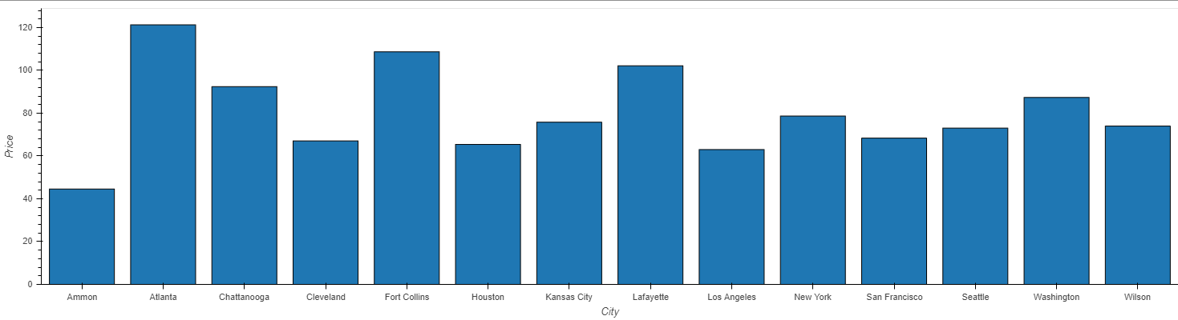
Average cost of Broadband by City

Slide 11
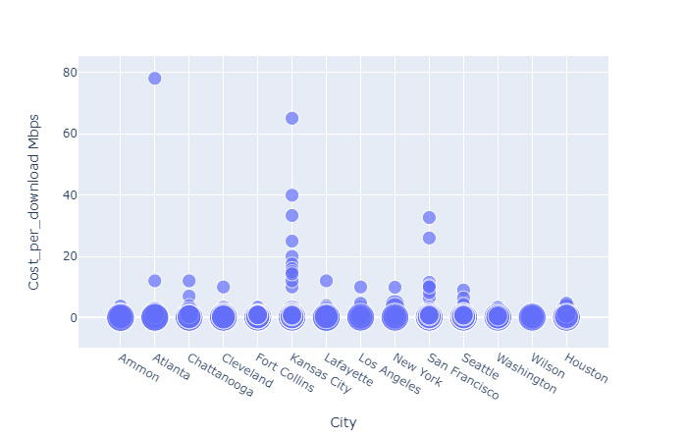
Cost per Mbps by City (plotted by the size of internet tier speed)

Slide 12

FCC Complaints data
In 2019, the FCC received 9,661 (34% of total complaints) complaints related to connectivity issues and 3,198 complaints related to speed (11% of total complaints
In YTD 2020, the FCC received 16,174 complaints related to connectivity (representing a 67% increase YoY,) and 5,429 related to speed (representing a 70% increase YoY)

Slide 13
Conclusion - Philippe

