Slide 1

Connectivity in the Age of COVID-19
Presenters: Colin Neagle, Phillipe Volcy, Michael Foster and Victor Molina
Notes:
NOTE:
To change the image on this slide, select the picture and delete it. Then click the Pictures icon in the placeholder to insert your own image.

Slide 2

Agenda
Introduction – Colin Neagle
Why we chose this topic
What datasets we used
Explain the internet data set
The Cost of Broadband – Michael Foster
Sample cities selected
Cost as a function of median income – a growing class inequity
$/MB by city
The Current Broadband and Cellular Infrastructure – Victor Molina
Major metropolitan areas
The growing inequity between rural and urban infrastructure
Known Problem Areas – Michael FCC Complaint Data
Conclusion– Philippe
The case for broadband as a public service

Slide 3
The growing inequity arising from the work and learn from home world
Broadband vs Internet
“Broadband refers to high-speed internet access that delivers faster speeds via DSL, Cable, fiber, wireless, or satellite”₁
Broadband is a term defined by the FCC, and is periodically updated to reflect advances in technology
The FCC’s current definition, which was updated in 2015 is ‘25/3’, which denotes 25 mbs download / 3 mbs upload
Our series of Mbps download speeds for this report.
Why does this matter?
The average US household uses 5 internet devices.
High speed availability
Affordability

Slide 4
The growing inequity arising from the work and learn from home world: Lack of Choice for the Consumer
The US Market for internet service is dominated by just 4 companies:
AT&T, Charter, Comcast (Xfinity), and Verizon.
Most US cities are only limited by ISP’s in their area
The essential nature of the internet
In an April 2020 Study₂, 53% of Americans stated that access to the internet has been essential to them during the Covid-19 Pandemic.

Slide 5
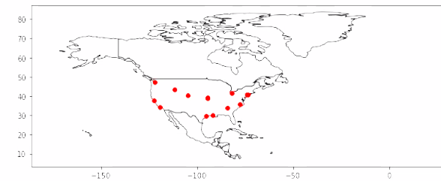
GeoPandas Map of the cities in our study

Slide 6
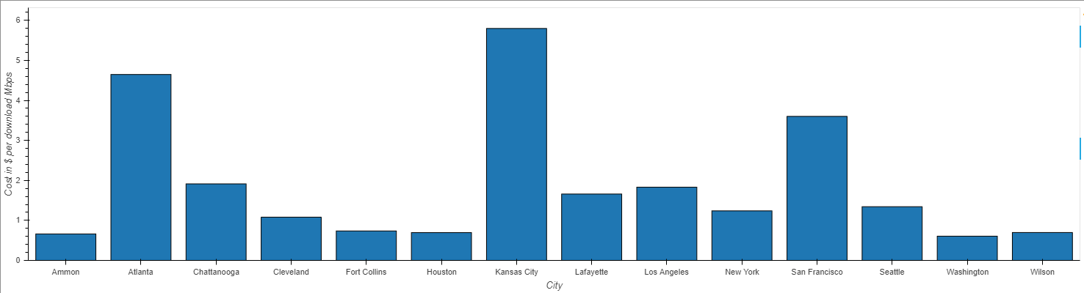
Average Download Speed Mbps by City

Slide 7
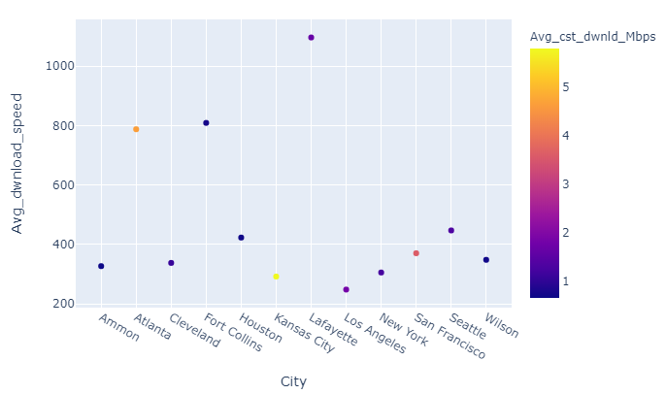
Average Download Speed and Avg Cost per Download Mbps by City

Slide 8
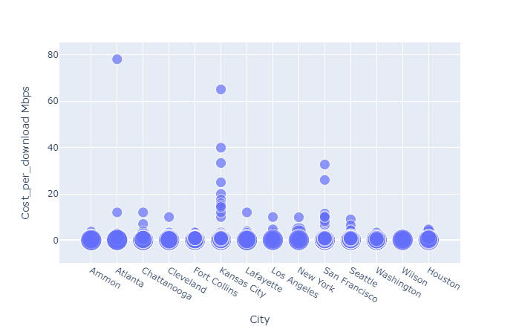
Cost per Mbps by City (plotted by the size of internet speed series)

Slide 9
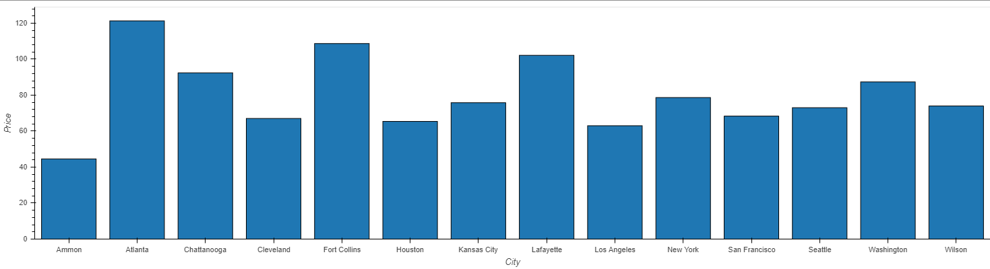
Average cost of Broadband by City

Slide 10
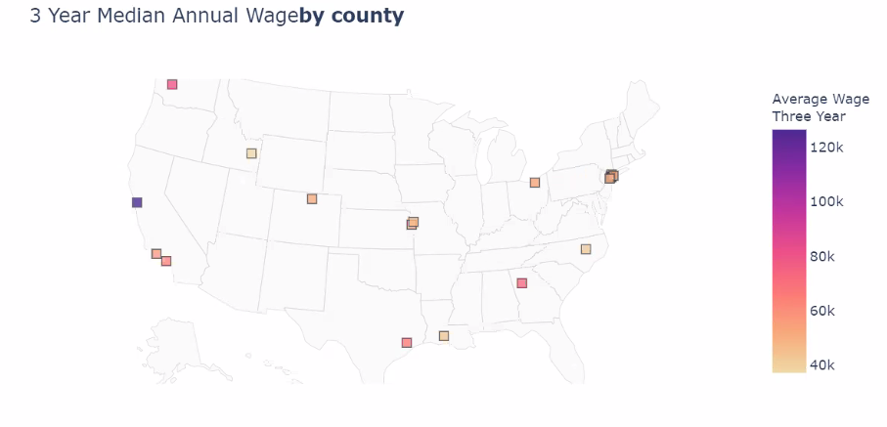
Plot of Cities with 3 Years Median Wage

Slide 11
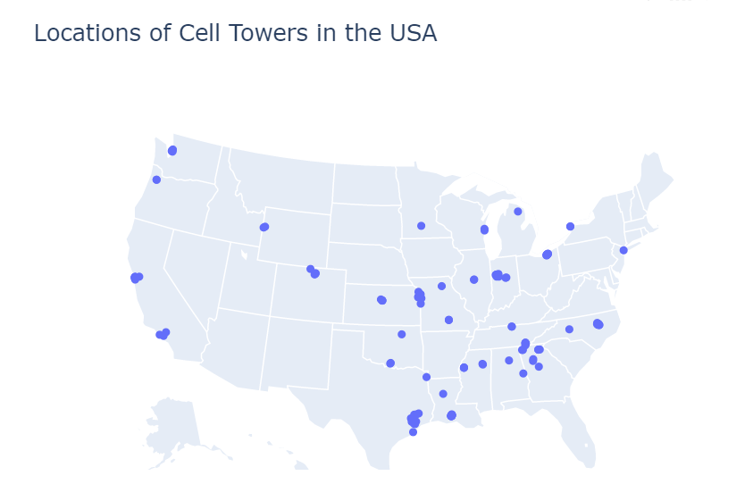
Cellular and Fixed Broadband Infrastructure

Slide 12
FCC Complaints data

Slide 13
Conclusion - Philippe
Have to talk about Ammond, ID. Read first 10 pages of the report, it explains why they chose that city, why its cheap there (municipal infrastructure (ie public), and 20 states have outlawed similar solutions

