Slide 1
WorkboxPlugin with Service Worker: Chunk Build Management
Handling Chunk Mismatches During API Traffic Flips

Slide 2
Scenario Overview
- Server A has chunk version 1
- Server B has chunk version 2
- When API traffic flips from A to B, clients with cached version 1 chunks encounter mismatches when receiving version 2 API responses.

Slide 3
What is WorkboxPlugin with Service Worker?
WorkboxPlugin simplifies creating service workers during Webpack builds by automating:
- Precaching of static assets (JS, CSS, images)
- Cache management and invalidation
- Supporting offline and faster loading experiences

Slide 4
How WorkboxPlugin with Service Worker Works
- Service worker is generated during Webpack build
- Precaches files at the install phase
- Handles cache invalidation at activation phase
- Intercepts network requests at fetch phase and serves cached or network assets
- Updates caches with new versions in the background

Slide 5
Architecture Design: WorkboxPlugin and Service Worker

Slide 6
Architecture Design: WorkboxPlugin and Service Worker
The architecture involves:
1. Webpack Build Process: Generates service-worker.js
2. Service Worker Lifecycle: Install -> Activate -> Fetch -> Update
3. Cache Strategies: Cache First, Network First
4. Cache Invalidation: Clear outdated chunks after flipping API traffic between versions

Slide 8
Service Worker Lifecycle Diagram

Slide 9
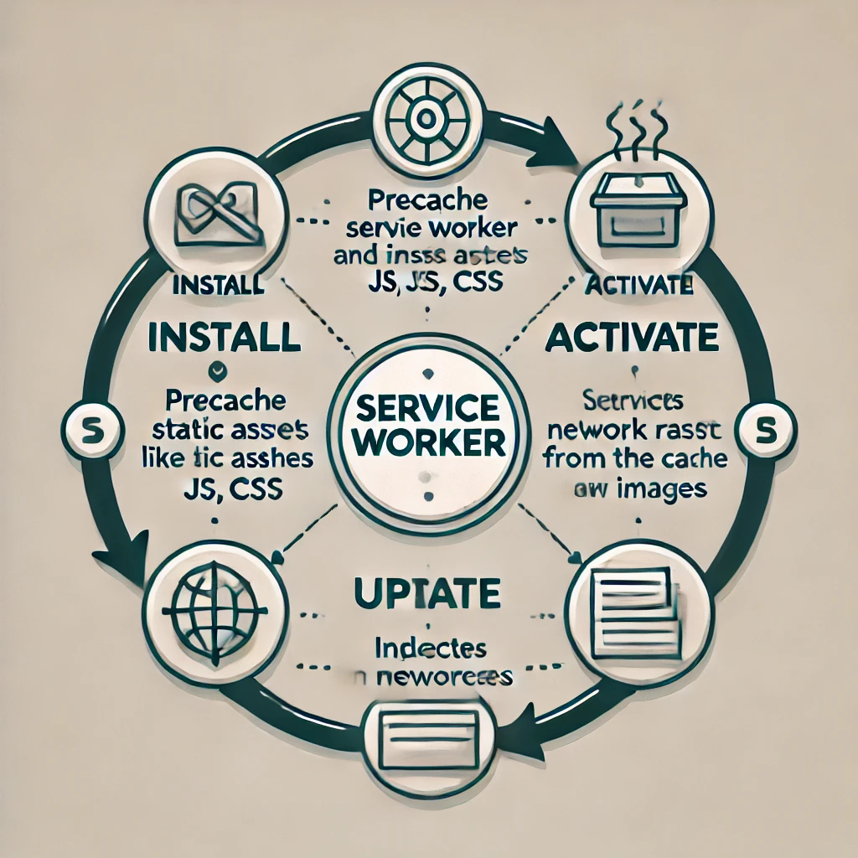
Service Worker Lifecycle Diagram

