Slide 1
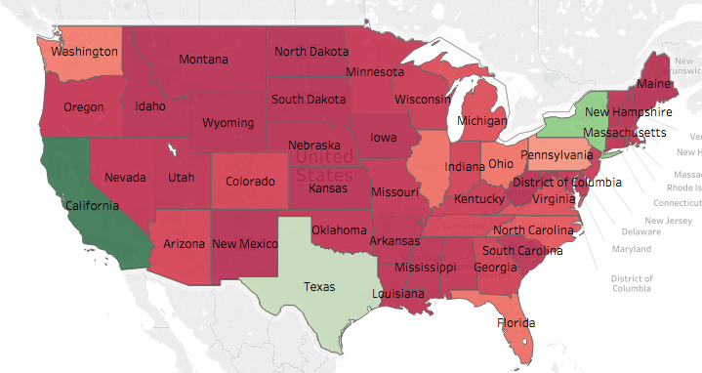
SUPER STORE DATASET ANAYLSIS
Name: Vishal Naik

Slide 2
Introduction (Problem Statement)
If you are a consumer, you have probably stepped foot into a store to make a purchase. This dataset explores the analytics collected by a fictional store called SuperStore. Upon exploration, the dataset shows us a bunch of analytics in 3 separate sheets (Orders, Returns, and People). In the Orders sheet, every single transaction is represented by a row.
PROBLEM STATEMENT: Provide a detailed analysis of the profitability of the Superstore!
- What are the most profitable and least profitable states?
- Create a map to show how well states are performing
- How does sales vary by region and order year?
- Who had the most sales?

Slide 3
Data Preparation (Gathering, Cleaning & Preprocessing)
There are 9994 observations.
We proceed to remove duplicate values. Duplicate values may have been a consequence of data mining. In this dataset, there are no duplicate values.
We then proceed to remove NA (Not Available) values. Additionally, missing values can be corrected by replacing data with new values — such as the mean, median, or mode, or by simply removing the rows.
We then Perform Dimensionality Reduction (Feature Selection) to remove unnecessary attributes that don’t add value to our work
Outliers that might affect the data can also be removed since they might affect the data and provide wrong information

Slide 4
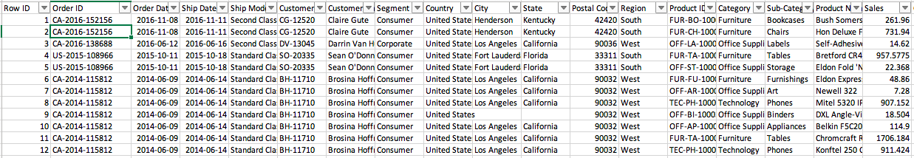
Exploratory Data Analysis
There are 4 different Regions: South, West, East, Central
There are 3 categories: Furniture, Office Supplies, Technology
There are 3 customers segments: Consumer, Corporate, Home Office
Please look at Tableau file: SuperStoreAnalysis.twb for more information

Slide 5
Key Insights:
Overall, our profits look strong. But there are some problem areas.
Anna Andreadi sold the most in her region: West. Kelly William sold the least in her region: Central
Discounting (particularly with Office Supplies) is one of the key reasons for losses but might be needed in order to penetrate the market to compete. More specifically, Tables are almost 30% discounted, which is mostly occurs at the Central Region
Shipping Mode also has an effect on Profitability. The better our shipping mode, the costlier it is. And hence, the costlier the shipping mode, the less our profits seem to increase.
Out of all the transactions conducted, only 7% have been refunded.

Slide 6
Answers to Stakeholder Questions:
What products, by category or subcategory, are unprofitable?
By category, Furniture is unprofitable. By sub-category, specifically, Tables are unprofitable.
Is this related to one or more product manufacturers?
This is most likely related to more than one product manufactures.
In a map, show whether or not this is a local or regional issue.
This seems to be a regional issue.
Use a scatter-plot with trend lines to explore the underlying reasons for why profits are lower for certain products and locations. Attempt to determine the root cause, whether it’s correlated to expedited shipping costs, specific customer segments, or other factors found in the data set.
Discounting is one of the key reasons for losses. Additionally, expedited shipping may explain the root causes of why profits are lower in some regions
Demonstrate how the profit trend lines change if outliers are addressed.
There is not much of an effect on profitability after outliers are addressed.
From the scatterplot, create a cross-tab that lists unprofitable customer orders.
Look at sheet: [CSV] Crosstab

Slide 7
Recommendations:
Look into Discounting techniques.
Use R or Python to conduct further statistical analysis.
Use Unsupervised Machine Learning Algorithms such as Apriori, or K-means Clustering to reveal more information about the data in order to discover new information.

