Slide 1
Sentiment Analysis
-Varun Negandhi

Slide 2
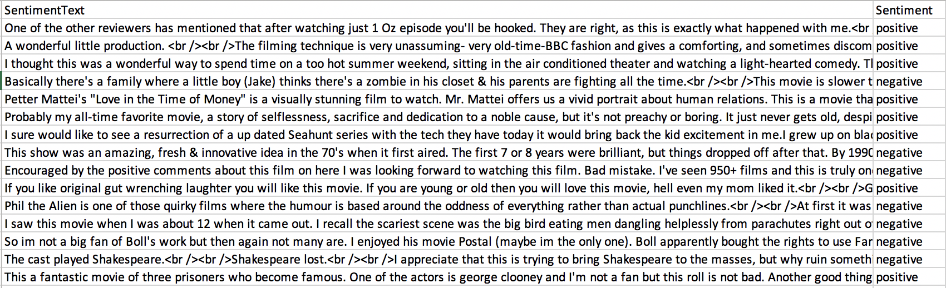
Dataset Overview
Training Data: 50000 reviews
Test Data: 25000 reviews

Slide 3
Types of approach
Machine Learning – SVM
Deep Learning - Keras

Slide 4
Machine Learning Approach:
Toolkit: SVM
Method: Select dataset -> Clean Dataset -> Vectorize -> Select parameters -> SVM -> Evaluate -> Test Data -> Clean Dataset -> Vectorize -> SVM from training -> Evaluate
Parameters tested: Cost factor C, Type of kernel

Slide 5
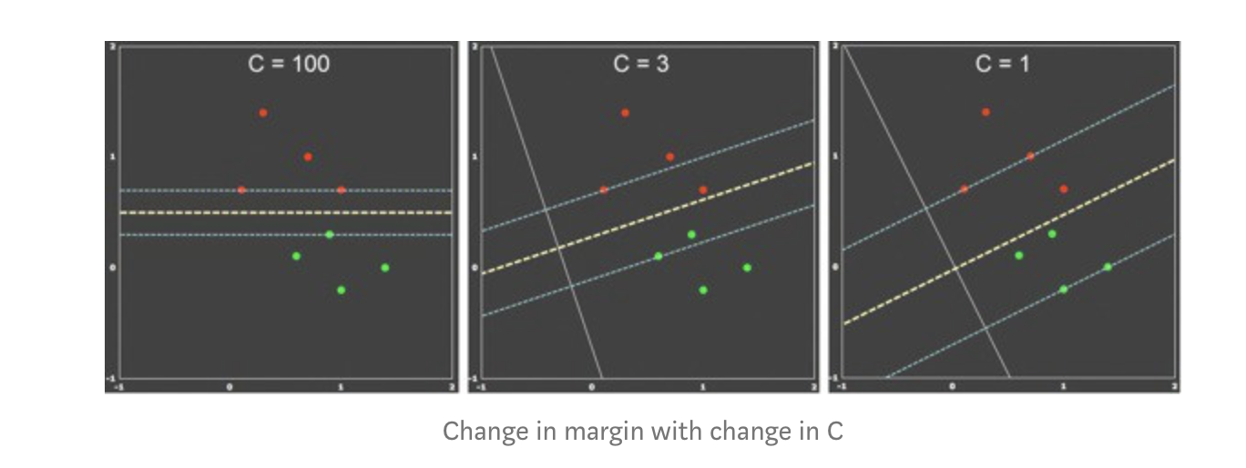
Cost factor C
Two things to deal with:
Larger margin , low misclassification error

Slide 6
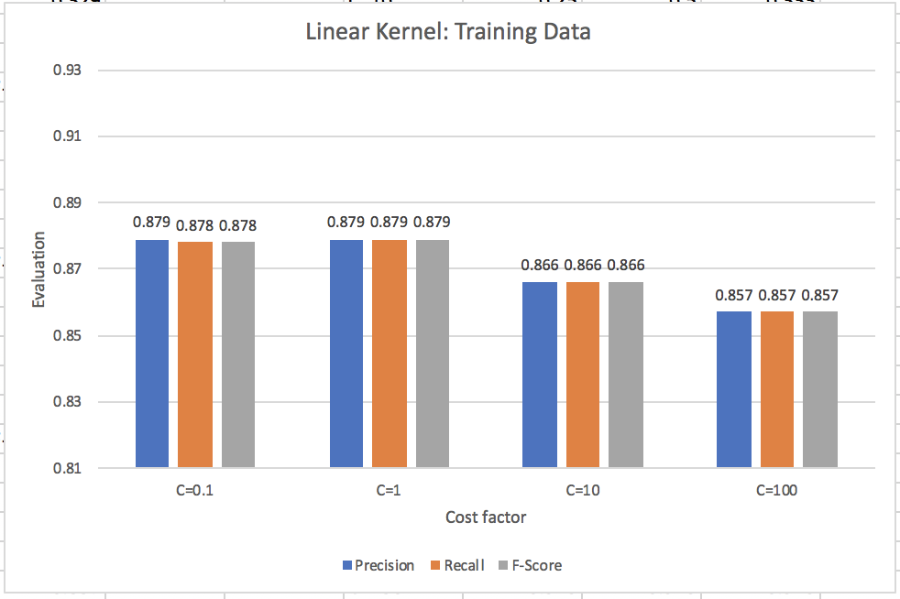
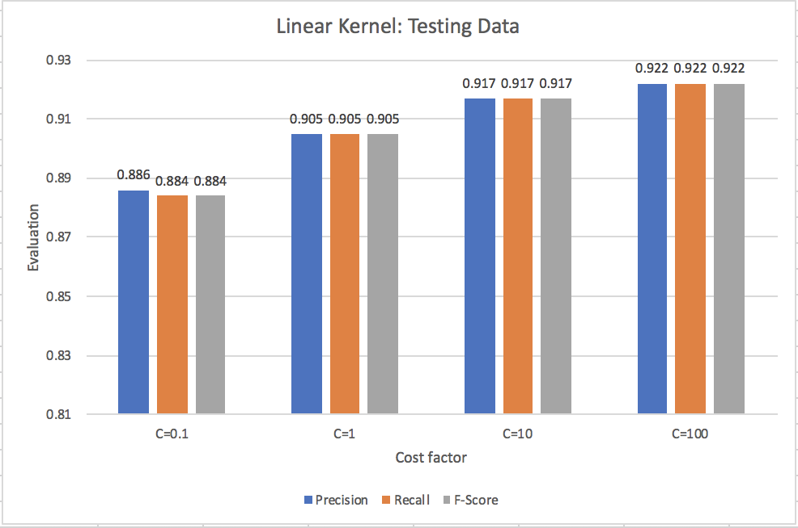
Results: Linear Kernel

Slide 7
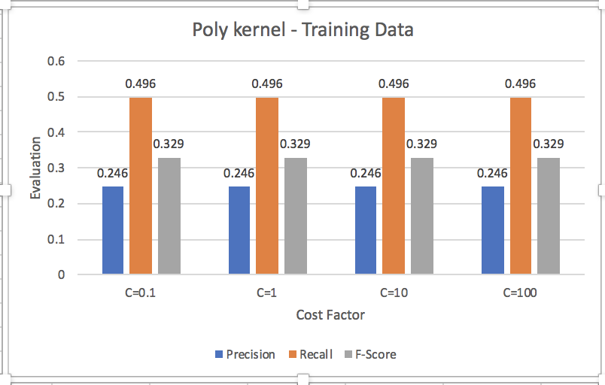
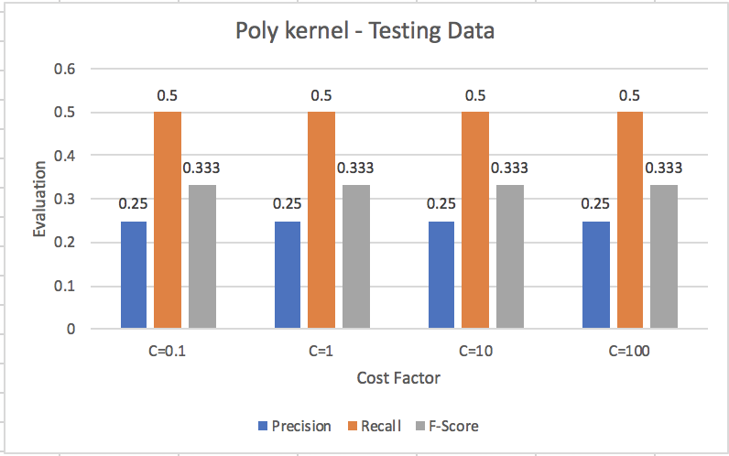
Results: Poly kernel

Slide 8
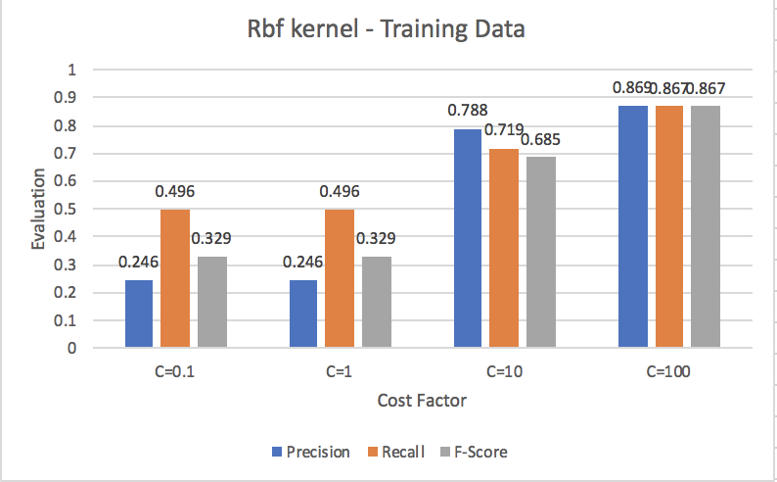
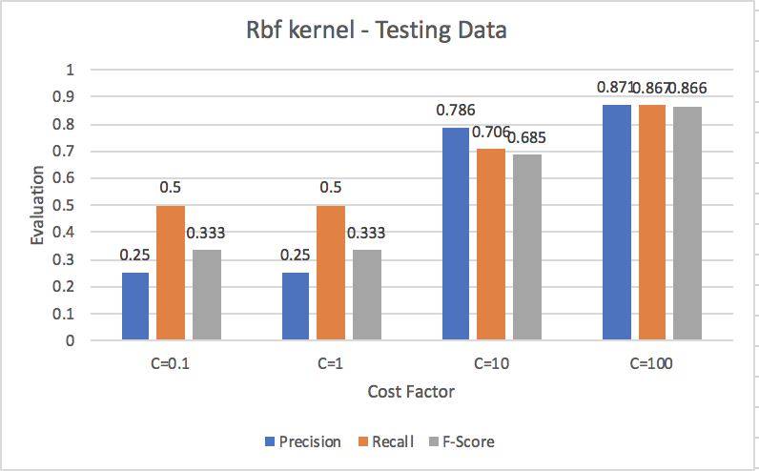
Results: Rbf kernel

Slide 9
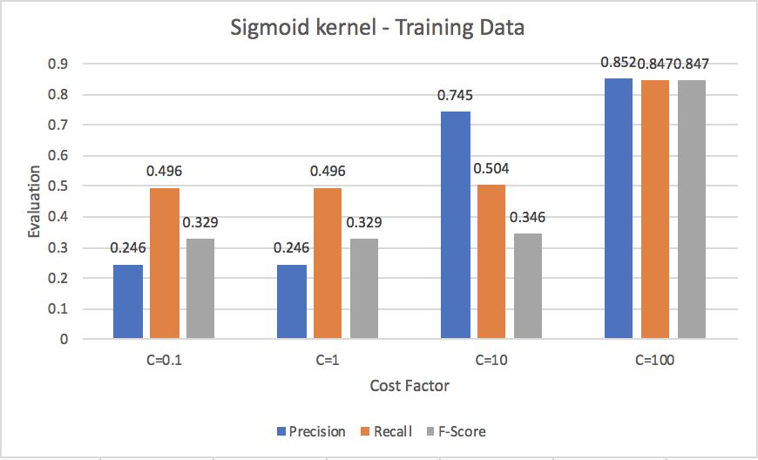

Results: Sigmoid kernel

Slide 10
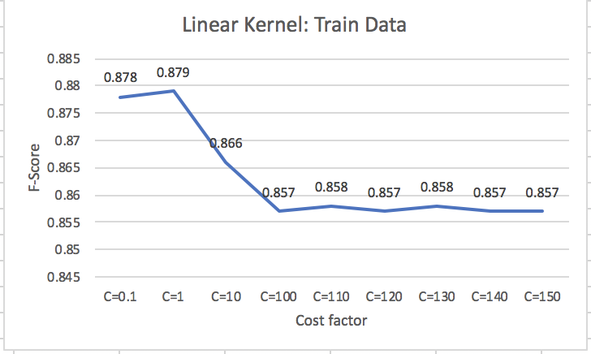
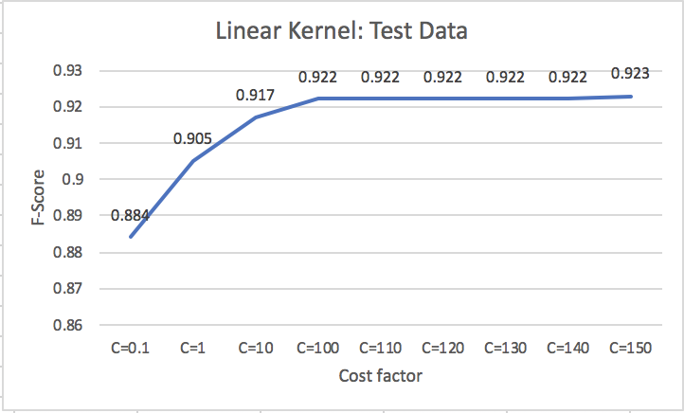
Further investigation : Linear Kernel

Slide 11
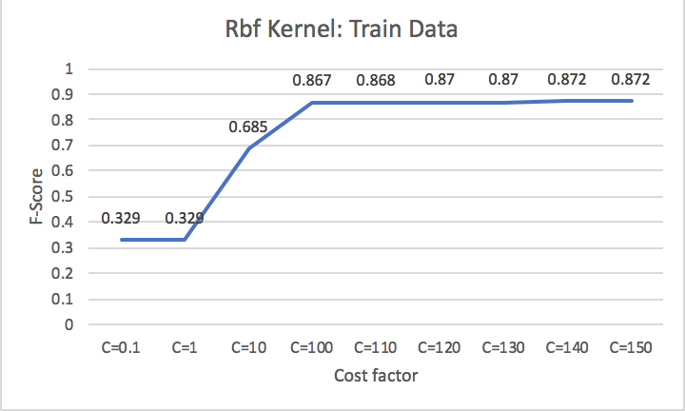
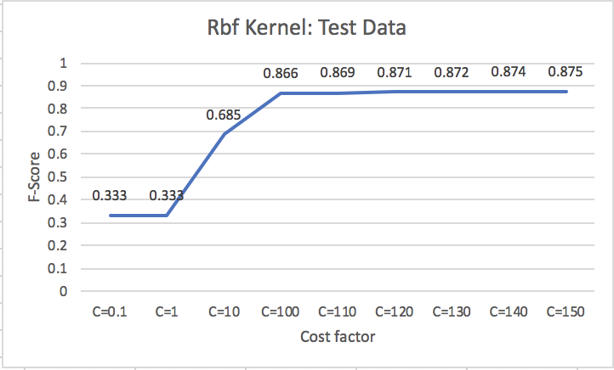
Further Investigation: Rbf Kernel

Slide 12
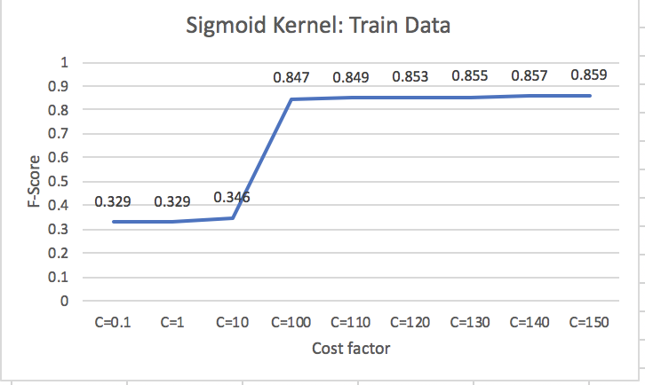
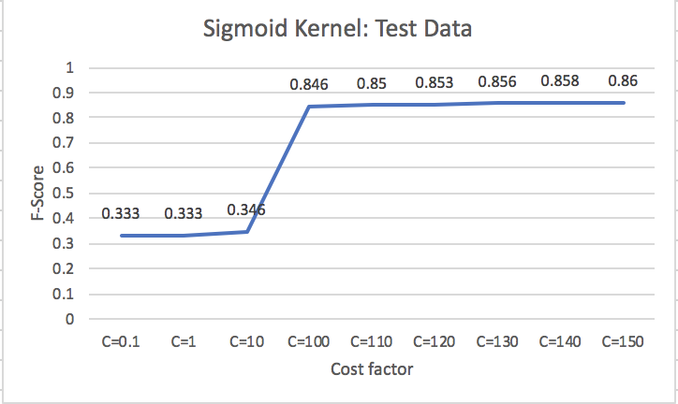
Further Investigation : Sigmoid kernel

Slide 13
Deep Learning Approach:
Toolkit: Keras
Method: Select dataset ->Clean data -> Tokenize words in data -> Split data into training and validation set -> Build deep neural network with keras -> Train data and obtain validation dataset measure -> Apply test data -> Evaluate
Parameters: Number of neurons in each layer and Number of hidden layers

Slide 14
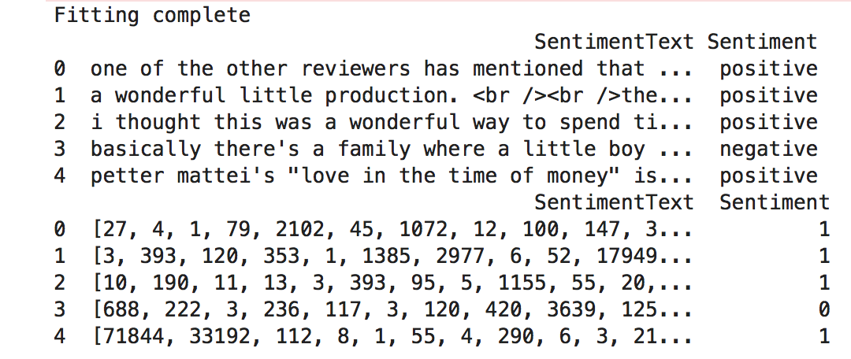
Preprocessing: Tokenize words

Slide 15
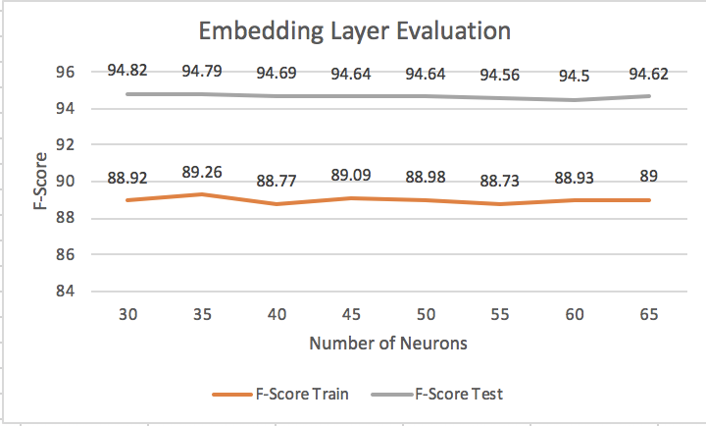
Deep Learning : Experiment 1

Slide 16
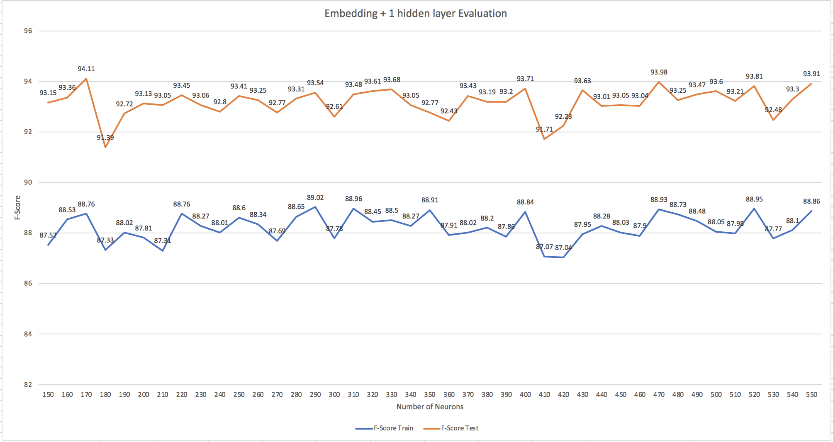
Deep Learning : Experiment 2

Slide 17
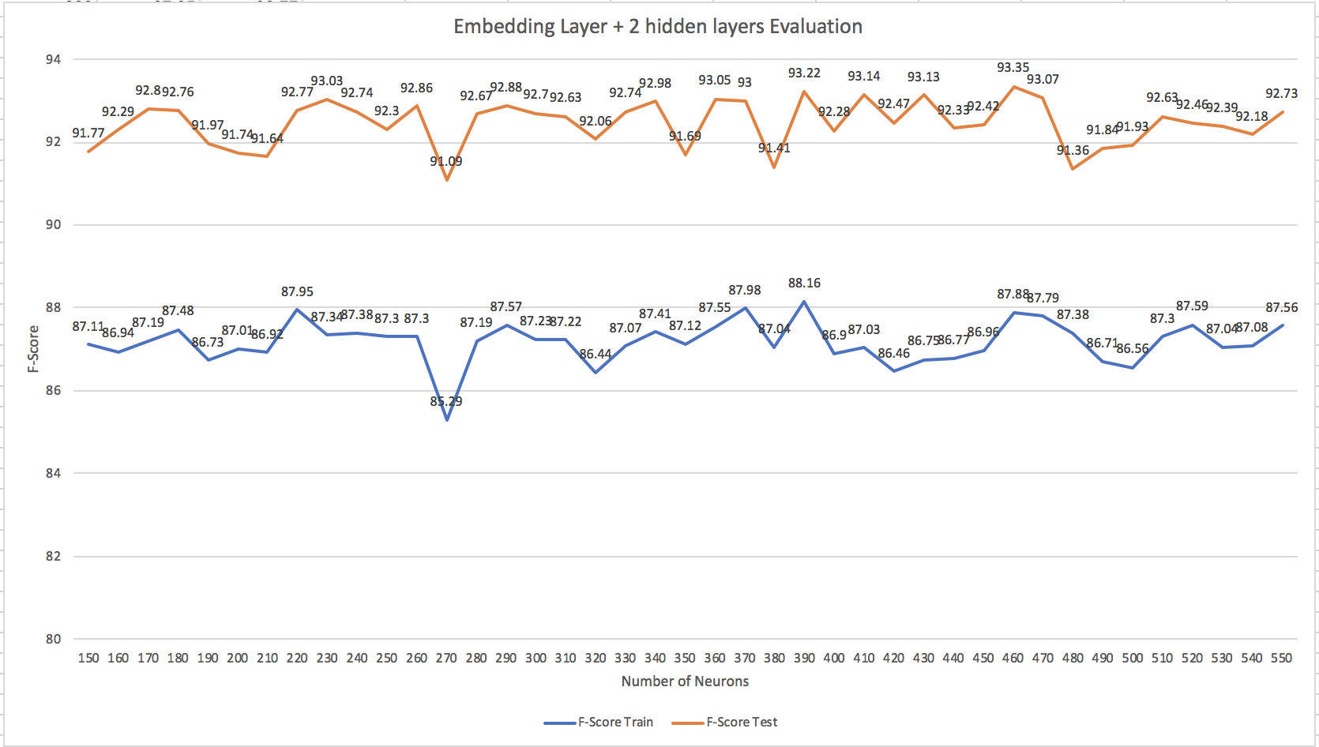
Deep Learning : Experiment 3

Slide 18
Review example
"""It's not even 5 days since i purchased this product.I would say this a specially blended worst Phone in all formats.
ISSUE 1: Have you ever heard of phone which gets drained even in standby mode during night? Kindly please see the screenshot if you want to believe my statement.My phone was in full charge at night 10:07 PM . I took this screenshot and went to sleep.Then I woke up at morning and 6:35 AM and battery got drained by 56% in just standby condition.If this is the case consider how many hours it will work, during day-time. It's not even 5 hours the battery is able to withstand.
ISSUE 2:
Apart from the battery, the next issue is the heating issue .I purchased a iron box recently from Bajaj in this sale. But I realized this phone acts a very good Iron box than the Bajaj Iron box. I am using only my headphones to get connected in the call. I am not sure when this phone is will get busted due to this heating issue. It is definitely a challenge to hold this phone for even 1 minute. The heat that the phone is causing will definitely burn your hands and for man if you keep this phone in your pant pocket easily this will lead to infertility for you. Kindly please be aware about that.
Issue 3:
Even some unknown brands has a better touch sensitivity. The touch sensitivity is pathetic, if perform some operation it will easily take 1-2 minutes for the phone to response.For your kind information my system has 73% of Memory free and the RAM is also 56% free.Kindly please make this Review famous and lets make everyone aware of this issue with this phone. Let's save people from buying this phone. There are people who don't even know what to do if this issue happens after 10 days from the date of purchase. So I feel at least this review will help people from purchasing this product in mere future
Negative: 0.63645095
Positive: 0.36354908

Slide 19
Learnings from the project
LSTM approach failure
Machine Learning: Huge computation time
Deep Learning: Needs lot of experiments to come up with right set of parameters.
Is my model correct based on train and test values?
Experimenting more can reveal more secrets about the data assuming you have a good computer and a Wi-fi…

Slide 20

Thank you

