Slide 1
Trend Analysis of Climate in Norway
Group4:
Nicolai Munsterhjelm
Bishnu Poudel
Nasibeh Mohammadi
28 Aug 2019

Slide 2

Introduction
Weather condition affects every sector of society and is an important element of people’s daily lives. Accurate weather forecast can increase productivity of people and businesses.
Weather in Norway is unpredictable due to varying topography.
Analyzing historical data is important to predict future trends.
Over the past 100 years, the Norwegian climate has become warmer. Climate change is already happening. Environmental change is being observed on all continents and in all the major oceans.

Slide 3



Methods
Data extracted from eklima.met.no for relevant time frame and weather stations
Supporting data from the International Disaster Database (http://www.emdat.be) and the world bank (https://data.worldbank.org/indicator/en.atm.co2e.pc)
Initial data cleaning in Excel
Data transformation and regression analysis in python
Visualization using matplotlib and ArcGIS

Slide 4
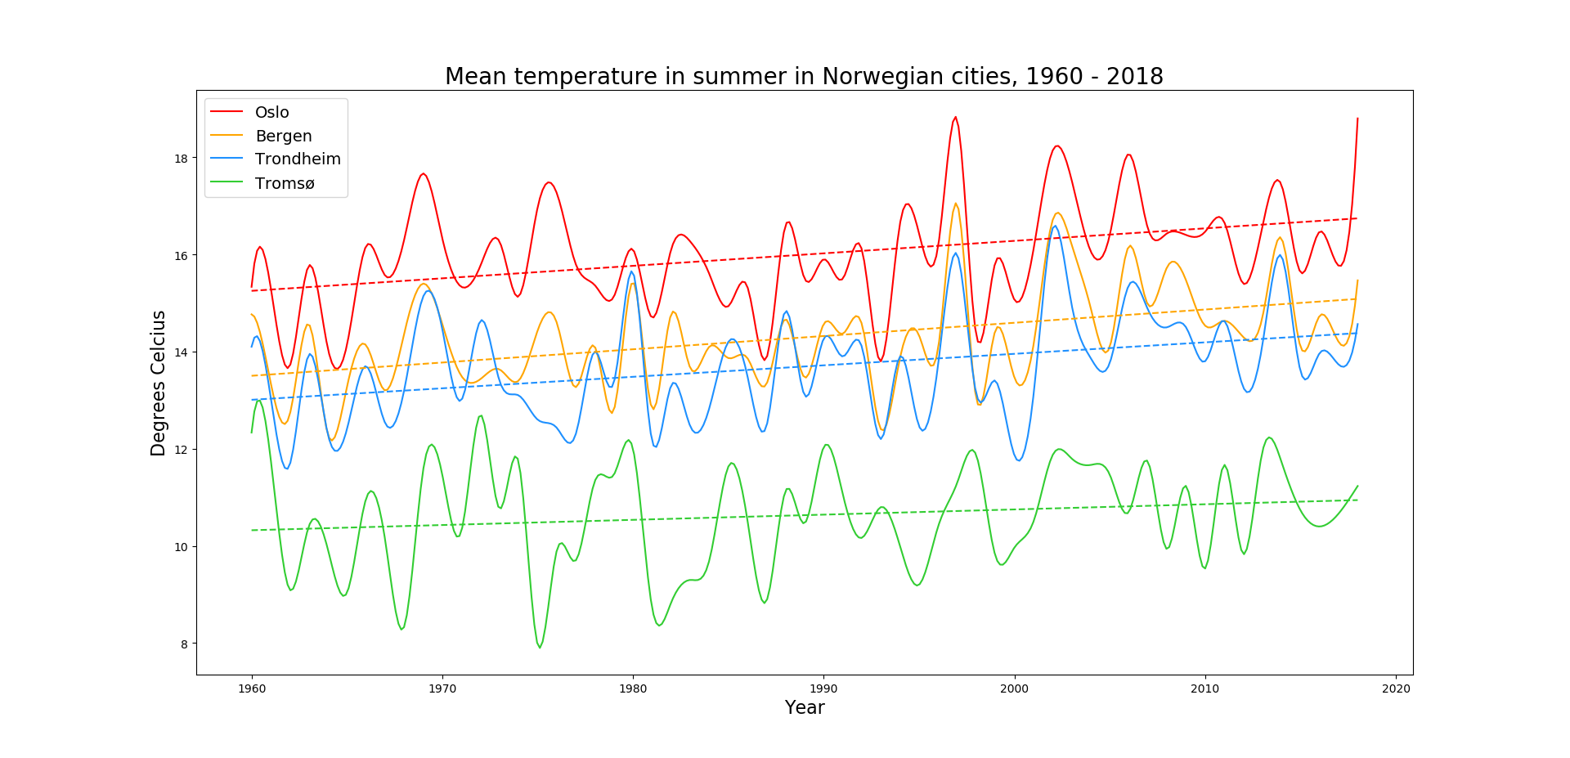
During summer, temperature is increasing in Oslo, Bergen, Trondheim and Tromsø.

Slide 5
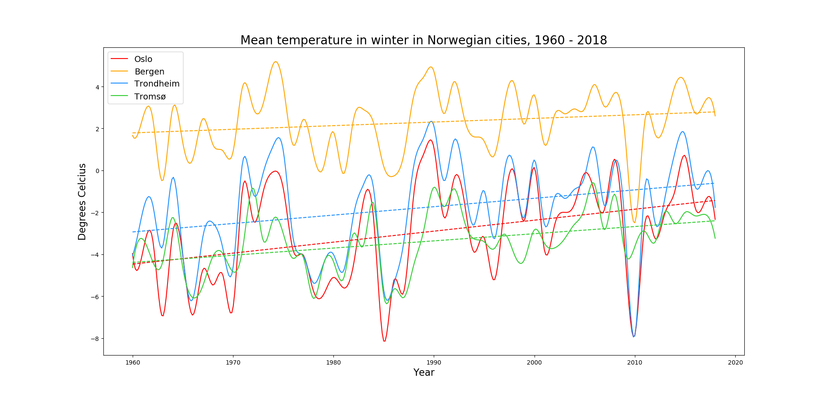
Winter temperatures are rising as well.

Slide 6
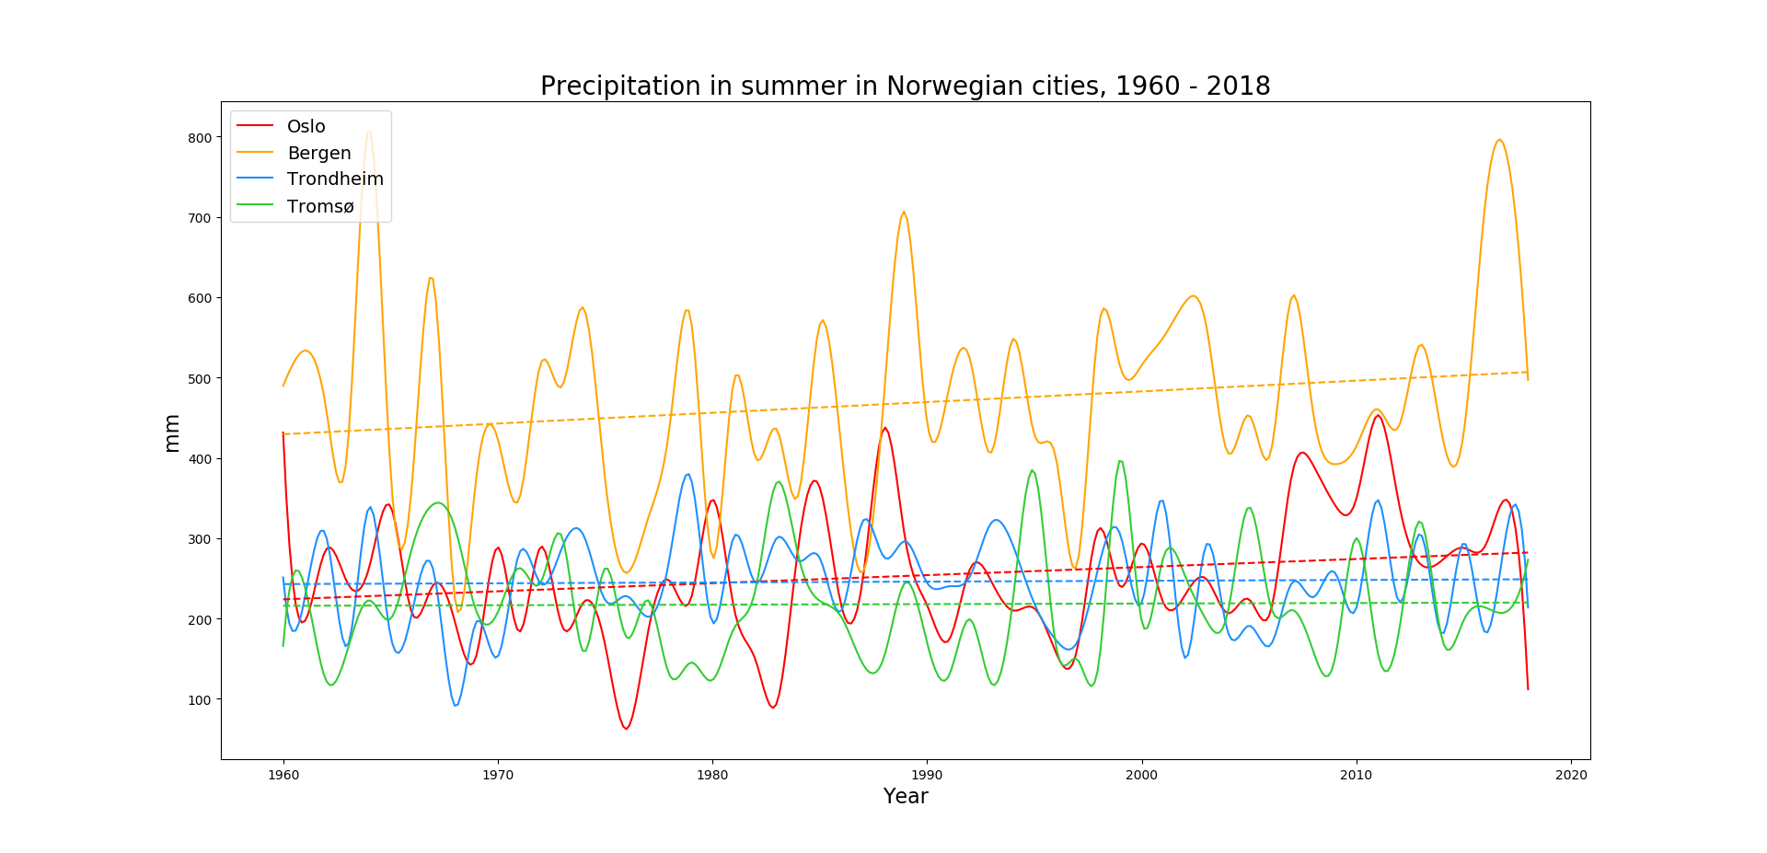
Bergen has the most precipitation in summer.

Slide 7
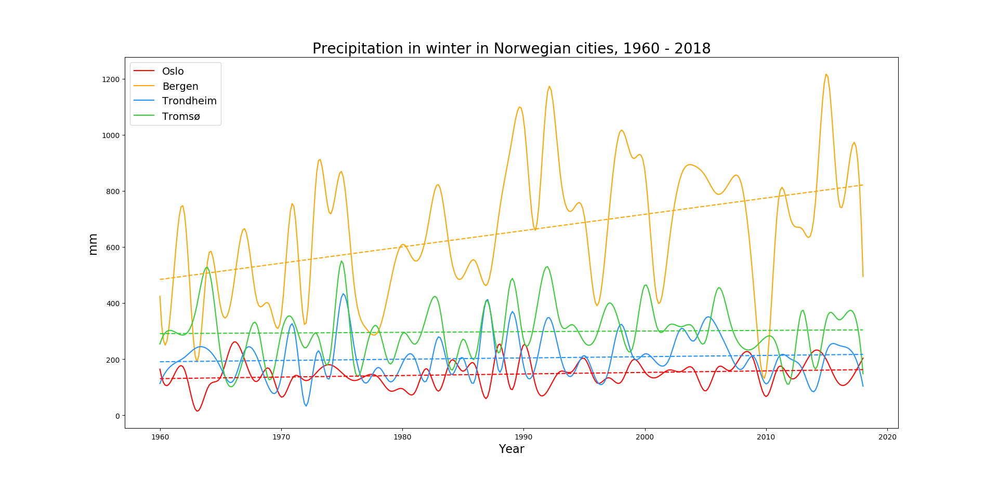
Bergen has more precipitation than the other cities in winter. Probably due to its location between ocean and mountains. It is also increasing faster than the others.

Slide 8
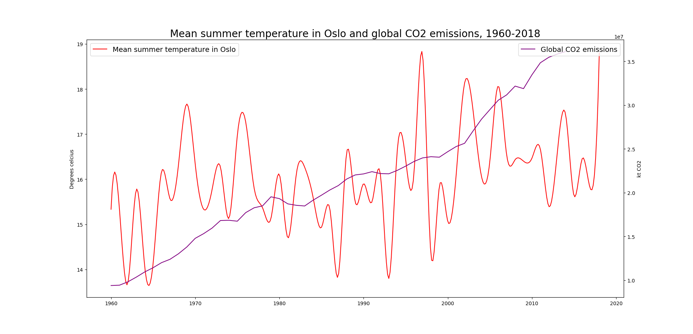
A positive correlation between global CO₂ emissions and temperature rise.

Slide 9
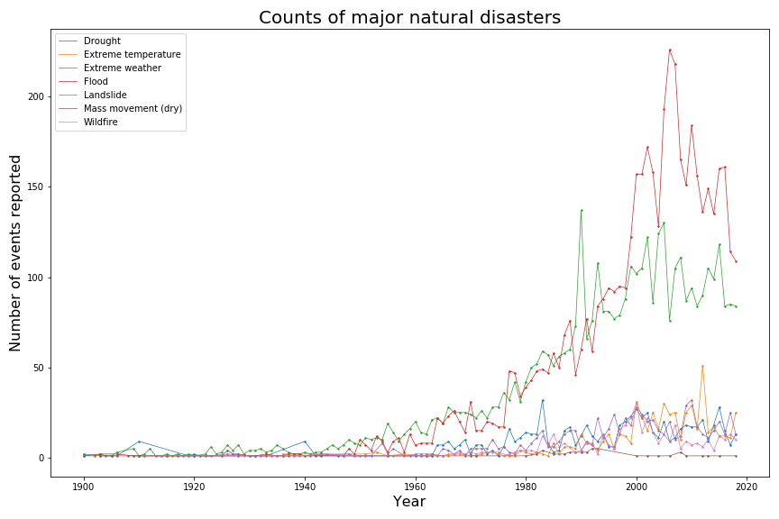
One of the consequences of the global temperature rise. We can see that the instances of floods, extreme weather and extreme temperature are increasing.

Slide 10
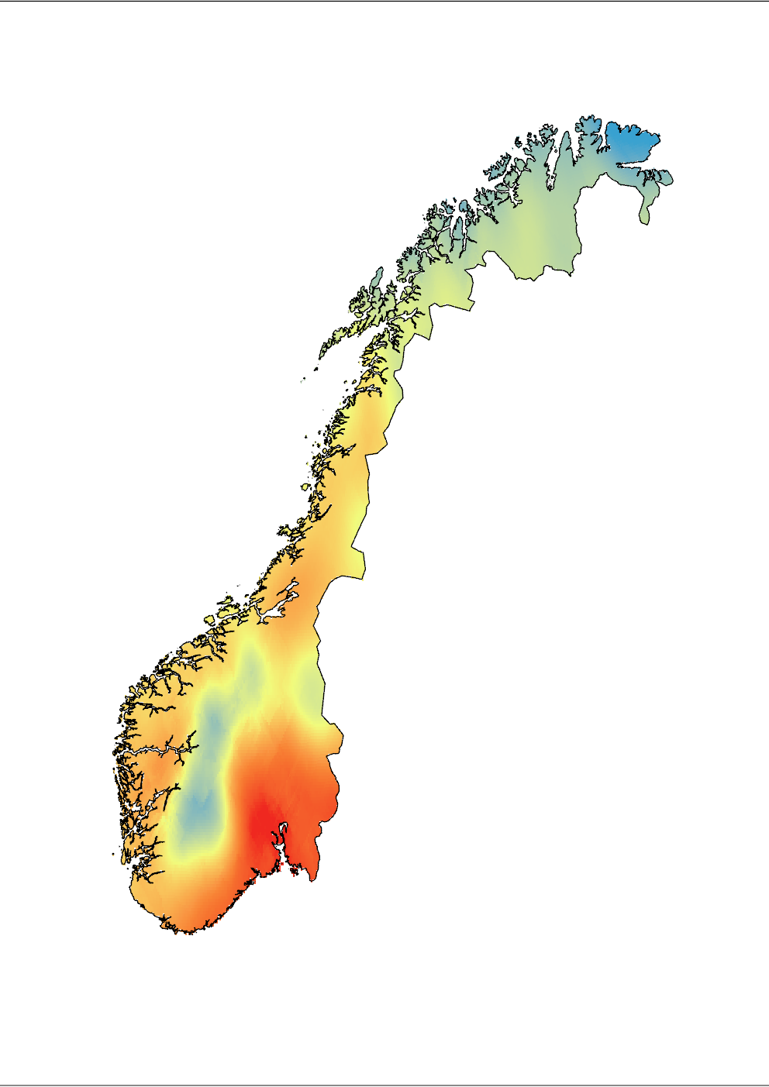
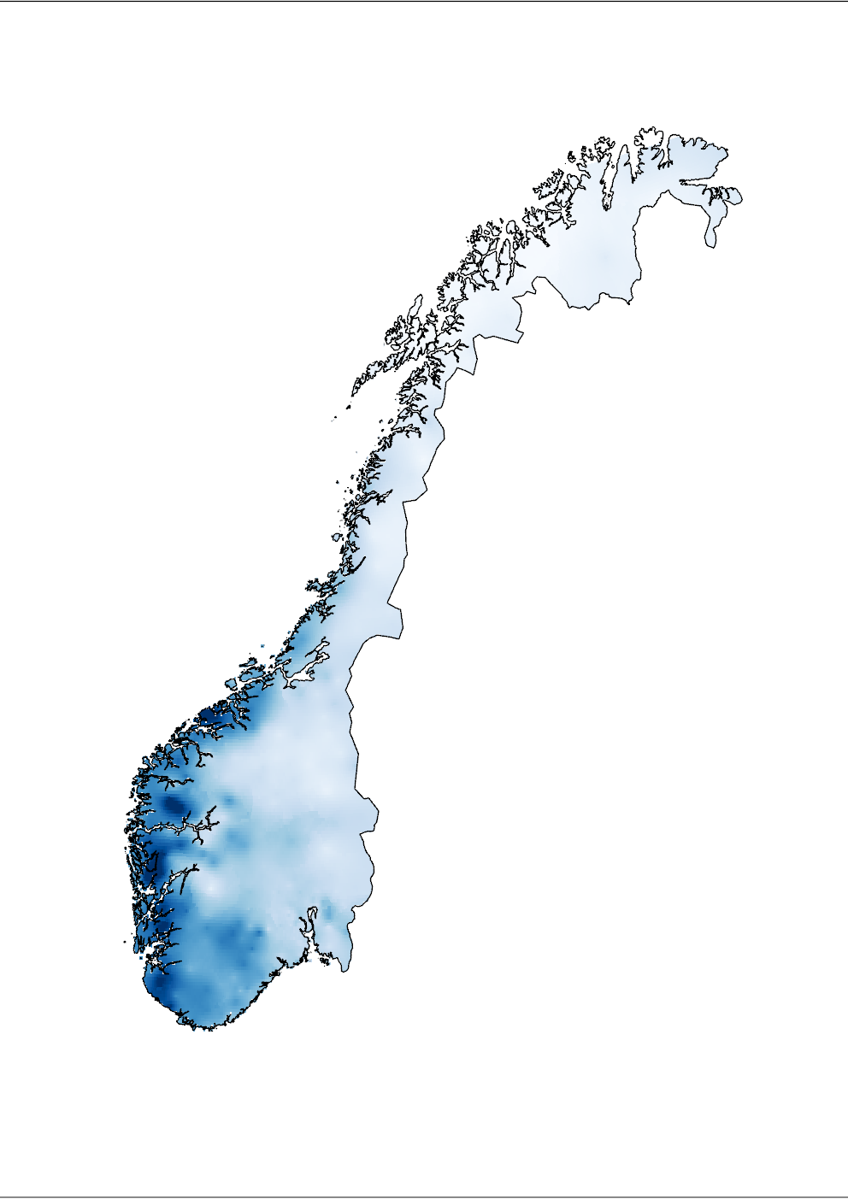
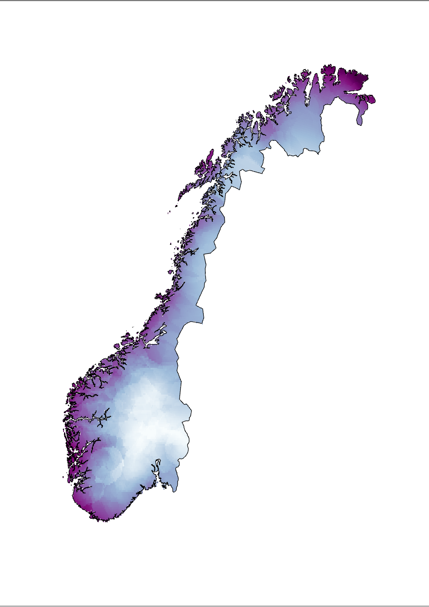
Mean temperature for July
Warmest: South-Eastern Norway
Coldest: Central mountains & northern Norway
Precipitation for July
Most precipitation: Western Norway
Humidity for July
Most humid: The coast in Western &Northern Norway

Slide 11
Temperature

Slide 12

Discussion
Results confirmed our expectations. There is a general rise in temperature.
Precipitation increasing as well, not necessarily at the same rate.
CO₂ emissions is the potential cause for rise in temperature.
From our geographical analysis, Southeastern Norway is the warmest, Western Norway is the wettest
We can expect higher temperatures and more precipitation in Norway in the future, as well as increased frequency of natural disasters

Slide 13
Thank you

