Slide 1
Air Quality Market & Product Fit Analysis Domain - Consumer Appliances Function – Market Research Analytics
Presented by Soham Vaghasia
For Airpure Innovation

Slide 2
Problem Statement
AirPure Innovations is a startup tackling India’s air pollution crisis. With uncertainty around product features, target markets, and consumer demand, the company needs data-driven insights before investing in R&D. Key questions are
Which cities should we target for air purifier products?
How does AQI relate to health and consumer behavior?
What features do existing products lack?
Which cities have the highest demand for air purifiers, and what is the market size in these regions?
To find whether there is a strong demand for air purifier in the market ?

Slide 3
Data Sources & Methodology
Datasets from Dataful
• Primary dataset
o AQI (2022 – 2025)
• Secondary datasets
o Health-related consequences (2022 – 2025)
o Vehicle data (2022 – 2025)
o Population data
• Metadata
• Supporting documents

Slide 4
Tools & Technology Used
Power BI (Data Modeling, Dashboard Development)
Microsoft Excel (Data Cleaning & Shaping)
DAX (Custom Measures)
Power Query (ETL & Data Integration)
Data Sourcing & Feature Engineering (Original/augmented datasets, public data enrichment)

Slide 5
PRIMARY ANALYSIS

Slide 6
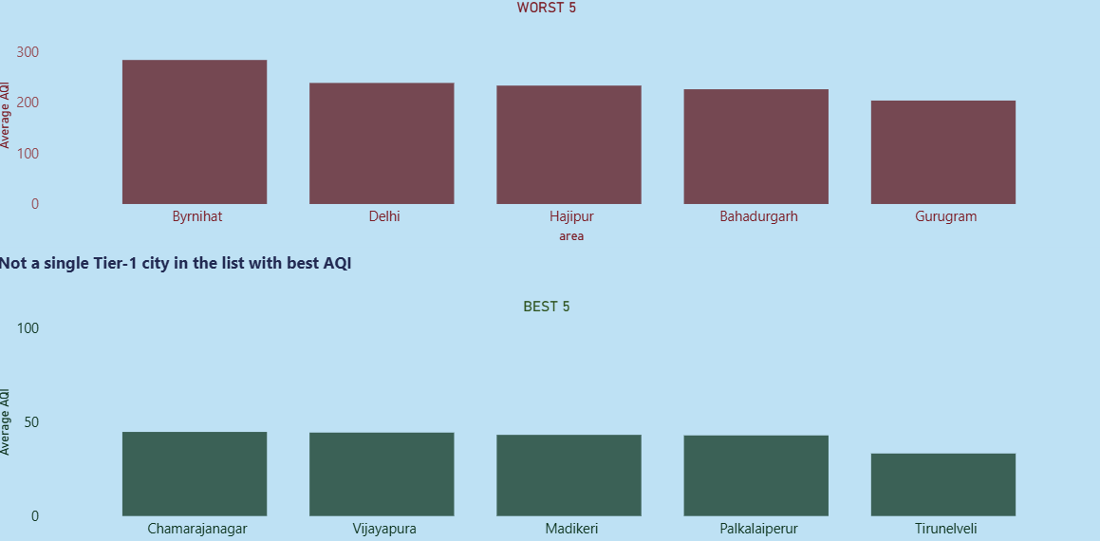
Top 5 & Bottom 5 areas with highest avg. AQI
RED – FEATURES THE TOP 5 POLLUTED AREAS[INCLUDES A TIER-1 CITY]
GREEN – FEATURES THE TOP 5 CLEANEST CITY[DOES NOT INCLUDE A TIER-1 CITY]

Slide 7
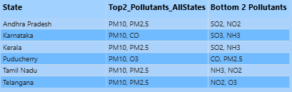
MAJOR POLLUTANTS FROM SOUTH INDIA AFFECTING AQI
- PM10 & PM2.5 are the pollutants which should be encountered by the air purifiers as they are highest in the South India

Slide 8
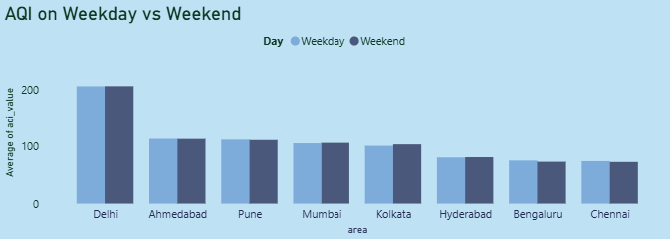
AQI Weekday vs Weekend
- AQI is usually high on weekday.
- Kolkata shows the highest difference margin among tier-1 cities

Slide 9
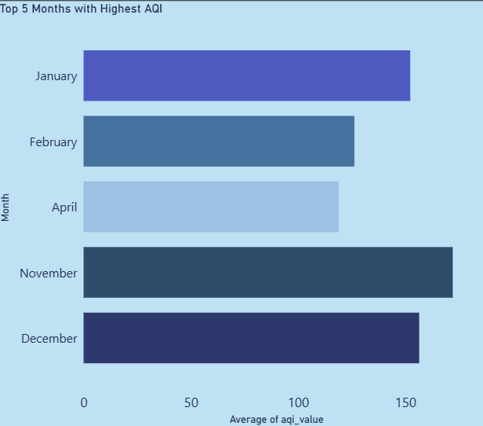
Worst AQI [In Months]
-States with high distinct areas such as Bihar, Delhi, Gujarat, Maharashtra, Madhya Pradesh, Haryana, West Bengal, Tamil Nadu, Karnataka and Rajasthan were considered.

Slide 10
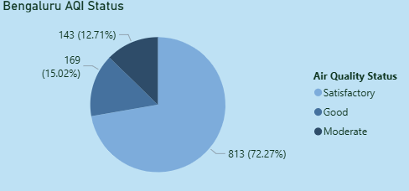
Bengaluru Air Quality Status
-Bengaluru mostly recorded satisfactory weather .

Slide 11
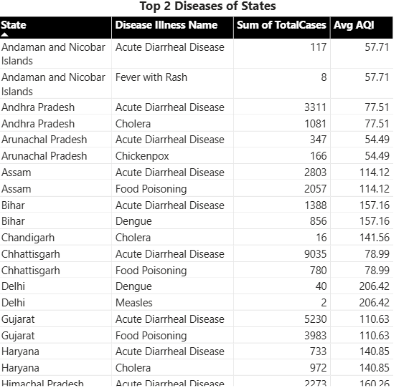
Disease Reported
-Tree Map of the states showing their Top 2 diseases along with total cases registered
-Kerela, Karnataka and Maharashtra are the areas showing most disease reported

Slide 12
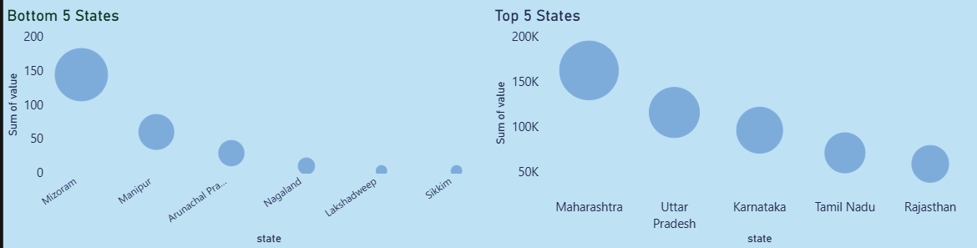
EV Adoption
-The bubble size shows the units of EV
-Maharashtra is the highest consumer of EV, while Sikkim is the lowest

Slide 13
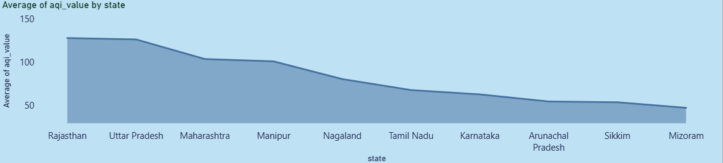
EV Adoption
-Rajasthan, Uttar Pradesh & Maharashtra despite being the highest consumer of EV, still shows high average AQI value

Slide 14
SECONDARY ANALYSIS

Slide 15
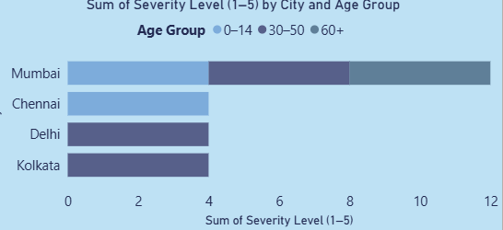
AGE GROUP AFFECTED BY AIR POLLUTION
-Children in Mumbai show the highest pollution-linked severity scores, while Delhi leads in overall impact.

Slide 16
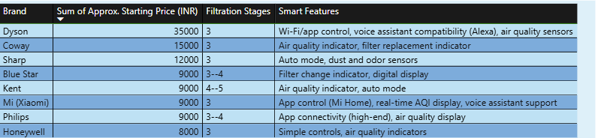
MAJOR COMPETITORS IN THE INDIAN AIR PURIFIER MARKET
-Dyson is considered as the most expensive air purifier in Indian market

Slide 17
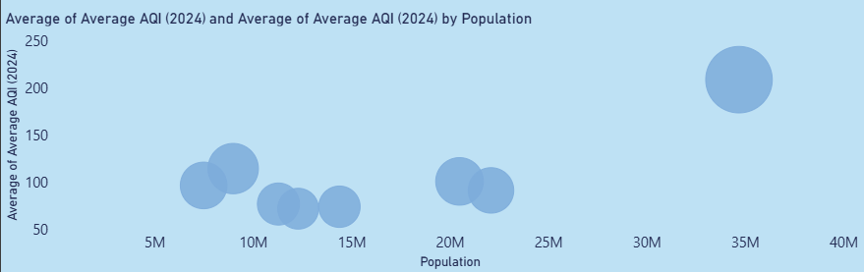
RELATION BETWEEN CITY POPULATION AND AVG. AQI
-Delhi stands on top of the list.
-Bubble size indicate the avg. AQI value.

Slide 18
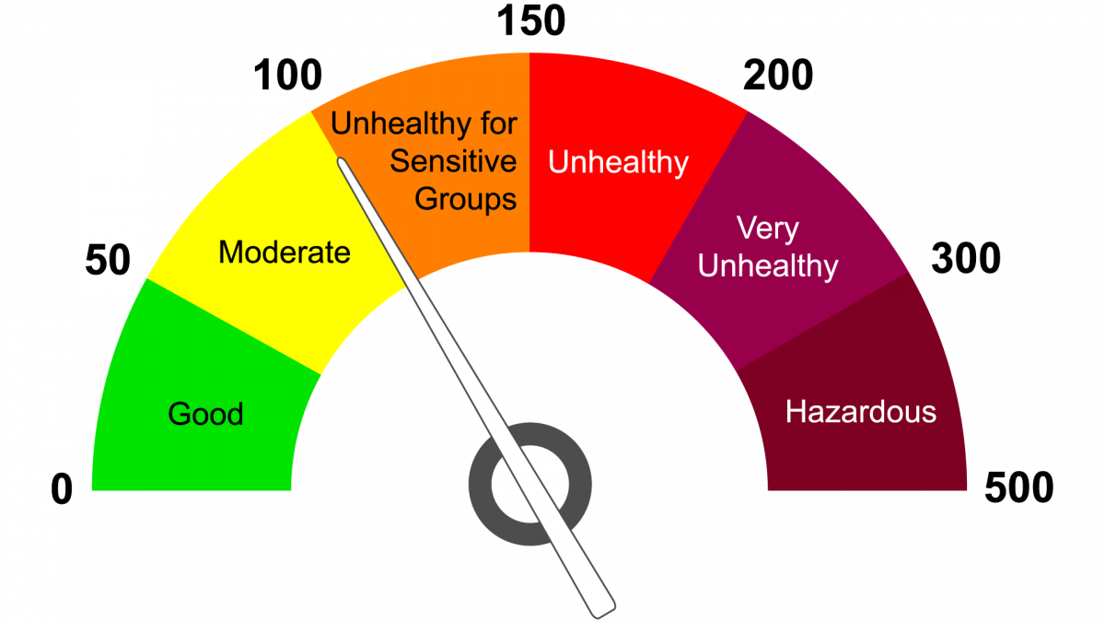
AQI AWARENESS AMONG INDIANS
-Only 11% Indians have AQI awareness

Slide 19
POLLUTION CONTROL POLICIES
🏛 Policy / Program | 📈 Impact Area | ✅ Outcome
National Clean Air Programme (NCAP) | Pan-India (non-attainment cities) | Target: 20–30% AQI reduction by 2024
Faster Adoption and Manufacturing of EVs (FAME II) | Urban traffic-heavy cities | Reduced vehicle-based emissions
Bharat Stage VI emission norms | All India | Cleaner fuel and vehicles post-2020
Smog Towers / Anti-smog guns | Delhi, NCR | Experimental reduction in PM2.5
Ban on firecrackers / Construction dust control | Seasonal, regional | AQI spike control in metros
Policies like NCAP and Bharat Stage VI have shown tangible improvement in AQI trends in cities like Ahmedabad and Pune. However, cities like Delhi and Kolkata remain heavily polluted, suggesting regional enforcement gaps and need for localized solutions.

Slide 20
CRITICAL ANALYSIS

Slide 21
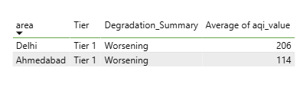
TIER 1 CITIES SHOWING IRREVERSIBLE AQI DEGRADATION

Slide 22
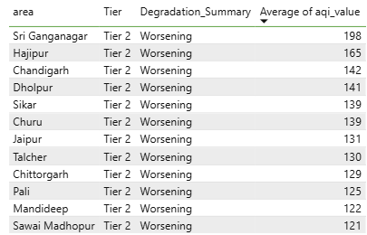
TIER 2 CITIES SHOWING IRREVERSIBLE AQI DEGRADATION

Slide 23
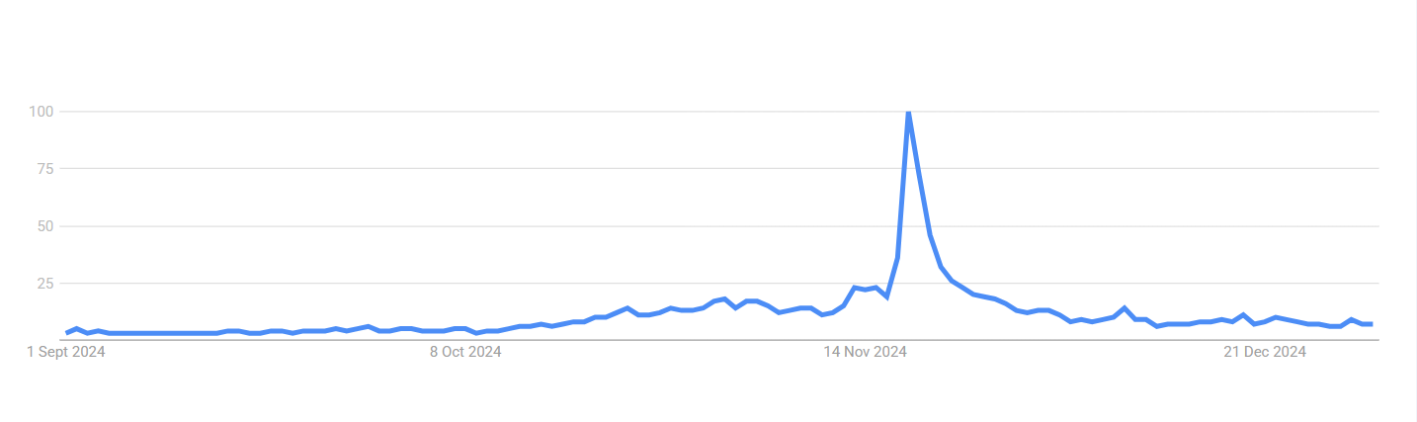
SEARCH FOR AIR PURIFIER DURING DIWALI
Demand Surge: Air purifier demand is highly seasonal and closely tied to pollution events like Diwali.
Marketing Opportunity: Brands should intensify advertising, promotions, and inventory positions leading up to Diwali to capture this surge.

Slide 24
PRODUCT FEATURE GAP
Current market offerings often lack critical modern features like real-time AQI syncing, smart app connectivity, and compact design, especially in budget-friendly segments.
Budget brands compromise on smart features and aesthetic design.
Opportunity to differentiate lies in combining affordability with intelligence.

Slide 25
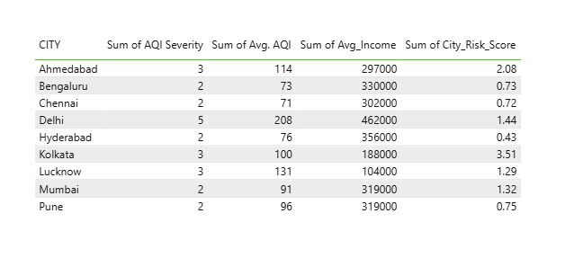
CITY RISK SCORE
Higher the score, bigger the risk
City_risk_score = AQI Severity * Avg. AQI * 1/Avg_Income

Slide 26
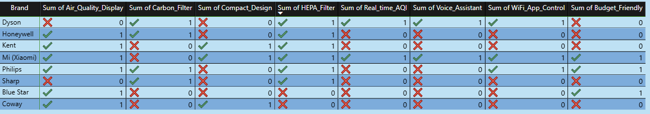
COMPETITOR FEATURE GAP MATRIX
Mi[Xiaomi]’s air purifier provides more feature than any other brand at a affordable price

Slide 27
PRODUCT REQUIREMENT

Slide 28
MUST HAVE FEATURES
HEPA Filter - High Efficiency Particulate Air filters, are designed to remove at least 99.97% of particles that are 0.3 microns in size from the air, making them essential for improving indoor air quality [present in 6 brands].
AQI Display – It displays the air quality index of the area [present in 6 brands].
These are absolutely essential, as nearly all leading brands already offer them and Indian customers are increasingly aware of their importance.

Slide 29
FEATURES ONLY FEW PRODUCTS OFFER
WiFi/App Control (offered by only 3 brands)
Lets users monitor and control their air purifier remotely using a smartphone app.
Common functions: Turn on/off, adjust fan speed or modes, schedule operations, and view basic air quality data.
Benefits: Convenience, real-time alerts, integration into smart home systems.
2. Voice Assistant Integration (2 brands)
Allows the air purifier to respond to voice commands via platforms like Amazon Alexa or Google Assistant.
Benefits: Hands-free control, ideal for tech-savvy consumers or accessibility needs.

Slide 30
FEATURES ONLY FEW PRODUCTS OFFER
Real-Time AQI Monitoring (2 brands)
- Displays current Air Quality Index (AQI) in real time, often through a digital screen or mobile app.
Benefits: Users can see immediate changes in indoor air quality and make informed decisions (e.g., increase purification or ventilate).
Auto Mode (2 brands)
- The purifier automatically senses room air quality and adjusts fan speed or filtration power accordingly.
- Benefits: Energy saving, ensures optimal air purification without manual intervention

Slide 31
FEATURES TO HAVE [Tier 1]
1. AQI Display
2. HEPA Filter
3. WiFi/App Control
4. Voice Assistant
5. Real Time AQI
6. Auto Mode

Slide 32
COST PER UNIT[TIER 1]
Component/Feature | Estimated Cost (INR per unit)
HEPA Filter | 1,200
Air Quality Display | 500
WiFi/App Control | 700
Voice Assistant Integration | 800
Real-Time AQI Monitoring | 600
Unique Feature (App Allergen Alert) | 1,000
Assembly, Casing, Fan, Power Supply | 1,500
Packaging | 300
Marketing (per unit allocation) | 700
Total Estimated Unit Cost | 7,300

Slide 33
TIER 1 PRICING
Feature/Metric | Value (INR)
Unit Cost | 7,300
Selling Price | 9,999
Profit per Unit | 2,699
Profit Margin | 27%

Slide 34
FEATURES TO HAVE [Tier 2]
1. AQI Display
2. HEPA Filter
3.Compact Design
[USE ANY ONE]
1. WiFi/App Control
2. Voice Assistant
3. Real Time AQI
4. Auto Mode

Slide 35
COST PER UNIT [TIER 2]
Component/Feature | Estimated Cost (INR)
HEPA Filter | 1,200
Air Quality Display | 500
Compact Design (housing + fan) | 1,000
Basic Assembly & Power Supply | 700
Packaging | 200
Marketing (unit allocation) | 200
Total Estimated Unit Cost | 3,800

Slide 36
TIER 2 PRICING
Feature/Metric | Value (INR)
Unit Cost | 3,800
Selling Price Range | 5,320 – 6,840
Profit per Unit | 1,520 – 3,040
Profit Margin | 28% – 44%

Slide 37
ADVANTAGES
Tier | Key Advantages
Tier 1 | - Premium positioning supports advanced features (WiFi/App, Voice Assistant, Real-time AQI) appealing to urban consumers. - Higher profit margin allows investment in customer service, branding, and technology improvements. - Enhanced brand perception through innovation and high-end features.
Tier 2 | - Lower price maximizes affordability, opening access to a wide, price-conscious customer base in emerging cities. - Core must-have features ensure broad appeal while controlling costs. - High sales potential through larger market reach and volume, driving quick brand penetration.

Slide 38
Executive Summary
- Identified top polluted cities with irreversible AQI degradation
- Assessed health impacts by age group and location
- Analyzed behavioral and market triggers for purifier adoption
- Recommended product pricing and city prioritization

Slide 39
Thank You

