Slide 1

MEAN Full Stack Developer
Dec 3rd 2020

Slide 2







MEAN - Architecture
Parse Request
Get Database
Make Request
client
Give Response
return Request
Return Database
Angular

Slide 3
Angular
application design framework and development platform for creating efficient and sophisticated single-page apps
Google designed Angular as a ground-up rewrite of AngularJS
AngularJS -> Angular 2 -> Angular 3 … -> Angular 11
Initial release - AngularJS October 20, 2010
Latest release - Angular 11 was released on November 11, 2020
TypeScript is a programming language developed and maintained by Microsoft. It is a strict syntactical superset of JavaScript
ES is a JavaScript standard meant to ensure the interoperability of Web pages across different Web browsers. ECMAScript is commonly used for client-side scripting on the World Wide Web, and it is increasingly being used for writing server applications and services using Node.js.

Slide 4
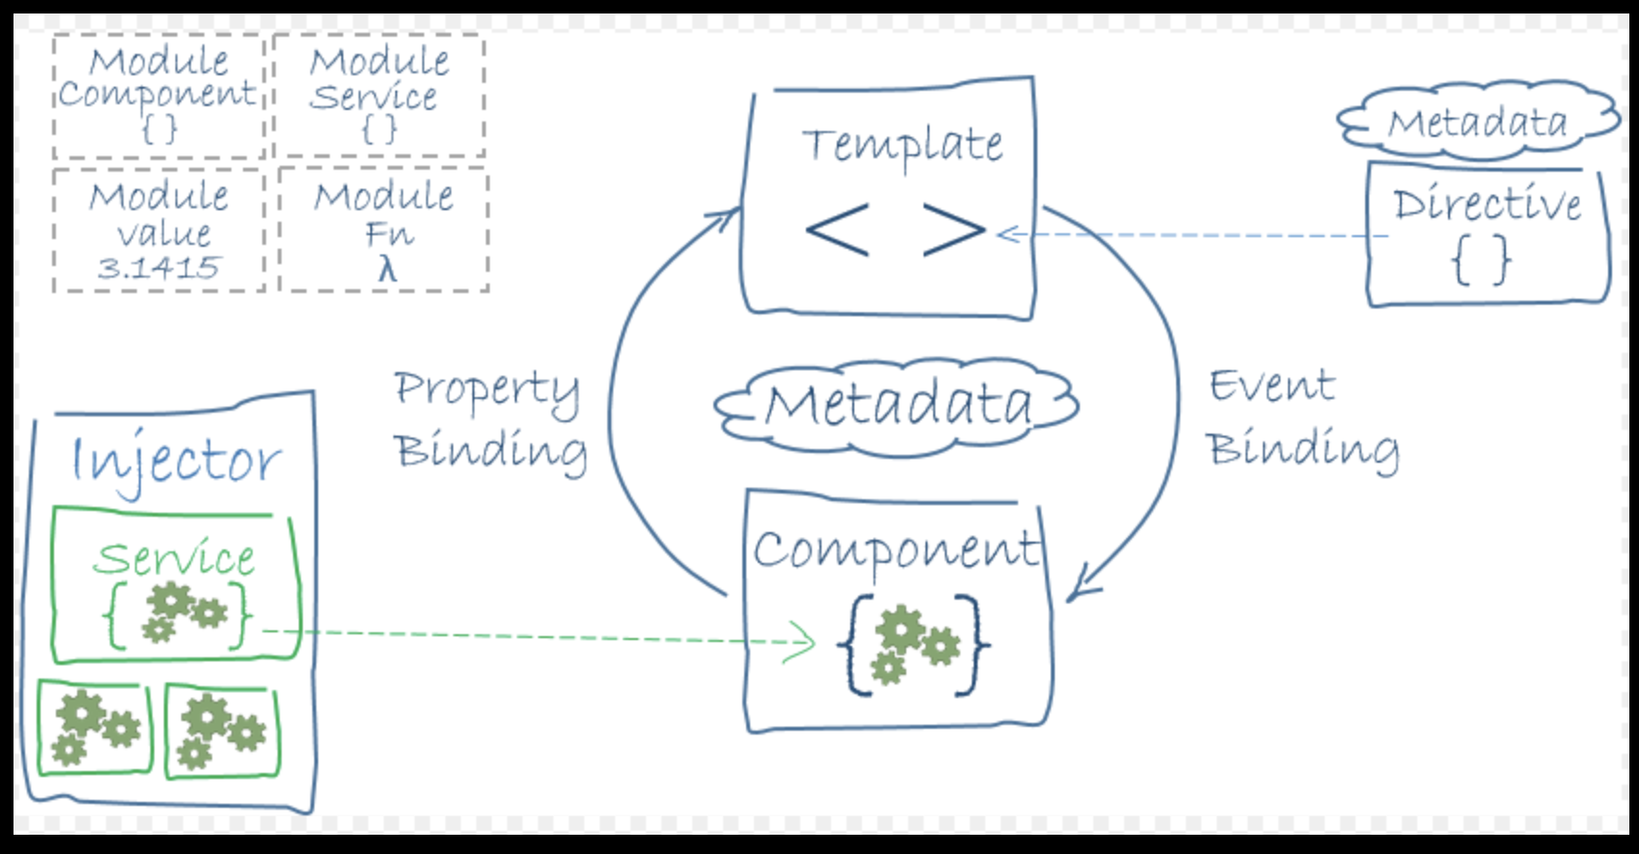
Angular - Architecture

Slide 5
Angular CLI
The Angular CLI is a command-line interface tool that you use to initialize, develop, scaffold, and maintain Angular applications directly from a command shell.
It makes it easy to create an application that already works, right out of the box. It already follows our best practices!
npm install -g @angular/cli
ng new my-app --routing
cd my-app
ng serve
Or
ng server –port 8080

Slide 6
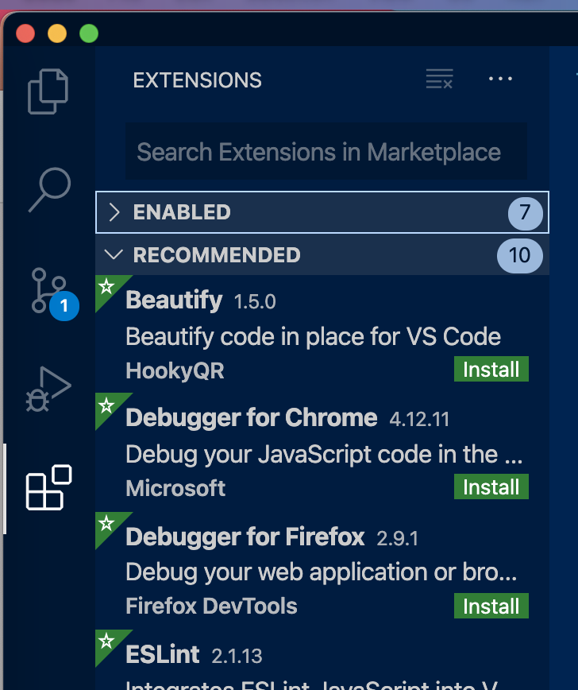
Install extension
Visual studio code
Angular essentials
Prettier - Code formatter

Slide 7
Project Structure
Package.json
A package.json is a JSON file that exists at the root of a Javascript/Node project.
It holds metadata relevant to the project and it is used for managing the project's dependencies, scripts, version and a whole lot more.
package-lock.json
package-lock.json is automatically generated for any operations where npm modifies either the node_modules tree, or package.json

Slide 8
src folder (where angular application lives)
app folder (where we write all the angular components)
assests (static images and css files)
Environment (environmental variable)
index.html (inject all our coding into this file)

Slide 9
Selector
A selector is one of the properties of the object that we use along with the component configuration.
A selector is used to identify each component uniquely into the component tree, and it also defines how the current component is represented in the HTML DOM.
import { Component } from '@angular/core';
@Component({
selector: 'app-root',
templateUrl: './app.component.html',
styleUrls: ['./app.component.css']
})
export class AppComponent {
title = 'my-app';
}
When we create a new component using Angular CLI, the newly created component looks like this.

Slide 10
templateurl, styleUrls
The relative path or absolute URL of a template file for an Angular component. If provided, do not supply an inline template using template.
One or more relative paths or absolute URLs for files containing CSS stylesheets to use in this component.

Slide 11
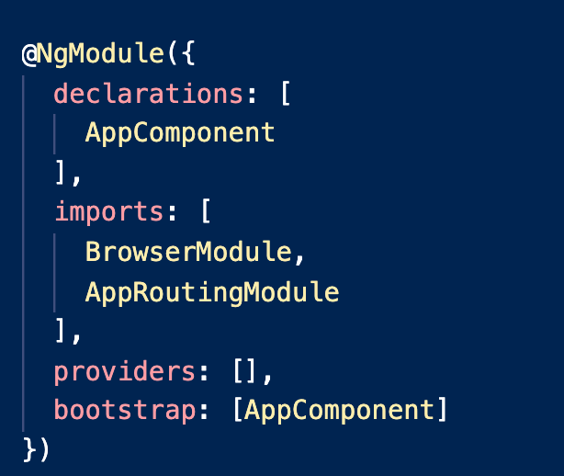
app.module.ts
NgModules configure the injector and the compiler and help organize related things together.
Declares which components, directives, and pipes belong to the module.
Imports other modules with the components, directives, and pipes that components in the current module need
Provides services that other application components can use
Bootstrap launch our application

Slide 12
Module
In Angular, a module is a mechanism to group components, directives, pipes and services that are related, in such a way that can be combined with other modules to create an application

Slide 13
How to create Components
Components are basically classes that interact with the .html file of the component, which gets displayed on the browser
Creating new component using cli command
ng generate <schematic>
Example: ng generate component login
or
ng g c login

Slide 14
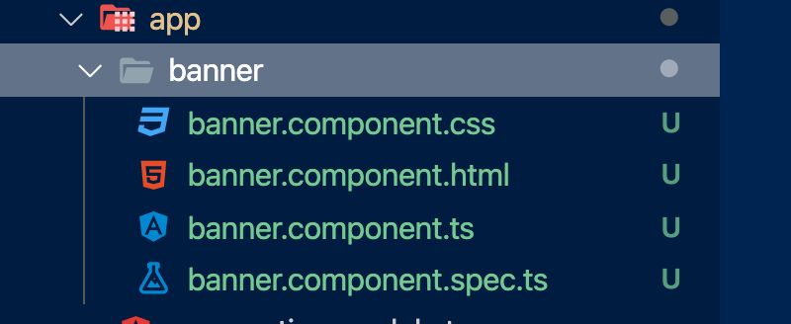
Start developing the Application
Delete the existing code in app.component.html
Create the banner component using below command
ng generate component banner
Add the created component to main app component
Refresh the browser you will see the changes.

Slide 15
Add angular material
Angular Material is a UI component library for Angular JS developers.
Angular Material components help in constructing attractive, consistent, and functional web pages and web applications while adhering to modern web design principles like browser portability, device independence, and graceful degradation.
npm i --save @angular/material @angular/cdk
npm i @angular/animations

Slide 16
How to use angular/material module
Import the all the material which are going to use for our application module files (app.module.ts)
Example: let get the toolbar from material library
import { MatToolbarModule } from '@angular/material/toolbar';
@NgModule({
declarations: [
AppComponent,
BannerComponent
],
imports: [
BrowserModule,
AppRoutingModule,
MatToolbarModule
],

Slide 17
Import the material theme css in style.css file
@import '@angular/material/prebuilt-themes/deeppurple-amber.css’;
Create login & Registration component by using angular CLI commands
ng g c login
ng g c registration
ng g c home
<mat-toolbar color="primary">
<mat-toolbar-row>
<button mat-button>
TCS
</button>
<button mat-button>
Login
</button>
<button mat-button>
Registration
</button>
</mat-toolbar-row>
</mat-toolbar>

Slide 18
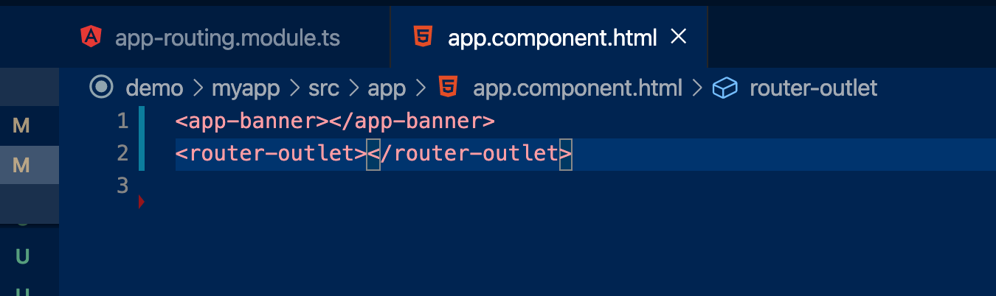
Adding routing
Open app-routing.module.ts file
Add routing path and include the router outlet in app component html file
const routes: Routes = [{
path:'',
component:HomeComponent
},{
path:'register',
component:RegistrationComponent
},{
path:'login',
component:LoginComponent
}];

Slide 19
String interpolation
What is String Interpolation?
Components render data, but data can change in time, so it needs to be dynamic.
We use curly braces inside other curly braces to render dynamic data
{{ data }} and this representation is called string interpolation.
Bring dynamic data from backend to display it in the front end UI screen

Slide 20
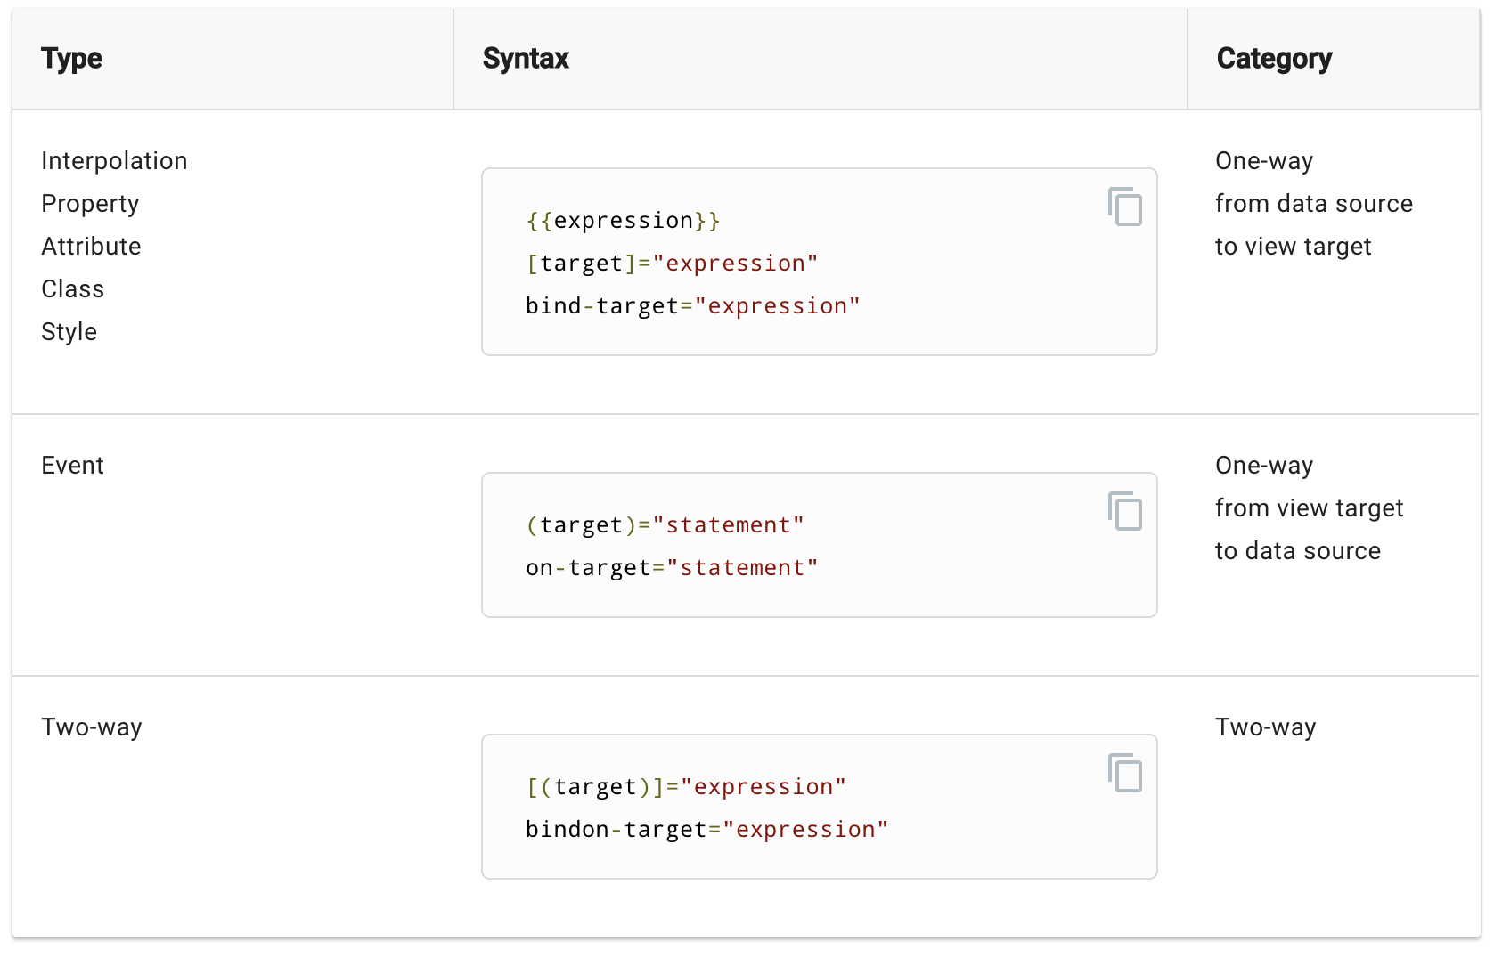
Data Binding

Slide 21
FormsModule
Build an Angular form with a component and template.
Use ngModel to create two-way data bindings for reading and writing input-control values
The NgModel directive reconciles value changes in the attached form element with changes in the data model, allowing you to respond to user input with input validation and error handling.
import { FormsModule } from '@angular/forms';

Slide 22
Event binding
Writing click event to listen action from html
<button (click)="onSubmitForm()">Submit</button>
This is send data from html to typescript file
onSubmitForm(){
alert("Registration submitted");
}

Slide 23
Workout
{{ }}
[ ]
( )
[( )]

Slide 24
Angular Forms
Angular Forms allow you to manage data by sending inputs to the server for processing.
A FormGroup aggregates the values of each child FormControl into one object, with each control name as the key
every form input you have in a reactive form should be bound by a form control
FormControl
FormGroup
import { ReactiveFormsModule, FormsModule } from '@angular/forms';

Slide 25
Example
<form [formGroup]="loginForm">
<div class="form-group">
User Name:
<input type="text” formControlName="user_name"class="form-control/>
</div>
</form>

Slide 26
An Observer is a consumer of values delivered by an Observable
Observables are lazy Push collections of multiple values
A Subscription is an object that represents a disposable resource, usually the execution of an Observable

Slide 27
Observable observer subscriptions
Source
Database
http request
(get or post)
Observable
New paper company
Registration Service
subscribe
subscribe
House 4
House1
House 2
House 3
Registration component

Slide 28
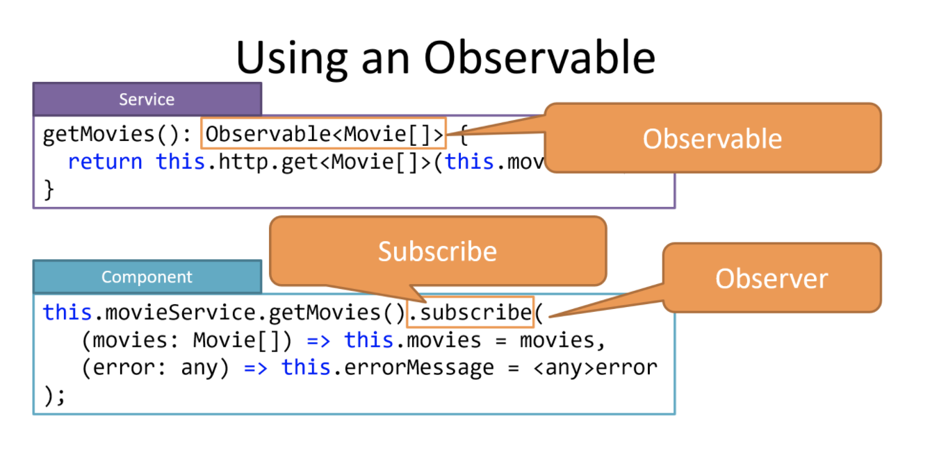
Observable observer subscriptions

Slide 29
Create Service to call express api
ng g service registration
const registerUserURL = 'http://localhost:3000/api/registerUser';
constructor(private httpclient: HttpClient) { }
register(user: any): Observable<any> {
return this.httpclient.post<any>(registerUserURL, user).pipe(
tap((res: any ) => {
})

Slide 30
Call service inside component
this.registrationService.register(this.registerForm.value).subscribe((res) =>{
})
Add http client module in app.module.ts to invoke the http request to call express api
import { HttpClientModule } from '@angular/common/http';

Slide 31
To allow cross origin resource sharing
Inside Expressjs api project
app.use((req, res, next)=>{
res.setHeader("Access-Control-Allow-Origin", "*");
res.setHeader("Access-Control-Allow-Methods", "GET, POST, PUT, DELETE, OPTIONS");
res.setHeader("Content-Type", "application/json");
res.setHeader("Access-Control-Allow-Headers", "Content-Type,X-Requested-With,accept,Origin,Access-Control-Request-Method,Access-Control-Request-Headers,Authorization");
next();
})

Slide 32
Any questions ?

