Slide 1

Analyzing IMDB Movie Details and Reviews
Ramazan Yol
Duan Tu
Sanah Suri
Shravan Patankar
Oscar González
I
INMAS Workshop February 2022

Slide 2
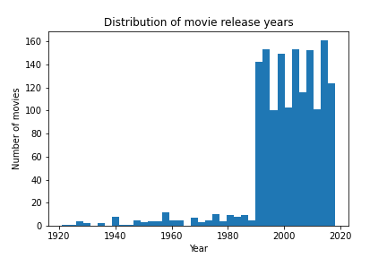

Slide 3
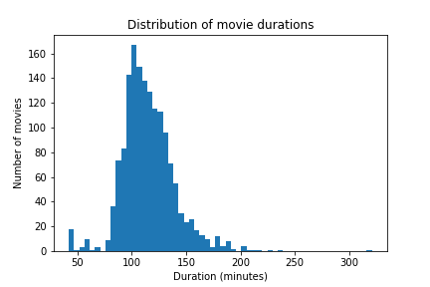
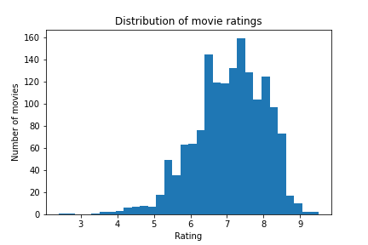
Distribution of movie durations and ratings

Slide 4
Predicting if a review has spoilers using ML
Training Data Cleaning:
Incorporating phrases in addition to words (for example: ‘great’, ‘movie’ and ‘great movie’ were all in our training data)
Removing common/neutral words (‘a’, ‘the’, ‘is’, ‘are’, etc) and rare words

Slide 5
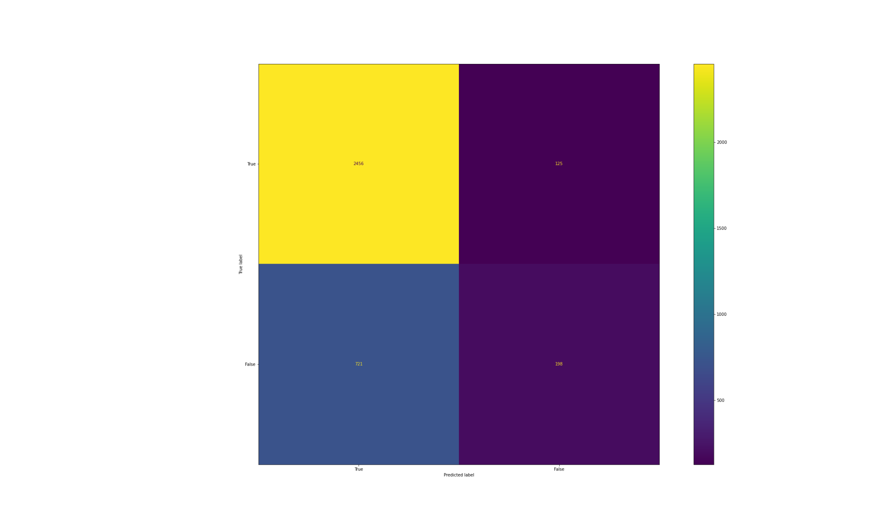
Confusion matrix
False negative
False positive

Slide 6
Model Results
Logistic Regression
Logistic Regression with TF-IDF
Mean accuracy on training data | 0.9198
Mean accuracy on test data | 0.6925
Mean accuracy on training data | 0.8196
Mean accuracy on test data | 0.75257

Slide 7
Model Results
Logistic Regression CV
K-Nearest Neighbors
Mean accuracy on training data | 0.8026
Mean accuracy on test data | 0.75828
Mean accuracy on training data | 0.803
Mean accuracy on test data | 0.7017

Slide 8
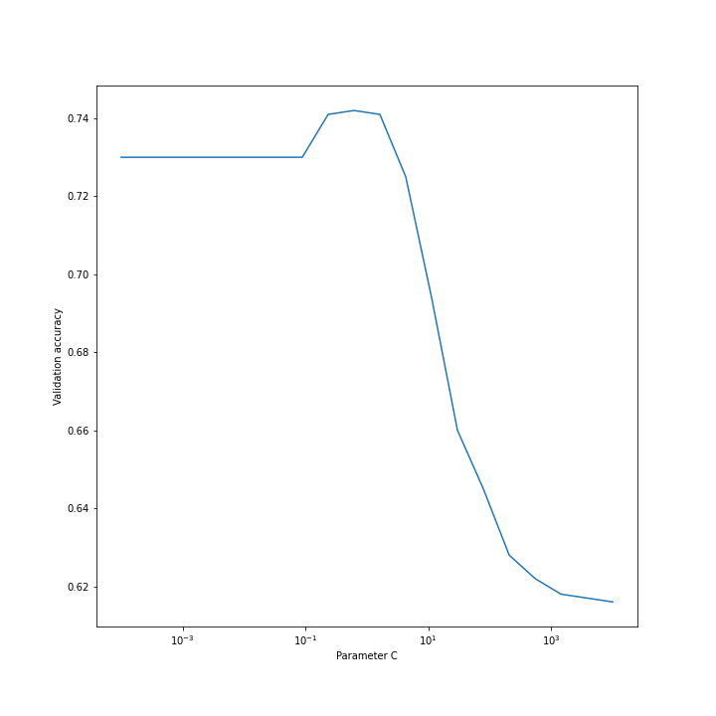
Validation Accuracy

Slide 9
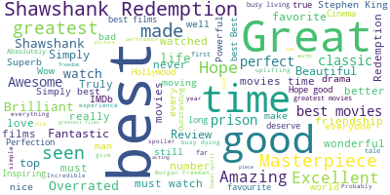
Word Clouds

Slide 10
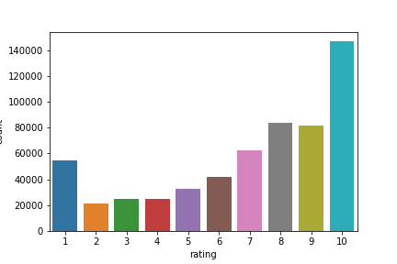
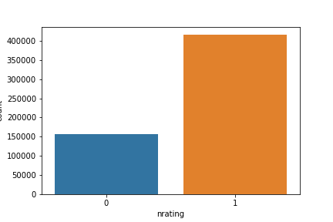
Rating Distribution & Simplified Sentiment Analysis

Slide 11
Sentiment Analysis with Multinomial Naive Bayes Algorithm
Positive vs Negative reviews
Predicts if a review is Positive or Negative with ~82% accuracy
Cleaning the data and TF-IDF makes the accuracy worse (and slower)

Slide 12
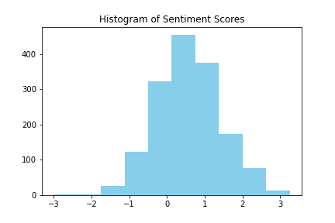
Sentiment Score Distribution

Slide 13
Sentiment analysis
Assigned each movie review a sentiment score using a dataset of words with sentiment scores between -5 and 5
Sentiment Scores for Reviews
Maximum | Minimum | Mean | Median
3.25 | -3.0 | 0.558861683 | 0.5454

Slide 14
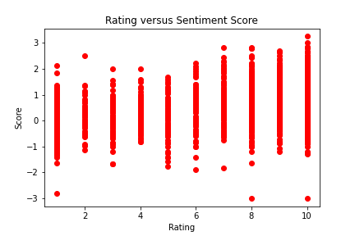
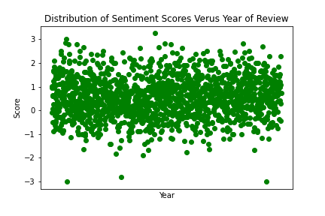
Comparison of Sentiment Score with Ratings and Year

Slide 15
Predicting Sentiment Score from Review (an attempt)
Logistic Regression
Logistic Regression with TF-IDF
Mean accuracy on training data | 1.0
Mean accuracy on test data | 0.74
Mean accuracy on training data | 0.3775
Mean accuracy on test data | 0.41

Slide 16

Greed and class discrimination threaten the newly formed symbiotic relationship between the wealthy Park family and the destitute Kim clan.
Comedy?
Adventure??
Thriller????
Prediction Answer
Yes Yes
No No
No Yes

Slide 17

With his debts mounting and angry collectors closing in, a fast-talking New York City jeweler risks everything in hope of staying afloat and alive.
Comedy?
Crime??
Thriller????
Prediction Answer
Yes No
Yes Yes
No Yes

Slide 18
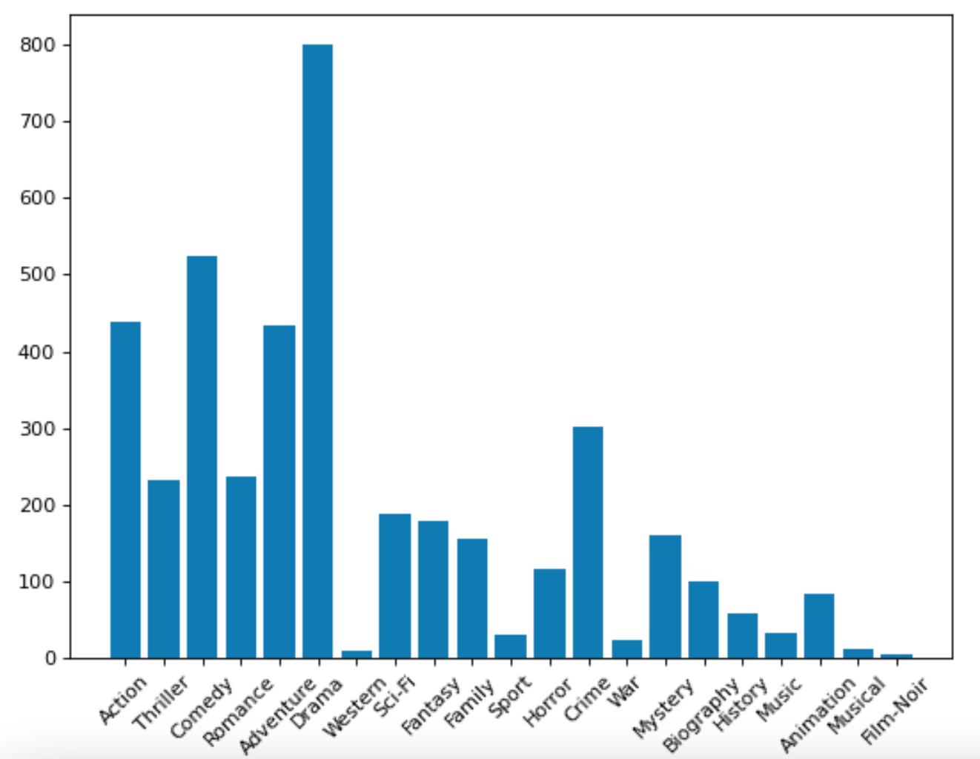
Genre Distribution
Number of Data Points
Comedy: 525
Adventure: 433
Crime: 302
Thriller: 233
Drama: 799
Remark:
Both movies are “Drama” and the model predicted correctly!

Slide 19
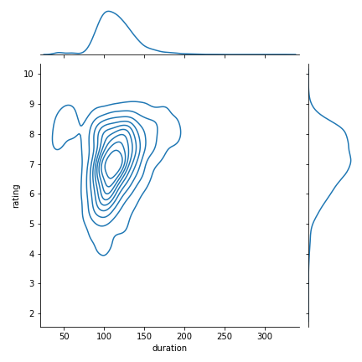
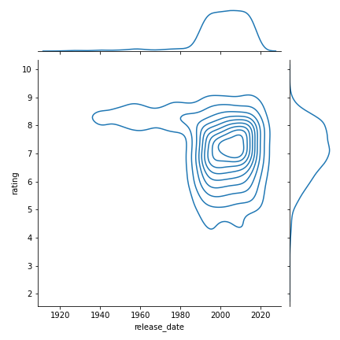
sns plots - possible relations with rating

Slide 20
Regression models on movie details
Natural language processing and Logistic/ Linear regression
Predicting rating using duration or plot summary does not work - accuracy ~5%
Key takeaway - several logistic regression models were unsuccessful, however one can predict genre from plot well!

Slide 21
Predicting movie genre using plot summary
72-75% accuracy for `Comedy’ (on testing data)
80% for ‘Action’
87% for `Thriller’
99% for `War’
500/1500 movies are `Comedy’. Blind guess of `No’ gives 66%, 75%, 80% respectively

Slide 22


