Slide 1


Understanding Node.js
Node.js is a JavaScript runtime environment that allows developers to build fast and scalable network applications.
VP
by Vivek Parmar

Slide 2

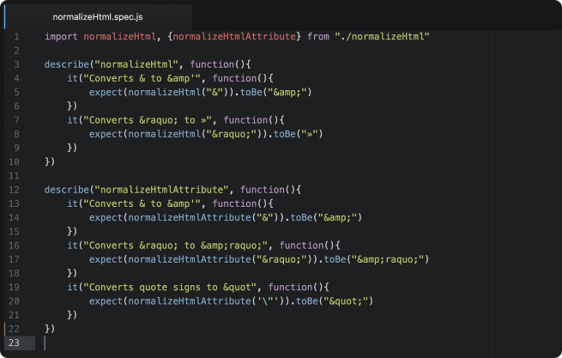
Advantages of Node.js
1
Performance
2
Scalability
Node.js is built on the Chrome V8 JavaScript engine, which is known for its speed and efficiency.
Node.js is a single-threaded, non-blocking, event-driven architecture which makes it highly scalable and suitable for handling concurrent requests.
3
Large Community
4
Lightweight
Node.js has a large and active community of developers, which provides access to a wide range of libraries and frameworks.
Node.js is lightweight and requires minimal resources, making it suitable for deploying on cloud platforms.

Slide 3


Disadvantages of Node.js
Callback Hell
Single-Threaded
Node.js's asynchronous nature can lead to complex nested callbacks, making code difficult to read and maintain.
Node.js is single-threaded, which can be a limitation for applications that require CPU-intensive operations.
Limited Support for Multi-Core Systems
Node.js is primarily designed for single-threaded execution, making it less efficient for multi-core systems.

Slide 4
Comparison to other available languages
Python
Java
PHP
Python is a general-purpose language with a focus on readability and simplicity, while Node.js is designed specifically for building server-side applications.
Java is a compiled language that is known for its robustness and security, while Node.js is interpreted and offers greater flexibility.
PHP is a server-side scripting language, similar to Node.js, but PHP is typically used for web development, while Node.js has a broader range of applications.

Slide 5
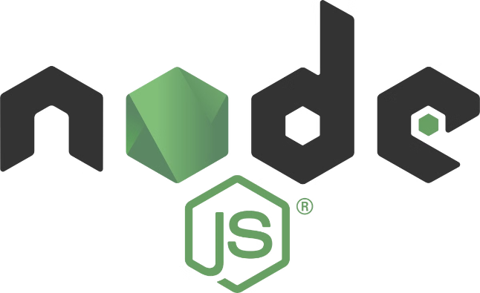
Installing Node.js
1
Download
Download the appropriate installer for your operating system from the official Node.js website.
2
Run the Installer
Run the installer and follow the on-screen instructions to install Node.js and npm (Node Package Manager).
3
Verify Installation
Open your terminal or command prompt and type 'node -v' to check the version of Node.js.

Slide 6



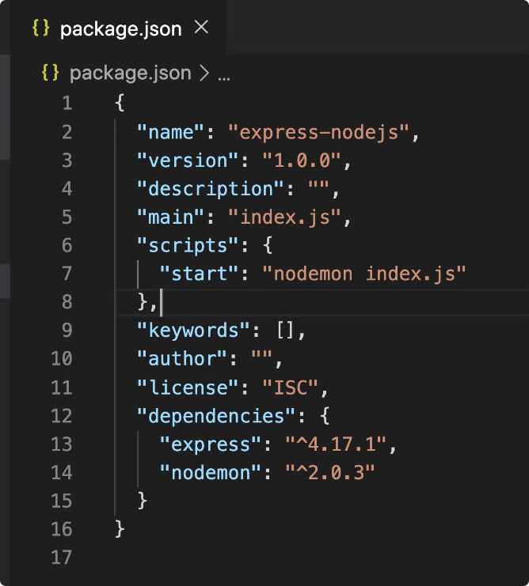


Creating a Node.js server
Create a Project Directory
Create a new folder for your Node.js project.
Create a Server File
Create a file named 'server.js' or a similar name in the project directory.
Write Server Code
Write the following code in the server file:
Run the Server
Run the server using the command 'node server.js' in your terminal.
const http = require('http');
const hostname = '127.0.0.1';
const port = 3000;
const server = http.createServer((req, res) => {
res.statusCode = 200;
res.setHeader('Content-Type', 'text/plain');
res.end('Hello World\n');
});
server.listen(port, hostname, () => {
console.log(`Server running at http://${hostname}:${port}/`);
});

Slide 7

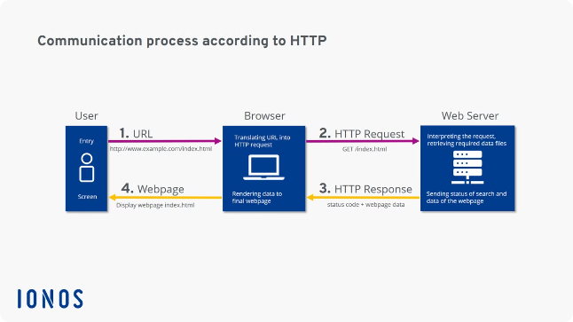
Handling HTTP requests in Node.js
Request Method
Description
GET
Retrieve data from the server.
POST
Send data to the server.
PUT
Update existing data on the server.
DELETE
Remove data from the server.

Slide 8


Conclusion and key takeaways
Node.js offers powerful capabilities for building modern applications. By understanding its advantages, disadvantages, and core concepts, you can leverage its strengths effectively.

