Slide 1
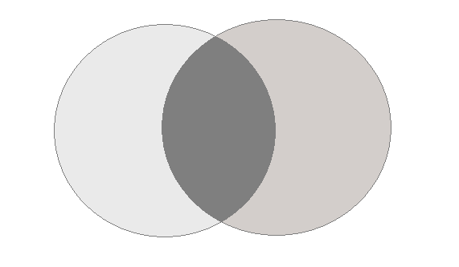
IFuzzer
LangFuzz
4
23
51
overlap
1 Month
3 Months

