Slide 1
Sliceo Tracker
Turn campaign traffic into actionable lead and revenue insight
Client walkthrough deck
Date: 2026-04-28
Notes:
Start with a high-level promise: visibility, attribution clarity, and operational control.

Slide 2
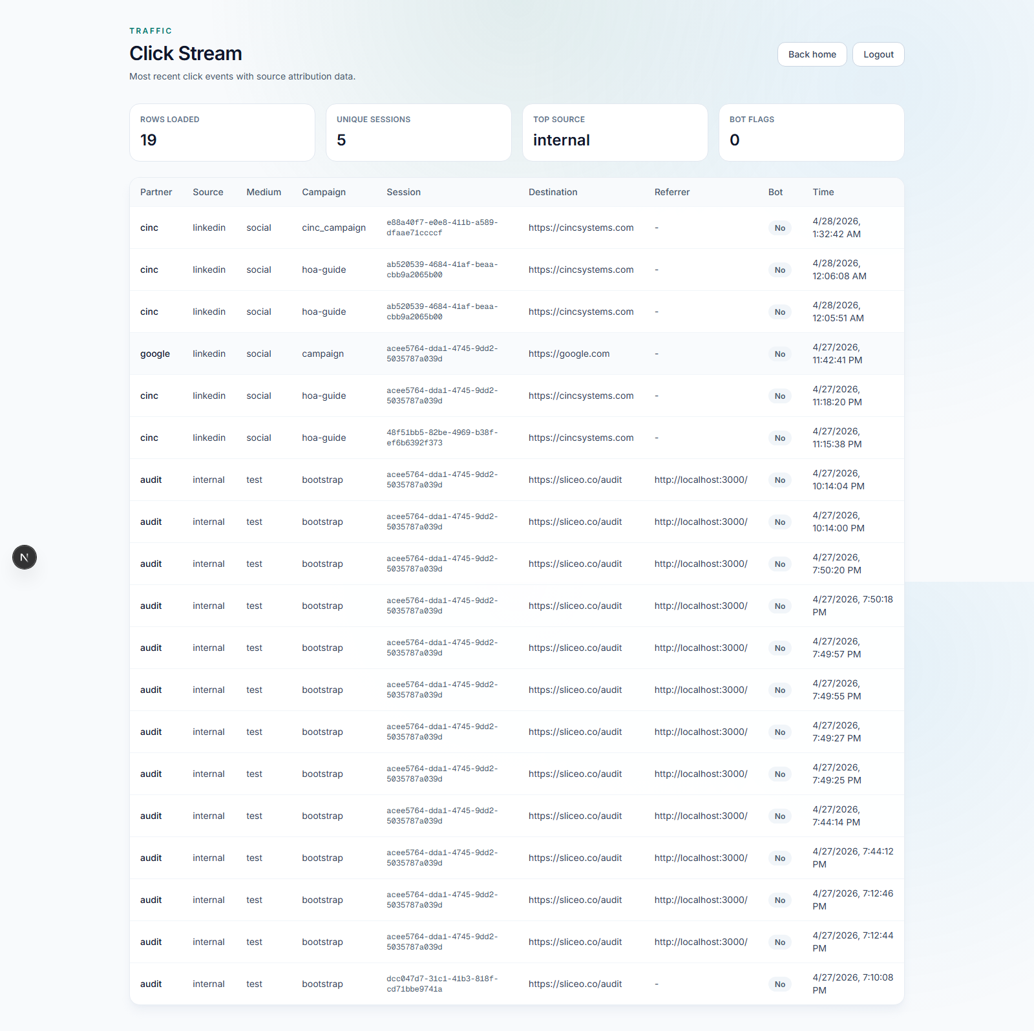
The Business Problem
Most teams run campaigns but cannot clearly answer: "Which campaign actually drove this lead?"
Traffic data, lead data, and webhook/CRM delivery data are often disconnected
Teams lose time on manual reconciliation and reporting
Decision-making becomes reactive instead of data-driven
Notes:
Explain that raw clicks alone are not enough without end-to-end linkage.

Slide 3
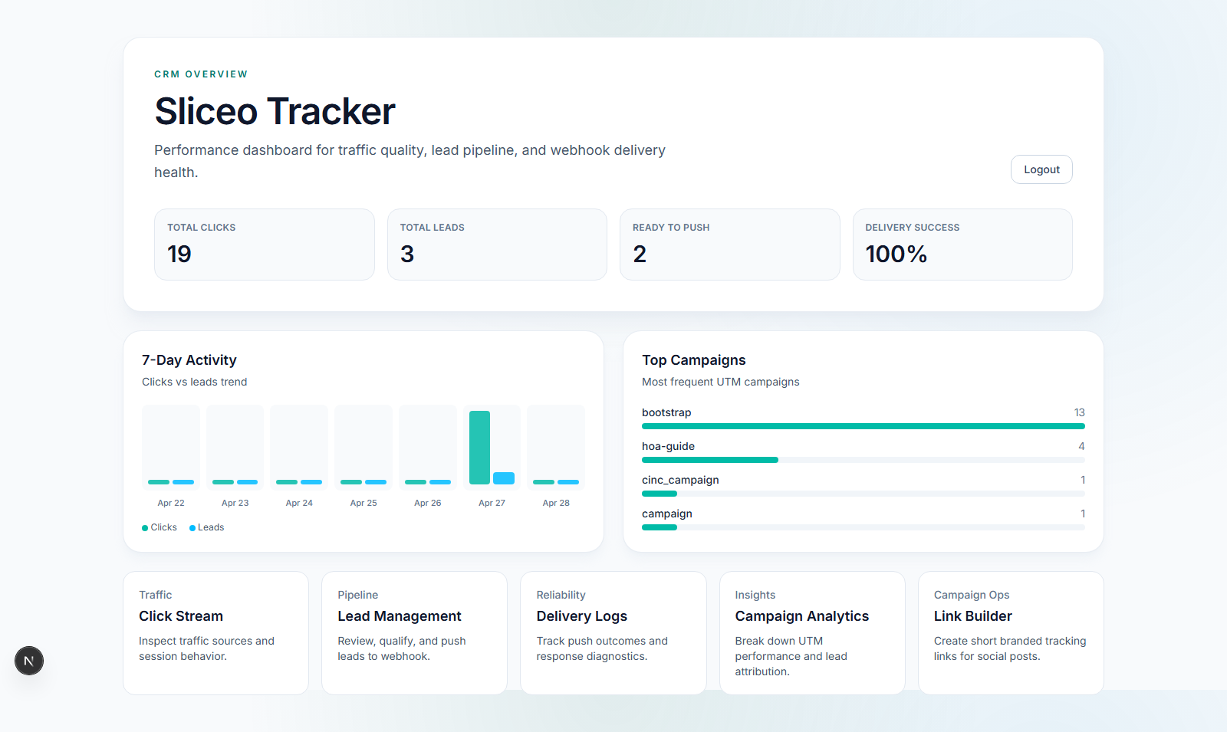
What This System Solves
Captures campaign clicks in real time with source, medium, campaign, referrer, and session context
Connects those clicks to submitted leads with attribution logic
Tracks whether leads were successfully delivered to downstream systems
Gives leadership one place to monitor marketing performance and operational reliability
Notes:
Position this as an integrated marketing operations layer, not just a tracker.

Slide 4
Step 1 - Secure Access and Team Visibility
Authorized users log in and access a private analytics workspace
Keeps campaign intelligence internal and client-safe
Enables collaboration across marketing, operations, and leadership
Notes:
Mention role-ready foundation for future team expansion.

Slide 5
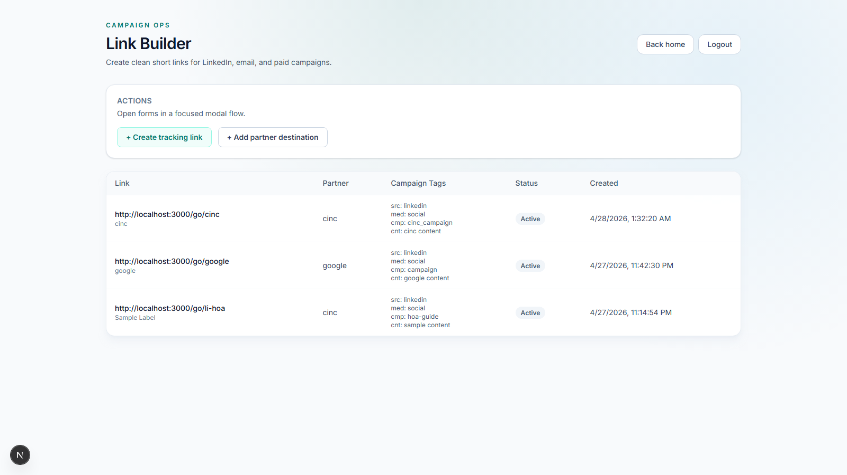
Step 2 - Create Clean Campaign Links
Team creates short, professional links for LinkedIn, email, and ads
Each link can carry pre-defined campaign metadata
Removes messy URLs from client-facing channels
Increases consistency across campaign launches
Notes:
Highlight ease of use and brand-safe links.

Slide 6
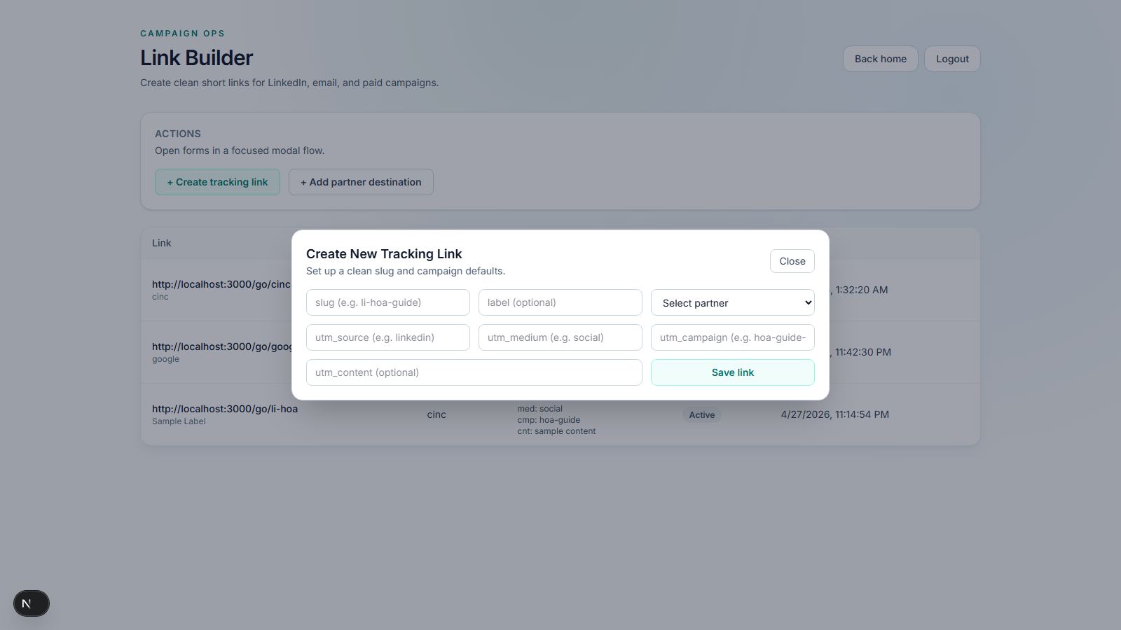
Step 3 - Launch Faster With Modal Workflows
Quick modal flow for adding campaign links
Quick modal flow for adding/updating destinations
Reduces friction during go-live or campaign pivots
Encourages disciplined campaign setup
Notes:
Emphasize operational speed for marketing teams.

Slide 7
Step 4 - Monitor Traffic Quality
Click Stream shows who is engaging and from where
Analyze partner/source quality, suspicious patterns, and top traffic channels
Use this to validate campaign distribution performance early
Notes:
Good point to discuss "quality before volume."

Slide 8
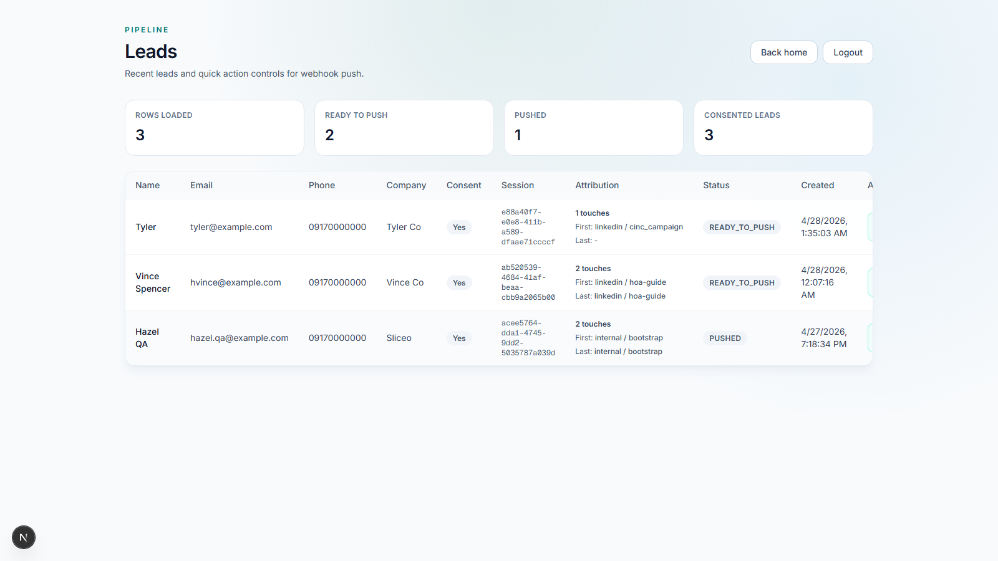
Step 5 - Track Leads and Attribution
Lead records are connected to campaign journeys
First-touch, last-touch, and assist attribution reveal the full conversion path
Teams can see not just who converted, but how they converted
Notes:
Explain this as the bridge between marketing activity and sales outcomes.

Slide 9
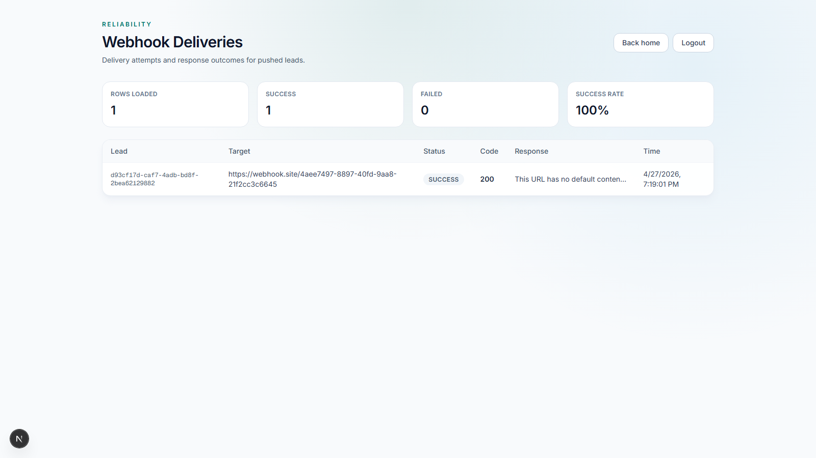
Step 6 - Validate Delivery Reliability
Delivery screen confirms whether each lead reached external systems
Immediate visibility into failed deliveries and response issues
Protects revenue by catching integration failures quickly
Notes:
This is operational risk management for growth teams.

Slide 10
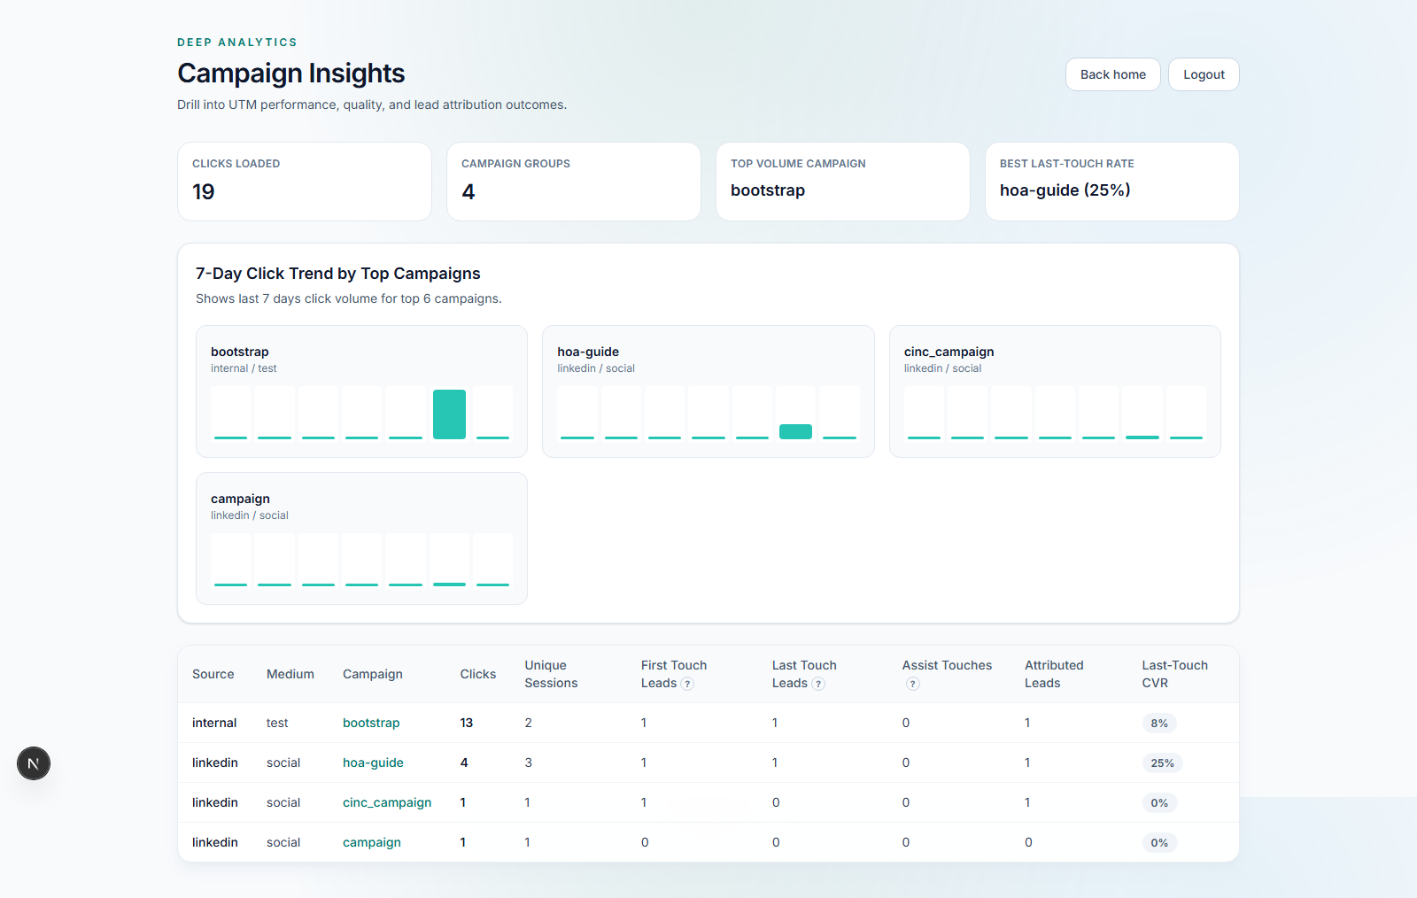
Step 7 - Analyze Campaign Performance
Campaign Insights compares campaign groups by volume and attribution impact
Identify top-performing and underperforming campaigns quickly
Supports smarter budget reallocation and messaging optimization
Notes:
This is where leadership gets strategic signal, not just activity metrics.

Slide 11
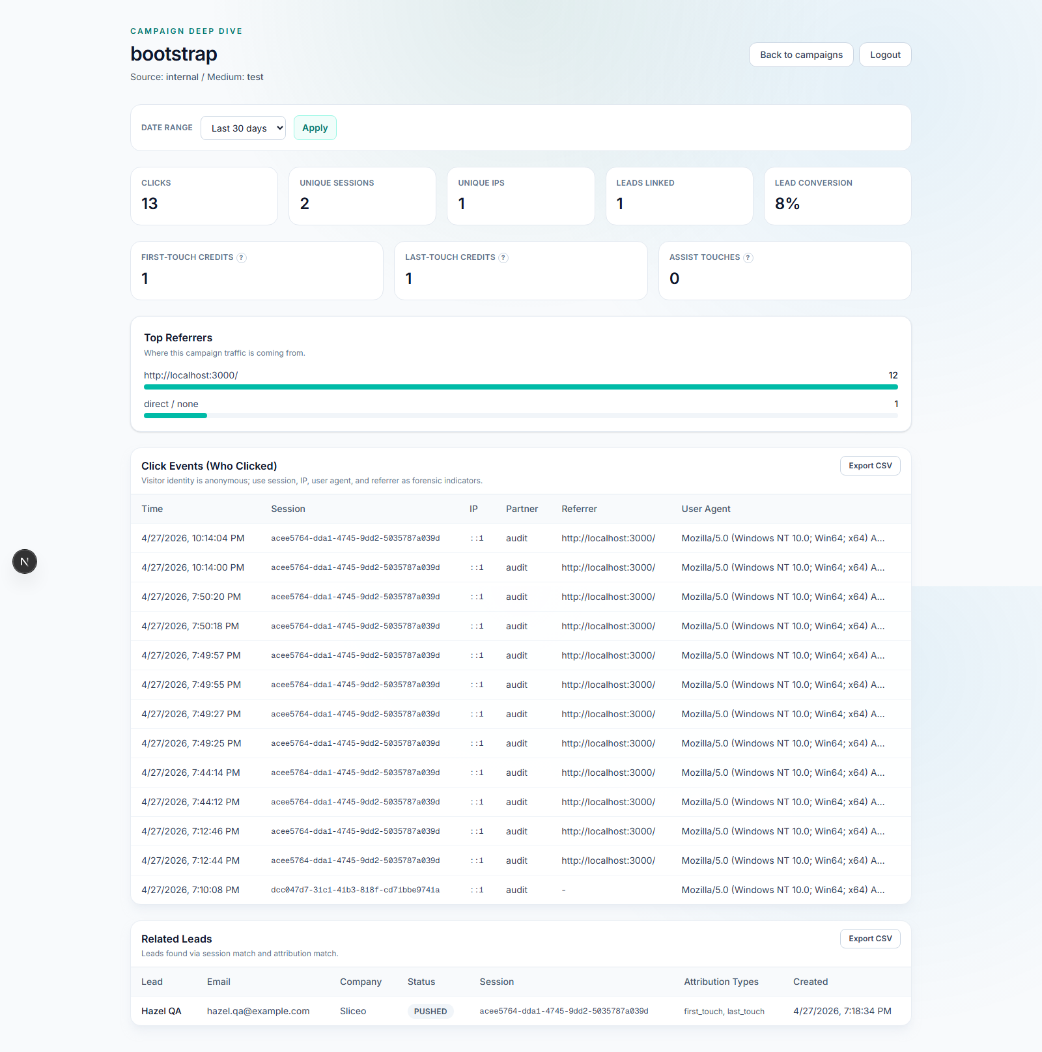
Step 8 - Drill Into One Campaign
Deep campaign page shows click behavior, referrers, and linked leads
Includes date filtering and CSV exports for client reporting
Enables practical diagnostics: "Why did this campaign underperform this week?"
Notes:
This is the "investigation" view for analysts and account managers.

Slide 12
Example Client Value Scenario #1
A LinkedIn campaign shows high clicks but low lead conversion
Drilldown reveals low-quality referrer mix and weak assist/last-touch profile
Team adjusts targeting and landing page messaging
Conversion quality improves in the next cycle
Notes:
Present as a realistic optimization cycle.

Slide 13
Example Client Value Scenario #2
Leads are being generated but sales team reports missing records in CRM
Delivery view shows webhook failures and response errors
Ops team fixes endpoint/auth configuration
Lead loss is stopped and reporting accuracy is restored
Notes:
Demonstrates direct operational and revenue protection value.

Slide 14
Reporting and Client Communication Value
Exportable campaign and lead views support monthly reporting packs
Clear attribution language improves confidence in performance reviews
Easier to justify budget shifts with evidence-based campaign insights
Notes:
Strong point for agencies and in-house teams presenting to stakeholders.

Slide 15
Why This Matters to Clients
Better visibility into what actually drives qualified demand
Faster campaign decisions with less guesswork
Fewer lost leads due to delivery failures
Stronger confidence in marketing ROI conversations
Notes:
Close with outcomes and confidence, not technical implementation.

