Slide 1
RISC ARCHITECTURE · VERILOG HDL · FUNCTIONAL VERIFICATION
SiliconLite: Design & Verification of a 5-Stage Pipelined RISC Processor
Verilog RTL implementation, directed testbench verification, and generic cell synthesis.
V. Sathya Pranav Karthik - ECE (SASTRA University)
IF · FETCH
ID · DECODE
EX · EXECUTE
MEM · ACCESS
WB · WRITEBACK
Notes:
Introduce the SiliconLite processor project: a clean, synchronous 5-stage RISC core implemented in Verilog RTL. State the educational scope: functional verification via directed test suites and gate-level generic synthesis using Yosys.

Slide 2
PIPELINE ARCHITECTURE & OVERLAP
A compact pipelined RISC processor lets five instructions overlap
Objective: implement a compact five-stage pipelined RISC processor in Verilog.
01
02
03
04
05
STAGE 01
STAGE 02
STAGE 03
STAGE 04
STAGE 05
IF
ID
EX
MEM
WB
Program Counter + Instruction Memory fetch the 32-bit instruction word.
Register File reads rs1, rs2; Immediate Generator and control decoding.
ALU execution, branch-target calculation and forwarding multiplexers.
Data Memory loads and stores; branch resolution.
Write ALU result or loaded memory data to destination register (rd).
MEM/WB
ID/EX
Commit: RF[rd]
IF/ID
EX/MEM
CONCURRENCY & THROUGHPUT
Synchronous pipeline registers isolate datapath stages, enabling single-cycle throughput for independent instructions. Different instructions occupy different stages concurrently. Ideal CPI = 1.0 under hazard-free instruction streams; pipeline interlocks maintain correctness across hazards without software intervention.
Notes:
Walk through the 5 pipeline stages. Highlight the 4 pipeline register barriers isolating the datapath. Point out how each physical block (PC, IMEM, RegFile, ALU, DMEM) operates independently during each cycle.

Slide 3
ISA SPECIFICATION & DATAPATH
The RTL implements an educational instruction subset
SiliconLite targets a focused, synthesizable 32-bit RISC subset for pipelined hazard handling and control flow.
Instruction subset
Core datapath blocks
R-type — ADD, SUB, SLT: register-register arithmetic and signed comparison; AND, OR, XOR: bitwise logic on rs1 and rs2. Path: IF → ID → EX → WB.
I-type — ADDI: arithmetic with 12-bit sign-extended immediate. Path: IF → ID → EX → WB.
Memory — LW, SW: synchronous 32-bit word load and store. Path: IF → ID → EX → MEM → WB.
Control — BEQ, BNE: conditional PC-relative branch evaluation. Path: IF → ID → EX (Branch target).
PC → Instruction ROM → Decoder & Control → Register File → ALU → Data RAM
Instruction fetch & decode: PC register, Instruction ROM, 32×32-bit Dual-Port Register File, Immediate Sign Extender. Execute & memory: 32-bit Arithmetic Logic Unit, Branch Target Adder, Zero/Comparison Detector, Data RAM. Control & interlocks: Forwarding multiplexers (EX/MEM, MEM/WB), Load-Use Hazard Unit, Branch Flush Controller.
SiliconLite is a pedagogical subset engineered for RTL verification, not a fully compliant RV32I specification.
Notes:
Emphasize the explicit educational scope: this is not full RV32I, but contains every canonical instruction format necessary to stress data hazards, memory load-use delays, and control branches.

Slide 4
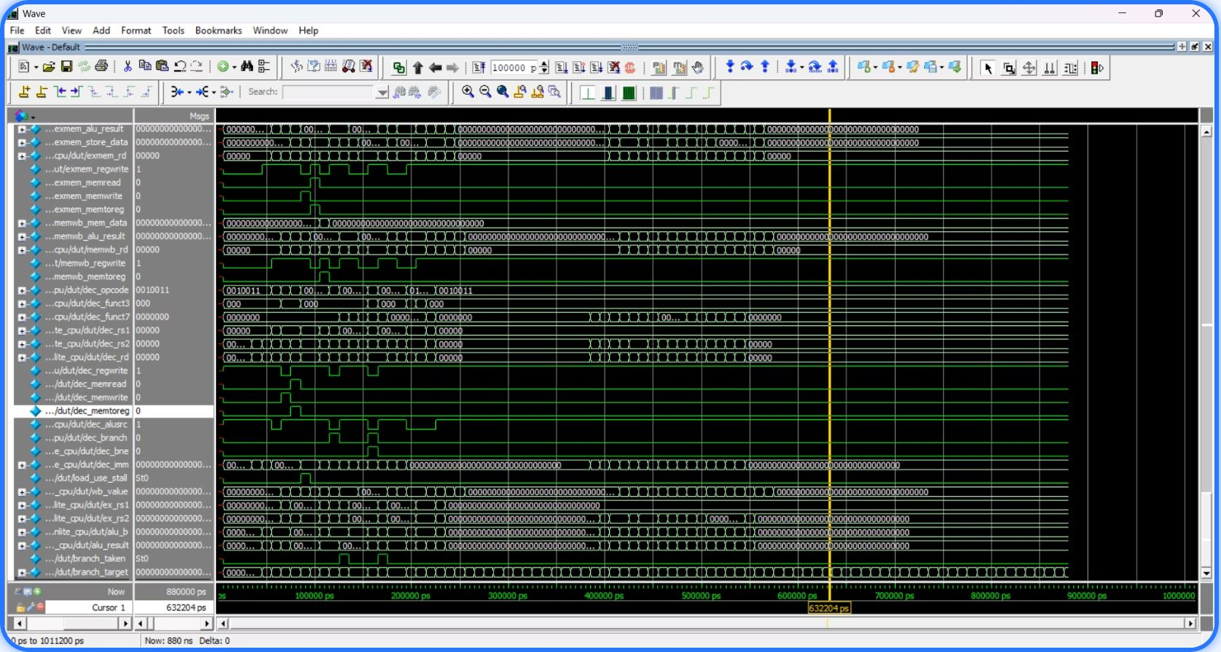
HAZARD DETECTION & RESOLUTION
Forwarding, stalls and flushes keep the pipeline correct
DATA FORWARDING
EX/MEM and MEM/WB forwarding supply results to dependent instructions.
LOAD-USE HAZARD
One-cycle stall: bubble inserted into ID/EX; PC and IF/ID held.
ModelSim waveform showing decode, load_use_stall, wb_value, alu_result, branch_taken and branch_target signals.
CONTROL HAZARD
Taken branch: PC redirected; younger instructions flushed.
Notes:
Point to the simulation capture on the right. Note how load_use_stall asserts high when a load destination matches the next decode stage source register. Walk through how the branch flush discards speculative instructions without corrupting architectural state.

Slide 5
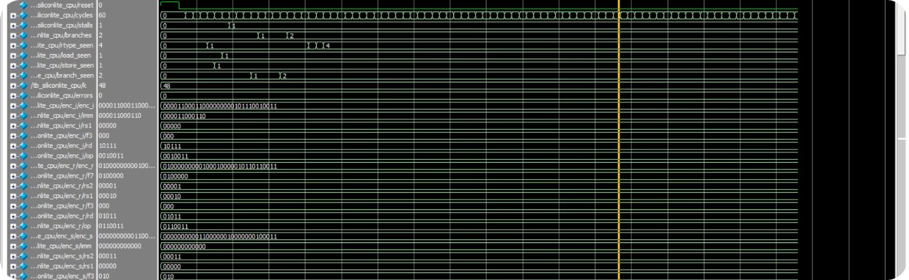
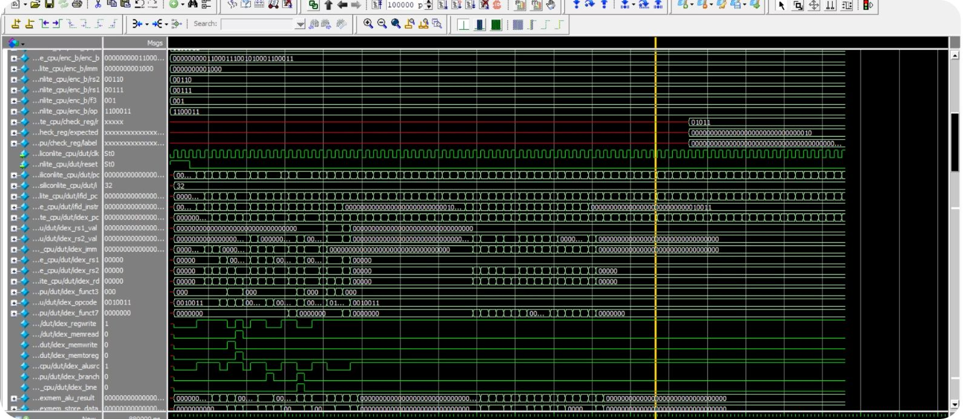
SIMULATION EVIDENCE · RUN OVERVIEW
Waveform evidence: clock, reset and pipeline progression
SIGNAL OVERVIEW & ERROR TRACE
DUT PIPELINE ADVANCEMENT
tb_siliconlite_cpu/clk toggles; reset is asserted briefly at the start. Stalls, branches, rtype_seen, load_seen, store_seen and branch_seen counters step up; errors remains 0. Cursor at 632204 ps, cycles = 60 at that cursor.
DUT internal signals (pc, ifid_instr, idex_* fields and control flags) change cycle by cycle as instructions advance through the pipeline.
Notes:
Detail the exact waveform cursor: 632,204 ps represents cycle 60 of the verification run. Note that the error monitor wire remains flat at zero across the entire execution window, validating architectural stability.

Slide 6
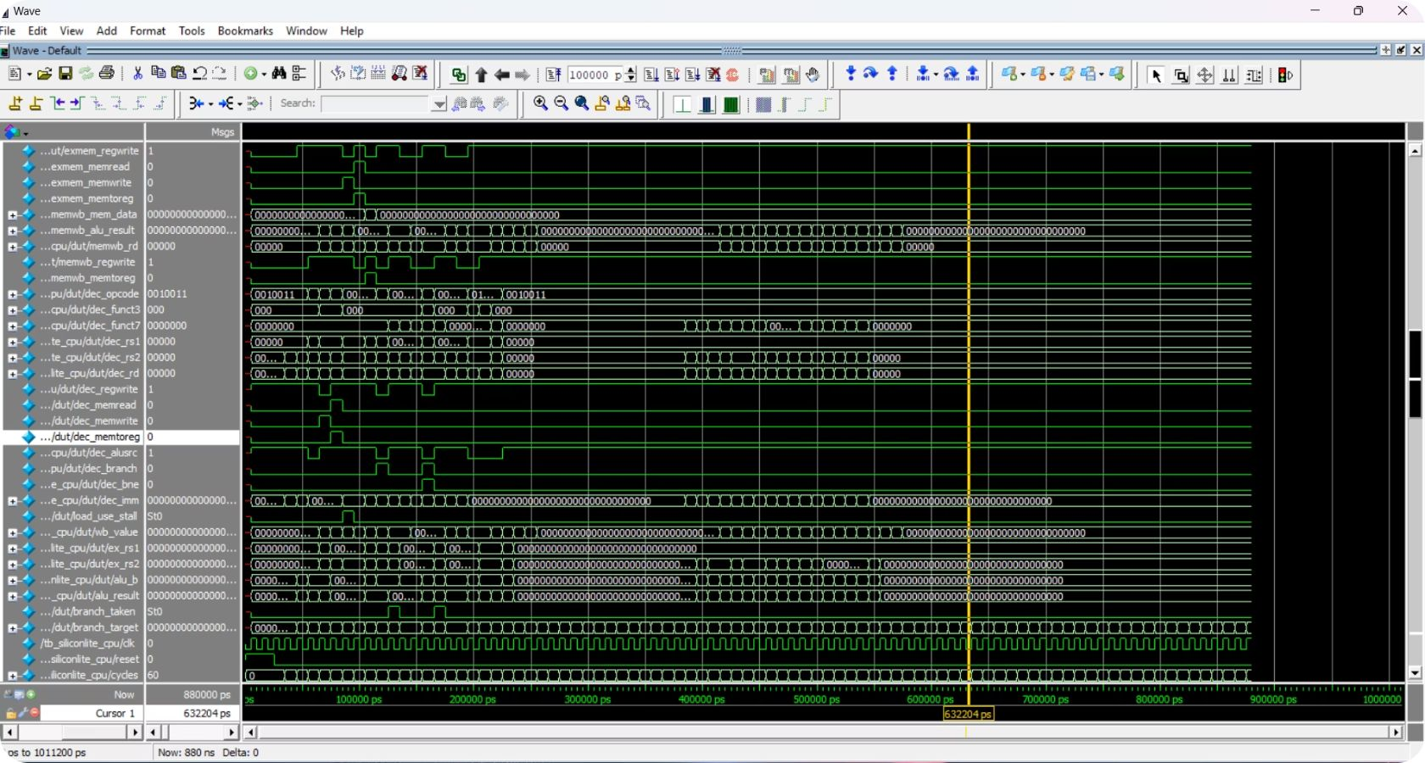
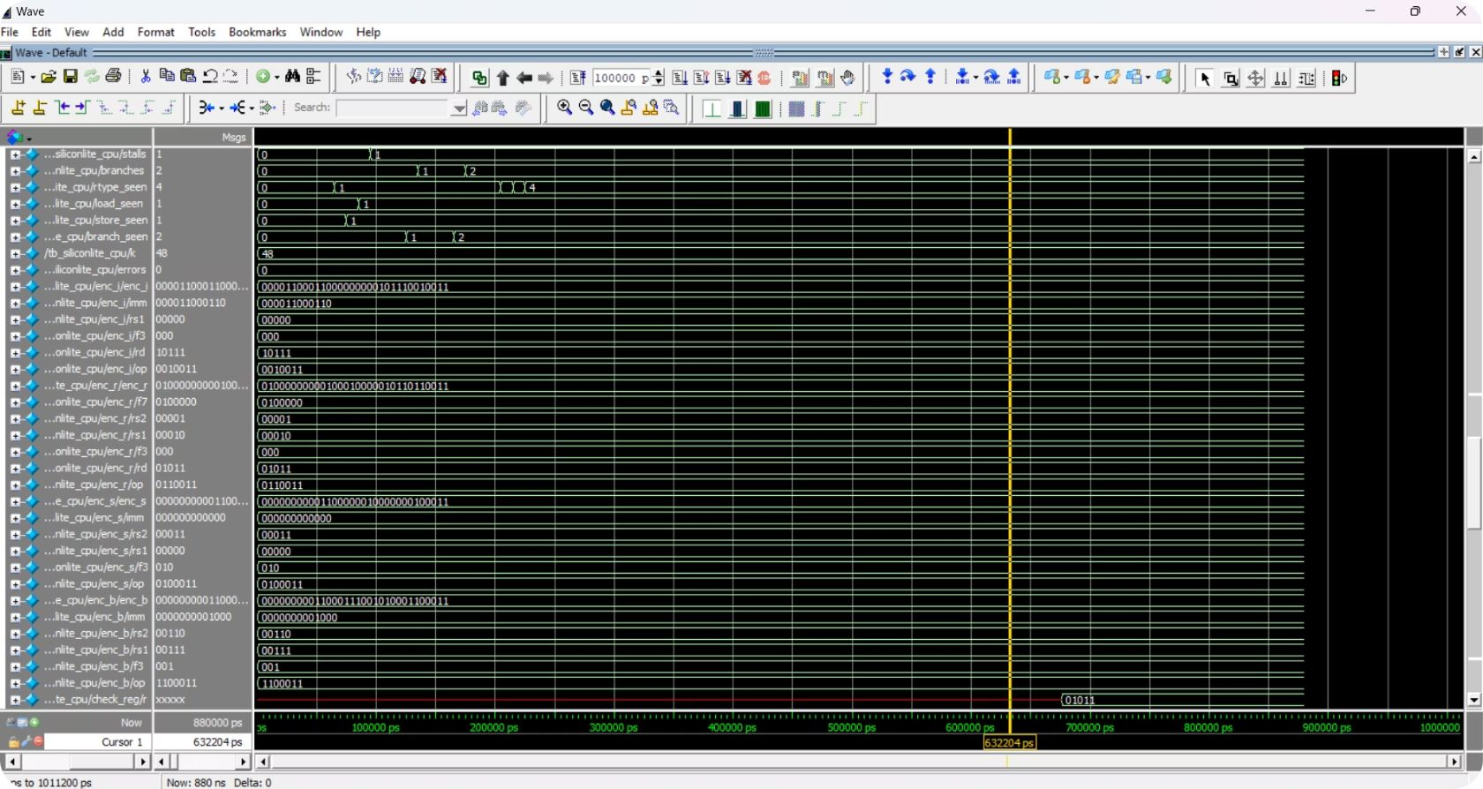
Waveform evidence: execute, memory, write-back and branch control
Signals: exmem_regwrite, exmem_memread/memwrite, memwb_*, wb_value, alu_result, load_use_stall, branch_taken and branch_target.
Stalls, branches and branch_seen counters reaching 2; 1 stall recorded; errors 0.
Notes:
Explain the telemetry shown in both captures: the exact memory strobes in EX/MEM matching the instruction schedule, and the branch telemetry registering both taken branches without corrupting the subsequent instructions.

Slide 7
FUNCTIONAL VERIFICATION SCORECARD
Directed verification passed with 12 of 12 checks
Self-checking testbench confirms exact register file writeback and memory state after 65 active simulation cycles.
Register / Memory | Observed Value | Verification Test Case
x1 | 5 | ADDI baseline initialization check
x2 | 7 | Immediate sign extension & load
x3 | 12 | ADD operation with data forwarding (x1 + x2)
x4 | 12 | SW to RAM followed by LW load-use stall
x5 | 13 | Post-stall dependent ALU arithmetic
x7 | 42 | BEQ taken branch target execution block
x8 | 8 | BNE taken branch target validation
Memory word 0 | 12 | Synchronous RAM write integrity check
VERIFICATION RESULT
12 / 12
100% Directed Checks Passed
Compilation: 0 Errors · 0 Warnings
EXECUTION METRICS
Total Active Cycles: 65
Load-Use Stalls: 1 cycle
Branches Evaluated: 2 taken
Simulation Status: PASS
Extracted directly from the recorded simulation transcript. All assertions evaluated with zero delta mismatches.
Notes:
Review the register scorecard. Trace each architectural value back to its verifying operation: x3 tests forwarding, x4 tests load-use stall, x7 and x8 verify branch targets, and Memory word 0 confirms that the SW instruction committed correctly.

Slide 8
SYNTHESIS RESULTS · YOSYS 0.70+221
Yosys generic synthesis completed with 112 cells
GENERIC CELL BREAKDOWN
GENERIC MAPPING
AND cells dominate the 112-cell netlist.
Generic gate-level mapping provides an architectural structural baseline without standard-cell library bias. Clean RTL was synthesized using the Yosys generic mapping flow, without technology constraints.
Cell type | Count
AND | 49
$_SDFF_PP0_ | 33
XOR | 29
NOT | 1
METHODOLOGICAL INTEGRITY · NO EXTRAPOLATED NUMBERS
Generic logic counts are not physical area, power, timing or maximum frequency. No physical silicon area (µm²), dynamic power, critical path slack, maximum operating frequency (Fmax), or ASIC or FPGA figures are claimed.
33 synchronous flip-flops hold registered pipeline stages.
Notes:
Stress the engineering rigor: generic logic counts are not physical area, power, or Fmax. No ASIC fabrication or FPGA utilization numbers are fabricated. The 33 flip-flops correspond to the pipeline stage registers and architectural state.

Slide 9
Conclusion and future work
Delivered
Future work
Five-stage pipeline, educational instruction subset, forwarding, load-use stalling, and branch flushing
Directed functional verification passed; generic synthesis completed
Broader instruction tests
Reference-model verification
Functional coverage
FPGA or standard-cell target
Timing analysis
Repository: [GitHub URL to be added]
THANK YOU / QUESTIONS
Notes:
Summarize the key architectural accomplishments: a verified 5-stage pipeline with solid hazard handling and clean synthesis. Close by inviting evaluator questions on the hazard unit, verification coverage, or synthesis breakdown.

